Slide 1
Hierarchical Attention Networks for Document Classification
Oct 10, 2019
汇报人：江聚勇
导 师： 张 凯

Slide 2
1 Introduction 2 Hierarchical Attention Networks 3 Experimental Recurrence 4 References 5 My Opinion
提纲

Slide 3
1
Introduction
引言

Slide 4
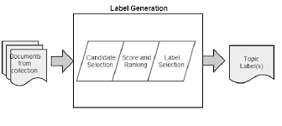
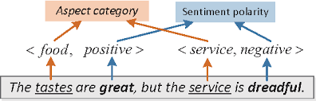
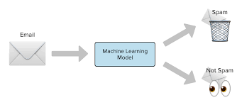
1 研究背景和意义
Text classification is one of the fundamental task in Natural Language Processing. The goal is to assign labels to text.
Here is its broad application :
Topic labeling
Sentiment classification
Spam detection

Slide 5
2 研究现状和不足
Traditional approaches and recent approaches used deep learning of text classification to learn text representations :
Linear methods
BOWand BOW+TFIDF
n-grams and n-grams+TFIDF
Bag-of-means
SVMs
SVM+Unigrams
Bigrams
Text Features
AverageSG
SSWE
Neural Network methods
CNN-word
CNN-char
LSTM
Conv-GRNN and LSTM-GRNN
Deficiency
A sequence of tokens is relevant rather than simply filtering for (sequences of) tokens, taken out of context.

Slide 6
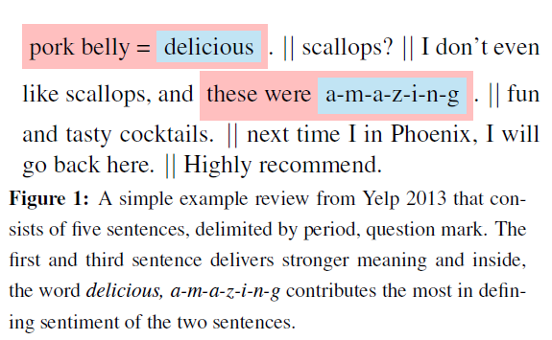
3 创新启发点
The intuition underlying is that not all parts of a document are equally relevant for answering a query and that determining the relevant sections involves modeling the interactions of the words, not just their presence in isolation.
Documents have a hierarchical structure (words form sentences, sentences form a document), we likewise construct a document representation by first building representations of sentences and then aggregating those into a document representation.
Different words and sentences in a documents are differentially informative. Moreover, the importance of words and sentences are highly context dependent,i.e. the same word or sentence may be differentially important in different context.

Slide 7
2
Hierarchical Attention Networks
引言

Slide 8
2.1
Non-Attention
引言

Slide 9
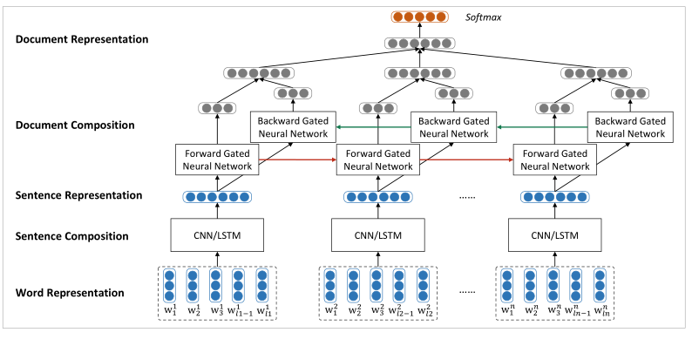
1 Model Architecture
使用两个神经网络分别建模句子和文档，采用一种自下向上的基于向量的文本表示模型。首先使用CNN/LSTM来建模句子表示，接下来使用双向GRU模型对句子表示进行编码得到文档表示。
The neural network model for document level sentiment classification.
stands for the i-th word in the n-th sentence. is sentence length.

Slide 10
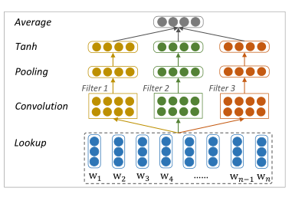
2 Sentence Composition
词向量是从语料库中使用Word2vec模型训练出来的，保存在词嵌入矩阵中。使用CNN/LSTM模型学习句子表示，将变长的句子表示成相同维度的向量，以消除句子长度不同所带来的不便。从而，GRU模型的输入是长度相同的句子向量。卷积模型如下图所示，filter的宽度分别取1，2，3来编码unigrams，bigrams和trigrams的语义信息。最后使用一个Average层捕获全局信息并转化为固定长度的输出向量。
Sentence composition with convolutional neural network

Slide 11
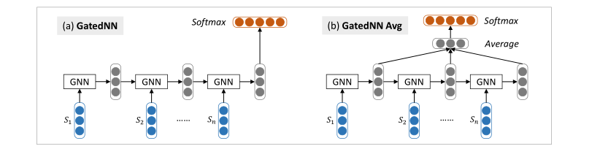
3 Document Modeling
使用GRU模型，输入是定长的句子向量，输出固定长度的文本向量，这里会对最后每个单元的输出向量进行取平均操作，虽然会忽略句子顺序的信息，但是相对来说较为简单方便，如下图所示，其中GNN代表GRU的一个基础计算单元。
Document modeling with gated recurrent neural network

Slide 12
2.2
With-Attention
引言

Slide 13
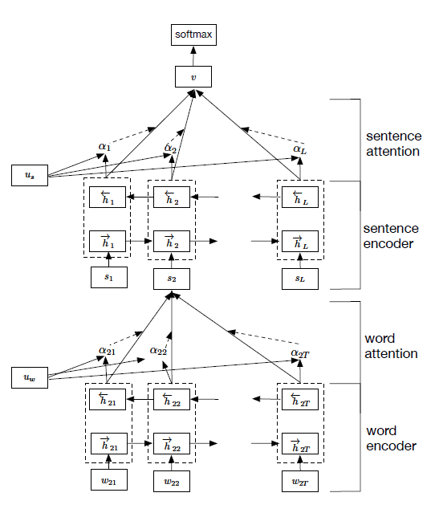
1 Model Architecture
The overall architecture of the Hierarchical Attention Network (HAN) consists of several parts: a word sequence encoder, a word-level attention layer, a sentence encoder and a sentence-level attention layer.

Slide 14
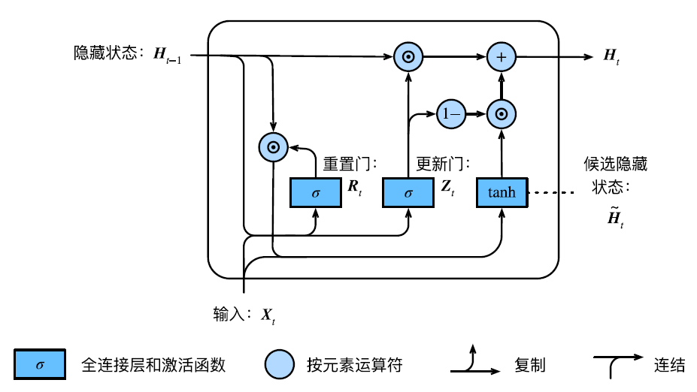
2 GRU-Based Sequence Encoder

Slide 15
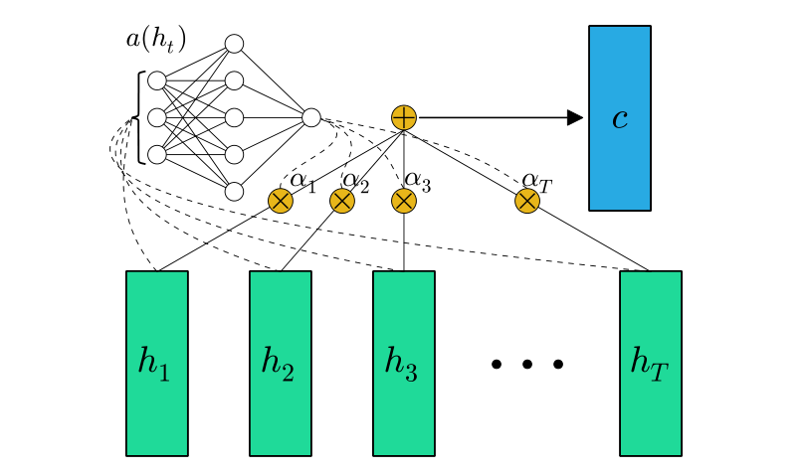
3 Hierarchical Attention
Vectors in the hidden state sequence ht are fed into the learnable function a(ht) to produce a probability vector. The vector c is computed as a weighted average of ht, with weighting given by .

Slide 16
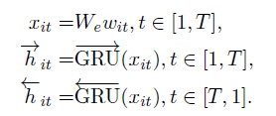
3 Hierarchical Attention
Assume that a document has L sentences and each sentence contains words. with represents the words in the i-th sentence. The proposed model projects the raw document into a vector representation.
Word Encoder
Given a sentence with words , ,first embed the words to vectors through an embedding matrix .
Use a bidirectional GRU to get annotations of words by summarizing information from both directions for words. The bidirectional GRU contains the forward GRU which reads the sentence from to and a backward GRU which reads from to :

Slide 17
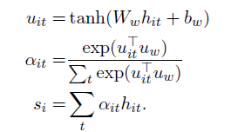
3 Hierarchical Attention
Word Attention
Not all words contribute equally to the representation of the sentence meaning. Hence, using attention mechanism to extract such words that are important to the meaning of the sentence and aggregate the representation of those informative words to form a sentence vector.
Feed the word annotation through a one-layer MLP(多层感知机) to get as a hidden representation of .
Measure the importance of the word as the similarity of with a word level context vector and get a normalized importance weight through a softmax function.
Compute the sentence vector as a weighted sum of the word annotations based on the weights.

Slide 18

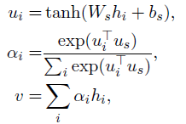
3 Hierarchical Attention
Sentence Encoder
Using a bidirectional GRU to encode the sentences.
Concatenate and to get an annotation of sentence i, i.e., .
summarizes the neighbor sentences around sentence i but still focus on sentence i.
Sentence Attention
To reward sentences that are clues to correctly classify a document, using attention mechanism and introduce a sentence level context vector and use the vector to measure the importance of the sentences.
V is the document vector that summarizes
all the information of sentences in a document.

Slide 19
4 Document Classification
The document vector v is a high level representation of the document and can be used as features for document classification :
Using the negative log likelihood of the correct labels as training loss, where j is the label of document d :

Slide 20
3
Experimental Recurrence

Slide 21
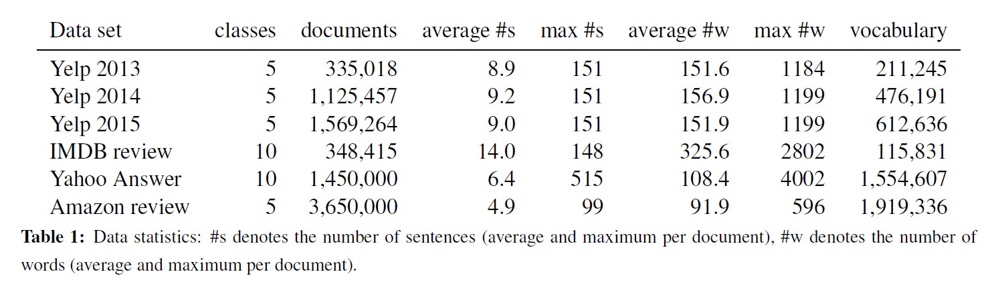
1 Dataset Introduction
These data sets can be categorized into two types of document classification tasks: sentiment estimation and topic classification. The statistics of the data sets are summarized in Table 1. We use 80% of the data for training, 10% for validation, and the remaining 10% for test.

Slide 22
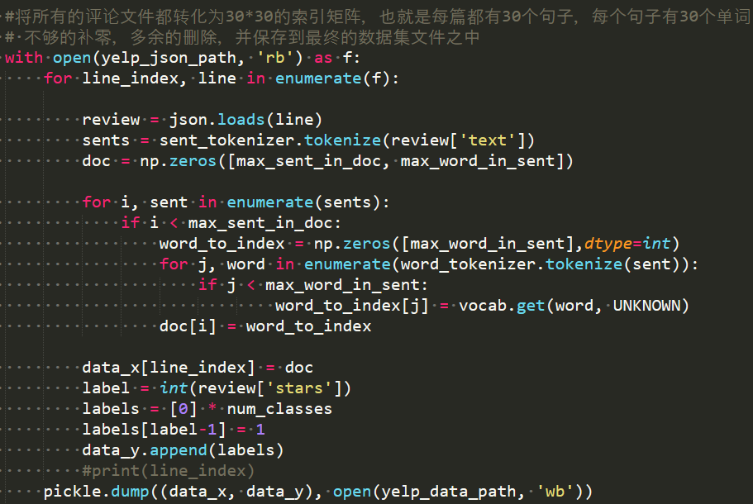
2 Dataset Processing
Yelp2013的Review数据。大规模的数据可以在官网https://www.yelp.com/dataset/challenge上下载，压缩数据大概2GB左右，还有一个较小规模的数据集，大概200M+https://github.com/rekiksab/Yelp-Data-Challenge-2013/tree/master/yelp_challenge/yelp_phoenix_academic_dataset，用于此次论文复现。
将较小规模数据集yelp_academic_dataset_review.json文件解压，每一行是一个评论的文本，主要有vote, user_id, review_id, stars, data, text, type, business_id几项，针对文本分类任务，只需要使用stars评分和text评论内容。{“votes”:{“funny”:0,“useful”:5,“cool”:2},“user_id”:“rLtl8ZkDX5vH5nAx9C3q5Q”,“review_id”:“fWKvX83p0-ka4JS3dc6E5A”, “stars”: 5, “date”: “2011-01-26”, “text”: “My wife took me here on my birthday for breakfast and it was excellent. …}
在数据中，每篇文档的句子个数不一样，每个句子的单词数也不一样，本次复现中采用他人的想法，将每篇文档都处理为30*30的矩阵，将每篇文章中多余30的句子截断，将每个句子中多于30的单词进行截断。
Key Code

Slide 23
3 Model configuration
Split documents into sentences and tokenize each sentence using Stanford's CoreNLP.
Only retain words appearing more than 5 times in building the vocabulary and replace the words that appear 5 times with a special UNK token.
Obtain the word embedding by training an unsupervised word2vec model on the training and validation splits and then use the word embedding to initialize .
The word embedding dimension to be 200 and the GRU dimension to be 50.
Using a mini-batch size of 64 and documents of similar length (in terms of the number of sentences in the documents) are organized to be a batch.
Use stochastic gradient descent to train all models with momentum of 0.9.
pick the best learning rate using grid search on the validation set.

Slide 24
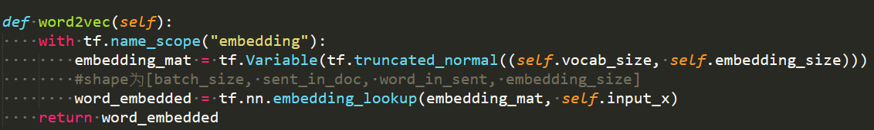
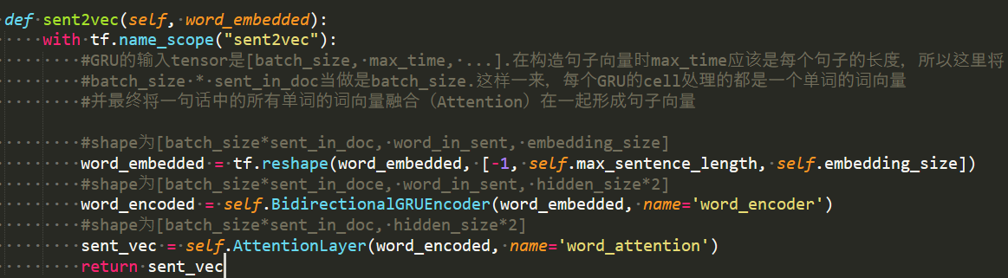
4 Model Training
Embedding
Word Encoder: word level bi-directional GRU to get rich representation of words.Word Attention: word level attention to get important information in a sentence

Slide 25
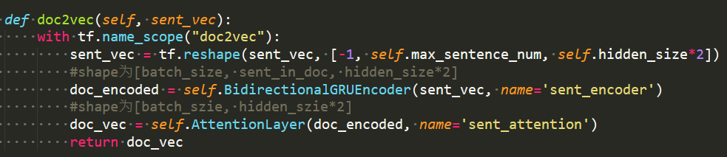
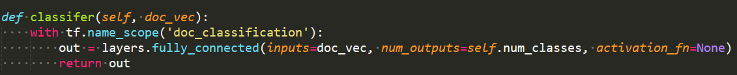
4 Model Training
Sentence Encoder: sentence level bi-directional GRU to get rich representation of sentences.Sentence Attetion: sentence level attention to get important sentence among sentences
FC(Softmax直接和交叉熵损失函数写在一起以保证数值的稳定性)

Slide 26
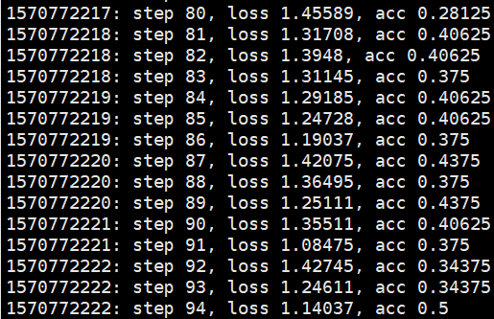
4 Model Training
模型的训练效果不太好，准确率只能达到50%左右。原因分析如下：
数据集较小，采用随机初始化的方式做嵌入层，词向量的表达不准确。
用30*30的矩阵代表一篇文章，并不能很好的表示文章，所以应该首先进行排序，将相似大小的文章放在一起然后再做截断或者填充。

Slide 27
4
References

Slide 28
References
[1] Yang, Zichao, et al. "Hierarchical attention networks for document classification." Proceedings of the 2016 conference of the North American chapter of the association for computational linguistics: human language technologies. 2016.
[2] Raffel, Colin, and Daniel PW Ellis. "Feed-forward networks with attention can solve some long-term memory problems." arXiv preprint arXiv:1512.08756 (2015).
[3] Tang, Duyu, Bing Qin, and Ting Liu. "Document modeling with gated recurrent neural network for sentiment classification." Proceedings of the 2015 conference on empirical methods in natural language processing. 2015.
[4] Bahdanau, Dzmitry, Kyunghyun Cho, and Yoshua Bengio. "Neural machine translation by jointly learning to align and translate." arXiv preprint arXiv:1409.0473 (2014).
[5] Lai, Siwei, et al. "Recurrent convolutional neural networks for text classification." Twenty-ninth AAAI conference on artificial intelligence. 2015.

Slide 29
5
My Opinion

Slide 30
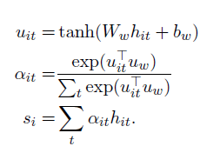
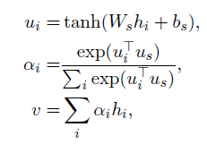
My Opinion
总目标“准确进行文档分类”：1.文档本身具有层次结构，单词构成句子，句子构成文档，自下向上的文本表示；2.单词和句子的意义除考虑自身的孤立意义还需考虑上下文语境来共同决定整个文档的意义。从而会出现，相同的单词和句子在同一文档中的不同位置会有不同的意思，以及相同的单词和句子在不同的文档中有着不同的意思。综合说明，单词和句子的意义应当由自身以及上下文语境来决定。那上下文语境，体现在：构词，构句…，本论文：单词构成了句子，在一个句子中的上下文信息决定了单词的意思，反过来又决定了整个句子的意思，而这种意思的体现，又表现在注意到某一些单词的重要性，而一个单词的重要性又是受上下文的影响， 体现了一个结合上下文信息单词的重要性，再利用softmax 函数将一个句子中所有的单词的重要性进行归一化，体现一个句子中单词之间的相对重要性，最后利用加权，得出一个句子受这些作用性不同的单词所得到的整体句子更为准确和更为重要的意义。本文利用这种逻辑来解决了两层结构的关系，单词构成句子，句子构成文档。反过来思考，文档的意义是由某一些重要的句子决定的，句子的意义是由某一些重要的单词决定的。这样的思路，可能会存在的漏洞就在于GRU信息之间的流动，是否足够的高效，能将逻辑上的思路很好的建模到模型中训练出来。
Word Attention Sentence Attention

Slide 31
My Opinion
体现单词对句子意义的重要性以及句子对文档分类正确的重要性的方法，是否可以进一步简化，原文使用的利用MLP训练每一个单词的隐层状态信息[-1,1],并利用softmax层进行求分配权重，并重新作用于每一个单词的隐藏状态求加权平均值，作为整个句子的（结合了上下文，并体现注意力机制）特征信息。
对于现实中的各种复杂的语句，本论文的处理方式，不能很好的处理那种：单个词对于句子的意思来说，不具有很重要的意义，但是前后不同位置，几个不同单词的微弱作用综合的影响可能决定了一句话的意思，也就是一种网络的结构，虽然GRU利用双向循环来使得句子前后的单词，共同对一个词产生了影响，但是这种利用重置门reset gate和更新门update gate来控制前后的信息流动，依然可能会损耗掉一些很直观的信息，解决思路：1.创造新的模型结构来处理这种现象 2.改进原来的模型结构。“今天天气很不好，所以我去看了一部电影，今天的天气瞬间变好了。”

Slide 32
My Opinion
New Idea
倘若将一个句子中的单词构成一个以单词为节点，节点表示词向量（word2vec),那么句子的单词先后的顺序（有起始节点，有节点流向）让一个单词是否是起始节点成为一个维度特征（不用训练），word2vec多一个维度n+1，1表示起始，0表示非起始，再利用有向图来表示顺序，那么节点与节点之间边的权重，表示关系的紧密程度，也就是上下文的语境致使每一个单词之间的紧密程度是不一样的。这样的一个网络表示了一个句子，丰富的权重关系代表了句子不同的语义。同样的处理的思想，和本论文一样的分层思想，利用句子来构造文档，不同句子之间有着不同的紧密连接程度，以及句子有先后关系。利用这样一个大网络来进行训练分类，是否也能很好的进行文档的分类。(省去了注意力机制，省去了循环神经网络的使用，不过使用这些方式可能可以减少整个图网络的训练参数)。

Slide 33
Thank You!
E-mail: jiangjuyong@hhu.edu.cn
TEL:18761157121

