Slide 1


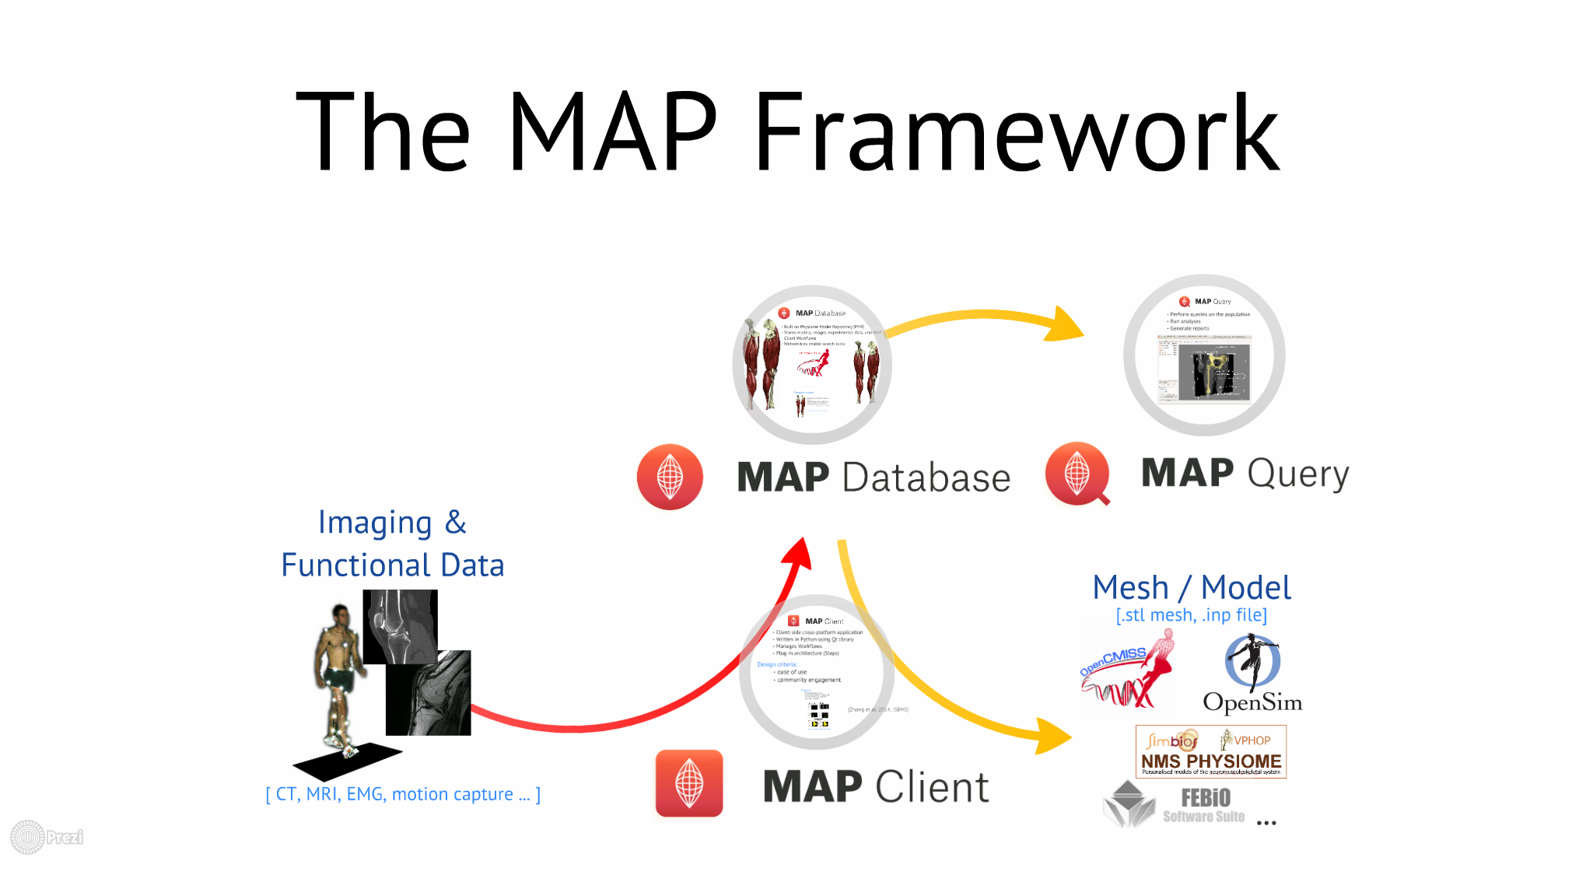
MAP
MAP Client FAI Workshop
September 2016
Workshop Overview

Slide 2
Workshop Goals
Install and run MAP Client
Import/build/run MAP Client workflows for FAI Project
Create your own workflows/plugins

Slide 3
Day 1 Overview
Key websites and documentation
MAP & MAP Client
Key MAP Client Concepts
MAP Client Workflows for FAI
Install MAP Client and run some workflows

Slide 4
Day 2 Overview
Plugin framework and walkthrough
Write a simple plugin
FAI workflow plugins
Ideas for new workflows/plugins

Slide 5
Where to find information?
This workshop (doc, examples)
map-client-fai-workshop.readthedocs.io
github.com/juzhang/mapclient-fai-workshop
MAP Client
map-client.readthedocs.io
github.com/MusculoskeletalAtlasProject/mapclient
MAP Client Plugins
github.com/mapclient-plugins

Slide 6
Overview of MAP & MAP Client

Slide 7
[Besier et al. (2014) WCB]

Slide 8

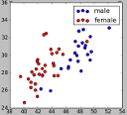


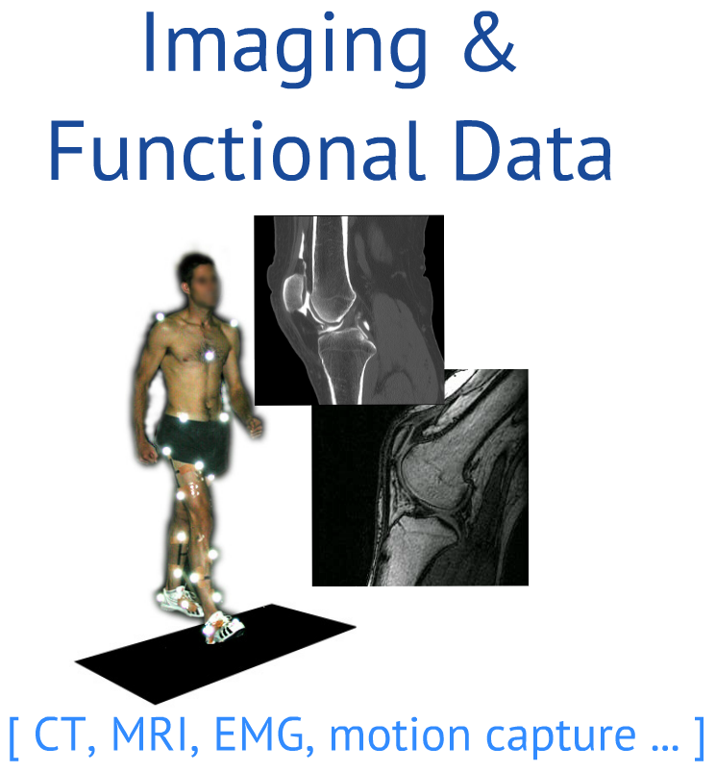
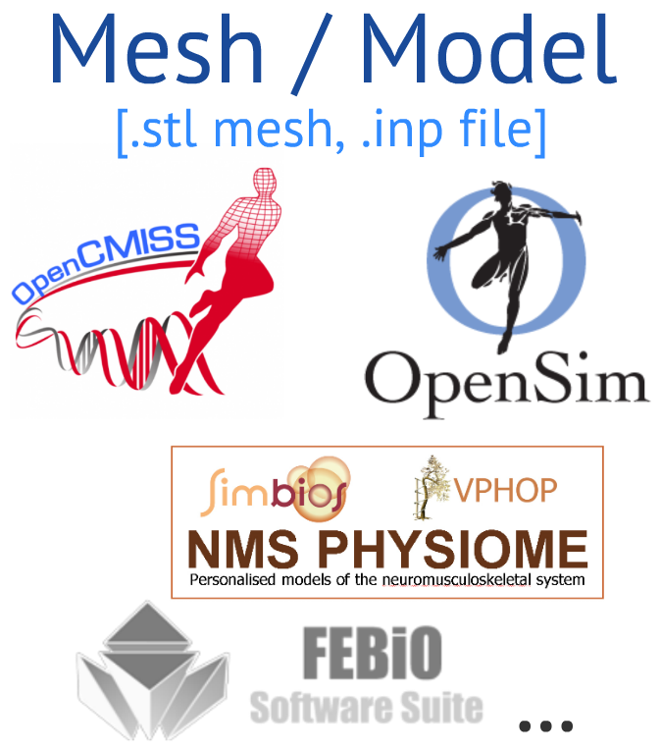


MAP Framework

Slide 9
Motivation for the MAP Client

Slide 10

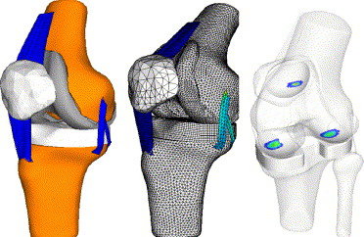
Patient-specific Musculoskeletal Simulations
Rigid-body model
Markers
Kinematics
BCs: Muscle/Joint Reaction forces
Continuum model
Stress & Strain
Contact Pressures
Drive multiscale models
Image
segmentations
[Halloran et al. (2005) J Biomech]

Slide 11
Patient-specific Musculoskeletal Simulations
Rigid-body model
Scaled full limb/body geometry
Markers
Continuum model
Patient-specific local geometry
Image
segmentations
[Halloran et al. (2005) J Biomech]

Slide 12
Patient-specific Musculoskeletal Simulations
Rigid-body model
Patient-specific lower limb geometry
MAP
Continuum model
Patient-specific local geometry
[Halloran et al. (2005) J Biomech]
Notes:
One goal of the MAP Client is to provide more patient specific rigid body models

Slide 13
Model Generation Process
Segmentation
Mimics, ITKSnap, Slicer, ITK, Matlab, Python, …
Registration
Meshlab, matlab, …
Meshing
Hypermesh, Netgen, Tetgen, VTK, …
Model Output
OpenSim, FEBio, Abaqus, OpenCMISS/Zinc
Common workflows
Many possible steps

Slide 14
MAP Client – Workflow Manager

Slide 15
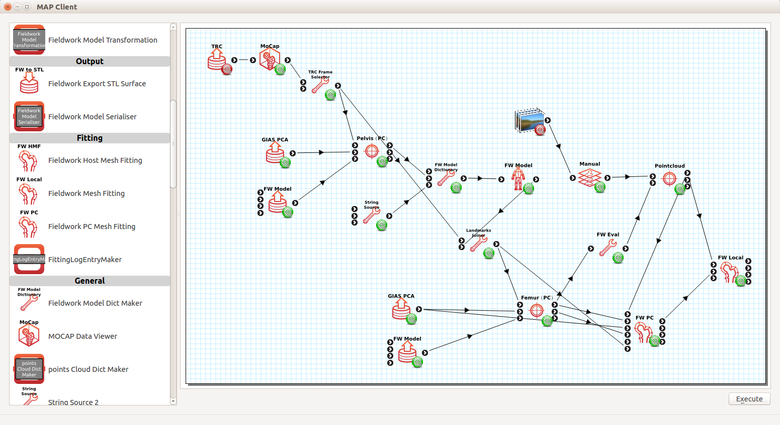
MAP Client – Workflow Manager
Notes:
Open-source workflow manager
Workflow steps provided by plugins
Interfaces with MAP database

Slide 16
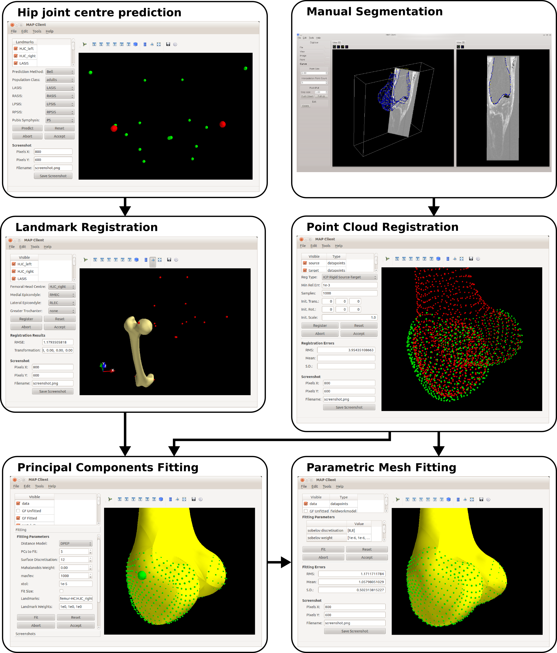
MAP Client
Plugins are used as Steps in Workflows
Plugins focus around MSK model generation
Free and open source
Client and plugins written in Python
[Zhang et al. (2014) Biomedical Simulation]

Slide 17
MAP Client
Plugins:
Segmentation
Manual
Registration
Point cloud
Landmarks
Mesh fitting
to point clouds
to landmarks
I/O
Images, mocap, STL, OBJ, VRML, etc
https://github.com/mapclient-plugins
Workflows:
Model generation from landmarks and segmentations
Model estimation from partial data
Lower limb generation from landmarks

Slide 18
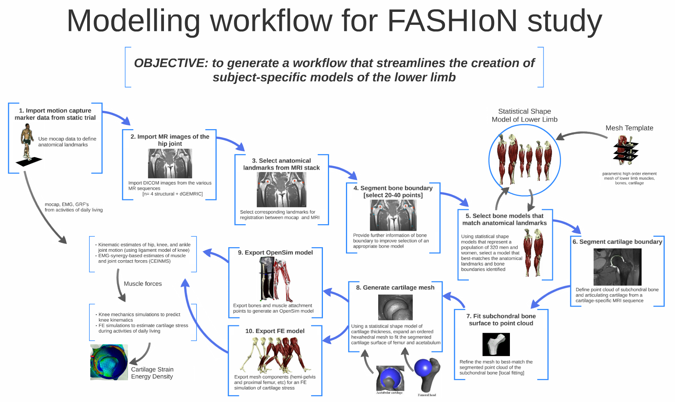

Slide 19
DEMO TIME!

Slide 20
Installing MAP Client
Follow instructions on the MAP Client Installation page.

Slide 21
Import and Run a Workflow
Follow the instructions on the Run a Workflow page.

Slide 22

Acknowledgements
MAP
NZ: Thor Besier
Hugh Sorby
Peter Hunter
Poul Nielsen
Justin Fernandez
Kumar Mithraratne
Vickie Shim
Duane Malcolm
AUS: David Lloyd
Mark Taylor
John Clement
David Thomas
OpenSim
Scott Delp
Jennifer Hicks
Ajay Seth
Ayman Habib
James Dunne
Chris Dembia
Tom Uchida
US Food & Drug Administration
National Center for Simulation in Rehabilitation Research

