Slide 1
So you want to do a RNAseq Experiment Differential Expression Analysis
Last updated: Feb 2nd, 2017
Matt Settles
Director, Bioinformatics Core

Slide 2
Experimental Design
Differential Expression Analysis

Slide 3
Treating Bioinformatics as a Data Science
Seven stages to data science
Define the question of interest
Get the data
Clean the data
Explore the data
Fit statistical models
Communicate the results
Make your analysis reproducible
Data science done well looks easy and that’s a big problem for data scientists
simplystatistics.org
March 3, 2015 by Jeff Leek

Slide 4
What is Differential Expression
Differential expression analysis means taking the normalised sequencing fragment count data and performing statistical analysis to discover quantitative changes in expression levels between experimental groups.
For example, we use statistical testing to decide whether, for a given gene, an observed difference in fragment counts is significant, that is, whether it is greater than what would be expected just due to natural random variation.

Slide 5
Designing Experiments
Beginning with the question of interest ( and working backwards )
The final step of a DE analysis is the application of a linear model to each gene in your dataset.
Traditional statistical considerations and basic principals of statistical design of experiments apply.
Control for effects of outside variables, avoid/consider possible biases, avoid confounding variables in sample preparation.
Randomization of samples, plots, etc.
Replication is essential (triplicates are THE minimum)
You should know your final (DE) model and comparison contrasts before beginning your experiment.

Slide 6
Three outcomes Goldilocks and the three bears
Technical and/or biological variation exceeds that of experimental variation, results in 0 differentially expressed genes
Experiment induces a significant phenotype with cascading effects and/or little to no biological variation between replicates (ala cell lines), results in 1000s of DE genes. Some of which are directly due to experiment; however, most due to cascading effects.
Technical artifacts are controlled. Biological variation is induced in the experiment, and cascading effects are controlled, or accounted for, results in 100s of DE genes directly applicable to the question of interest.

Slide 7
General rules for preparing samples
Prepare more samples then you are going to need, i.e. expect some will be of poor quality, or fail
Preparation stages should occur across all samples at the same time (or as close as possible) and by the same person
Spend time practicing a new technique to produce the highest quality product you can, reliably
Quality should be established using Fragment analysis traces (pseudo-gel images, RNA RIN > 7.0)
DNA/RNA should not be degraded
260/280 ratios for RNA should be approximately 2.0 and 260/230 should be between 2.0 and 2.2. Values over 1.8 are acceptable
Quantity should be determined with a Fluorometer, such as a Qubit.

Slide 8
Sample preparation
In high throughput biological work (Microarrays, Sequencing, HT Genotyping, etc.), what may seem like small technical details introduced during sample extraction/preparation can lead to large changes, or technical bias, in the data.
Not to say this doesn’t occur with smaller scale analysis such as Sanger sequencing or qRT-PCR, but they do become more apparent (seen on a global scale) and may cause significant issues during analysis.

Slide 9
Be Consistent
BE CONSISTENT ACROSS ALL SAMPLES!!!

Slide 10
Generating RNA-seq libraries
Considerations
QA/QC of RNA samples
What is the RNA of interest
Library Preparation
Stranded Vs. Unstranded
Size Selection/Cleanup
Final QA

Slide 11
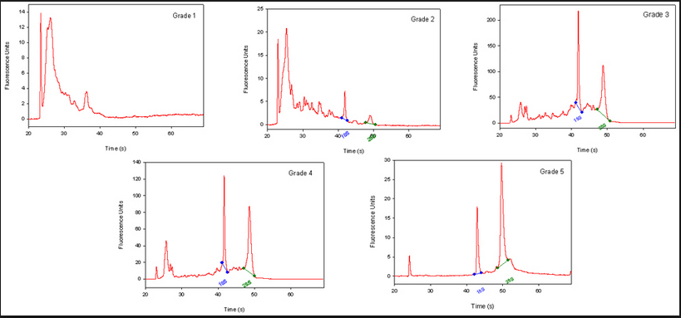
QA/QC of RNA samples
RNA Quality and RIN (RQN on AATI Fragment Analyzer)
RNA sequencing begins with high-quality total RNA, only an Agilant BioAnalyzer (or equivalent) can adequately determine the quality of total RNA samples. RIN values between 7 and 10 are desirable.
BE CONSISTANT!!!

Slide 12
RNA of interest
From “total RNA” we extract “RNA of interest”. Primary goal is to NOT sequence 90% (or more) ribosomal RNAs, which are the most abundant RNAs in the typical sample. there are two main strategies for enriching your sample for “RNA of interest”.
polyA selection. Enrich mRNA (those with polyA tails) from the sample by oligo dT affinity.
rRNA depletion. rRNA knockdown using RiboZero (or Ribominus) is mainly used when your experiment calls for sequencing non-polyA RNA transcripts and non-coding RNA (ncRNA) populations. This method is also usually more costly.
rRNA depletion will result in a much larger proportion of reads align to intergenic and intronic regions of the genome.

Slide 13
Library Preparation
Some library prep methods first require you to generate cDNA, in order to ligate on the Illumina barcodes and adapters.
cDNA generation using oligo dT (3’ biased transcripts)
cDNA generation using random hexomers (less biased)
full-length cDNAs using SMART cDNA synthesis method
Also, can generate strand specific libraries, which means you only sequence the strand that was transcribed.
This is most commonly performed using dUDP rather than dNTPs in cDNA generation and digesting the “rna” strand.
Can also use a RNA ligase to attach adapters and then PCR the second strand and remainder of adapters.

Slide 14
Size Selection/Cleanup/qA
Final insert size optimal for DE are ~ 150bp
Very important to be consistent across all samples in an experiment on how you size select your final libraries. You can size select by:
Fragmenting your RNA, prior to cDNA generation.
Chemically heat w/magnesium
Mechanically (ex. ultra-sonicator)
Cleanup/Size select after library generation using SPRI beads or (gel cut)
QA the samples using an electrophoretic method (Bioanalyzer) and quantify with qPCR.
Most important thing is to be consistent!!!

Slide 15
[SUMMARY] Generating RNA-seq libraries
Considerations
QA/QC of RNA samples [Consistency across samples is most important.]
What is the RNA of interest [polyA extraction is recommended.]
Library Preparation
Stranded Vs. Unstranded [Standard stranded library kits]
Size Selection/Cleanup [Target mean 150bp or kit recommendation]
Final QA [Consistency across samples is most important.]

Slide 16
Sequencing Depth
Coverage is determined differently for ”Counting” based experiments (RNAseq, amplicons, etc.) where an expected number of reads per sample is typically more suitable.
The first and most basic question is how many reads per sample will I get Factors to consider are (per lane):
1. Number of reads being sequenced
2. Number of samples being sequenced
3. Expected percentage of usable data
$$\frac{reads}{sample}=\frac{reads.sequenced ∗0.8}{samples.pooled}$$
Read length, or SE vs PE, does not factor into sequencing depth.

Slide 17
Sequencing
Characterization of transcripts, or differential gene expression
Factors to consider are:
Read length needed depends on likelihood of mapping uniqueness, but generally longer is better and paired-end is better than single-end. (2 x >75bp is best)
Interest in measuring genes expressed at low levels ( << level, the >> the depth and necessary complexity of library)
The fold change you want to be able to detect ( < fold change more replicates, more depth)
Detection of novel transcripts, or quantification of isoforms requires >> sequencing depth
The amount of sequencing needed for a given sample/experiment is determined by the goals of the experiment and the nature of the RNA sample.

Slide 18
Barcodes and Pooling samples for sequencing
Best to have as many barcodes as there are samples
Can purchase barcodes from vendor, generate them yourself from IDTdna (example), or consult with the DNA technologies core.
Best to pool all samples into one large pool, then sequence multiple lanes
IF you cannot generate enough barcodes, or pool into one large pool, RANDOMIZE samples into pools.
Bioinformatics core can produce a randomization scheme for you.
This must be consider/determined PRIOR to library preparation

Slide 19
Cost Estimation
RNA extraction and QA/QC (Per sample)
Enrichment of RNA of interest + library preparation (Per sample)
Library QA/QC (Bioanalyzer and Qubit)
Pooling ($10/library) [If you do your own libraries]
Sequencing (Number of lanes)
Bioinformatics (General rule is to estimate the same amount as data generation, i.e. double your budget)
http://dnatech.genomecenter.ucdavis.edu/prices/
Example: 12 samples, ribo-depletion libraries, target 30M reads per sample, Hiseq 3000 (2x100).

Slide 20
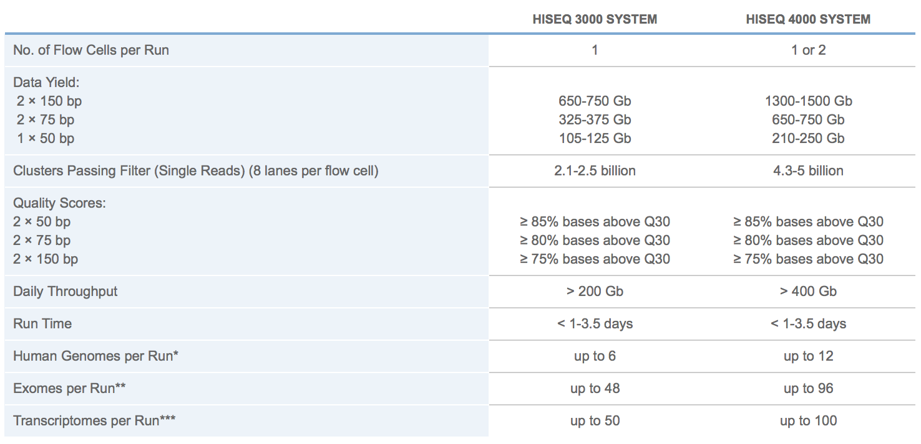
Illumina sequencing
2500
http://www.illumina.com/systems/hiseq-3000-4000/specifications.html
MiSeq

Slide 21
Cost Estimation
12 Samples
QA Bioanalyzer = $98 for all 12 samples
Library Preparation (ribo-depletion) = $383/sample = $4,596
Sequencing = $2346 per lane
2.1 - 2.5 Billion reads per run / 8 lanes = Approximately 300M reads per lane
Multiplied by a 0.8 buffer equals 240M expected good reads
Divided by 12 samples in the lane = 20M reads per sample per lane.
Target 30M reads means 2 lanes of sequencing $2346 x 2 = $4692
Bioinformatics, simple pairwise comparison design, DE only $2000
This is the most basic analysis, for in depth collaborative analysis double sequencing budget.
Total = $98 + $4596 + $4692 + $2000 = $11,386
Approximately $950 per sample @ 40M reads per sample

Slide 22
Overview of RNA-SEQ data analysis

Slide 23
Prerequisites
Access to a multi-core (24 cpu or greater), ‘high’ memory 64Gb or greater Linux server.
Familiarity with the ’command line’ and at least one programming language.
Basic knowledge of how to install software
Basic knowledge of R (or equivalent) and statistical programming
Basic knowledge of Statistics and model building

Slide 24
RNA-seq pipeline overview

Slide 25
Sequence Preprocessing

Slide 26
Why Preprocess reads
We have found that aggressively “cleaning” and processing reads can make a large difference to the speed and quality of assembly and mapping results. Cleaning your reads means, removing reads/bases
that are:
other unwanted sequence (polyA tails in RNA-seq data)
artificially added onto sequence of primary interest (vectors, adapters, primers)
join short overlapping paired-end reads
low quality bases
originate from PCR duplication
not of primary interest (contamination)
Preprocessing also produces a number of statistics that are technical in nature that should be used to evaluate “experimental consistancy”

Slide 27
Read Preprocessing strategies, many over time
Identity and remove contaminant and vector reads
Reads which appear to fully come from extraneous sequence should be removed.
Quality trim/cut
“end” trim a read until the average quality > Q (Lucy)
remove any read with average quality < Q
eliminate singletons/duplicates
If you have excess depth of coverage, and particularly if you have at least x-fold coverage where x is the read length, then eliminating singletons is a nice way of dramatically reducing the number of error-prone reads.
Read which appear the same (particularly paired-end) are often more likely PCR duplicates and therefor redundant reads.
eliminate all reads (pairs) containing an “N” character
If you can afford the loss of coverage, you might throw away all reads containing Ns.
Identity and trim off adapter and barcodes if present
Believe it or not, the software provided by Illumina, either does not look for, or does a mediocre job of, identifying adapters and removing them.

Slide 28
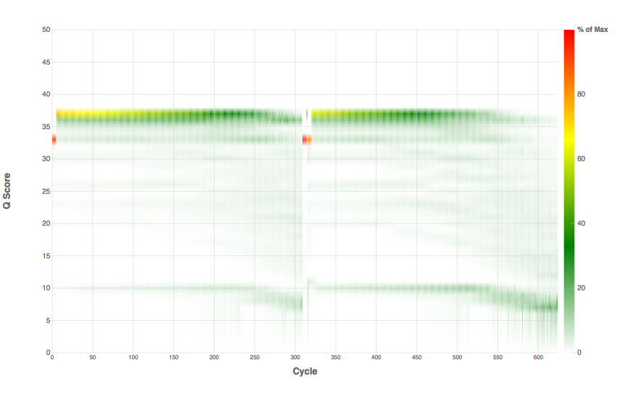
Library prep, fragmentation, adapter addition
PCR enrichment
DNA/RNA, could contain ‘contamination’
Final Library, size distribution
Possible addition of phiX
Sequencing Characteristics/ Quality

Slide 29
Preprocessing
Map reads to contaminants/PhiX and extract unmapped reads [bowtie2 --local
Remove contaminants (at least PhiX), uses bowtie2 then extracts all reads (pairs) that are marked as unmapped.
Super-Deduper [ PE reads only ]
Remove PCR duplicates (we use bases 10-35 of each paired read)
FLASH2 [ PE reads only ]
Join and extend, overlapping paired end reads
If reads completely overlap they will contain adapter, remove adapters
Identify and remove any adapter dimers present
Scythe [ SE Reads only ]
Identify and remove adapter sequence
Sickle
Trim sequences (5’ and 3’) by quality score (I like Q20)
cleanup
Run a polyA/T trimmer
Remove any reads that are less then the minimum length parameter
Produce preprocessing statistics

Slide 30
Why Screen for PhiX
PhiX is a common control in Illumina runs, facilities rarely tell you if/when PhiX has been spiked in
Does not have a barcode, so in theory should not be in your data
However
When I know PhiX has been spiked in, I find sequence (many X coverage) every time
When I know PhiX has not been spiked in, I do not find sequence
Better safe than sorry and screen for it.

Slide 31
Super Deduper
Read 2
Read 1
Data | Alignment Algorithm | MarkDuplicates | Rmdup | Super Deduper | FastUniq | Fulcrum | Total # of Reads
PhiX | BWA MEM | 1,048,278 (0.25%) | 1,011,145 (1.05%) | 1,156,700 (13.7%) | 4,202,526 | 3,092,155 | 4,750,299
 | Bowtie 2 Local | 1,054,725 (6.62%) | 948,784 (10.2%) | 1,166,936 (14.0%) | 4,236,647 | 3,103,872 | 4,790,972
 | Bowtie 2 Global | 799,524 (0%) | 800,868 (0.12%) | 896,487 (9.92%) | 3,768,641 | 2,704,114 | 4,293,787
Acropora digitifera | BWA MEM | 5,132,111 (2.26%) | 6,906,634 (44.5%) | 5,133,339 (10.2%) | 12,968,469 | 2,103,567 | 54,108,240
 | Bowtie 2 Local | 4,688,809 (4.03%) | 5,931,862 (38.9%) | 3,971,743 (9.32%) | 9,893,903 | 4,259,619 | 41,728,154
 | Bowtie 2 Global | 1,457,865 (3.62%) | 1,512,966 (24.2%) | 1,185,838 (11.4%) | 3,014,498 | 1,286,031 | 11,600,847
https://github.com/dstreett/Super-Deduper

Slide 32
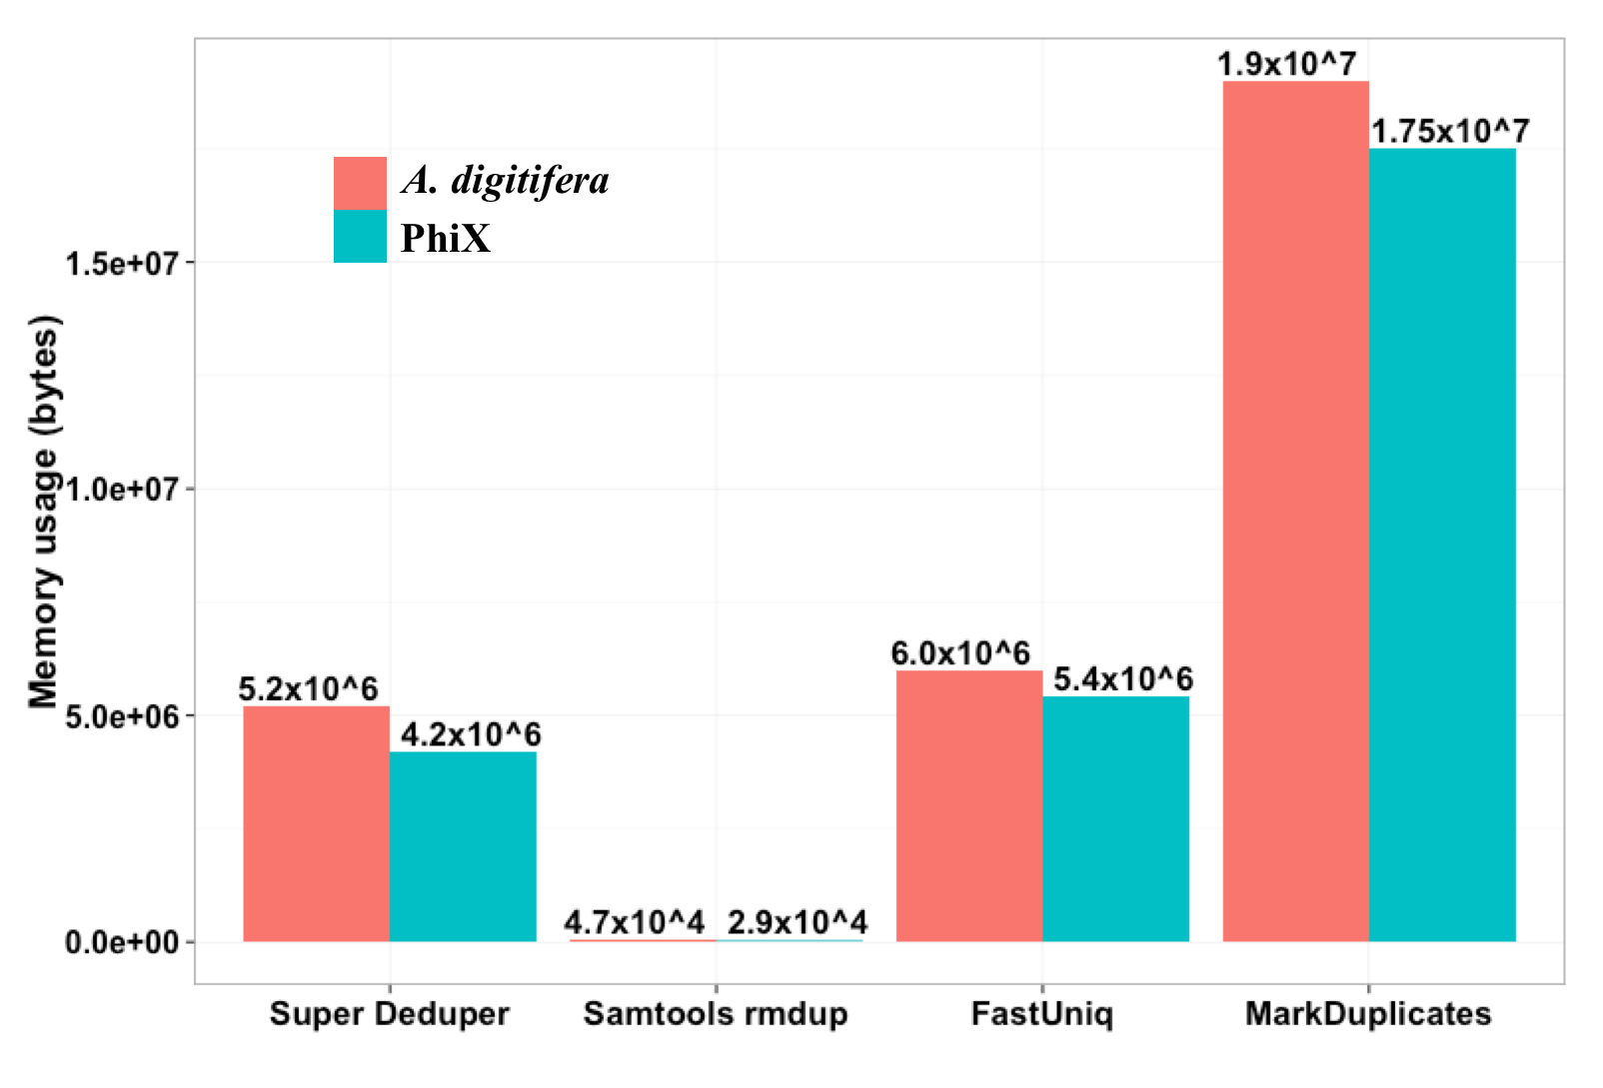
Super Deduper
Figure 1: ROC curves. Only a representative subset of the different start positions is shown. The image on the left shows the full ROC curves and the image on the left is a zoomed in view of corner of the curves. Each curve represents a start position and each point represents a length. The labeled point in the image on the right is the default start and length for Super Deduper.
We calculated the Youden Index for every combination tested and the point that acquired the highest index value (as compared to Picard MarkDuplicates) occurred at a start position of 5bp and a length of 10bps (20bp total over both reads)

Slide 33
Flash2 – overlapping of reads and adapter removal in paired end reads
Insert size
Insert size > length of the number of cycles
Read 2
Target Region
Read 1
Product: Read Pair
Insert size < length of the number of cycles (10bp min)
Insert size
Read 2
Target Region
Read 1
Product: Extended, Single
Insert size < length of the read length
Insert size
Read 2
Target Region
Read 1
Product: Adapter Trimmed, Single
https://github.com/dstreett/FLASH2

Slide 34
QA/QC
Beyond generating better data for downstream analysis, cleaning statistics also give you an idea as to the quality of the sample, library generation, and sequencing quality used to generate the data.
This can help inform you of what you might do in the future.
I’ve found it best to perform QA/QC on both the run as a whole (poor samples can affect other samples) and on the samples themselves as they compare to other samples (REMEMBER, BE CONSISTANT).
Reports such as Basespace for Illumina, are great ways to evaluate the runs as a whole.
PCA/MDS plots of the preprocessing summary are a great way to look for technical bias across your experiment

Slide 35
Sequence Mapping

Slide 36
Mapping vs Assembly
Given sequence data,
Assembly seeks to put together the puzzle without knowing what the picture is
Mapping tries to put together the puzzle pieces directly onto an image of the picture
In mapping the question is more, given a small chunk of sequence, where in the genome did this piece most likely come from.
The goal then is to find the match(es) with either the “best” edit distance (smallest), or all matches with edit distance less than max edit dist. Main issues are:
Large search space
Regions of similarity (aka repeats)
Gaps (INDELS)
Complexity (RNA, transcripts)

Slide 37
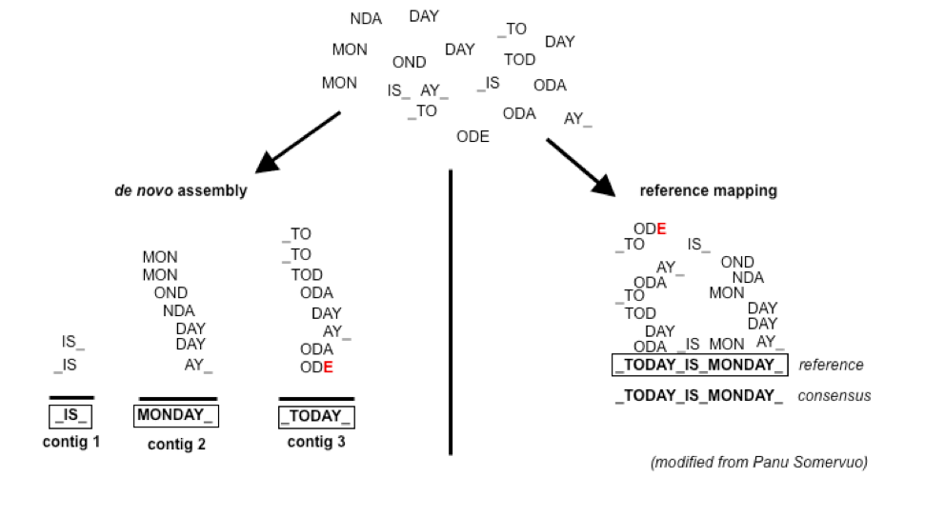
Example

Slide 38
Consideration
Placing reads in regions that do not exist in the reference genome (reads extend off the end) [ mitochondrial, plasmids, structural variants, etc. ].
Sequencing errors and variations: alignment between read and true source in genome may have more differences than alignment with some other copy of repeat.
What if the closest fully sequenced genome is too divergent? (3% is a common assumed alignment capability)
Placing reads in repetitive regions: Some algorithms only return 1 mapping; If multiple: map quality = 0
Algorithms that use paired-end information => might prefer correct distance over correct alignment.

Slide 39
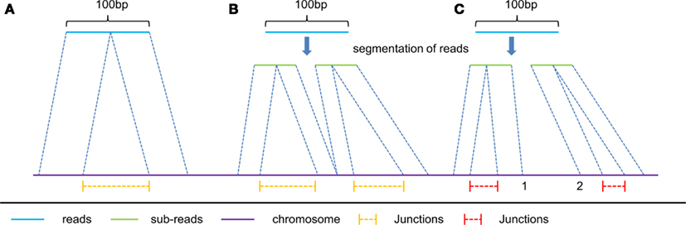
Intron/exon junctions
In RNA-seq data, you must also consider splice junctions, reads may span an intron

Slide 40
Some Aligners
Spliced Aligners
Tophat (Bowtie2)
GSNAP
SOAPsplice
MapSplice
TrueSite
star
Aligners that can ’clip’
Bowtie2 in local mode
bwa-mem
https://en.wikipedia.org/wiki/List_of_sequence_alignment_software

Slide 41
Genome vs Transcriptome Reference
May seem intuitive to map RNAseq data to transcriptome, but its not that simple.
Transcriptomes are rarely complete,
Which transcript, canonical transcript? Shouldn’t map to all splice variants as these would show up as multi-mappers
More so, a mapper will do its damndest to map every read, somewhere, provided the result meets its minimum requirements.
Need to provide a mapper with all possible places the read could arisen from, which is best represented by the genome. Otherwise you get mismapping because its close enough.

Slide 42
Genome and Annotation
Genome fasta files and Annotation files go together! Should be identified before beginning any analysis
Genome fasta files should include all primary chromosomes, unplaced sequences and un-localized sequences, as well as any organelles. Should not contain any contigs that represent patches or alternative haplotypes.
Annotation file should be GTF (preferred), and should be the most comprehensive you can find.
Chromosome names in the GTF should match those in the fasta, they don’t always do.
Star recommends the Gencode annotations for mouse/human

Slide 43
Preparing a sam file for counting and stats
Samtools is used to manipulate mapping files for counting, common steps include:
samtools view [to convert from sam to bam]
samtools sort [possibly by read and not by position, htseq-count requirement]
samtools index
samtools idxstats
samtools flagstat
samtools stats
Check with the counting application as to its input requirements.

Slide 44
QA/QC
Mapper produce summary statistics, view the summary report (in a text editor) and compare across samples.
Other additional summary statistics can be produced with:
samtools flagstat
samtools idxstats
samtools stats
Produce a multi-dimensional scaling (MDS) plots of the summary files, the purpose is to look for patterns in the plot that are non-random, and may be influenced by technical artifacts

Slide 45
Estimate known genes and transcripts expression – Counting

Slide 46
Counting as a measure of expression
The more you can count (and HTS sequencing systems can count a lot) the better the measure of copy number for even rare transcripts in a population.
Most RNA-seq techniques deal with count data. Reads are mapped to a reference genome, transcripts are detected, and the number of reads that map to a transcript (or gene) are counted.
Read counts for a transcript are roughly proportional to the gene’s length and transcript abundance.
technical artifacts should be considered during counting
mapping quality
mapability (uniqueness), the read is not ambiguous

Slide 47
Read Counting with HTSEQ-COUNT
Problem:
Given a sam/bam file with aligned sequence reads and a list of genomic feature (genes locations), we wish to count the number of reads (fragments) than overlap each feature.
Features are defined by intervals, they have a start and stop position on a chromosome.
For this workshop and analysis, features are genes which are the union of all its exons. You could consider each exon as a feature, for alternative splicing.
Htseq-count has three overlapping modes
union:
intersection-strict
intersection-nonempty

Slide 48
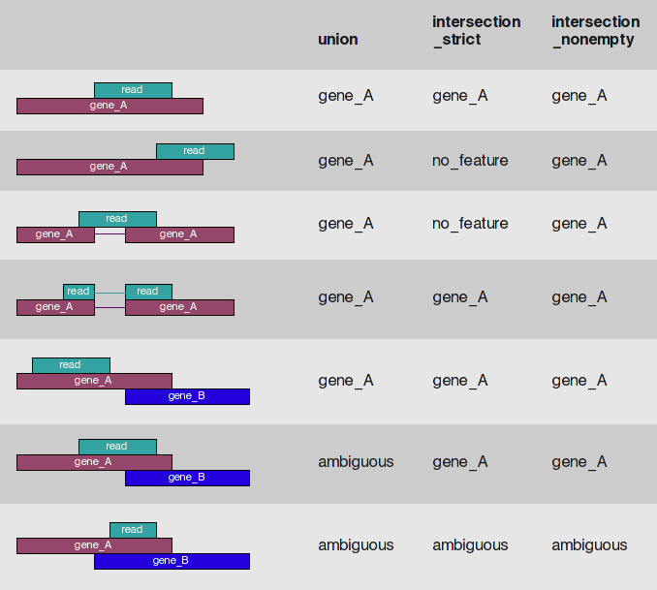
Htseq-count

Slide 49
Counting genes -- STAR
Counts coincide with Htseq-counts under default parameters. Need to specify GTF file at genome generation step or during mapping.
Output, 4 columns
GeneID
Counts for unstranded
Counts for first read strand
Counts for the second read strand
Chose the columns that makes sense and generate a matrix table, columns are sample, rows are genes.

Slide 50
QA/QC
View summary report (in a text editor)
Produce a multi-dimensional scaling (MDS) plots of the summary files, the purpose is to look for patterns in the plot that are non-random, and may be influenced by technical means.
Statistics such as:
% Multimapped reads
% Uniquely mapped reads
Splice sites
Unmapped
Chimeric
Etc.

Slide 51
Differential Expression Analysis using edgeR/Limma Voom

Slide 52
Differential Expression Analysis
Differential Expression between conditions is determined from count data, which is modeled by a distribution (ie. Negative Binomial Distribution, Poisson, etc.)
Generally speaking differential expression analysis is performed in a very similar manner to DNA microarrays, once and normalization have been performed.
A lot of RNA-seq analysis has been done in R and so there are many packages available to analyze and view this data. Two of the ‘best’ are:
DESeq, developed by Simon Anders (also created htseq) in Wolfgang Huber’s group at EMBL
edgeR/Voom (extension to Limma [microarrays] for RNA-seq), developed out of Gordon Smyth’s group from the Walter and Eliza Hall Institute of Medical Research in Australia
http://bioconductor.org/packages/release/BiocViews.html#___RNASeq

Slide 53
Basic steps procedure – edger/limma voom
Read the count data in
Filter genes(uninteresting genes, e.g. unexpressed)
Calculate normalizing factors (sample-specific adjustment)
Calculate dispersion (gene-gene variance-stabilizing transformation)
Fit a model of your experiment
Perform likelihood ratio tests on comparisons of interest (using contrasts)
Adjust for multiple testing, Benjamini-Hochberg (BH) is the defaults.
Check results for confidence
Attach annotation if available and write tables

Slide 54
Filtering genes
Most common filter is to remove genes that are less then X reads counts across a certain number of samples. EX.
rowSums(cpms <= 1) < 3 , require at least 1 cpm in at least 3 samples to keep
A second less used filter to is minimum variance across all samples, so if a gene isn’t changing (constant expression) its not interesting no need to test.

Slide 55
NORMALIZATION
In differential expression analysis, only sample-specific effects need to be normalized, NOT concerned with comparisons and quantification of absolute expression.
Sequence depth – is a sample specific effect and needs to be adjusted for.
RNA composition - finding a set of scaling factors for the library sizes that minimize the log-fold changes between the samples for most genes (uses a trimmed mean of M-values between each pair of sample)
GC content – is NOT sample-specific (except when it is)
Gene Length – is NOT sample-specific (except when it is)
Normalization in edgeR/Voom is model-based, you calculate normalizing factors using the function calcNormFactors function which by default uses TMM (trimmed means of M values). Assumes most genes are not DE.

Slide 56
RPKM vs FPKM vs CPM vs model based
RPKM - Reads per kilobase per million mapped reads
FPKM - Fragments per kilobase per million mapped reads
logCPM – log Counts per million [ good for producing MDS plots, estimation of normalized values in model based ]
Model based - original read counts are not themselves transformed, but rather correction factors are used in the DE model itself.

Slide 57
Transformation
Transformation turn the gene count data into a distribution more suitable for statistical analysis (more ”normal” like).
Most common
Limma-trended transformation, logCPM, best when total counts per sample are relatively close to each other (~3-fold)
Voom, is best used when library sizes are quite variable across samples

Slide 58
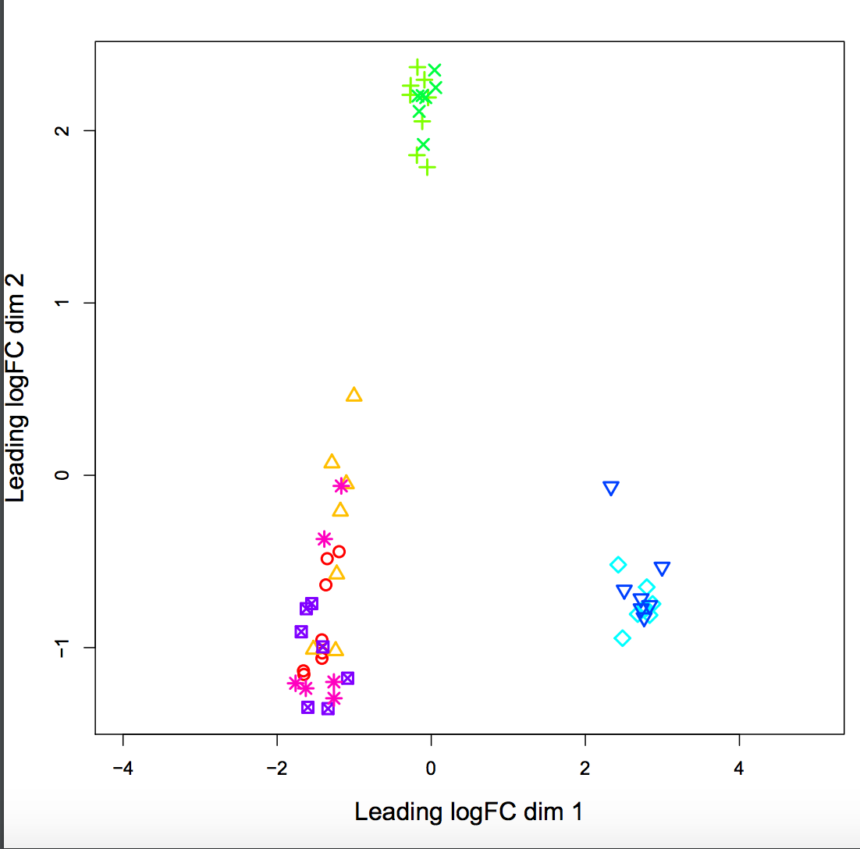
QA/QC
MDS plots of logCPM

Slide 59
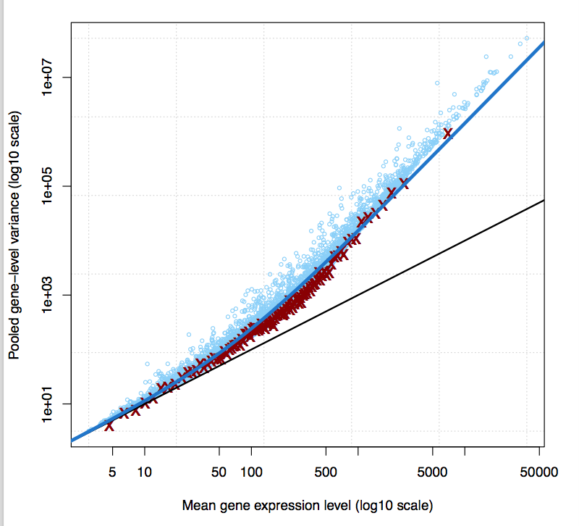
Variance Stabilization - eBayes
The variance characteristics of low expressed genes are different from high expressed genes, if treated the same, the effect is to over represent low expressed genes in the DE list.

Slide 60
Multiple testing correct
Simply a must! Best choices are
FDR (false discovery rate)
qvalue
The FDR (or qvalue) is a statement about the list and no longer about the gene. So a FDR 0.05, says you expect 5% false positives in the list of genes with an FDR of 0.05 and less.
The statement “Statistically significant” means FDR of 0.05 or less.
My opinion is these genes do not require further validation (eg qrtPCR)
You can dip below FDR 0.05, but in my opinion you then need to validate those genes.

Slide 61
EdgeR/Limma Manual
Both edgeR and limma voom have VERY comprehensive user manuals
Limma voom https://bioconductor.org/packages/release/bioc/vignettes/limma/inst/doc/usersguide.pdf
edgeR http://bioconductor.org/packages/release/bioc/vignettes/edgeR/inst/doc/edgeRUsersGuide.pdf

Slide 62
Summarization and Visualization

Slide 63
The Top Table
The basic table
Gene_ID: The Gene Id from the GTF file
logFC: log fold change, positive values indicate up-regulation, negative numbers indicate down-regulation
logCPM: log counts per million, average ‘expression’ value of the gene
LR: log ratio of the test (ignore)
Pvalue: raw p-value for that gene (best to sort on)
FDR: false discover rate for that gene
Annotation is added in additional columns (must first uncomment the line to do so in the R script

Slide 64
Visualization and Next step tools
Visualization
Integrated Genome Viewer (https://www.broadinstitute.org/igv/)
Further Annotation of Genes
DAVID (http://david.abcc.ncifcrf.gov/tools.jsp)
ConsensusPathdb (http://cpdb.molgen.mpg.de/)
NetGestalt (http://www.netgestalt.org/)
Molecular Signatures Database (http://www.netgestalt.org/)
PANTHER (http://www.pantherdb.org/)
Cognoscente (http://vanburenlab.medicine.tamhsc.edu/cognoscente.shtml)
Pathway Commons (http://www.pathwaycommons.org/)
Readctome (http://www.reactome.org/)
PathVisio (http://www.pathvisio.org/)
Moksiskaan (http://csbi.ltdk.helsinki.fi/moksiskaan/)
Weighed Gene Co-Expression Network Analysis (WGCNA)s
More tools in R Bioconductor

Slide 65
Gene Set enrichment analysis (GSEA) And GO/Pathway Enrichment
Gene set enrichment analysis
A computational method that determines whether an a priori set of genes (e.g. gene ontology group, or pathway) shows statistically significant, concordant differences between two biological states (e.g. phenotypes)
Gene Ontology/Pathways enrichment analysis
Given a set of genes that are up-regulated, which gene ontologies or pathways are over-represented (or under-represented) using annotations for that gene set.

Slide 66
Software
Preprocessing:
Python 2.7
Modules: argparse, optparse, distutils
bowtie2 - contaminant screening
http://bowtie-bio.sourceforge.net/bowtie2/index.shtml
Super-Deduper – Identify and remove PCR duplicates
https://github.com/dstreett/Super-Deduper
Sickle – Trim low quality regions
https://github.com/dstreett/sickle
Scythe – Identify and remove adapters in SE reads
https://github.com/ucdavis-bioinformatics/scythe
FLASH2 – Join overlapping reads, identify and remove adapter in PE reads
https://github.com/dstreett/FLASH2

Slide 67
Software
Mapping:
Bwa mem – map reads to a reference
http://sourceforge.net/projects/bio-bwa/files/
samtools – processing of sam/bam file
http://www.htslib.org/
Read Counting:
samtools – processing of sam/bam file
http://www.htslib.org/
HTeq-0.6.1 htseq_count – count reads occurrences within genes
http://www-huber.embl.de/users/anders/HTSeq/
OR simultaneous read mapping and counting:
Star
https://github.com/alexdobin/STAR [performs both alignment and counting]

Slide 68
Software
Analysis of differential expression:
R http://www.r-project.org/
R Packages: EdgeR, limma from bioconductor – differential expression analysis
http://bioconductor.org/packages/release/bioc/html/edgeR.html
http://bioconductor.org/packages/release/bioc/html/limma.html
https://genomebiology.biomedcentral.com/articles/10.1186/gb-2014-15-2-r29
RStudio
https://www.rstudio.com/

Slide 69
Files and file types

Slide 70
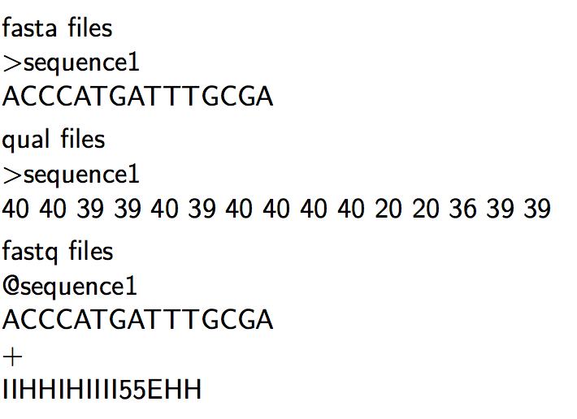
Sequencing Read files

Slide 71
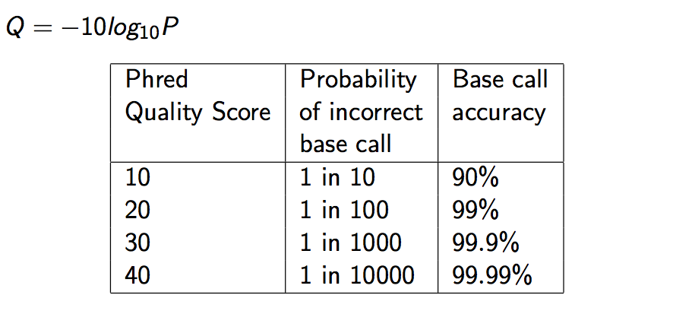
Quality Scores

Slide 72
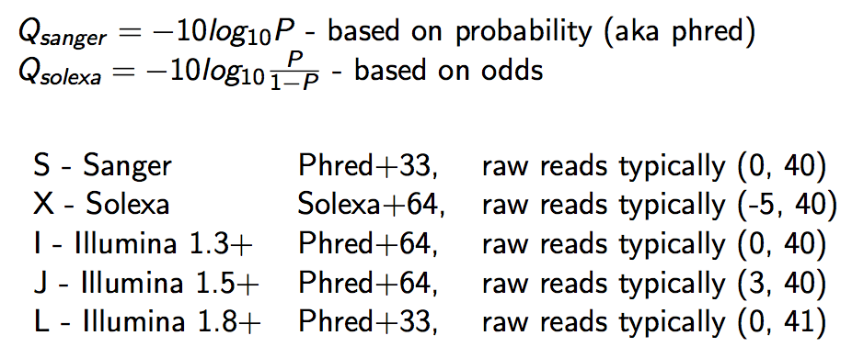
Qscore Conversion

Slide 73
Illumina Read naming conventions
CASAVA 1.8 Read IDs
@EAS139:136:FC706VJ:2:2104:15343:197393 1:Y:18:ATCACG
EAS139 the unique instrument name
136 the run id
FC706VJ the flowcell id
2 flowcell lane
2104 tile number within the flowcell lane
15343 ’x’-coordinate of the cluster within the tile
197393 ’y’-coordinate of the cluster within the tile
1 the member of a pair, 1 or 2 (paired-end or mate-pair reads only)
Y Y if the read fails filter (read is bad), N otherwise
18 0 when none of the control bits are on, otherwise it is an even number
ATCACG index sequence

Slide 74
SAM/BAM Files
SAM (Sequence Alignment/Map) format = unified format for storing read alignments to a reference sequence(Consistent since Sept. 2011).
http://samtools.github.io/hts-specs/SAMv1.pdf
http://samtools.github.io/hts-specs/SAMtags.pdf
BAM = binary version of SAM for fast querying

Slide 75
SAM/BAM files
SAM files contain two regions
The header section
Each header line begins with character ’@’ followed by a two-letter record type code
The alignment section
Each alignment line has 11 mandatory fields. These fields always appear in the same order and must be present, but their values can be ’0’ or ’*’, if the corresponding information if unavailable, or not applicable.

Slide 76
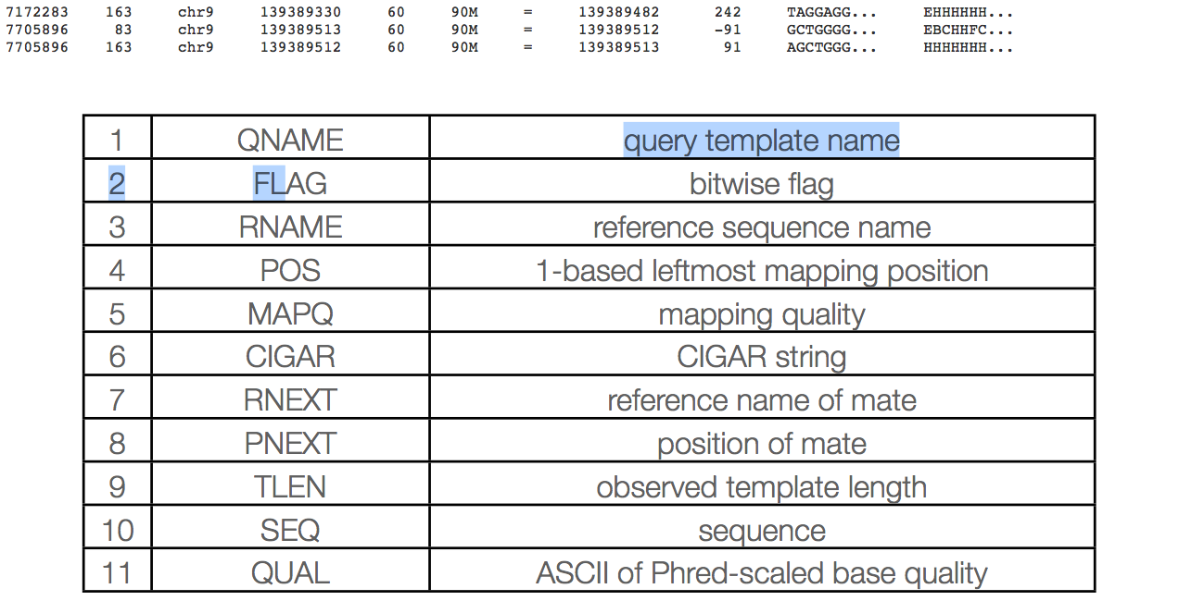
Sam columns

Slide 77
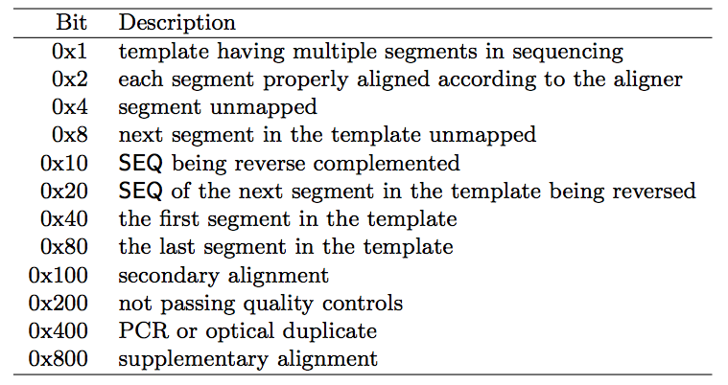
Sam flags

Slide 78
Mapq explained
MAPQ, contains the "phred-scaled posterior probability that the mapping position" is wrong.
In a probabilistic view, each read alignment is an estimate of the true alignment and is therefore also a random variable. It can be wrong. The error probability is scaled in the Phred. For example, given 1000 read alignments with mapping quality being 30, one of them will be incorrectly mapped to the wrong location on average.
A value 255 indicates that the mapping quality is not available.

Slide 79
Mapq explained
The calculation of mapping qualities is simple, but this simple calculation considers many of the factors below:
The repeat structure of the reference. Reads falling in repetitive regions usually get very low mapping quality.
The base quality of the read. Low quality means the observed read sequence is possibly wrong, and wrong sequence may lead to a wrong alignment.
The sensitivity of the alignment algorithm. The true hit is more likely to be missed by an algorithm with low sensitivity, which also causes mapping errors.
Paired end or not. Reads mapped in pairs are more likely to be correct.

Slide 80
Mapq explained
When you see a read alignment with a mapping quality of 30 or greater, it usually implies:
The overall base quality of the read is good.
The best alignment has few mismatches.
The read has few or just one ‘good’ hit on the reference, which means the current alignment is still the best even if one or two bases are actually mutations, or sequencing errors.
In practice however, each mapper seems to compute the MAPQ in their own way.

Slide 81
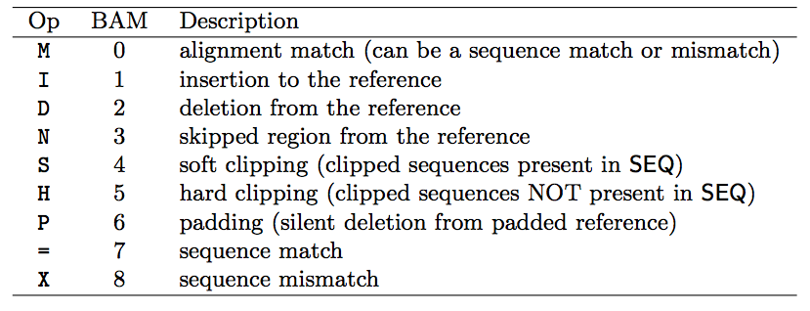
Sam cigar
Compact Idiosyncratic Gapped Alignment Report (CIGAR) SAM flag field:

Slide 82
CIGAR Example
0 0 0 0 0 0 0 0 0 1 1 1 1 1 1 1 1 1 1 2
Ref Pos: 1 2 3 4 5 6 7 8 9 0 1 2 3 4 5 6 7 8 9 0
Reference: C C A T A C T G A A C T G A C T A A C
Read: A C T A G A A T G G C T
POS: 5
CIGAR: 3M1I6M1D2M
** mismatches are not considered in standard CIGAR

Slide 83
GFF/GTF files
The GFF (General Feature Format) format consists of one line per feature, each containing 9 columns of data (fields). The GTF (General Transfer Format) is identical to GFF version 2.
Fields must be tab-separated and all fields must contain a value; “empty” fields should be denoted with a ‘.’.
Columns:
Seqname: Name of the sequence chromosome
Source: the program, or database, that generated the feature
Feature: feature type name, (e.g. gene, exon, cds, etc.)
Start: start position of the feature, sequences begin at 1
End: stop position of the feature, sequences begin at 1
Score: a floating point value (e.g. 0.01)
Strand: Defined as ‘+’ (forward),or ‘-’ (reverse)
Frame: One of ‘0’, ‘1’, ‘2’, ‘0’ represents the first base of a codon.
Attribute: A semicolon-separated list of tag-value pairs, providing additional information about each feature.

Slide 84
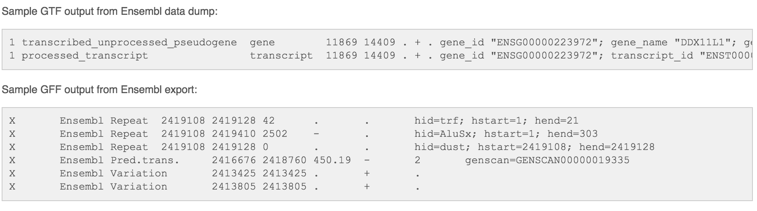
GFF/GTF files

