Slide 1
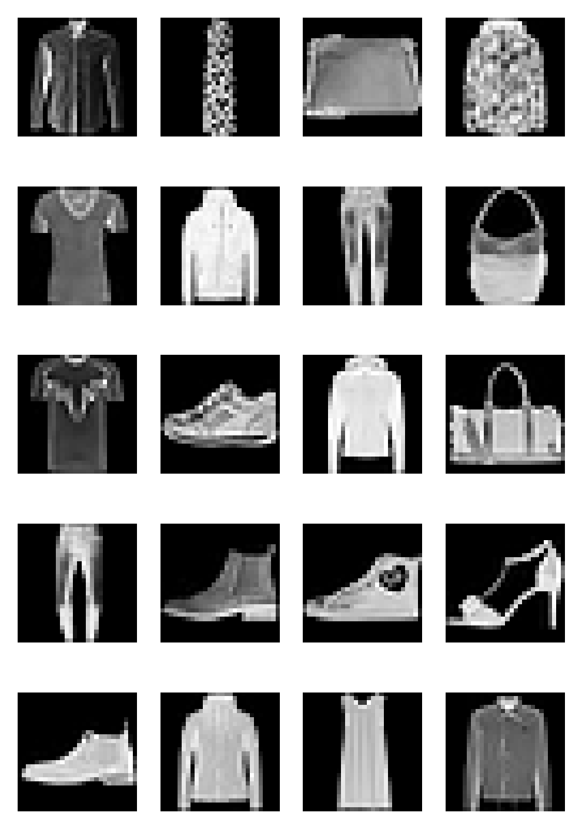
IT8303 AI Human Interface Assignment 1
Justin Zhou Yong
7455604N

Slide 2
CNN Overview
Manufacturing factory dataset – factory_data.csv

Slide 3
CNN Implementation
Manufacturing factory dataset – factory_data.csv

Slide 4
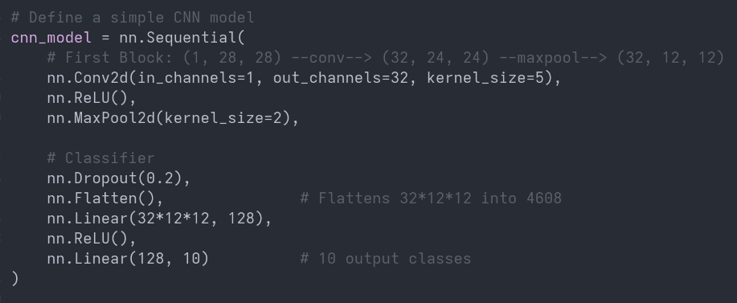
Baseline Model
Model from Lab 4

Slide 5
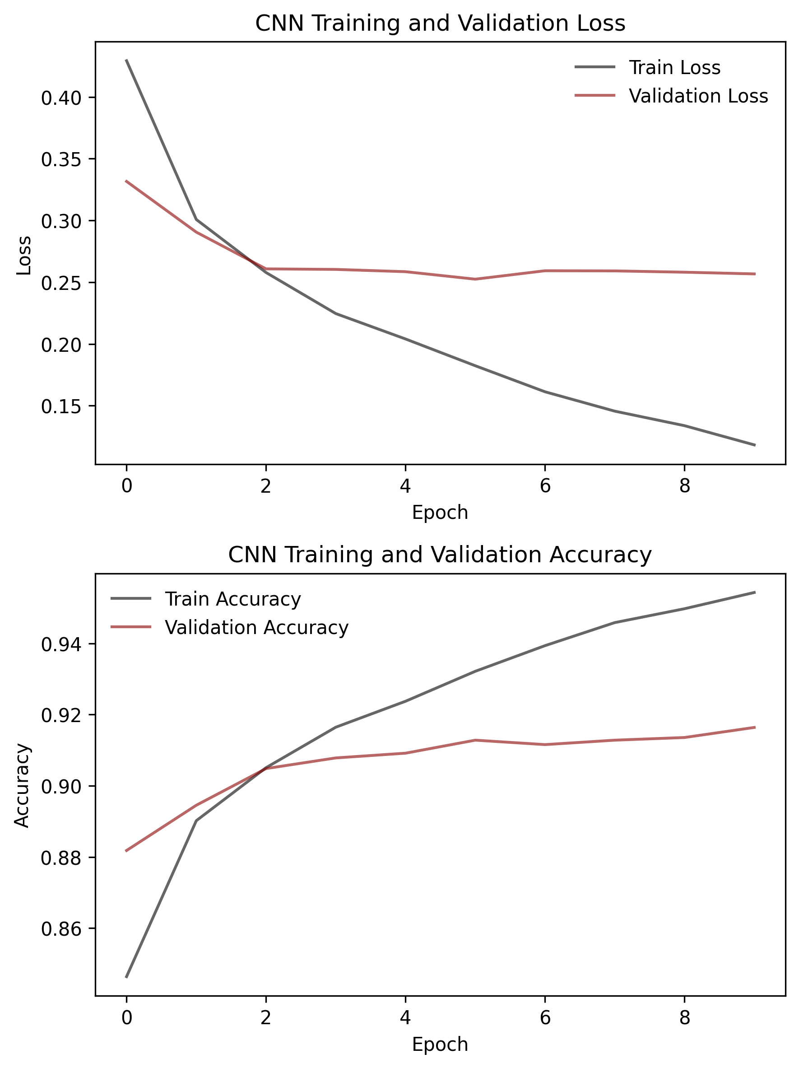
Model Performace
Manufacturing factory dataset – factory_data.csv
Overfitting beyond 2 epochs.

Slide 6
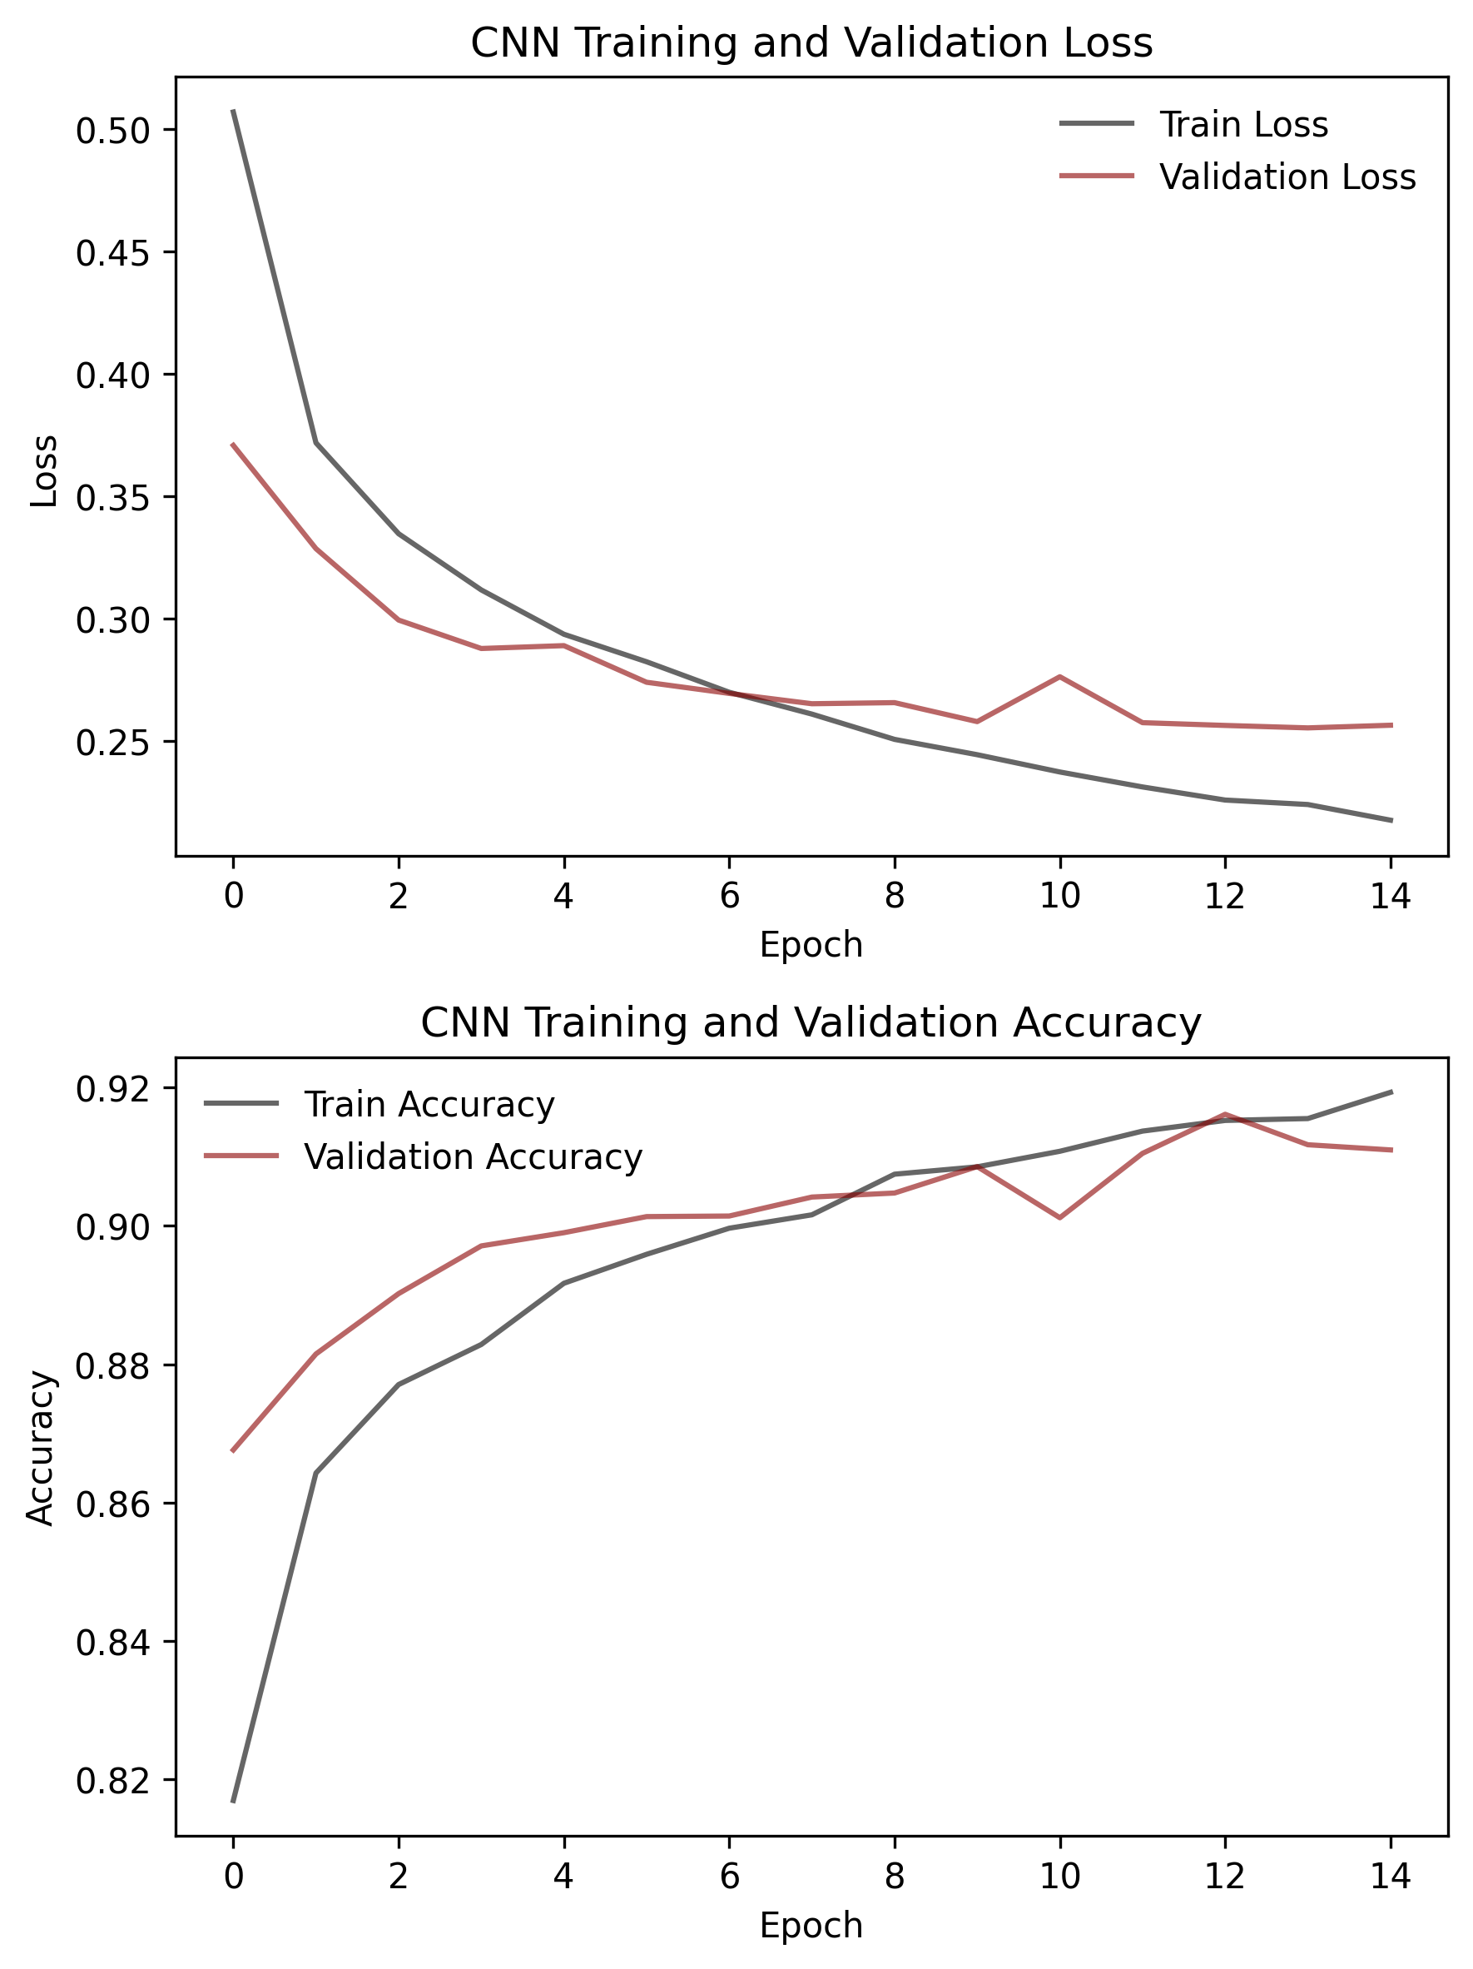
Data Augmentation
The fix for overfitting
asdfsadf

Slide 7
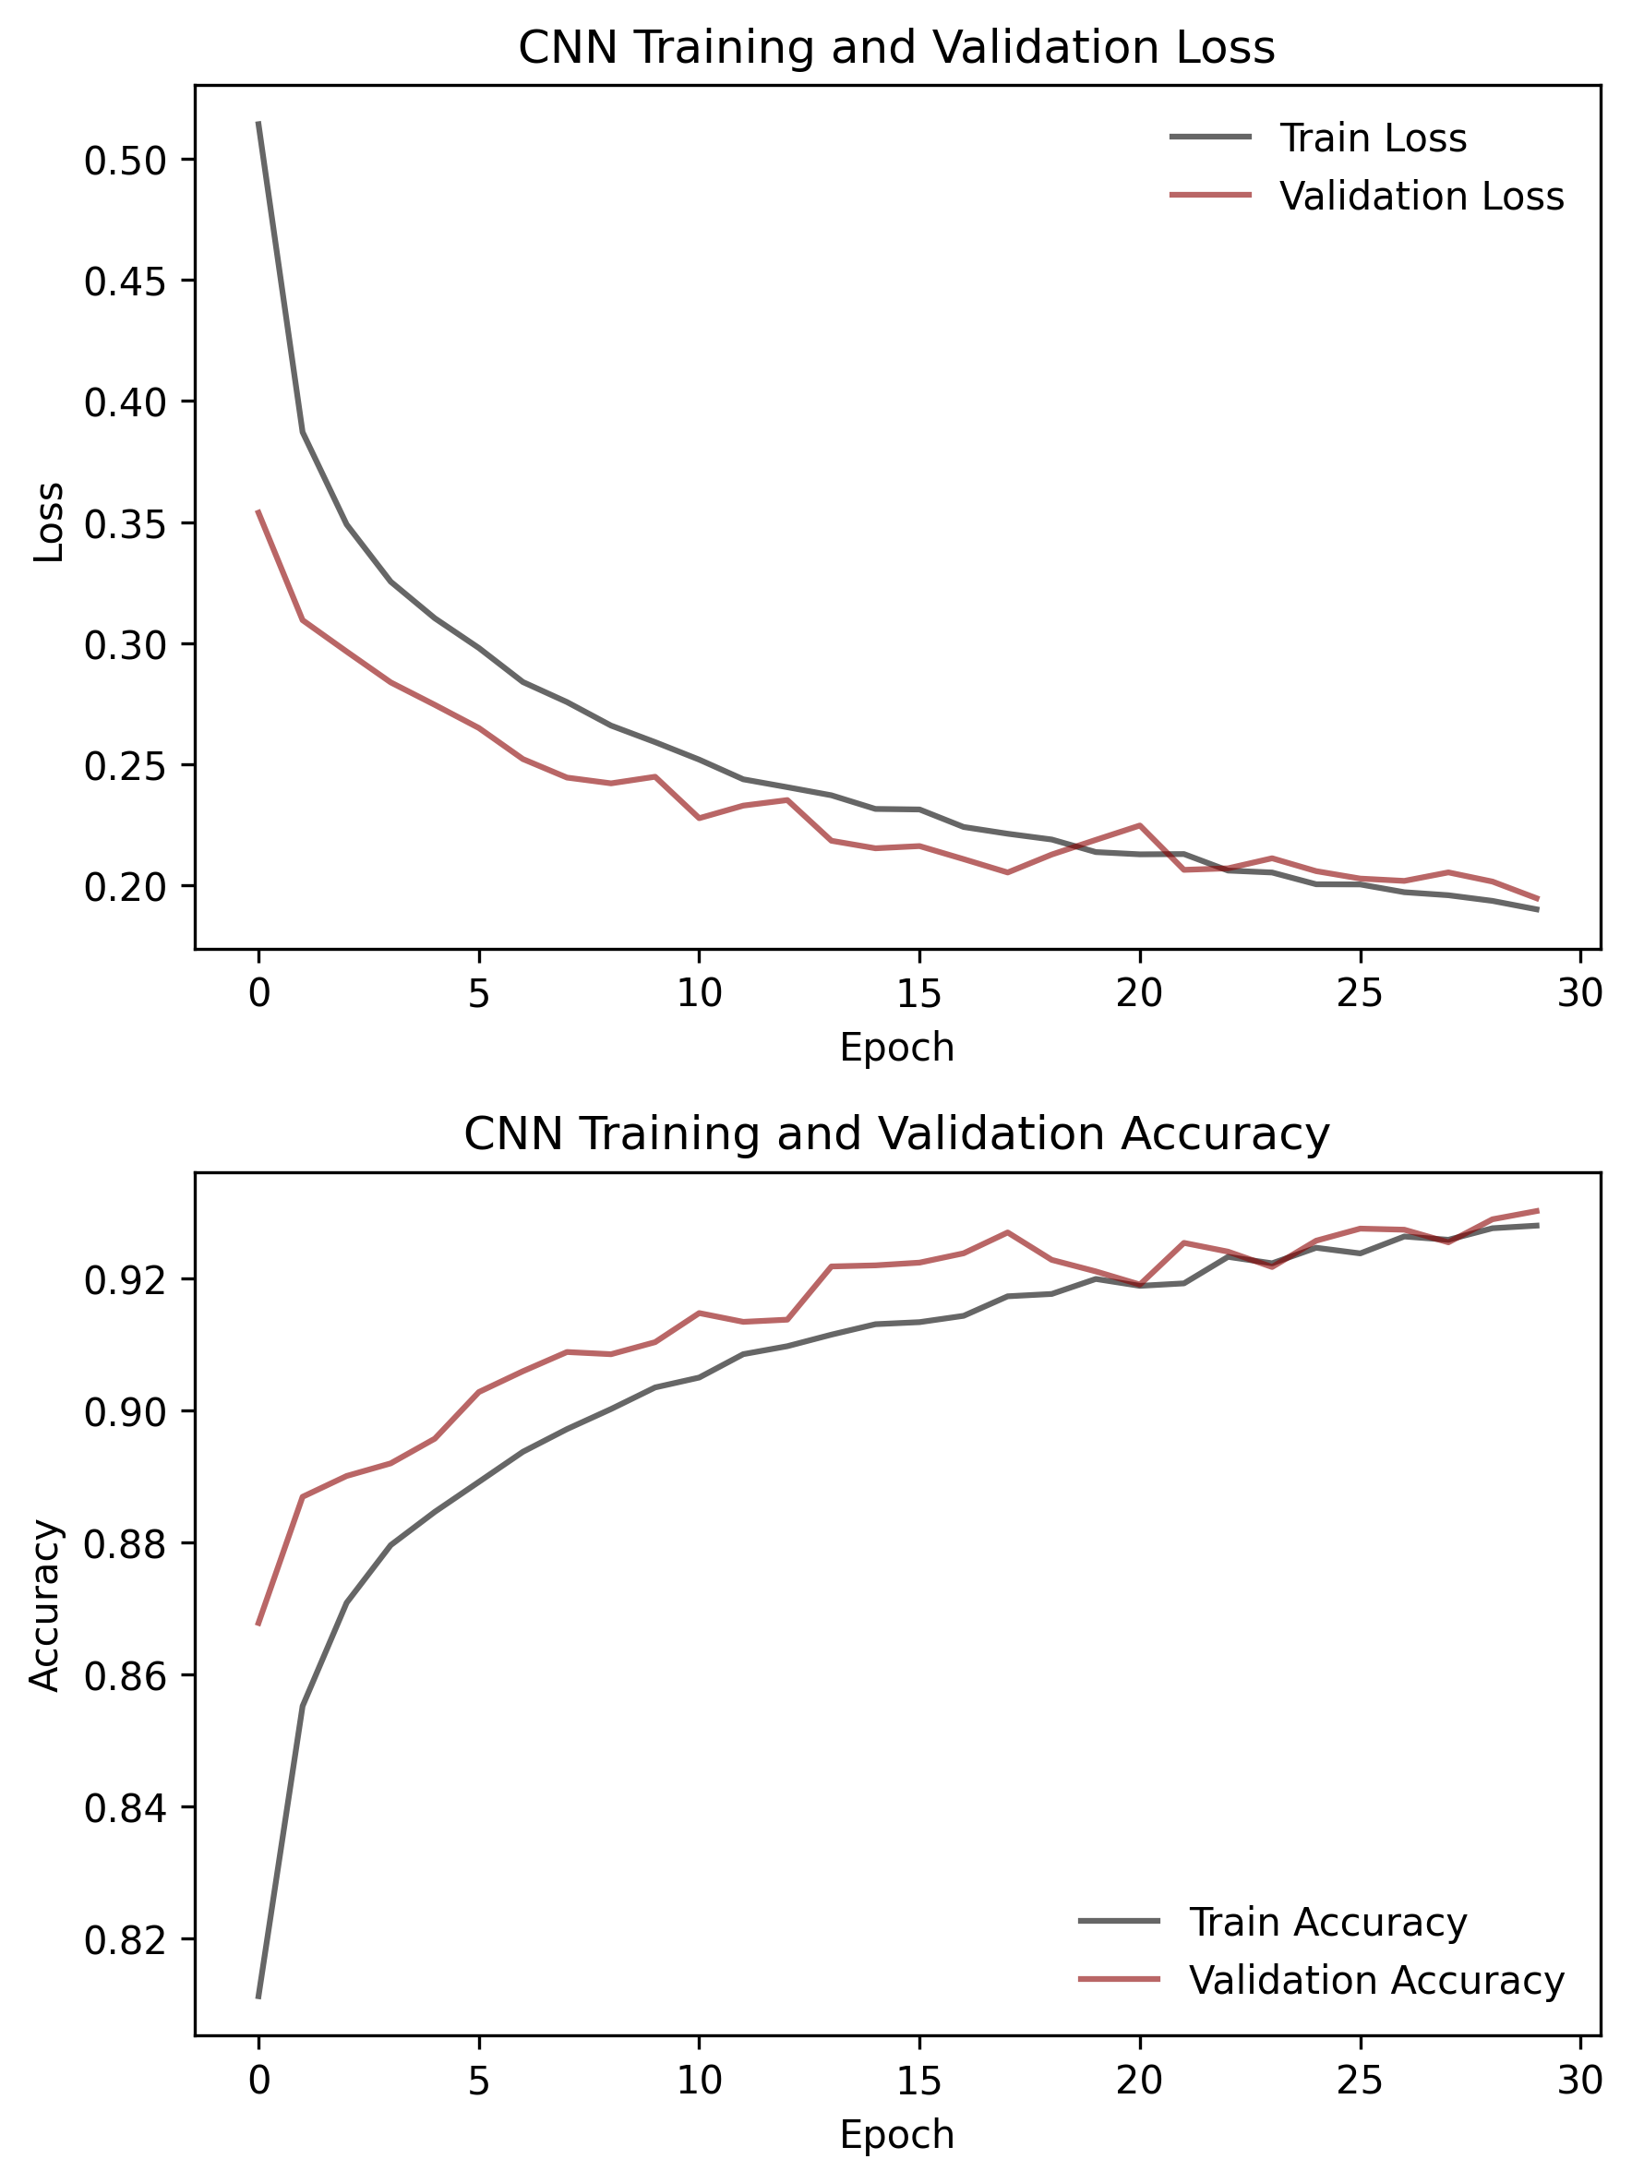
Performance after Augmentation
Manufacturing factory dataset – factory_data.csv
asdfsadf

Slide 8
Discussion
Manufacturing factory dataset – factory_data.csv
asdfsadf

