Slide 1






PERSONAL PORTFOLIO
BY . VARSHINI A

Slide 2
INTRODUCING
The personal portfolio project is designed to showcase my skills, experience, and projects. The portfolio includes sections for my profile, contact information, education, skills and coursework, and project details. The goal is to provide a comprehensive overview of my professional background in a visually appealing format.

Slide 3
HTML STRUCTURE
THE HTML FILE IS ORGANIZED INTO KEY SECTIONS:
  HEADER: DISPLAYS PROFILE PICTURE, NAME, AND TITLE.
  Contact Information: Includes date of birth, phone number, email, LinkedIn profile, personal website, and address.
  Education: Lists educational background and degrees.
  Skills and Coursework: Highlights key skills and completed coursework.
  Projects: Describes projects and their relevance.
  Footer: Contains copyright information.

Slide 4
CSS STYLING
THE CSS FILE DEFINES THE STYLING FOR THE PORTFOLIO
  FLEXBOX LAYOUT: USED FOR ALIGNING AND SPACING ELEMENTS.
  Profile Picture Styling: Ensures the profile picture is displayed correctly with a round shape.
  Typography: Consistent font styles for readability.
  Responsive Design: Adjusts layout based on screen size for better accessibility.

Slide 5
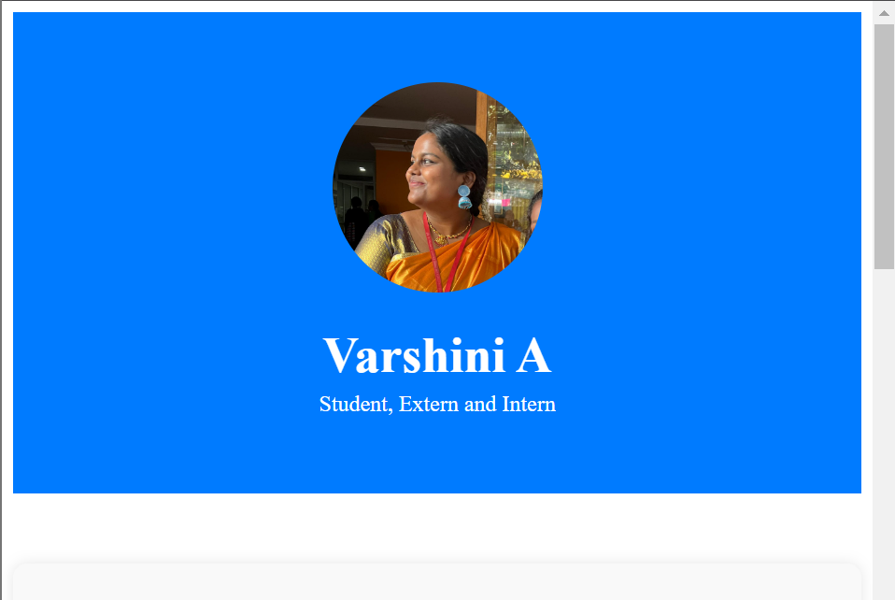

Slide 6
PROFILE SECTION
THE PROFILE SECTION INCLUDES:
  PROFILE PICTURE: CENTER-ALIGNED WITH A CIRCULAR SHAPE.
  Name and Title: Displayed prominently below the profile picture.
  Container: Ensures content is well-organized and centered.

Slide 7
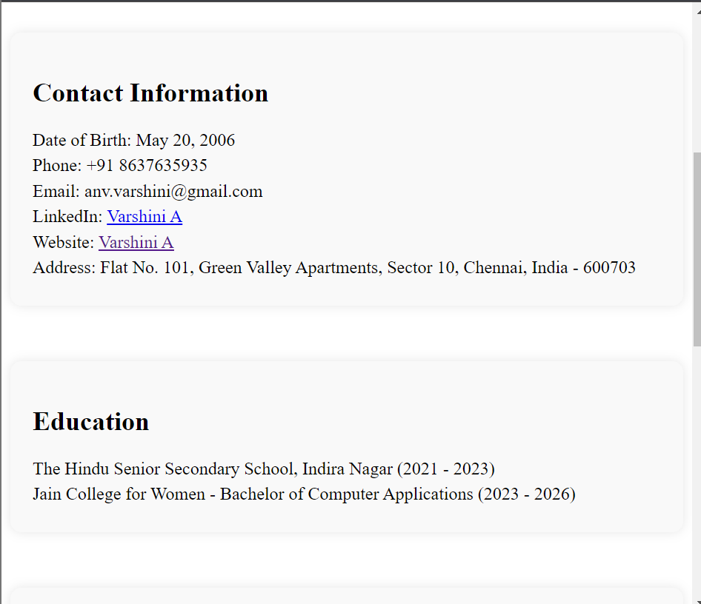

Slide 8
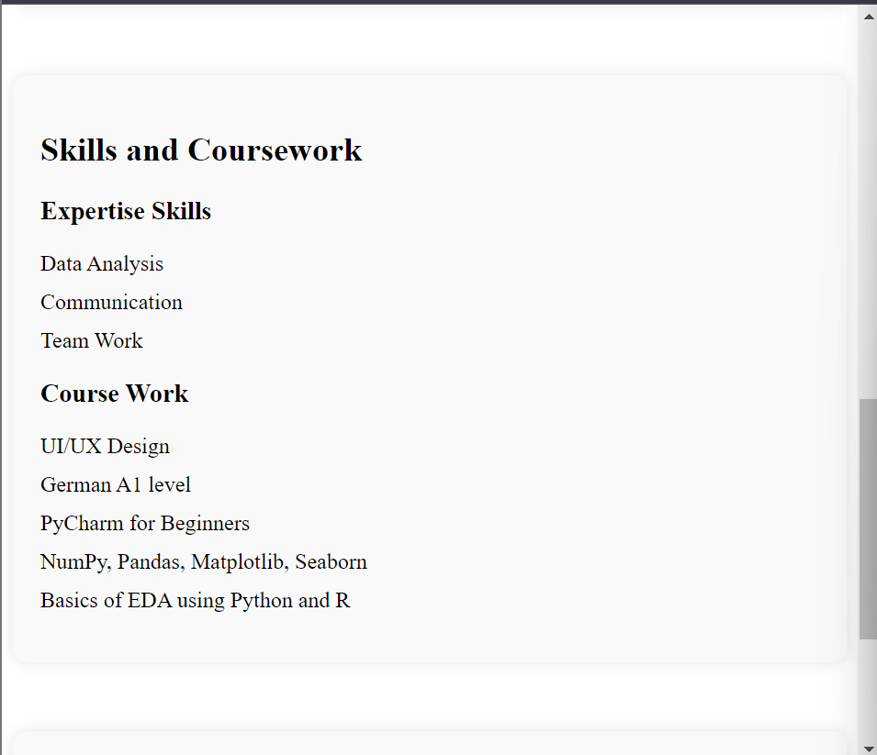

Slide 9
CONTACT INFORMATION
THE CONTACT INFORMATION SECTION PROVIDES:
  PERSONAL DETAILS: DATE OF BIRTH, PHONE NUMBER, EMAIL, LINKEDIN, PERSONAL WEBSITE, AND ADDRESS.
  Links: Clickable links for LinkedIn profile and personal website.
  Formatting: Ensures information is easy to read and well-organized.

Slide 10
EDUCATION AND SKILLS
THE EDUCATION AND SKILLS SECTION HIGLIGHTS:
  EDUCATIONAL BACKGROUND: LISTS SCHOOLS, DEGREES, AND YEARS ATTENDED.
  SKILLS AND COURSEWORK: PROVIDES A LIST OF KEY SKILLS AND RELEVANT COURSEWORK.
  LIST FORMATTING: USES BULLET POINTS FOR CLARITY AND READABILITY.

Slide 11
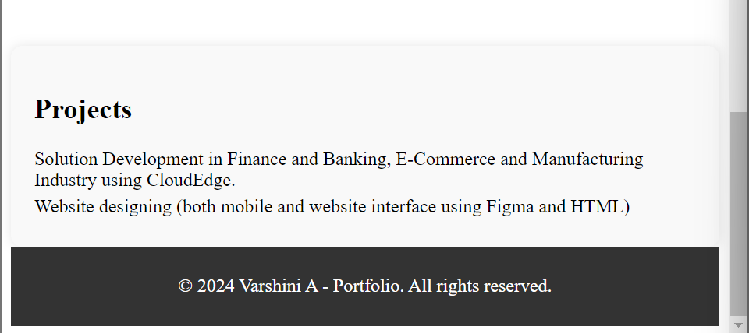

Slide 12
PROJECTS SECTION
THE PROJECT SECTION DESCRIBES
  PROJECT DETAILS: LISTS PROJECTS WITH BRIEF DESCRIPTIONS.
  RELEVANCE: EXPLAINS THE IMPORTANCE OF EACH PROJECT.
  FORMATTING: ENSURES EACH PROJECT IS CLEARLY SEPARATED AND EASY TO READ.

Slide 13
CONCLUSION
IN CONCLUSION, THE PERSONAL PORTFOLIO EFFECTIVELY PRESENTS MY PROFESSIONAL BACKGROUND AND SKILLS. THE USE OF HTML AND CSS ENSURES A VISUALLY APPEALING AND USER-FRIENDLY LAYOUT, PROVIDING A COMPREHENSIVE OVERVIEW OF MY EXPERIENCE AND CAPABILITIES.

Slide 14






LANDING PAGE OF TBATE
overview and explanation
BY VARSHINI A

Slide 15

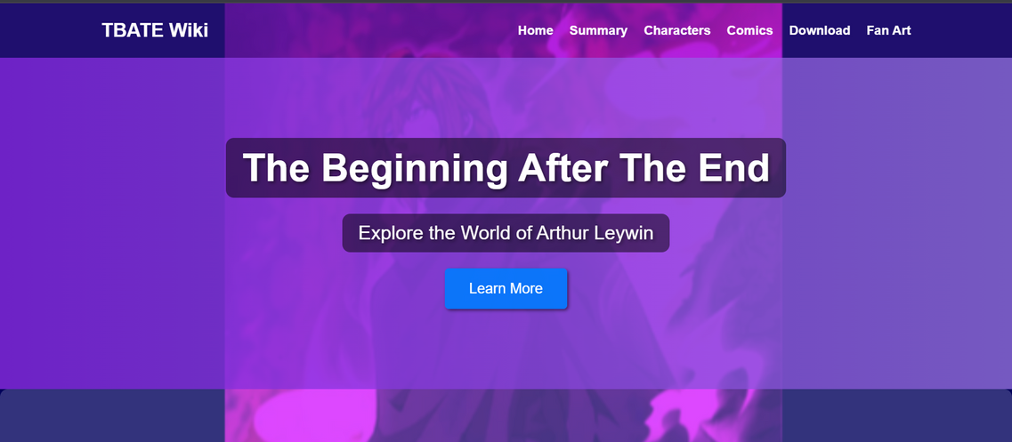



INTRODUCTION
purpose of the tbate landing page
KEY features - summary,
characters, comincs, download
links, fan art.

Slide 16
HTML STRUCTURE
The HTML file is structured into key sections to organize the content effectively. It includes:
  Header: Contains the logo and navigation links.
  Hero Section: Features a title and a call-to-action button.
  Summary Section: Provides an overview of the story.
  Characters Section: Displays the main characters with images and descriptions.
  Comics Section: Includes a link to the comic adaptation.
  Download Section: Provides a link to download the ePub version.
  Fan Art Section: Showcases fan art images.
  Footer: Contains copyright information.

Slide 17
CSS STYLING
The CSS file defines the styles for layout and design. Key CSS rules include:
  Flexbox: Used for alignment and spacing in various sections.
  Background Images and Colors: Enhance the visual appeal.
  Button Styling: Makes the call-to-action buttons stand out.
  Responsive Design: Ensures the page looks good on different screen sizes.

Slide 18
ENHANCEMENTS AND AESTHETICS
To enhance the aesthetics of the landing page, several visual improvements were made:
  Background Image: A subtle background image adds depth to the page.
  Gradient Overlay: Applied to the hero section for a modern and dynamic look.
  Button Hover Effects: Provide visual feedback when users interact with buttons.
  Typography: Consistent font styles and sizes improve readability and visual consistency.

Slide 19
INTERACTIVE ELEMENTS
Interactive elements improve user experience:
  New Tab Links: External links open in new tabs for convenience.
  Hover Effects: Buttons and links change color on hover to indicate interactivity.
  Responsive Navigation: Navigation links adjust based on screen size.

Slide 20
CHARACTER SECTION
The character section is designed to showcase the main characters:
  Character Cards: Each character is displayed in a card format with an image, name, and description.
  Flexbox Layout: Ensures characters are well-aligned and spaced evenly.
  Image Styling: Rounded corners and shadows add a polished look to character images.

Slide 21
FAN ART GALLERY
The fan art gallery section showcases fan creations:
  Center Alignment: Images are center-aligned for a balanced layout.
  Flexbox Gallery: Flexbox is used to create a responsive and visually appealing gallery.
  Image Spacing: Adequate spacing between images ensures a clean look.

Slide 22
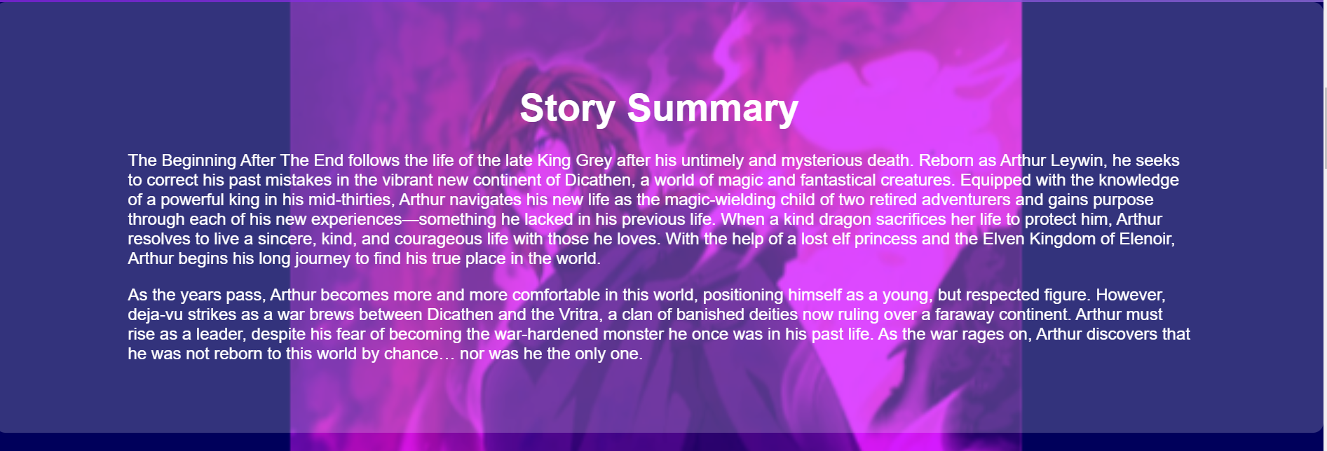

Slide 23
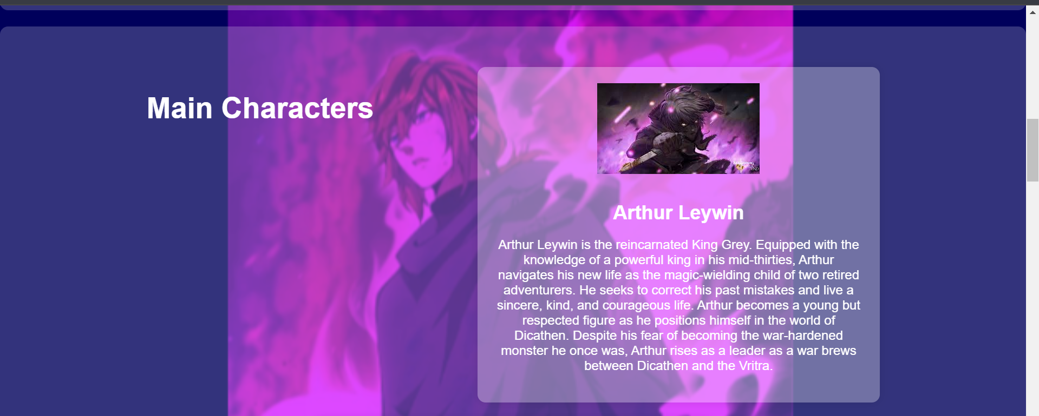

Slide 24
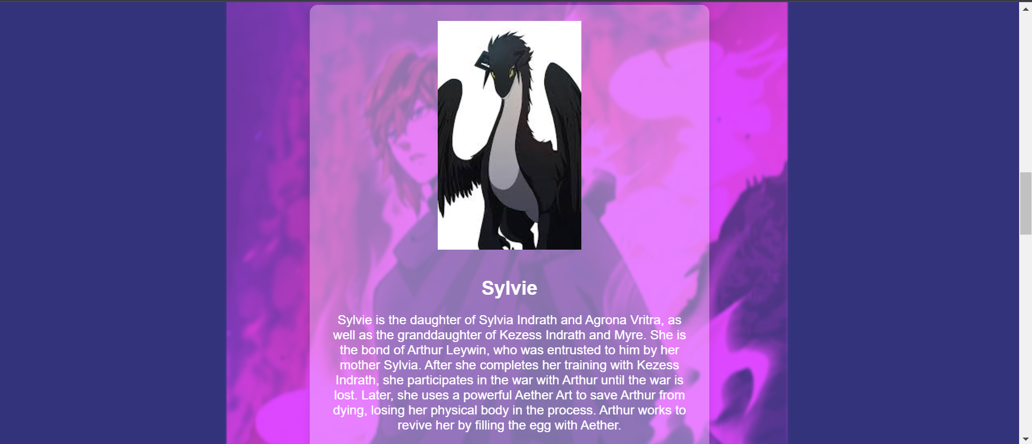

Slide 25
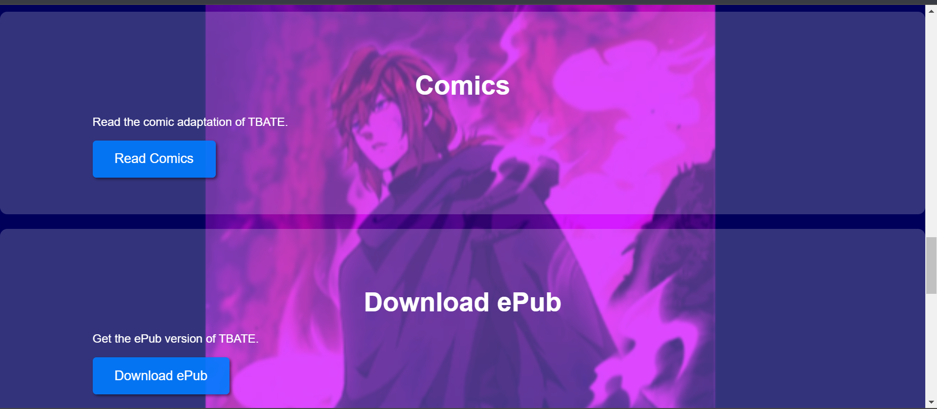

Slide 26
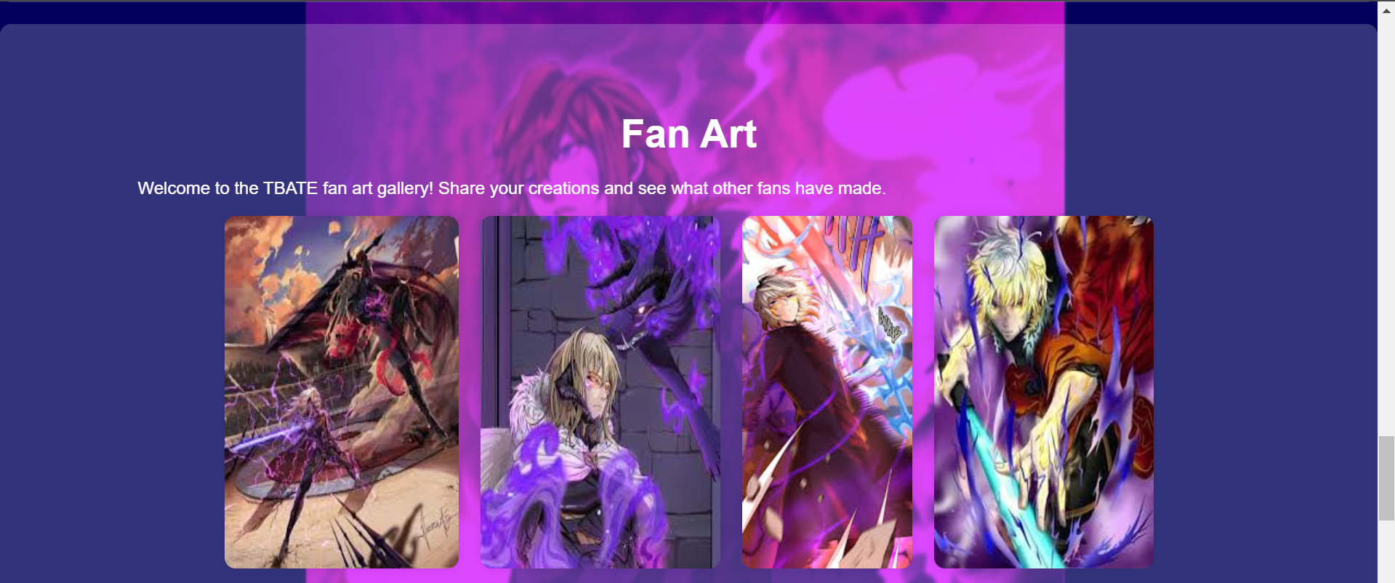

Slide 27


Slide 28






CONCLUSION
IN CONCLUSION, THE TBATE LANDING PAGE EFFECTIVELY SHOWCASES THE STORY AND ITS CHARACTERS WHILE PROVIDING INTERACTIVE ELEMENTS AND AESTHETIC ENHANCEMENTS TO ENGAGE USERS. THE USE OF HTML, CSS, AND RESPONSIVE DESIGN PRINCIPLES ENSURES A SMOOTH USER EXPERIENCE ACROSS DEVICES.

Slide 29

Temperature
Converter
By . Varshini A

Slide 30
Introduction
The temperature converter project allows users to input a temperature in Celsius, Fahrenheit, or Kelvin and convert it to another unit. The interface includes an input field, dropdown menus for selecting units, a convert button, and a display area for the result. The project aims to provide a simple and efficient way to perform temperature conversions.

Slide 31
HTML STRUCTURE
The HTML file for the temperature converter is structured into several key sections:
  Input Field: Allows users to enter a temperature value.
  Dropdown Menus: Enable users to select the units to convert from and to.
  Convert Button: Triggers the conversion process when clicked.
  Result Display: Shows the converted temperature and unit for easy viewing.

Slide 32
CSS STYLING
The CSS file defines the styling for the converter to ensure a user-friendly and appealing interface:
  Flexbox Layout: Used for aligning and spacing elements consistently.
  Input and Dropdown Styling: Ensures input fields and dropdowns are easy to use and visually appealing.
  Button Styling: Makes the convert button prominent and easy to click with hover effects for interactivity.
  Result Display Styling: Clearly shows the conversion result with appropriate spacing and font size.

Slide 33
JavaScript LOGIC
The JavaScript file handles the conversion logic:
  Input Validation: Ensures the input is a valid number.
  Conversion Function: Converts temperature between Celsius, Fahrenheit, and Kelvin.
  Event Listener: Listens for the convert button click and triggers the conversion.

Slide 34
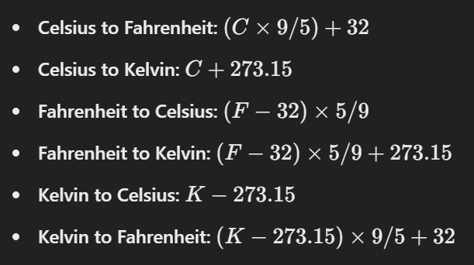
CONVERSION ALGORITHM
The conversion algorithm includes:

Slide 35
CHARACTER SECTION
The character section is designed to showcase the main characters:
  Character Cards: Each character is displayed in a card format with an image, name, and description.
  Flexbox Layout: Ensures characters are well-aligned and spaced evenly.
  Image Styling: Rounded corners and shadows add a polished look to character images.

Slide 36
FAN ART GALLERY
The fan art gallery section showcases fan creations:
  Center Alignment: Images are center-aligned for a balanced layout.
  Flexbox Gallery: Flexbox is used to create a responsive and visually appealing gallery.
  Image Spacing: Adequate spacing between images ensures a clean look.

Slide 37
Conclusioin
In conclusion, the TBATE landing page effectively showcases the story and its characters while providing interactive elements and aesthetic enhancements to engage users. The use of HTML, CSS, and responsive design principles ensures a smooth user experience across devices.

Slide 38
OASIS INFOBYTE
Voice Assistant
Basic Command Recognition to Advanced NLP Capabilites
By
Varshini A
Voice Assitant

Slide 39

I
INTRODUCTION
Brief Overview of the Voice Assistant Project
The voice assistant project aims to develop a system that can understand and respond to voice commands. This project demonstrates the evolution from a simple voice command recognition system to a more sophisticated assistant that utilizes natural language processing (NLP) and integrates with various APIs for providing services like weather updates, news headlines, and web search results.
2
2

Slide 40
I
INTRODUCTION
Comparison of Easy and Advanced Versions
The easy version of the voice assistant focuses on recognizing and responding to basic voice commands, demonstrating the foundational concept of speech recognition. In contrast, the advanced version incorporates NLP capabilities, text-to-speech conversion, and integrates multiple APIs, significantly enhancing its functionality and user interaction.
3
2

Slide 41

I
EASY VERSION
Objective: Recognize and Respond to Simple Voice Commands
Features
  Simple command recognition.
  Responds to the command "Hello".
The goal of the easy version is to understand and respond to basic voice commands. It involves minimal functionality but sets the foundation for more complex implementations.
Technologies Used
  Python
  Library: speech_recognition
4
2

Slide 42
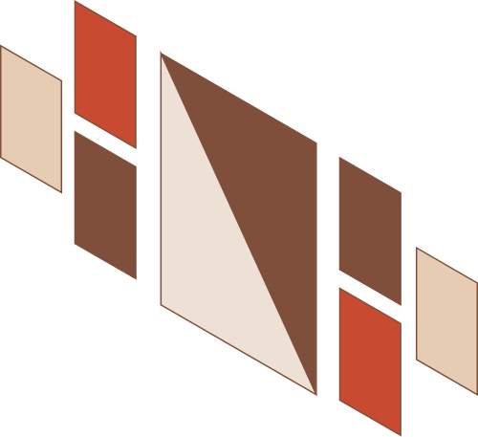

I
IMPLEMENTATION
  Speech Recognition Using speech_recognition: The assistant listens for audio input and converts it into text using Google's Speech Recognition API.
  Handling Basic Commands: The system checks for specific commands like "Hello" and responds appropriately.
5
2

Slide 43

II
ADVANCED VERSION
Objective:: Create a Sophisticated Voice Assistant with NLP Capabalilities
The advanced version aims to create a comprehensive voice assistant that can understand complex queries, provide detailed responses, and offer various services through API integrations.
Features
  Speech recognition.
  Text-to-speech conversion.
  Weather updates.
  News headlines.
  Web search (Google, Wikipedia).
6
2

Slide 44

II
ADVANCED VERSION
Technologies Used
  Python
  Libraries: speech_recognition, pyttsx3, spacy, requests, feedparser, webbrowser, wikipedia
7
2

Slide 45
Implementation
Speech Recognition and Text-to-Speech: The assistant converts speech to text and vice versa, enabling interactive communication with the user.
Natural Language Processing with spacy: The assistant uses NLP to understand and process user queries.
API Integration (OpenWeatherMap, News API): The assistant fetches weather updates and news headlines through API calls.
8
2

Slide 46
Potential Future Improvements
  Enhanced NLP: Integrate more advanced NLP models to improve understanding and context handling.
  Multi-Language Support: Add support for multiple languages to cater to a wider audience.
  Additional Services: Integrate more APIs for additional services like calendar management, email reading, and smart home control.
  User Personalization: Allow the assistant to learn user preferences and customize responses accordingly.
  Security Enhancements: Implement authentication mechanisms to ensure secure interactions.
Summary of Both Versions
The easy version of the voice assistant serves as a basic introduction to speech recognition, handling simple commands with minimal functionality. The advanced version significantly expands on this by incorporating natural language processing, text-to-speech, and API integrations, providing a much richer and interactive user experience.
9
2

Slide 47
OASIS INFOBYTE
Thank you
for listening!
Student
Varshini A

Slide 48









wEATHER APP
Presented By Varshini A

Slide 49



brief overview of the weather app project
The Weather App project is designed to fetch and display weather information based on user input. This project is divided into two versions: a simple console-based application and a more sophisticated graphical user interface (GUI) version.

Slide 50



Comparison of easy and advanced versions
The easy version of the Weather App is a basic console application that retrieves weather information using the OpenWeatherMap API based on a city name input by the user. The advanced version enhances the user experience by providing a GUI, allowing users to input the city name and view detailed weather data more interactively.

Slide 51



Easy version
Objective: Fetch and Display Weather Information
Features
Technologies Used
The goal of the easy version is to fetch weather data based on the city name provided by the user and display it in the console.
  User input for city name.
  Weather information display (description, temperature, humidity).
  Python
  Library: requests

Slide 52

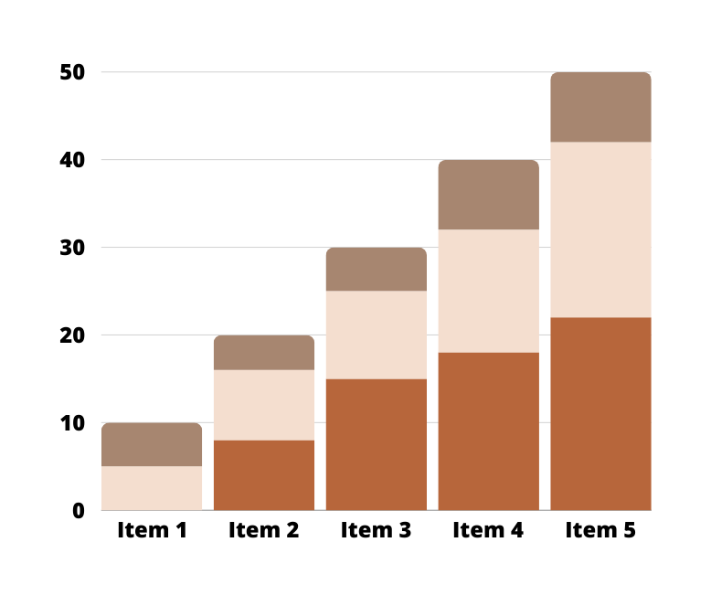
implementation
  API Integration with OpenWeatherMap: The application uses the requests library to fetch weather data from the OpenWeatherMap API.
  User Input Handling: The application prompts the user to input a city name.
  Data Display: Weather data, including description, temperature, and humidity, is displayed in the console.

Slide 53
advanced version
Objective: Provide a Graphical Interface for Weather Information
Features
Technologies Used
The advanced version aims to create a user-friendly application with a graphical interface for fetching and displaying weather information.
  GUI for user input.
  Detailed weather data display.
  Enhanced error handling.
  Python
  Libraries: tkinter, requests

Slide 54
implementation
  GUI Design with tkinter: The application uses tkinter to create a graphical interface for user interaction.
  API Integration with OpenWeatherMap: Similar to the easy version, the application uses the requests library to fetch weather data from the OpenWeatherMap API.
  Data Display and Error Handling: The weather data is displayed in the GUI, with improved error handling for invalid input or API request failures.

Slide 55



summary of both versions
Potential Future Improvements
  Extended Weather Forecasts: Provide weather forecasts for multiple days.
  Location Services Integration: Automatically fetch weather data based on the user's current location.
  Additional Weather Data: Include more detailed weather information such as wind speed, precipitation, and UV index.
  Improved User Interface: Enhance the GUI with better design elements and user experience improvements.
  Notifications and Alerts: Add functionality to notify users of severe weather alerts or significant changes in weather conditions.
The easy version of the Weather App is a simple console-based application that retrieves and displays weather data based on user input. The advanced version enhances the user experience by providing a graphical interface, making it easier and more intuitive for users to interact with the application and view weather information.

Slide 56
Thank You

Slide 57

BMI Calculator
  From Command-Line to GUI-Based Applications
Presented By:
Varshini A

Slide 58

Overview
  Introduction
  Easy Version Implementation
  Easy Version Overview
  Methodology
  Easy Version Technologies Used
  Results
  Conclusion

Slide 59

Introduction
Brief Overview of the BMI Calculator Project The BMI (Body Mass Index) calculator project aims to provide a tool for users to determine their BMI based on their height and weight. The project is divided into two versions: a simple console-based implementation and a more advanced graphical user interface (GUI) version.
Comparison of Easy and Advanced Versions The easy version of the BMI calculator is a basic console application that takes user input for height and weight, calculates the BMI, and categorizes it. The advanced version includes a GUI for a more user-friendly experience, along with additional features like unit conversion and error handling.

Slide 60

Easy Version
Objective: Calculate BMI Using User Input The easy version's goal is to perform BMI calculations based on user input for height and weight, and provide a categorization based on the calculated BMI.
Features
  User input for height and weight.
  BMI calculation.
  Categorization of BMI.
Technologies Used
  Python

Slide 61

Implementation
  User Input Handling: The application prompts the user to input their height in meters and weight in kilograms.
  BMI Formula Implementation: The BMI is calculated using the formula: BMI = kg/m^2
  Categorization: The BMI value is categorized into underweight, normal weight, overweight, or obesity.

Slide 62
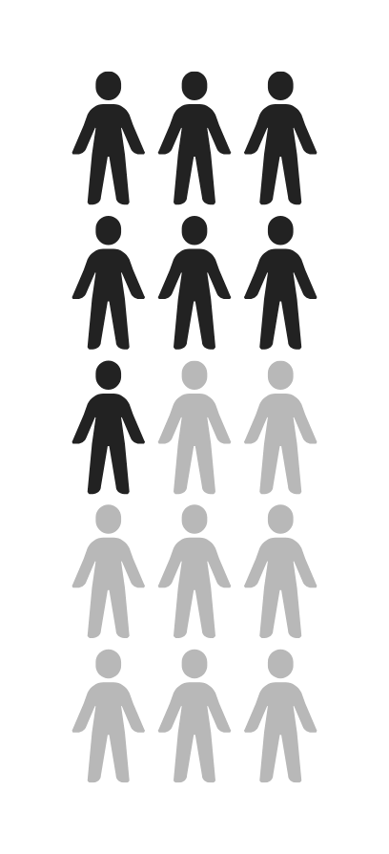
Advanced Version
Objective: Provide a Graphical Interface for BMI Calculation The advanced version aims to create a user-friendly application with a graphical interface for calculating BMI, including unit conversions and enhanced error handling.
Features:
  GUI for user input.
  BMI calculation.
  Categorization.
  Data visualization (future improvement).
Technologies Used:
  Python
  Library: tkinter

Slide 63
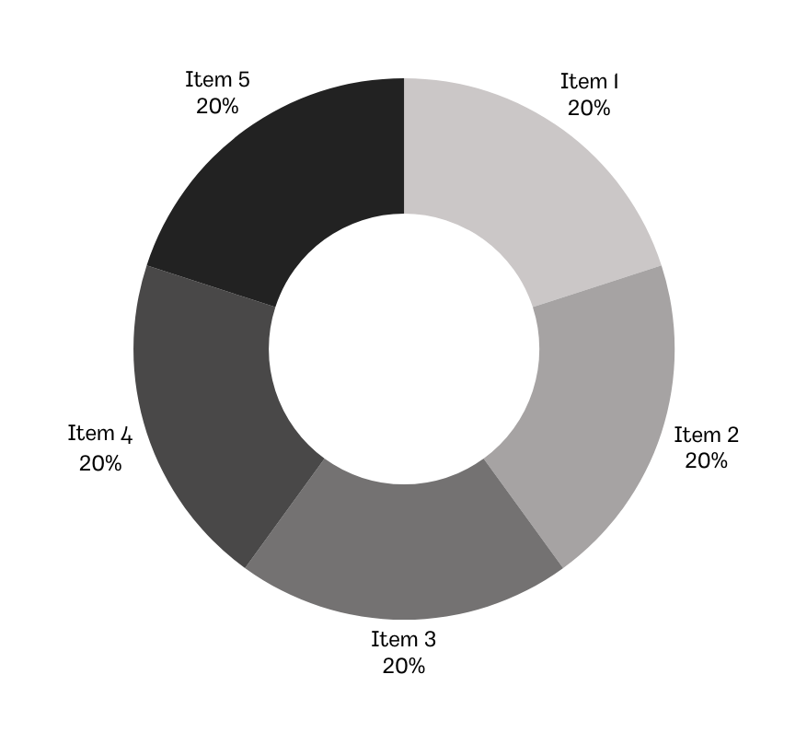
Implementation
  GUI Design with tkinter: The application uses tkinter to create a graphical interface for user interaction.
  BMI Calculation and Categorization: Similar to the easy version, but with added functionality for unit conversion and better user interaction.
  Error Handling: The application includes error messages for invalid input and unexpected errors.

Slide 64



  Summary of Both Versions
The easy version of the BMI calculator is a straightforward console application that handles basic input and output for BMI calculation. The advanced version significantly enhances user experience by providing a graphical interface, unit conversion, and better error handling.

Slide 65
Potential Future Improvements
  Data Visualization: Add graphical representations of BMI data for better understanding.
  Health Recommendations: Provide personalized health and fitness recommendations based on BMI.
  Historical Data Tracking: Allow users to track their BMI over time.
  Integration with Wearable Devices: Connect with fitness trackers to automatically update height and weight data.
  Multi-Language Support: Offer the application in multiple languages to reach a broader audience.

Slide 66

B
Y
V
A
R
S
H
I
N
I
Password Generator Project
From Command-Line to GUI-Based Secure Password Generation

Slide 67

Brief Overview of the Password Generator Project
The Password Generator project aims to create a tool for generating random passwords based on user-defined criteria. This project is divided into two versions: a basic console-based application and a more advanced graphical user interface (GUI) version.
Comparison of Easy and Advanced Versions
The easy version is a simple console application that generates a random password based on user input for the number of letters, symbols, and numbers. The advanced version enhances functionality by providing a graphical interface, making it more user-friendly and offering additional options for password complexity.

Slide 68

Objective: Generate Random Passwords Based on User-Defined Criteria
The goal of the easy version is to generate a random password using user-specified parameters such as the length and character types (letters, symbols, numbers).
Features
  User input for password length and character types.
  Random password generation.
Technologies
  Python
  Library: random

Slide 69



Implementation
User Input Handling
  User Input Handling: The application prompts the user to input the number of letters, symbols, and numbers for the password.
  Randomization Logic: The application uses the random library to generate a password by randomly selecting characters from predefined lists.
Implementation
Randomization Logic

Slide 70
Advanced Version
The advanced version aims to create a user-friendly application with a graphical interface, allowing users to easily generate secure passwords with additional complexity options.
Features
  GUI for user input.
  Random password generation.
  Password complexity options.
Technologies Used
  Python
  Libraries: tkinter, random
Objective: Provide a Graphical Interface for Generating Secure Passwords

Slide 71

Implementation
  GUI Design with tkinter: The application uses tkinter to create a graphical interface for user interaction.
  Randomization Logic: Similar to the easy version, the application uses the random library to generate a password by randomly selecting characters from predefined lists.
  Password Complexity Handling: The application includes options for specifying the number of letters, symbols, and numbers in the password, as well as ensuring a shuffled final password for added security.

Slide 72

summary of both versions
The easy version of the Password Generator is a simple console-based application that generates random passwords based on user-defined criteria. The advanced version enhances the user experience by providing a graphical interface and additional options for password complexity, making it easier for users to generate secure passwords.

Slide 73
  Password Strength Indicator: Add a feature to indicate the strength of the generated password.
  Password History: Save and display previously generated passwords.
  Additional Complexity Options: Include options for avoiding similar characters (e.g., 1, l, I, |) or repeating characters.
  Customization: Allow users to customize character sets and include/exclude specific characters.
  Clipboard Functionality: Add a feature to copy the generated password to the clipboard for easy use.
  Password Management: Integrate with password management tools to save and manage generated passwords securely.
Potential
Future
Improvements

Slide 74

Thank you!
22/08/22 · Week 6 Term 3

