Slide 1
Train Ticket Booking System Status
Group #1

Slide 2
SOA Implementation / Design
Implemented Scenarios:
Search tickets
Display details for selected itinerary
Select Itinerary
Enter traveler information
Sign in by Google for customer
Check out as guest or singed-in user

Slide 3
Plan to split the SOA into microservice architecture
Break the monolithic SOA Service into micro-services
Itinerary
SearchTicket
UserManagement
GetOrCreateUser
Payment
ProcessPayment
OrderManagement
CheckoutRequest
User
Itinerary
Travelers information
Payment confirmation number

Slide 4
Quality Attribute Utility Tree and Tactics (SOA)
(Business Importance, Risk in achieving)
Scenarios
Latency
(M,H)
When user clicks on search itinerary the list of stops are displayed with in 3 seconds
Tactics: Database queries will be modified to improve the performance
Performance
Throughput
(M,L)
When user visits the site within peak hours between 10 AM to 4 PM, system should support 1000 users concurrently using the website
Tactics: Whole application include website and backend is having 100 instances throughout peak hours
(H,H)
New/Change
Functionality
Build the capability to provide list of traveler's insurance option within 6 weeks
Tactics: Modify existing SOA service to add insurance information. Create a new table that has list of available insurance policies.
Modifiability
Technology Stack Change
(M,L)
Underlying database changes from SQL Server to NoSQL Couchbase within 8 weeks
Tactics: The SOA service must be modified to switch from SQL to NoSQL
Utility
(H,H)
In case of software failure the whole Website goes down. It would take within 3 hours to come back
Tactics: Engage SOA service development team and wait for them to recover. Move the Website and SOA Service into Cloud for auto-failover
App failure
Availability
Hardware failure
(H,H)
When the hardware failure happens, it would take 10 hours to recover
Tactics: Triage the hardware issue and recover the website. Move the Website and SOA Service into Cloud for auto-failover
Data
Confidentiality
(H,L)
PCI information such as Credit Card information must be encrypted end-to-end in the transmitting from Website till Stripe API
Security
Threat
Handling
When DDoS attack the website must restore within 1 hour
(M,H)

Slide 5
Quality Attribute Utility Tree and Tactics (Micro-Service)
(Business Importance, Risk in achieving)
Scenarios
Latency
(M,H)
When user clicks on search itinerary the list of stops are displayed with in 1 second
Tactics: The load is distributed into smaller micro-service. Data is cached in the Itinerary micro-service only
Performance
Throughput
(M,L)
When user visits the site within peak hours between 10 AM to 4 PM, system should support 5000 users concurrently using the website
Tactics: Load is distributed to micro-services and each micro-service is enabled to auto-scale
(H,H)
New/Change
Functionality
Build the capability to provide list of traveler's insurance option within 3 weeks
Tactics: Create new AddOn micro-service to handle insurance information. Having its own database. A dedicated development to work on the task
Modifiability
Technology Stack Change
(M,L)
Underlying database changes from SQL Server to NoSQL Couchbase within 4 weeks
Tactics: Multiple teams one for each micro-service would work on migrating from SQL to NoSQL
Utility
(H,H)
In case of software failure the whole Website goes down. It would take within 1 hours to come back
Tactics: Smaller failure group size because multiple micro-service. Mean time to recover would be faster
App failure
Availability
Hardware failure
(H,H)
When the hardware failure happens, it would take 2 hours to recover
Tactics: Each micro-service is deployed separately on different VMs
Data
Confidentiality
(H,L)
PCI information such as Credit Card information must be encrypted end-to-end in the transmitting from Website till Stripe API
Security
Threat
Handling
When DDoS attack the website must restore within 1 hour
Tactics: the whole website is not down because it may impact to specific micro-service
(M,H)

Slide 6
Scenario 1 - Modifiability : Support user login using Google sign in
Portion of Scenario | Customer should be able to login using Google account
Source | End Customer
Stimulus | Customer choose to login using Google
Artifact | trainsim-client, trainsim-api
Environment | Runtime
Response | User will be authenticated after user login by Google API successfully, and email address will be saved into database.
Response Measure | Low to Medium effort Less than 2-person week in calendar time

Slide 7
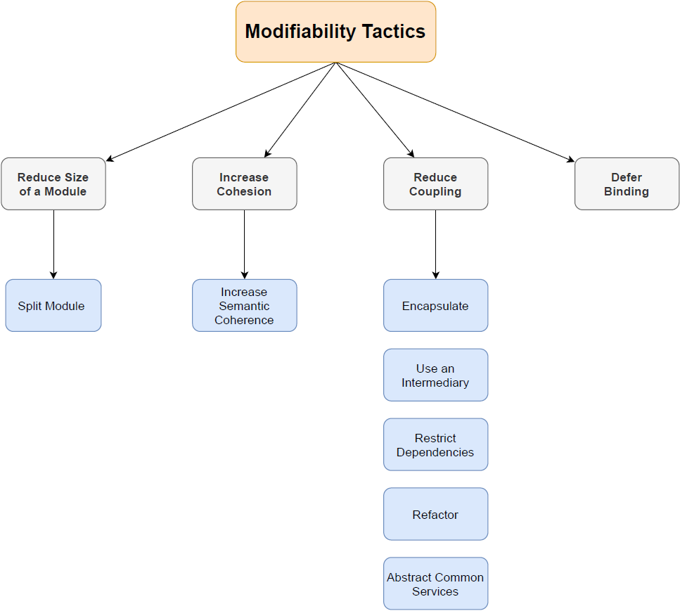


Change Deployed
Change Request

Slide 8
QA – Modifiability- Scenario 1: Modifiability : Support user login using Google sign in
Tactics subject | Description
QA | Modifiability scenario
Tactic | Reduce Coupling -> Restrict Dependencies
Details | Make modification to trainsim-api so that the SQL statements rely on SQL standards.
Response | User can login successfully and record can be found in database
SOA vs Microservice architecture | Microservice will use its own database, which has same structure in SOA and removes all foreign key restraint in other tables.

Slide 9
QA - Performance - Scenario 1
Portion of Scenario | Possible Values
Source | Developer,
Stimulus | Search itinerary details within 1 second
Artifacts | trainsim-client, trainsim-api
Environment | Run time
Response | Make modification to trainsim-client and trainsim-api, so that the trainsim-client interaction with trainsim-api is much faster. Try implementing cache as middle layer between trainsim-client and trainsim-api. This will reduce the calls to trainsim-api and increase the response times.
Response Measure | Medium to High effort Less than 4-person week in calendar time

Slide 10
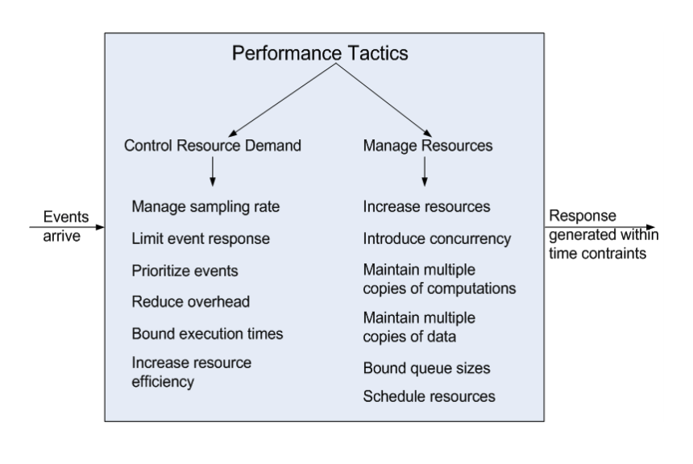
Performance Tactics

Slide 11
QA – Performance - Scenario 1: Tactics to Apply
Tactics subject | Description
QA | Performance scenario
Tactic | Manage Resources --> Maintain Multiple copies of data
Details | Make modification to trainsim-client, so that the pulled itineraries via trainsim-api are stored in cache with configurable TTL (Time to Live). This caching layer would be independent microservice. So that the next time the same trip has been selected, the cached itinerary will be given back to trainsim-client, instead of calling otp client via trainsim-api.
Response | Test and deploy the caching layer with configurable TTL
SOA vs Microservice architecture | Performing this tactic will introduce microservice caching layer. Thus, once the trainsim-client and trainsim-api are converted into microservice with individually deployable docker, caching layer would play much big role in decreasing the response times of itinerary details.

