Slide 1


Factors affecting homicide rates in the US
Presented By:
Jesid Acosta
Hammad Muniem
Kavin Veerapandian

Slide 2

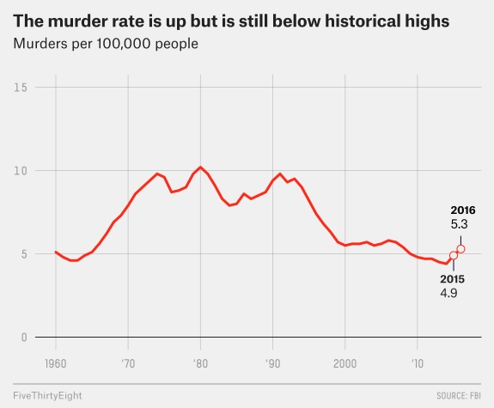
Problem & Significance
Definition
A recent study by Iowa State University Sociology Professor Matt DeLisi has revealed that besides the obvious loss of human life, murder costs society an estimated $17.25 million per offense
Increased crime has been shown to have a dramatic effect on social fabric, or the interpersonal relations between members of a community, because crime creates fear. The more that people are aware of crime, the more that they tend to fear becoming victims of crime.
Homicide | Murder | Manslaughter
Killing of one person by another | Homicide committed with “malice aforethought” | Killing of human being without malice aforethought

Slide 3
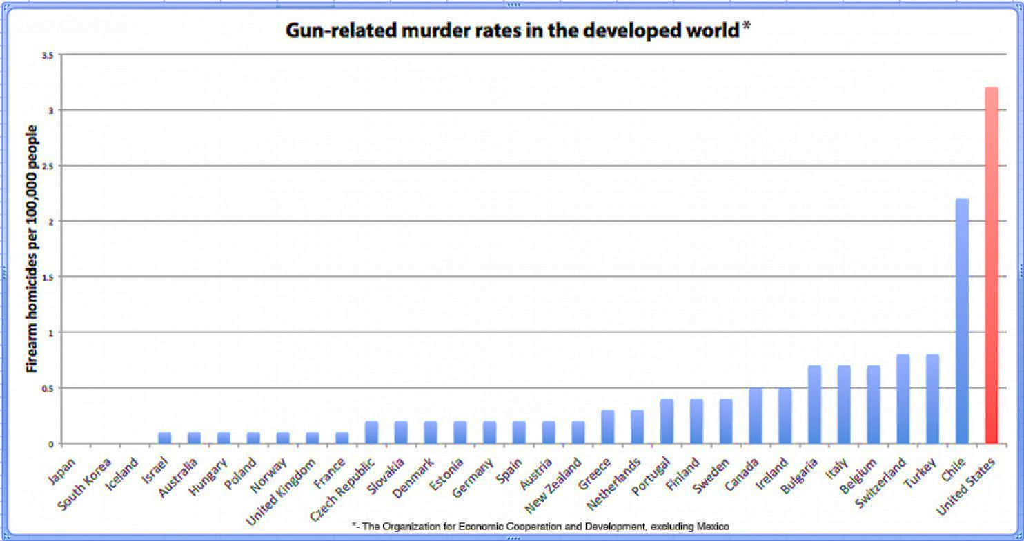
Problem & Significance

Slide 4
Why?
Every life is precious
Who?
State Legislative Members
What?
Factors contributing to high homicide rate
Notes:
Definition Homicide (FBI): “willful (nonnegligent) killing of one human being.”
All require the intention to kill, but they differ in terms of the degree of premeditation:
First Degree: a homicide that is both intentional and premeditated
Second Degree: the killing is intentional but lacks premeditation, because a person is provoked under circumstances likely to provoke any reasonable person and kills in the “heat of passion,”
Voluntary Manslaughter: depending on the degree of the mitigating circumstances

Slide 5
Literature Review
Article | Cause | Intervention
Making Your State Safer: Factors Influencing Interstate Homicide Rates in the United States 2007 | Predictor variables included: Income Education Percentage population of African American Brady Campaign Report Card (Score of states based on how strict their gun laws are) State Unemployment Rate Percentage of population between 18-24 years of Age Large City | Presence of Large Cities was the most significant factor in determining high homicide rates. Brady Report card was also very significant showing that States with strict gun controls had lower homicide rates. All other factors also influenced homicide rate in the hypothesized direction but the aforementioned were the most significant.
Immigration, Economic Disadvantage, and Homicide A Community-level Analysis of Austin, Texas 2009 | Tests percentage of new immigrants in Texas and its connection to homicide rates. Increase in immigration does not result in greater homicide rates as stated by previous studies. | Increase in immigration does not result in greater homicide rates. Economic disadvantage however was linked to higher homicide rates.

Slide 6
Literature Review
Article | Cause | Intervention
Wolfgang Stroebe (2015), Firearm Availability and Violent Death: The Need for a Culture Change in Attitudes toward Guns | increased gun availability: increases probability of intention of homicidal intent Increase probability of execution of homicidal intent: If guns were not available, the same distribution of homicidal intentions would result in considerably fewer homicides | A federal registration system for all firearms: help law enforcement keeps guns away from those prohibited from possessing them reduce illegal firearm sales and transfers Public health campaign emphasizing that gun ownership poses a risk to the owner as well as their family
Shane Darke (2009), The toxicology of homicide offenders and victims: A review | links between substance use and violence: Proximal: the direct psychopharmacological effects of a substance leads to propensity of violence Distant(lifestyle related): (i) ‘economic compulsive’ violence & (ii) ‘systemic’ violence that results from the dynamics of drug markets | Stable, prolonged treatment is associated with substantial reductions in drug use, crime and mortality. The individual is thus removed from the distal risk surrounding the drug market, as well as the proximal effects of substances limit the availability of firearms to psychostimulant users involved in drug markets

Slide 7
Literature Review
Article | Cause | Intervention
Firearm Laws and Firearm Homicides:A Systematic Review (JAMA Internal Medicine - 2017) | Firearm homicides are the leading cause of injury. Decreasing firearm availability appears to show decrease in homicides. | In the aggregate, stronger gun policies were associated with decreased rates of firearm homicide, even after adjusting for demographic and sociologic factors. Laws that strengthen background checks and permit-to-purchase seemed to decrease firearm homicide rates. Specific laws directed at firearm trafficking, improving child safety, or the banning of military-style assault weapons were not associated with changes in firearm homicide rates. The evidence for laws restricting guns in public places and leniency in gun carrying was mixed.
State gun laws, gun ownership, and mass shootings in the US_ cross sectional time series (BMJ 2019) | Predictors: year, state population, median household income, percent high school graduation, percent female, headed households, percent in poverty, percent unemployment, incarceration rate, percent white and restrictiveness-permissiveness score of state gun laws. States with more permissive gun laws and greater gun ownership had high rates of mass shootings. | States with more restrictive gun laws and greater gun ownership had lower rates of mass shootings.
The short-term and localized effect of gun shows: Evidence from California and Texas(MIT Press 2011) | Predictors: All gun deaths, gun suicides, gun homicides, demographic characteristics of ZIP codes, population, pop density, land area, fraction rural, fraction Hispanic, fraction black, fraction below poverty line, fraction of suicides by guns. | Results suggest that gun shows do not increase the number of homicides or suicides and that the absence of gun show regulations does not increase the number of gun related deaths as proponents of these regulations suggest.

Slide 8
Predictor Variables - Causes
Name | Effect | Rationale
NumDrugUsers | + | Psychoactive drugs appear to show in significant amounts in homicidal events. Long-term treated patients also appear to be less likely to re-commit violent crimes.
NumAlcoholUsers | + | There is a high prevalence of alcohol usage in homicides. It has been shown that the rates of alcohols sales in some manner seem to correlate with the number of homicides
Property Crime | + | Increased levels of crime in an area may make it more permissible for more violent crime (broken windows theory)
Serious Mental Illness | + | individuals with mental illness appear to have a higher propensity to be involved in potentially violent events that could lead to homicide, especially if interacting with other psychoactive substance
Unemployment rate | + | As shown by previous research, unemployment rate is linked to economic distress which is also linked to high homicide rates
Gini Index | + | Increased inequality results in more violent crime including homicide as per our research.
TotalWeapons | + | Handguns, machine guns and others small projectile launchers registered

Slide 9
Predictor Variables - Causes
Name | Effect | Rationale
Big Cities | + | Cities may create greater returns to crime because criminals may have greater access to the wealthy and face a greater density of victims in urban areas.
Black | + | As per literature review, crime we expect that the proportion of Black population will be positively correlated with homicide rate.
Hispanic | + | As per our research, Hispanics are twice as likely to be incarcerated for violent crimes than White Non-Hispanics, therefore we expect some correlation between violent crime and Hispanic origin
Adults 19-25 | + | According to the Bureau of Justice Statistics, young adults are most vulnerable and perpetuators of violent crime including homicide

Slide 10
Predictor Variables - Interventions
Name | Effect | Rationale
LawEnforcementOfficers | - | Increased presence of law enforcement may act as deterrent from potential criminal activity (with a diminishing effect due to saturation)
SubAbuseInpatientCareBeds | - | As the number of treatment beds increases per state, we can expect a decrease in alcohol or drug abuse which may lead to a decrease in homicides
Education | - | With education, we expect the population to have better opportunities for higher income and hence, a decrease in violent crime
Background Check | - | Will limit bad users (folks with substance abuse or past criminal history) from access
Waiting Period | - | Will increase barrier for entry for individuals that may want to use it in hasty, violent act
Permits | - | Restrict access and allow for better tracing of users

Slide 11
Variables related to Firearms
Variables | Effect | Rationale
AnyOtherWeapon | Universal Background checks for all firearms | Permit for handguns
Machinegun | Universal background checks for handguns | Permit for carrying concealed weapons
ShortBarreledRifle | Waiting Period for all firearms | Ban on assault weapons
ShortBarreledShotgun | Waiting period for handguns | Background check in gunshows – firearms
TotalWeapons | Permit for all firearms | Background checks in gunshows – handguns
Rationale: Increase in access and easier access of projectile weapons facilitates homicide intent into action
Gun Policies | Laws that increase traceability or decrease access

Slide 12






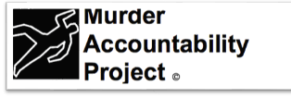

Data Sourcing

Slide 13
Next Steps:
What factors help reduce homicides?
Exploratory Data Analysis:
Dependent Variable (DV)
DV interaction with regressors – identify relationships between causes and interventions captured in model
Transformation:
Cleaning, Standardization & Feature Engineering
Explore appropriate model specifications
Identify states of interest & compare
Notes:
Think further about our question:
Ways to skin the cat, compare state by state, look at changes overtime or a mix.

