Slide 1
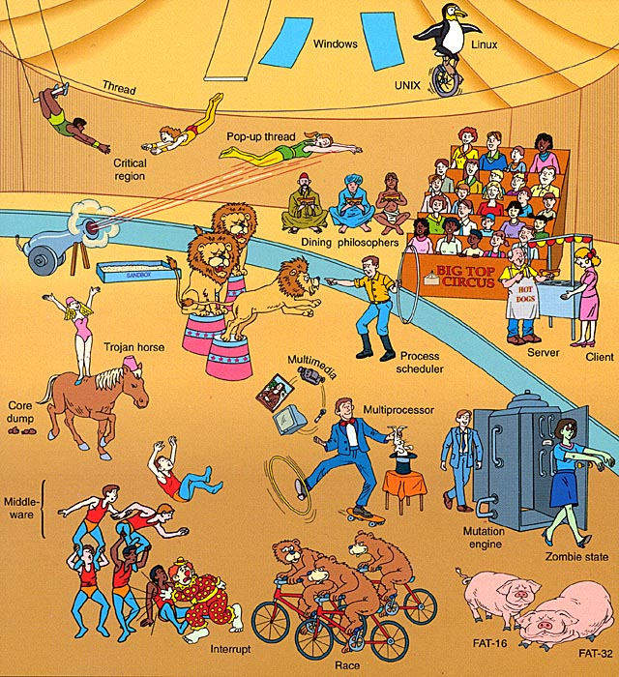
Operating Systems OS2 Week 1
Joris Geurts

Slide 2
OS2 week planning
thread pool, cyclic barrier, countdown latch
readers-writers
reentrant lock, condition
sockets
deadlock
banker's algorithm
recap

Slide 3
Organization
Same as OS1:
7 weeks:
2 blocks of 2 hours; each time
Theory
Class assignments
If time permits, work on weekly assignments
Homework:
work on weekly assignments
Theory exam in week 8
no laptop, no books, no paper
Intranet:
slides + lab manual
Canvas:
Handing in assignments/attendance

Slide 4
Practical
Weekly assignments, made in couples
Delivery in Canvas (ask for invitation to join the course)
Practical is highly recommended but not mandatory
Delivered assignments will be checked for completeness
If you want to discuss your assignment with teacher, ask for it
Otherwise, discussion will be done at random as far as time permits
E-S41: Practicum groups 1-20
E-S42: Practicum groups 21-40
E-S43: Practicum groups 41-60

Slide 5
Overview
Repetition OS1
Package java.util.concurrent
Thread Pools
CyclicBarrier
CountdownLatch
Notes:
Next: what is an OS

Slide 6
Recap OS1 (I)
Linux

Slide 7
Recap OS1 (I)
Linux
Java FX GUI

Slide 8
Recap OS1 (I)
Linux
Java FX GUI
events
JAT

Slide 9
Recap OS1 (I)
Linux
Java FX GUI
events
JAT
threads

Slide 10
Recap OS1 (I)
Linux
Java FX GUI
events
JAT
threads
Platform.runLater()

Slide 11
Recap OS1 (I)
Linux
Java FX GUI
events
Shared
objects
JAT
threads
Platform.runLater()

Slide 12
Recap OS1 (I)
Linux
Java FX GUI
synchronized
events
Shared
objects
JAT
threads
Platform.runLater()

Slide 13
Recap OS1 (I)
Linux
Java FX GUI
synchronized
events
Shared
objects
wait/notify
JAT
threads
Platform.runLater()

Slide 14
Recap OS1 (II)
Shared data: data that is used in several threads
Critical Section: code that is involved in reading and writing shared data
Mutual exclusion: only one thread is executing a Critical Section
In Java:
synchronized
Now practice with class assignment, part 1.

Slide 15
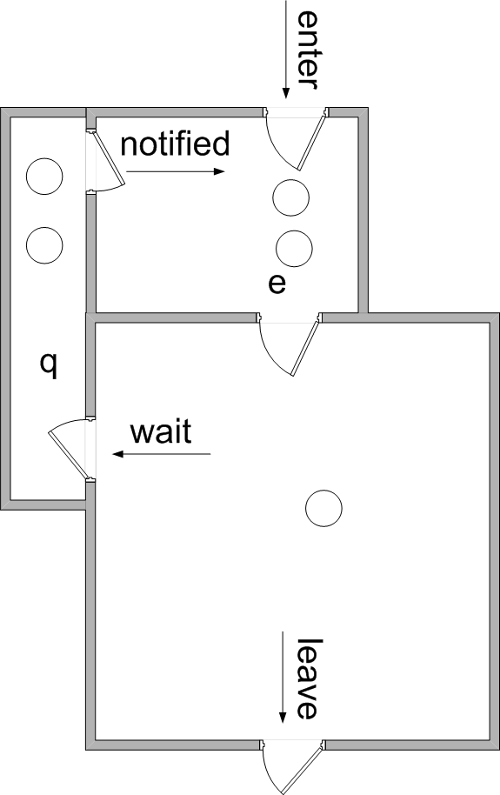
Recap OS1 (III): wait/notify
Dentist practice:
Treatment room (t)
Waiting room (e) for patients that just came in
Waiting room (q) for patients that just received a painkiller, and have to wait until it kicks in
t

Slide 16
Package java.util.concurrent
Contains synchronization interfaces/classes
Thread Pools
CyclicBarrier
CountdownLatch
…

Slide 17
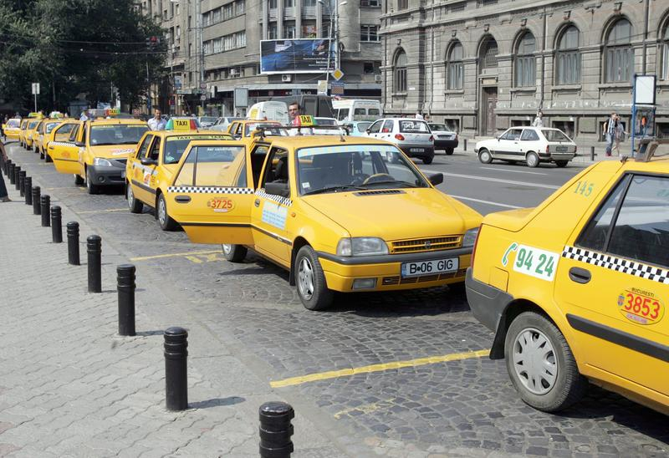
Thread Pool
Contains number of threads; executing/waiting for tasks
We can give tasks to thread pool:
task executed by one of the threads
if all threads busy, task has to wait
thread stays alive when task finished
non-active threads are blocked (take no CPU-time)
Advantages:
Re-using old thread is faster than creating new thread
Number of threads is limited to size of pool

Slide 18
Thread Pools in Java
Creating thread pool with 10 threads:
ExecutorService pool = Executors.newFixedThreadPool(10);
Giving a task to the thread pool:
pool.execute(task);
task must be a Runnable
task will be executed by one of the threads
unpredictable when task will actually start

Slide 19
Thread Pools in Java
Defining a task:
class MyTask implements Runnable { public void run() { System.out.println(“test”); }
Offering task to thread pool:
Runnable r = new MyTask(); pool.execute(r);
Same task can also be started directly on a thread:
Thread thread = new Thread(r);

Slide 20
Closing a Thread Pool
We must be able to shut down a thread pool in a controlled way
We can do this with method shutdown()
pool.shutdown();
no new tasks can be submitted anymore
when all tasks are finished, thread pool is deleted

Slide 21
Interrupting threads in a threadpool
Note that pool.shutdown() does not interrupt running threads in a threadpool, they just run to completion
If you want to interrupt them, you can use pool.shutdownNow().
The effect of shutdownNow() is the same as of shutdown():
no new tasks can be submitted anymore
when all tasks are finished, thread pool is deleted
but in addition:
an interrupt is sent to all running threads in the threadpool
the call prevents waiting tasks from starting
(Note that it is up to the programmer to handle the interrupt inside the thread)
To interrupt specific threads in a threadpool, see:
http://stackoverflow.com/questions/3777772/how-to-stop-a-thread-in-a-threadpool

Slide 22
Example
A thread pool running 5 tasks:
public class ThreadPoolExample {
public static void main(String[] args) {
// create the thread pool
ExecutorService pool =
Executors.newCachedThreadPool();
// run each task using a thread in the pool
for (int i = 0; i < 5; i++) {
pool.execute(new MyTask());
}
// shut down the pool
pool.shutdown();
}
}
Notes:
22
Problem: runnables don’t return values! What if you want something computed? -> Callables & Futures. (threadpooltest example from Core JAVA I)
Pause
Note:
You can also use submit instead of execute.
Execute is fire and forget (can only be used with Runnables)
Submit is more generic (can be used with Runnables but also with Callables),
will return a Future object that can be used to inspect the results of the execution.

Slide 23
5 Thread Pool architectures
Single thread executor - pool of size 1
ExecutorService pool = Executors.newSingleThreadExecutor();
Fixed thread executor - pool of fixed size
ExecutorService pool = Executors.newFixedThreadPool(size);
Cached thread pool - creates new threads when necessary; deletes unused threads after 60 sec
ExecutorService pool = Executors.newCachedThreadPool();
Scheduled thread pool – fixed size pool for scheduled or repeated execution (after certain delay)
ScheduledExecutorService pool = Executors.newScheduledThreadPool(size);
Single scheduled thread pool – pool of size 1 for scheduled or repeated execution
ScheduledExecutorService pool = Executors.newSingleThreadScheduledExecutor();
Notes:
23
Cached: idle threads are kept for 60 seconds
Fixed: threads above poolsize are put in a queue
Scheduled: replacement for java.util.Timer to execute tasks (especially for the single scheduled thread pool)
Note:
Use a cached threadpool only when you have a reasonable number of threads, or when they have a short duration.

Slide 24
Thread pools
Now practice with class assignment part 2

Slide 25
Synchronizers
Java offers a package with synchronization-mechanisms: java.util.concurrent
In this package we find:
Semaphore (not discussed here)
CountdownLatch
CyclicBarrier
…

Slide 26
CyclicBarrier
Let a number of threads wait for each other
CyclicBarrier cb = new CyclicBarrier(5);
Suppose we have 5 threads that do the following:
... // do a certain calculation cb.await(); ... // wrapping up
The first 4 threads will be blocked in cb.await()
As soon as the 5th arrives, all 5 continue

Slide 27
CountDownLatch
Wait until 0 is reached
Is initialized to a certain value
Has a countDown() method that lowers the value
Has an await() method where threads are blocked
When the value becomes 0, all blocked threads are woken up

Slide 28
Example CountDownLatch (1)
Suppose
you have a thread pool,
N tasks for that pool,
main thread must wait until all N tasks are finished

Slide 29
Example CountDownLatch (2)
class WorkerRunnable implements Runnable { CountDownLatch doneSignal; WorkerRunnable(CountDownLatch d) { doneSignal = d; } public void run() { doWork(); doneSignal.countDown(); } }
CountDownLatch doneSignal = new CountDownLatch(N); ExecutorService e = ... for (int i = 0; i < N; i++) e.execute(new WorkerRunnable(doneSignal)); try { doneSignal.await(); } catch (InterruptedException ex) {}
Notes:
Next: atomic variables (when you just need simple data sharing)

Slide 30
Main differences
CyclicBarrier:
Used to synchronize one group of similar threads
They all wait for each other
CountDownLatch:
There are 2 groups of threads
One group that is waiting for another group
The threads in the waiting group call cd.await()
The other threads call cd.countdown()
Each group can also consist of one single thread

Slide 31
Assignments
Thread Pool instead of separate threads (optimize your hardware!)
Disable the Start button / enable the Stop button:
CountDownLatch

Slide 32
Further reading
http://java.dzone.com/articles/java-concurrency-%E2%80%93-part-7
http://tutorials.jenkov.com/java-util-concurrent/executorservice.html

Slide 33
Synchronization primitives
Now practice with class assignment part 3

