Slide 1
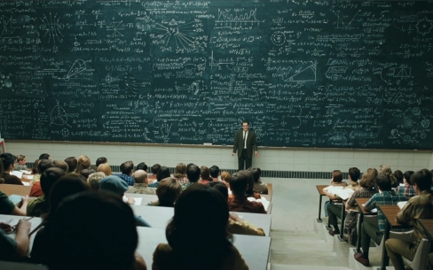
OS2, week 2
The readers-writers problem
Monitors

Slide 2
OS2 week planning
thread pool, cyclic barrier, countdown latch
readers-writers, monitors
reentrant lock, condition
sockets
deadlock
banker's algorithm
recap

Slide 3
Recap (I) week 1
Thread pool
Count down latch / cyclic barrier

Slide 4
Recap (II) synchronized
In previous weeks, we solved the Critical Section (CS) problem by using
synchronized
We could wait inside a synchronized section with
wait()
notify()
notifyAll()

Slide 5
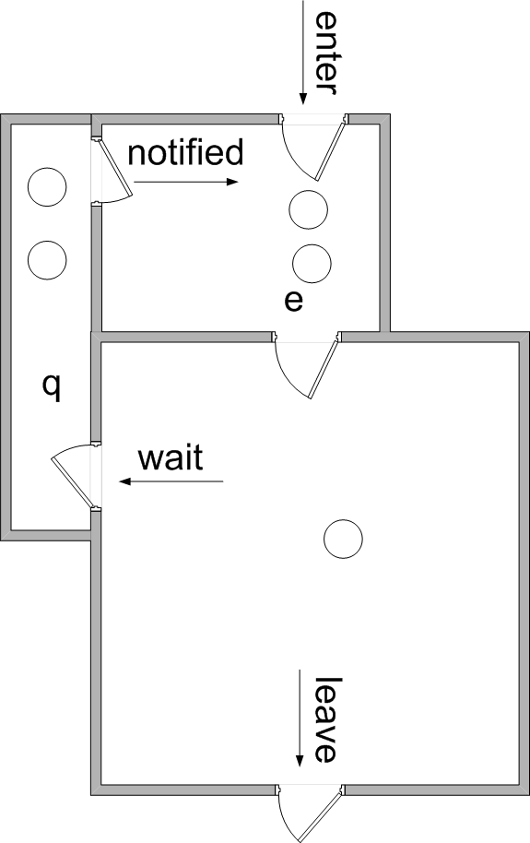
wait in while
Why use while-statement for wait()?
After wait, thread goes into ‘q’
After notifyAll, threads leave ‘q’ and go to ‘e’ to wait for their turn
Things can change in the meantime
When thread leaves ‘e’, it is not sure that it is still allowed to continue
Therefore:
check condition again
wait again if necessary
list
thread C:
{
list.add();
notifyAll();
}
thread A:
{
if (list.isEmpty())
wait();
list.get();
}
thread B:
{
if (list.isEmpty())
wait();
list.get();
}
thread A:
{
while (list.isEmpty())
wait();
list.get();
}
thread B:
{
while (list.isEmpty())
wait();
list.get();
}

Slide 6
Readers-Writers Problem
A data set is shared among a number of threads
Two types of threads:
Readers
They only read the data set; do not perform any updates
Writers
They change the data set (and perhaps read as well)
Restriction:
Writers must be alone:
allow unlimited number of readers at the same time, but without a writer
allow only one writer; no other writers at the same time
allow no readers and writers together
Notes:
6
Semaphore solution: see book
Synchronized solution: see book/demo
Next: JAVA reentrantlock & conditions

Slide 7
Solution with a Monitor
What do we mean by a 'Monitor'?
All synchronization issues are concentrated in a Monitor:
(Note: there is no standard class with name Monitor)
A monitor is ‘just’ a class, with some special features:
it contains all shared state variables (private) (Not the dataset)
it contains all synchronization code
It has one public method for every synchronization event
all these methods are synchronized
methods can contain wait/notify/notifyAll
usually, only one object is made of this class
this object is shared by all threads
Notes:
Why not put the dataset in the monitor?
That would prevent multiple readers from accessing the shared data
For which points are synchronization methods needed?

Slide 8
Readers-Writers Monitor
Make a class ReaderWriterMonitor with 4 methods:
enterReader()
exitReader()
enterWriter()
exitWriter()

Slide 9
Structure of a reader/writer
General structure of a reader:
while(true) { RW.enterReader(); ... // read dataset (CS) RW.exitReader(); }
General structure of a writer:
while(true) { RW.enterWriter(); ... // update dataset (CS) RW.exitWriter(); }
More complicated if reader/writer can be interrupted in CS

Slide 10
Inside the monitor
In this monitor, we use the following private variables:
readersActive → number of readers in CS
writersActive → number of writers in CS

Slide 11
Reader part of monitor
public synchronized void enterReader() throws InterruptedException { while (writersActive > 0) { wait(); } readersActive++; }
public synchronized void exitReader() { readersActive--; notifyAll(); }

Slide 12
Writer part of monitor
public synchronized void enterWriter() throws InterruptedException { while (writersActive > 0 || readersActive > 0) { wait(); } writersActive++; }
exitWriter() similar to exitReader()

Slide 13
Writer part of monitor
There is a problem when a writer leaves the CS, and there are both readers and writers waiting:
does he wake up a reader, or
does he wake up a writer?
Suppose we want to give precedence to the writers:
count number of waiting readers and waiting writers: readersWaiting and writersWaiting

Slide 14
Precedence for writers
Replace in enterReader() the while-statement by:
while((writersActive != 0) || (writersWaiting > 0)){ readersWaiting++; wait(); readersWaiting--; }
And similar in enterWriter()

Slide 15
Assignment for week 2
Readers-writers application:
implement the monitor class
implement the following features:
readers-have-priority
writers-have-priority
kill a ball
Look at the ThreadOverview

Slide 16
Further reading
Links:
http://docs.oracle.com/javase/tutorial/essential/concurrency/guardmeth.html

