Slide 1

OS2, week 3
ReentrantLocks
Conditions

Slide 2
OS2 week planning
thread pool, cyclic barrier, countdown latch
readers-writers
reentrant lock, condition
sockets
deadlock
banker's algorithm
recap

Slide 3
Overview this week
ReentrantLock
Condition
Notes:
Next: what is an OS

Slide 4
Drawbacks of synchronized
In the previous week, we solved the Readers-Writers application with a monitor, by using synchronized, with wait/notify/notifyAll
Problems when using notify and/or notifyAll:
we don’t know which thread is woken up by notify
notifyAll will wake up all threads from the queue, but maybe we want to wake only a few threads
We would like several queues in which threads can wait

Slide 5
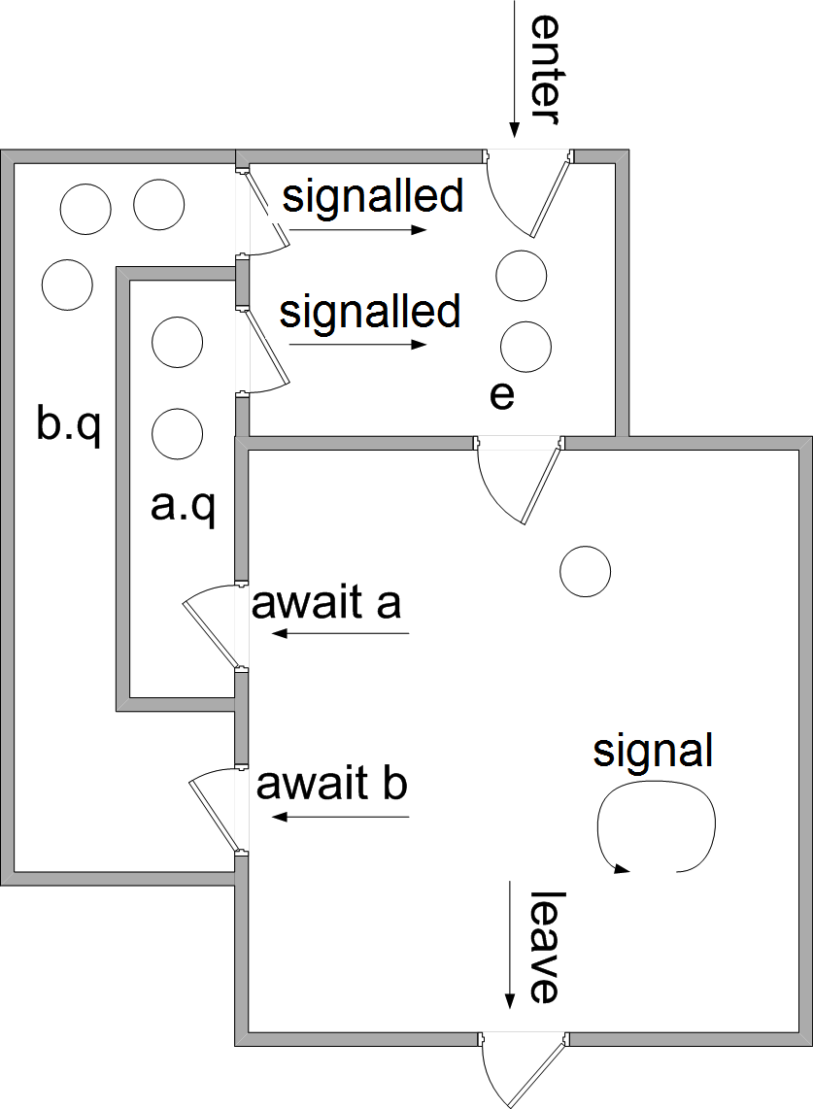
Analogy
Dentist with multiple waiting rooms
Room a:
to wait for sedation to kick in
Room b:
to wait for result of a test

Slide 6
ReentrantLock
Advanced monitors are made with objects of class ReentrantLock
This can be used to create a Critical Section:
Lock monLock = new ReentrantLock(); monLock.lock(); ...... // Critical Section monLock.unlock();
This is an alternative for synchronized

Slide 7
Unlocking a ReentrantLock
In order to make sure that the lock is always unlocked:
monLock.lock(); try { ...... // Critical Section } finally { monLock.unlock(); }

Slide 8
Condition
Inside such a lock, threads can wait in different queues
For this we have class Condition
every Condition object has its own waiting queue
can only be used inside a lock
Methods of Condition:
await()
replaces the wait method
signal()
replaces the notify method
signalAll()
replaces the notifyAll method

Slide 9
Monitor
How do we create a monitor out of this?
A monitor is again a ‘normal’ class, that handles all synchronization issues
Contains all shared variables
Methods are synchronized
Now with a ReentrantLock (instead of synchronized)
Methods can contain blocking statements
Now with Conditions (instead of wait, notify, notifyAll)

Slide 10
2 kinds of Monitors
Note that we can now have 2 kinds of Monitors:
Like in week 2:
With synchronized/wait/notify(All)
Like now:
With ReentrantLock and Conditions
public synchronized int take() {
while (queue.empty())
wait();
return queue.get();
}
public int take() {
monLock.lock();
try {
while (queue.empty())
condq.await();
} finally {
monLock.unlock();
return queue.get();
}
}

Slide 11
How to use a Condition
Often, a thread must wait until certain requirement is satisfied
For each such requirement, we create a Condition object:
The thread checks the requirement, and
if not satisfied, it calls await()on the Condition for that requirement
When the requirement is satisfied, another thread calls signal() or signalAll()
signal will wake up one random waiting thread from that Condition
signalAll will wake up all waiting threads from that Condition

Slide 12
How to use a Condition
General guidelines for using Conditions:
Specify the requirement that threads are waiting for: <expression>
Eg: if threads are waiting for x to become positive, <expression> is: x>0
Choose a meaningful name for the Condition object
Eg: xPos
Use !<expression> in a while that contains await
Eg: while(!(x>0)) { xPos.await(); }
Use <expression> in an if that contains signal
Eg: if(x>0) xPos.signal();
(if–statement is not always necessary)

Slide 13
Example
So if we want to wait until a variable x is positive:
Lock monLock = new ReentrantLock(); Condition xPos = monLock.newCondition()
public void m1() {
monLock.lock(); try { while (!(x > 0)) { xPos.await(); } ...... } finally { monLock.unlock(); }
}
public void m2() {
monLock.lock() try { ...... if (x > 0) { xPos.signal(); } } finally { monLock.unlock(); }
}

Slide 14
Assignment week 3
Make a new monitor for readers-writers application
No synchronized/wait/notify, but instead:
Use one ReentrantLock object
Use two Condition objects
Use lock, unlock, await, signal, signalAll
Use some shared variables

Slide 15
Some remarks
. How many ReentrantLocks do you need?
- How many Conditions do you need?

Slide 16
Some remarks
. How many ReentrantLocks do you need?
In general, equal to the number of objects to which you synchronize.
e.g. Synchronized methods only -> synchronize on this -> 1 lock
How many Conditions do you need?
Depends on what the threads are waiting for
- nr of different, non mutually exclusive, boolean expressions for the wait

Slide 17
Example:
. public synchronized void enterProducer()
{
while ((!bufferEmpty)||(producerInCS))
{
try {
wait();
} catch (InterruptedException ex) { ...}
producerInCS = true;
}
public synchronized void enterConsumer()
{
while (bufferEmpty)
{
try {
wait();
} catch (InterruptedException ex) { ...}
}
}

Slide 18
Further reading
http://baptiste-wicht.com/posts/2010/09/java-concurrency-part-5-monitors-locks-and-conditions.html
Java Core, Volume 1, Chapter 14 “Multithreading”

