Slide 1
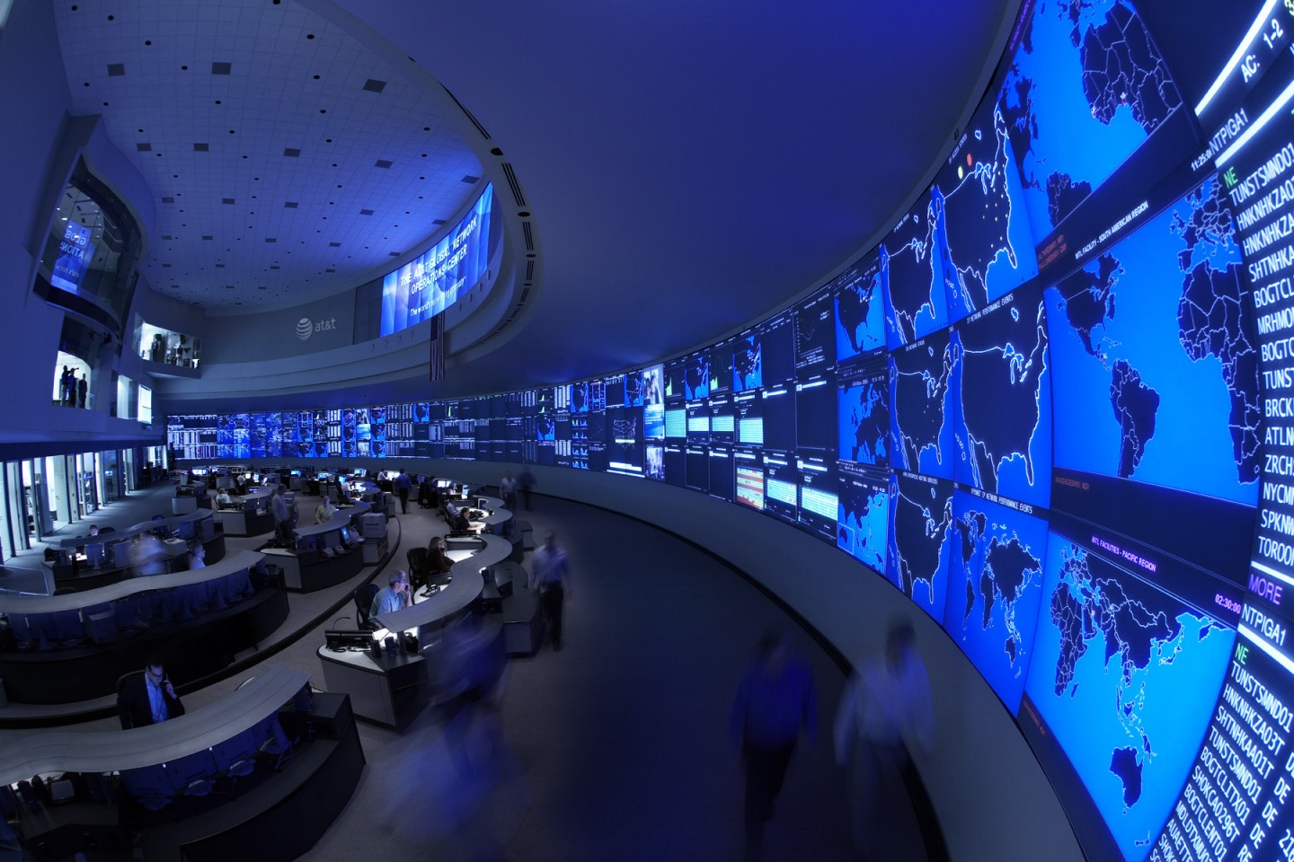
OS2
network sockets

Slide 2
week planning
1 | thread pool, cyclic barrier
2 | readers-writers
3 | reentrant lock, condition
4 | sockets
5 | deadlock
6 | banker's algorithm
7 | recap.
8 | exam
9

Slide 3
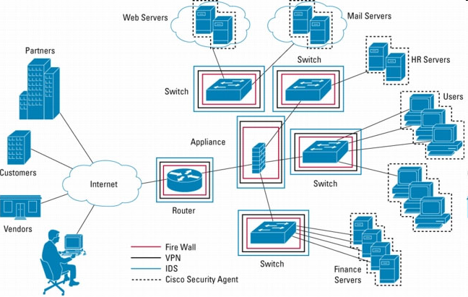

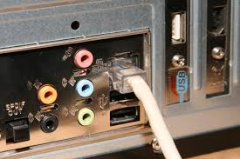
TCP/IP stack
server
Application Layer
Transport Layer
client
Internet Layer
Network Access Layer

Slide 4
TCP/IP stack
Application Layer: FTP, HTTP, …
Transport Layer: TCP or UDP ports
Internet Layer: IP address
Network Access Layer: MAC address

Slide 5
Socket
End point of a connection between two processes
Sockets are identified by
IP address
Transport protocol (TCP/UDP)
Port number
Sockets enable cross platform communication

Slide 6
Transport Layer
TCP:
connection oriented
packets arrive in order
missed packets will be noticed and resend
class Socket
UDP:
connectionless
packet order not guaranteed
missed packets unnoticed
class DataGramSocket

Slide 7
Server side
Server uses ServerSocket.accept to wait for client who wants to connect
Once a connection from a client is accepted, a new Socket is created automatically:
ServerSocket ss = new ServerSocket(port); Socket sc = ss.accept();
New Socket sc is used for communication with client
Original ServerSocket ss can be used to wait for further connections

Slide 8
Client side
Client uses Socket as endpoint of connection
Socket provides:
InputStream:
Use a Scanner to read text from a stream
OutputStream:
Use a PrintWriter to write text to a stream
See TCP Client/Server projects on SharePoint
PrintWriter
Scanner
OutputStream
InputStream
pw.println(73);
→ "73"
i = sc.nextInt();
Socket
Socket
InputStream
Scanner

Slide 9
Using threads
A server usually creates a new thread for every connection:
ServerSocket ss = new ServerSocket(port); while (true) { Socket sc = ss.accept(); Runnable r = new ClientHandler(sc); Thread t = new Thread(r); t.start(); }
In that way, the main thread can continue to wait for the next connection

Slide 10
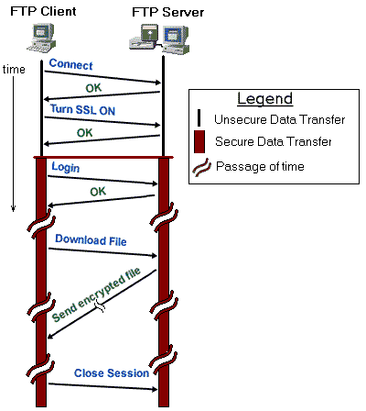
Communication protocol
We have to define how Server and Client will communicate:
Text (or Binary)?
Who sends first message?
What to answer?
Etc.
Example FTP:

Slide 11
Communication Protocol
Decide format for communication
Binary
ObjectOutputStream / ObjectInputStream
Text
Simple command-response (eg. SMTP or HTML)
JSON (e.g. Jackson / Gson )
XML ( e.g JAXB / XStream )

Slide 12
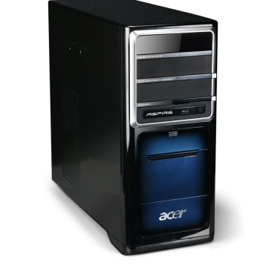
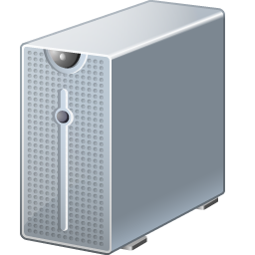

Assignment
One or more Console applications;
calculate pixels of a tile on request
You can choose:
GUI=server; Console=client
or
GUI=client; Console=server
tile information
pixel + color information
Communication through sockets
One GUI application;
shows the fractal

Slide 13
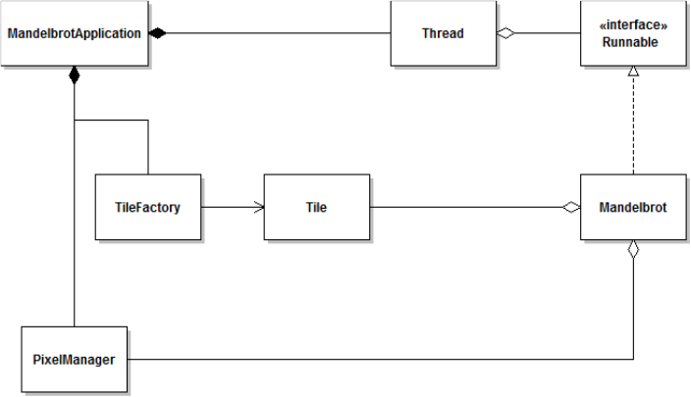
Assignment
GUI application
Console application(s)

Slide 14
Assignment
Develop it in small steps!
Run and study the demo TCP programs from Sharepoint
Make a GUI + 1 Console,
GUI sends tilenumber to Console
Console calculates pixels, and sends them back
Repeated until all tiles are calculated
Add more Consoles (for example 2 or 4)

Slide 15
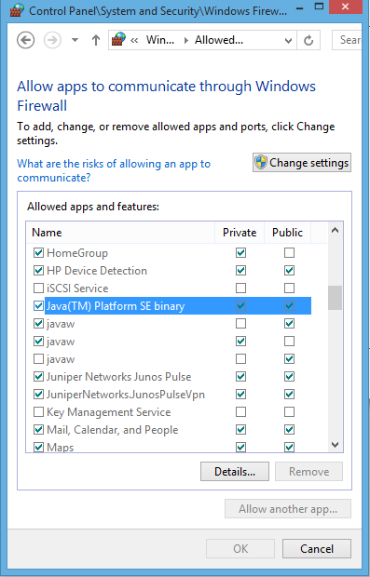
Windows tips
http://www.howtogeek.com/77132/how-to-enable-ping-echo-replies-in-windows-8/
Make sure that JVM is not blocked by the Firewall:
Control Panel → System and Security → Windows Firewall → Allow an app through Windows Firewall
Enable Private and Public for "Java(TM) Platform SE binary"
(perhaps: delete in this list other (older) instances of the JVM)

Slide 16
How to enable telnet:
telnet is a command line tool that can be used as a simple client to test your own server
In Windows, it can be enabled as shown in this tutorial:
http://social.technet.microsoft.com/wiki/contents/articles/910.windows-7-enabling-telnet-client.aspx

Slide 17
further reading
http://docs.oracle.com/javase/tutorial/networking/sockets/index.html

