Slide 1

OS2
network sockets

Slide 2
week planning
1 | thread pool, cyclic barrier
2 | readers-writers
3 | reentrant lock, condition
4 | sockets
5 | deadlock
6 | banker's algorithm
7 | recap.
8 | exam
9

Slide 3
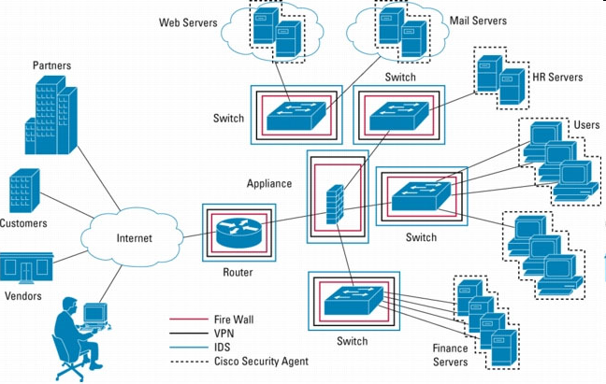
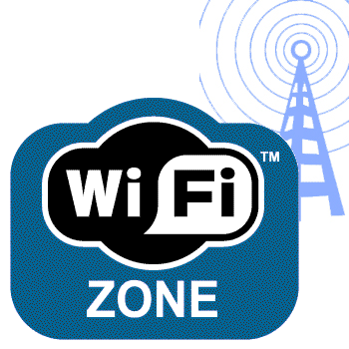
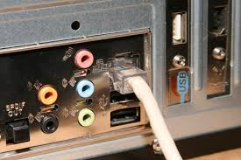
TCP/IP stack
server
Application Layer
Transport Layer
client
Internet Layer
Network Access Layer

Slide 4
TCP/IP stack
Application Layer: FTP, HTTP, …
Transport Layer: TCP or UDP ports
Internet Layer: IP address
Network Access Layer: MAC address

Slide 5
Introduction: standalone application
Standalone application
One process, one address space
Only local method calls
Process/ address space
Some java
Application
request
Database helper
response
database
PC

Slide 6
Introduction: client-server application
Client server application
Two processes, two address spaces
Local proxies (local standins) manage interprocess/pc communication
Only local method calls to/from proxies
Process/ address space
Process/ address space
Some java
Application
request
Proxy
(stand-in for
Some java
Application )
request
Proxy
(stand-in for
Database helper)
Database helper
response
response
database
PC
PC
Client
Server

Slide 7
Introduction: client-server application
Proxy at client-side acts as if it were a local database helper.
(It abstracts the application from the distributed nature of the database.)
The java application does not notice that it talks to a proxy instead of the real database helper.
Process/ address space
Process/ address space
Some java
Application
request
Proxy
(stand-in for
Some java
Application )
request
Proxy
(stand-in for
Database helper)
Database helper
response
response
database
PC
PC
Client
Server

Slide 8
Introduction: client-server application
Proxy at client-side acts as if it were a local database helper.
Consists of:
A proxy class with the same API as the database helper, which communicates with
A socket (combined with wrapper objects for more advanced API)
Process/ address space
Process/ address space
Some java
Application
request
Proxy
(stand-in for
Some java
Application )
request
Proxy
(stand-in for
Database helper)
Database helper
response
response
database
PC
PC
Client
Server

Slide 9
Sockets
Socket is a basic building block (in application layer) in order to enable communication between different processes on different PC’s.
Existing class in Java
Socket connects to another socket in a different process space
Enables communication with other socket
Translates message from own address space into TCP (or UDP) message(s) on the connection and sends to other socket(s)
Receives messages from other socket(s) via the connection, translates them into messages in own address space

Slide 10
Sockets
When a socket is created it tries to connect to a socket at the other side of the connection.
What information is needed?

Slide 11
Sockets
When a socket is created it tries to connect to a socket at the other side of the connection.
What information is needed?
IP address of the PC where the other socket resides
Port number
Which protocol to use for communication (TCP or UDP)

Slide 12
Socket
End point of a connection between two processes
Sockets are identified by
IP address
Transport protocol (TCP/UDP)
Port number
Sockets enable cross platform communication

Slide 13
Transport Layer
TCP:
connection oriented
packets arrive in order
missed packets will be noticed and resent
class Socket
UDP:
connectionless
packet order not guaranteed
missed packets unnoticed
class DataGramSocket

Slide 14
Sockets
When a socket is created it tries to connect to a socket at the other side of the connection.
If the socket does not find a socket object to connect to, you will get an IOException.
Be prepared for IOExceptions at all times.
It is practically impossible to create sockets at client and server side at exactly the same moment.
To solve that problem, at the server side, we create a server socket.
The server socket waits until a socket at the other side of the connection tries to connect, creates a socket and connects the two.

Slide 15
Server side
Server uses ServerSocket.accept to wait for client who wants to connect
Once a connection from a client is accepted, a new Socket is created automatically:
ServerSocket ss = new ServerSocket(port); Socket sc = ss.accept();
New Socket sc is used for communication with client
Original ServerSocket ss can be used to wait for further connections

Slide 16
Sockets
The only difference between client and server is in the way the socket is created.
At the client side, by using the constructor of Socket:
Socket s = new Socket(ipaddress, port);
At the server side, via the server socket:
ServerSocket ss = new ServerSocket(port);
Socket s = ss.accept();

Slide 17
Client side
Client uses Socket as endpoint of connection
Socket provides:
InputStream:
Use a Scanner to read text from a stream
OutputStream:
Use a PrintWriter to write text to a stream
See TCP Client/Server projects on SharePoint
PrintWriter
Scanner
OutputStream
InputStream
pw.println(73);
→ "73"
i = sc.nextInt();
Socket
Socket
InputStream
Scanner

Slide 18
Wrapper classes
For text based communication:
Use wrapper classes: Scanner and PrintWriter (both at client and server side)
How?
Create Socket s (different at client and server side)
InputStream is = s.getInputStream();
OutputStream os = s.getOutputStream();
Scanner sc = new Scanner(is);
PrintWriter pw = new PrintWriter(os, true);
Examples of communication via scanner and print writer:
int i = sc.nextInt();
String str = sc.nextLine();
pw.println(“Hello”)’;
Auto flush

Slide 19
Wrapper classes
For object based communication:
Use wrapper classes: ObjectInputStream and ObjectOutputStream (both at client and server side)
How?
Create Socket s (different at client and server side)
InputStream is = s.getInputStream();
OutputStream os = s.getOutputStream();
ObjectOutputStream oos = new ObjectOutputStream(os, true);
ObjectInputStream ois = new ObjectInputStream(is);
Examples of communication via object input stream and object output stream:
Person p = new Person(name, age);
oos.writeObject(p);
Object o = ois.readObject();
Person pers = (Person)o;
Auto flush

Slide 20
Wrapper classes
For object based communication:
Use wrapper classes: ObjectInputStream and ObjectOutputStream (both at client and server side)
Some remarks:
Make sure to create ObjectOutputStream object before ObjectInputStream object (at at least one side of the connection).
Else communication will not start.
ObjectOutputStream oos = new ObjectOutputStream(os, true);
ObjectInputStream ois = new ObjectInputStream(is);
When sending objects, make sure that the corresponding classes are Serializable:
public class Person implements Serializable
{ .. // class definition
}

Slide 21
Some demos
OS2 week 4 examples
1. socketclient_atomicclock_1
A client only
Text based communication
2. socketserver_echoserver_2a
A server only
Can be tested via telnet
Text based communication
3. clientserver_objectstreams_3
Client and server implementation
Object based communication

Slide 22
Some demos
TCP examples
TCPClientServerConsole
Text based communication
Shows how multiple clients can communicate with one server
TCPClient and JavaFXTCPServer
Shows how to use sockets in combination with a JavaFX application

Slide 23
Using threads
A server usually creates a new thread for every connection:
ServerSocket ss = new ServerSocket(port); while (true) { Socket sc = ss.accept(); Runnable r = new ClientHandler(sc); Thread t = new Thread(r); t.start(); }
In that way, the main thread can continue to wait for the next connection

Slide 24
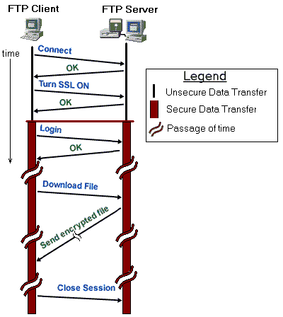
Communication protocol
We have to define how Server and Client will communicate:
Text (or Binary)?
Who sends first message?
What to answer?
Etc.
Example FTP:

Slide 25
Communication Protocol
Decide format for communication
Binary
ObjectOutputStream / ObjectInputStream
Text
Simple command-response (eg. SMTP or HTML)
JSON (e.g. Jackson / Gson )
XML ( e.g JAXB / XStream )

Slide 26
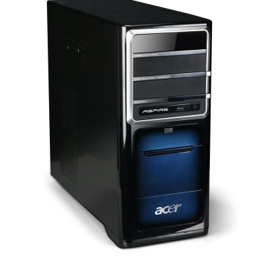
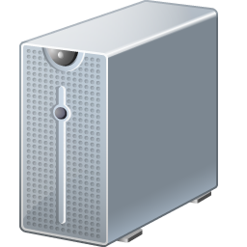
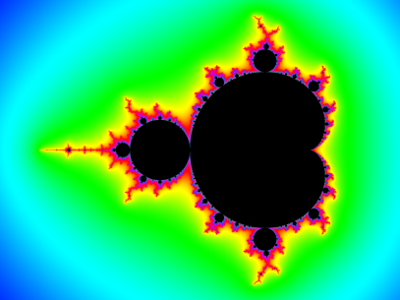
Assignment
One or more Console applications;
calculate pixels of a tile on request
You can choose:
GUI=server; Console=client
or
GUI=client; Console=server
tile information
pixel + color information
Communication through sockets
One GUI application;
shows the fractal

Slide 27
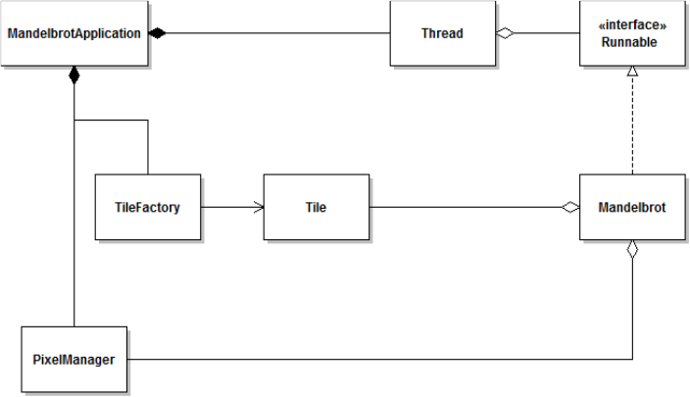
Assignment
GUI application
Console application(s)

Slide 28
Assignment
Develop it in small steps!
Run and study the demo TCP programs from Sharepoint
Make a GUI + 1 Console,
GUI sends tilenumber to Console
Console calculates pixels, and sends them back
Repeated until all tiles are calculated
Add more Consoles (for example 2 or 4)

Slide 29
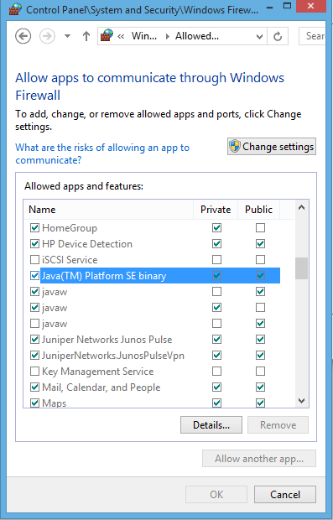
Windows tips
http://www.howtogeek.com/77132/how-to-enable-ping-echo-replies-in-windows-8/
Make sure that JVM is not blocked by the Firewall:
Control Panel → System and Security → Windows Firewall → Allow an app through Windows Firewall
Enable Private and Public for "Java(TM) Platform SE binary"
(perhaps: delete in this list other (older) instances of the JVM)

Slide 30
How to enable telnet:
telnet is a command line tool that can be used as a simple client to test your own server
In Windows, it can be enabled as shown in this tutorial:
http://social.technet.microsoft.com/wiki/contents/articles/910.windows-7-enabling-telnet-client.aspx

Slide 31
further reading
http://docs.oracle.com/javase/tutorial/networking/sockets/index.html

Slide 32
Class assignments
Echo service
Chat application
Peer-to-peer
One server, multiple clients (advanced)

