Slide 1
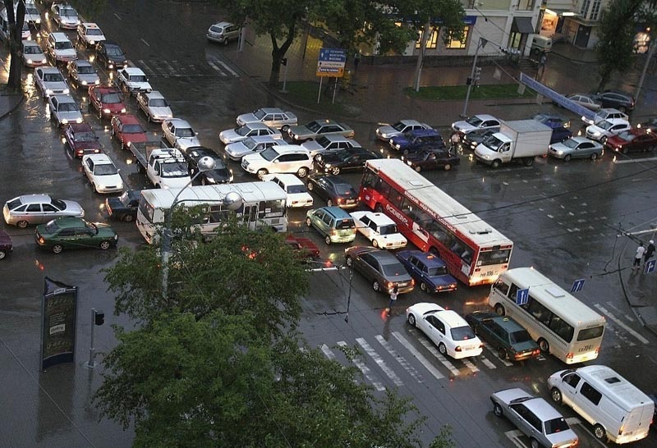
OS2
network sockets
OS2
Week 5
Deadlock

Slide 2
week planning
1 | thread pool, cyclic barrier
2 | readers-writers
3 | reentrant lock, condition
4 | sockets
5 | deadlock
6 | banker's algorithm
7 | recap.
8 | exam
9

Slide 3
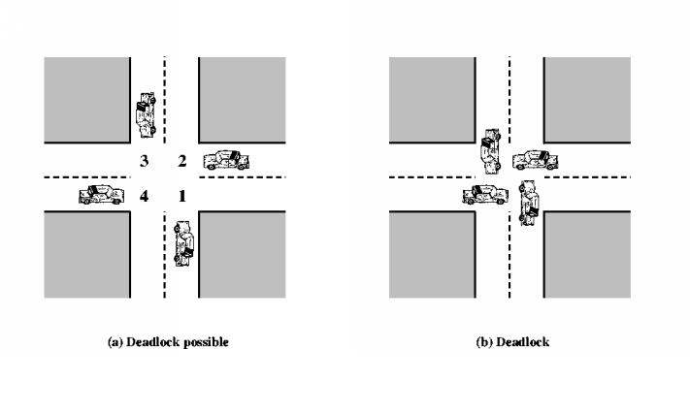
Deadlock
Two (or more) processes are waiting for each other, and it is impossible that they will ever continue
printer
thread
B
thread
A
hard disk

Slide 4




Deadlock
Give me the diamond little girl!
Not until you give me the money first!

Slide 5
Deadlock conditions
Mutual exclusion
Hold and wait
No preemption
Circular waiting
Deadlock is only possible if: A ⋀ B ⋀ C ⋀ D

Slide 6

Deadlock
Give me the diamond little girl!
Not until you give me the money first!
A: Mutual exclusion: No resource can be held by two persons at the same time
B: Hold and wait: They’re both holding one resource and waiting for the other
C: No preemption: There is no 3rd party that takes their resources away and reassigns them
D: Circular waiting: They’re waiting on each other

Slide 7
deadlock prevention
Deadlock is not possible if: ¬ (A ⋀ B ⋀ C ⋀ D)
= ¬A ⋁ ¬B ⋁ ¬C ⋁ ¬D
¬A = no mutual exclusion
might be impossible (e.g. a printer)
¬B = no hold-and-wait
claim all resources at the same time (else: wait!)
¬C = preemption
might be impossible (e.g. a printer)
¬D = no circular wait
claim resources in ascending order (use hashCode())

Slide 8
Deadlock solving strategies
Detection & recovery
Let processes execute uninhibited
If deadlock happens: (e.g.) kill processes
Prevention
Static rules such that deadlock can never occur
Avoidance
Dynamic rules: OS grants a request only when it is safe

Slide 9
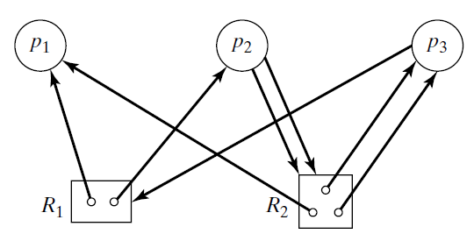
Resource allocation graph
Purpose: find out if deadlock occurs
Represents: particular state of the system
Vertices: processes and resources
Arrows:
p → R: p requests R
R → p: p holds R
Example:
p₁ holds one of R₁
p₂ holds one of R₁ and requests two of R₂

Slide 10
Reduction
Process p is blocked: it has a non-removable outgoing arrow
(removable means: requested resource is free)
Reduction: repeatedly remove a non-blocked process and all its incoming connections ("process has been completed")
Remaining set:
if empty: OK
else: deadlock (a cycle)
Q: is this graph reducible?
A: yes, sequence = p₁, p₃, p₂

Slide 11
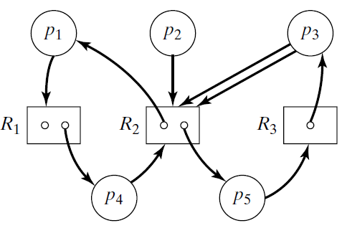
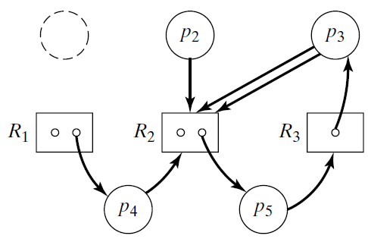
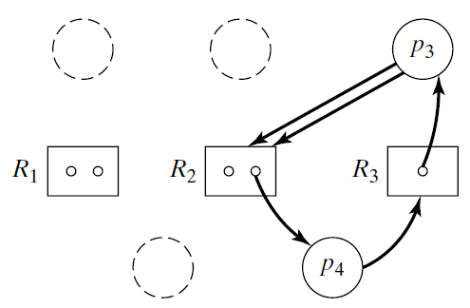

reduction (II)
Q: is this graph reducible?
A: no;
sequence: p₁, p₂, p₄, deadlock!

Slide 12
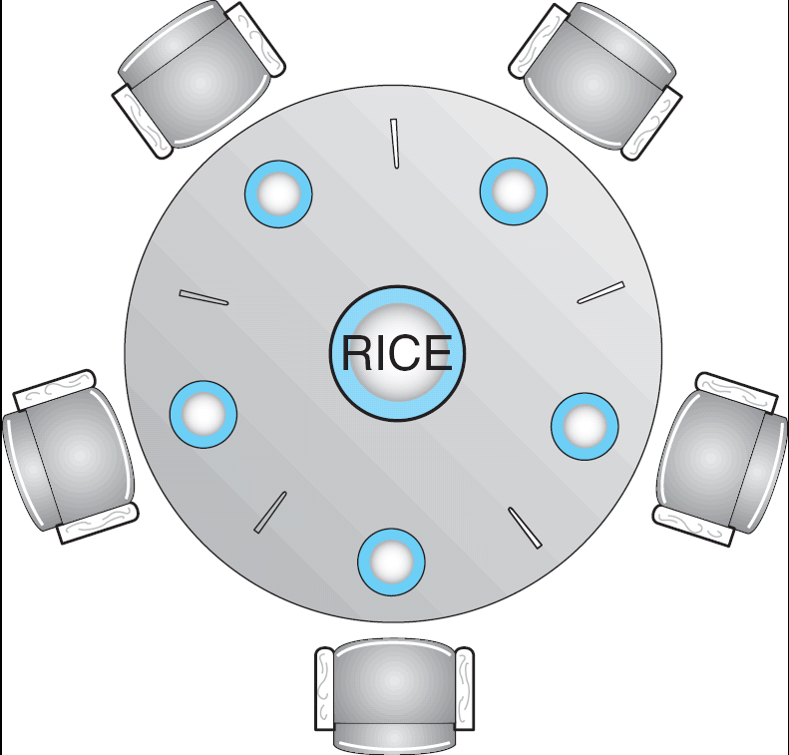
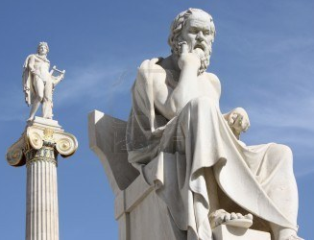
Dining-Philosophers Problem
5 philosophers spend their life thinking and eating
They eat only rice and only at this table
Each philosopher needs 2 chopsticks to eat the rice
There are only 5 such sticks
Shared data
Bowl of rice (data set)
Array: Chopstick[5] chopstick;
Fun video: https://www.youtube.com/watch?v=p1Ut0rulf-s
Notes:
Ideal for showing deadlocks!

Slide 13
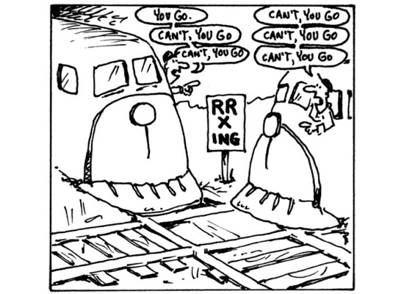
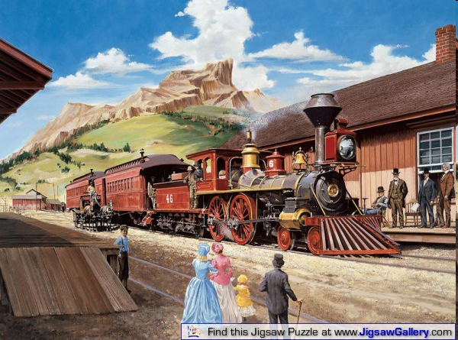
Law passed by the Kansas Legislature in early 20th century:
"When two trains approach each other at a crossing, both shall come to a full stop and
neither shall start upon again until the other has gone."

Slide 14
Assignments
Bank application
Implement dining philosophers
Reduce a resource graph

Slide 15
Further reading
https://courses.cs.washington.edu/courses/cse451/14wi/lectures/9-deadlock.pptx
http://www.cs.uic.edu/~jbell/CourseNotes/OperatingSystems/7_Deadlocks.html

