Slide 1
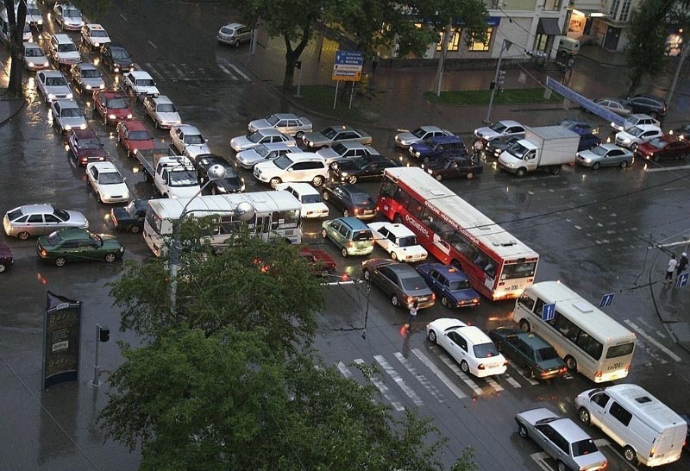
OS2
network sockets
OS2
Week 5
Deadlock

Slide 2
week planning
1 | thread pool, cyclic barrier
2 | readers-writers
3 | reentrant lock, condition
4 | sockets
5 | deadlock
6 | banker's algorithm
7 | recap.
8 | exam
9

Slide 3
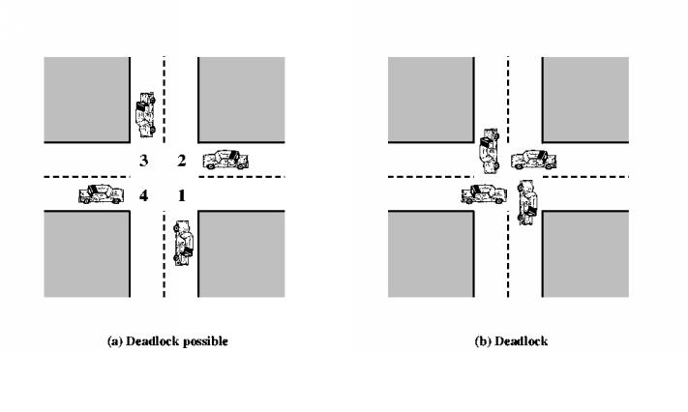
Deadlock
Two (or more) processes are
waiting for each other, and
it is impossible that they will ever continue
printer
thread
B
thread
A
hard disk

Slide 4




Deadlock
Give me the diamond little girl!
Not until you give me the money first!

Slide 5
Deadlock conditions
Mutual exclusion
Hold and wait
No preemption
Circular waiting
Deadlock is only possible if: A ⋀ B ⋀ C ⋀ D

Slide 6

Deadlock
Give me the diamond little girl!
Not until you give me the money first!
A: Mutual exclusion: No resource can be held by two persons at the same time
B: Hold and wait: They’re both holding one resource and waiting for the other
C: No preemption: There is no 3rd party that takes their resources away and reassigns them
D: Circular waiting: They’re waiting on each other

Slide 7
deadlock prevention
Deadlock is not possible if: ¬ (A ⋀ B ⋀ C ⋀ D)
= ¬A ⋁ ¬B ⋁ ¬C ⋁ ¬D
¬A = no mutual exclusion
    might be impossible (e.g. a printer)
¬B = no hold-and-wait
    claim all resources at the same time (else: wait!)
¬C = preemption
    might be impossible (e.g. a printer)
¬D = no circular wait
    claim resources in ascending order (use hashCode())

Slide 8
Deadlock solving strategies
Detection & recovery
  Let processes execute uninhibited
  If deadlock happens: (e.g.) kill processes
Prevention
  Static rules such that deadlock can never occur
Avoidance
  Dynamic rules: OS grants a request only when it is safe

Slide 9
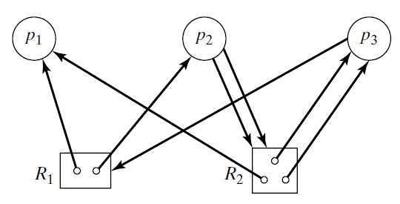
Resource allocation graph
Purpose: find out if deadlock occurs
Represents: particular state of the system
Vertices: processes and resources
Arrows:
  p → R: p requests R
  R → p: p holds R
Example:
  p₁ holds one of R₁
  p₂ holds one of R₁
  and requests two of R₂

Slide 10
Reduction
Process p is blocked: it has a non-removable outgoing arrow
  (removable means: requested resource is free)
Reduction: repeatedly remove a non-blocked process and all its incoming connections
("process has been completed")
Remaining set:
  if empty: OK
  else: deadlock (a cycle)
Q: is this graph reducible?
A: yes, sequence = p₁, p₃, p₂

Slide 11
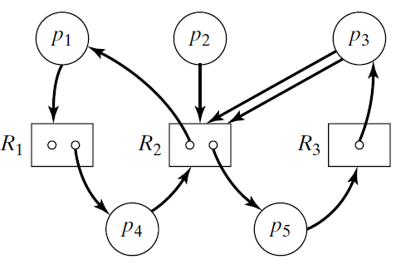
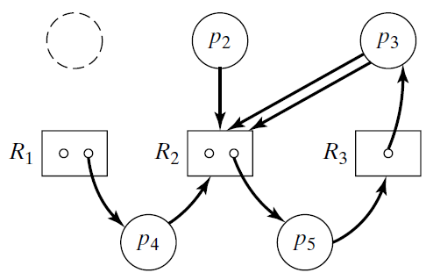
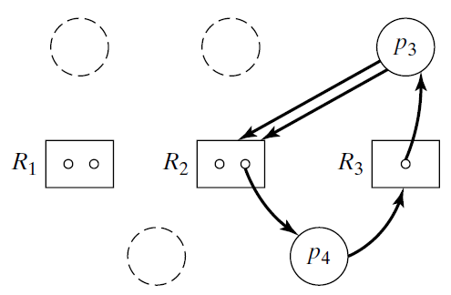

reduction (II)
Q: is this graph reducible?
A: no;
sequence: p₁, p₂, p₄, deadlock!

Slide 12
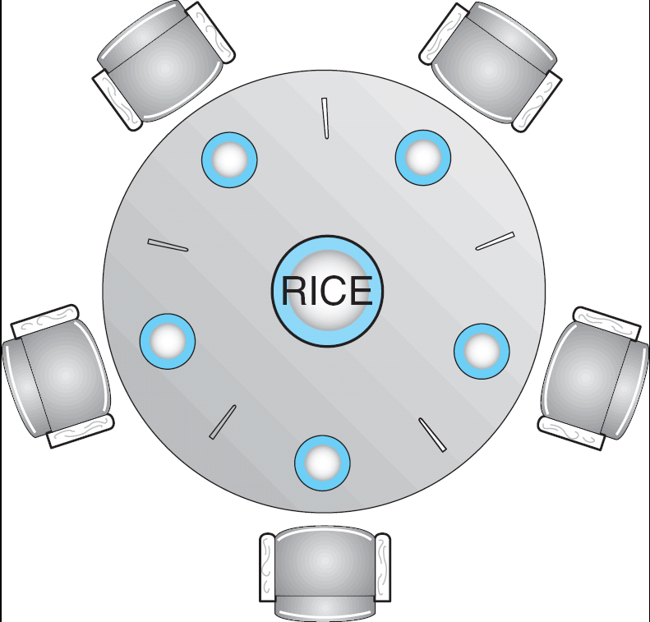
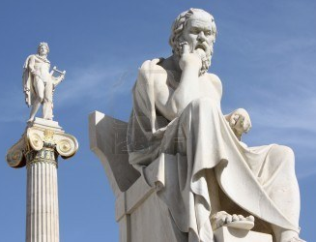
Dining-Philosophers Problem
5 philosophers spend their life thinking and eating
They eat only rice and only at this table
Each philosopher needs 2 chopsticks to eat the rice
There are only 5 such sticks
Shared data
  Bowl of rice (data set)
  Array: Chopstick[5] chopstick;
Fun video: https://www.youtube.com/watch?v=p1Ut0rulf-s
Notes:
Ideal for showing deadlocks!

Slide 13
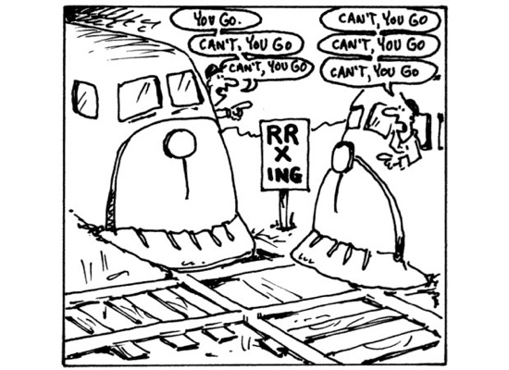
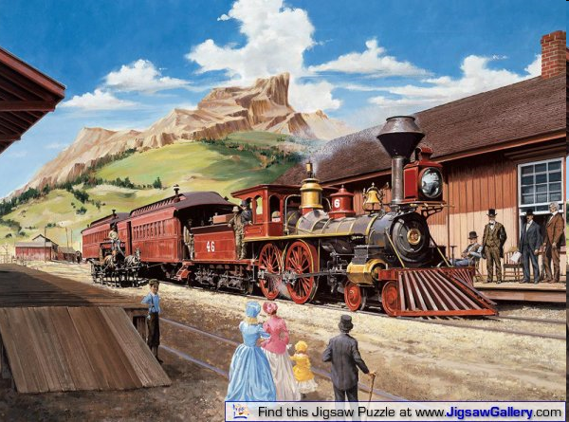
Law passed by the Kansas Legislature in early 20th century:
"When two trains approach each other at a crossing, both shall come to a full stop and
neither shall start upon again until the other has gone."

Slide 14
Further reading
https://courses.cs.washington.edu/courses/cse451/14wi/lectures/9-deadlock.pptx
http://www.cs.uic.edu/~jbell/CourseNotes/OperatingSystems/7_Deadlocks.html

Slide 15
Assignments
Bank application
Implement dining philosophers
Reduce a resource graph

Slide 16
Bank application
An increasing number of brokers (threads) will transfer money. Each broker transfers money from a random from-account (a1 or a-from) to a to-account (a2 or a-to)
Start with 8 accounts A[0]..A[7] with balance 100
Total balance is 800
A[0]
100
A[1]
100
A[2]
100
A[3]
100
A[4]
100
A[5]
100
A[6]
100
A[7]
100

Slide 17
Bank application
Then we start the brokers one by one.
Broker B1 randomly selects a-to and a-from, and an amount of money.
E.g. a-from = A[2] and a-to = A[5], amount = 30
A[0]
100
A[1]
100
A[2]
100
A[3]
100
A[4]
100
A[5]
100
A[6]
100
A[7]
100
a-from
B1
a-to

Slide 18
Bank application
Broker B1 gets the balance of A[2] and A[5], changes them, and stores the result back in A[2] and A[5].
Total balance is 800.
Then broker B1 does the next transaction, etc.
The total remains 800
A[0]
100
A[1]
100
A[2]
70
A[3]
100
A[4]
100
A[5]
130
A[6]
100
A[7]
100
a-to
a-from
B1

Slide 19
Bank application
Then a next broker B2 is started. B2 now does transactions in parallel with B1. This is ok, as long as B1 and B2 choose different accounts for their transactions.
B2
a-from
a-to
A[0]
100
A[1]
100
A[2]
70
A[3]
100
A[4]
100
A[5]
130
A[6]
100
A[7]
100
a-to
a-from
B1

Slide 20
Bank application
However, if two brokers choose the same account, a race condition may occur and the total balance is no longer 800.
E.g.
B2
a-from
a-to
A[0]
100
A[1]
100
A[2]
70
A[3]
100
A[4]
100
A[5]
130
A[6]
100
A[7]
100
a-to
a-from
B1

Slide 21
Bank application
B1 gets balance of A[0] and A[2] (100 and 70).
Then B2 will get balance of A[2] and A[6] (70 and 100)
B1 transfers 50, so balance A[0] = 50 and A[2] = 120
Then B2 transfers 50, so balance A[6] = 50 and A[2] = 120 (70+50)
B2
a-from
a-to
A[0]
50
A[1]
100
A[2]
120
A[3]
100
A[4]
100
A[5]
130
A[6]
50
A[7]
100
a-to
a-from
B1

Slide 22
Bank application
Total balance is now 750 (!?) So we lost 50 euro’s.
That is because each brokers copies the balance locally.
-> Use synchronization to solve this issue (Brokers need exclusive access to accounts)
B2
a-from
a-to
A[0]
50
A[1]
100
A[2]
120
A[3]
100
A[4]
100
A[5]
130
A[6]
50
A[7]
100
a-to
a-from
B1

Slide 23
Bank application
Now imagine B1 selects a-to = A[1] and a-from = A[2]
B2 selects a-to = A[2] and a-from = A[1]
B1 claims A[2], then B2 claims A[1] -> deadlock!
B2
a-from
a-to
A[0]
50
A[1]
100
A[2]
120
A[3]
100
A[4]
100
A[5]
130
A[6]
50
A[7]
100
a-from
a-to
B1

