Slide 1

OS2
Banker's algorithm

Slide 2
Week planning
1 | thread pool, cyclic barrier
2 | readers-writers
3 | reentrant lock, condition
4 | sockets
5 | deadlock
6 | banker's algorithm
7 | recap.
8 | exam
9

Slide 3



Duckburg
Donald Duck says: “I need a loan of at most $400 for my new car”:
First he borrows $300 to buy the car
…
Then he needs an extra loan of $100 for some repairs
…
He will pay back everything later
Scrooge McDuck has $500
Gyro Gearloose says: “I need a loan of at most $400 for my new invention”:
First he needs a loan of $200 to buy necessary stuff
…
Later he needs an extra loan of $200 to perform some tests
…
He will pay back everything later

Slide 4
Deadlock avoidance
Banker only gives you a loan when he is sure that he can later give you all you need (avoid: you ask for more money than banker has available)
OS only gives resource to process when it is sure that it can give other needed resources later also (avoid: process asks for resources which are not available)
Banker's algorithm
Essential:
OS must know how much each process will ask at most
This is called: claim

Slide 5
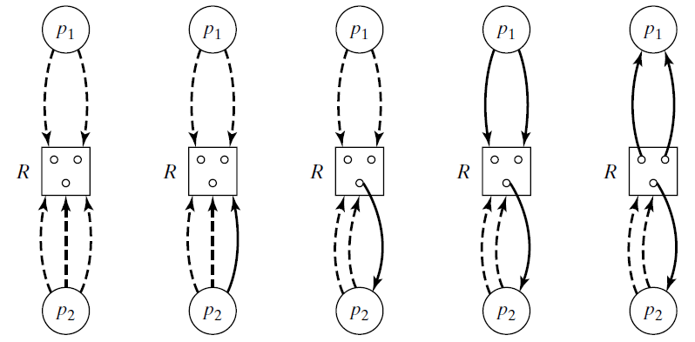
Maximum claim graph
Rules:
All processes request resources after each other and release them at the end
OS only grants a resource request if all processes can still acquire their maximum claim
p₂ will requests at most 3 instances of R
p₂ now actually requests one R
OS grants the request
(dotted arrows → claim)

Slide 6
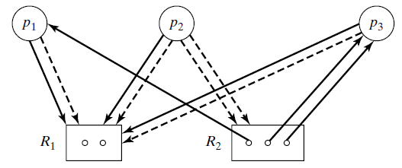
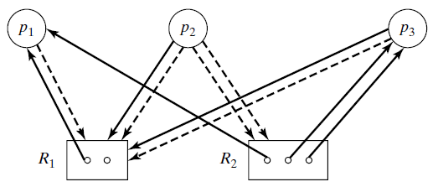
Example I
p₁ requests one R₁ Shall the OS grant this request?
Pretend OS grants the request
Check if graph can be reduced (with the claims)
Yes, so OS will grant the request

Slide 7
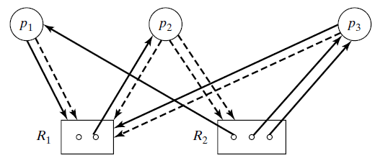
Example II
p₂ requests one R₁ Shall the OS grant this request?
Pretend OS grants the request
Check if graph can be reduced (with the claims!)
NO, deadlock possible!
So OS will not grant the request (p₂ has to wait)

Slide 8
Example III
p₃ requests one R₁. Shall the OS grant this request?

Slide 9
Using tables instead of a graph
_{c} | R₁ | R₂
 | 2 | 3
c[j] number of type j resources
max[i,j] maximum number of type j resources needed by process i
current state (in red):
av[j] available resources of type j
alloc[i,j] resources of type j in use by process i
claim[i,j] max number resources of type j to be claimed by process i
note:
av[j] = c[j] - Σi:alloc[i,j]
alloc[i,j] + claim[i,j] = max[i,j]
max | R₁ | R₂
p₁ | 2 | 1
p₂ | 2 | 2
p₃ | 2 | 2
_{av} | R₁ | R₂
 | 2 | 0
alloc | R₁ | R₂
p₁ | 0 | 1
p₂ | 0 | 0
p₃ | 0 | 2
claim | R₁ | R₂
p₁ | 2 | 0
p₂ | 2 | 2
p₃ | 2 | 0

Slide 10
Algorithm
State is safe: OS is able to give all processes their max claim of resources (so they can finish)
Assume the current state is safe
Consider a new request by process i
req[i,j] : number of resources of type j requested by process i
New state is obtained as follows:
av[j] = av[j] - req[i,j];
alloc[i,j] = alloc[i,j] + req[i,j];
claim[i,j] = claim[i,j] - req[i,j];
Check if new state is safe
find sequence of processes to finish

Slide 11
Algorithm in action (I)
_{c} | R₁ | R₂
 | 2 | 3
Current state:
p₃ requests one R₁; new temporary state:
Safe? YES, possible sequence of processes to finish: p₃, p₁, p₂
Proof: see next slide
_{av} | R₁ | R₂
 | 2 | 0
alloc | R₁ | R₂
p₁ | 0 | 1
p₂ | 0 | 0
p₃ | 0 | 2
claim | R₁ | R₂
p₁ | 2 | 0
p₂ | 2 | 2
p₃ | 2 | 0
max | R₁ | R₂
p₁ | 2 | 1
p₂ | 2 | 2
p₃ | 2 | 2
_{av} | R₁ | R₂
 | 1 | 0
alloc | R₁ | R₂
p₁ | 0 | 1
p₂ | 0 | 0
p₃ | 1 | 2
claim | R₁ | R₂
p₁ | 2 | 0
p₂ | 2 | 2
p₃ | 1 | 0

Slide 12
Algorithm in action (II)
_{av} | R₁ | R₂
 | 1 | 0
alloc | R₁ | R₂
p₁ | 0 | 1
p₂ | 0 | 0
p₃ | 1 | 2
claim | R₁ | R₂
p₁ | 2 | 0
p₂ | 2 | 2
p₃ | 1 | 0
The new temporary state:
OS gives max claim to p₃:
p₃ finishes:
OS gives max claim to p₁ and p₁ finishes:
OS gives max claim to p₂ and p₂ finishes:
_{av} | R₁ | R₂
 | 0 | 0
alloc | R₁ | R₂
p₁ | 0 | 1
p₂ | 0 | 0
p₃ | 2 | 2
claim | R₁ | R₂
p₁ | 2 | 0
p₂ | 2 | 2
p₃ | 0 | 0
_{av} | R₁ | R₂
 | 2 | 2
alloc | R₁ | R₂
p₁ | 0 | 1
p₂ | 0 | 0
p₃ | 0 | 0
claim | R₁ | R₂
p₁ | 2 | 0
p₂ | 2 | 2
p₃ | 0 | 0
_{av} | R₁ | R₂
 | 2 | 3
alloc | R₁ | R₂
p₁ | 0 | 0
p₂ | 0 | 0
p₃ | 0 | 0
claim | R₁ | R₂
p₁ | 0 | 0
p₂ | 2 | 2
p₃ | 0 | 0
_{av} | R₁ | R₂
 | 2 | 3
alloc | R₁ | R₂
p₁ | 0 | 0
p₂ | 0 | 0
p₃ | 0 | 0
claim | R₁ | R₂
p₁ | 0 | 0
p₂ | 0 | 0
p₃ | 0 | 0

Slide 13
Algorithm in action (III)
_{av} | R₁ | R₂
 | 1 | 0
alloc | R₁ | R₂
p₁ | 0 | 1
p₂ | 0 | 0
p₃ | 1 | 2
claim | R₁ | R₂
p₁ | 2 | 0
p₂ | 2 | 2
p₃ | 1 | 0
So OS grants original request of p₃, and the temporary state becomes the new safe state
Next request: p₁ requests one R₁; new temporary state:
_{av} | R₁ | R₂
 | 0 | 0
alloc | R₁ | R₂
p₁ | 1 | 1
p₂ | 0 | 0
p₃ | 1 | 2
claim | R₁ | R₂
p₁ | 1 | 0
p₂ | 2 | 2
p₃ | 1 | 0
Safe?
NO: no resources available (each process waits for another process to finish) request of p₁ will not be granted; p₁ has to wait
Conclusion: in a new safe state, OS must check again a new request before it can be granted

Slide 14
Assignment
Banker's algorithm
graph
tables

Slide 15
Further reading
http://csit.udc.edu/~byu/COSC4740-01/Lecture7.pdf
http://www.cis.upenn.edu/~lee/03cse380/lectures/ln8-deadlock.pdf
http://en.wikipedia.org/wiki/Banker%27s_algorithm

