Slide 1

predicting Taxi ETA times in nyc
Final Project for APMA 4990: Introduction to Data Science Industry
Joseph Archer and John Vahedi

Slide 2
Preview
Data Integrity
Feature Creation
Exploratory Analysis
Model Selection
Results and model comparison

Slide 3
data integrity

Slide 4
Filters
Eliminate nulls/na
Latitude and longitude
latitude between 40.5 and 41
longitude between -74.3 and -73.5
Speed
filtered between 2 mph and 70 mph
not used as a feature due to data leakage

Slide 5
feature creation

Slide 6
Data Gathering
Weather data (GSOD)
NYC Points of Interest
Notes:
weather was only over 6 months

Slide 7
Feature Creation
Geospatial
Points of interest
River latitude and longitude
L1 and L2 norm
Geohash
Time
Time cos and sin
Weekend
Rush hour
Categorical time
Unique
Rushed distance
Higher order latitude and longitude
Google maps distance

Slide 8

Feature Creation
Geospatial
Points of interest
River latitude and longitude
L1 and L2 norm
Geohash

Slide 9

Feature Creation
Time
Time cos and sin
Weekend
Rush hour
Categorical time

Slide 10

Feature Creation
Unique
Rushed distance
Higher order latitude and longitude
Google maps distance

Slide 11
Feature Engineering Geospatial 1
Feature Created | Explanation
Point of interest | Binary classification if the latitude/longitude was within 1000 ft of a hospital or airport
river latitude and longitude | Perform a 59 degree rotation transformation on latitude and longitude so that they align with the street grid of NYC and also roughly with the river angles

Slide 12
Feature Engineering Geospatial 2
Feature Created | Explanation
L2 and L1 norm | Calculate the L2 and L1 norm between pickup and dropoff. Use the SQL type of geography point to avoid defining a separate haversine distance
Geohash | Binary classification if the pickup location was in a neighboring geohash area to the dropoff location. Calculated for a geohash length of 8, 7, 6, 5, and 4

Slide 13
Feature Engineering Time 1
Feature Created | Explanation
Time cos and sin | Cos/sin transformation of pickup time over each day and also over a week at a time.
Weekend | Binary classification if it is the weekend defined from midnight Friday to midnight on Sunday (possible improvement)

Slide 14
Feature Engineering Time 2
Feature Created | Explanation
Rush hour | Binary classification if it is the weekday and between 8-9 am or 5-6 pm (possible improvement)
Categorical time | Binned the week into 30 min bins and treated as a categorical variable

Slide 15
Feature Engineering Unique
Feature Created | Explanation
Rushed distance | Multiplication of the rush hour by the distance traveled. Cut off 20 seconds from the testing RMSE for Random Forest (5 fold CV).
Higher order latitude and longitude | Squared the latitude and longitude of pickup and dropoff and included as separate variables to possibly pick up on the obstruction of central park.
Google maps distance | Use the google maps API to calculate the street distance between the pickup and drop-off

Slide 16
Model selection and comparison

Slide 17
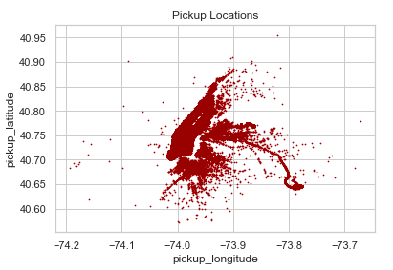
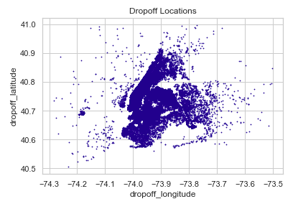
Exploratory Analysis
Notes:
Pickups were more centrally located than drop-offs – concentrations around the airports

Slide 18
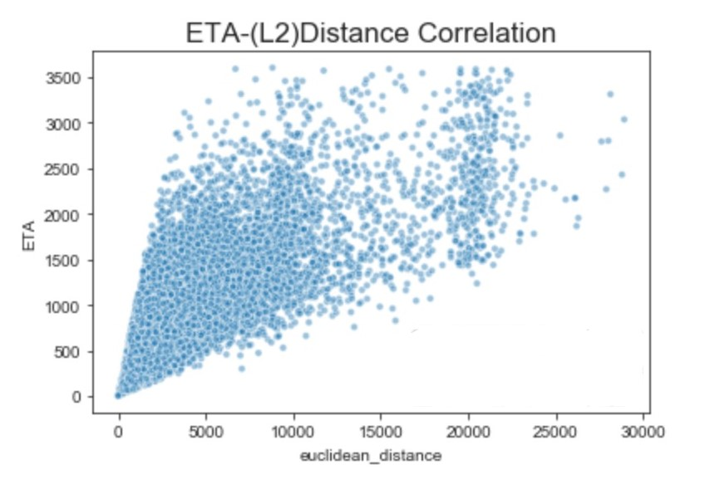
Exploratory Analysis

Slide 19
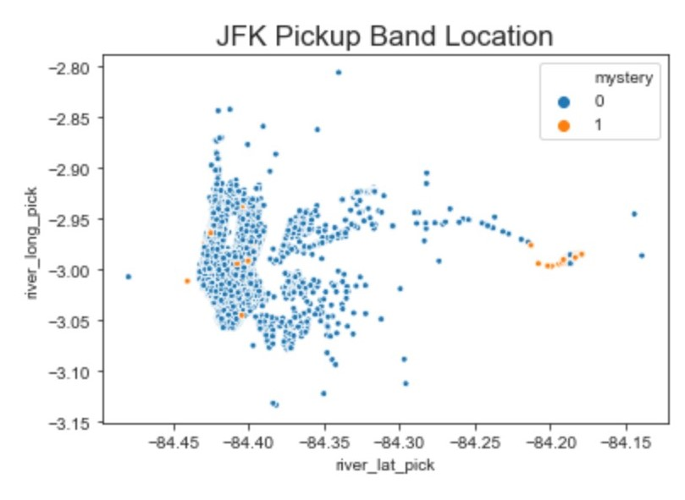
Exploratory Analysis

Slide 20
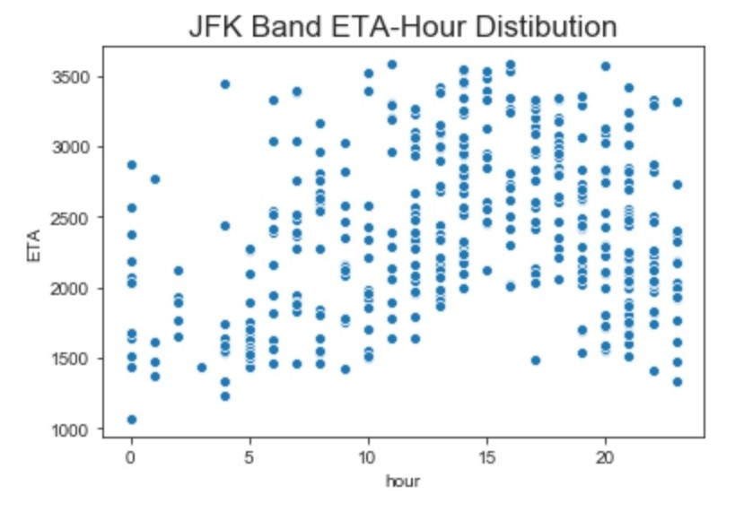
Exploratory Analysis

Slide 21
Model Selection
Ensemble methods
Random forest
Adaboost
Linear methods
Ridge Regression
Lasso
Classification method as a regressor
KNN

Slide 22
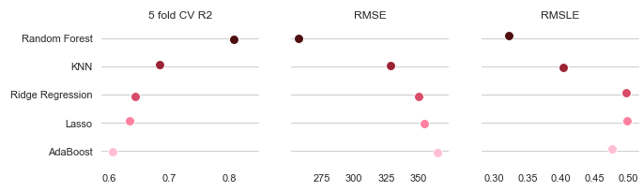
Model comparison

Slide 23
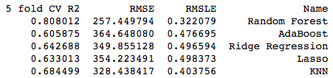
Model comparison

Slide 24

Thank you
Questions?

