Slide 1

Smart City - Smart Parking Management Using Machine Learning

Slide 2

Subject: -
DS -670 CAPSTONE: BIG DATA & DATA ANALY

Slide 3

Team members: -
Bijnaben Amarabhai Chandera
Jayesh Vala
Thanuboadhi Naveen Reddy

Slide 4
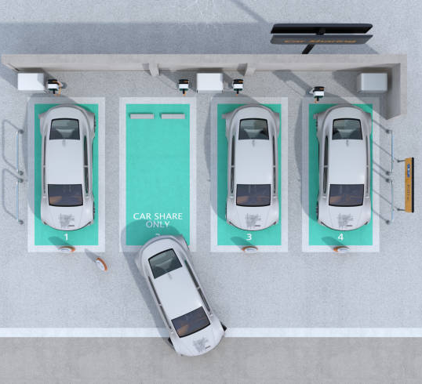
Introduction
The rise in car ownership has led to an increased demand for parking spaces, particularly in smart urban areas that have embraced the internet of things (IoT). As a result, challenges such as traffic congestion, limited parking facilities, and road safety are being tackled through IoT technology.
To address these issues and enhance the convenience for car users, several parking management systems have been implemented. These systems integrate smart devices, wireless algorithms, and mobile applications to alleviate traffic issues and improve the overall parking experience.

Slide 5

Abstract & Keywords
  This project aims to develop a smart parking system leveraging Machine Learning and the Internet of Things
  Addressing parking challenges in urban areas by optimizing parking space utilization
  Enhancing urban mobility and reducing environmental impact through efficient parking solutions
Keywords: Smart City, Smart Parking Management, Machine Learning, IoT, Urban Efficiency, Traffic Congestion, Environmental Sustainability

Slide 6
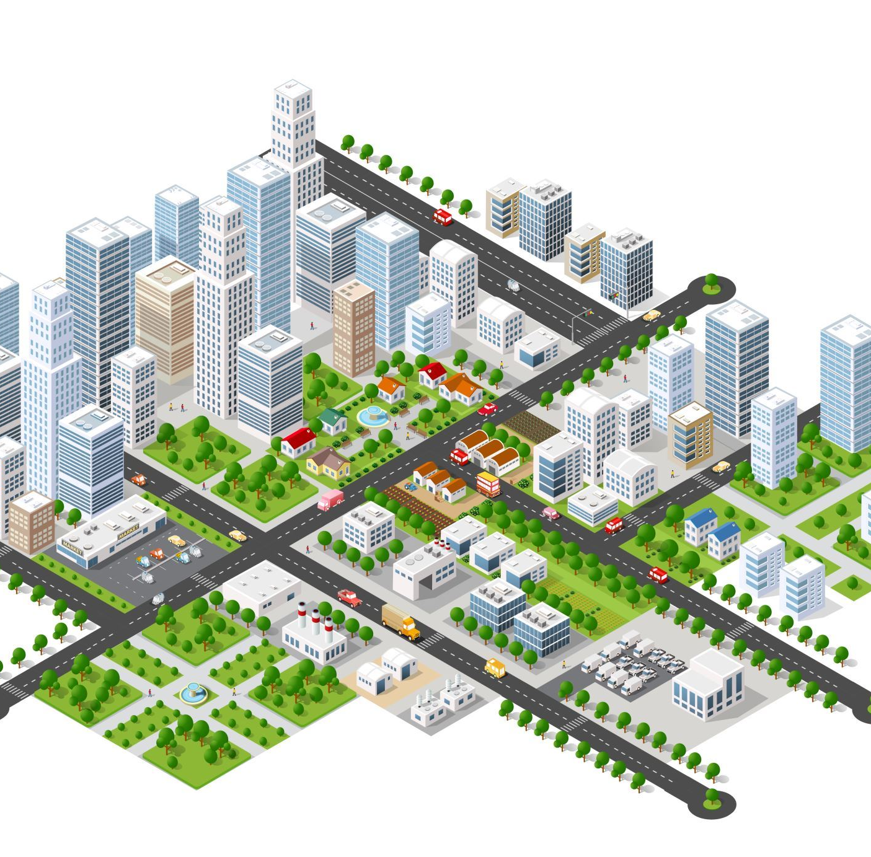
Challenges
Urbanization Challenges
  Increasing population and vehicle numbers in urban areas
  Scarcity of parking spaces leading to traffic congestion
Technology as a Solution
  Potential of ML and IoT to revolutionize urban parking
  Smart technologies for real-time parking monitoring and management
Project Aim
  To evaluate the efficacy of smart parking systems in urban settings
  Contribution to sustainable urban development

Slide 7
Problem Statement
Ineffective parking management is an important factor in traffic jams and pollution in a rapid urbanization cities
The challenge lies in developing a machine learning-driven smart parking solution that optimizes parking space utilization, reduces search time for parking, lowers carbon emissions, and enhances the overall urban living experience

Slide 8



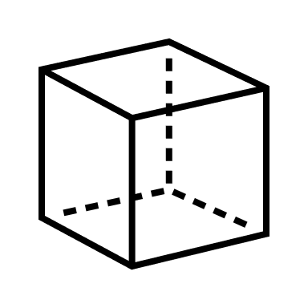




Public Ledger
Parking area
Transaction is updated
if valid
Consensus
Mechanism
System interface service providers
Send transaction for validation
Parking area
Transaction
Interface for integrated
parking services
Parking area
Scanner
Parking
Request/Response
Mobile App
Parking area
User
Architecture of Smart Parking Management

Slide 9

MVP
The Minimum Viable Product (MVP) for the smart parking management system is a streamlined version of the solution that contains the core features necessary to demonstrate the value of machine learning applications within the context of smart city initiatives such as Real-time Parking Availability Detection, Predictive Analytics, Dynamic Pricing Model and User-Friendly App Interface.

Slide 10
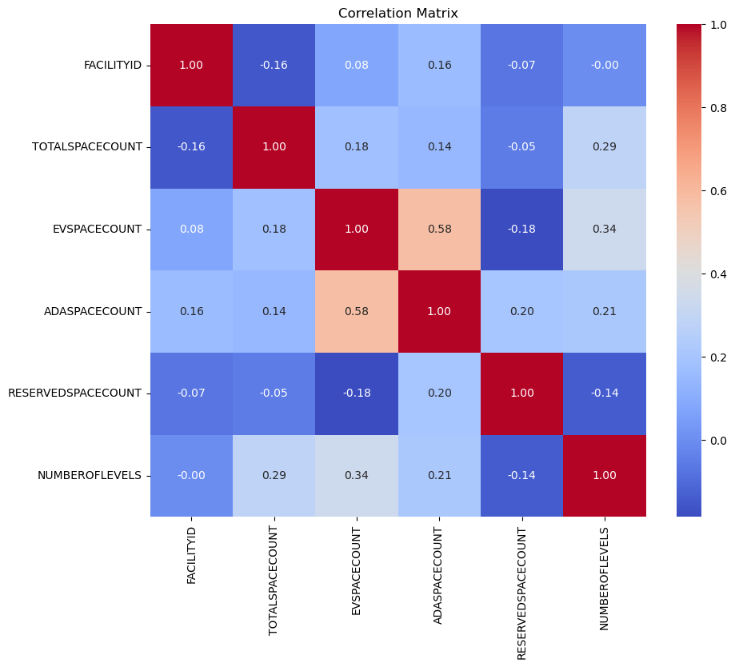
Methodology
Data Preparation
  Data cleaning and preprocessing for accurate model training
  Techniques for data imputation to handle missing or incomplete data
Machine Learning Models
  Linear Regression: To predict parking availability based on various factors
  Decision Tree and Random Forest: For classification and regression tasks in parking management
  Gradient Boosting Regressors: Advanced model for improved accuracy
Evaluation Metrics
  Mean Squared Error , R-squared, Root Mean Squared Error , Mean Absolute Percentage Error for model performance assessment

Slide 11
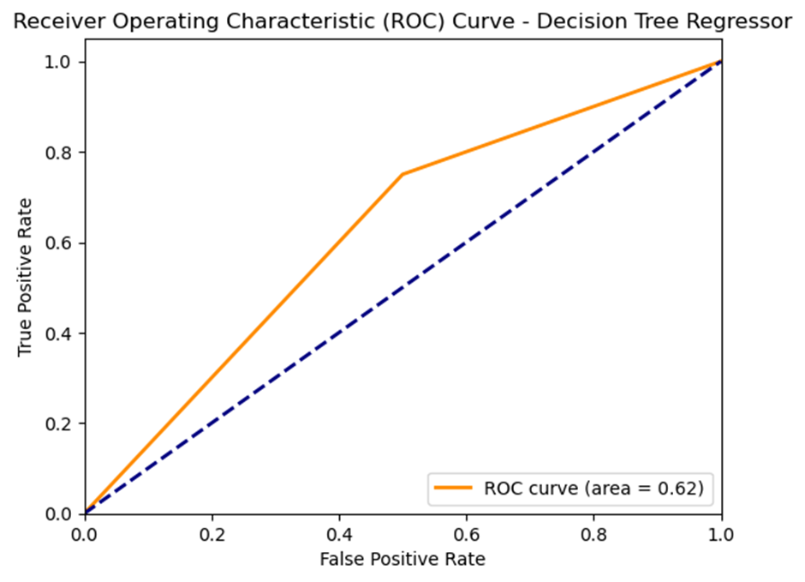
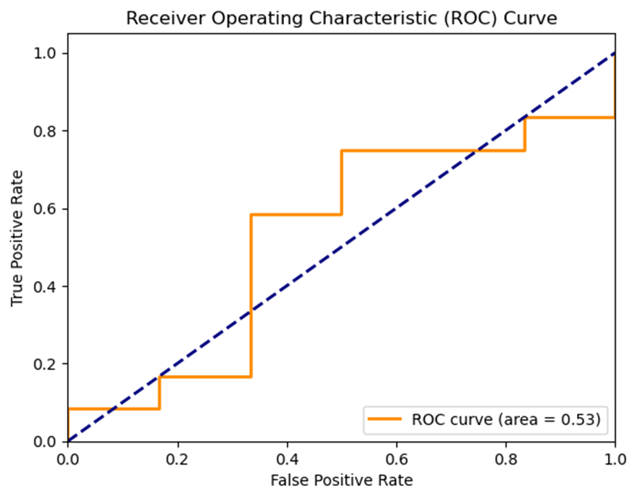
Results Analysis
Linear Regression Performance
  Mean Squared Error : 183,385.54
  R-squared: 0.375, indicating moderate prediction accuracy
  Root Mean Square Error : 428
  Mean Absolute Percentage Error : 298
Decision Tree Regressor Performance
  MSE: 210,688.5, suggesting less accuracy
  R-squared: 0
  RMSE: 459
  MAPE: 323.18, indicating lower fit to the data

Slide 12
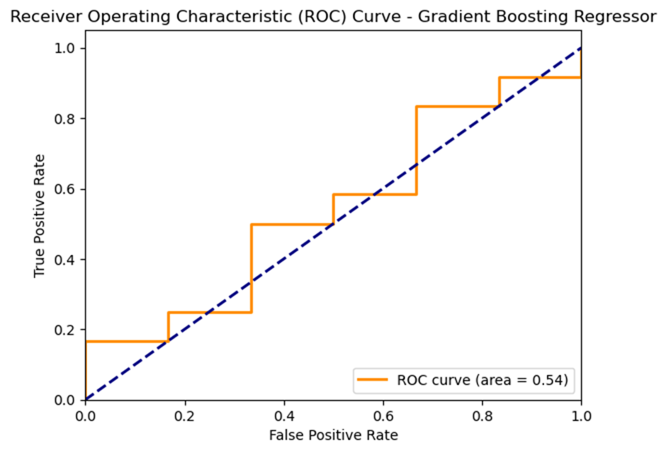
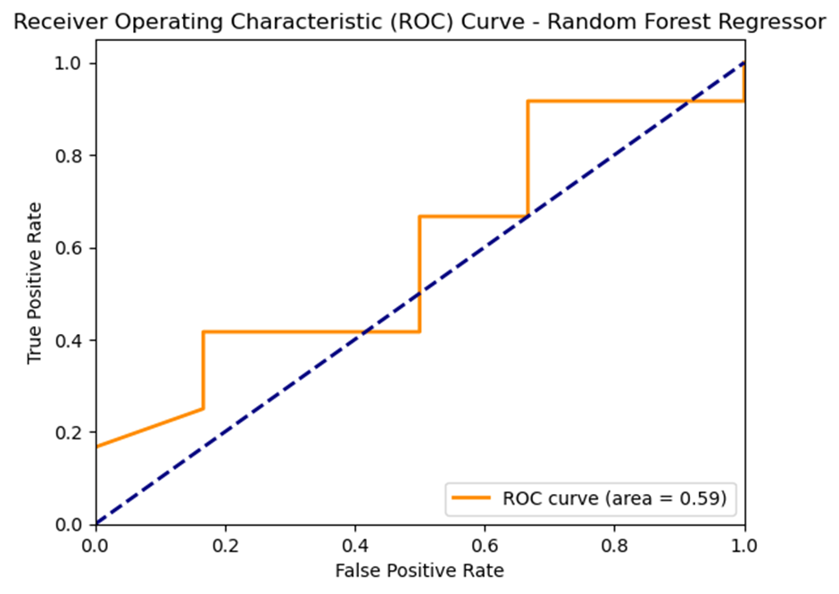
Results Analysis
Random Forest Regressor Performance
  MSE: 154,943.12, showing improvement
  R-squared: 0.472, better predictive performance
  RMSE: 393
  MAPE: 307
Gradient Boosting Regressor Performance
  MSE: 110,159.3, the best among all models
  Highest R-squared: 0
  Lowest RMSE: 331
  Lowest MAPE: 241.01, indicating highest accuracy for parking availability prediction

Slide 13
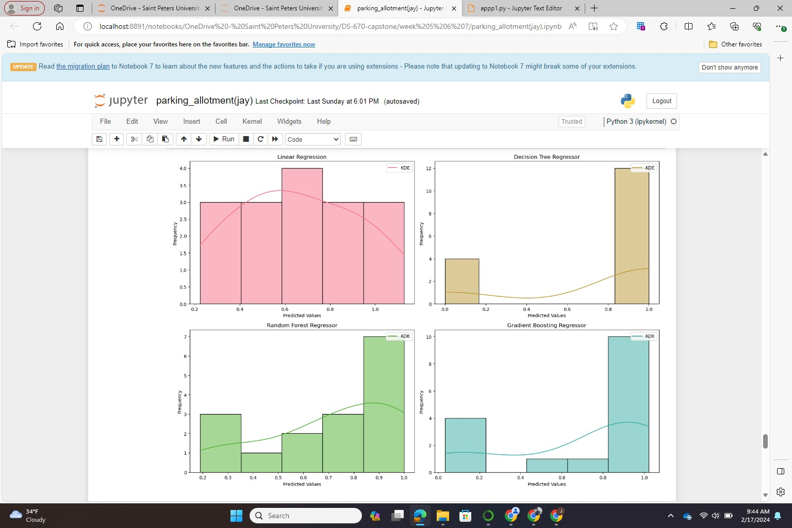
Results Analysis
ROC Curve Analysis
  Gradient Boosting Regressor: Area of 0.54, modest predictive power
  Random Forest Regressor: Area of 0.59, fair predictive ability
  Decision Tree Regressor: Area of 0.62, better performance in class distinction
  Linear Regression: Area of 0.53, slightly better than a random guess
Histograms and Model Confidence
  Illustrate distribution of predicted values
  Visualize frequency of predictions at different thresholds
  Indicate confidence levels of each model’s predictions

Slide 14
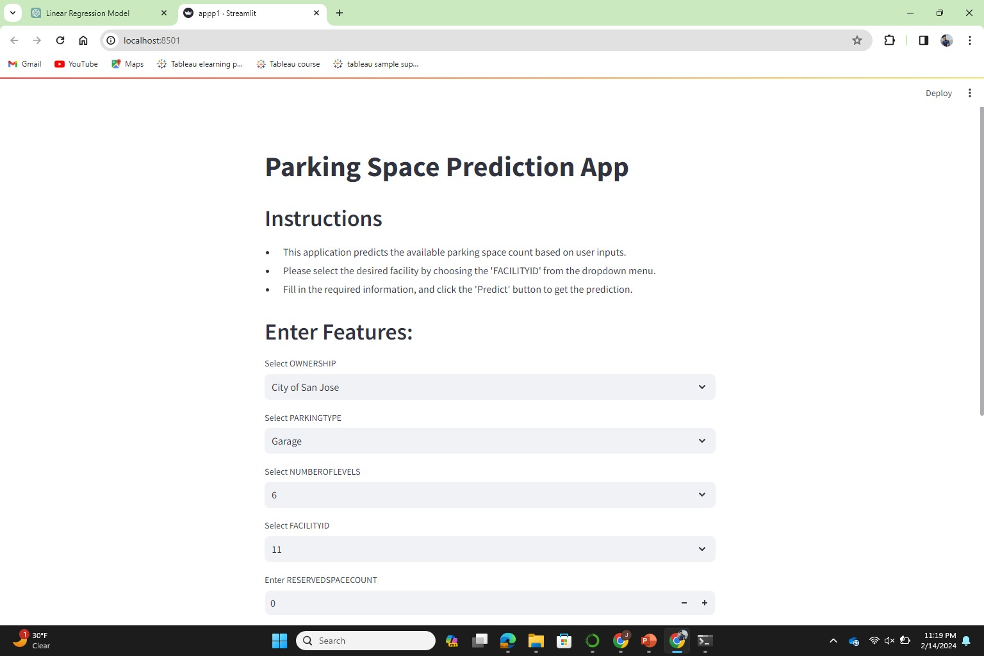
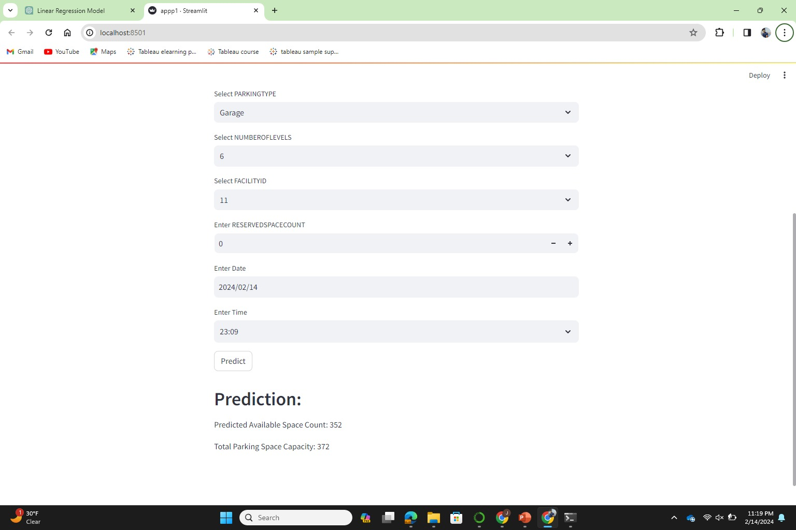
SREAMLIT APP

Slide 15

REFERENCES
[1] C. Tiexin, T. Miaomiao, and M. Ze, ‘‘The model of parking demand forecast for the urban CCD,’’ Energy Procedia, vol. 16, pp. 1393–1400, 2012.
( https://doi.org/10.1016/j.egypro.2012.01.221)
[2] B. Yang, N. Fantini, and C. S. Jensen, ‘‘iPark,’’ in Proc. 16th Int. Conf. Extending Database Technol. (EDBT), Mar. 2013, pp. 705–708. (https://doi.org/10.1145/2452376.2452459)
[3] X. Chen, ‘‘Parking occupancy prediction and pattern analysis,’’ Dept. Comput. Sci., Stanford Univ., Stanford, CA, USA, Tech. Rep. CS229-2014, 2014.
[4] T. Tiedemann, T. Voegele, M. M. Krell, J. H. Metzen, and F. Kirchner, ‘‘Concept of a data thread-based parking space occupancy prediction in a Berlin pilot region,’’ in Proc. AAAI Workshop, AI Transp., 2015, pp. 1–6.
(https://www.researchgate.net/profile/Mario-Michael-Krell/publication/311734424_Concept_of_a_Data_Thread_Based_Parking_Space_Occupancy_Prediction_in_a_Berlin_Pilot_Region/links/6221872797401151d2faac8f/Concept-of-a-Data-Thread-Based-Parking-Space-Occupancy-Prediction-in-a-Berlin-Pilot-Region.pdf)
[5] Y. Ji, D. Tang, P. Blythe, W. Guo, and W. Wang, ‘‘Short-term forecasting of available parking space using wavelet neural network mode
l,’’ IET Intell. Transp. Syst., vol. 9, no. 2, pp. 202–209, 2015.
( https://doi.org/10.1049/iet-its.2013.0184)

Slide 16
REFERENCES
[6] E. Vlahogianni, K. Kepaptsoglou, V. Tsetsos, and M. Karlaftis, ‘‘A real time parking prediction system for smart cities,’’ J. Intell. Transp. Syst., vol. 20, no. 2, pp. 192–204, 2016.
(https://doi.org/10.1080/15472450.2015.1037955)
[7] M. Caliskan, A. Barthels, B. Scheuermann, and M. Mauve, ‘‘Predicting parking lot occupancy in vehicular ad hoc networks,’’ in Proc. IEEE 65th Veh. Technol. Conf. (VTC7-Spring), Apr. 2007, pp. 277–281.( DOI: 10.1109/VETECS.2007.69)
[8] Z. Yang, H. Liu, and X. Wang, ‘‘The research on the key technologies for improving efficiency of parking guidance system,’’ in Proc. IEEE Int. Conf. Intell. Transp. Syst., Oct. 2003, pp. 1177–1182.( DOI: 10.1109/ITSC.2003.1252670)
[9] D. Teodorović and P. Lučić, ‘‘Intelligent parking systems,’’ Eur. J. Oper. Res., vol. 175, no. 3, pp. 1666–1681, 2006.( https://doi.org/10.1016/j.ejor.2005.02.033)
[10] G. Yan, W. Yang, D. B. Rawat, and S. Olariu, ‘‘SmartParking: A secure and intelligent parking system,’’ IEEE Intell. Transp. Syst. Mag., vol. 3, no. 1, pp. 18–30, Jan. 2011.
(DOI: 10.1109/MITS.2011.940473)

