Slide 1



Introduction to Bayesian Optimization

Slide 2
Contents
Motivation
Gaussian distributions
Bayesian optimization
Gaussian processes & Gaussian regression
Priors, Posteriors & Acquisition functions
Applications
Leveraging hidden-space representations of chemical options

Slide 3
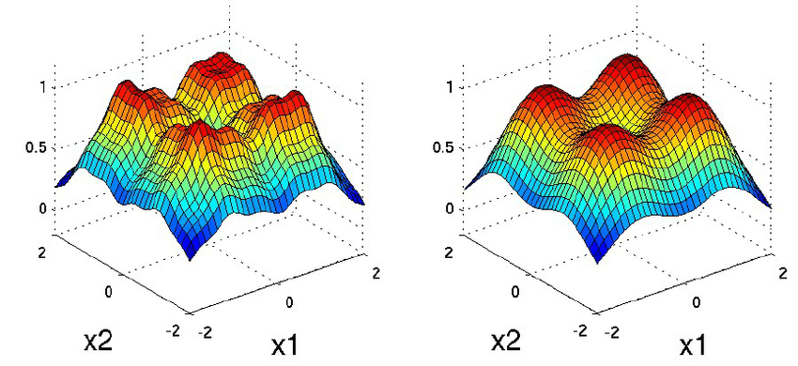

Why Bayesian Optimization?
Optimization: finding the maximum/minimum of a function $f$
$$f: {(x}_{1},x_{2},…,x_{n})↦y$$
Traditional numerical optimization algorithms: Newton-Raphson, gradient descent, etc.
Bayesian optimization is a heuristic optimization approach that avoids making use of gradient information → suitable for black-box functions for which no gradient can be established
Notes:
Science => often optimization problems (there is a specific quantity or property that you want to optimize, and you have a number of parameters x1, x2,…,xn to finetune => all these parameters are independent dimensions of an n dimensional space, so f assigns a value to every point in that space)
Example: I want to optimize the yield of a reaction by adjusting the temperature and the solvent, or I want to optimize the hyperparameters of a machine learning model…
Many methods exist to numerically find the optimum of a function (Newton-Raphson, gradient descent), but these typically require many iterations/evaluations, and access to the gradient of the function => it does not work for black-box functions

Slide 4
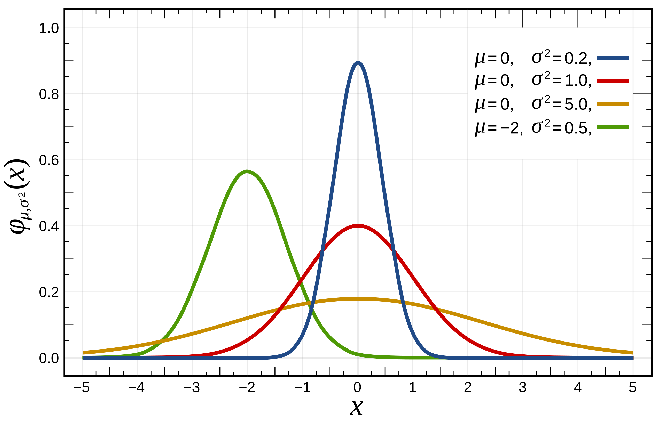

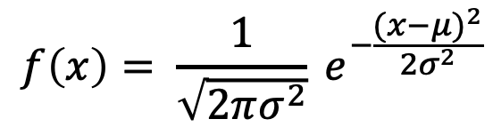
Preliminary concepts: Gaussian distribution
Gaussian distribution = normal distribution
A distribution is normal when its probability density function has the following shape:
$$f\left(x\right)= \frac{1}{\sqrt{2πσ^{2}}} e^{−\frac{{(x−μ)}^{2}}{2σ^{2}}}$$
When a variable X is normaly distributed, we write:
$$X\sim N(μ;σ^{2})$$
Notes:
Before we can start discussing what Bayesian optimization really entails, we first need to cover a couple of fundamental concepts => Gaussian/normal distributions
Mu is mean, sigma is standard deviation
Example of a normal distribution in practice: human height (if you take a sample of many French men or women, and you measure each of them and make a barplot, then you are going to get a Gaussian curve)

Slide 5
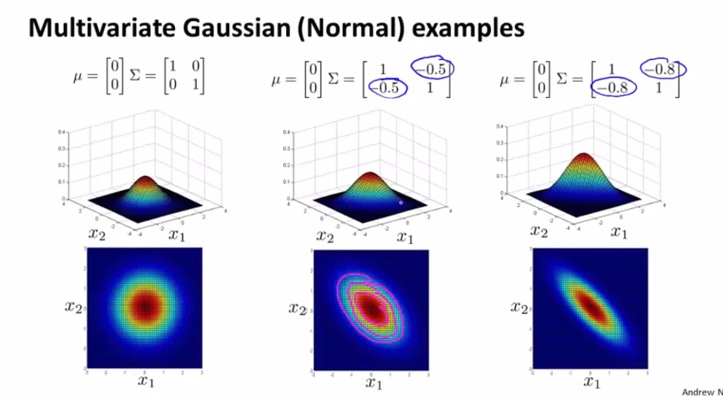
Preliminary concepts: multivariate Gaussian distribution
A multivariate Gaussian distribution is a generalization of the 1D normal distribution to multiple dimensions → we go from a normally distributed variable X to a normally distributed vector X:
$$X\sim N\left(μ;Σ^{2}\right);μ∈ℝ^{n} \& Σ∈ℝ^{n x n}$$
Every component of X, needs to be a normally distributed variable, and individual components can (or cannot) be correlated (strongly)
Notes:
Mu is the mean vector and sigma is the covariance matrix
Example of variables without significant covariance: length & IQ (both short and tall people can be either smart or dumb -> independent variables; knowledge about one doesn’t tell me anything about the other)
Example of variables with significant covariance: length & shoe size (someone who is tall is likely to also have a big shoe size; someone short is likely to have a small shoe size -> both variables in isolation are normally distributed, but they are not independent)

Slide 6
Bayesian Optimization in a nutshell
In BO, we assume we can evaluate the function $f$ (NOT its gradient or Hessian) at any point x, i.e., given x, we can obtain $f$(x)
Instead of finding the best x given $f$, we try to figure out the best model of $f$ given its evaluation at the previously observed points {x₁, x₂, …, x_{n}}
y
x
Notes:
Example: yield => I can evaluate for a series of reaction conditions the yield, but I don’t know what happens if I perturb one of the variables
We know the function passes through the points previously evaluated, but how does the function look like? You could come up with many plausible functions…
Let’s focus on a 1D input space for a moment, and imagine 4 points for which the function has been evaluated so far. There are multiple functions that I can fit through these points -> which one is the correct one?

Slide 7
Bayesian Optimization in a nutshell
In BO, we assume we can evaluate the function $f$ (NOT the gradient or Hessian) at any point x, i.e., given x, we can obtain $f$(x)
Instead of finding the best x given $f$, we try to figure out the best model of $f$ given its evaluation at the previously observed points {x₁, x₂, …, x_{n}}
y
x
Notes:
With current info => no way to know which one is most probable
But imagine I do an additional measurement: new point falls straight on the purple curve -> I think you would all intuitively agree that among the 3 options I drew, the odds that the purple one is the correct one will rise after this observation.
This gives conceptual sense about BO: we model a distribution of probable functions, conditioned on the datapoints we currently have at our disposal => this distribution = prior
Next, new points are selected for evaluation => function values enable us to discard some possible function & update function distribution => posterior
Extremely dumbed down, but this is core idea BO => based on current knowledge, you construct distributions of functions => you do a measurement => update distribution to reflect new knowledge

Slide 8
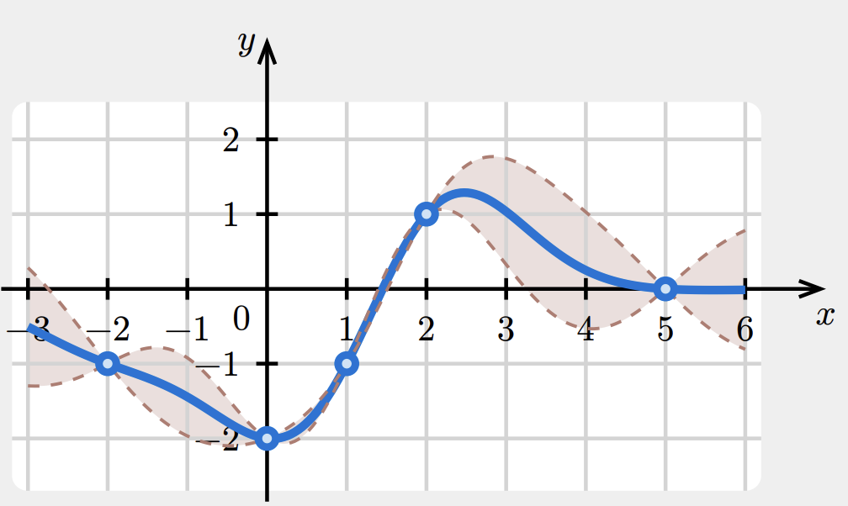
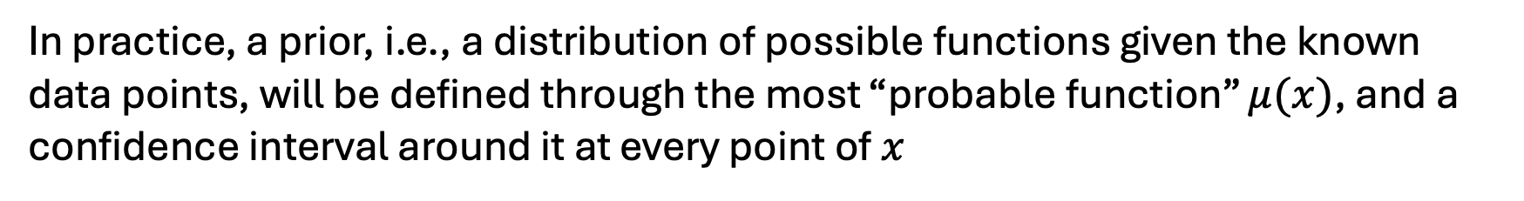
Bayesian Optimization in a nutshell
In practice, a prior, i.e., a distribution of possible functions given the known data points, will be defined through the most “probable function” $μ(x)$, and a confidence interval around it at every point of $x$
Based on this information, we select which point(s) to query next => results in posterior distribution of possible functions
Notes:
Then you get a picture like this one in 1D => 5 points computed/evaluated for f, with current minimum at -2 and maximum at +1
Based on this distribution => blue function most probable; confidence interval around it shaded in brown (cut-off taken at 1 SD around mean)
brown area: gives the distribution of the expected outcome of a new measurment at any given value of x => close to the previously measured points, the confidence interval is very narrow (measured value is likely going to be very similar to the point you already evaluated)
As you move further away between two points, the uncertainty becomes bigger => bigger shifts become possible
If you want to find the optimum of this function, you preferably evaluate it at a point where you stand a high chance of improving on the current maximum/minimum!

Slide 9
Bayesian Optimization cycle
new measurements
{x_{j}, f(x_{j})}
?
previous measurements
{x_{i}, f(x_{i})}
function distribution:
prior
Updated function distribution:
posterior
Notes:
Conceptually, this is what happens: previous experiments inform setting of the prior => prior informs new meaurements (you want to evaluate at points with likely maximum value for f => new measurements inform posterior
Now how do we do all this in practice? How do we define the most probable function and the confidence interval??? For that we need to introduce some more mathematical background

Slide 10
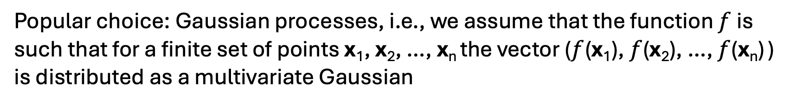
Gaussian processes and regression
To construct the distribution of likely functions based on the previously performed experiments, we need to make use of a machine learning model
Popular choice: Gaussian processes, i.e., we assume that the function $f$ is such that for a finite set of points x₁, x₂, …, x_{n} the vector ($f$(x₁), $f$(x₂), …, $f$(x_{n}) ) is distributed as a multivariate Gaussian
In other words, we assume that the function value in every (possible) evaluation point x is normally distributed, and the normal distributions between individual evaluation points can either be strongly or poorly correlated
Notes:
New measurements => will also exhibit correlation with the outcome of my preceding measurements => I need to estimate to what extent there will be correlation
Intuitive: adjacent to previous measurement, I assume almost perfect correlation => new experiment is expected to give almost same result; the further away from previous measurements, the more uncertain I get => this is also reflected in plot

Slide 11

Gaussian processes and regression
So, a Gaussian process is completely defined by the following two quantities
The mean function $m(x)$, assigning to each $x$ the expected value $𝔼\left[f(x)\right]$
The covariance function $K(x_{i},x_{j})$, assigning to each pair of points$x_{i},x_{j}$ the covariance (or correlation) between $f(x_{i})$and$f(x_{j})$
The covariance function $K(x_{i},x_{j})$ is also called the kernel of the Gaussian process → the radial basis function (RBF) kernel is a common choice:
$$K\left(x_{i},x_{j}\right)≔k∗e^{−\frac{{\left\|x_{i}−x_{j}\right\|}_{ }^{2}}{2σ^{2}}}$$
Notes:
Choice of kernel => not set in stone, but should be sensible: close points should correlate with each other (i.e., K should be big) & far away, points should not (i.e., K should be small) + we want some flexibility in the kernel, i.e., we want it to contain some parameters, so that it can be fit based on the data (more specifically, we want to be able to finetune at which point we consider points to be far away…)
The RBF function fulfills these criteria => there is a dependence on the distance between the two points, and I have 2 parameters (k and sigma) which determine how the covariance behaves
You may recognize shape: corresponds again to a Gaussian function
k = variance; sigma = lengthscale

Slide 12
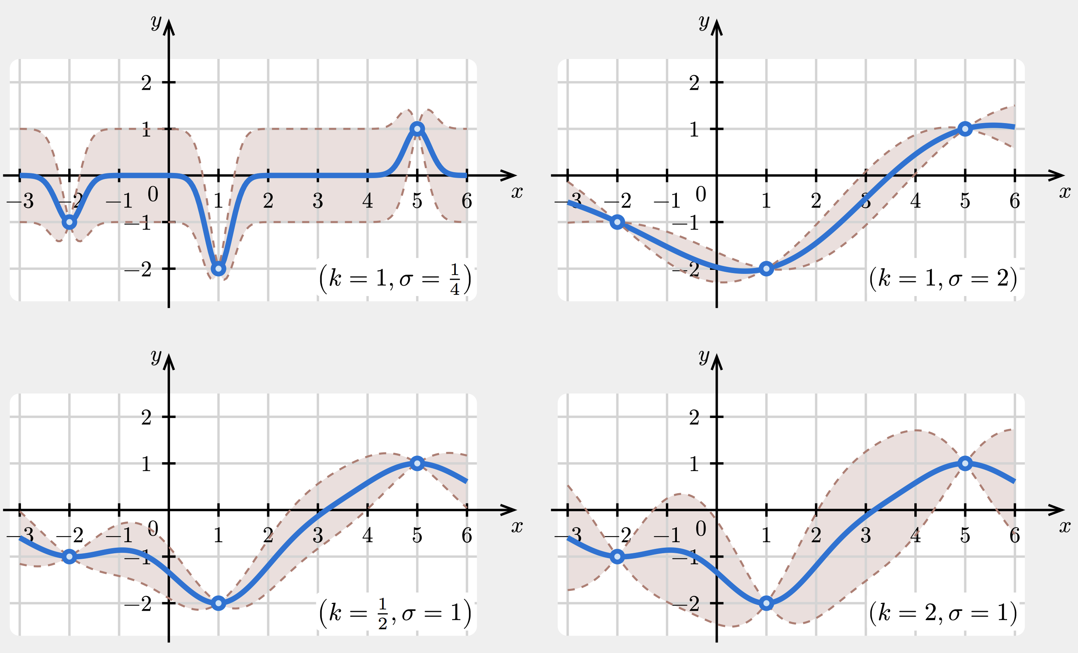
Covariance functions
What is the influence of the parameters in the RBF kernel?
Notes:
k indicates the intrinsic magnitude of the confidence interval; sigma indicates the lengthscale at which the covariance changes
To give you some intuition: 4 scenarios
k big, sigma small => far away from previous measurements: fast increase of uncertainty to maximal value
k big, sigma big => high values can be reached, but only far away from previous measurements
k small, sigma big => low values can be reached, but only far away from previous measurements
k small, sigma small => low values can be reached, but they are reached rapidly
As a side-note, how do we finetune these parameters on the previously determined data points?
-> If the target values y for my measured points change only gradually, i.e., the previous measurements appear highly correlated, then it likely makes sense to assume that future points will also behave this way -> k will be small and sigma big.
if however my previously measured points result in y values that swing widely back and forth, then you likely want k to be big and sigma small
Typically this will be algorithmically optimized!!

Slide 13
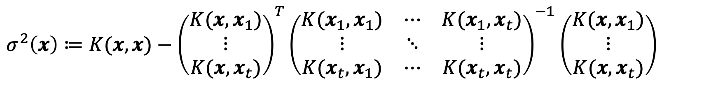
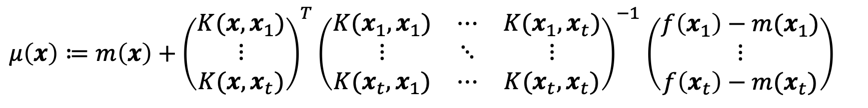
Defining the prior
With the help of the covariance function, we can define the conditional distribution of $f(x)$for any $x$ (NO PROOF):
$μ\left(x\right)≔m\left(x\right)+{\left(\begin{matrix}K(x,x_{1}) \\ ⋮ \\ K(x,x_{t})\end{matrix}\right)}^{T}{\left(\begin{matrix}K(x_{1},x_{1}) & ⋯ & K(x_{1},x_{t}) \\ ⋮ & ⋱ & ⋮ \\ K(x_{t},x_{1}) & ⋯ & K(x_{t},x_{t})\end{matrix}\right)}^{−1}$ $\left(\begin{matrix}f\left(x_{1}\right)−m(x_{1}) \\ ⋮ \\ f\left(x_{t}\right)−m(x_{t})\end{matrix}\right)$
$σ^{2}\left(x\right)≔K(x,x)−{\left(\begin{matrix}K(x,x_{1}) \\ ⋮ \\ K(x,x_{t})\end{matrix}\right)}^{T}{\left(\begin{matrix}K(x_{1},x_{1}) & ⋯ & K(x_{1},x_{t}) \\ ⋮ & ⋱ & ⋮ \\ K(x_{t},x_{1}) & ⋯ & K(x_{t},x_{t})\end{matrix}\right)}^{−1}$ $\left(\begin{matrix}K(x,x_{1}) \\ ⋮ \\ K(x,x_{t})\end{matrix}\right)$

Slide 14
Defining the prior
Notes:
These expressions look very complex! But we can demonstrate straightforwardly that they give rise to the kind of images shown a couple of slides ago

Slide 15
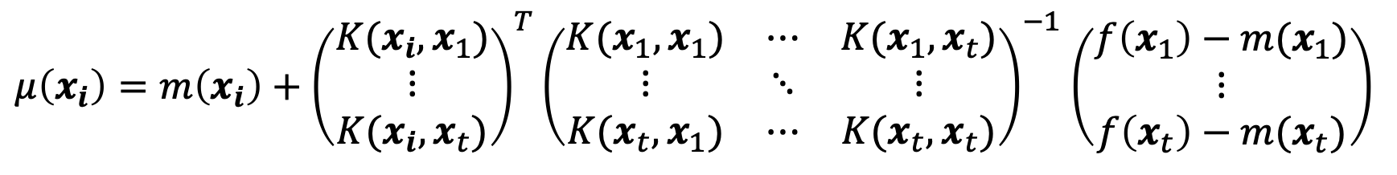
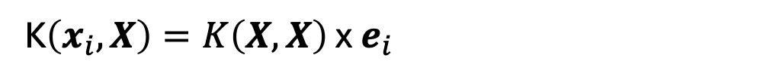
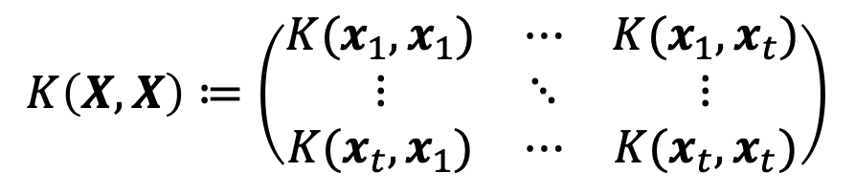
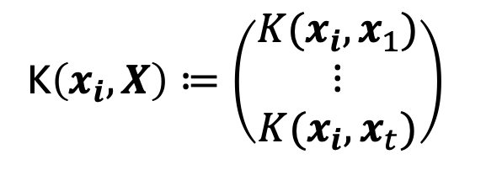
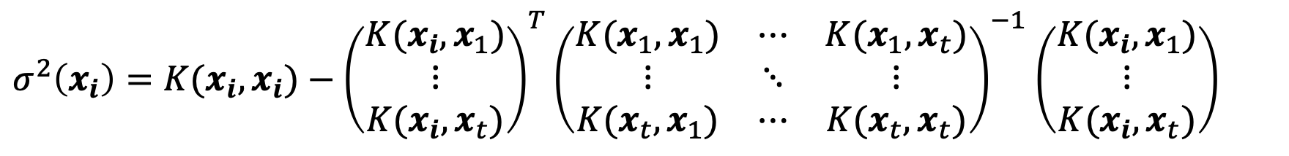
Defining the prior
For any observed datapoint $x_{i}$, $μ\left(x_{i}\right)$=$f\left(x_{i}\right)$ and $σ^{2}\left(x_{i}\right)$=0
$μ\left(x_{i}\right)=m\left(x_{i}\right)+{\left(\begin{matrix}K(x_{i},x_{1}) \\ ⋮ \\ K(x_{i},x_{t})\end{matrix}\right)}^{T}{\left(\begin{matrix}K(x_{1},x_{1}) & ⋯ & K(x_{1},x_{t}) \\ ⋮ & ⋱ & ⋮ \\ K(x_{t},x_{1}) & ⋯ & K(x_{t},x_{t})\end{matrix}\right)}^{−1}$ $\left(\begin{matrix}f\left(x_{1}\right)−m(x_{1}) \\ ⋮ \\ f\left(x_{t}\right)−m(x_{t})\end{matrix}\right)$
$σ^{2}\left(x_{i}\right)=K(x_{i},x_{i})−{\left(\begin{matrix}K(x_{i},x_{1}) \\ ⋮ \\ K(x_{i},x_{t})\end{matrix}\right)}^{T}{\left(\begin{matrix}K(x_{1},x_{1}) & ⋯ & K(x_{1},x_{t}) \\ ⋮ & ⋱ & ⋮ \\ K(x_{t},x_{1}) & ⋯ & K(x_{t},x_{t})\end{matrix}\right)}^{−1}$ $\left(\begin{matrix}K(x_{i},x_{1}) \\ ⋮ \\ K(x_{i},x_{t})\end{matrix}\right)$
To simplify notation, let’s define:
K$\left(x_{i},X\right)≔\left(\begin{matrix}K(x_{i},x_{1}) \\ ⋮ \\ K(x_{i},x_{t})\end{matrix}\right)$
$$K\left(X,X\right)≔\left(\begin{matrix}K(x_{1},x_{1}) & ⋯ & K(x_{1},x_{t}) \\ ⋮ & ⋱ & ⋮ \\ K(x_{t},x_{1}) & ⋯ & K(x_{t},x_{t})\end{matrix}\right)$$
Furthermore, if we define $e_{i}∈ℝ^{n}$ as the i^{th} indicator vector:
K$\left(x_{i},X\right)=K\left(X,X\right)$ x $e_{i}$
Notes:
More specifically, we will prove the following statement

Slide 16
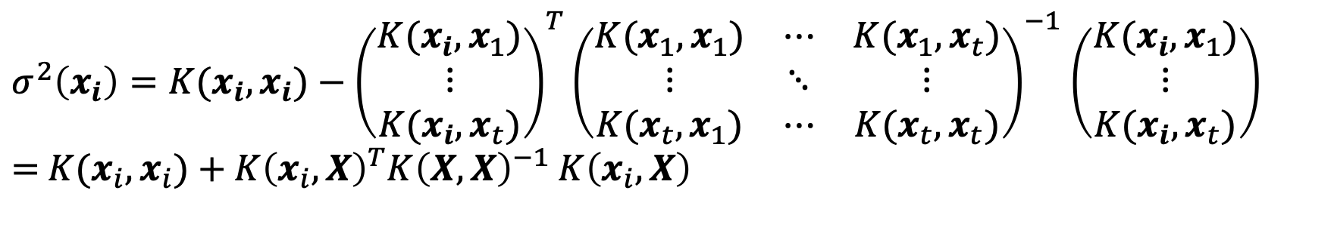
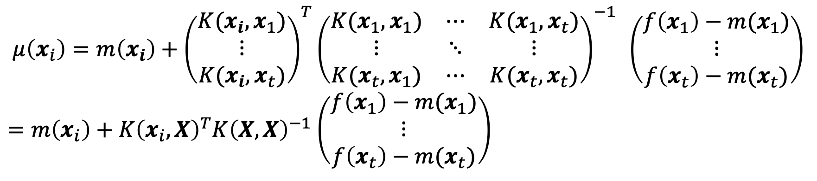
Defining the prior
For any observed datapoint $x_{i}$, $μ\left(x_{i}\right)$=$f\left(x_{i}\right)$ and $σ^{2}\left(x_{i}\right)$=0
After simplification, we get:
$$μ\left(x_{i}\right)=m\left(x_{i}\right)+{\left(\begin{matrix}K(x_{i},x_{1}) \\ ⋮ \\ K(x_{i},x_{t})\end{matrix}\right)}^{T}{\left(\begin{matrix}K(x_{1},x_{1}) & ⋯ & K(x_{1},x_{t}) \\ ⋮ & ⋱ & ⋮ \\ K(x_{t},x_{1}) & ⋯ & K(x_{t},x_{t})\end{matrix}\right)}^{−1} \left(\begin{matrix}f\left(x_{1}\right)−m(x_{1}) \\ ⋮ \\ f\left(x_{t}\right)−m(x_{t})\end{matrix}\right)$$
$=m\left(x_{i}\right)+{K\left(x_{i},X\right)}^{T}{K\left(X,X\right)}^{−1}$ $\left(\begin{matrix}f\left(x_{1}\right)−m(x_{1}) \\ ⋮ \\ f\left(x_{t}\right)−m(x_{t})\end{matrix}\right)$
$σ^{2}\left(x_{i}\right)=K(x_{i},x_{i})−{\left(\begin{matrix}K(x_{i},x_{1}) \\ ⋮ \\ K(x_{i},x_{t})\end{matrix}\right)}^{T}{\left(\begin{matrix}K(x_{1},x_{1}) & ⋯ & K(x_{1},x_{t}) \\ ⋮ & ⋱ & ⋮ \\ K(x_{t},x_{1}) & ⋯ & K(x_{t},x_{t})\end{matrix}\right)}^{−1}$ $\left(\begin{matrix}K(x_{i},x_{1}) \\ ⋮ \\ K(x_{i},x_{t})\end{matrix}\right)$
$=$ $K(x_{i},x_{i})+{K\left(x_{i},X\right)}^{T}{K\left(X,X\right)}^{−1}$ $K\left(x_{i},X\right)$
Notes:
More specifically, we will prove the following statement

Slide 17
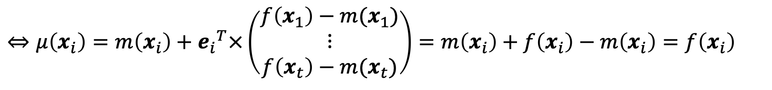
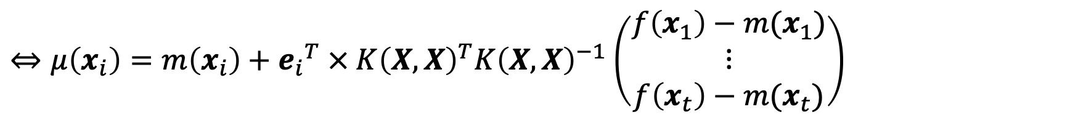
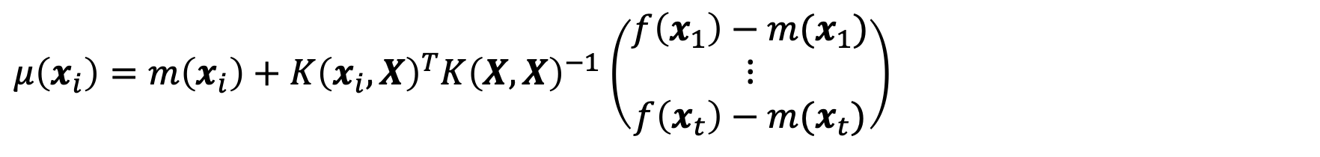
Defining the prior
Pr$oof that μ\left(x_{i}\right)=$ $f\left(x_{i}\right)$:
$μ\left(x_{i}\right)=m\left(x_{i}\right)+{K\left(x_{i},X\right)}^{T}{K\left(X,X\right)}^{−1}$ $\left(\begin{matrix}f\left(x_{1}\right)−m(x_{1}) \\ ⋮ \\ f\left(x_{t}\right)−m(x_{t})\end{matrix}\right)$
$⇔μ\left(x_{i}\right)=m\left(x_{i}\right)+{e_{i}}^{T}{ × K\left(X,X\right)}^{T}{K\left(X,X\right)}^{−1}$ $\left(\begin{matrix}f\left(x_{1}\right)−m(x_{1}) \\ ⋮ \\ f\left(x_{t}\right)−m(x_{t})\end{matrix}\right)$
$⇔μ\left(x_{i}\right)=m\left(x_{i}\right)+{e_{i}}^{T}×\left(\begin{matrix}f\left(x_{1}\right)−m(x_{1}) \\ ⋮ \\ f\left(x_{t}\right)−m(x_{t})\end{matrix}\right)=m\left(x_{i}\right)+$ $f\left(x_{i}\right)−m\left(x_{i}\right)=f\left(x_{i}\right)$
Notes:
E_i^T => row vector with 1 value at index i, 0 in all other positions (different than 1^T from previous lectures)

Slide 18
Defining the prior
Similarly, we get for $σ^{2}(x_{i})$:
$σ^{2}\left(x_{i}\right)=K(x_{i},x_{i})+{K\left(x_{i},X\right)}^{T}{K\left(X,X\right)}^{−1}$ $K\left(x_{i},X\right)$
$⇔σ^{2}\left(x_{i}\right)=K\left(x_{i},x_{i}\right)+{e_{i}}^{T}× {K\left(X,X\right)}^{T}{K\left(X,X\right)}^{−1}$ $K\left(X,X\right) × e_{i}$
$$⇔σ^{2}\left(x_{i}\right)=K\left(x_{i},x_{i}\right)+{e_{i}}^{T}× K\left(X,X\right) × e_{i}=K\left(x_{i},x_{i}\right)−K\left(x_{i},x_{i}\right)=0$$
Notes:
As soon as you move away from a previously measured point, sigma will start deviating from 0 => brown shaded area

Slide 19
Bayesian Optimization cycle
Regression algorithm (Gaussian Processes) + covariance function (RBF)
new measurements
{x_{j}, f(x_{j})}
?
previous measurements
{x_{i}, f(x_{i})}
function distribution:
prior
Updated function distribution:
posterior
Notes:
Update => prior definition is informed also by algorithm (GP) + choice of variance function

Slide 20
Acquisition functions
Now, what policy do we use to decide which points to sample/acquire next?
Notes:
Previously, we discussed that if you want to find the optimum of this function, you preferably evaluate it at a point where you stand a high chance of improving on the current maximum/minimum.
How do turn this into an algorithmic selection?

Slide 21
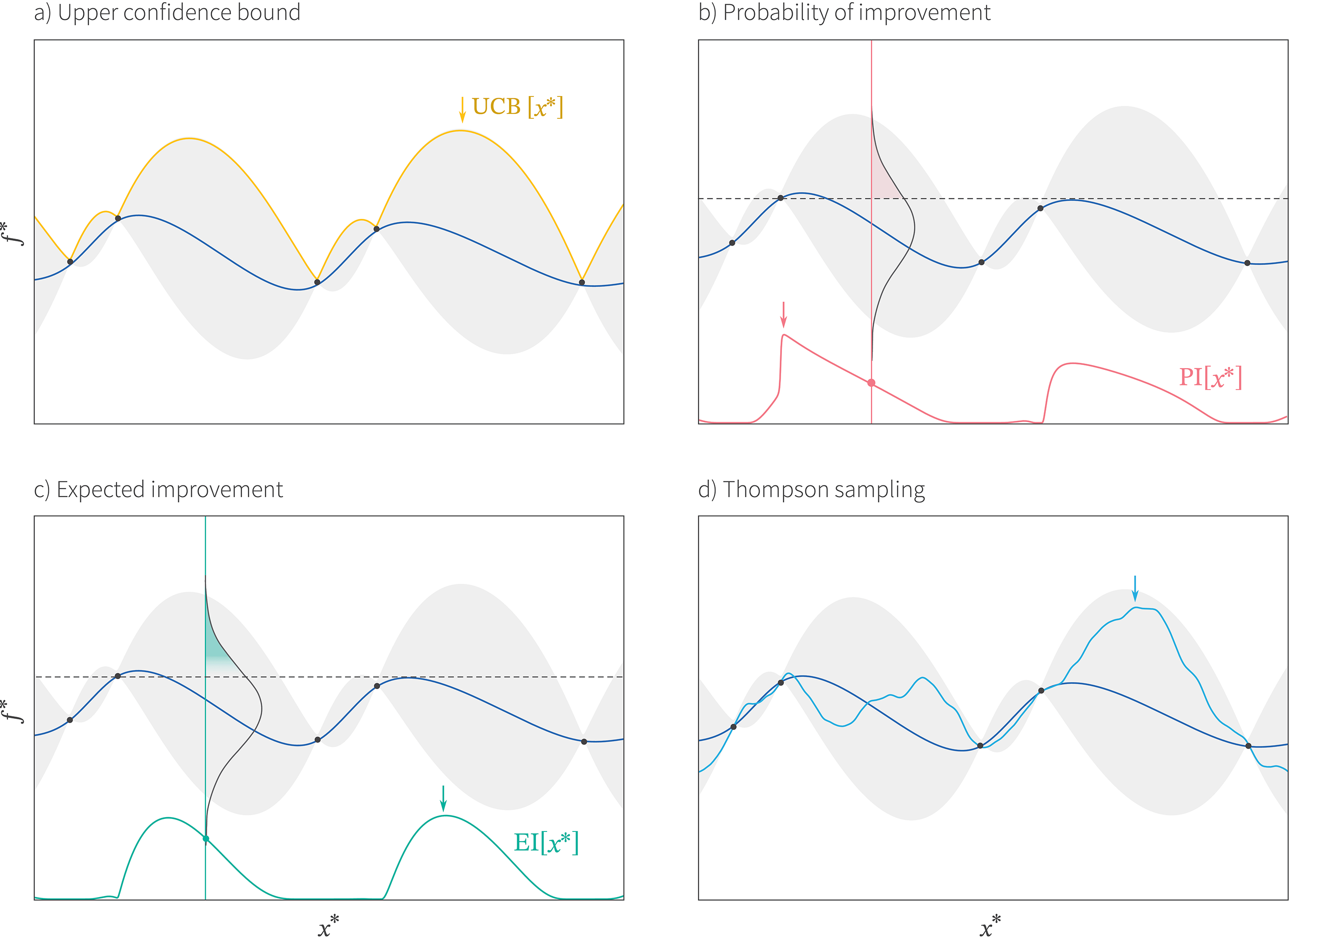
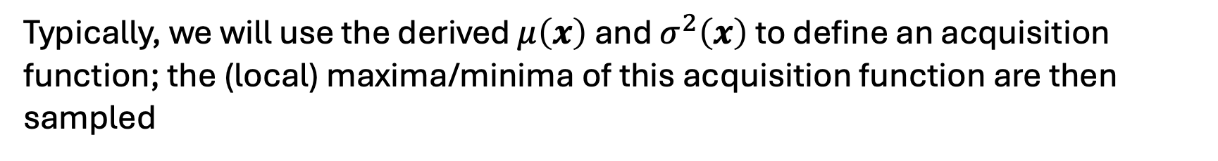
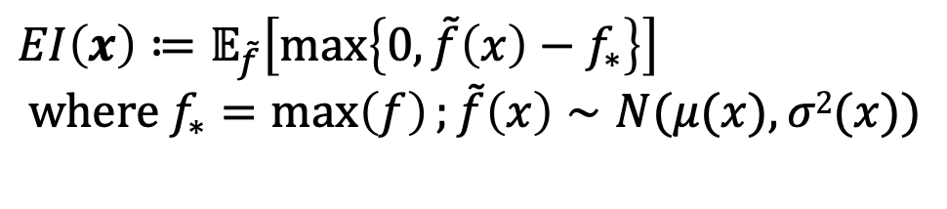
Acquisition functions
Typically, we will use the derived $μ\left(x\right)$ and $σ^{2}\left(x\right)$ to define an acquisition function; the (local) maxima/minima of this acquisition function are then sampled
Lower/Upper Confidence Bound (LCB/UCB):
$$UCB\left(x\right)≔μ\left(x\right)+β∗σ^{2}\left(x\right) where β≥0$$
Other types of acquisition functions have been
proposed over the years:
Expected Improvement (EI):
$$EI\left(x\right)≔𝔼_{\tilde{f}}\left[\max\left\{0, \tilde{f}\left(x\right)−f_{∗}\right\}\right]$$
$$where{ f}_{∗}=\max\left(f\right);\tilde{f}\left(x\right)∼N(μ(x),σ2(x))$$
Notes:
In practice, EI quantifies how much improvement over the current best observation $f_{∗}$ is expected on average at a candidate point $x$, given the predictive distribution of the Gaussian Process.
Correct interpretation of the equation: the Expected Improvement integrates the portion of the predictive distribution $\tilde{f}\left(x\right)$ that exceeds the current best value $f_{∗}$, weighing each possible improvement by how likely it is under the model’s uncertainty.
=> When at point x, the probability distribution to reach a value higher than f* is zero, then EI will be 0; if there is even a very small chance that the measurement at this point will yield a value higher than f*, then EI is not zero.

Slide 22
Bayesian Optimization cycle
Acquisition function
Regression algorithm (Gaussian Processes) + covariance function (RBF)
new measurements
{x_{j}, f(x_{j})}
previous measurements
{x_{i}, f(x_{i})}
function distribution:
prior
Updated function distribution:
posterior
Notes:
If you understand this scheme in full, then you have a pretty good sense what BO is about

Slide 23
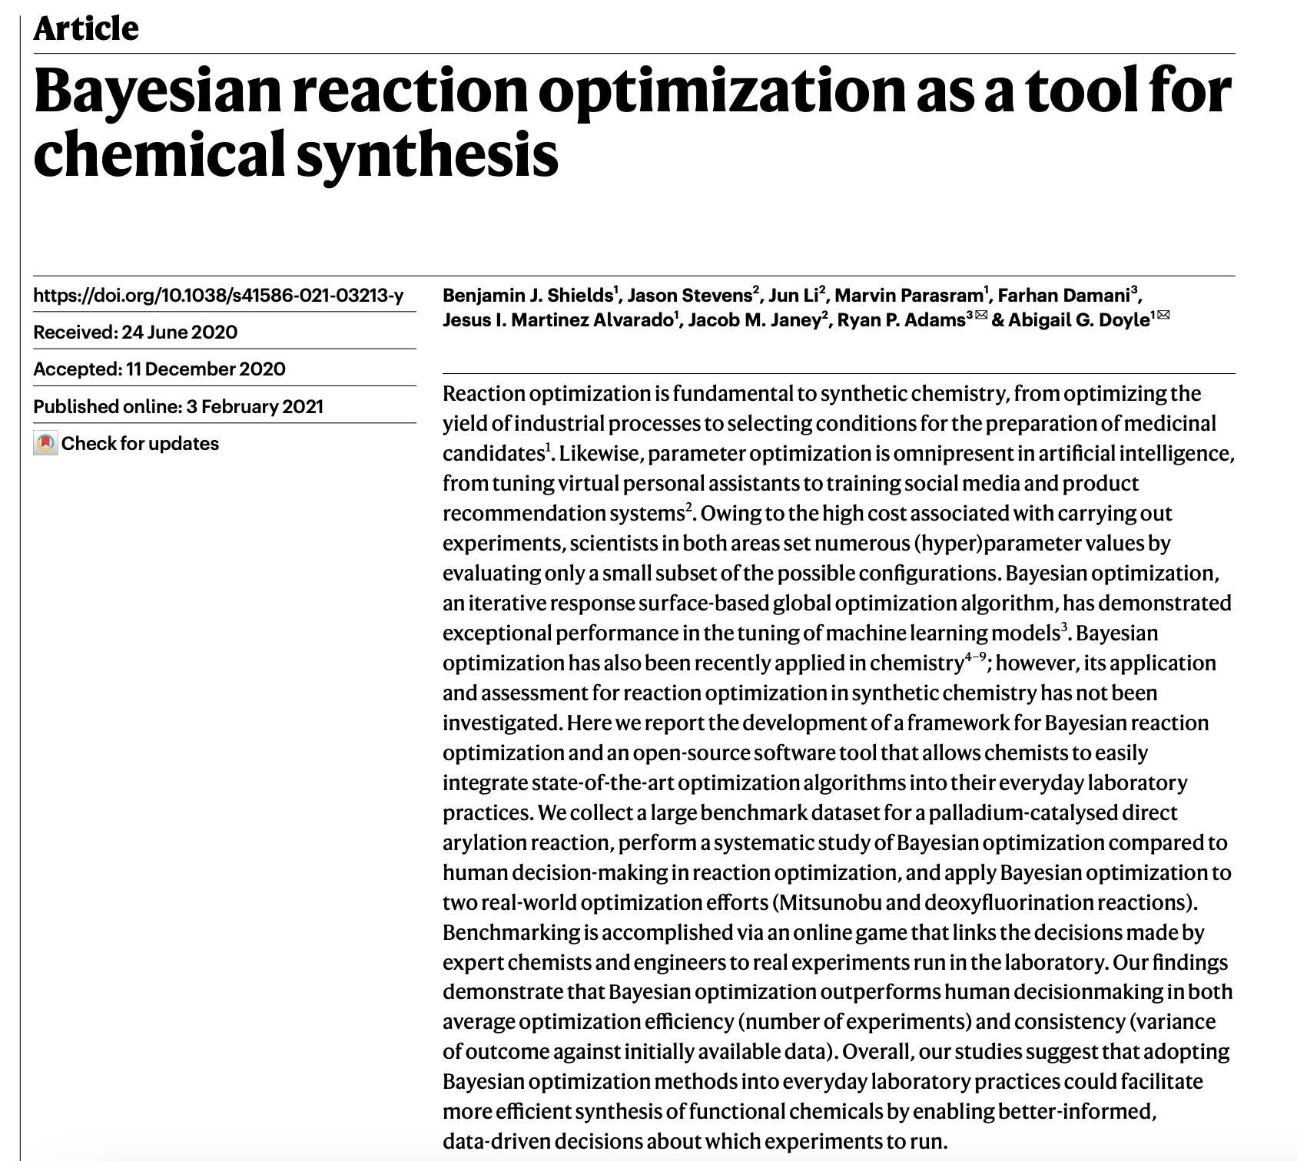
Applications
Notes:
Applications in medicinal chemistry => two pioneering papers in the field
First one: nature paper from a couple of years ago =>authors demonstrated that BO outperforms human decision making when trying to optimize the yield of chemical reactions

Slide 24
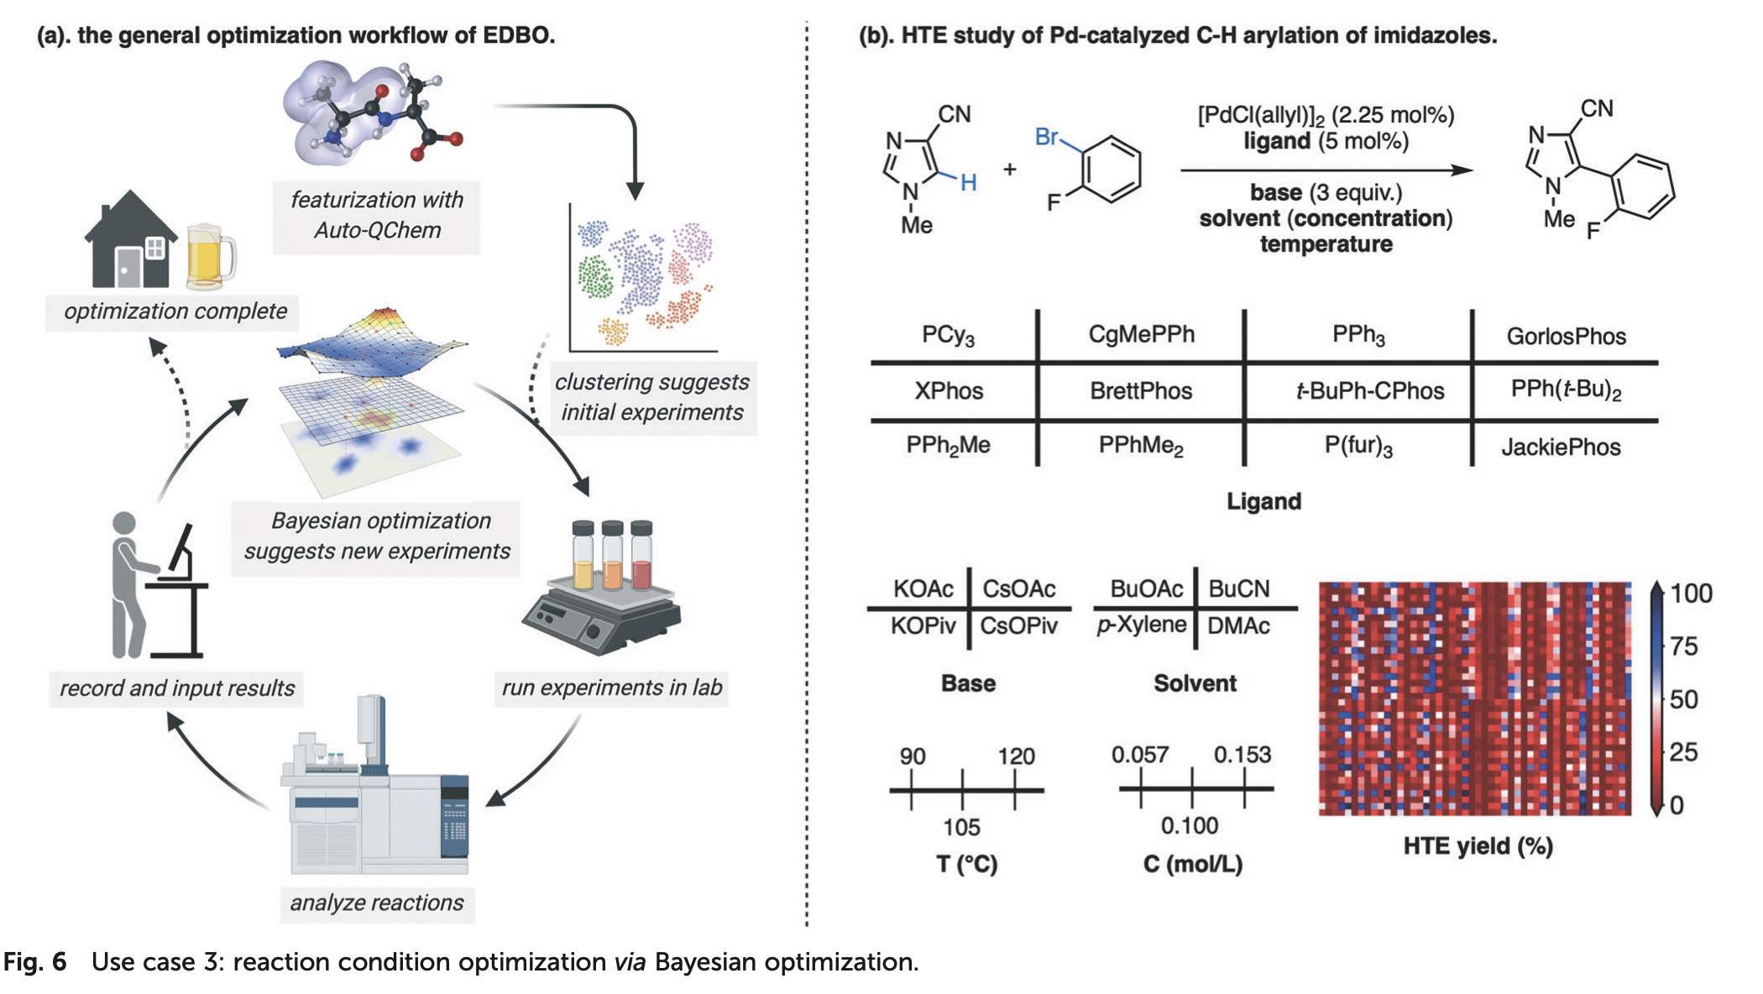
Applications
Problem: many of the variables (ligand, base, solvent) are categorical; how do I define distances between the different options, so that I can define a covariance function for them?
Notes:
Multiple variables => x is now no longer 1D, but a point in an N dimensional space
Beyond the scope of this lecture: in principle you can learn distinct lengthscales, i.e., distances over which decoherence sets in, for different variables
Regardless, traditionally: one-hot encoding for all options for a given variable => is not a good idea because all options are equidistant then
=> I cannot distinguish between “chemically similar” and “chemically distinct” options => covariance function cannot be finetuned

Slide 25
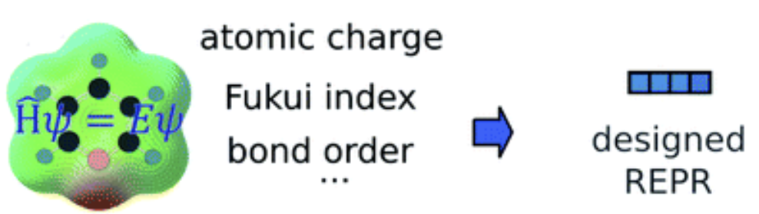
Applications
Problem: many of the variables (ligand, base, solvent) are categorical; how do I define distances between the different options, so that I can define a covariance function for them?
→ solution: common encoding, for example by computing DFT descriptors for each option (gives a position to each in chemical space, and distances become meaningful)
Notes:
e.g., I represent the solvent by its dielectric constant => polar solvents are likely to behave similarly, apolar solvents will be different
Works especially well when you have 100s or 1000s of possibilities (e.g., ligand options for Pd catalyst).

Slide 26
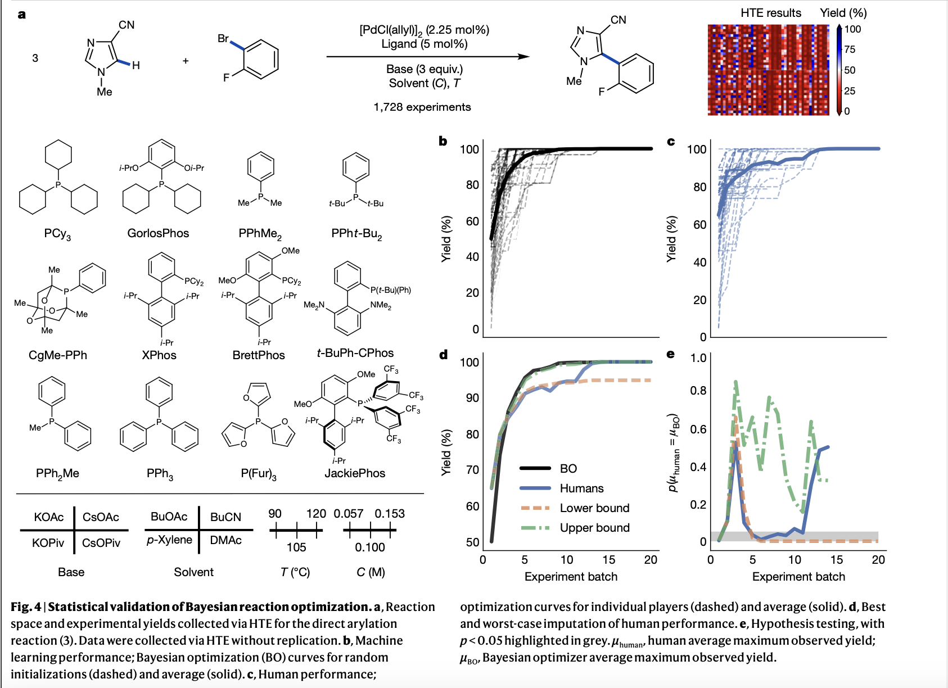
Applications
Notes:
Explain game

Slide 27
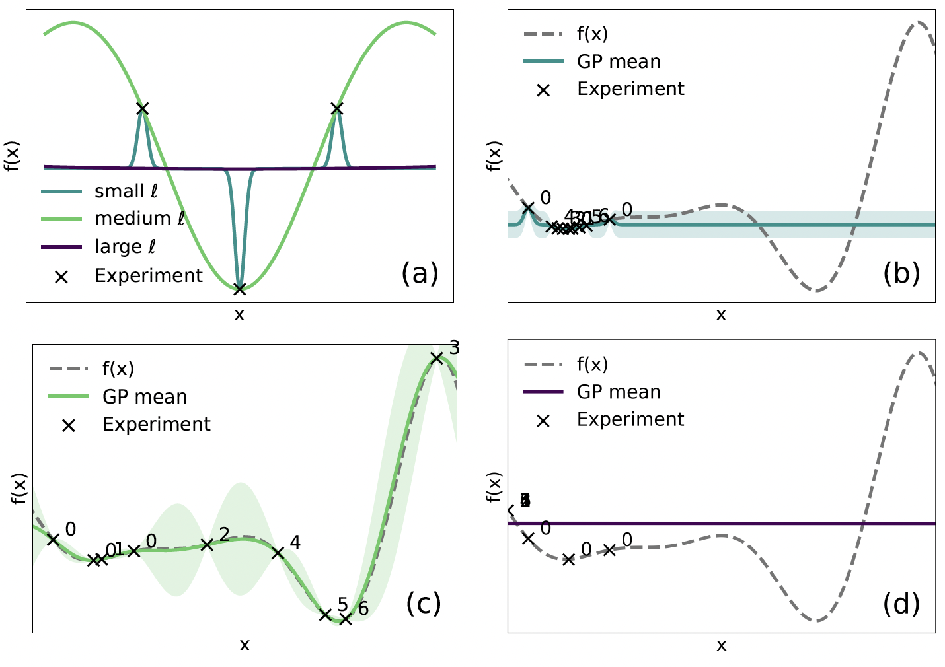
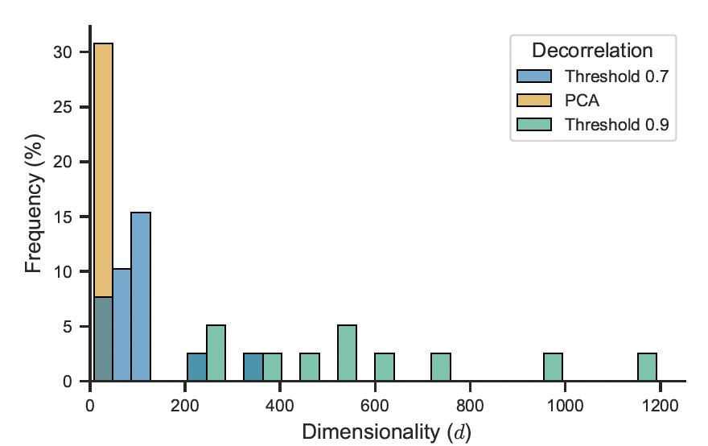
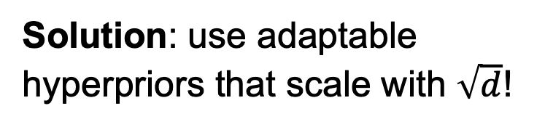
Leveraging hidden-space representations in BO
How to define similarity between chemical options in the BO search space?
Solution: use adaptable hyperpriors that scale with $\sqrt{d}$!

Slide 28
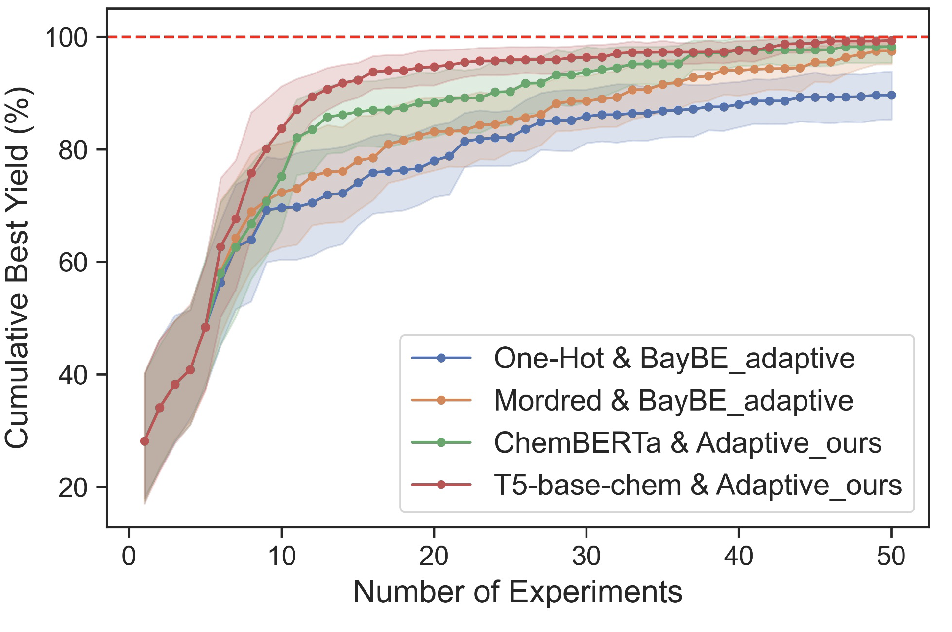
Leveraging hidden-space representations in BO

Slide 29
Further reading
https://www.mit.edu/~gfarina/2024/67220s24_L16_bayesian_optimization/L16.pdf
https://pubs.rsc.org/en/content/articlehtml/2021/sc/d0sc06805e
https://chemrxiv.org/doi/abs/10.26434/chemrxiv.10001986/v1

