Slide 1
Example System Design
John Valentino

Slide 2
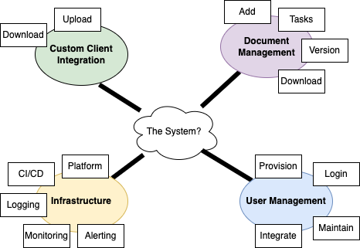
Highest-Level System Needs

Slide 3
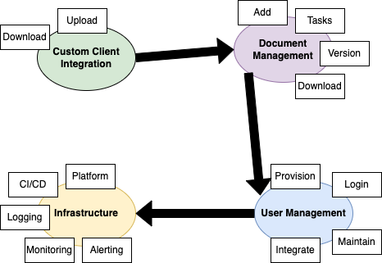
“Need” Dependencies

Slide 4
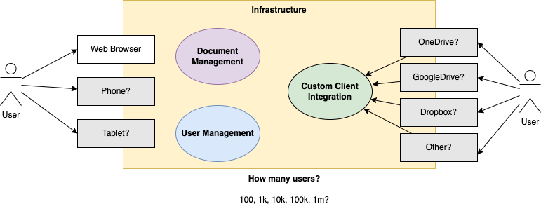
User Interface Perspective

Slide 5
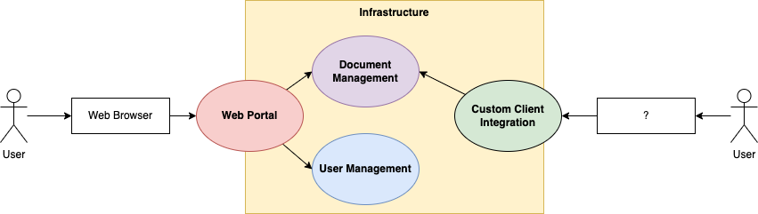
MVP

Slide 6
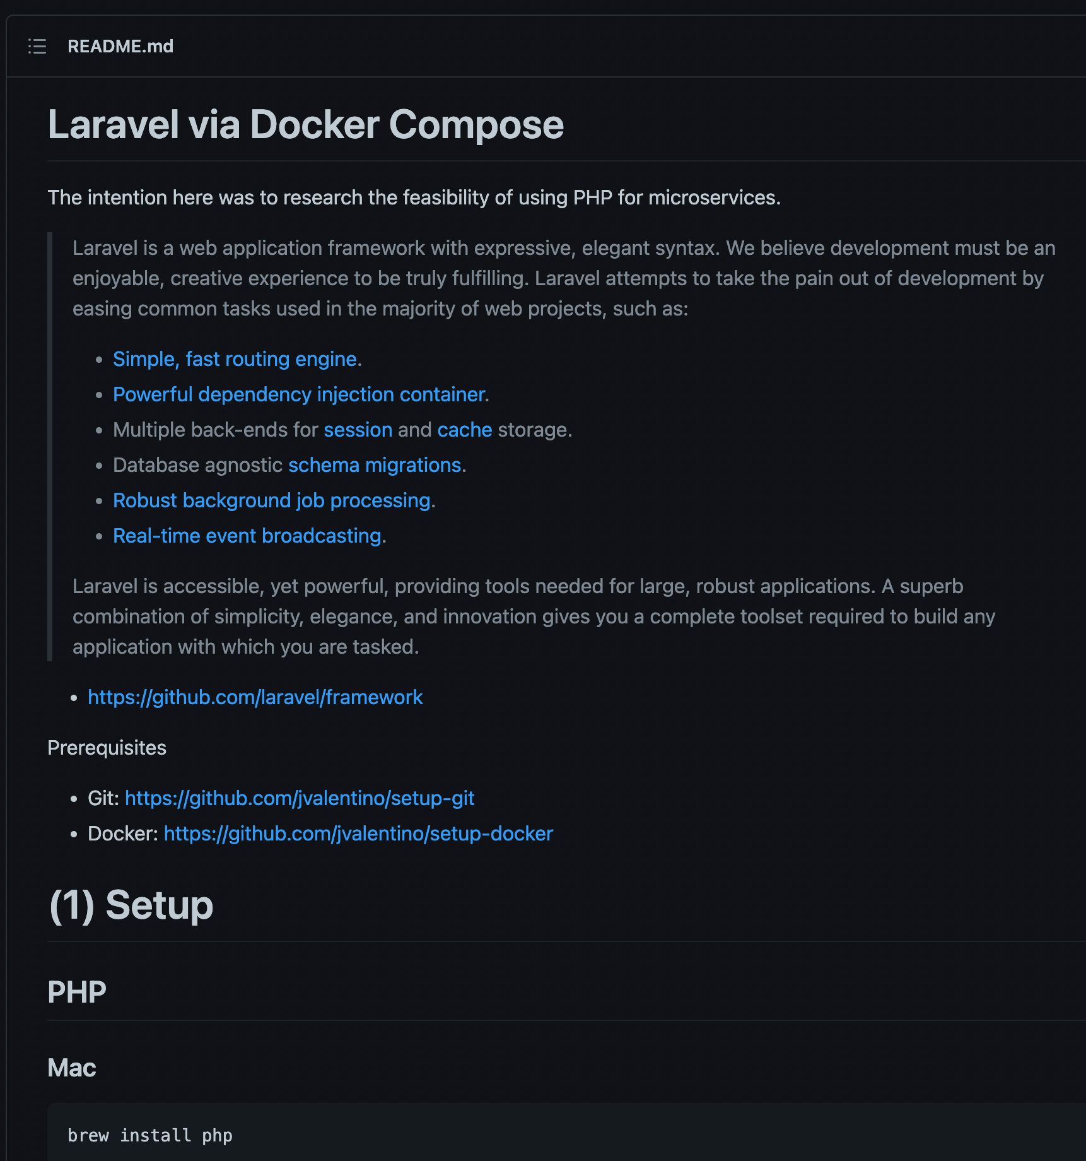
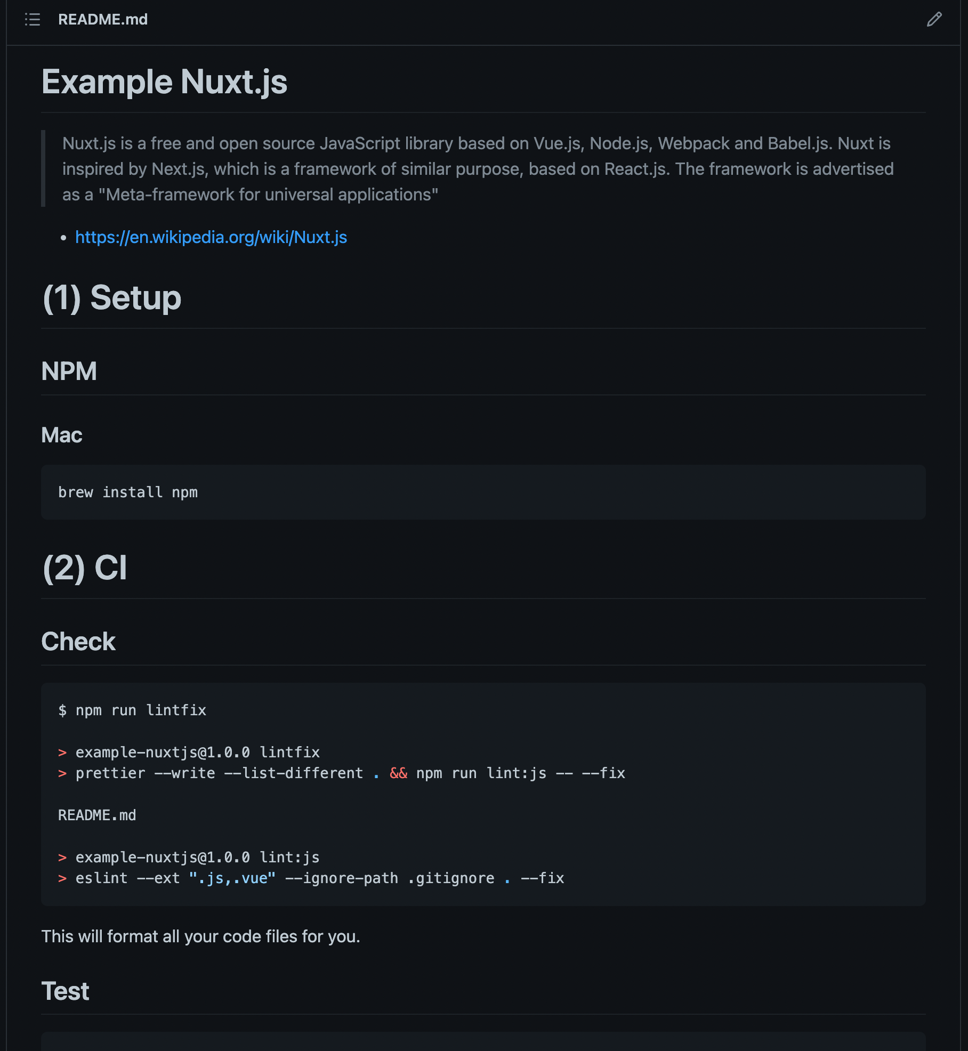
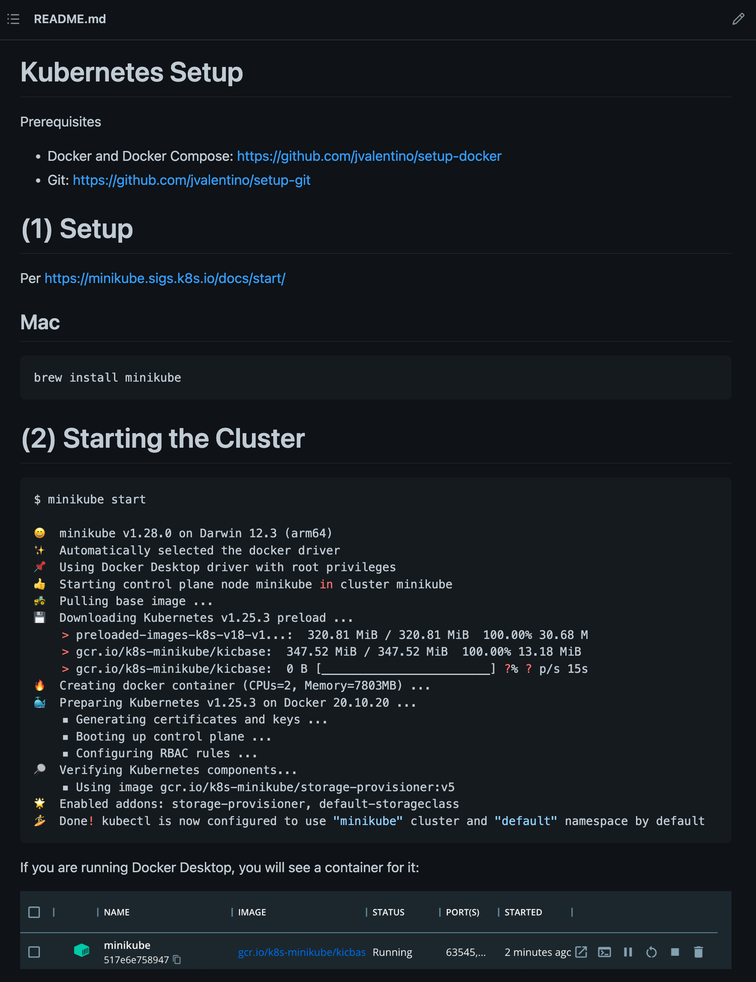
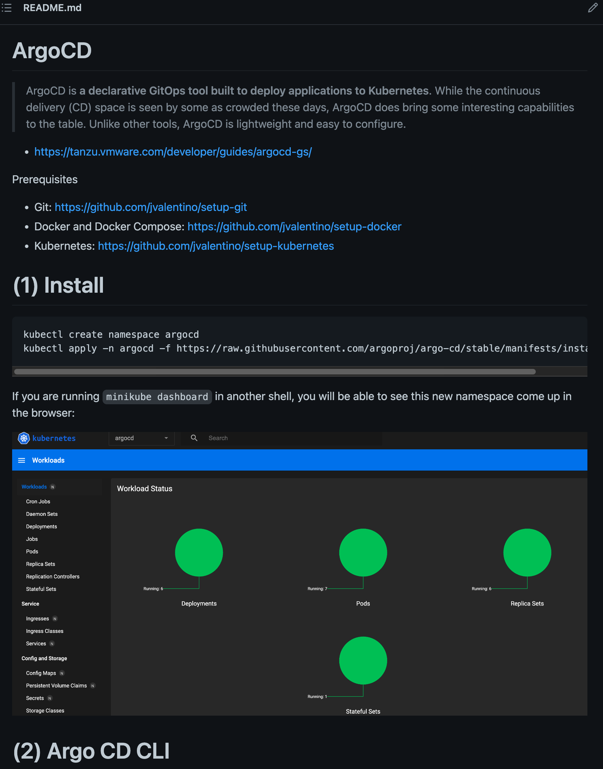
Constraints/Preferences
https://github.com/jvalentino/example-docker-laravel
https://github.com/jvalentino/example-nuxtjs
https://github.com/jvalentino/setup-kubernetes
https://github.com/jvalentino/setup-argocd

Slide 7
Architectural & Design Principles
Domain Driven Design
Microservices
High Availability
Fault Tolerant
Defense in Depth
Backend for Frontend
Cloud First
Contract Driven Development (Swagger)

Slide 8
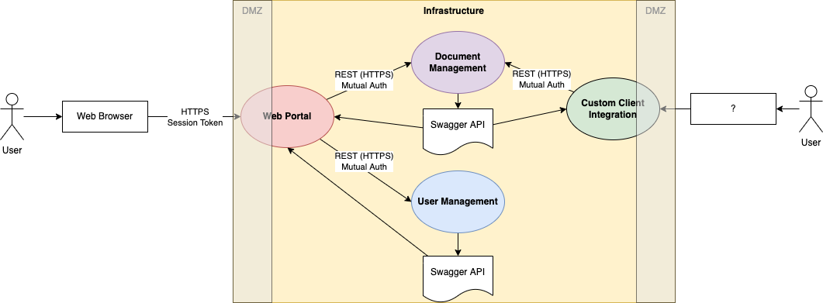
Contracts and Paths of Communication

Slide 9
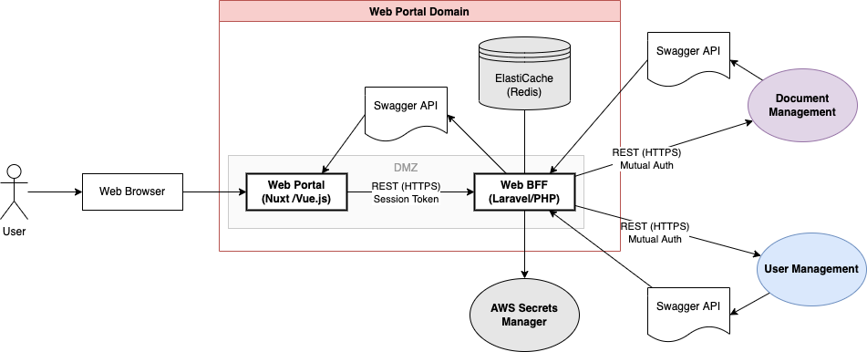
Domain: Web Portal

Slide 10
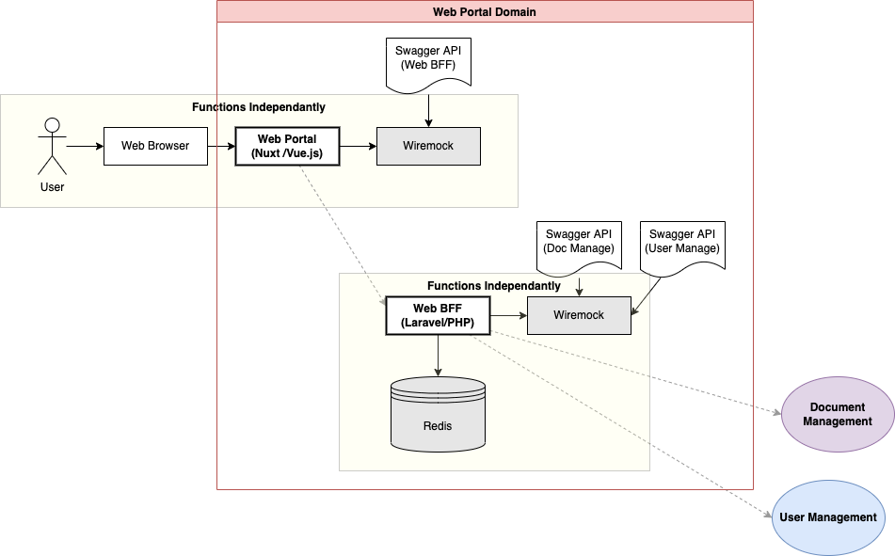
Web Portal: Dev/Test in Isolation

Slide 11
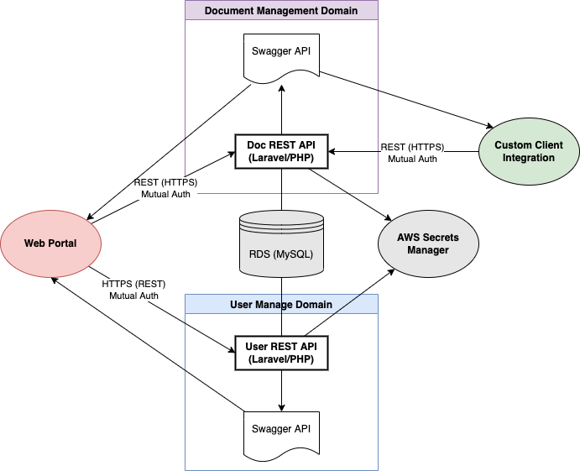
Domains: User and Document

Slide 12
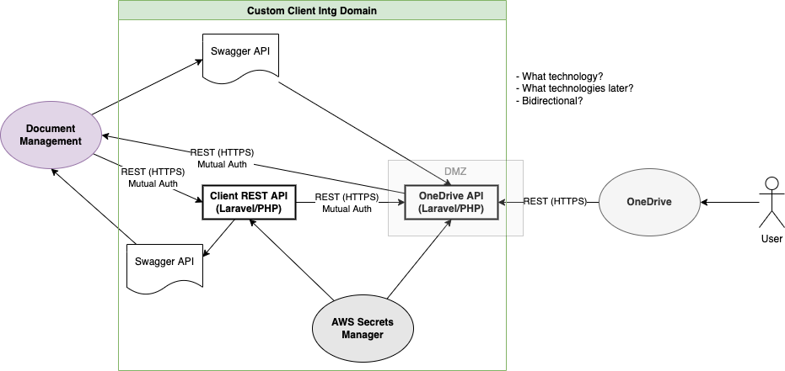
Domain: Custom Client Integration

Slide 13
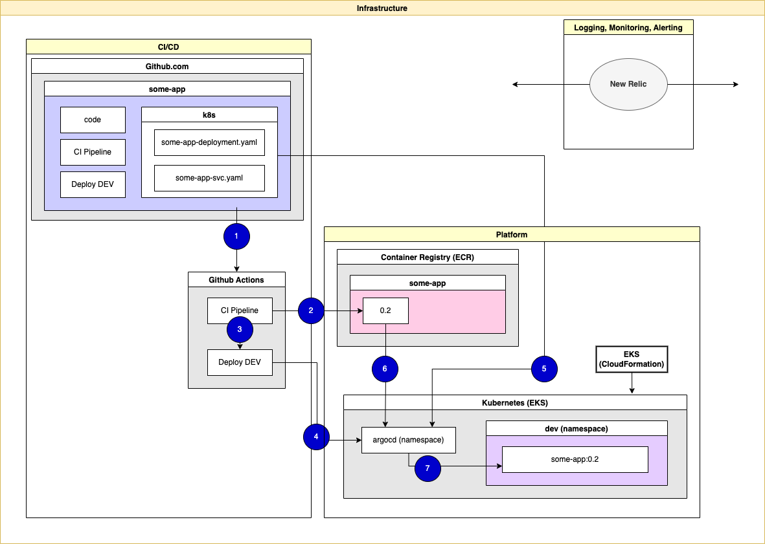
Domain: Infrastructure

Slide 14
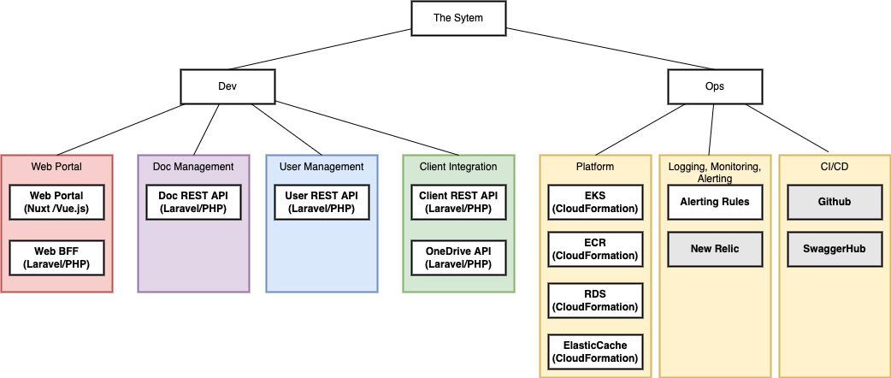
Product Taxonomy

Slide 15
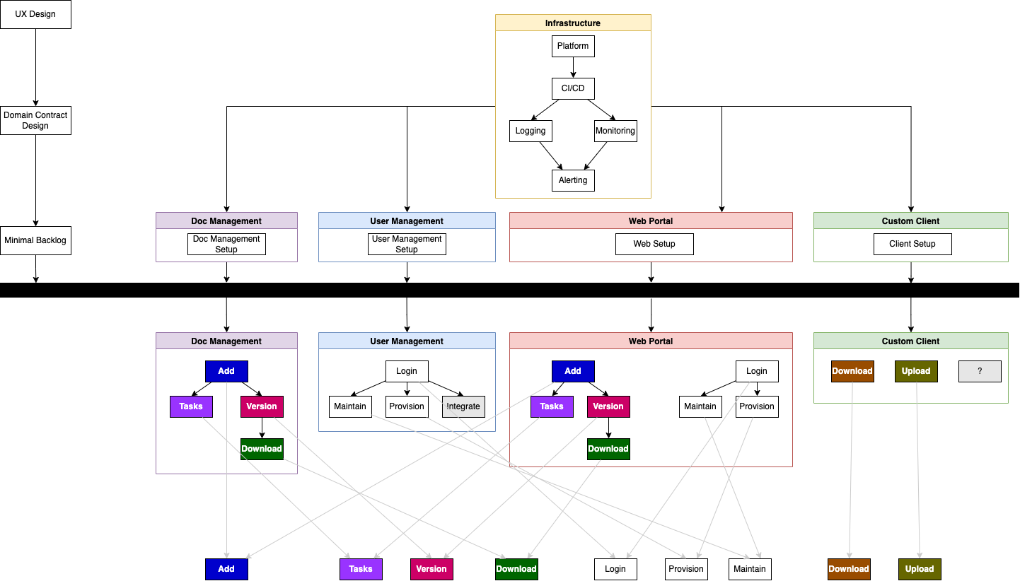
Feature & Activity Flow

Slide 16
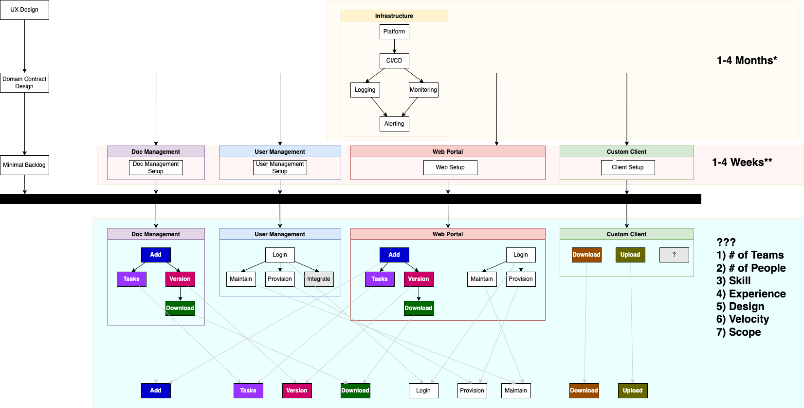
Timeline: Probably, but too many variables

Slide 17
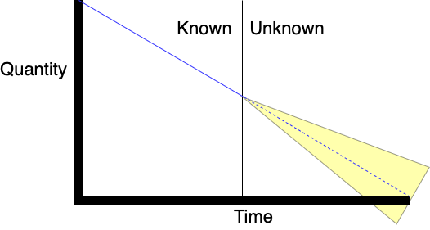
Understanding Uncertainty Over Time

Slide 18
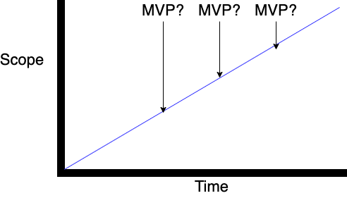
Time = Scope

Slide 19
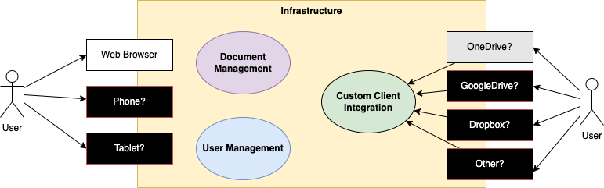
Scope Management!

