Slide 1
MILFIT Design
John Valentino

Slide 2
What?
Replacement for NAVFIT
Using modern software standards
Runs on MAC and Windows
Real-time spellcheck and validation
Delivered over-the-web, as an installer, or as a standalone executable
View/open multiple FITREPS/EVALS at a time
CAC Integration for PDF Signing

Slide 3
Why?
NAVFIT 98 is
Antiquated
Error prone
Not user friendly
Windows only
Infrequently updated

Slide 4
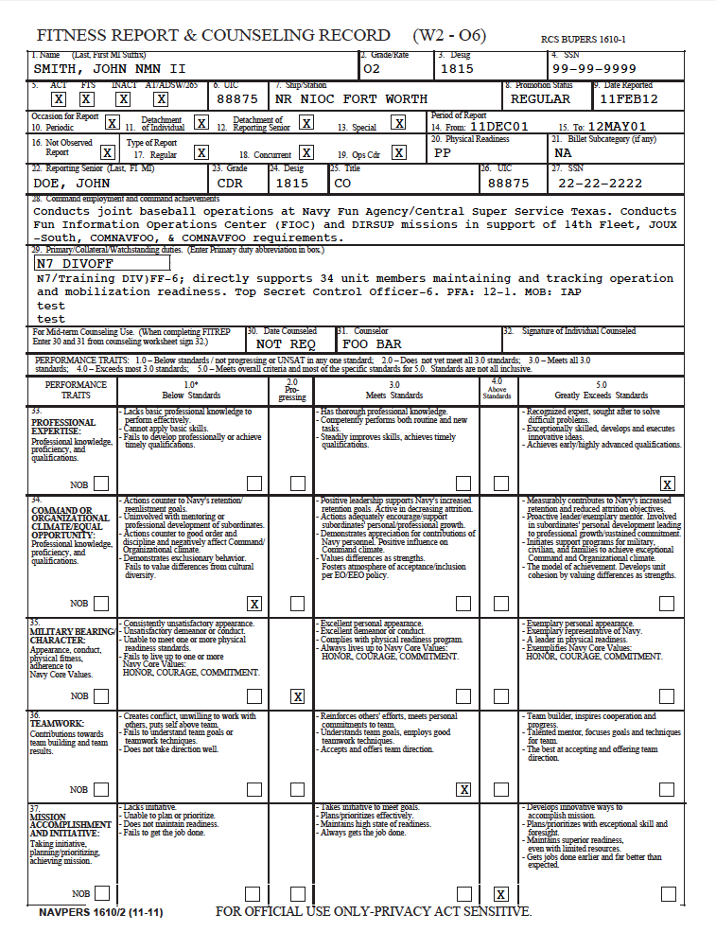
Basic Visual Design
File
File
x + -
Name | Rank/Rate | Member Avg | NOB | Significant Problems | Progressing | Promotable | Must Promote | Early Promote
SMITH, JOHN | LT | N/A | X
ZULU, FRED | LT | 3.33 |  |  |  | X
ALPHA, GEORGE | LT | 3.35 |  |  |  | X
Edit
Delete
x + -
Edit
Delete
File Resize
1
x + -
File Resize
Edit
Delete
1

Slide 5
Basic Design Features
Deal with one FITREP/EVAL at a time
Deal with multiple FITREPs/EVALs as a group
Be able to add and remove FITREPs/EVALs to and from a group
Multi-Window Desktop Interface

Slide 6
Technical Design
Source PDFs are used in their empty forms
The application GUI converts the source PDF to an image and renders it on the screen
The user/application provides the text that is written on top of the source PDF, which is output as separate PDF
The source PDF can be changed at anytime, the application just has to provide the positional mappings of what fields go where (X,Y)
This means the system works for any PDF
The mapping of fields to X,Y positions are provided by an XML document for easy maintenance
It is also possible to build a GUI to maintain or generate new field mappings to PDFs in the future

