Slide 1
G1061
Time Series Analyses

Slide 2
Exploration of Top 7 Maintenance Drug Categories
The drug categories with the highest proportion of maintenance drugs:
Antihyperglycemics
Cardiovascular
Thyroid Preps
Anti-Parkinson Drugs
CNS Drugs
Cardiac Drugs
Diuretics
Look at trends in drug use for all 7 categories together and individually
Analysis relative to members who have taken those drugs (not all members)

Slide 3
Propensity Score Matching
Create group of non-Motion members that is statistically similar to Motion members
Matched on:
Age (only 18+ considered)
Gender
Most recent RAF (most recent of RAF_2014, RAF_2015, or RAF_2016)
Subscriber type
Member months
Month of enrollment (month with first steps for Motion, month of policy enrollment in Motion for non-Motion)

Slide 4
Matched Groups
28,105 unique members actively enrolled in Motion (with steps)
Of those, 9,527 use a drug from at least one of the 7 predominantly maintenance drug categories
10,500 non-Motion members matched for comparison
Of those, 3,344 use a drug from at least one of the 7 predominantly maintenance drug categories

Slide 5
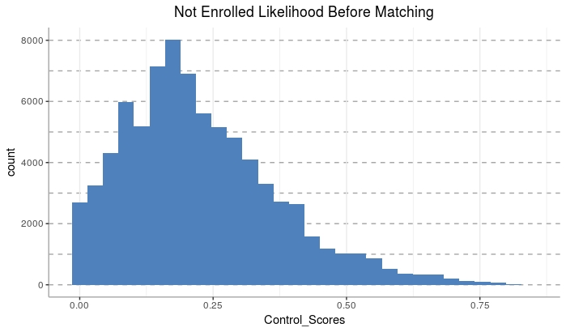
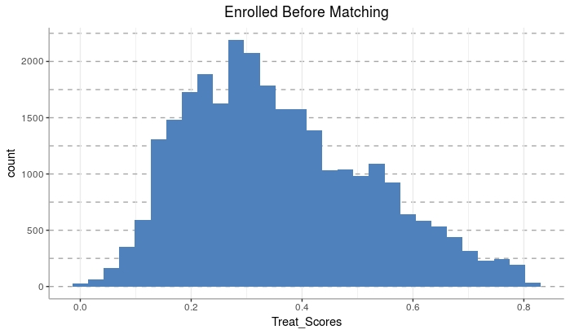
Matched Groups
Non-Motion Pre-Match
Motion

Slide 6
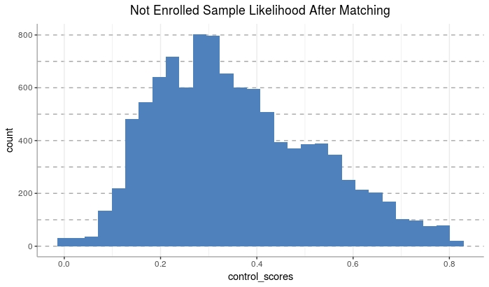
Matched Groups
Non-Motion Post-Match
Motion

Slide 7
Member Counts Per Drug Category
All 7
Motion: 9,527
Non-Motion: 3,344
Antihyperglycemics
Motion: 2,293
Non-Motion: 668
Cardiovascular
Motion: 6,485
Non-Motion: 2,308
Thyroid Preps
Motion: 2,061
Non-Motion: 672
Anti-Parkinson’s Drugs
Motion: 129
Non-Motion: 59
CNS Drugs
Motion: 1,642
Non-Motion: 615
Cardiac
Motion: 1,454
Non-Motion: 586
Diuretics
Motion: 3,189
Non-Motion: 2,973

Slide 8
% Growth in Trend Per Drug (For Users of that Drug)
 | Enrolled |  | Not Enrolled
Drug Category | % Change One Year Prior to Motion to Motion Start | % Change Motion Start to One Year After Motion | % Change One Year Prior to Motion to Motion Start | % Change Motion Start to One Year After Motion
All 7 | 62.60% | 22.31% | 35.23% | 20.55%
Antihyperglycemics | 93.81% | 37.38% | 30.12% | 8.66%
Cardiovascular | 38.55% | 0.41% | 47.48% | 2.87%
Thyroid Preps | 24.37% | 5.84% | 30.79% | - 1.75%
Anti-Parkinson’s | 79.52% | 80.78% | 388.72% | 654.98%
CNS Drugs | 94.18% | 36.73% | 106.63% | 1.90%
Cardiac Drugs | 41.24% | 49.41% | 37.71% | 22.08%
Diuretics | 43.60% | 13.73% | 32.13% | 20.98%

Slide 9
% Growth in Trend Per Drug (For Users of that Drug) Using Month 1 as Proxy for Month 0
 | Enrolled |  | Not Enrolled
Drug Category | % Change One Year Prior to Motion to One Month After Motion Start | % Change One Month After Motion Start to One Year After Motion | % Change One Year Prior to Motion to One Month After Motion Start | % Change One Month After Motion Start to One Year After Motion
All 7 | 66.54% | 19.42% | 38.28% | 17.89%
Antihyperglycemics | 99.14% | 33.71% | 32.78% | 6.48%
Cardiovascular | 40.80% | - 1.20% | 49.68% | 1.35%
Thyroid Preps | 25.90% | 4.56% | 32.61% | - 3.10%
Anti-Parkinson’s | 89.06% | 71.66% | 466.91% | 550.85%
CNS Drugs | 103.59% | 30.41% | 113.41% | - 1.34%
Cardiac Drugs | 45.06% | 45.47% | 40.93% | 19.30%
Diuretics | 47.10% | 11.02% | 32.98% | 20.22%

Slide 10
% Growth in Trend Per Drug (For Users of that Drug) Using Months -1 and 1 as Proxy for Month 0
 | Enrolled |  | Not Enrolled
Drug Category | % Change One Year Prior to Motion to One Month Prior to Motion Start | % Change One Month After Motion Start to One Year After Motion | % Change One Year Prior to Motion to One Month Prior to Motion Start | % Change One Month After Motion Start to One Year After Motion
All 7 | 58.48% | 19.42% | 32.11% | 17.89%
Antihyperglycemics | 87.59% | 33.71% | 27.85% | 6.48%
Cardiovascular | 36.44% | - 1.20% | 44.70% | 1.35%
Thyroid Preps | 21.76% | 4.56% | 28.95% | - 3.10%
Anti-Parkinson’s | 75.72% | 71.66% | 317.98% | 550.85%
CNS Drugs | 86.47% | 30.41% | 98.95% | - 1.34%
Cardiac Drugs | 35.90% | 45.47% | 33.71% | 19.30%
Diuretics | 41.43% | 11.02% | 33.64% | 20.22%

Slide 11
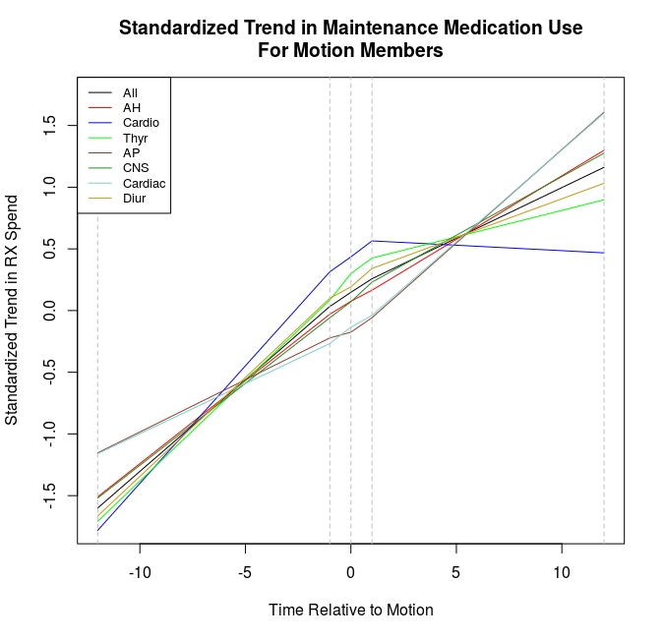
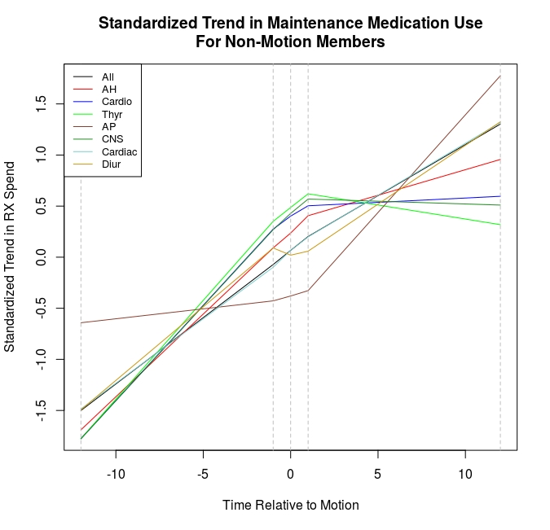
Summary of Trend in RX Spend for Motion vs. Matched Non-Motion Members
Motion
Non-Motion

Slide 12
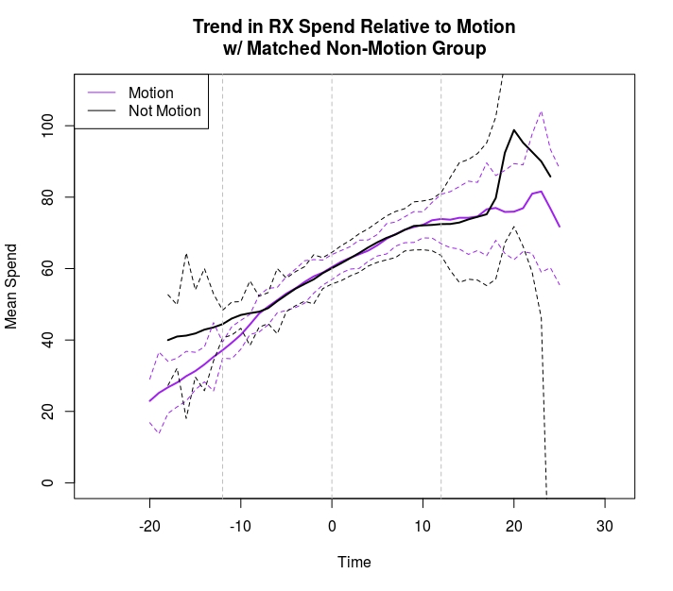
Trend Comparison for all 7 Drug Categories

Slide 13
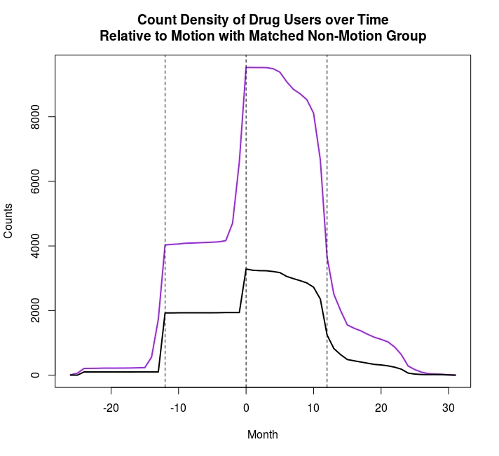
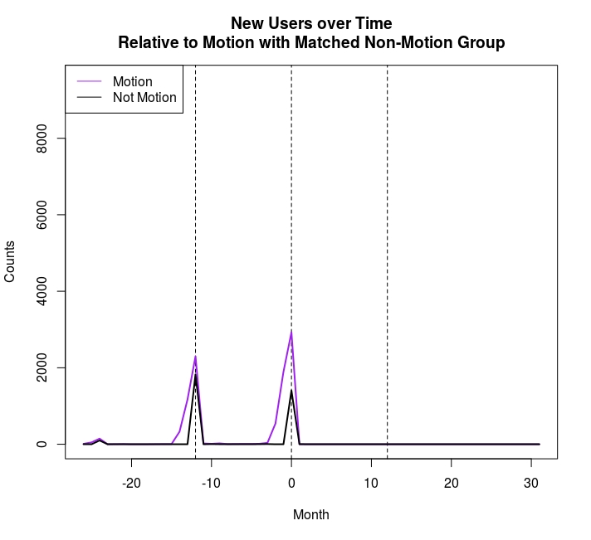
Trend Comparison for all 7 Drug Categories
Count of Members Over Time
Count of New Members Over Time

Slide 14
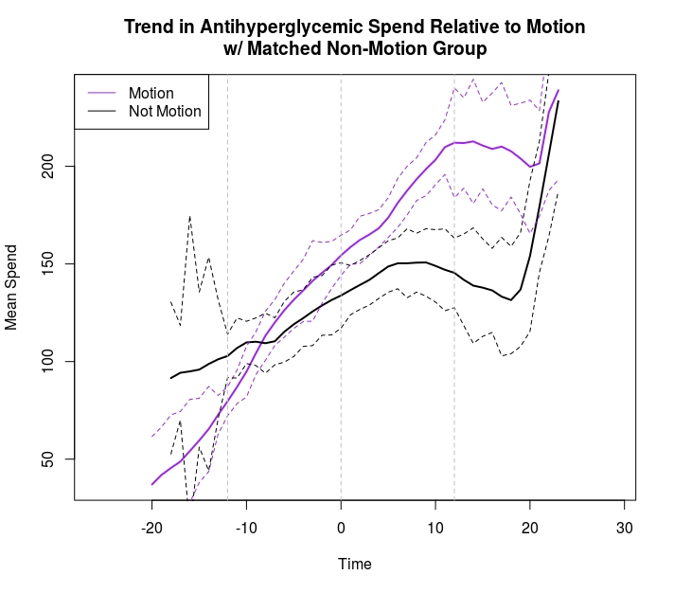
Trend Comparison for Antihyperglycemics

Slide 15
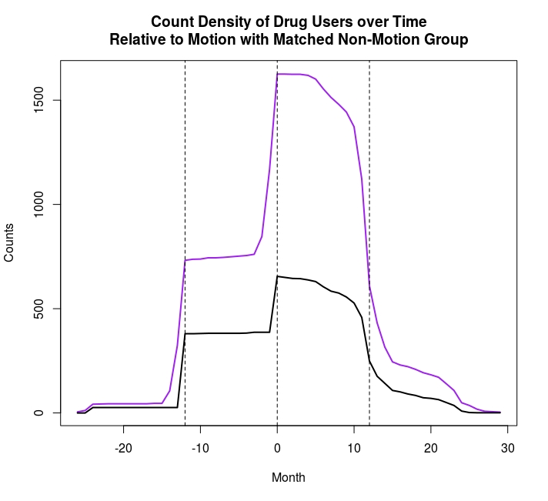
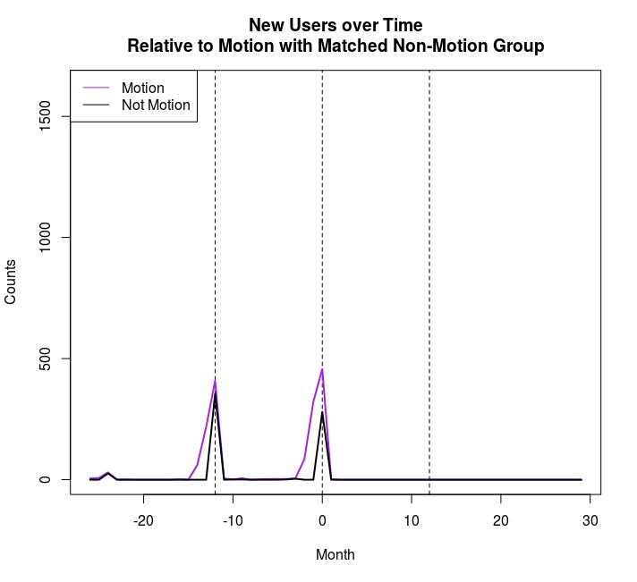
Trend Comparison for Antihyperglycemics
Count of Members Over Time
Count of New Members Over Time

Slide 16
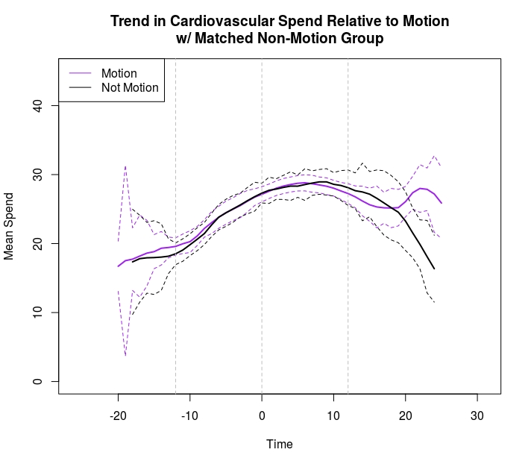
Trend Comparison for Cardiovascular Drugs

Slide 17
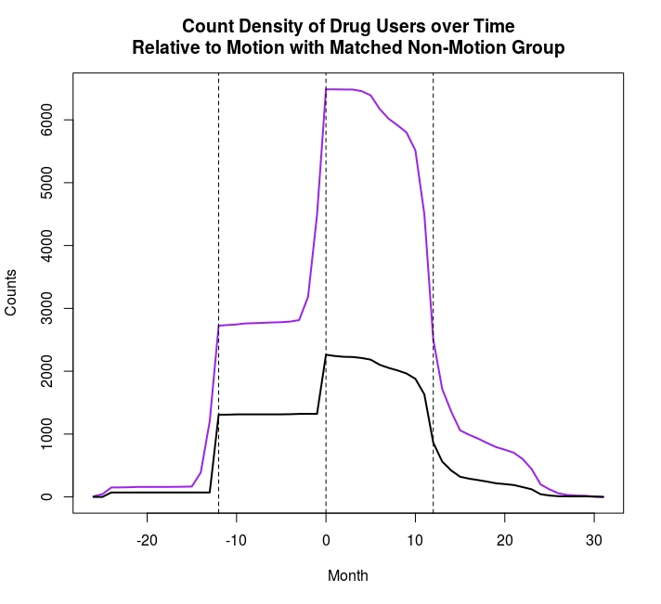
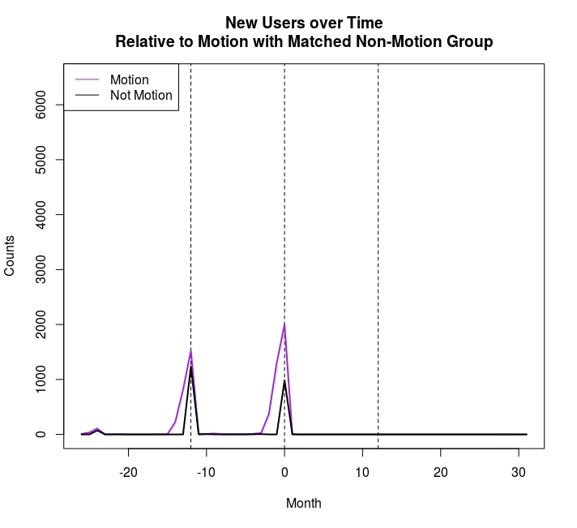
Trend Comparison for Cardiovascular Drugs
Count of Members Over Time
Count of New Members Over Time

Slide 18
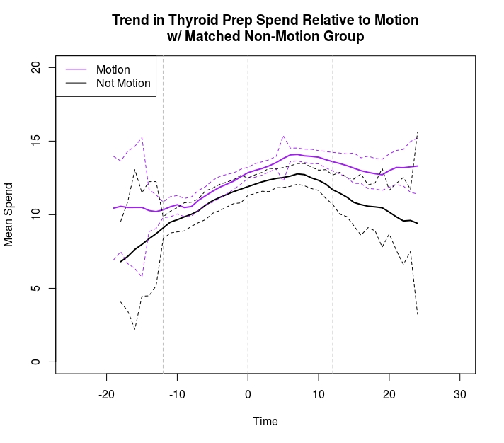
Trend Comparison for Thyroid Preps

Slide 19
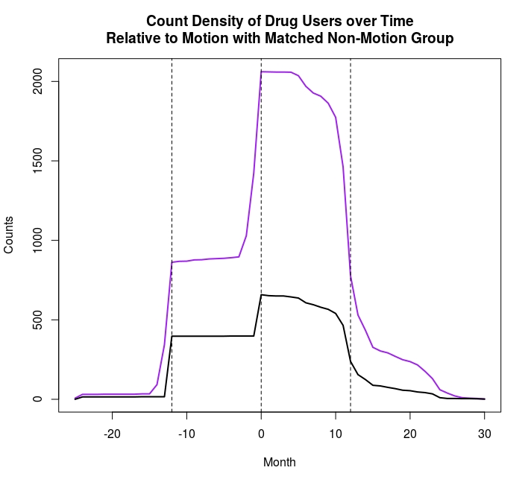
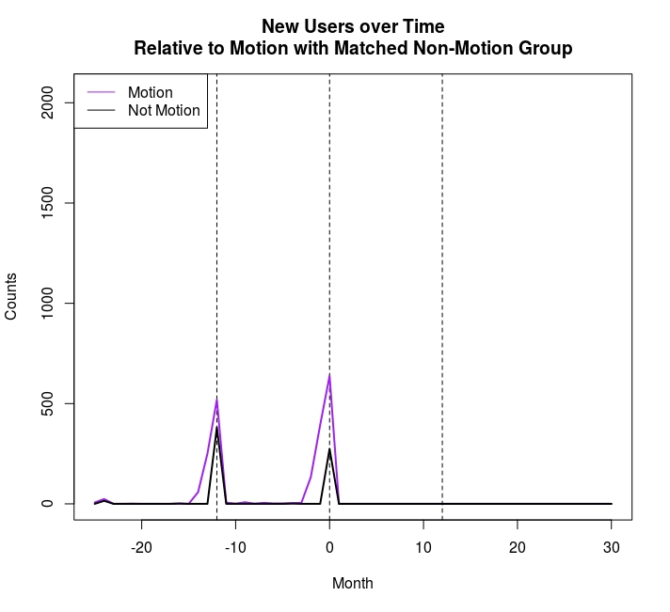
Trend Comparison for Thyroid Preps
Count of Members Over Time
Count of New Members Over Time

Slide 20
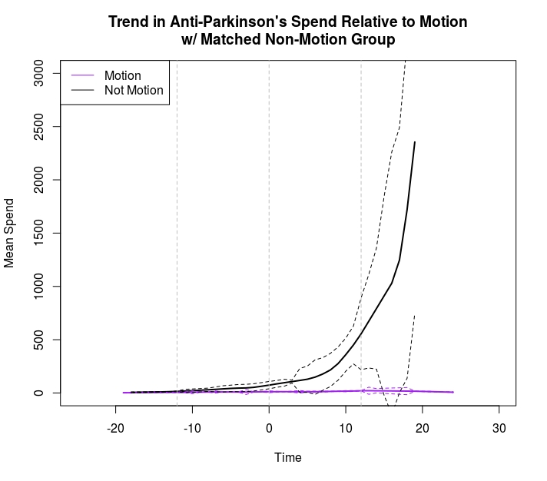
Trend Comparison for Anti-Parkinson’s Drugs

Slide 21
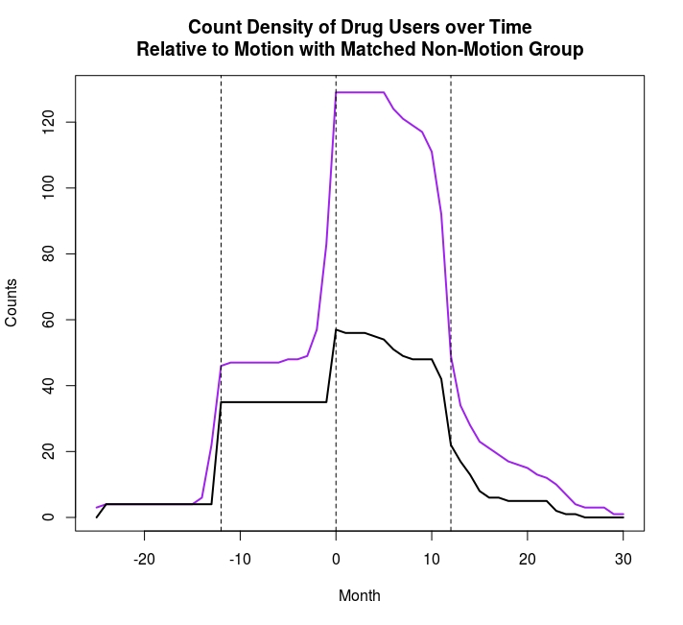
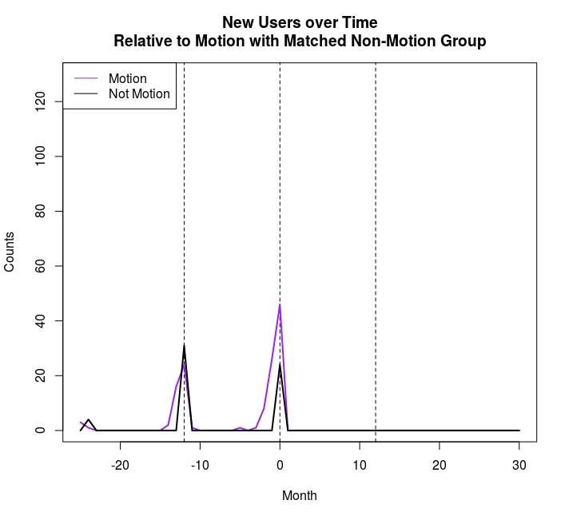
Trend Comparison for Anti-Parkinson’s Drugs
Count of Members Over Time
Count of New Members Over Time

Slide 22
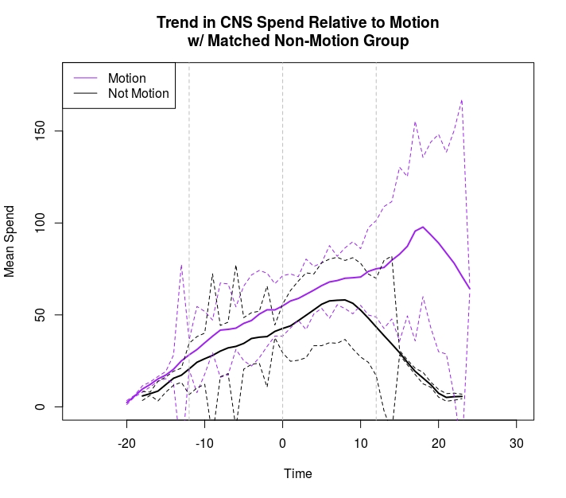
Trend Comparison for CNS Drugs

Slide 23

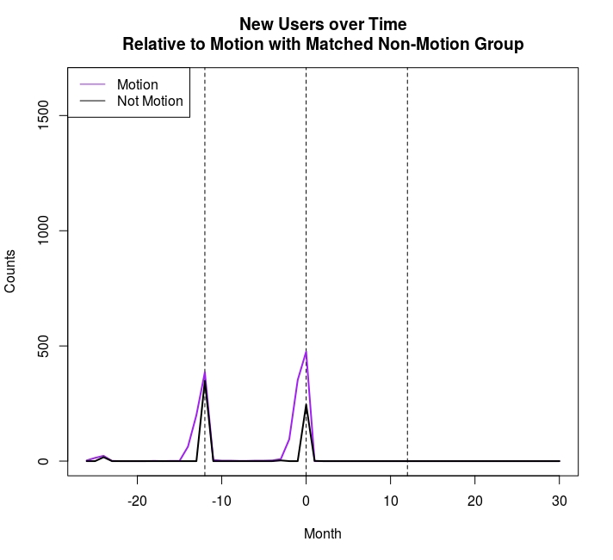
Trend Comparison for CNS Drugs
Count of Members Over Time
Count of New Members Over Time

Slide 24
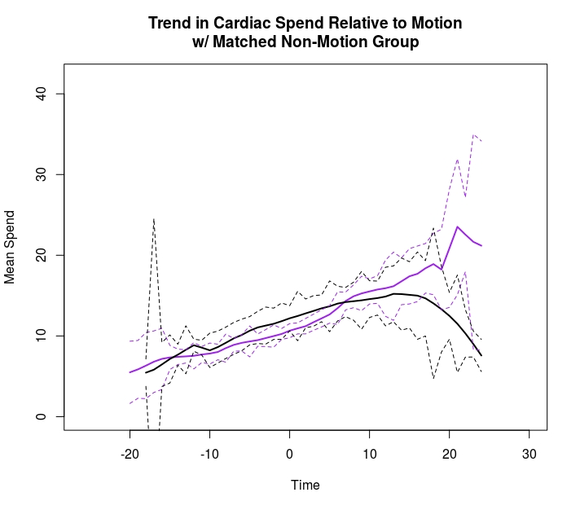
Trend Comparison for Cardiac Drugs

Slide 25

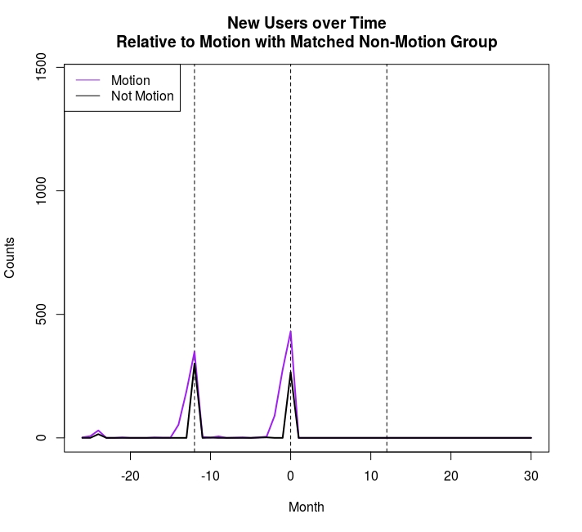
Trend Comparison for Cardiac Drugs
Count of Members Over Time
Count of New Members Over Time

Slide 26
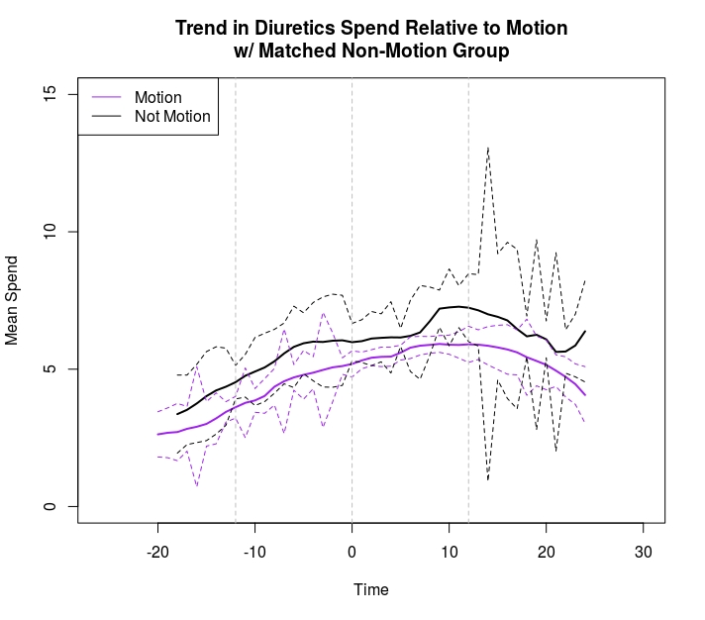
Trend Comparison for Diuretics

Slide 27
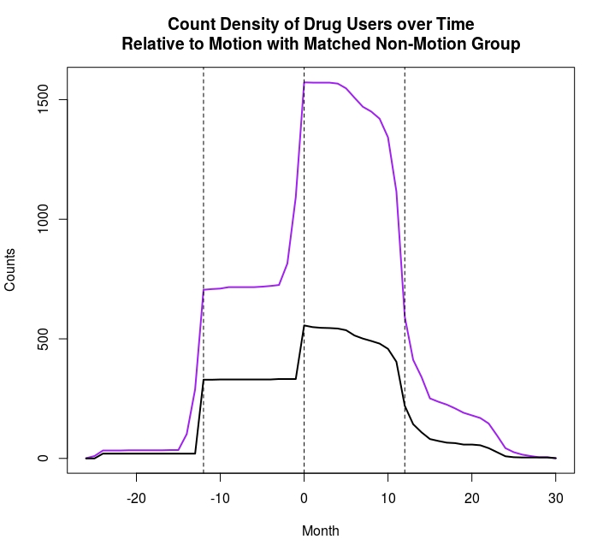
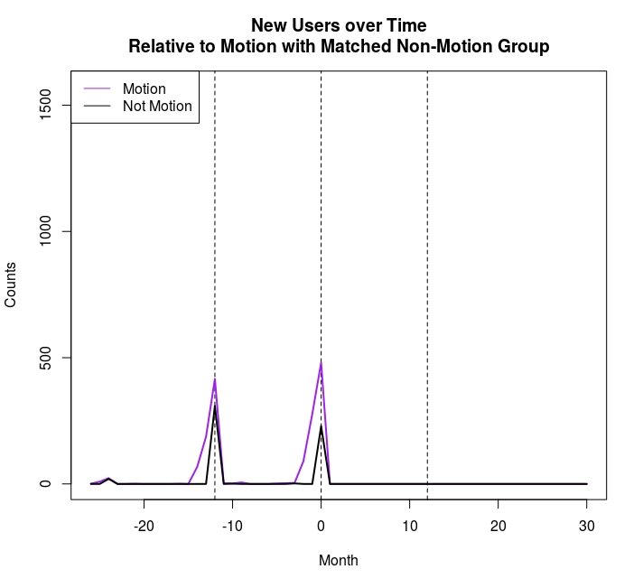
Trend Comparison for Diuretics
Count of Members Over Time
Count of New Members Over Time

