Slide 1
Microservices
Johnny Vanderhorst
Web420
Bellevue university

Slide 2
Microservices
Microservices are a loosely coupled collection of services that form an application.
Microservices are services/applications that perform a single task or have a single responsibility.
Microservices can be deployed, scaled and tested independently.
Microservices allow for continuous delivery/deployment of large complex applications.

Slide 3
API gateway
Large applications that use a microservice architecture has data spread across many services. When a request is sent the application must fetch information from all these different services to return the requested results. API Gateways help to solve this issue by providing a single point of entry.

Slide 4
API gateway
API gateways sit between clients and services. All requests go through the API gateway first. It is responsible for request routing, composition and protocol translation. API gateways decouple clients from services, eliminating the exposure of services directly to the clients. API gateways perform other tasks besides routing requests from clients to services:
Authentication
SSL termination
Rate limiting
IP whitelisting
Logging and monitoring
Response caching
Web application firewall
Servicing static content

Slide 5
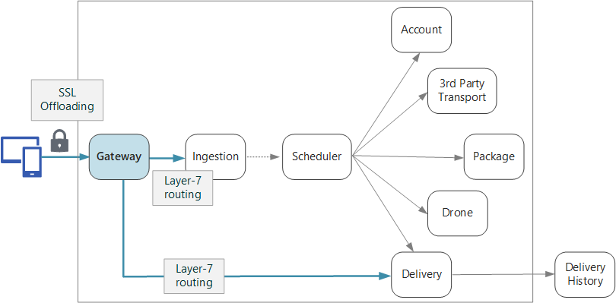
API gateway
API Gateway example:
Garcia, C & Wasson, M. (2017). Designing Microservices: API gateways.

Slide 6
Microservices advantages
Improves fault isolation
Eliminates long-term commitment to single technology stacks
Easier to understand

Slide 7
Microservices disadvantages
Complexity of developing distributed system
Multiple databases and transaction management
Cumbersome testing
Complexity of deployment

Slide 8
Microservices deployment
Deploying microservices does present some challenges. The microservce architect consists of many services that can be written in a variety of languages and frameworks. Each service will have its own specific deployment, resource, scaling and management requirements. One of the key benefits of a microservice architecture is its speed of development and efficiency, deployment must also be fast, reliable and cost-effective.

Slide 9
Microservices deployment
There are a few approaches to microservice deployment:
Multiple Service Instances per Host Pattern - provision one or more physical or virtual hosts and run multiple service instances on each one.
Service Instance per Host Pattern - package each service as a virtual machine (VM) image.
Service Instance per Container Pattern - each service instance runs in its own container.
Serverless Deployment

Slide 10
Microservices deployment
Key Areas of Microservice Deployment
Ensure infrastructure is in place for the rollout. Load balancers, monitoring systems, orchestration and administration systems, and security products all must be ready to go before even rolling out service one.
Select a container operating system. The lack of dependencies among today’s popular container OS will allow for further customization which will allow it to be hosted in any environment and quick testing.
Orchestrate deployment

Slide 11
Scaling microservices
One of the major benefits of microservices is the ability to scale each service independently.
Demand may surge for one component of an app or a certain subset of data and a microservices architecture enables you to scale only the app components impacted, rather than the entire application and underlying infrastructure.

Slide 12
References
Badola, Vineet. (2015). Microservices is a way of breaking large software projects into loosely coupled modules, which communicate with each other through simple APIs. Retrieved from https://cloudacademy.com/blog/microservices-architecture-challenge-advantage-drawback/
Fowler, M. & Lewis, J. (2014). Microservices: A Definition of this New Architectural Term. Retrieved from https://www.martinfowler.com/articles/microservices.html
Garcia, C & Wasson, M. (2017). Designing Microservices: API gateways. Retrieved from https://docs.microsoft.com/en-us/azure/architecture/microservices/gateway
Handy, Alex. (2018). Deploying Microservices Doesn’t Have to Be a Pie Fight. Retrieved from https://thenewstack.io/deploying-microservices-doesnt-have-to-be-a-pie-fight/
Richardson, Chris. (n.d.). Pattern: API Gateway / Backend for Front-End. Retrieved from http://microservices.io/patterns/apigateway.html
Richardson, Chris. (2016). Choosing a Microservices Deployment Strategy. Retrieved from https://www.nginx.com/blog/deploying-microservices/

