Slide 1
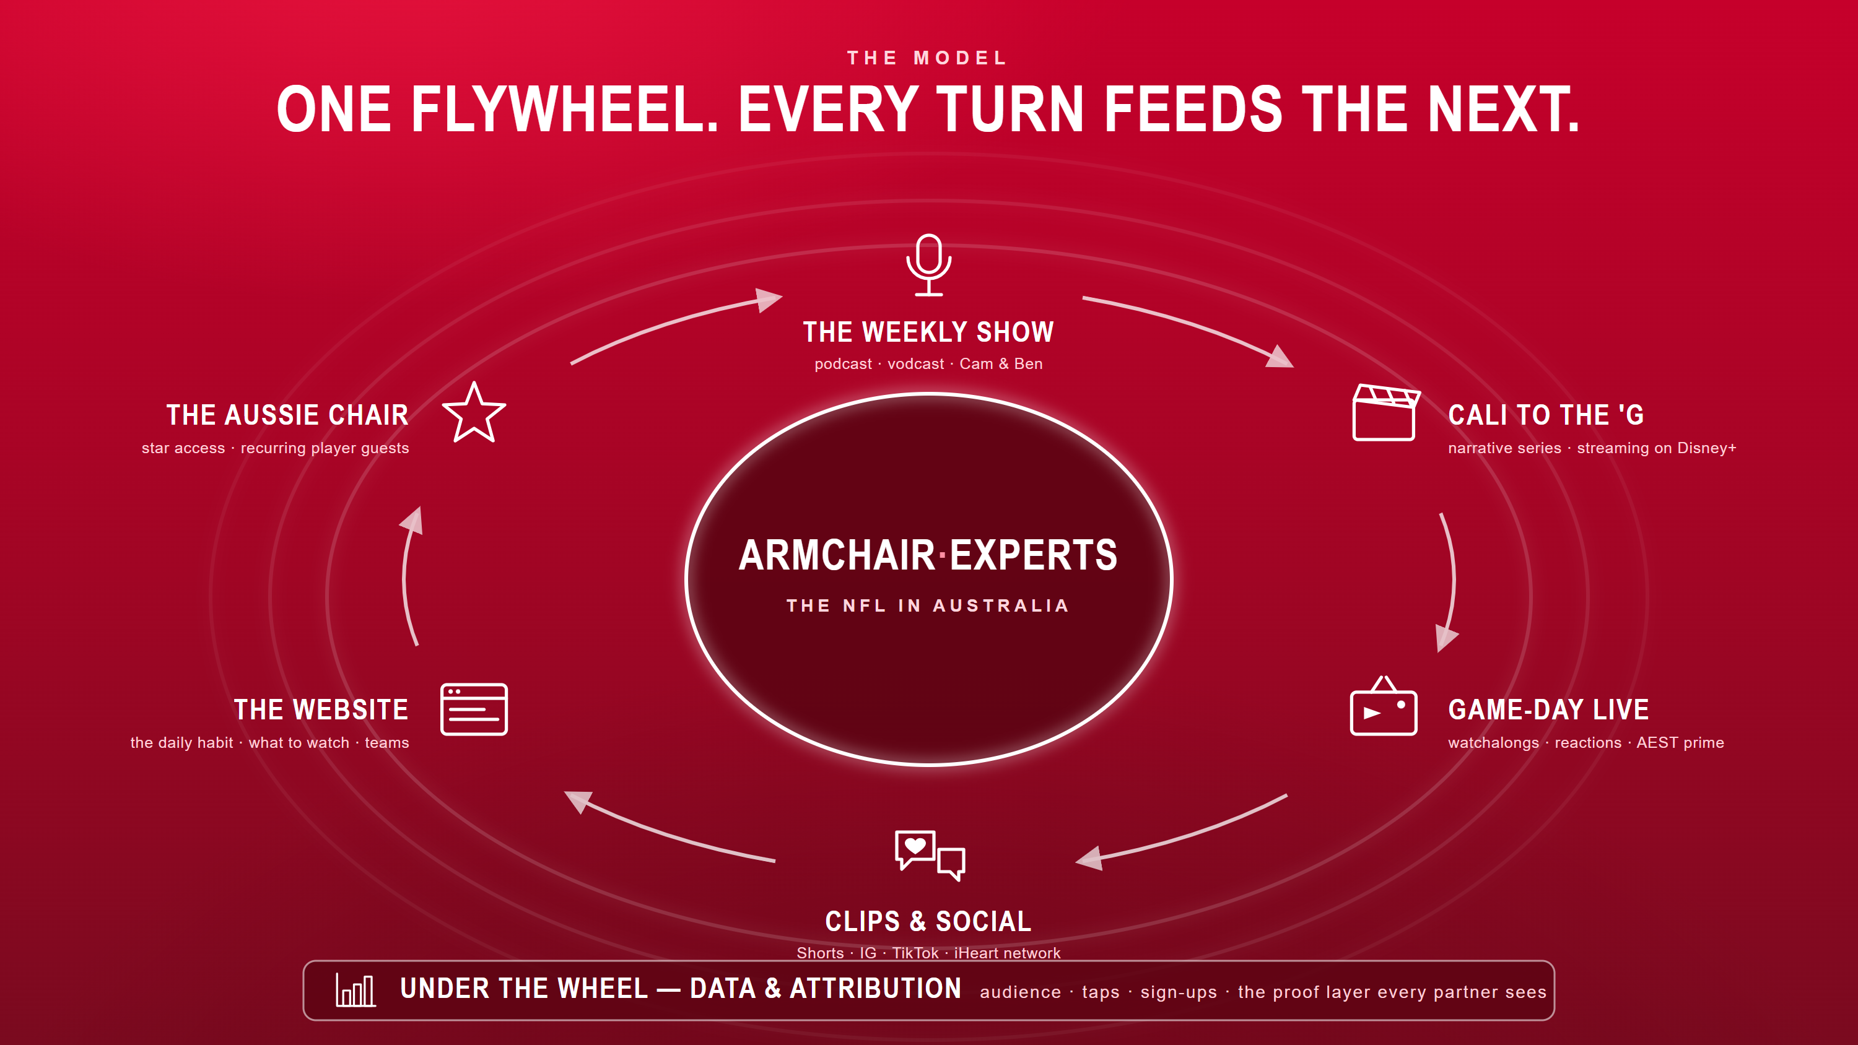

Slide 2
THE AUDIENCE
Armchair·Experts
Who Disney+ is really buying
STREAMING PARTNER · Disney+
Not impressions — a pre-qualified pool of streaming-ready NFL fans, indexed exactly where the league wants Australian growth.
000k
Monthly audience
Across audio, video & social
00%
Watch-through
Avg completion on the video show
00%
Men 18–34
The NFL's core AU growth demo
000k
Social reach / mo
Instagram + TikTok combined
WHO THEY ARE
WHY IT MATTERS TO DISNEY+
Already NFL-curious but under-served — no trusted Australian voice, no clear place to watch.
Streaming-native: they subscribe readily and follow talent across platforms.
Concentrated in the metro markets and the exact demo Disney+ and the NFL both want.
Every other slide is inventory. This is the reason to buy it — audited reach, engaged completion, and fit.
Draft — replace bracketed figures with Armchair's actuals (downloads, watch-time, audience survey, socials). Live platform: armchair-nfl.vercel.app. Concept for pitch purposes; not affiliated with the NFL, ESPN or Disney+.

Slide 3
THE PROOF
Armchair·Experts
How we prove it drove subscriptions
STREAMING PARTNER · Disney+
Turning “awareness” into a number Disney+ can bank — one tracked path from a mention to a sign-up.
01
Awareness
Show, social & the iHeart network put the NFL story in front of fans.
02
Intent
A unique tracked deep-link & on-air promo code in every episode.
03
Conversion
A co-branded, code-gated giveaway page captures the referral.
04
Prove it
A shared dashboard reconciles spend against sign-ups fortnightly.
›
›
›
MEASURED BY
Reach & impressions
MEASURED BY
Click-through rate
MEASURED BY
Attributed sign-ups
MEASURED BY
Cost per acquisition
HOW IT'S WIRED
THE UNLOCK — ALREADY LIVE
A unique UTM deep-link & Disney+ promo code per episode — credit is unambiguous.
A giveaway landing page that gates entry behind the sign-up path.
A fortnightly report to Disney+ — reach, clicks, sign-ups, CPA. Nothing behind the curtain.
Every “Watch on Disney+” tap in the hub is one of these tracked links — and the hub is running today at armchair-nfl.vercel.app. Product and measurement are the same system.
Live platform: armchair-nfl.vercel.app — palette & type match, so the pitch reads as one system. Concept for pitch purposes; not affiliated with the NFL, ESPN or Disney+.

Slide 4
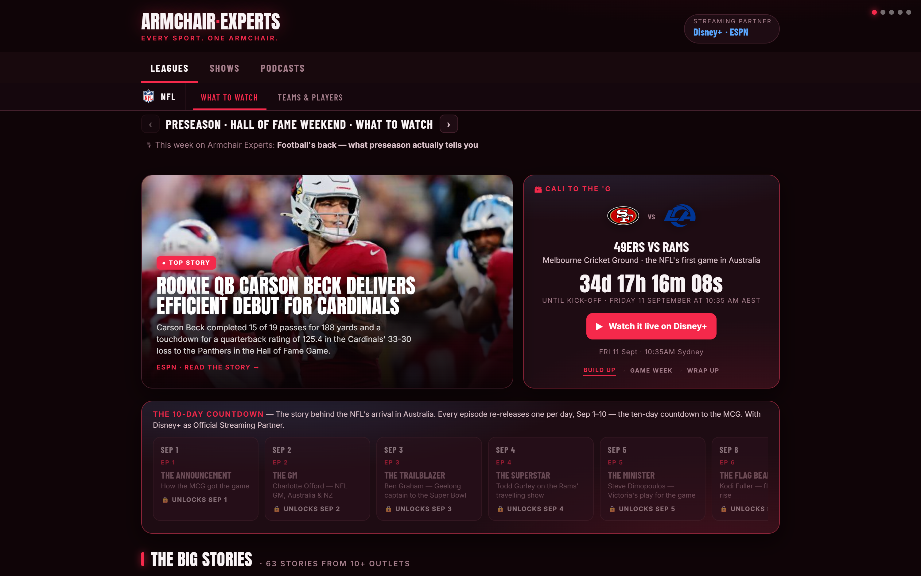
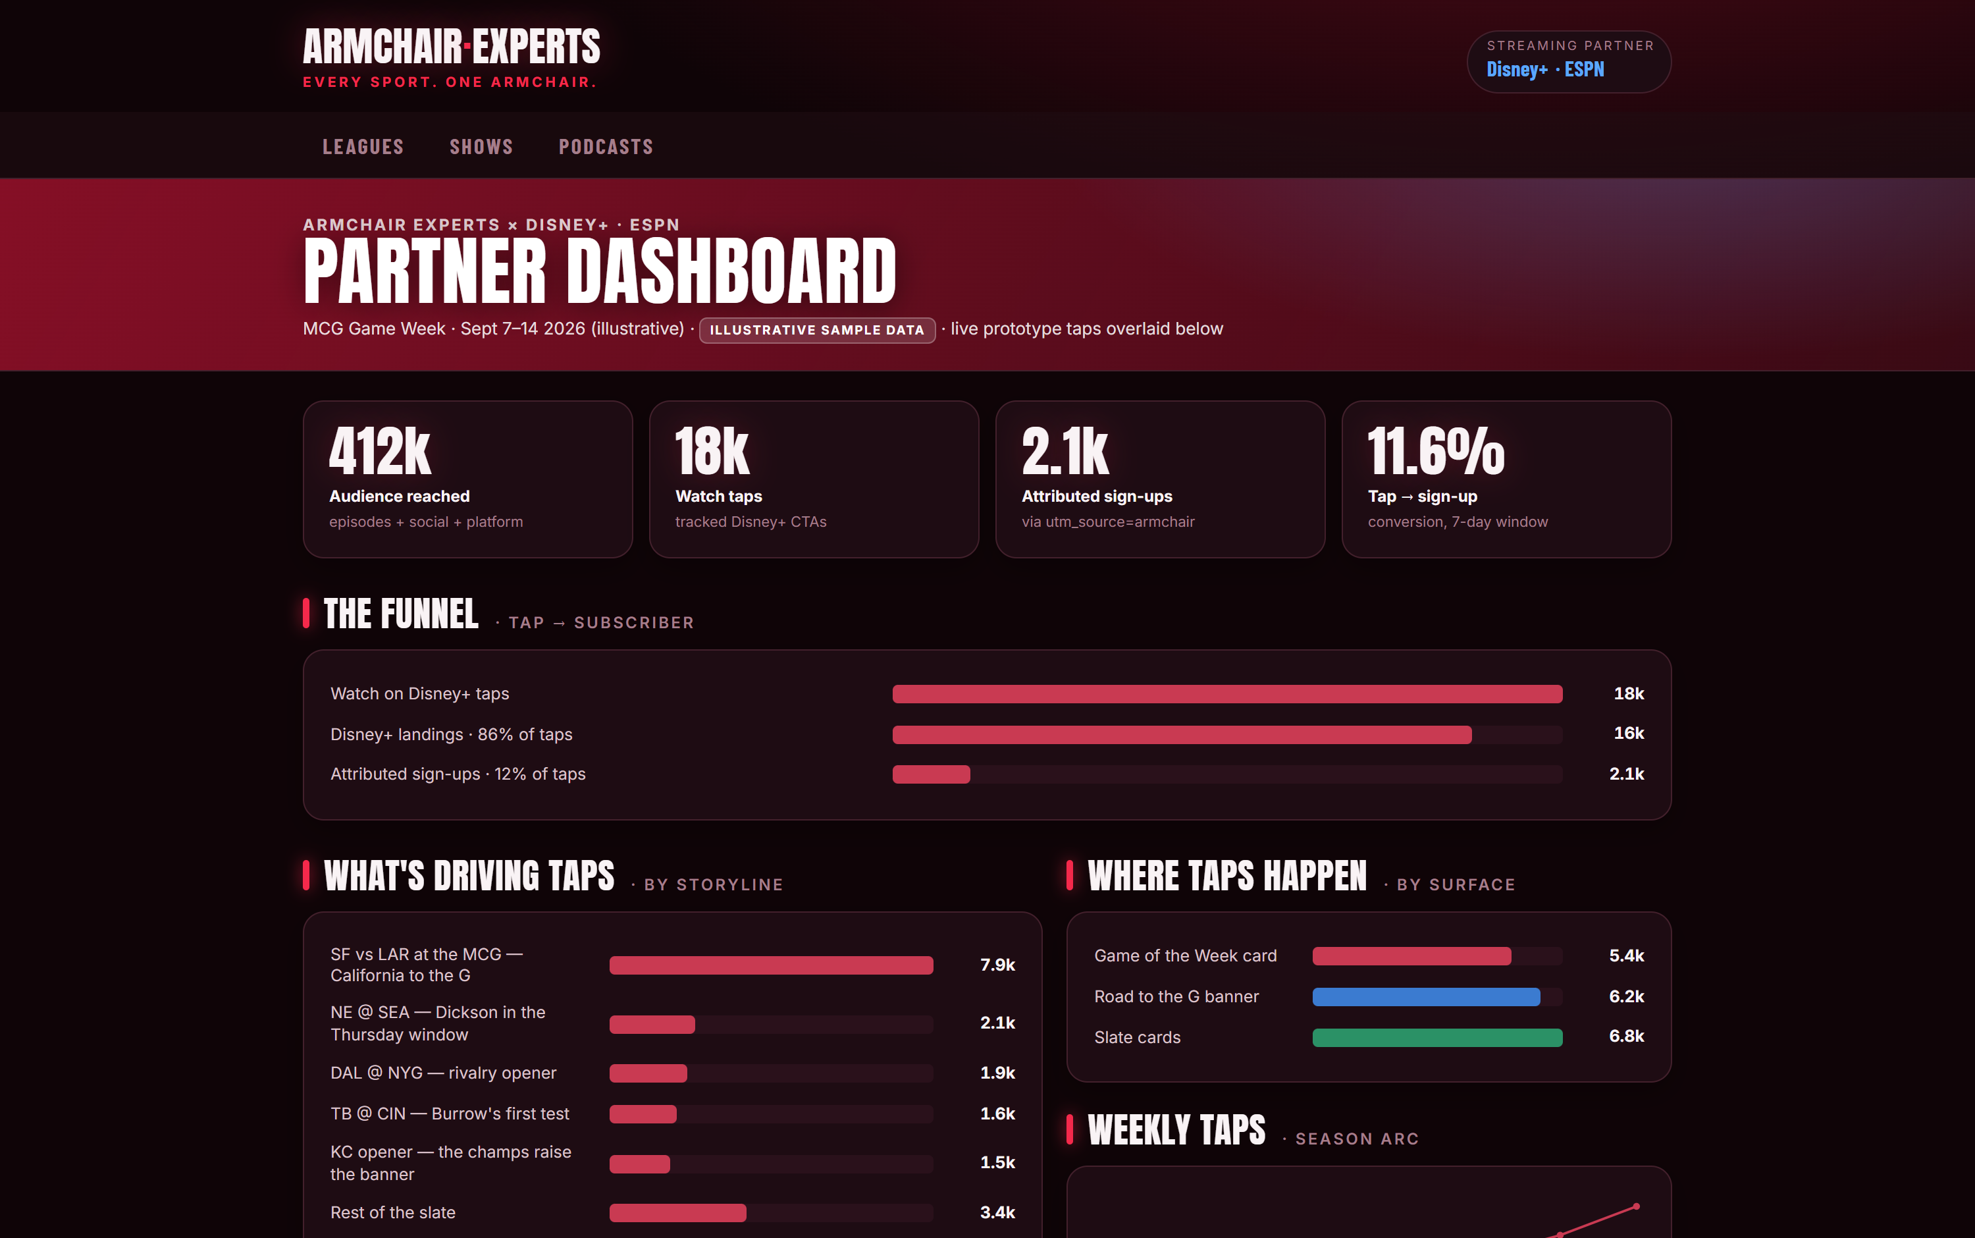
THE PLATFORM — LIVE NOW
Armchair·Experts
Not a concept. It's running.
STREAMING PARTNER · Disney+
The utility layer from this deck is built and live on real NFL data — every game in Australian time, the MCG countdown, tracked Disney+ taps, and the partner dashboard that proves what they drove.
The What to Watch hub — Road to the G countdown, the Experts' calls, every kickoff in AEST/AWST
The partner dashboard — taps by storyline, the funnel, attribution wired end-to-end
Screenshots are the live product on real ESPN data, 2026-08-07. Built on the ListTrac engine. Concept for pitch purposes; not affiliated with the NFL, ESPN or Disney+.
Open it now — armchair-nfl.vercel.app · live schedule, 32 team pages, player stats, the lot

