Slide 1
Optimization of an Inverse Convection Solution Strategy
Joseph VanderVeer and Yogesh Jaluria
Presented by Joseph VanderVeer
Sunday November 24, 2013
Notes:
We started with an inverse solution strategy which worked fairly well, but we realized it had some limitations and issues. This talk covers one of our attempts to increase the methods capabilities.
So what is an inverse problem?

Slide 2
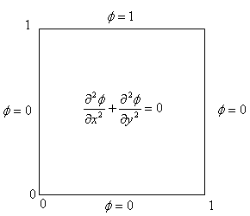
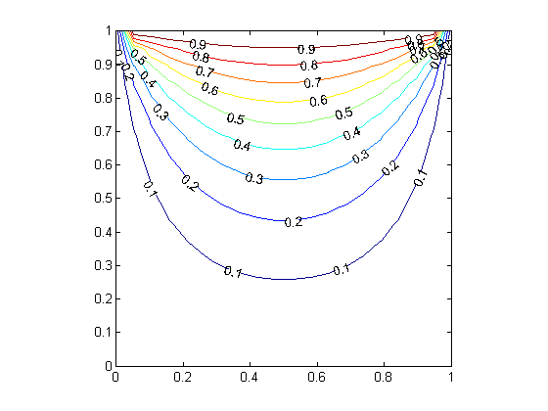

What is an inverse problem?
Forward Problem
Inverse Problem
.
.
. . .
∞
Notes:
The top is an example of what a normal forward problem is… We start with boundaries and solve for the entire domain solved for.
The bottom is an example of what what an inverse problem is… Start with a few select data points within the domain and solve for the entire domain.
The typical inverse problem has an infinite number of possible solutions. The key is limiting the number of possible solutions to a range small enough to no longer matter which is the correct solution

Slide 3
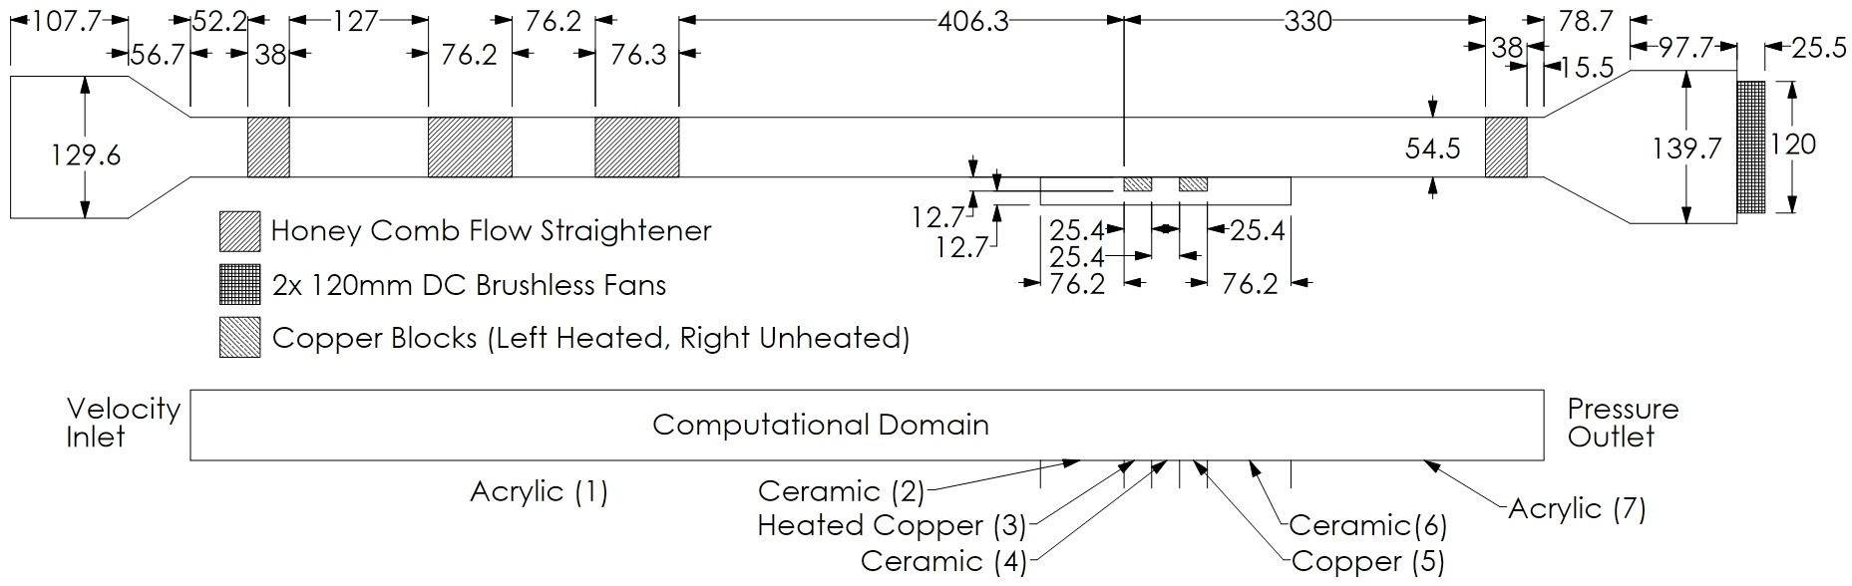
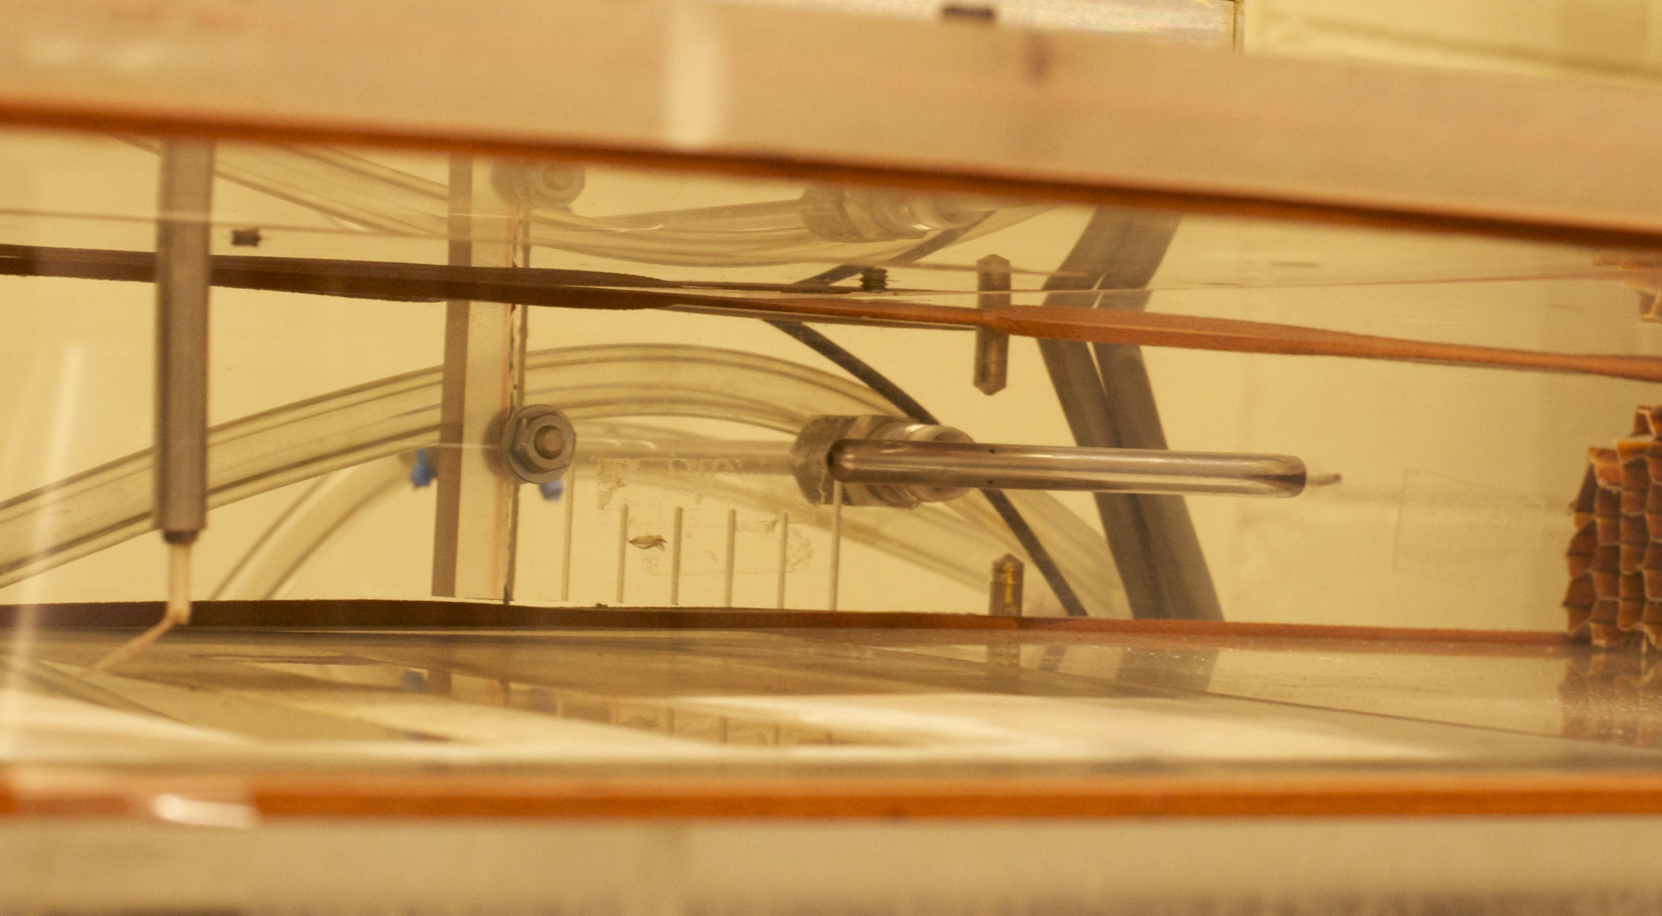
Our inverse problem: Plume in a crosswind
Notes:
The inverse problem we are going to discuss today is a plume in a crosswind. We wish to determine the plume source temperature and plume source location utilizing only a few sampled locations down stream.
This is a figure and picture of the experimental apparatus and the numerical domain.
----The wind tunnel can produce velocities up to 5.0m/s
----Heater is flush mounted in a ceramic base. Capabilities to have two simultaneous plumes.

Slide 4
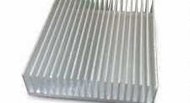
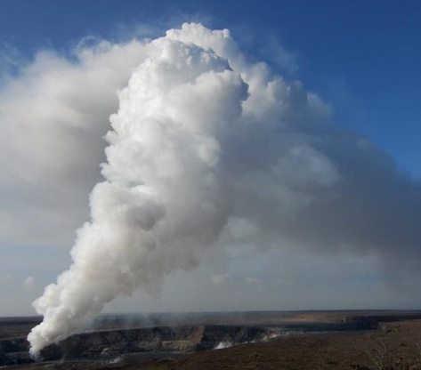
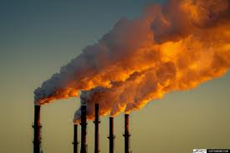

Why an inverse plume in a crosswind?
Thermal management
Environmental flows
Fires
Notes:
So why an inverse plume in a crosswind?
Extensions of this topic include a jet in a crosswind such as smoke stacks and a plume with no crosswind such as a fire in a room.
How can the inverse be useful? Potentially in many ways such as
Differentiating which electronic component is outputting the most heat with a minimal of sensors.
Remote determination of toxic fume release rate of a volcano. (Kilauea)
Fires in urban environment such as rooms and buildings.

Slide 5
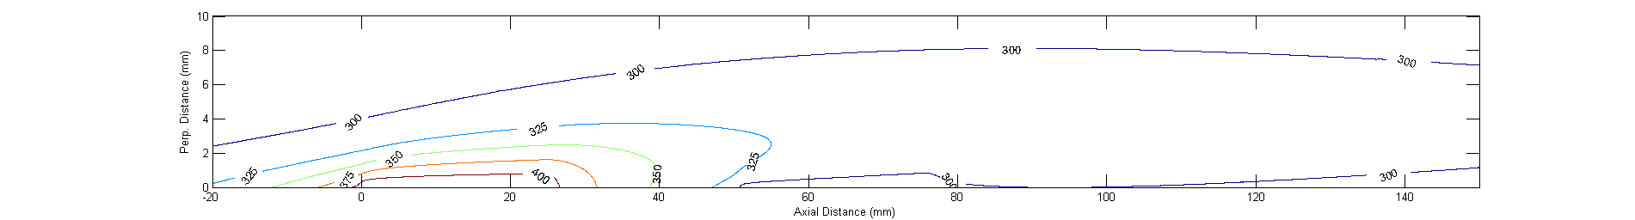
Typical thermal profile
Notes:
This is a contour plot of the typical thermal plume generated.
We used Fluent from Ansys workbench version 13. Comparisons with experimental results show the domain is indeed turbulent.
------This is U=0.6m/s and T = 425K

Slide 6
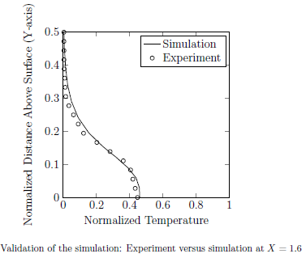
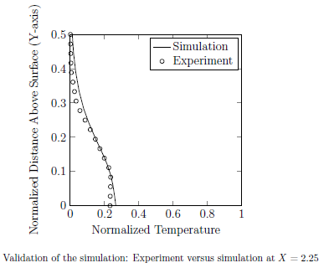
Numerical – experimental results
Notes:
The solution strategy discussed shortly requires the experimental and numerical results to correlate well for the strategy to function properly with experimental data.
These two graphs show the correlation between the experimental and numerical results at two locations.
-----The error here is less than 5% everywhere and deemed acceptable.

Slide 7
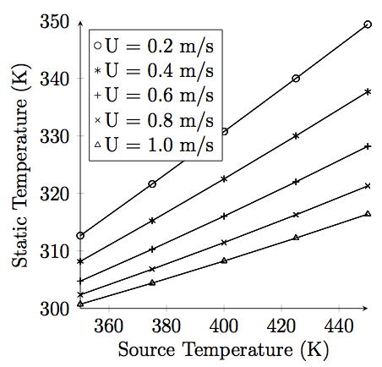
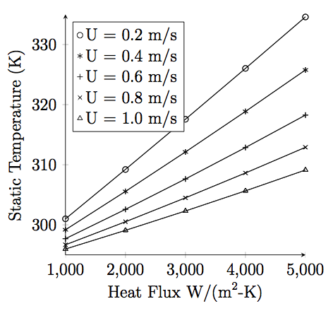
Solution strategy
Constant source temperature
Constant source heat flux
Notes:
Now I will discuss the inverse solution strategy: We start with acknowledging that the local static temperature is linearly related to source output, either constant temperature or constant heat flux. These plots are just one location example, but the results are similar everywhere
---Location is axial 50mm downstream and perpendicular 4mm above the heater
It is linear because we neglect the variations in density and buoyancy effects in the energy equation.

Slide 8
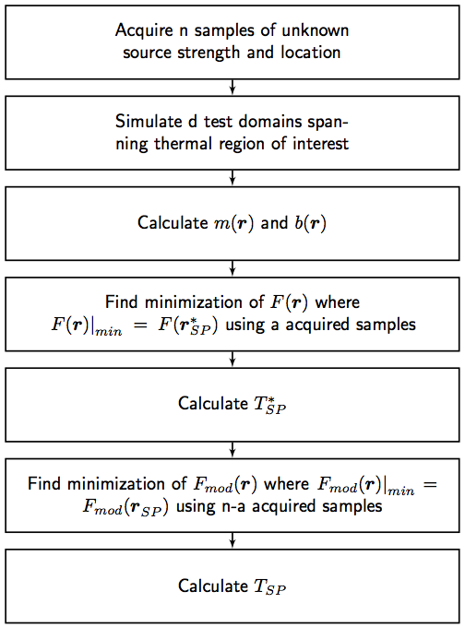
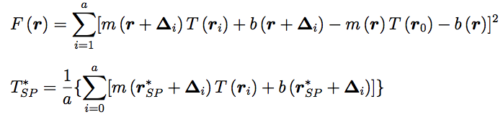
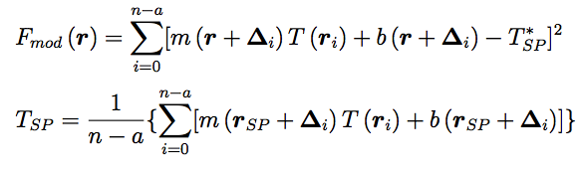
Solution strategy (cont’d)
Notes:
This is the methodology used. We start by acquiring the limited samples within the domain. Then simulate the domain spanning the thermal region of interest. So we can then calculate the linear functions m and b.
Because the linear functions m and b are functions of the axial and perpendicular directions we “try” to apply a known pattern of data sampling or “search shape” to resolve both the source strength and source location.
This is accomplished by searching the domain for the location where the search shape has the minimum error between sampled points.
We then calculate the source strength from this, and then redo the minimization with the “known” source strength and with a new set of acquired data. From here the source location can be determined.
Lastly, we can calculate the new source strength which should be closer to the correct source strength the original predicted one.

Slide 9
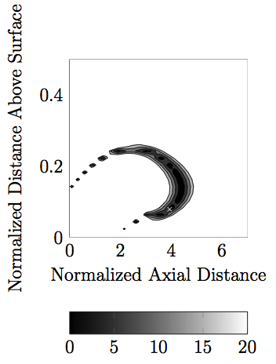
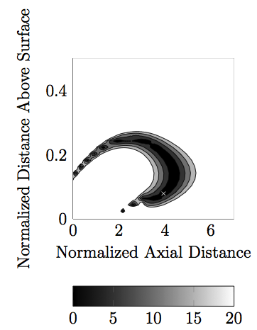
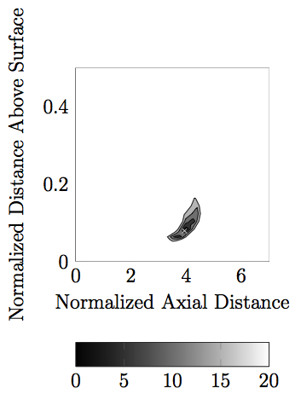
Solution strategy (cont’d)
Two Points
“Search Shape”
One Point
Point 5
Point 3
Three Points
Point 1
Point 2
Point 4
Notes:
This is a sample of the “search shape” we first attempted to use, which worked fairly well.
The following graphs are the percent error associated with an incorrect result and effectively the gradient of convergence of the solution.
------These are examples from Source Temp at 425K Free stream velocity of 0.6m/s and location of (100mm, 2mm)
Using one point from the domain there are several distinct slowly converging solutions possible.
Using two points does not result in a significant increase in convergence or narrowing the possible solutions (even if we transpose points 2 and 3)
Three points does significantly increase the convergence, but still results in a possibility of multiple solutions.
Turns out that if we increase the number of points to 5 we get a high rate of convergence and usually one possible solution (a graph of this will show nothing its so small)

Slide 10
Where is the opportunity for optimization?
Why this?
And not one of these?
Notes:
So where is the opportunity for optimization?
The “search shape” we originally used had no physical bearing on the underlying problem.
Physical intuition makes you think you need at least some resolution in both axial and perpendicular directions, but other than that there are not any real indicators what should be chosen.
Possibly one of the other options shown here.

Slide 11
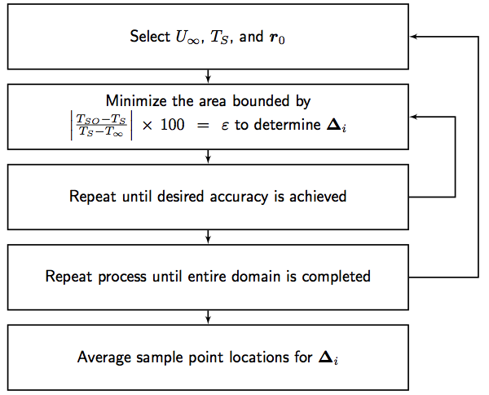


Inverse optimization methodology
Notes:
While it is possible to optimize for one condition the real goal is to have the best possible search shape for all conditions.
The optimization process covers a wide range of parameters, free stream velocity, Source strength, and location of acquired samples within the domain.
We checked every possibility from our range of parameters and selected the “search shape” which maximize the gradient towards the correct solution.
The range of parameters are free stream velocity 0-1m/s source strength 350-450 perpendicular location 0 – 10mm and lastly axial locations 0-150mm
which total 1050 combinations.
These parameters were selected to cover the range possible for the experiment. (1m/s max due to material –thermal limitations. Any faster and the plume gets blown so thin its difficult to measure. Any hotter and the wind tunnel melts)

Slide 12
Results of the optimization
Before
After
Notes:
The results of all of this optimization is that we started with an L shape with 5 total samples, and resulted with 3 samples in the odd shape shown on the right.
This is an average of all of the parameter sets from the optimization.
The number of samples were reduced to 3 since the error associated with the source strength prediction was below the experimental error (+-2K) even at 3 points.

Slide 13
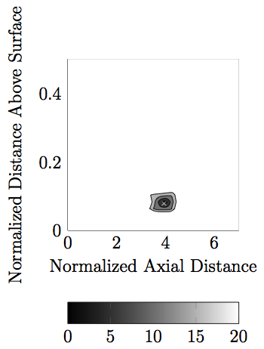
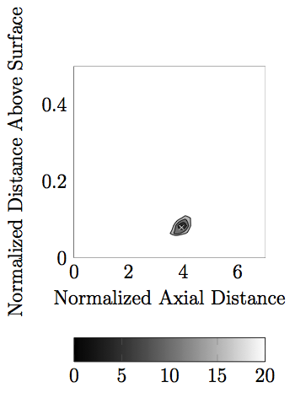
Results of the optimization (cont’d)
Two Points
Three Points
Notes:
The one point error map shown previously will be the same since one point in a relative shape is always just one point and the results will always be the same.
The error map shown on the right with the new optimized search shape results in a dramatic decrease in the possible solutions even with 2 sample points.
With 3 sample points the number of possible solutions reduces to one relatively quickly converging solution.

Slide 14
Results from the solution strategy
Original Shape Error
Optimized Shape Error
Notes:
These two graphs demonstrate the difference between the before and after optimized search shape.
These unique cases quite nicely show the problem with the original search shape.
Samples 2 and 4 show a large error in the perpendicular direction which infers that the converged answer was not the correct answer, but one of the close alternatives. 5, 6, and 7 are a more typical result from the original search shape.
Notice the scale of the two plots a maximum of 12% versus a maximum of 0.6%
Overall these results show that the optimized search shape is more consistent with predicting the correct solution of the inverse problem.

Slide 15
Conclusions
Optimization results in
a significant reduction of possible solutions
an increase in convergence gradient
a decrease in solution error from the typical 5% to less than 0.5%
a decrease of required samples from 5 to 3
Overall the inverse solution strategy is now more capable, but still requires work such as expansion into the 3rd dimension and transient solutions.
Notes:
The inverse solution strategy was already a capable and useful tool for solving inverse convection problems.
After the optimization the accuracy was significantly increased while decreasing the possibility of the false solutions. The optimization also reduced the required number of samples from 5 to 3.

Slide 16
Thank you
Questions?
Notes:
Any Questions

