Slide 1
ChIP-seq analysis
M. Defrance, C. Herrmann, S. Le Gras, D. Puthier, M. Thomas.Chollier, J. van Helden
Data visualization, quality control, normalization & peak calling
  Presentation (Carl Herrmann)
  Practical session
Peak annotation
  Presentation (Matthieu Defrance)
  Practical session
From peaks to motifs
  Presentation (Jacques van Helden)
  Practical session
Reads
Peaks
Annotations
Motifs

Slide 2
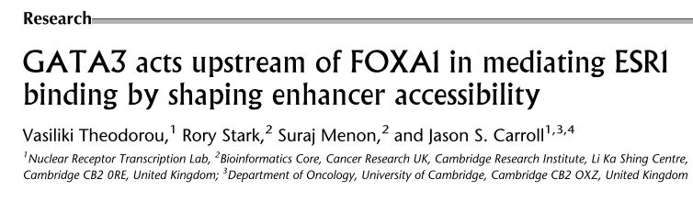
Datasets used
Oestrogen-receptor (ESR1) is a key factor in breast cancer development
Goal of the study: understand the dependency of ESR1 binding on presence of co-factors, in particular GATA3, which is mutated in breast cancers
Approaches: GATA3 silencing (siRNA), ChIP-seq on ESR1 in wt vs. siGATA3 conditions, chromatin profiling

Slide 3
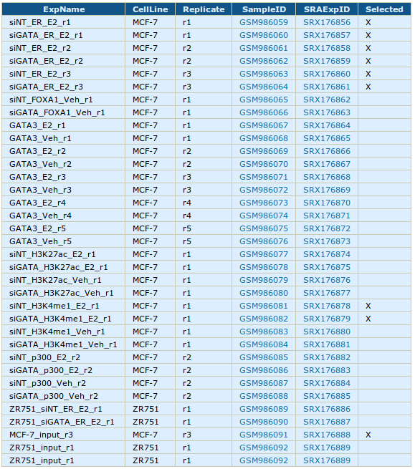
Datasets used
ESR1 ChIP-seq in WT & siGATA3 conditions
( 3 replicates = 6 datasets)
H3K4me1 in WT & siGATA3 conditions
(1 replicate = 2 datasets)
Input dataset in MCF-7
(1 replicate = 1 dataset)
p300 before estrogen stimulation
GATA3/FOXA1 ChIP-seq before/after estrogen stimulation
microarray expression data, etc ...

Slide 4
Hands on !!
Let's have a look at the data

Slide 5
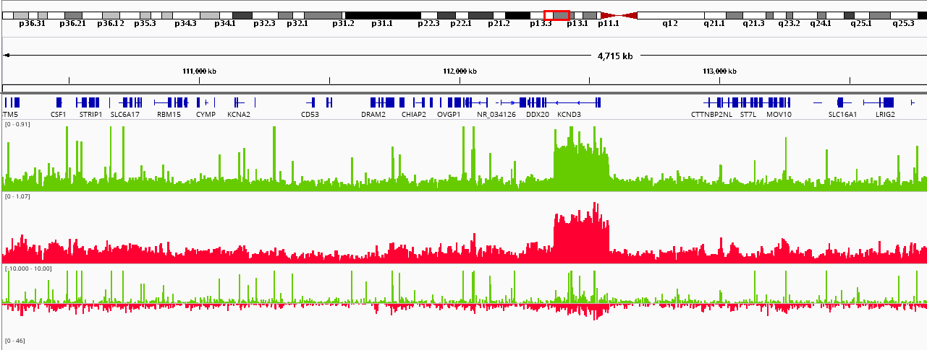
What we want to do
do we have
more signal here ...
… than here ?

Slide 6
Keys aspects of ChIP-seq analysis
Quality Control : do I have signal ?
Determine signal coverage
Modelling noise levels
Scaling/normalizing datasets
Detecting enriched peak regions
Performing differential analysis

Slide 7
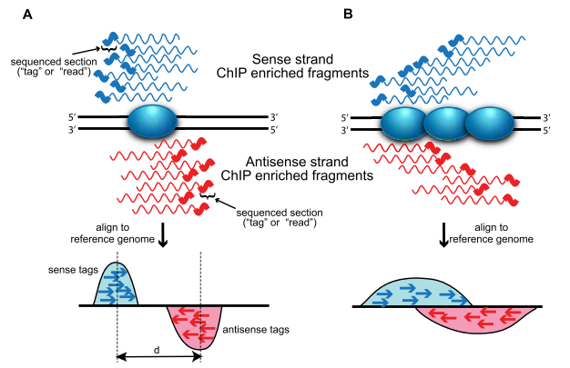
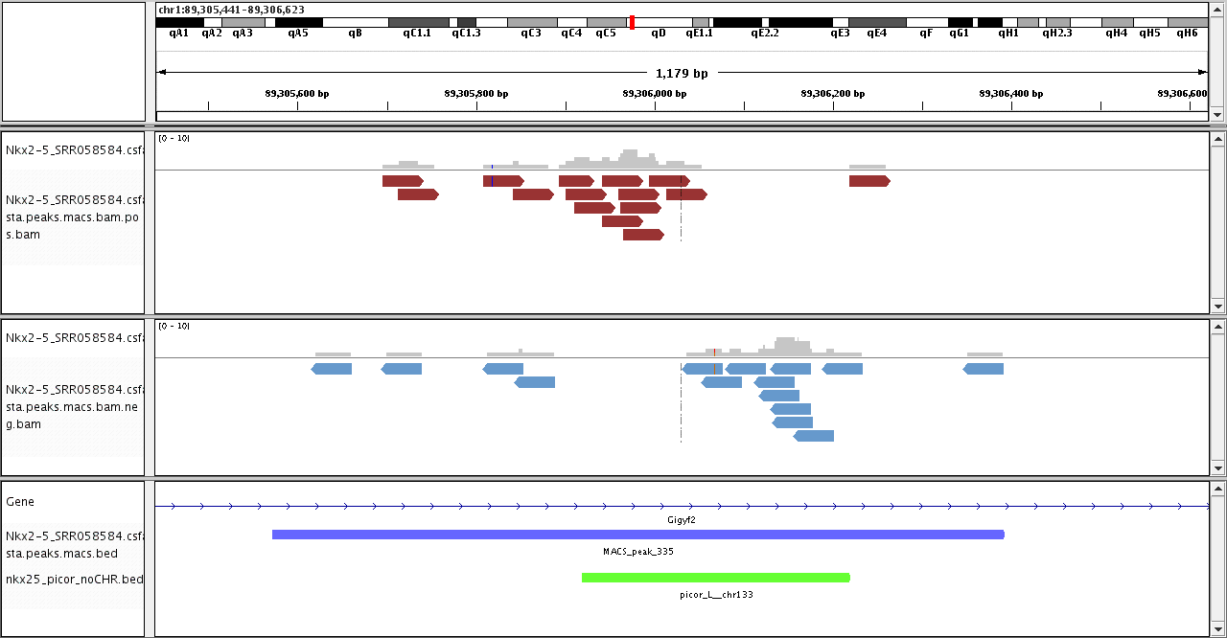
0. Principle of ChIP-seq
The binding site itself is
generally not sequenced !
We expect to see a typical strand asymmetry in read densities
→ ChIP peak recognition pattern
[Wilbanks & Faccioti PLoS One (2010)]

Slide 8
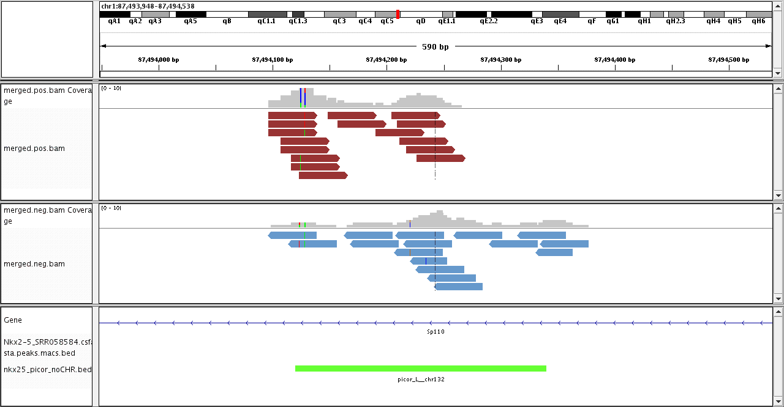
0. Principle of ChIP-seq
Strand asymmetry is blurred when multiple proteins bind
or in case of histone modifications ChIP
[Wilbanks & Faccioti PLoS One (2010)]

Slide 9
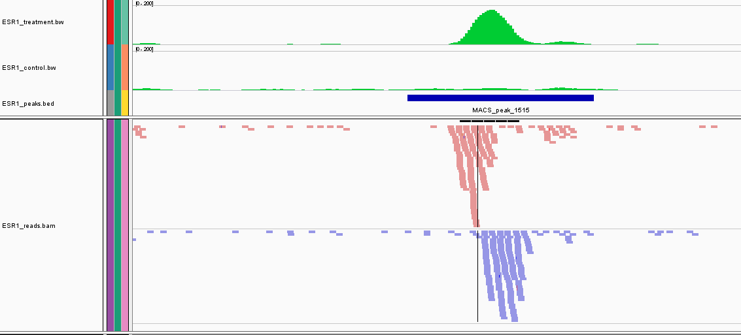
Principle of ChIP-seq
treatment read density (=WIG/bigWig)
input read density (=WIG/bigWig)
peak (=BED)
aligned reads + strand (=BAM)
aligned reads - strand (=BAM)

Slide 10
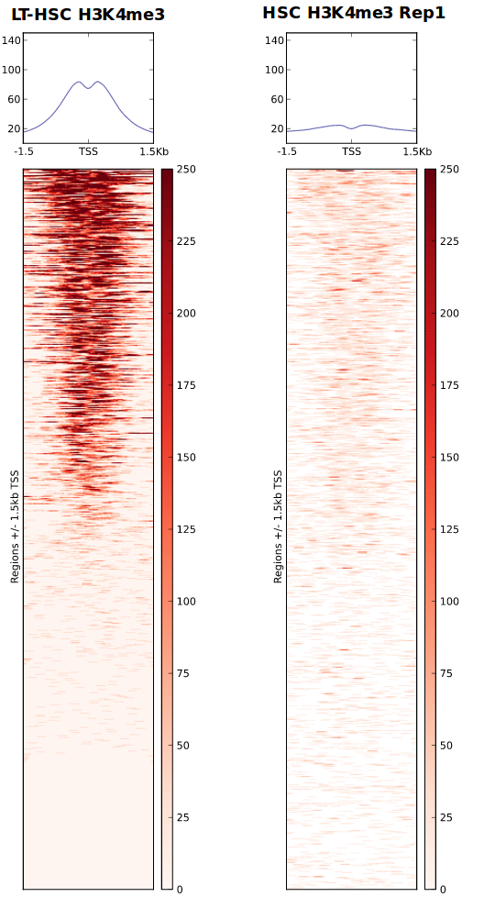
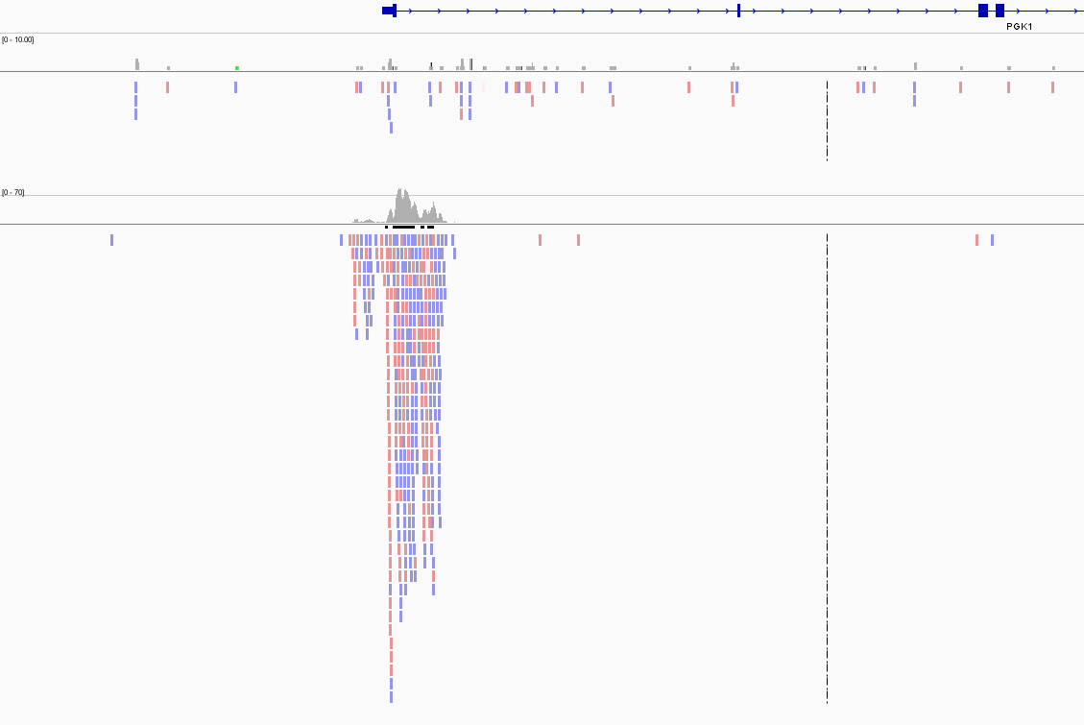
1. Quality control
Qualitative
  Look at your favourite gene/locus in IGV !
  Heatmap of signal
  → e.g. H3K4me3 at promoters

Slide 11
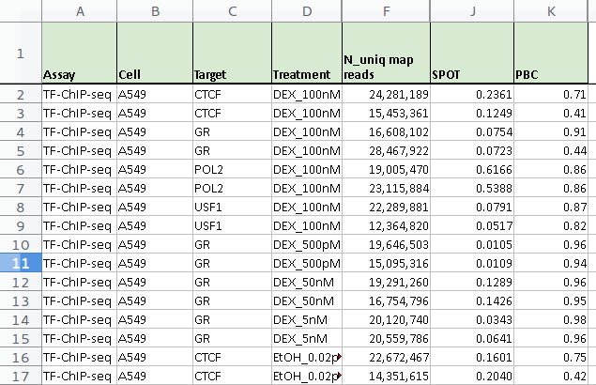
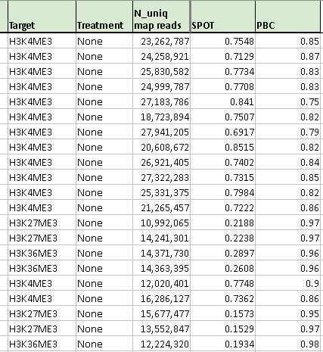
1. Quality control
Quantitative
  Fraction of reads in peaks (FRiP)
  → depends on type of ChIP (TF/histone)
  PCR Bottleneck coefficient (PBC) : measure of library complexity
Genomic positions
with 1 read aligned
PBC < 0.5
0.5 < PBC < 0.8
0.8 < PBC
Genomic positions
with ≥ 1 read aligned
https://www.encodeproject.org/data-standards/2012-quality-metrics/

Slide 12
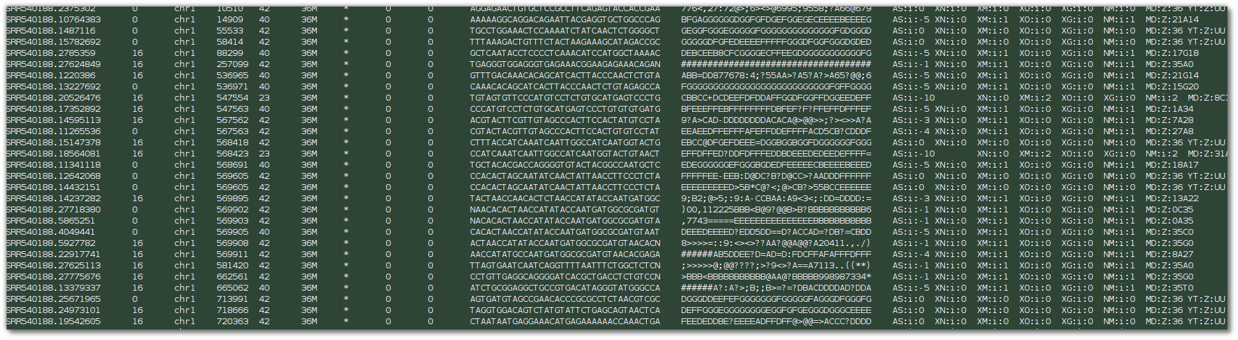
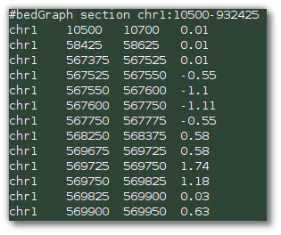
2. from reads to coverage
to visualize the data, we use coverage plots (=density of fragments per genomic region)
need to reduce BAM file to more compact format
→ bigWig/bedGraph

Slide 13
2. from reads to coverage
Reads are extended to 3' to fragment length
Read counts are computed for each bin
Counts are normalized
  reads per genomic content
  → normalize to 1x coverage
  reads per kilobase per million reads per bin
→ deepTools : bamCoverage

Slide 14
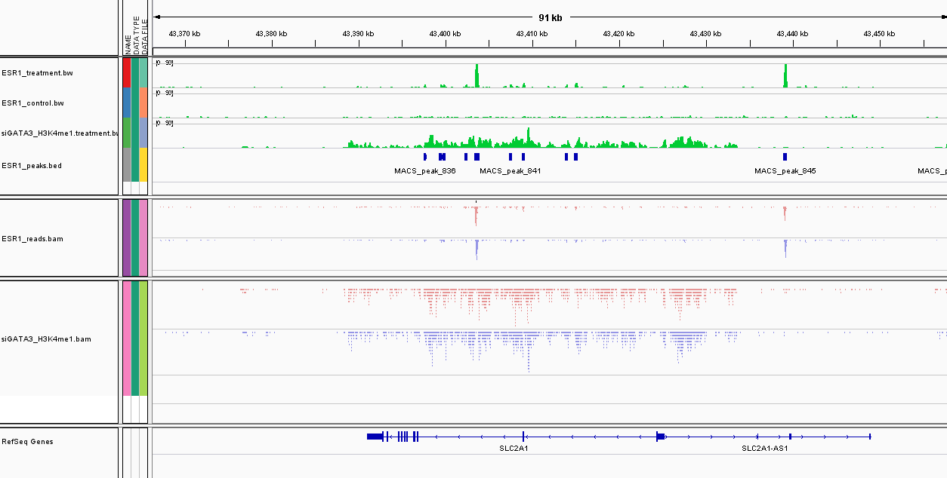
2. from reads to coverage
ESR1
input
H3K4me1
ESR1
reads
H3K4me1
reads

Slide 15
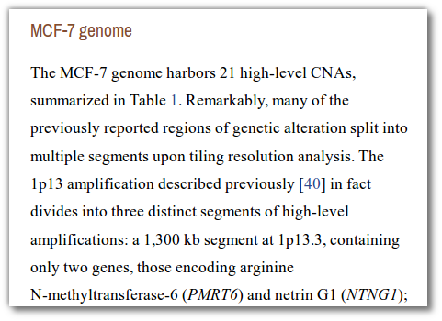
3. signal and noise
MCF7 genome
hg19 reference genome

Slide 16
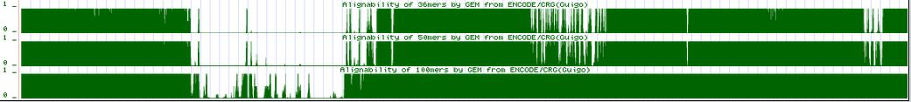
3. signal to noise
treatment
input
k=35
k=50
k=100
Mappability issue : “alignability” track shows, how many times a read from a given position of the genome would align
  a=1 → read from this position ONLY aligns to this position
  a=1/n → read from this position could align to n locations
→ we usually only keep uniquely aligned reads : positions with a < 1 have no reads left

Slide 17
3. signal to noise
The availability of a control sample in
mandatory !
→ mock IP with unspecific antibody
→ sequencing of input (=naked) DNA

Slide 18
4. modelling background level
How to get a noise free track ?
naïve subtraction treatment – input is not possible, because both libraries have different sequencing depth !
Solution 1 : before subtraction, scale both libraries by total number of reads (library size)
  RPGC
  RPKM

Slide 19
4. modelling background level
scale smaller dataset
Treatment
N= 10 M reads
Input
N'= 12 M reads
Problem : signal influences scaling factor
More signal (but equal noise) → artificial noise over-estimation

Slide 20
4. modelling background level
input
1
area ~ number of reads = 10
10
5
treatment
1
area ~ number of reads = 10 + 4 + 4 = 18
10
Scaling by library size : upscale input by 18/10 = 1.8
5
treatment
estimated noise level
1
Noise level is over-estimated !
10

Slide 21
4. modelling background level
input
1
area ~ number of reads = 10
10
5
treatment
1
area ~ number of reads = 10 + 9 + 4 = 23
10
Scaling by library size : upscale input by 23/10 = 2.3
5
treatment
estimated noise level
1
10

Slide 22
4. modelling background level
input
1
area ~ number of reads = 10
10
5
treatment
1
area ~ number of reads = 10 + 9 + 4 = 23
10
Scaling by library size : upscale input by 23/10 = 2.3
5
treatment
estimated noise level
1
10

Slide 23
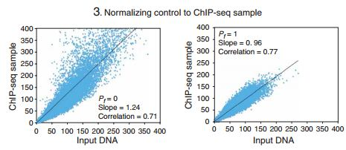
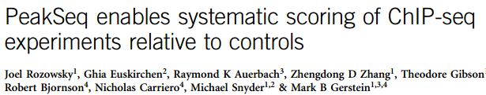
4. modelling background level
more advanced : linear regression by excluding peak regions (PeakSeq)
read counts in 1Mb regions in input and treatment
all regions
excluding enriched (=signal) regions

Slide 24
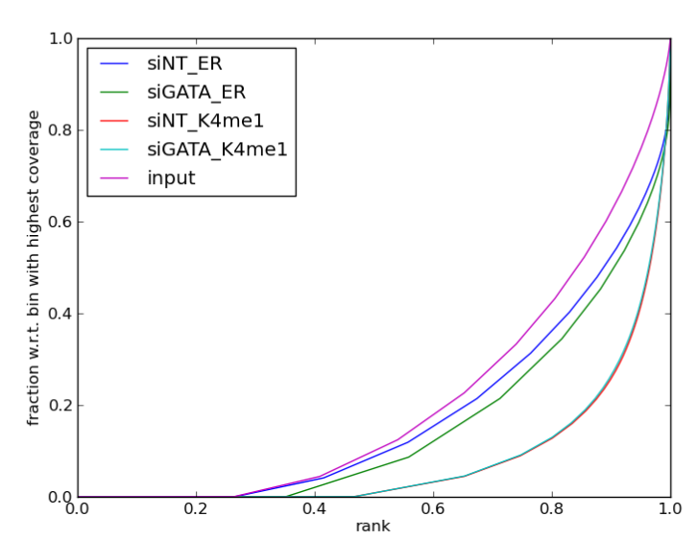
4. modelling background level
Alternative strategy
(deepTools → Diaz et al.)
  bin genome into n 10 kb windows
  count reads in each window for input (X_{i}) and treatment (Y_{i})
  total number of reads is N_{X} and N_{Y}
  order Y_{i} from less to most enriched → Y_{(i)}
  define and plot
  p_{j} = proportion of reads in the j less enriched windows
25% of the genome
contains no reads !
90% of the genome
contain ~ 25% of reads

Slide 25
4. modelling background level
this is were pj and qj
differ most
this is were p_{j} and q_{j}
differ most
both datasets contain only noise in this range
treatment dataset
contains signal
→ scale according to number of reads in this range

Slide 26
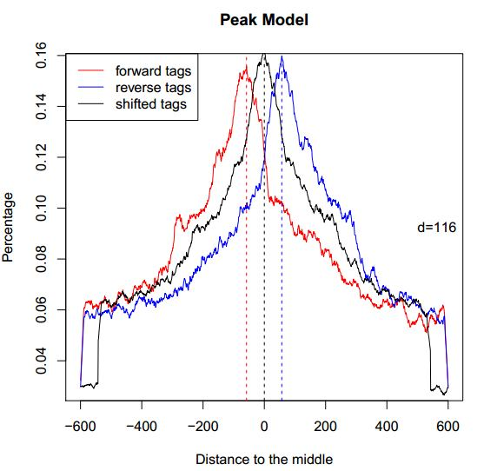
5. from reads to peaks
Tag shifting vs. extension
  positive/negative strand read peaks do not represent the true location of the binding site
  fragment length is d and can be estimated from strand asymmetry
  reads can be elongated to
  a size of d
  reads can be shifted by d/2
  → increased resolution
example of MACS model building
using top enriched regions

Slide 27
5. from reads to peaks
“Read shifting”
d

Slide 28
5. from reads to peaks
“Read extension”
d

Slide 29
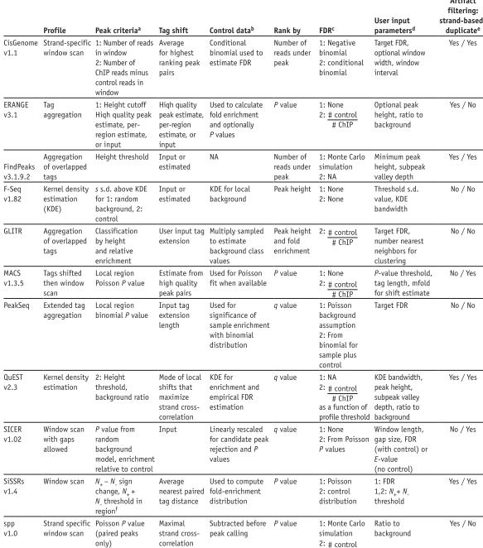

5. From reads to peaks: peak-calling approaches
Pepke,S., Wold,B. and Mortazavi,A. (2009) Computation for ChIP-seq and RNA-seq studies. Nature Methods, 6, S22–32.

Slide 30
Some methods separate the tag densities
into different strands and take advantage
of tag asymmetry
Most consider merged densities and
look for enrichment

Slide 31
Tag shift
Tag extension
Tags unchanged

Slide 32
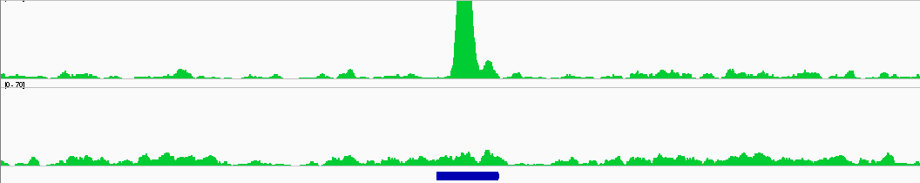
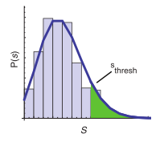
5. from reads to peaks
Determining “enriched” regions
  sliding window across the genome
  at each location, evaluate the enrichement of the signal wrt. expected background based on the distribution
  retain regions with P-values below threshold
  evaluate FDR
Pval < 1e-20
Pval ~ 0.6

Slide 33
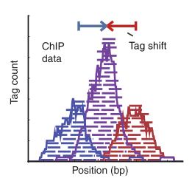
6. MACS [Zhang et al. Genome Biol. 2008]
Step 1 : estimating fragment length d
  slide a window of size BANDWIDTH
  retain top regions with MFOLD enrichment of treatment vs. input
  plot average +/- strand read densities → estimate d
enrichment
> MFOLD
treatment
control

Slide 34

5. MACS [Zhang et al. Genome Biol. 2008]
Step 2 : identification of local noise parameter
  slide a window of size 2*d across treatment and input
  estimate parameter λlocal of Poisson distribution
estimate λ over diff. ranges
→ take the max
1 kb
5 kb
10 kb
full genome

Slide 35
5. MACS [Zhang et al. Genome Biol. 2008]
Step 3 : identification of enriched/peak regions
  determine regions with P-values < PVALUE
  determine summit position inside enriched regions as max density
P-val = 1e-30

Slide 36
5. MACS [Zhang et al. Genome Biol. 2008]
Step 4 : estimating FDR
  positive peaks (P-values)
  swap treatment and input; call negative peaks (P-value)
increasing P-value
# negative peaks with Pval < p
FDR(p) =
# positive peaks with Pval < p
FDR = 2/25=0.08

Slide 37
How to choose a peak-caller and tune its parameters ?
More than 30 peak-callers are currently available (see Pepke et al., 2009 for a review of some of these).
Some are dedicated to broad peaks (e.g. SICER), others to narrow peaks (e.g. SWEMBL).
Some peak-caller have different settings for narrow peaks and broad peaks (e.g. MACS, SPP).
Thresholds affect drastically the number of peaks, and their width (small neighbour peaks can be regrouped in a wider peak).
With the same dataset, the number of peaks can vary from a few hundreds to >100.000, depending on tuning parameters !
Pepke,S., Wold,B. and Mortazavi,A. (2009) Computation for ChIP-seq and RNA-seq studies. Nature Methods, 6, S22–32.

Slide 38
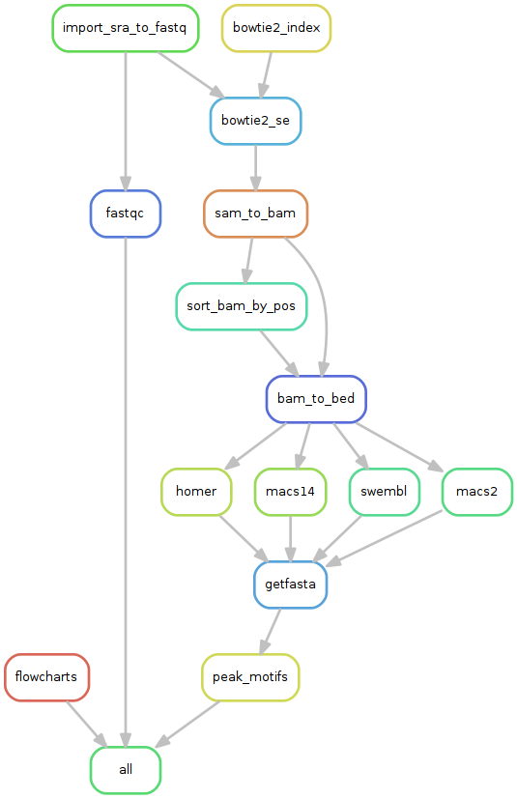
ChIP-seq workflow
Claire Rioualen, France Génomique project 2015-2016.
Workflow to compare peak-callers.

Slide 39
Mutual overlap between peaks (numbers of peaks)
Castro-Mondragon, Claire Rioualen, Bruno Contreras and Jacques van Helden (2016). MiMB.
Peak-caller | ID | f1 | f2 | f3 | f4 | f5 | f6 | f7 | f8 | f9 | f10 | f11
Macs2 (default) | f1 | 2931 | 3335 | 2699 | 2854 | 3408 | 532 | 1298 | 2224 | 2704 | 2848 | 3263
Macs2 (custom) | f2 | 2930 | 9711 | 5494 | 8136 | 9576 | 544 | 1340 | 2767 | 5020 | 8840 | 11973
Macs14 (custom) | f3 | 2895 | 7360 | 6242 | 7359 | 9767 | 535 | 1325 | 2659 | 4510 | 9518 | 17225
Homer | f4 | 2851 | 8884 | 6114 | 18812 | 16898 | 534 | 1328 | 2743 | 5091 | 17125 | 24503
SPP (fdr=0.01) | f5 | 2920 | 9291 | 6166 | 15364 | 24781 | 544 | 1333 | 2751 | 5104 | 20399 | 39018
SPP (fdr=0.001) | f6 | 534 | 640 | 533 | 534 | 680 | 544 | 532 | 533 | 536 | 557 | 654
SWEMBL (R=0.1; x=1.2) | f7 | 1374 | 1764 | 1294 | 1377 | 1786 | 534 | 1352 | 1343 | 1340 | 1368 | 1502
SWEMBL (R=0.07; x=1.2) | f8 | 2355 | 3606 | 2561 | 2861 | 3679 | 535 | 1352 | 2788 | 2765 | 2864 | 3424
SWEMBL (R=0.05; x=1.2) | f9 | 2852 | 6302 | 4224 | 5316 | 6697 | 538 | 1352 | 2787 | 5256 | 5541 | 7277
SWEMBL (R=0.02; x=1.2) | f10 | 2931 | 9692 | 6236 | 16734 | 20518 | 544 | 1352 | 2788 | 5256 | 31867 | 41904
SWEMBL (R=0.01; x=1.2) | f11 | 2931 | 9710 | 6242 | 18611 | 24365 | 544 | 1352 | 2788 | 5256 | 31864 | 92695

Slide 40
Mutual overlap between peaks (numbers of peaks)
Castro-Mondragon, Claire Rioualen, Bruno Contreras and Jacques van Helden (2016). MiMB.
Peak-caller | Peaks | ID | f1 | f2 | f3 | f4 | f5 | f6 | f7 | f8 | f9 | f10 | f11
Macs2 (default) | 2931 | f1 | 1 | 0.34 | 0.43 | 0.15 | 0.14 | 0.98 | 0.96 | 0.8 | 0.51 | 0.09 | 0.04
Macs2 (custom) | 9711 | f2 | 1 | 1 | 0.88 | 0.43 | 0.39 | 1 | 0.99 | 0.99 | 0.96 | 0.28 | 0.13
Macs14 (custom) | 6242 | f3 | 0.99 | 0.76 | 1 | 0.39 | 0.39 | 0.98 | 0.98 | 0.95 | 0.86 | 0.3 | 0.19
Homer | 18812 | f4 | 0.97 | 0.91 | 0.98 | 1 | 0.68 | 0.98 | 0.98 | 0.98 | 0.97 | 0.54 | 0.26
SPP (fdr=0.01) | 24781 | f5 | 1 | 0.96 | 0.99 | 0.82 | 1 | 1 | 0.99 | 0.99 | 0.97 | 0.64 | 0.42
SPP (fdr=0.001) | 544 | f6 | 0.18 | 0.07 | 0.09 | 0.03 | 0.03 | 1 | 0.39 | 0.19 | 0.1 | 0.02 | 0.01
SWEMBL (R=0.1; x=1.2) | 1352 | f7 | 0.47 | 0.18 | 0.21 | 0.07 | 0.07 | 0.98 | 1 | 0.48 | 0.25 | 0.04 | 0.02
SWEMBL (R=0.07; x=1.2) | 2788 | f8 | 0.8 | 0.37 | 0.41 | 0.15 | 0.15 | 0.98 | 1 | 1 | 0.53 | 0.09 | 0.04
SWEMBL (R=0.05; x=1.2) | 5256 | f9 | 0.97 | 0.65 | 0.68 | 0.28 | 0.27 | 0.99 | 1 | 1 | 1 | 0.17 | 0.08
SWEMBL (R=0.02; x=1.2) | 31867 | f10 | 1 | 1 | 1 | 0.89 | 0.83 | 1 | 1 | 1 | 1 | 1 | 0.45
SWEMBL (R=0.01; x=1.2) | 92695 | f11 | 1 | 1 | 1 | 0.99 | 0.98 | 1 | 1 | 1 | 1 | 1 | 1

Slide 41
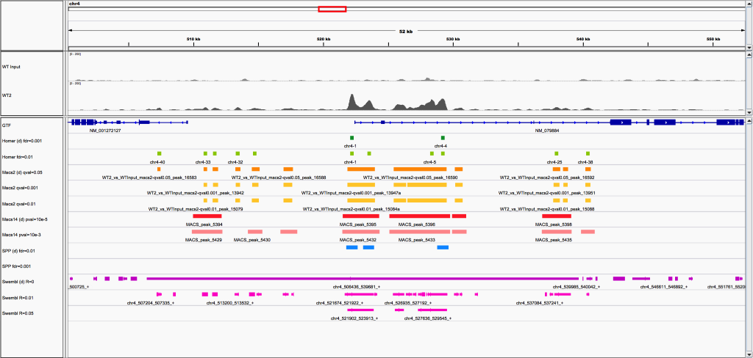
Peak-calling choices do matter !
With the same dataset, the number of peaks can vary from a few hundreds to >100.000, depending on tuning parameters !
Figure from Claire Rioualen, 2016, data from Andy Saurin (Abd-A in D.melanogaster)

Slide 42

Peak-calling choices do matter !
With the same dataset, the number of peaks can vary from a few hundreds to >100.000, depending on tuning parameters !
Figure from Claire Rioualen, 2016, data from Andy Saurin (Abd-A in D.melanogaster)

Slide 43
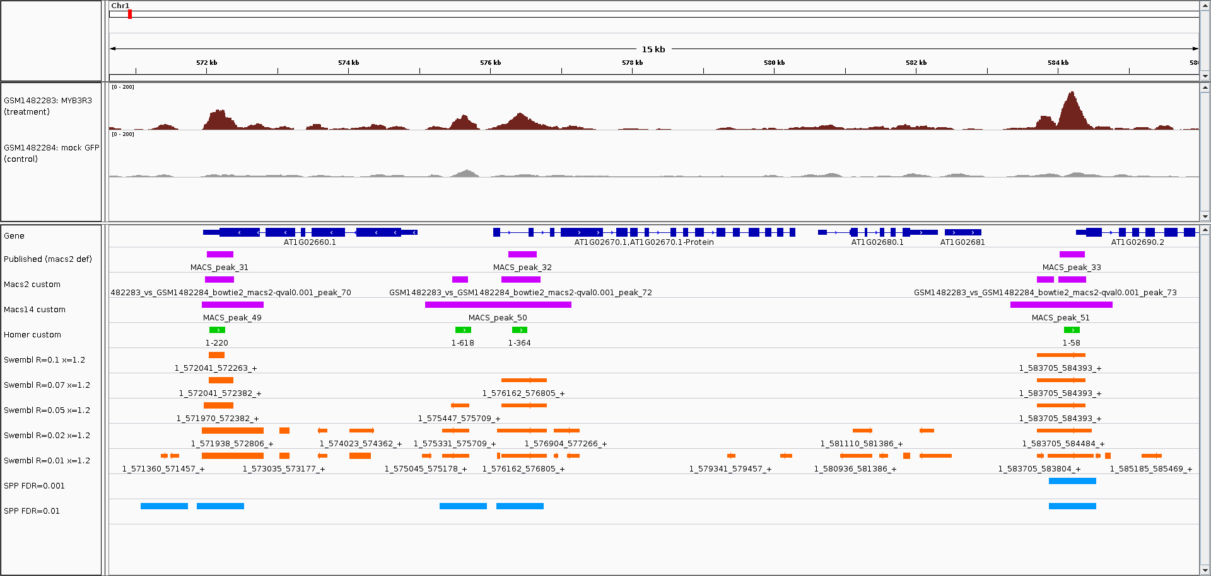
Peak-calling choices do matter !
With the same dataset, the number of peaks can vary from a few hundreds to >100.000, depending on tuning parameters !
Figure from Claire Rioualen, 2016, MYB3R ChIP-seq in A.thaliana

Slide 44
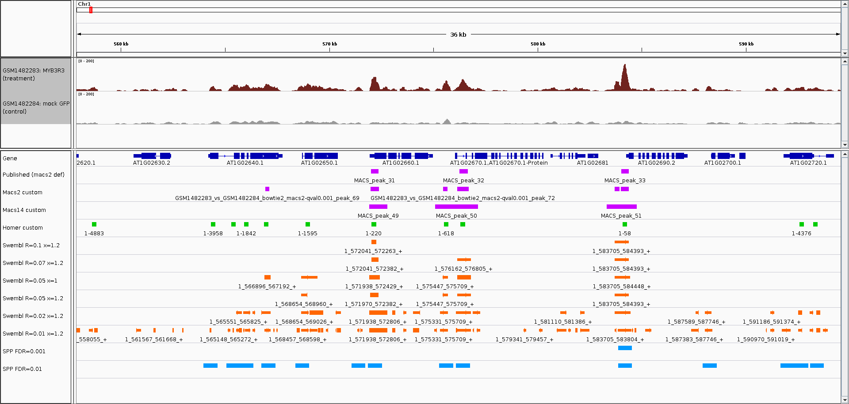
Peak-calling choices do matter !
With the same dataset, the number of peaks can vary from a few hundreds to >100.000, depending on tuning parameters !
Figure from Claire Rioualen, 2016, MYB3R ChIP-seq in A.thaliana

Slide 45
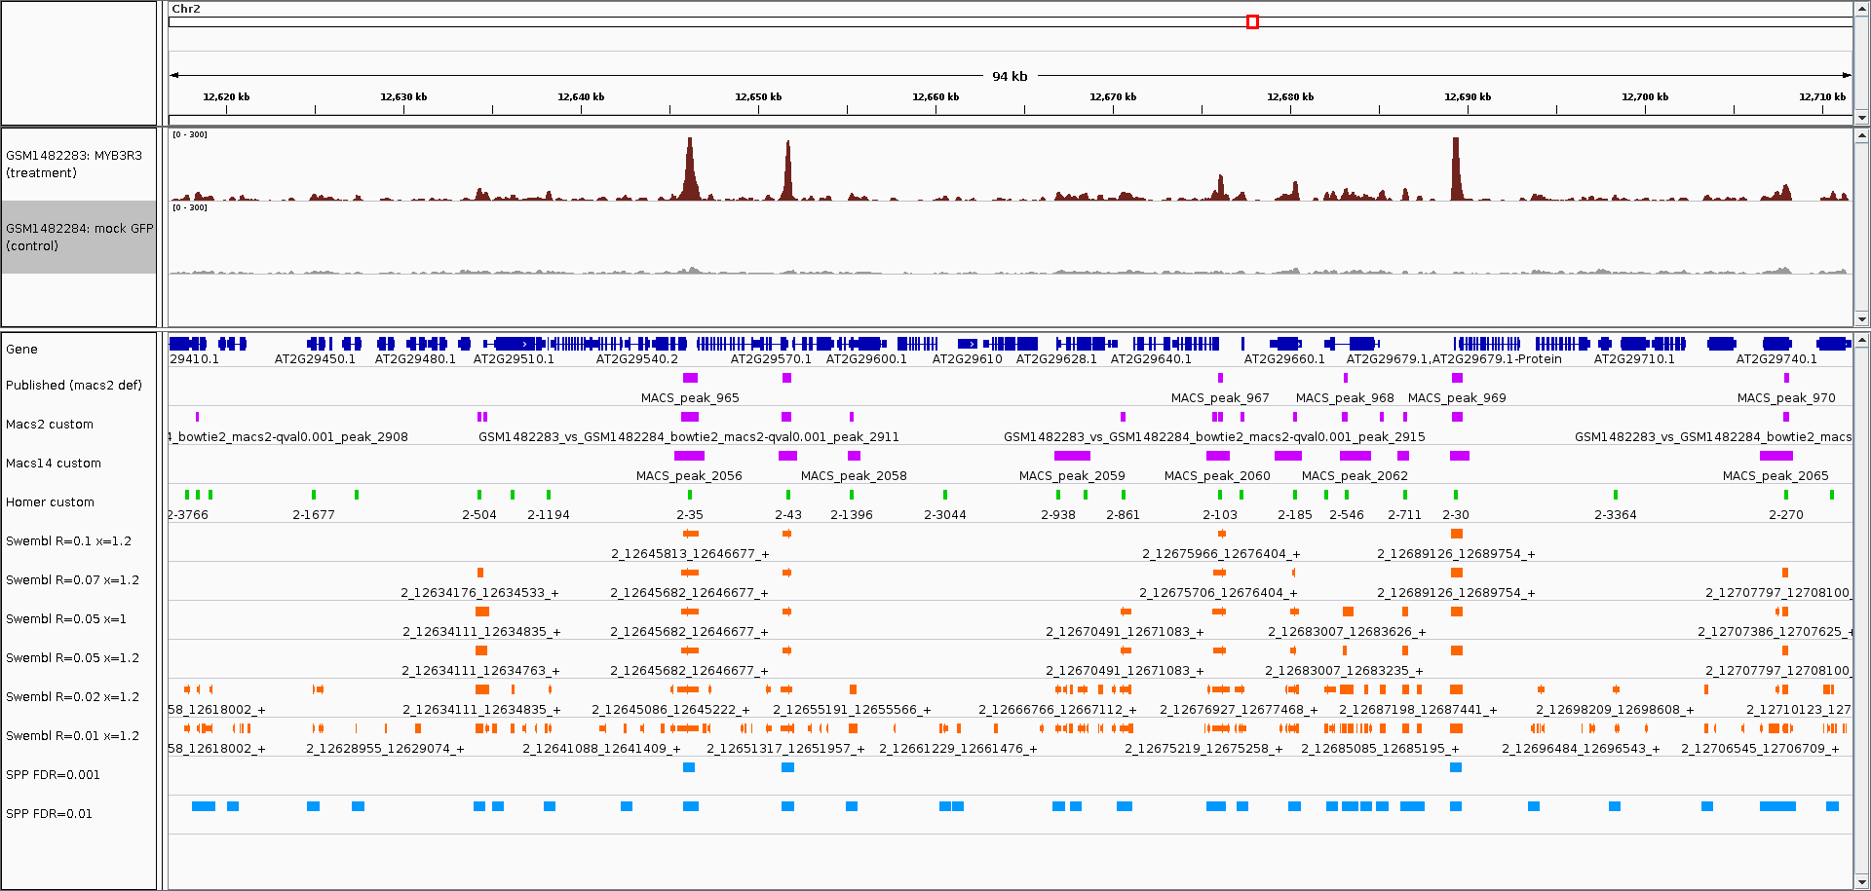
Peak-calling choices do matter !
With the same dataset, the number of peaks can vary from a few hundreds to >100.000, depending on tuning parameters !
Figure from Claire Rioualen, 2016, MYB3R ChIP-seq in A.thaliana

Slide 46
6. differential analysis
given ChIP-set datasets in different conditions, we want to find differential binding events between 2 conditions
  binding vs. no binding → qualitative analysis
  weak binding vs. strong binding → quantitative analysis
Condition A
Condition B
stronger
binding
in A
stronger
binding
in B
binding in A
no binding in B
no difference
binding in B
no binding in A

Slide 47
6. differential analysis
simple approach → compute common and specific peaks
Condition A
Condition B
Drawback :
- common peaks can hide differences in binding intensities
- specific peaks can result from threshold issues

Slide 48
6. differential analysis
quantitative approach
  select regions which have signal (union of all peaks)
  in these regions, perform quantitative analysis of differential binding based on read counts
statistical model
  without replicates : assume simple Poisson model (→ SICER-df)
  with replicates : perform differential test using DE tools from RNA-seq (diffBind using EdgeR, DESeq,...) based on read counts

Slide 49
6. differential analysis
without replicates (sicer-df)
  consider one condition to be the reference (condition A)
  call peaks on each condition independently
  take union of peaks
  assume Poisson model based on
  expected number of reads in region
  compute P-value, log(fold-change)
λ₁
λ₂
λ₃
λ₄
λ₅
n₁
n₂
n₃
n₄
n₅

Slide 50
6. differential analysis
with replicates (diffBind)
  provide list of peaks for replicates A and replicates B
  determine consensus peakset based on presence in at least n datasets
  compute read counts in each consensus peak in each dataset
  run DESeq / EdgeR to determine differential peaks between condition A and B (negative binomial model, variance estimated on replicates)
peaks A
peaks B
consensus peaks (if n ≥2)

Slide 51
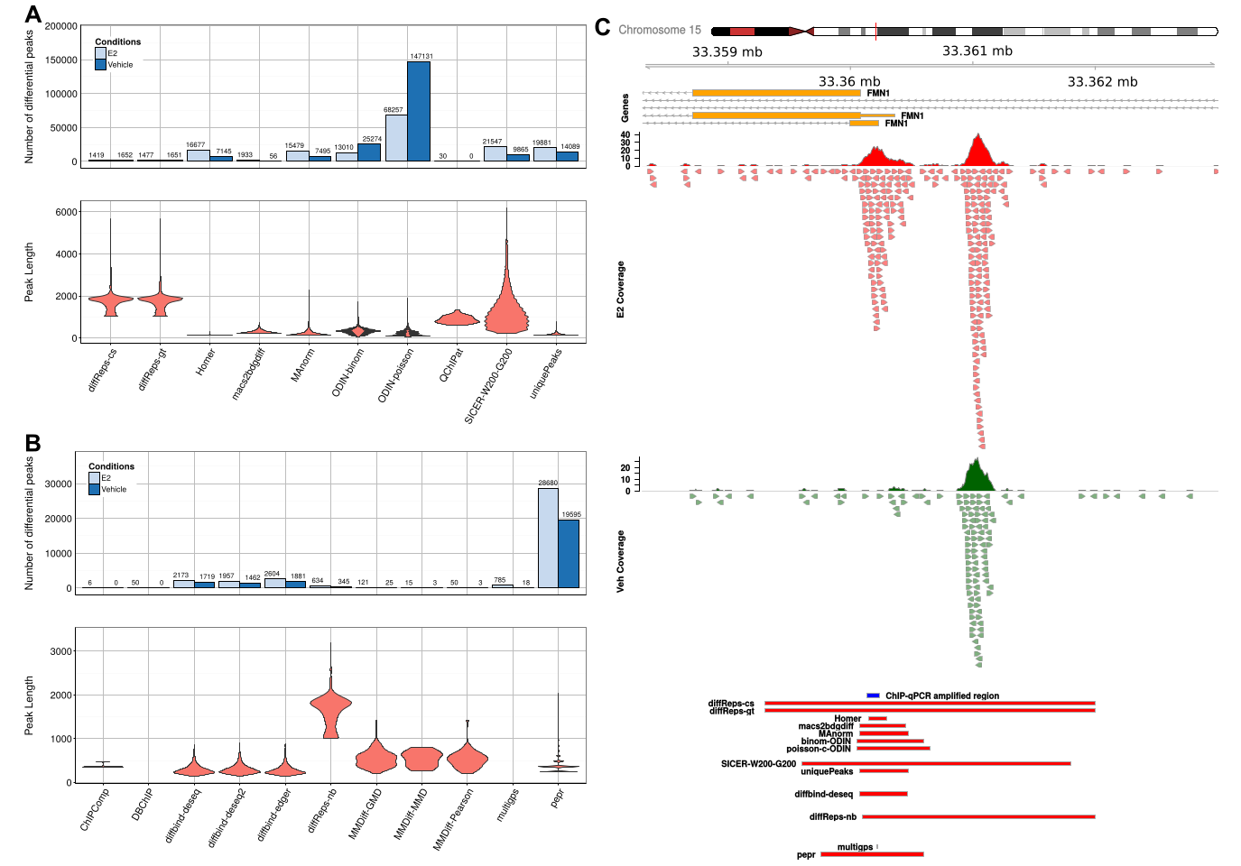
6. differential analysis
Considerable differences in peak numbers and sizes !

Slide 52
Program of the Practical Session
Step 0 : Find datasets on Gene Expression Omnibus
Step 1 : Import datasets into your Galaxy history
Step 2 : data inspection : coverage plots, correlation,...
Step 3 : peak calling using MACS
Step 5 : differential analysis
Step 6 : visualizing results in IGV

