Slide 1
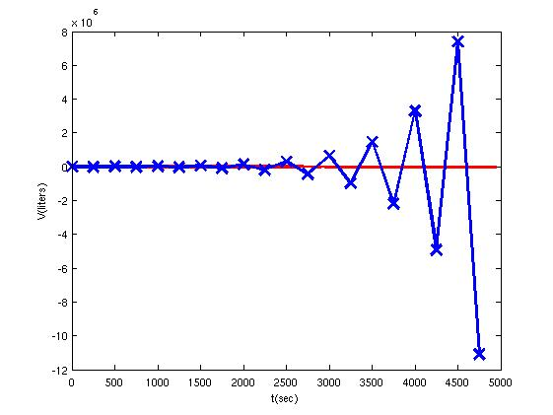


Heat diffusion equation
Timestep stability criterion
Essential versus natural
boundary conditions

Slide 2
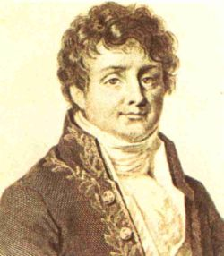
Heat diffusion: Fourier’s law
Joseph Fourier
dx
k
hot: T+ΔT
dT
T: cold
q
q
‘heat conductivity’
Notes:
2 ingredients for heat eqn:
Ingredient 1: Fourier’s law = empirical;
minus-sign because heat flows from H→C, i.e. in negative direction of T-gradient
1 material parameter needed: heat conductivity

Slide 3
Conservation of heat (energy)
using:
Δz
q(x)
q(x+ Δx)
Δy
Δx
Notes:
Ingredient 2) Heat conservation
Heat energy cannot (dis)appear, i.e.net influx increases total heat inside cube

Slide 4
Heat conservation and Fourier’s law
if
is constant
‘heat
diffusivity’
Notes:
Previously we used dv/dt = (Vnew-Vold)/Dt, or (V(t+dt)-V(t))/dt
Here, we can use the same, but with q and x instead of V and t:
Dq/dx = (q(x+dx)-q(x))/dx

Slide 5
From Physics to Model
Modelling one point/parameter through time:
n=0
time step n
n=N_{t}
T

Slide 6
From Physics to Model
Modelling N independent points through time:
n=0
time step n
n=N_{t}
T₁
T₂
T₃
location i
T₄
T₅

Slide 7
From Physics to Model
Modelling N dependent points through time:
n=0
time step n
n=N_{t}
T₁
T₂
T₃
location i
T₄
T₅

Slide 8
From Physics to Model
Modelling N dependent points through time:
n=0
time step n
n=N_{t}
T₁
T₂
T₃
location i
T₄
T₅
Model an array of data at time t, rather than a bunch of independent points

Slide 9
Initial and boundary conditions
Initial conditions need to be provided for every grid point (only at t=0).
Boundary conditions need to be provided for every time step (only at first and last grid point).
Δt
x
initial conditions
Δx
boundary conditions
t →

Slide 10
Time derivative → finite difference
T
dt
T^{n+1}
dT
T^{n}
t^{n}
t^{n+1}
t
Δt
Notes:
So how to describe this diffusion equation numerically, ie. to discretize it? It has a double derivative, but let’s first look at how we discretize a single derivative.
This is what we did for a single time derivative ….

Slide 11
Spatial derivative → finite difference
→
T
dx
T_{i+1}
dT
T_{i}
Other ways to calculate derivative:
x_{i}
x_{i+1}
x
Δx
Notes:
Exactly the same principle applies for a spatial derivative …
We cannot easily go forward and backward in time (not even in a numerical model, since we need an old solution to calculate the new one), but moving forward and backward in a spatial dimension is easier.
So we can write a spatial derivative in various different ways, and the solution of each of them is centred around a different location. We’ll be using all of these forms at some point during the course. In a way, it is up to you which ones to use, but some make more sense than others, and some work better than others, depending on the situation.

Slide 12
The second-order derivative
Notes:
Double derivative = derivative of derivative.
- Write d/dx(dTdx) = d/dx(S), then use the +-half dx discretisation (see previous slide) to calculate dS/dx
- then discretize each S = dT/dx again with the +-half dx approach

Slide 13
The second-order derivative
Notation !
How to program this in Python?
Notes:
How to program:
1) Loop i over all internal grid points
calculate each term
2) ( T(2:)-2*T(1:-1)+T(0:-2))/dx**2
3) np.diff(fin,n=2)/dx**2

Slide 14
Forward spatial derivative
Taylor expansion:
Truncate:
Re-arrange:
So this derivative is ‘first-order accurate’.
or:

Slide 15
Backward spatial derivative
Taylor expansion:
Truncate:
Re-arrange:
This derivative is also ‘first-order accurate’.
or:

Slide 16
The second-order derivative
Adding up:
or:
Re-arranging:
or:
This 2nd-derivative is ‘second-order accurate’ (i.e. more accurate).

Slide 17
Practical 2, part 1:
Modelling a cooling ocean lithosphere:
Familiarise yourself with the model and equations using a simple scenario and paper and pencil
Complete the model in Python by adding your own subfunction for diffusion
Explore how numerical and analytical solutions compare and the effect of different discretisation steps in time and space
If time permits, calculate the growth of the lithosphere with time
https://community.dur.ac.uk/jeroen.van-hunen/Subitop/session2.html

Slide 18
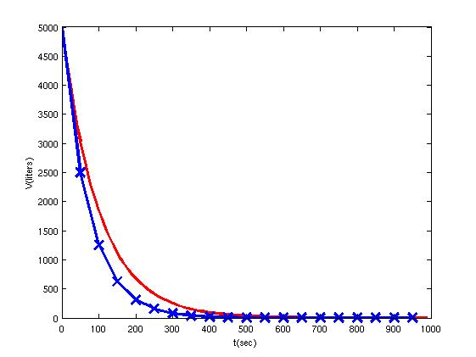
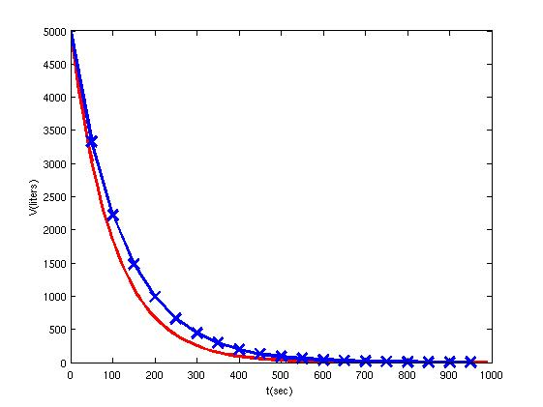
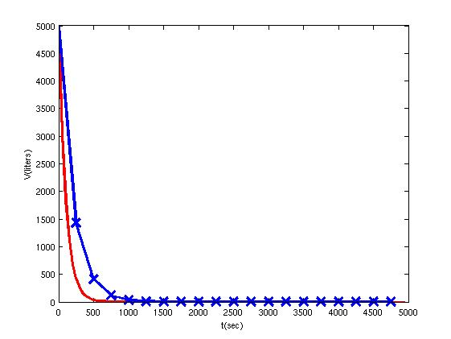
Stability criterion: exp. decay function
Δt=50 sec
Δt=250 sec
Euler
forward
Euler
backward

Slide 19
Stability criterion for Euler forward
Differential equation:
Discretized solution with error:
Subtract solution w/out error:
Error in solution:
To keep error from growing:
This restricts time step:
Notes:
-1<(1-aDt)<1
-2<-aDt, or 2>aDt or Dt<2/a
and
-aDt<0 (always ok because a and Dt are both positive

Slide 20
Stability criterion
a=0.01
so Δt_{crit}= 2/a = 200 sec.
Δt=50 sec
Δt=250 sec

Slide 21
Stability criterion for Euler backward
differential equation:
discretized solution:
So error in solution:
To keep error from growing:
Criterion always met!

Slide 22
Practical 2, Part 2
Try for yourself:
Use your radiogenic heating code:
Calculate Δt_{crit}
Increase t_{max} to 100 Gyrs
Try different Δt
Use your heat diffusion code:
Increase timestep and see what happens
https://community.dur.ac.uk/jeroen.van-hunen/Subitop/session2.html

Slide 23
Stability criterion for heat diffusion
Forward Euler time stepping method:
So error propagates as:

Slide 24
Stability criterion for heat diffusion
or
with
New error depends on , , and
These can cancel out or amplify each other.

Slide 25
Stability criterion for heat diffusion
with
Let’s look at 3 different error scenarios:
so that
so that
+ε
error
0
i-2
i-1
i
i+1
i+2
nodal point nr
−ε

Slide 26
Stability criterion for heat diffusion
Avoiding amplification:
i.e.: or or
So
has following stability criterion:
This is a simplified analysis.
The full Fourier analysis referred to as the
von Neumann stability criterion.

Slide 27
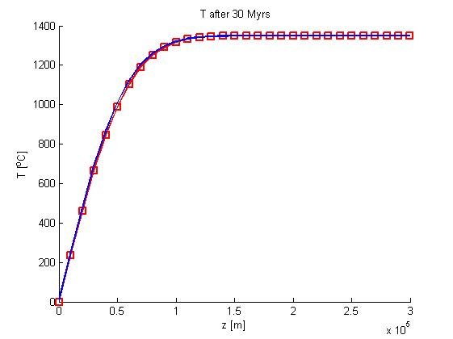
Example cooling oceanic plate
Δx = 10 km,
κ = 10⁻⁶ m²/s,
so Δt < 1.58 Myr
Results after 20
time steps of
Δt = 1.5 Myr

Slide 28
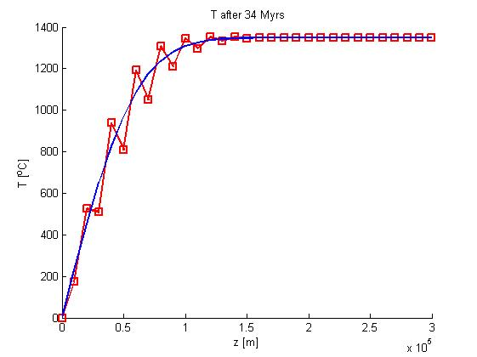
Example cooling oceanic plate
Δx = 10 km,
κ = 10⁻⁶ m²/s,
so Δt < 1.58 Myr
Results after 20
time steps of
Δt = 1.7 Myr
Only error amplification
where there is diffusion

Slide 29
Boundary conditions
Possible boundary conditions:
essential-, or Dirichlet boundary condition:
f = given (this is what we used so far)
natural-, flux-, or Neumann boundary condition:
gradient is given or = given
periodic boundary condition: link ends together
Notes:
ad 1) What we used sofar: point out why we this is not always an appropriate b.c.: base of lithosphere, we don’t know T, but perhaps know dT/dz better.
ad 2) Why is q=given or dT/dx=given equivalent? Examples: insulating boundary or symmetry boundary: dT/dx=0 or dT/dz=0.
ad 3) NB, not a real boundary condition, because the ‘boundary is essentially removed. Example: whole-mantle model: take a 40,000 km wide model and links ends to obtain a model without lateral boundaries.

Slide 30
Implementation of natural boundary conditions for the heat equation
Flux b.c. at nodal point 0: or
Since T₀ is not explicitly given as b.c., the usual d.e.
applies:
Discretize (e.g. with Forward Euler) for i=0:
What to do with T₋₁?
with
mesh
-1 0 1 2
Notes:
From d.e. to discretised d.e. for T0:
- ask for how many this is not immediately clear
- work out in class, asking for each step:
- how to discretize dT/dt:
- how to discretize d2T/dx2 for T0
- rearrange to get kappa, dt and dx together
- fill in for i=0:
T-1 is called a fictitious point or ghost point
How to solve for that, we’ll see in next slide.

Slide 31
Implementation of natural boundary conditions for the heat equation
Discretization of at end points:
So now the d.e. becomes:
or
or
Notes:
Discretization of dT/dx=c: draw on white board: for dT/dx at i=0, we could take (T1-T0)/dx, but this centres around i=0.5, not i=0. Similarly (T0-T-1)/dx would be wrong. Best is to take (T2-T0)/2dx. Draw 3-point system and graphically illustrate this issue.
T-1 and T1 are two nodal points away from each other so we should devide by 2dx, not dx. Clear?
So filling in b.c. in discretized d.e. enables us to eliminate T0.
So for the forward Euler case, we’d have to replace the line T0new=T0old by this one here.
For BE, we have to do something similar, but this means we have to somehow get this info into our matrix A and rhs vector.

Slide 32
Practical 2, Part 3
Natural boundary conditions
Apply to your oceanic lithosphere cooling model
Replace given T at base of model with given heat flux from mantle into the lithosphere
Zero heat flux is simplest: insulating base of the lithosphere
https://community.dur.ac.uk/jeroen.van-hunen/Subitop/session2.html

