Slide 1


More dimensions
(i,j-1)
Discretization
Stable 2-D timestepping
Advection-diffusion
(i-1,j)
(i,j)
(i+1,j)
Δz
(i,j+1)
Δx

Slide 2
Heat diffusion in 1-D: Euler forward
i-1
i
i+1
Δx
For constant k, C_{p}, k:
In Python:
df = kappa*dt*(fin[2:]-2*fin[1:-1]+fin[0:-2])/dz**2
or
df=kappa*dt*np.diff(fin,n=2)/dz**2
Notes:
So to repeat something you’ve seen many times before, and with which you are very familiar now: discretizing the 1-D time-dependent heat eqn, in this case using forward Euler time stepping:
We have a 1-D mesh, so a chain of nodal points, either in x or z direction, and heat diffuses between neighboring nodal points.

Slide 3
Heat diffusion in 2-D: Euler forward
(i,j-1)
For constant k, C_{p}, k:
(i-1,j)
(i,j)
(i+1,j)
Δz
(i,j+1)
Δx
In Python:
Notes:
In 2-D: sum of difffusion in x- and z- direction.
Take care of 2D indexing
Take care with size of each ‘derivative’ array: double derivative makes grid 2 points smaller in direction of derivative, so both derivative won’t have same size

Slide 4
Heat diffusion in 2-D: Euler forward
For constant k, C_{p}, k:
In Python:
df = kappa*dt*
( (fin[1:-1,2:]-2*fin[1:-1,1:-1]+fin[1:-1,0:-2])/dx**2
+(fin[2:,1:-1]-2*fin[1:-1,1:-1]+fin[0:-2,1:-1])/dz**2 )
or
d2fdx2 = np.diff(fin,n=2,axis=1)/dx**2
d2fdz2 = np.diff(fin,n=2,axis=0)/dz**2
df = kappa*d2fdx2[1:-1,:]+kappa*d2fdz2[:,1:-1]
Notes:
So to repeat something you’ve seen many times before, and with which you are very familiar now: discretizing the 1-D time-dependent heat eqn, in this case using forward Euler time stepping:
We have a 1-D mesh, so a chain of nodal points, either in x or z direction, and heat diffuses between neighboring nodal points.

Slide 5
Stability criterion for 1-D heat diffusion
with
Worst case error scenario:
+ε
error
0
i-2
i-1
i
i+1
i+2
nodal point nr
−ε
so that
Notes:
We saw this slide before, in week 9.
Error in solution grows proportional to T solution
It turns out that the worst type of errors are the alternating ones, where the errors on subsequent points flip from + to -.

Slide 6
Stability criterion for 1-D heat diffusion
with:
Avoiding amplification:
i.e.: or or
So the 1-D forward Euler heat diffusion equation has following stability criterion:
Notes:
In that case r<1/2 to stop errors from former timesteps grow in new timesteps, and so go out of hand after many timesteps.

Slide 7
Stability criterion for 2-D heat diffusion
For a uniform grid and κ = constant:
If Δx = Δz = Δ:
or:
(i,j-1)
(i-1,j)
(i,j)
(i+1,j)
Δz
(i,j+1)
Δx

Slide 8
Stability criterion for 2-D heat diffusion
Taking again the worst case scenario:
…
with
+
-
+
-
+
-
+
-
+
-
+
-
+
-
+
-
+
-
+
-
+
-
+
-
+
Notes:
In 2-D, exactly the same principle applies:
Error grows again with solution, but in this case we have more diffusion terms.
Applying the same idea that worst case error are the alternating ones (this now becomes a checkerboard in 2-D), we find a slightly different stability criterion

Slide 9
Stability criterion for 2-D heat diffusion
with:
Avoiding amplification:
I.e.: or or
So the 1-D forward Euler heat diffusion equation has following stability criterion:
Notes:
In this case r<1/4, and so the dt is half that of the 1-D case.
Note that this applies for dx=dz. If not, things become slightly more complicated. But in that case taking the smallest of dx and dz is always safe.
You can now work out for yourselves what dt would be in 3-D.

Slide 10
Natural boundary conditions in 2-D: Example for left boundary
T_{1,0}
T_{2,-1}
T_{2,0}
T_{2,1}
T_{3,0}

Slide 11
Implementation issues
Note the suggested index convention: T_{ij} → T[j,i]
(so T[row-nr, column-nr])
So np.diff(fin,n=1,axis=0)calculates difference between subsequent rows (i.e. in z-direction), np.diff(fin,n=1,axis=1)calculates difference between subsequent columns (i.e. in x-direction)
Defining a 2-D grid:
x = np.linspace(0,w,nx)
z = np.linspace(0,h,nz)
[xx,zz]= np.meshgrid(x,z)

Slide 12
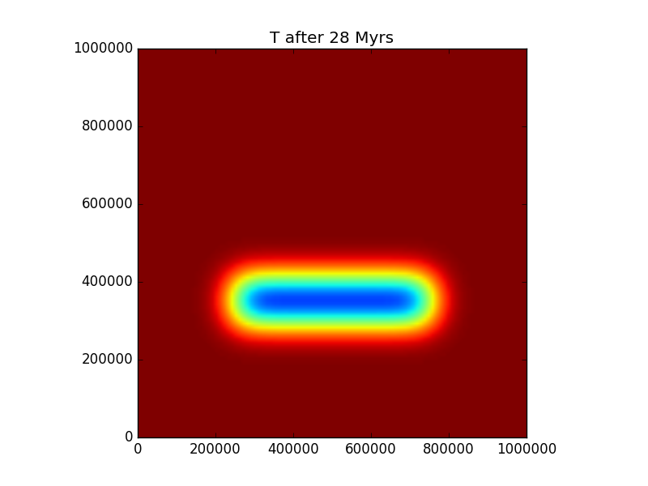
Practical 3, Part 1:
Implement a 2-D heat diffusion solver
Add natural boundary conditions
https://community.dur.ac.uk/jeroen.van-hunen/Subitop/session3.html

Slide 13
Advection-diffusion
Advection schemes
Advection-diffusion schemes
Implementation
x
i-2
i-1
i
i+1
i+2
j-2
z
j-1
v
j
v_{z}
j+1
v_{x}
j+2

Slide 14
Heat advection
Δz
v_{x}
v_{x}
T(x+ Δx)
T(x)
Δy
Δx
If inflowing material is hotter than outflowing
(so <0)→ flow ‘carries in’ heat → T will rise:
Notes:
Heat advection can easily be the dominant term in a moving system. How does it change the heat balance?
Again consider this cube we used before, but now material is allowed to flow through. If inflowing material is hotter than the outflowing material, then the cube is heating up. In that case, dT/dx<0 (increasing x makes T decrease).
Also the rate of heating is dependent on how quickly material flows in or out.

Slide 15
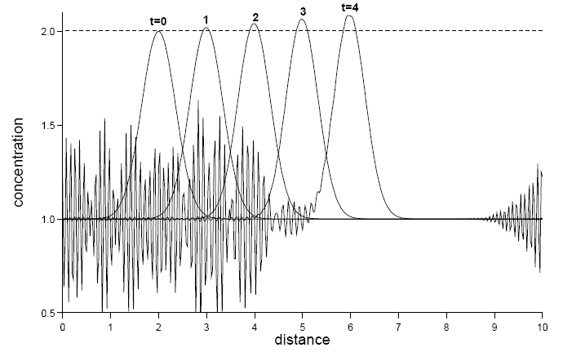
Advection: numerical methods in 1D
FTCS: Forward-Time-Central-Space
Numerically unstable
T
(Spiegelman, 2004)
v →
i-2
i-1
i
i+1
i+2
Notes:
This is an example where the physics is simple, but the numerical implementation is not so straightforward.
Simplest way to discretize equation would be FTCS : always unstable due to negative numerical diffusion
Numerically, it might be the most straightforward way, but physically, it is not:
It is like if you want to determine in a river whether water at 1 point will warm up or not, you take a simple upstream and one downstream, take difference, and base your prediction on that.

Slide 16
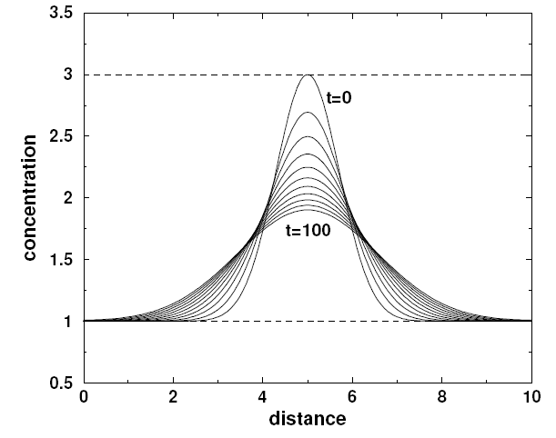
Advection: numerical methods in 1D
FTCS: Forward-Time-Central-Space
Upwinding: if v_{i}>0:
if v_{i}<0:
significant
numerical
diffusion
T
v →
(Spiegelman, 2004)
i-2
i-1
i
i+1
i+2
Notes:
It makes more sense to just look upstream, and forget about the downstream part.
Similarly, if you want to see if it is going to rain, you look for clouds in the direction where wind is coming, not if it is sunny in the opposite direction.
So this is the idea behind upwinding. Unfortunately, this is causing positive numerical diffusion: stable, but not desirable.

Slide 17
Advection: numerical methods in 1D
FTCS: Forward-Time-Central-Space
Upwinding: if v_{i}>0:
if v_{i}<0:
significant
numerical
diffusion
T
v ←
(Spiegelman, 2004)
i-2
i-1
i
i+1
i+2

Slide 18
Advection: numerical methods in 1D
FTCS: Forward-Time-Central-Space
Upwinding
Semi-Lagrangian:
Use velocity field* to find location X where T_{i} advected from in Δt
Interpolate T from points T_{i-1} and T_{i} to X
Copy T into T_{i}
T
* Better velocity field can
be found iteratively.
v →
i-2
i-1
i
i+1
i+2
Notes:
A perhaps better approach is to look where point i is coming from during last timestep, take T from there (through interpolation), and adopt this T for point i.

Slide 19
Advection: numerical methods in 1D
FTCS: Forward-Time-Central-Space
Upwinding
Semi-Lagrangian
(fully) Lagrangian: trivial
Lagrangian code (mesh moves with flow)
Particles

Slide 20
Advection: numerical methods in 2D
Upwinding: example:
x
i-2
i-1
i
i+1
i+2
j-2
z
j-1
v
j
v_{z}
j+1
v_{x}
j+2
Notes:
I won’t discuss FTCS in 2D ( not working anyway) or fully Lagrangian method (too much work here and trivial).

Slide 21
Advection: numerical methods in 2D
Semi-Lagrangian: example:
x
i-2
i-1
i
i+1
i+2
j-2
z
j-1
v
j
v_{z}
j+1
v_{x}
j+2

Slide 22
Courant time step criterion for upwinding
-
For
and
:
In 1-D:
or
In 2-D:

Slide 23
No time step criterion
for semi-Lagrangian method
Upwinding: time step needs to be smaller than advection time over 1 grid cell
Semi-Lagrangian: time step can be larger than advection time over 1 grid cell
x
i-2
i-1
i
i+1
i+2
j-2
z
j-1
v
j
v_{z}
j+1
v_{x}
j+2

Slide 24
Advection-diffusion equation
In 1-D:
In 2-D:

Slide 25
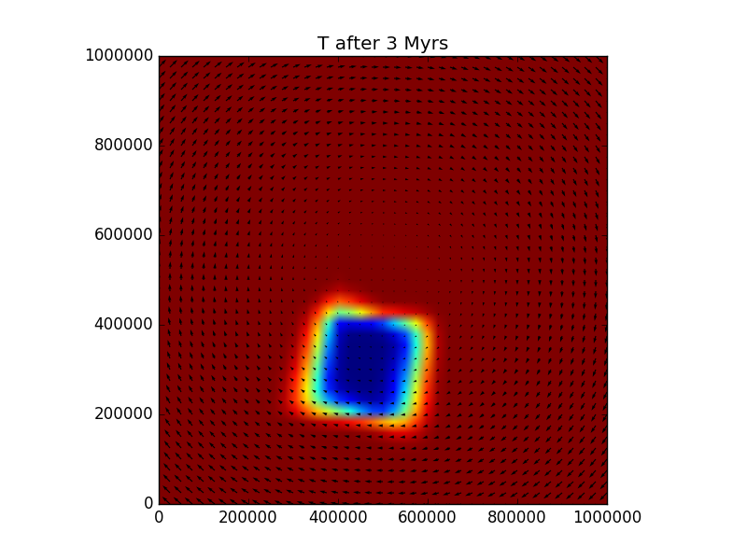
Practical 3, Part 2:
Implement a 2-D heat advection-diffusion solver
https://community.dur.ac.uk/jeroen.van-hunen/Subitop/session3.html

