Slide 1
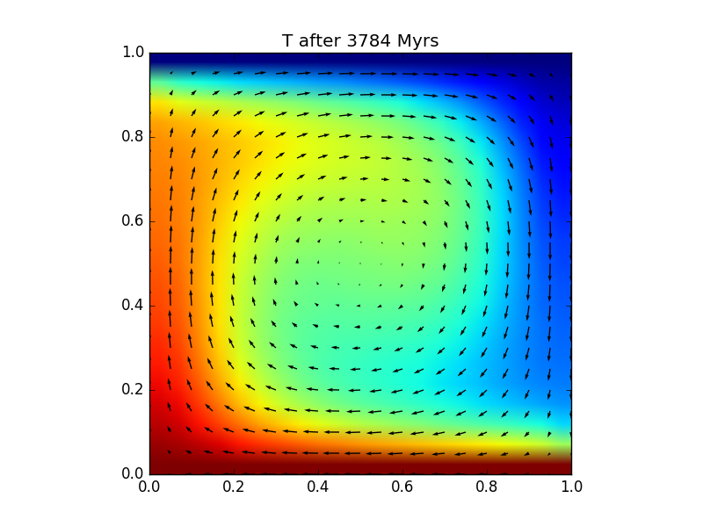


Solving the flow field
Conservation of momentum & mass
Numerical approach
Staggered grids
Solving matrix-vector systems
Rayleigh-Bénard convection
Calculating topography

Slide 2
Force balance: the Stokes equation (1)
Sum of forces equals 0:
difference in σ_{ij} over block
body force F_{i}
---------------------------------- +
total force = 0
σ_{zz}
σ_{xz}
σ_{zx}
σ_{zx}
σ_{xx}
σ_{xx}
F_{z}
σ_{xz}
σ_{zz}
Notes:
Stresses might act on its surface: shear stresses, normal stresses.
Gravity might pull it down or push it up.
For each direction we can add up all these terms:
in x-direction: sxx_left, sxx_right, sxz_top, sxz_bottom.
If sxx_left > sxx_right (and the other terms are 0) then that would push the block to the right. So the actual sxx is not as important here, but more the difference between left and right, or the ‘gradient’.
Same story for sxz: if sxz_top>sxz_bottom, then block will move to left. So sxz difference or rather sxz gradient is what determines how the block will move.
Mathematically, s_xx applies on surface dz, and s_xz applies on surface dx, so (sxx(x) – sxx(x+dx))*dz + (sxz(z)-sxz(z+dz))*dx=0 → divide by dx*dz gives the orange eqn on slide
In vertical direction similar story: szz_top, szz_bottom, szx_left, szx_right. Now we have gravity as well: Fz (we’ll look into that in a minute). So doing the same eqn gives similar expression + Fz*dx*dy*dz, and dividing by dx*dy*dz gets rid of these terms.
These are what we call the Stokes equations, and these equations determine how material flows left/right or up/down.
It also determines how material is deforming, but to be able to calculate that, we need to elaborate those stress terms a bit more

Slide 3
Force balance: the Stokes equation (1)
in x-dir.:
in z-dir.:
σ_{zz}
σ_{xz}
σ_{zx}
σ_{zx}
σ_{xx}
σ_{xx}
F_{z}
σ_{xz}
σ_{zz}
Notes:
Stresses might act on its surface: shear stresses, normal stresses.
Gravity might pull it down or push it up.
For each direction we can add up all these terms:
in x-direction: sxx_left, sxx_right, sxz_top, sxz_bottom.
If sxx_left > sxx_right (and the other terms are 0) then that would push the block to the right. So the actual sxx is not as important here, but more the difference between left and right, or the ‘gradient’.
Same story for sxz: if sxz_top>sxz_bottom, then block will move to left. So sxz difference or rather sxz gradient is what determines how the block will move.
Mathematically, s_xx applies on surface dz, and s_xz applies on surface dx, so (sxx(x) – sxx(x+dx))*dz + (sxz(z)-sxz(z+dz))*dx=0 → divide by dx*dz gives the orange eqn on slide
In vertical direction similar story: szz_top, szz_bottom, szx_left, szx_right. Now we have gravity as well: Fz (we’ll look into that in a minute). So doing the same eqn gives similar expression + Fz*dx*dy*dz, and dividing by dx*dy*dz gets rid of these terms.
These are what we call the Stokes equations, and these equations determine how material flows left/right or up/down.
It also determines how material is deforming, but to be able to calculate that, we need to elaborate those stress terms a bit more

Slide 4
Force balance: the Stokes equation (2)
Total stress σ
deformation part
+
motion part
‘deviatoric’ stress τ
deformation × viscosity η
velocity gradients × η
+
pressure P
Notes:
If a material is put under stress, two things might happen:
It might deform
It might move
These are clearly different processes, and should be separated. E.g. deformation depends on the strength of material, whereas movement has very little to do with strength.
So stress is split up in deformation part and motion part.
The motion part is due to pressure differences: material tends to flow from high to low pressure.
The deformation part can be rewritten in terms of deformation and viscosity.
Deformation is described in velocity gradient: if a block of material moves faster on one side than the other, it has to be deforming. (DRAW)

Slide 5
Force balance: the Stokes equation (3)
Using:
constant
Notes:
If a material is put under stress, two things might happen:
It might deform
It might move
These are clearly different processes, and should be separated. E.g. deformation depends on the strength of material, whereas movement has very little to do with strength.
So stress is split up in deformation part and motion part.
The motion part is due to pressure differences: material tends to flow from high to low pressure.
The deformation part can be rewritten in terms of deformation and viscosity.
Deformation is described in velocity gradient: if a block of material moves faster on one side than the other, it has to be deforming. (DRAW)

Slide 6
Force balance: the Stokes equation (4)
in x- and z-direction:
So we have:
2 equations
3 unknowns:
pressure P
velocities v_{x} & v_{z}
additional constraint required
Notes:
This results in these 2 equations:
Horizontally: horizontal pressure gradients drive material in horizontal direction, and horizontal velocity variations describe the horizontal shearing.
Vertically, the same, except that, in addition, gravity pulls dense material down.
Viscosity is a material parameter, and we assume that we know this.
Fz depends on material density, again, assumed to be known.
So only unknowns are P, vx, and vz. But we have only 2 equations, so we cannot uniquely solve this.

Slide 7
Mass conservation (continuity equation)
Net in/outflow = 0
v_{z} in
Δz
v_{x} in
v_{x} out
Δx
v_{z} out
Notes:
It turns out that we explicitly need to show how mass is conserved: material cannot simply disappear.
This is illustrated with small square: suppose material is not compressible.
Let’s look at horizontal flow: anything flowing in on left must flow out on right. So that would require vx_left=vx_right, or vx=constant over box, no vx-gradient.
If we only have vertical motion, same thing: no vz-gradient.
But if we have both, we can relax this constraint a bit: any net material flow in in horizontally must flow out vertically, or v.v. So any vx-gradient must be compensated with a vz-gradient. So vx-gradient +vz-gradient must be zero together.

Slide 8
Set of governing equations for mantle convection
Conservation of:
momentum:
mass:
heat:
Notes:
So last week, we learned about the equations that describe motion and deformation: Stokes equations, and an eqn for conservation of mass.
But the Stokes equation contains another unknown, the 4th: temperature, so we need a 4th eqn as well: the heat equation.
NB) delta T is one parameter, not 2: it is the change in T relative to some reference value, e.g. the average value, or the minimum value.
So we solve 4 eqns for 4 unknowns: u, v, P, and T. Other parameters in here are all material or model parameters, and we need to provide them.
Q1) Which are the material / model parameters in here?
A1) material params: eta, alpha, rho, kappa; model params = g.
Last week, we solved several simple 1D problems and only had to solve 1 eqn instead of all 4.
Q) Why did we only need to solve 1 eqn for the dyke flow?
1-D, so only need 1 of the Stokes eqns; in 1-D, mass conservation becomes a trivial equation: v is constant; and we assumed T to be constant in the dyke too, so no need to solve T-eqn.
It is important to keep in mind that solving this set of eqns in the general case cannot be done for every individual point in space and time, it needs to be done for a whole continuum in space and time.
(draw box) if a cold blob of material is entered on one end into the box, it is going to affect the flow everywhere in the box, because all the material points in the box are connected. In the shearing exercise from last week, changing the velocity of the overriding plate is not only going to affect the flow of material right next to the plate, but everywhere in the model domain.

Slide 9
Scaling and the Rayleigh number Ra
Scaling parameters with:
from which can be derived:
momentum:
mass:
heat:
,
,
,
Notes:
Another important aspect of these equations is that they can be scaled: a large-scale problem can be made identical to a small-scale problem: in the dyke problem: a dyke of 100 m wide and an excess T of 1000K can be scaled down to a 1 cm-wide problem with a dT of just a few K, and the solution would look identical, except for the scale.
To get more insight in the set of eqns, they are usually scaled, i.e. the actual scale is taken out of the problem. This often reduces the complexity of the system, and once we’ve solved it, we can put dimensions/scale back in. The way this works is to scale the whole problem down to a scale model with all parameters (distance, temperature, pressure, etc.) ranging between a fixed (non-dimensional) range, usually between 0 and 1. In doing so, we obtain a slightly different set of eqns.
So how does this work: we choose a certain scaling, using a minimum nr of scaling parameters: these are given in top row: scale length with a standard length, which is usually taken to be the height of the system we are modelling, but if that is not known, any typical length scale will do. Time is scaled with a typical diffusion time (remember diffusion time is propto distance ^2 over kappa), T is scaled with a standard T-range, usually the diff between min and max T, and viscosity (if variable) is scaled with a default eta.
From that we can derive the other parameters: v=x/t, so v-scaling is h/(h^2/kappa) = kappa/h, so v=v’*kappa/h. Stress and pressure scale as viscosity times time (you can see from units: Pa s / s = Pa
(NOTE TYPO ON SLIDE FOR ‘16/’17 eta/t instead of eta*t)
Work this out for yourself for the heat equation (show how done for lhs, then let students do rhs): go back to eqn on previous slide and non-dimensionalize:
DT*d(T’)/(dt’*h2/K) = KDT*d(T’)/(dx’2*h2) - v*hK/h*2DT*dT’/(dx’*h):
All parameters DT, h, and K cancel out.
This gives useful insight: apparently, all thermal systems behave the same if properly scaled. This illustrates how analogue models (e.g. subduction in a 1x1x1 box with honey) can be ‘scaled up’ to the size of the mantle.
Scaling simplifies the other equations as well: all model and material parameters (size of the domain h, density, gravity, temperature variation, viscosity, diffusivity) can then suddenly all be combined into one parameter. This parameter is called the Rayleigh number.
So apparently, systems with different h, or DT, or eta, rho, g, kappa all behave the same provided the combination of parameters (Ra) is the same. So we can create a convection cell in a 1x1x1 m box and simulate that of a 3000 cubed box with much higher eta, dT, etc., as long as Ra is the same for both systems.
Q) How many of you have heard of Ra?
Since all parameters in the equations are dimensionless (or ‘scaled’, i.e. their dimension is 1), Ra must be dimensionless as well. You should by now have all the information you need to work out the dimensions of all parameters in Ra. Check that for yourself (at home).
Alpha=1/K; rho=kg/m3; g=m/s2; DT=K, h=m; eta=Pa s=Ns/m2=kg/s,m, kappa=m2/s

Slide 11
Scaling and the Rayleigh number Ra
Scaling parameters with:
from which can be derived:
momentum:
mass:
heat:
,
,
,
with:
Notes:
Another important aspect of these equations is that they can be scaled: a large-scale problem can be made identical to a small-scale problem: in the dyke problem: a dyke of 100 m wide and an excess T of 1000K can be scaled down to a 1 cm-wide problem with a dT of just a few K, and the solution would look identical, except for the scale.
To get more insight in the set of eqns, they are usually scaled, i.e. the actual scale is taken out of the problem. This often reduces the complexity of the system, and once we’ve solved it, we can put dimensions/scale back in. The way this works is to scale the whole problem down to a scale model with all parameters (distance, temperature, pressure, etc.) ranging between a fixed (non-dimensional) range, usually between 0 and 1. In doing so, we obtain a slightly different set of eqns.
So how does this work: we choose a certain scaling, using a minimum nr of scaling parameters: these are given in top row: scale length with a standard length, which is usually taken to be the height of the system we are modelling, but if that is not known, any typical length scale will do. Time is scaled with a typical diffusion time (remember diffusion time is propto distance ^2 over kappa), T is scaled with a standard T-range, usually the diff between min and max T, and viscosity (if variable) is scaled with a default eta.
From that we can derive the other parameters: v=x/t, so v-scaling is h/(h^2/kappa) = kappa/h, so v=v’*kappa/h. Stress and pressure scale as viscosity times time (you can see from units: Pa s / s = Pa
(NOTE TYPO ON SLIDE FOR ‘16/’17 eta/t instead of eta*t)
Work this out for yourself for the heat equation (show how done for lhs, then let students do rhs): go back to eqn on previous slide and non-dimensionalize:
DT*d(T’)/(dt’*h2/K) = KDT*d(T’)/(dx’2*h2) - v*hK/h*2DT*dT’/(dx’*h):
All parameters DT, h, and K cancel out.
This gives useful insight: apparently, all thermal systems behave the same if properly scaled. This illustrates how analogue models (e.g. subduction in a 1x1x1 box with honey) can be ‘scaled up’ to the size of the mantle.
Scaling simplifies the other equations as well: all model and material parameters (size of the domain h, density, gravity, temperature variation, viscosity, diffusivity) can then suddenly all be combined into one parameter. This parameter is called the Rayleigh number.
So apparently, systems with different h, or DT, or eta, rho, g, kappa all behave the same provided the combination of parameters (Ra) is the same. So we can create a convection cell in a 1x1x1 m box and simulate that of a 3000 cubed box with much higher eta, dT, etc., as long as Ra is the same for both systems.
Q) How many of you have heard of Ra?
Since all parameters in the equations are dimensionless (or ‘scaled’, i.e. their dimension is 1), Ra must be dimensionless as well. You should by now have all the information you need to work out the dimensions of all parameters in Ra. Check that for yourself (at home).
Alpha=1/K; rho=kg/m3; g=m/s2; DT=K, h=m; eta=Pa s=Ns/m2=kg/s,m, kappa=m2/s

Slide 12
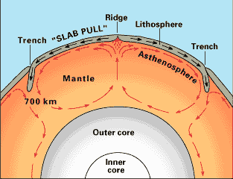
Scaling and the Rayleigh number Ra
h
η
ΔΤ
α
κ
Notes:
This slide gives an example: if we want to calculate how convection in the whole mantle operates, then we take the scaling parameters such that a problem the size and properties of the mantle is translated into a scaled problem of dimension 1: All the dimensional properties go into Ra.

Slide 13
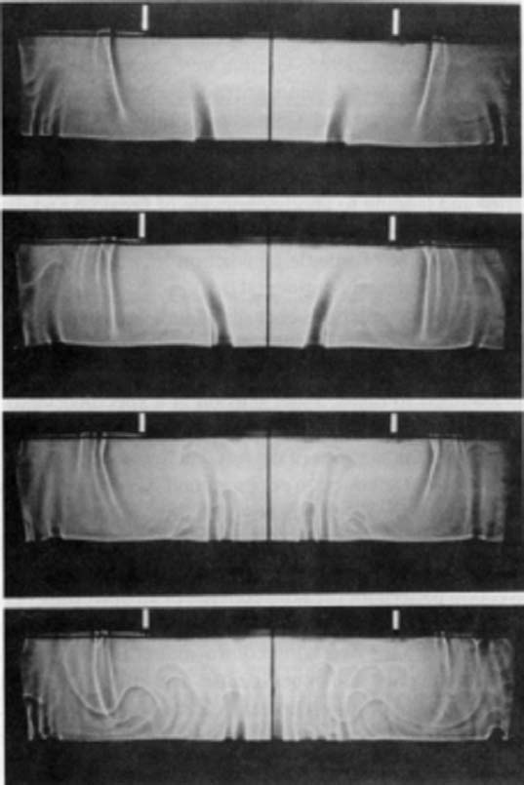
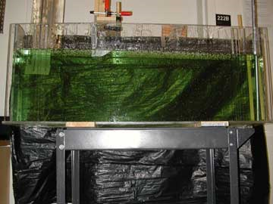

Analogue convection modelling
(Guillou and Jaupart,1995; geology.um.maine.edu)
Notes:
So, we can model mantle convection in a fish tank….
Just adjust mantle parameters to the material we put in the tank, adjust the box size to something practical (1 m or so).
Then choose a material with a viscosity that gives an Earth-like Ra: glucose syrup

Slide 14
Solving Stokes + continuity equations
1.
2.
3.

Slide 15
Solving the Stokes equations
Just like solving 2 equations with 2 unknowns:
→
→
We can solve the 3 * nx * nz flow equations as follows:
Large matrix
→

Slide 16
Calculating observables
Surface heat flow:
Free-slip surface ‘topography’:

Slide 17
Surface topography
Free-slip surface ‘topography’:
Simple to calculate
Instantaneous topography
Only works well over smooth surfaces, relatively long wavelengths
Real surface topography:
Allow surface nodes to move vertically and measure topography
Needs stabilisation of interface*
‘Sticky-air’ topography:
Create a non-diffusive interface with weak, light material on top of solid Earth
weak layer viscosity ~ 10¹⁸ – 10¹⁹ Pa s
Needs tracking and stabilisation of interface*
*(Kaus et al., 2010; Andrés-Martínez et al., 2015)

Slide 18
Practical 4:
Build a Releigh-Benard convection solver:
Convert a provided Stokes solver into a subfuction
Modify your advection-diffusion solver to incorporate this Stokes solver
Calculate derived quantities
like topography.
https://community.dur.ac.uk/jeroen.van-hunen/Subitop/session4.html

Slide 20
Extra: Staggered grids
T
v_{z}
v_{x}
P

Slide 21
Staggered grids: Stokes-x equation
1.
?
Pressure gradient discretisation
not centred around central v_{x} point

Slide 22
Staggered grids: Stokes-x equation
1.
?
Pressure gradient discretisation
not centred around central v_{x} point

Slide 23
Staggered grids: Stokes-x equation
1.
?
Pressure gradient discretisation
is centred around central v_{x} point,
but is not a grid point
Notes:
So this one might be best ….

Slide 24
Staggered grids: Stokes-z equation
2.
Pressure gradient discretisation
is centred around central v_{z} point,
but is not a grid point
Notes:
But then we have a problem applying the same pressure points to the vertical Stokes equation

Slide 25
Staggered grids: continuity equation
3.
?
?
Both velocity gradients not centred
around a common point
Notes:
And the continuity equation has some issues too.
One solution could be to use the wider derivatives: dP/dx = (Pi+1 – Pi-1)/2dx etc, but in this way you need a denser grid spacing to reach same accuracy.

Slide 26
Staggered grids
On this staggered grid, these
problems disappear
T
v_{z}
v_{x}
P
Notes:
There is a cleverer solution and this is why a staggered grid approach is introduced:
Explain ‘staggered’

Slide 27
Staggered grids: Stokes-x equation
Pressure gradient discretisation
is centred around central v_{x} point.
v_{x}

Slide 28
Staggered grids: Stokes-z equation
Pressure gradient discretisation
is centred around central v_{z} point.

Slide 29
Staggered grids: continuity equation
v_{x}
Both velocity gradients are centred
around a common point
Notes:
Even though pressure isn’t part of the equation, we are solving the continuity equation for the location of pressure.

Slide 30
Staggered grids: using ghost points
T
v_{z}
v_{x}
P
Adding ghost points to allow for
natural boundary conditions.
P, v_{x} and v_{z}.
But remember, these are no real
points, and values are copied
from internal points.

Slide 31
Staggered grids: adding unused points
T
v_{z}
v_{x}
P
Adding unused points to make
nr of grid points the same for
P, v_{x} and v_{z}.
So nothing will be solved there,
but these make the system nicely
Structured.

Slide 32
Staggered grids: numbering grid points
T
v_{z}
v_{x}
P
Continuity 1
Stokes-x 1
Stokes-z 1
Continuity 2
Stokes-x 2
Stokes-z 2
….
7
5
6
4
2
3
1
Notes:
Eqn1: no need to solve (added, non-physical point)
Eqn2: no need to solve: vx=0
Eqn3: no need to solve: vz=0
…
Point 6 = first to solve

