Slide 1
Python 2 → 3
Big data team Workshop
Friday July 1, 2016

Slide 2
Outline
Why bother? 5 min
What’s different in Python 3 15 min
What’s new in Python 3 15 min
Creating forward-compatible Python 2 code 5 min BREAK 10 min
Converting Python 2 code to Python 3 code 15 min
Hands-on 30 min

Slide 3
Why bother?

Slide 4
Some history
The Python devs (with BDFL Guido van Rossum) decided that they made a bunch of mistakes in the early days of developing Python.
The only way to fix that, is by introducing backwards-incompatible changes
Other languages, such as Java, usually avoid this at all costs, because there is a risk of fracturing the community.
Not Python!

Slide 5
Why bother?
Python 2 will be end of life in 2020
Lots of packages that we use are Python 3 compatible, so why not?
See e.g. the Python 3 Wall of Superpowers (https://python3wos.appspot.com) or the caniusepython3 project (https://caniusepython3.com)
Data science: matplotlib, scipy, numpy, pandas, scikit-learn
Software engineering: celery, flask, pymongo
New useful features in Python 3
Consider starting all new projects in Python 3.
Existing projects can usually be migrated without too much pain… Expect a migration plan from the AQAC group, starting after summer.

Slide 6
When not to bother at this point in time
If you absolutely need a package that’s not yet converted (e.g. thrift)
If you need interop with ROOT on a KAVE
Apparently you need ROOT 6 to work with Python 3, for which you need CentOS 7, and thus the latest KAVE. You might have better luck on your own laptop. For more info, check with Lodewijk!
Spark < 1.5.0 apparently does NOT work with Python 3
From: https://spark.apache.org/docs/1.4.0/programming-guide.html
“Spark 1.4.0 works with Python 2.6 or higher (but not Python 3). It uses the standard CPython interpreter, so C libraries like NumPy can be used.”
1.5.0 seems OK:
“Spark 1.5.0 works with Python 2.6+ or Python 3.4+. It can use the standard CPython interpreter, so C libraries like NumPy can be used. It also works with PyPy 2.3+.”
Notes:
PyPy is an alternative Python implementation that’s usually much faster than CPython thanks to a JIT Compiler (Just-in-time compiler). Python 3 support is in alpha.

Slide 7
What’s different in Python 3

Slide 8
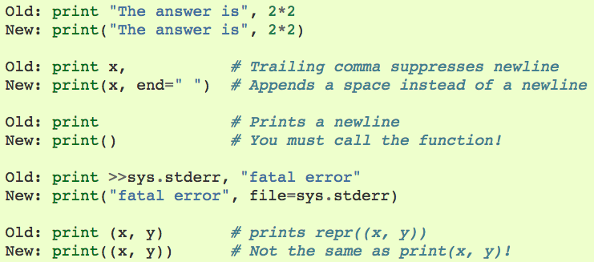
print is a function
Examples:
Rationale:
1) it’s not special enough to be a statement instead of a function
2) easier to replace print() with logging if it’s already a function (without dealing with messy >> syntax)
3) easier to replace print() on module level with a custom function by setting __builtin__.print
For more reasons and info see PEP-3105

Slide 9

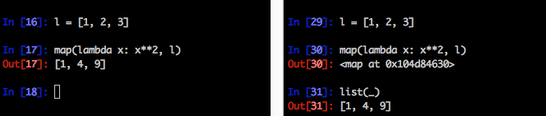
Views and iterators instead of lists
dict.keys(), dict.items() and dict.values() return “views” instead of lists:
dict.iterkeys(), dict.iteritems() and dict.itervalues() are no longer supported
map() and filter() return iterators:
range() now behaves like xrange(), the latter is removed
zip() now returns an iterator
Python 2.7
Python 3
Python 2.7
Python 3
Notes:
If you want the old map/filter behavior, consider using list comprehensions instead.
The major advantage of returning iterators is that they provide the records one by one. If you, for instance, zip 2 huge lists, it’ll take up a big chuck of memory immediately. With an iterator it doesn’t construct the entire list directly.

Slide 10
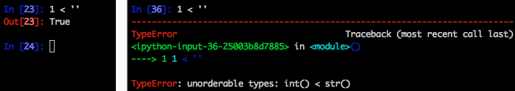
Safer comparisons
1 < '', 0 > None, len < len, None < None etc. now raise a TypeError instead of returning a boolean:
Effect on sorting: all items in whatever you’re sorting must be comparable to each other
Python 2.7
Python 3

Slide 11

Integers
long is renamed to int. There is no longer a limit to the value of integers.
1/2 now returns a float. Use 1//2 to get the old truncating behavior.
Integer literals no longer support a trailing l or L.
Python 2.7
Python 3

Slide 12
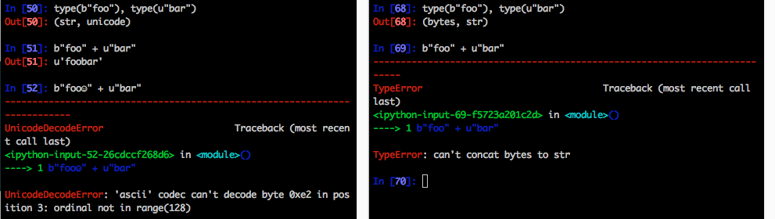
Text, Data, Unicode
The type for text is now str, in Python 2 this was unicode
The type for (binary) data is now bytes, in Python 2 this was str
Mixing text and data in Python 3 raises TypeError, in Python 2 this would work if you only had 7-bit (ASCII) bytes in the str, otherwise it would raise UnicodeDecodeError
There’s some gotchas and caveats, read up on this if you work with binary data.
Python 2.7
Python 3

Slide 13
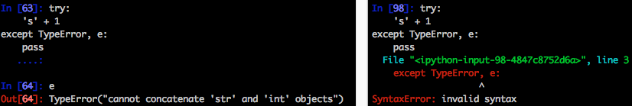
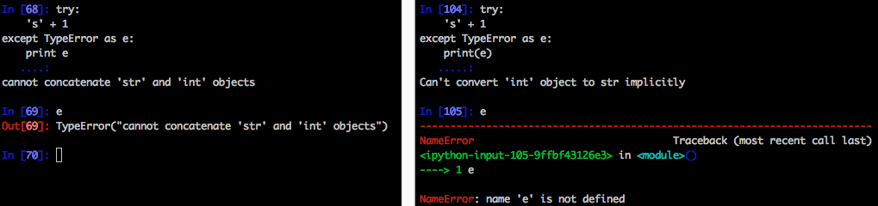
Old exception syntax removed
You now need to use the as syntax (also works in Python 2.7), but note that the exception is now only known within the except block:
Python 2.7
Python 3

Slide 14
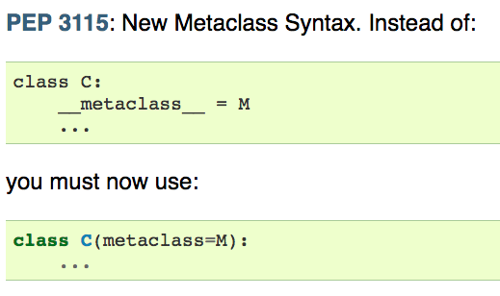
Other stuff
Removed <> (use != instead).
The from module import * syntax is only allowed at the module level, no longer inside functions.
But import * is a bad smell, try to be explicit in your imports!
The only acceptable syntax for relative imports is from .[module] import name. All import forms not starting with . are interpreted as absolute imports.
Some builtin modules are renamed.. E.g. ConfigParser to configparser, Queue to queue
String printing with % is deprecated and will be removed at some point in the future. Use str.format()
This is not exhaustive, please refer to
https://docs.python.org/3.0/whatsnew/3.0.html

Slide 15
What’s new in Python 3

Slide 16
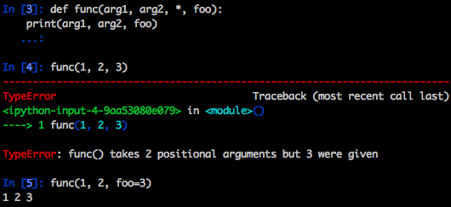
Keyword only arguments
Named parameters occurring after *args in the parameter list must be specified using keyword syntax in the call. You can also use a bare * in the parameter list to indicate that you don’t accept a variable-length argument list, but you do have keyword-only arguments.
Python 3

Slide 17
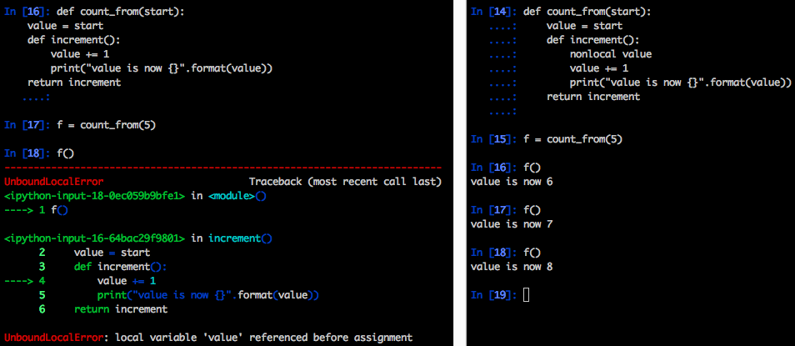
New nonlocal statement
You can now use nonlocal to refer to arguments defined outside of an inner function or closure.
Python 2.7
Python 3

Slide 18
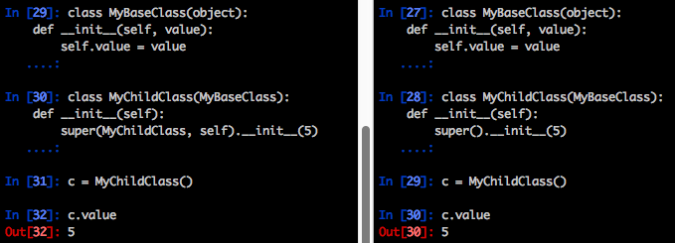
New super()
You can now invoke super() without arguments and (assuming this is in a regular instance method defined inside a class statement) the right class and instance will automatically be chosen. With arguments, the behavior of super() is unchanged.
Note: get used to always typing super().__init__(), instead of MyBaseClass.__init__().
This is the only way to invoke Python’s MRO (Method Resolution Order).
Python 2.7
Python 3

Slide 19
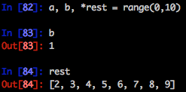
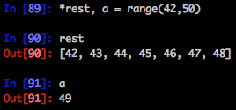
Extended iterable unpacking
You can now do something like:
More possibilities added in Python 3.5
Python 3

Slide 20

Type hints Since Python 3.5
You can now indicate the expected type for arguments and return types.
These are just “hints”, i.e. not enforced by the interpreter!
IDEs such as PyCharm use this to warn you if you supply something else.
Useful for large projects!
Provisional API (might be subject to backwards incompatible changes in future releases, but is unlikely)

Slide 21
Matrix multiplication Since Python 3.5
Added @ operator for matrix multiplication.
Makes for much more readable code.
Supported by Numpy.
Old:
New:
S = dot((dot(H, beta) - r).T, dot(inv(dot(dot(H, V), H.T)), dot(H, beta) - r))
S = (H @ beta - r).T @ inv(H @ V @ H.T) @ (H @ beta - r)

Slide 22
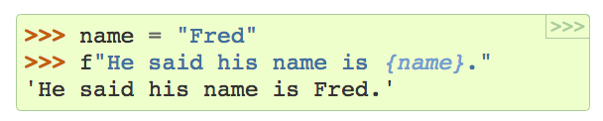
Formatted string literals Since Python 3.6 (stable version not yet released)
If you use “f” before a string, the variables are automatically taken from the local scope. Stuff between {} is similar to format strings accepted by str.format()

Slide 23
Creating forward-compatible Python 2 code

Slide 24
If you’re stuck on Python 2 but want to make a future migration as painless as possible…
Add the following imports: from __future__ import division, absolute_import, print_function,\ unicode_literals
Start using unicode for all unencoded text and str for binary or encoded data only (to let the 2to3 tool do most of the work for you)

Slide 25
BREAK

Slide 26
Converting Python 2 code to Python 3 code

Slide 27
There’s a tool for that
Use the 2to3 tool. This automatically:
Converts all print statements to print() function calls
Converts basestr to str
Converts dictionary methods (e.g. dict.itertiems() to dict.items())
Converts except X, e to except X as e
Removes from __future__ import new_feature statements
And much more. Full list: https://docs.python.org/2/library/2to3.html

Slide 28
4-step process
Start with excellent test coverage
Make sure it runs fine on the latest Python 2.7.x version of Python
Run Python 2 with the -3 command line switch. This enables warnings about features that will be removed (or change) in 3 (e.g. DeprecationWarning for integer division). Run your test suite again, and fix code that you get warnings about until there are no warnings left, and all your tests still pass.
Run the 2to3 source-to-source translator over your source code tree. Run the result of the translation under Python 3. Manually fix up any remaining issues, fixing problems until all tests pass again.

Slide 29
Hands-on

Slide 30
Time to get our feet wet!
Pre-reqs:
Setup Anaconda with a Python 3 environment
$ conda create -n py3k python=3 anaconda
Clone this repo with Python 2 code:
https://github.com/jvanlier/Python2to3Workshop
Quest:
make it run on Python 3! ☺ (see the README.md for the 4-step process)
diff the Python 2 version with the Python 3 version to understand what’s changed
Reward: Beer @ 17:00 in the bar

Slide 31

Solutions of issues remaining after 2to3 tool conversion
#1 Bytes/Strings: need to convert bytes to str first.
#2 Integer Change line 30 to: or:
#3 Exceptions. Move e to the except block.

Slide 32
The end

