Slide 1




Accessing and using spatiotemporal data: climate and satellite products
Class 2 – Practical: extracting climate data from GEE, visualization and statistics in R
Johanna Van Passel - Ghent University
Johanna.vanpassel@ugent.be

Slide 2
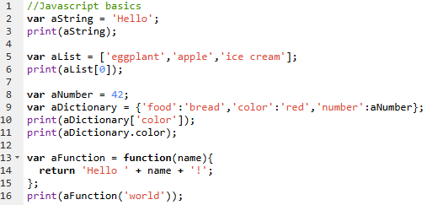
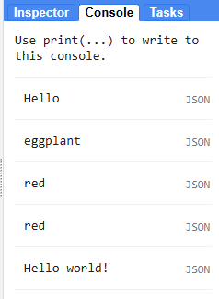
GEE coding: JavaScript basics
Always declare variable with ‘var’ statement
Terminate statements with ;
Print output using ‘print()’ statement
Lists are defined with []
Dictionaries are defined with {}
Indexing starts at 0
Functions are defined as follows
var functionName = function(x){
var result = x + 2
return result
};
Comments can be added using //
Notes:
A variable is defined using the var keyword followed by the name of the variable. Sometimes it is useful to store multiple values in a single variable, which is possible using a list in JavaScript. A new list can be created using square brackets and a comma separating the values. Another way to store multiple values in a single variable is through a dictionary. Dictionaries are useful when we want to refer to an item with its name rather than its position. You can create a dictionary using curly brackets {}. Functions are defined using the function keyword and allow you to group a set of operations together and repeat the same operations with different parameters without having to rewrite them every time.

Slide 3
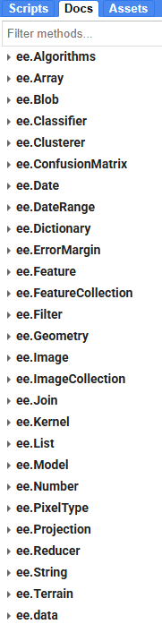
GEE coding: ee Object classes
GEE created specific classes, each with own methods:
  ee.ImageCollection()
  ee.Image()
  ee.Geometry()
  ee.Number()
  ee.String()
  ee.List()
  …

Slide 4
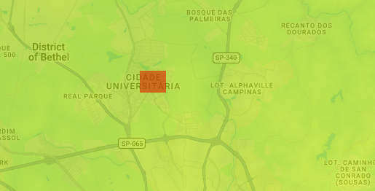
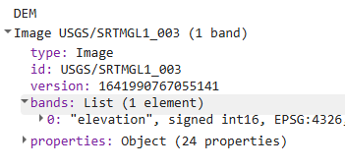
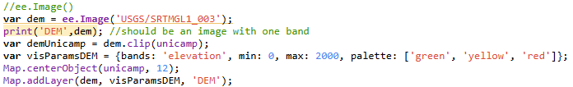
ee.Image()
Rasterlayer
Visualize:
  Use Map.addLayer(image, visProperties, layerName);
  visProperties: dictionary {} with different keys such as bands, min and max values, colour palette
Apply methods:
  Mathematical operations: .add(), .subtract(), .multiply (), .divide(), …
  Logical operations: .gt(), .gte(), .eq(), .lt(), .lte()
  Other: .clip(), …

Slide 5
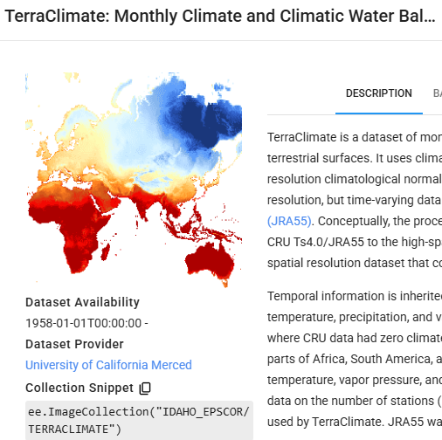

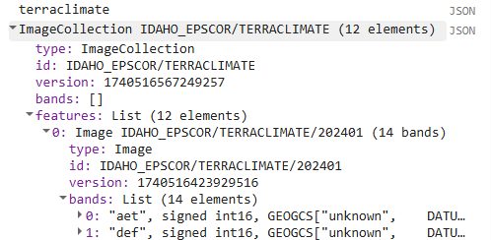
ee.ImageCollection()
Similar to rasterstack, officially list of images
Use search bar to find image collections
Filter on:
  Date: .filterDate(startdate, enddate)
  Area: .filterBounds(geometry)
  Other: .filter(ee.Filter.eq(propName, propValue)

Slide 6
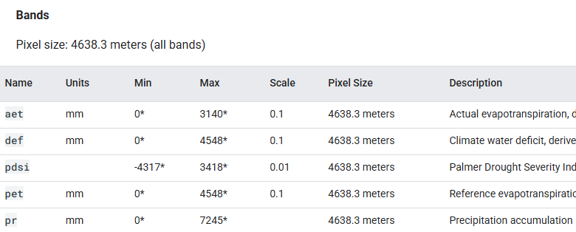
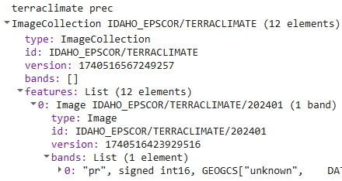
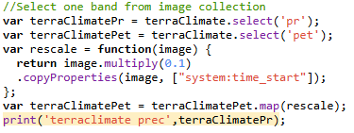
ee.ImageCollection()
Images can consist of multiple bands: .select()
GEE bands can have a scale and offset for memory reasons, necessary to recalculate:
var imageNew = image.multiply(scale).add(offset)

Slide 7
ee.ImageCollection()
Apply methods:
  Retrieve geometric shape (footprint) of a collection: .geometry()
  Merge collection with other collection: .merge(collection2)
  Mosaic different images of a collection into 1 image: .mosaic()
  Get the minimal value of a property over all elements: .aggregate_min(property)
  Get the first image of the collection: .first()

Slide 8
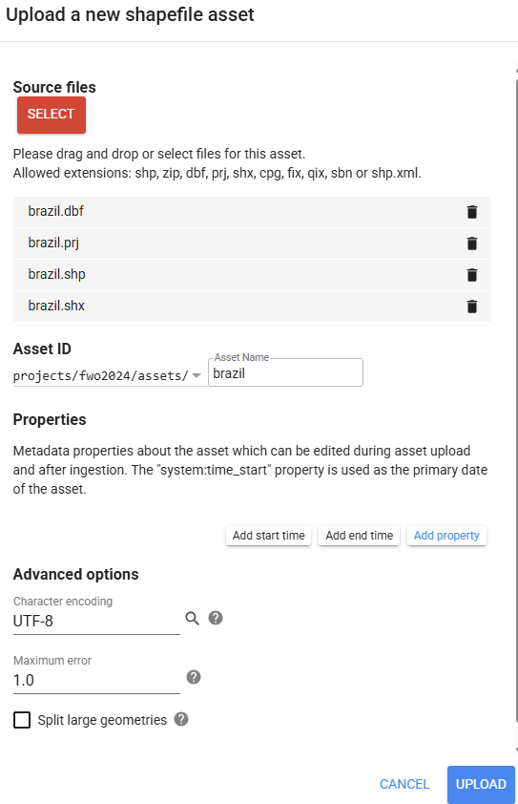
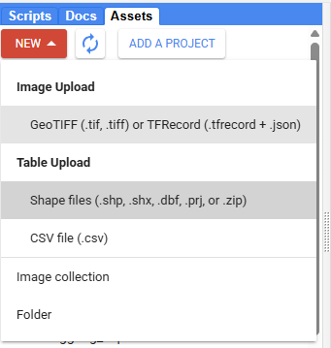
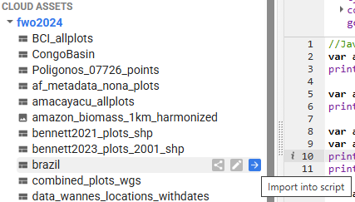

Retrieving the shape of a country
Option 1: upload a shapefile through ‘Assets’ and import feature to script

Slide 9
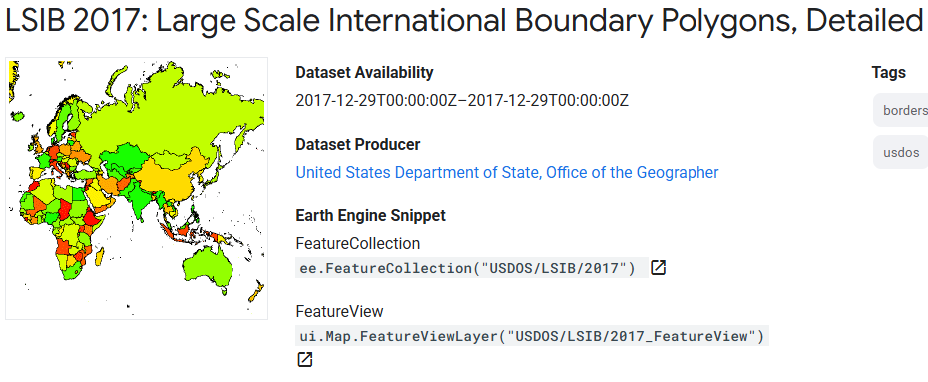

Retrieving the shape of a country
Option 2: through an Earth Engine collection “LSIB 2017”
ee.Feature(): vector file
ee.FeatureCollection(): list of vector files

Slide 10
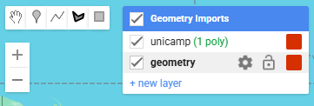
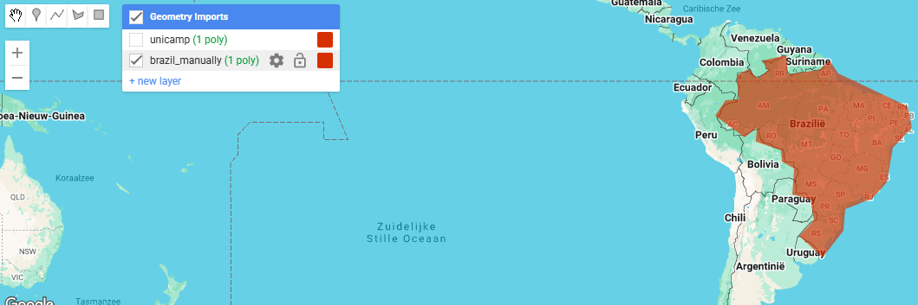
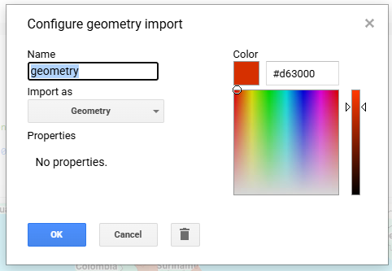

Retrieving the shape of a country
Option 3: by manually drawing a polygon

Slide 11

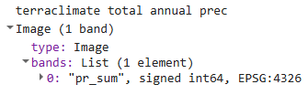
ee.Reducer()
Reducing = calculating statistics of image collections, images, feature collections, features, lists
Different statistics possible using .reduce(): ee.Reducer.sum(), ee.Reducer.min(), ee.Reducer.max(), ee.Reducer.variance(), …

Slide 12
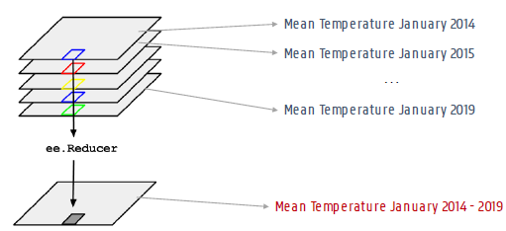
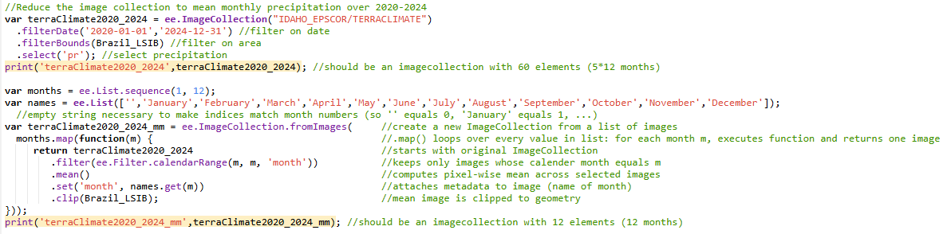
Extract climate data
precipitation January 2020
precipitation January 2021
Monthly mean precipitation
Resulting rasterstack
precipitation January 2024
→ Mean
Mean precipitation January 2020-2024

Slide 13
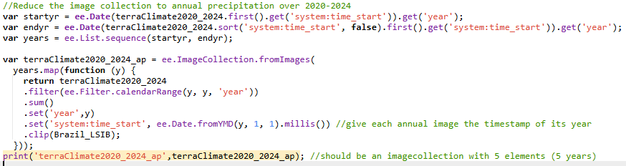
Extract climate data
precipitation January 2020
precipitation February 2020
Total annual precipitation
Resulting rasterstack
precipitation December 2020
→ Sum
Total annual precipitation 2020

Slide 14

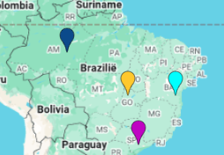
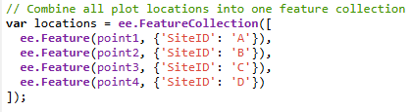
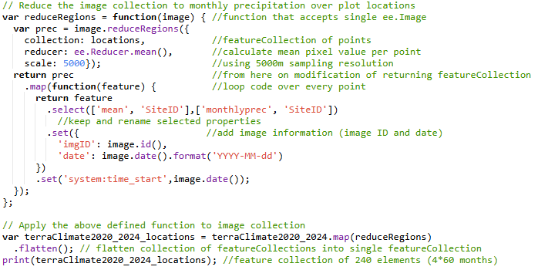
Extract climate data
Monthly precipitation per location
Resulting table

Slide 15
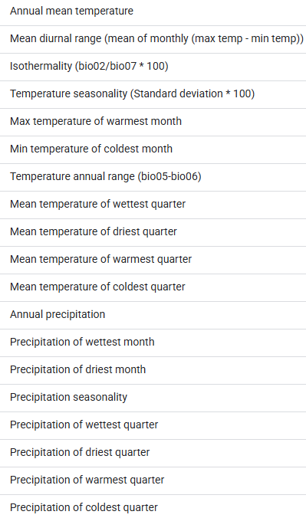
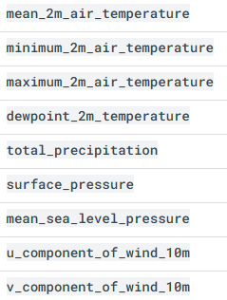
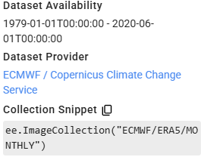
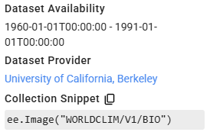
Extract climate data
WorldClim BIO Variables V1
ERA5 Monthly Aggregates

Slide 16
Export climate data
Exporting possible to:
  Google Drive: to save result locally
  Assets: access through GEE interface, easy to reuse result in other scripts
Apply on:
  Images : Export.image.toDrive() or Export.image.toAsset()
  Same for imageCollections, but they should first be converted to a multiband rasterstack using .toBands()
  Feature collections: Export.table.toDrive()

Slide 17
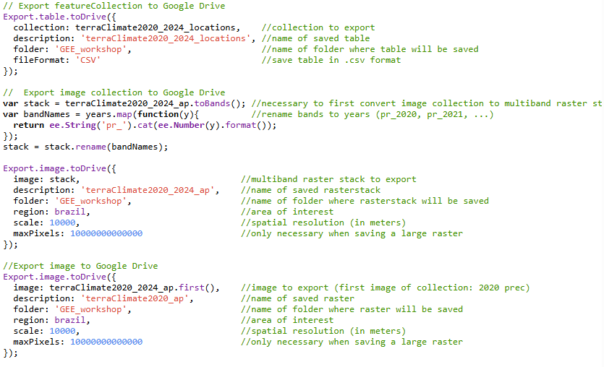
Export climate data

Slide 18
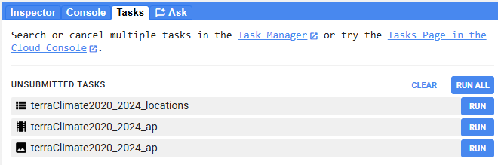
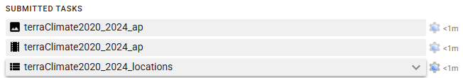
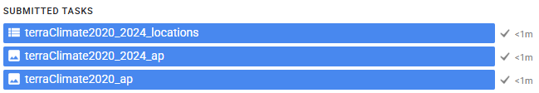
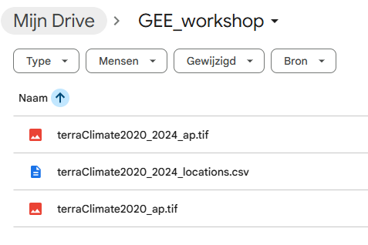
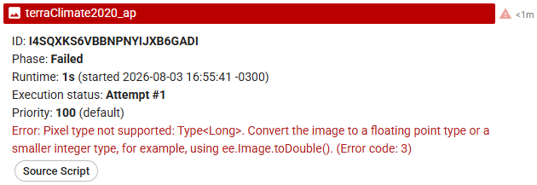
Export climate data
Once submitted, you can close GEE and it will keep running in the cloud
When unsuccessful, GEE will give an error message where it went wrong
Successful documents on Google Drive, to download locally

Slide 19
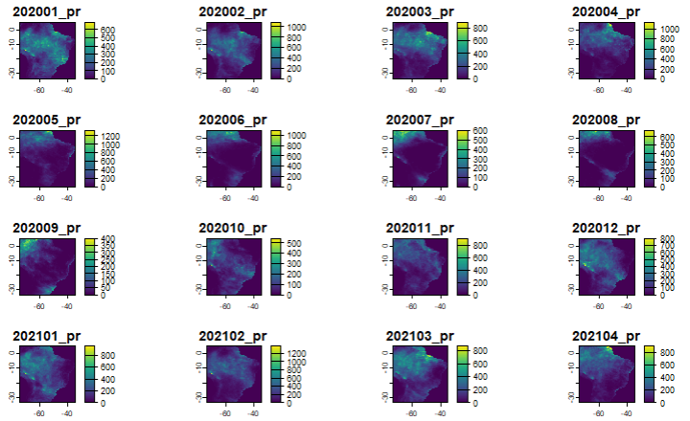
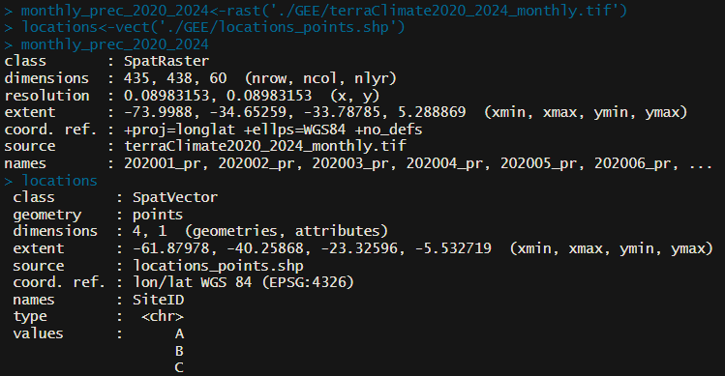
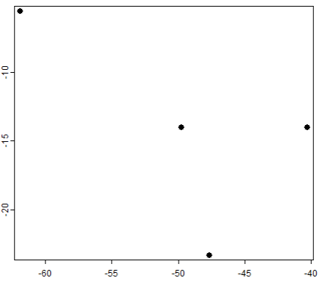
Visualize climate data in R
Package ‘terra’ to manage spatial data:
  Import raster data as spatraster using rast()
  Import vector data as spatvector using vect()
  Plot data using plot()

Slide 20
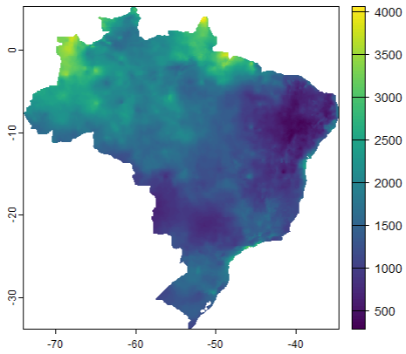
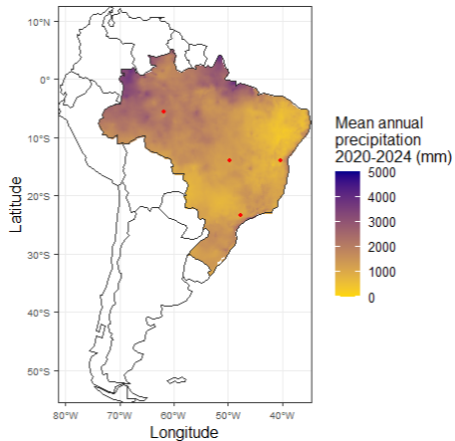
Visualize climate data in R
Base plot for basic plots
Package ‘ggplot2’ for fancy plots

Slide 21
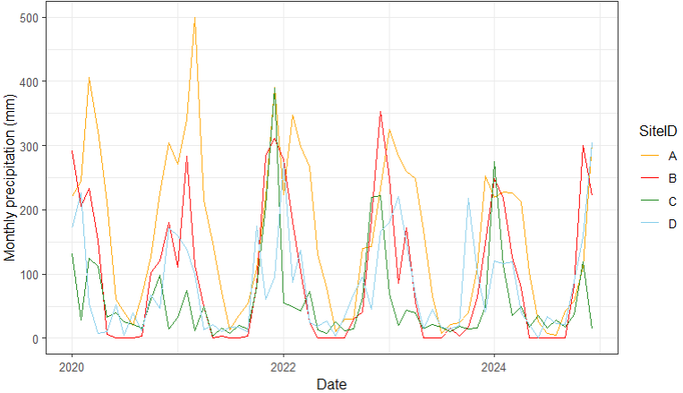
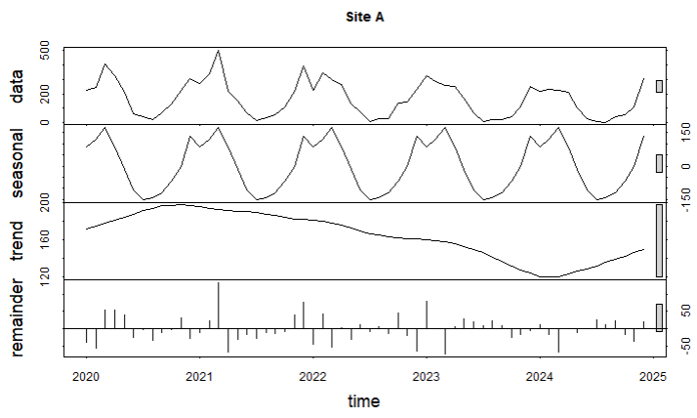
Visualize climate data in R
Create time series object with ‘ts_box’ package: using ts_ts()
Time series decomposition
  Long term trend
  Seasonal signal
  Remainder (noise)
STL: Seasonal and Trend decomposition using Loess
  Using stl()

Slide 22
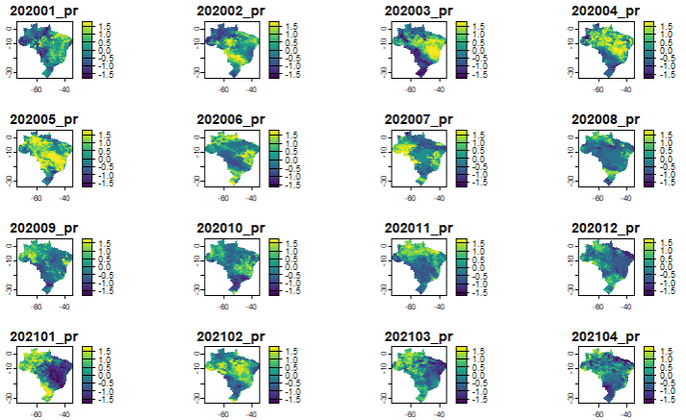
Visualize climate data in R
Standardized climate anomaly
  How different is climate from its usual state
  Anomaly = (value – mean value) / standard deviation
  Can be monthly or annual

Slide 23
Your turn
Pick a country or region
Create five points across the country and save as asset
Create rasterstacks of annual max temperature over 1995-2024 for the country and export as TIF files (adapt spatial resolution depending on size of country to lower computational time)
Extract monthly temperature time series for the 5 locations and export as CSV file
In R: Create nice graph of mean annual temperature across country over 1995-2025
In R: Create nice graph of the temperature time series for the 5 locations
In R: Calculate and plot temperature anomalies for the 5 locations
GEE example scripts:
  Intro 1: https://code.earthengine.google.com/d315be9254d73fdc30cf9f5b9a316c92
  Intro 2: https://code.earthengine.google.com/4fac502a0f98819ecd239e89364d3054
  Full example France: https://code.earthengine.google.com/793d6e358365d05e99eb0380a5634859

