Slide 1




Accessing and using spatiotemporal data:
climate and satellite products
Class 4 – Practical: extracting satellite data from GEE and comparison of satellite with climate data in R
Johanna Van Passel - Ghent University
Johanna.vanpassel@ugent.be

Slide 2
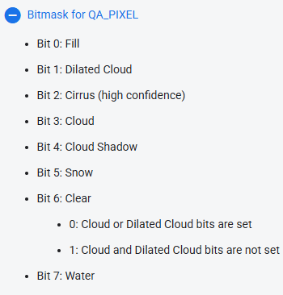
Landsat quality assessment (QA) band
Bitmask:
  Every pixel encoded using 8 bits
  Use bits to mask pixels with clouds or cloud shadows

Slide 3
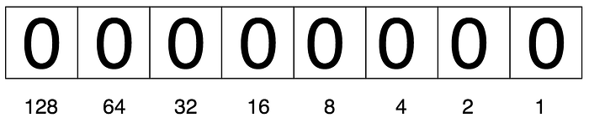

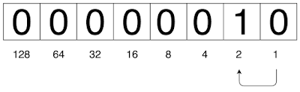
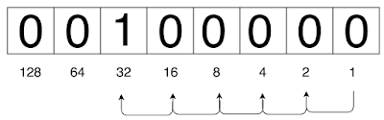
Landsat quality assessment (QA) band
Bitmask:
  Every pixel encoded using 8 bits
  Use bits to mask pixels with clouds or cloud shadows
  Each space represents a number
  ‘0’ and ‘1’ are switches:
    ‘0’: space is turned off
    ‘1’: space is turned on
    Sum of ‘1’ numbers gives pixel value
  Change pixel value from 1 to 2:
    1 << 1 (move one space to left)
  Change pixel value from 1 to 32:
    1 << 5 (move 5 spaces to left)
0
1
2
32

Slide 4
Landsat quality assessment (QA) band
Completely clear pixel:
  Binary: 00000000
  Decimal: 0
Cloudy pixel:
  Binary: 00001000
  Decimal: 8
Pixel with cloud and cloud shadow
  Binary: 00011000
  Decimal: 8 + 16 = 24

Slide 5
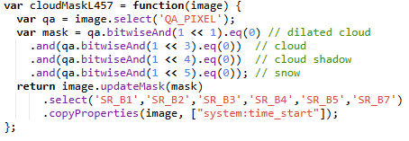
Landsat QA masking
qa.bitwiseAnd(1 << 3).eq(0)
Pixel with cloud and snow:
  Binary: 00101000
  Decimal: 8 + 32 = 40
  1<<3 has decimal value 8
  40.bitwiseAnd(8).eq(0)
  40.bitwiseAnd(8): 00101000 AND 00001000 → 00001000
  8.eq(0) → FALSE → pixel gets masked
Notes:
bitwiseAnd only keeps the spaces turned on (‘1’) that are turned on in both binary codes

Slide 6
Landsat QA masking: Landsat 4-5-7
Select QA band
Create a mask for all pixels that have dilated clouds, clouds, cloud shadows or snow
Image.updateMask(mask): pixels where mask is FALSE become missing values (NA)
Only select RGB, NIR, and SWIR bands
Copy system properties

Slide 7
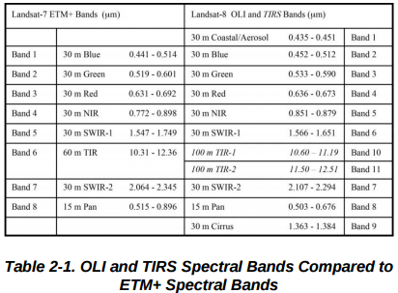
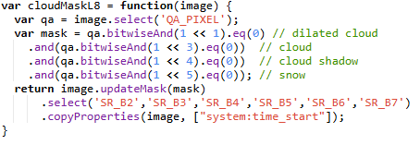
Landsat QA masking: Landsat 8
Same script for Landsat 8, except that selected bands have other names

Slide 8
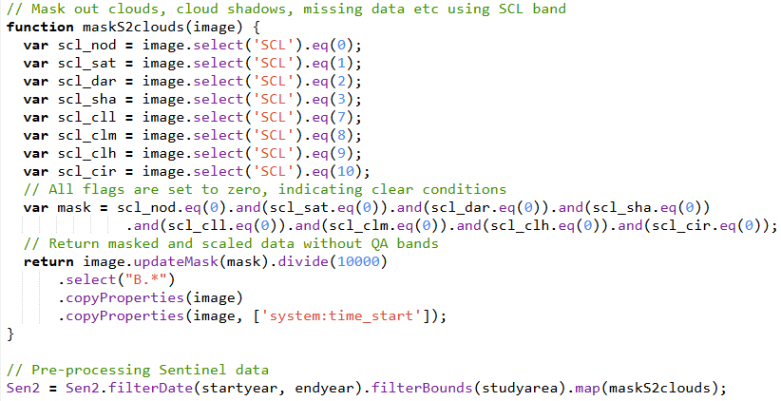
QA masking other satellites
Sentinel-2: using Scene Classification Layer (SCL) band

Slide 9
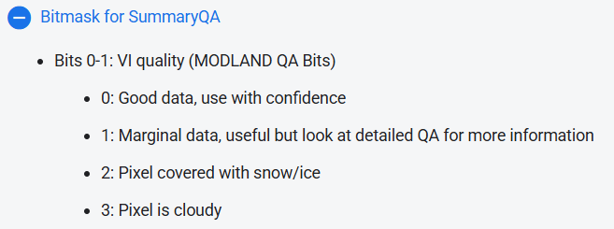
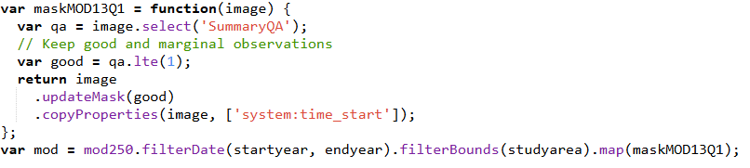
QA masking other satellites
MODIS: using SummaryQA bitmask band

Slide 10

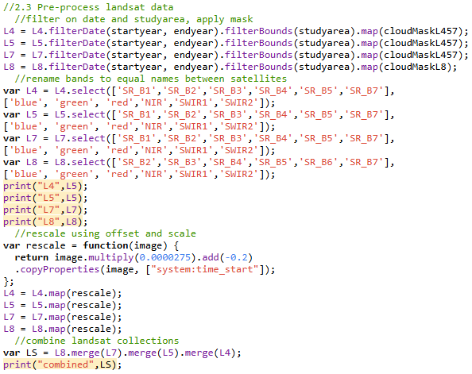
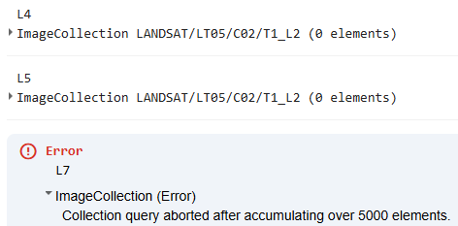
Combining Landsat collections
Filter on date and study area
Apply cloud mask
Select relevant bands and rename to equal names between satellites
Rescale values
Combine collections into one image collection

Slide 11
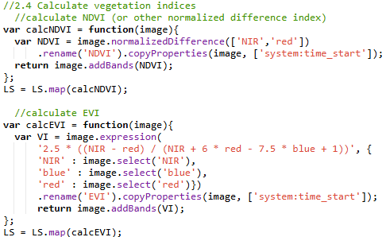
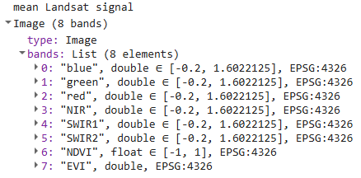
Calculate vegetation indices
Define expression:
  Normalized difference indices: .normalizedDifference([‘B1’, ‘B2’]) as shortcut for (B1 - B2) / (B1 + B2)
  Other expressions:
  .expression(‘B1 + B2 + 1’, {
  ‘B1’: image.select(‘B1’),
  ‘B2’: image.select(‘B2’)})
Give name to new band: .rename()
Copy image properties to new band: .copyProperties(image, [‘system:time_start’])
Add band to image: .addBands()

Slide 12
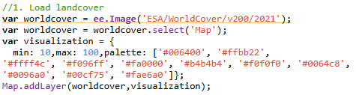
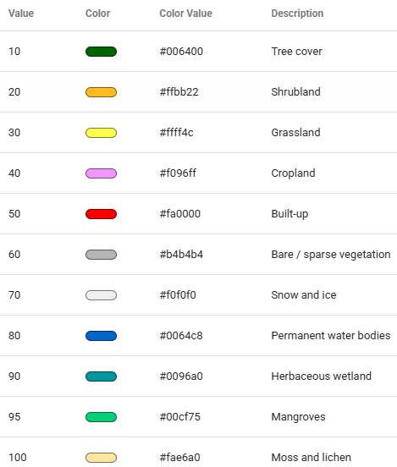
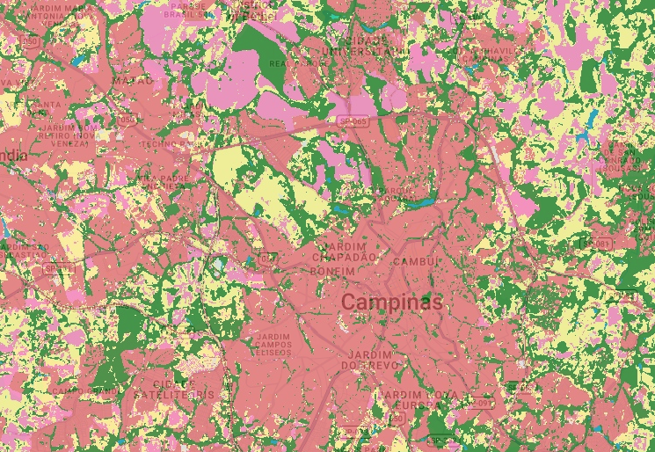
Visualizing land cover products

Slide 13

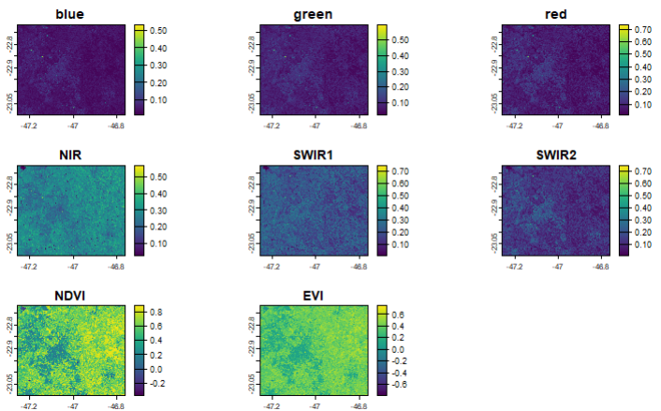
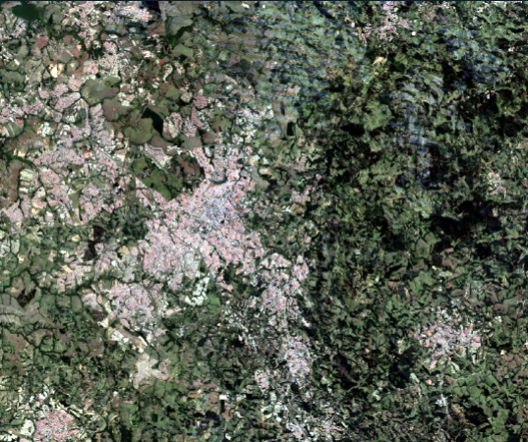
Visualizing Landsat bands in R
Visualize individual bands using plot()
Visualize RGB image using plotRGB()

Slide 14
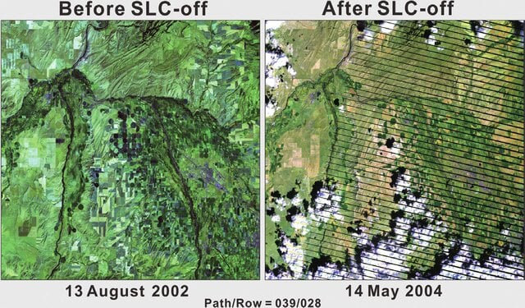
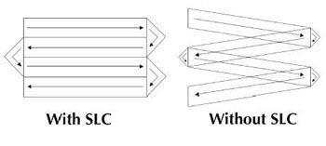
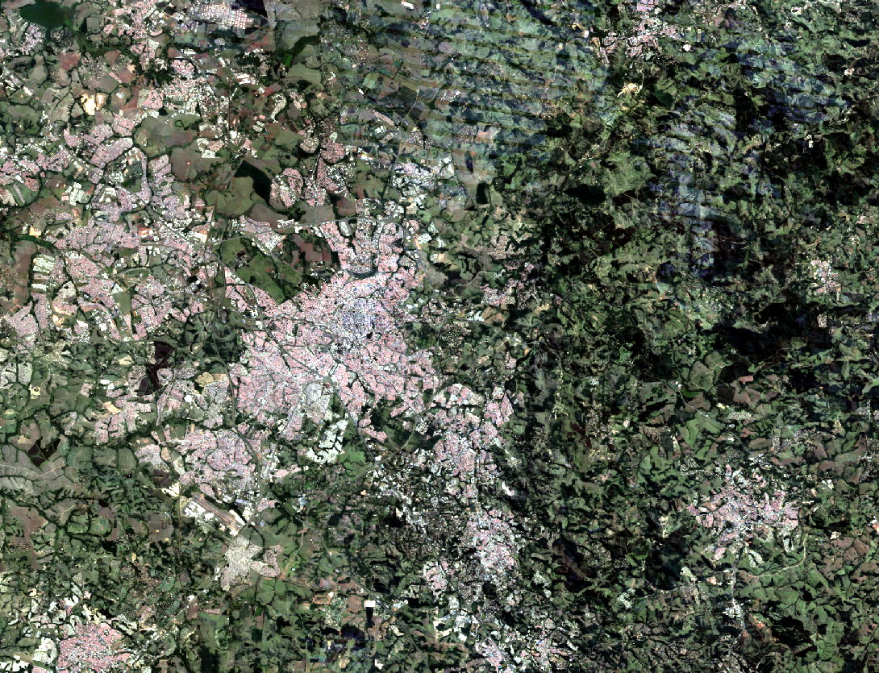
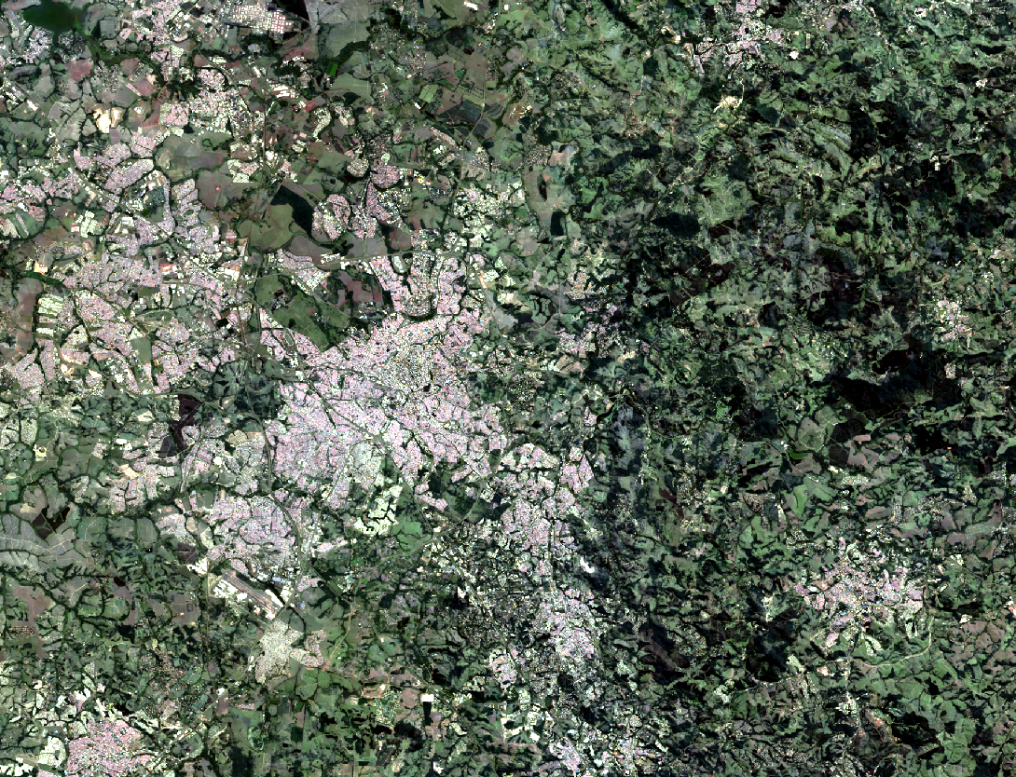
Striping in Landsat 7
Scan line corrector on Landsat 7 failed in 2003
Composite using both L7 and L8
Composite using only L8
Notes:
In 2003, scan line corrector on Landsat 7 failed: Each scene contains wedge-shaped gaps with no data. About 22% of each scene is missing.

Slide 15
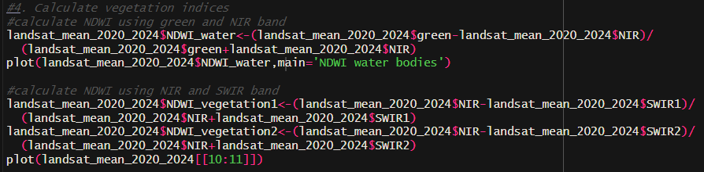
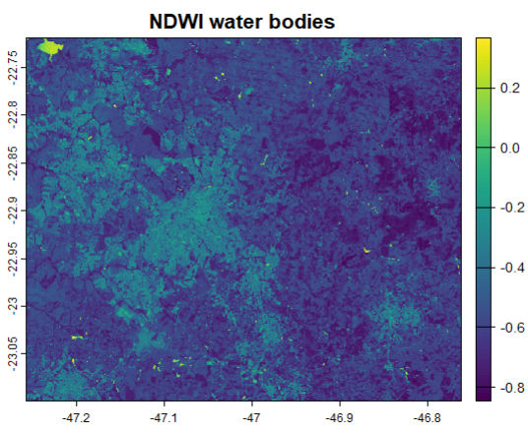
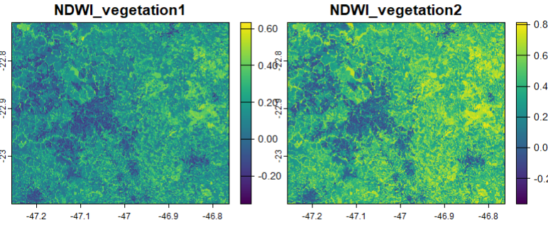
Calculating vegetation indices in R
Using second SWIR band increases difference between vegetation and urban areas

Slide 16
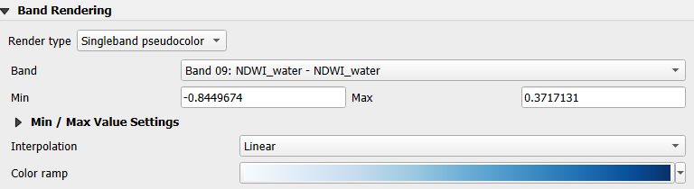
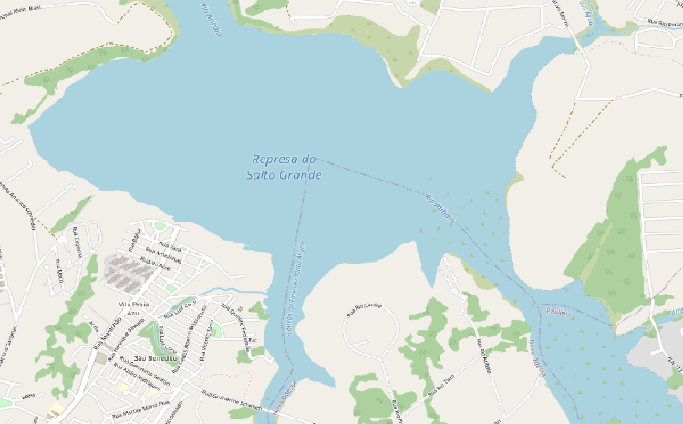
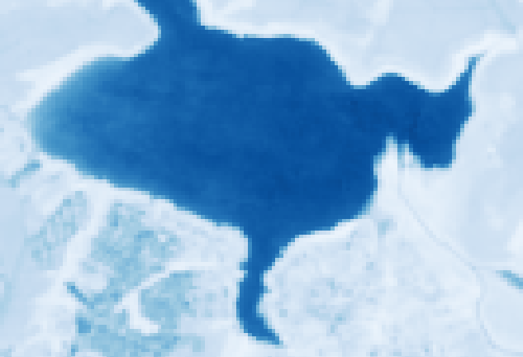
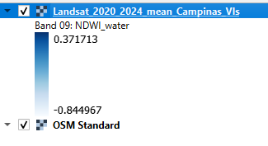
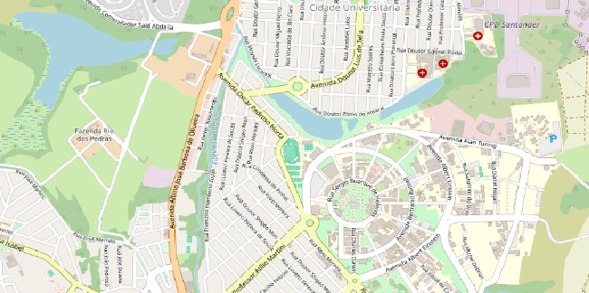
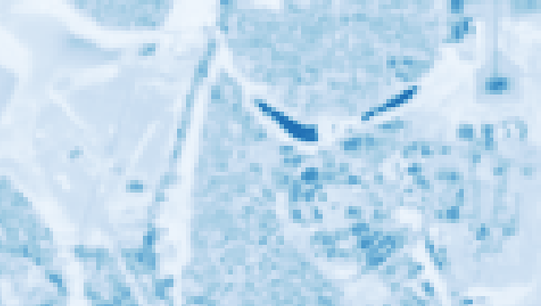

Check results in QGIS: NDWI – water bodies

Slide 17
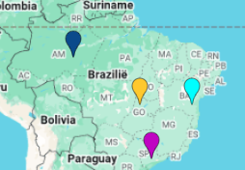
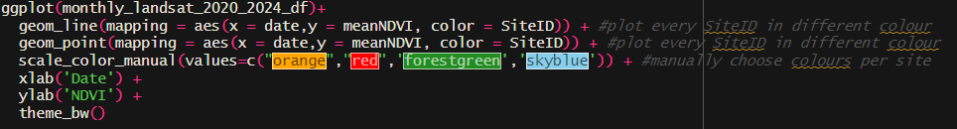
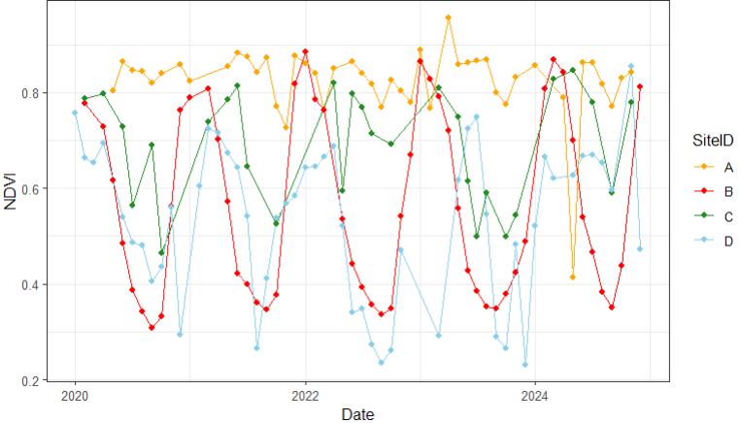
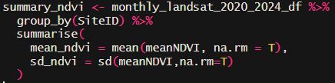
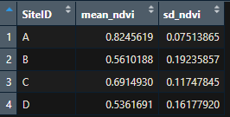
Plot NDVI time series in R
A
B
C
D

Slide 18
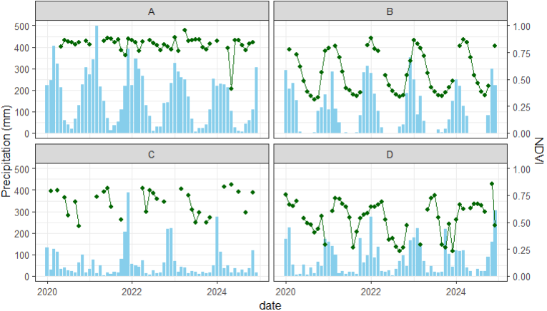
Relate NDVI and precipitation
A
B
C
D

Slide 19
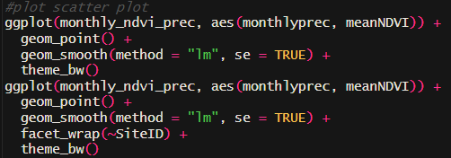
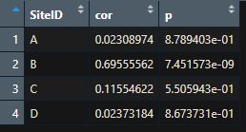
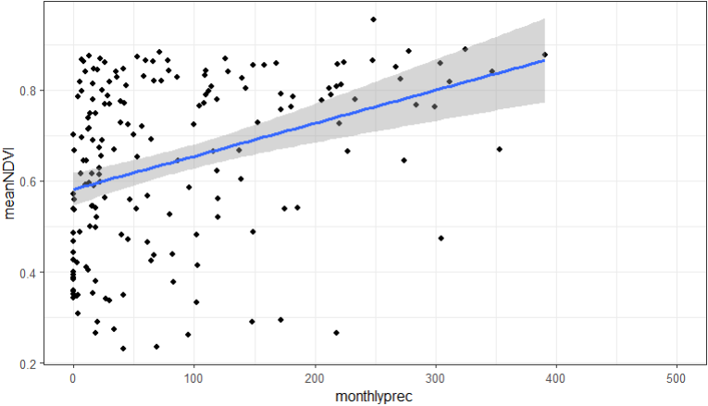
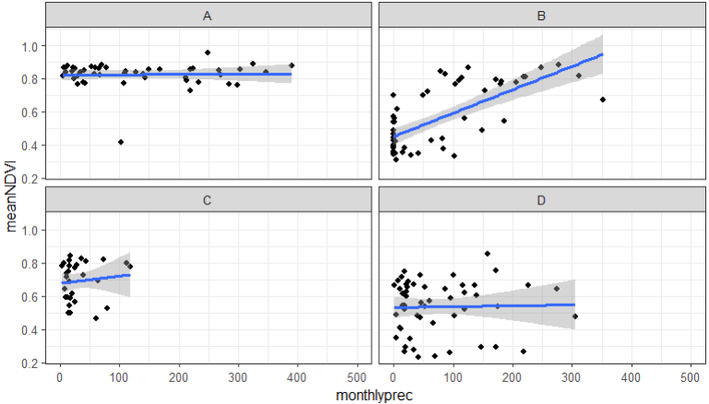
Relate NDVI and precipitation
A
B
C
D
Pearson correlation

Slide 20
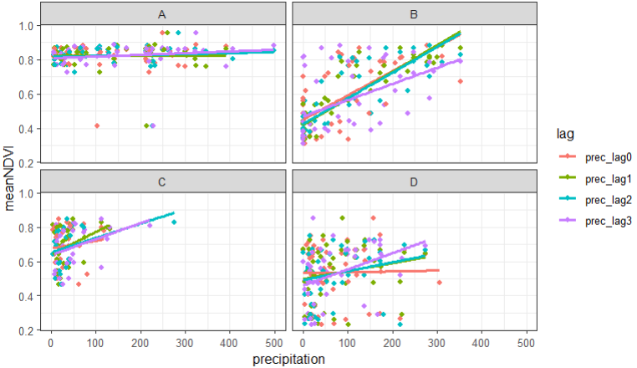
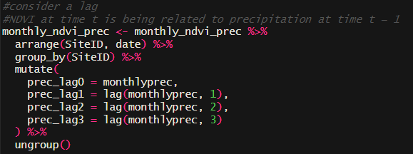
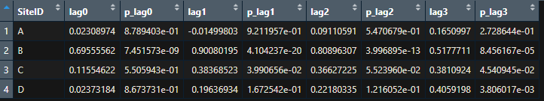
Relate NDVI and lagged precipitation
A
B
C
When considering lagged effect of precipitation: NDVI at time t is being related to precipitation at time t − 1/2/3 months
D

Slide 21
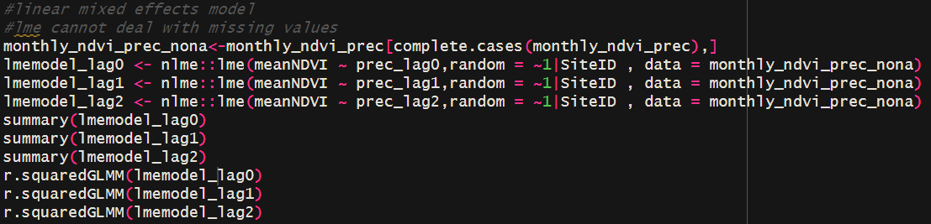
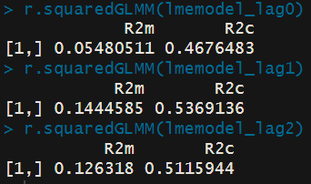
Relate NDVI and lagged precipitation
A
B
C
Linear mixed effects model
  Deal with hierarchical data: data points are grouped within sites
  Include SiteID as random effect
  R²m: marginal R² → variability explained by fixed effects (precipitation)
  R²c: conditional R² → variability explained by fixed and random effects (precipitation and SiteID)
D

Slide 22
Your turn
Create rasterstack of masked monthly Landsat bands + NDVI over 1995-2024 for the country/region
Extract monthly NDVI time series for the 5 locations and export as CSV file
Calculate the mean masked Landsat signal over 1995-2024 over the country and extract as TIF file (with a coarse spatial resolution)
In R: Calculate and plot a relevant vegetation index for the mean Landsat image
In R: Create nice graph of the NDVI time series for the 5 locations
In R: Calculate and visualize correlations between (lagged) temperature and NDVI time series for the 5 locations
GEE example scripts:
  Intro 1: https://code.earthengine.google.com/de7582b6f846bd2dc9c17f45b448e4e4
  Intro 2: https://code.earthengine.google.com/6f5026efd5f3a37d976a019d028a24a0
  Full example France: https://code.earthengine.google.com/ac0e4f4c83f614c7dadbe573a142e45a

