Slide 1


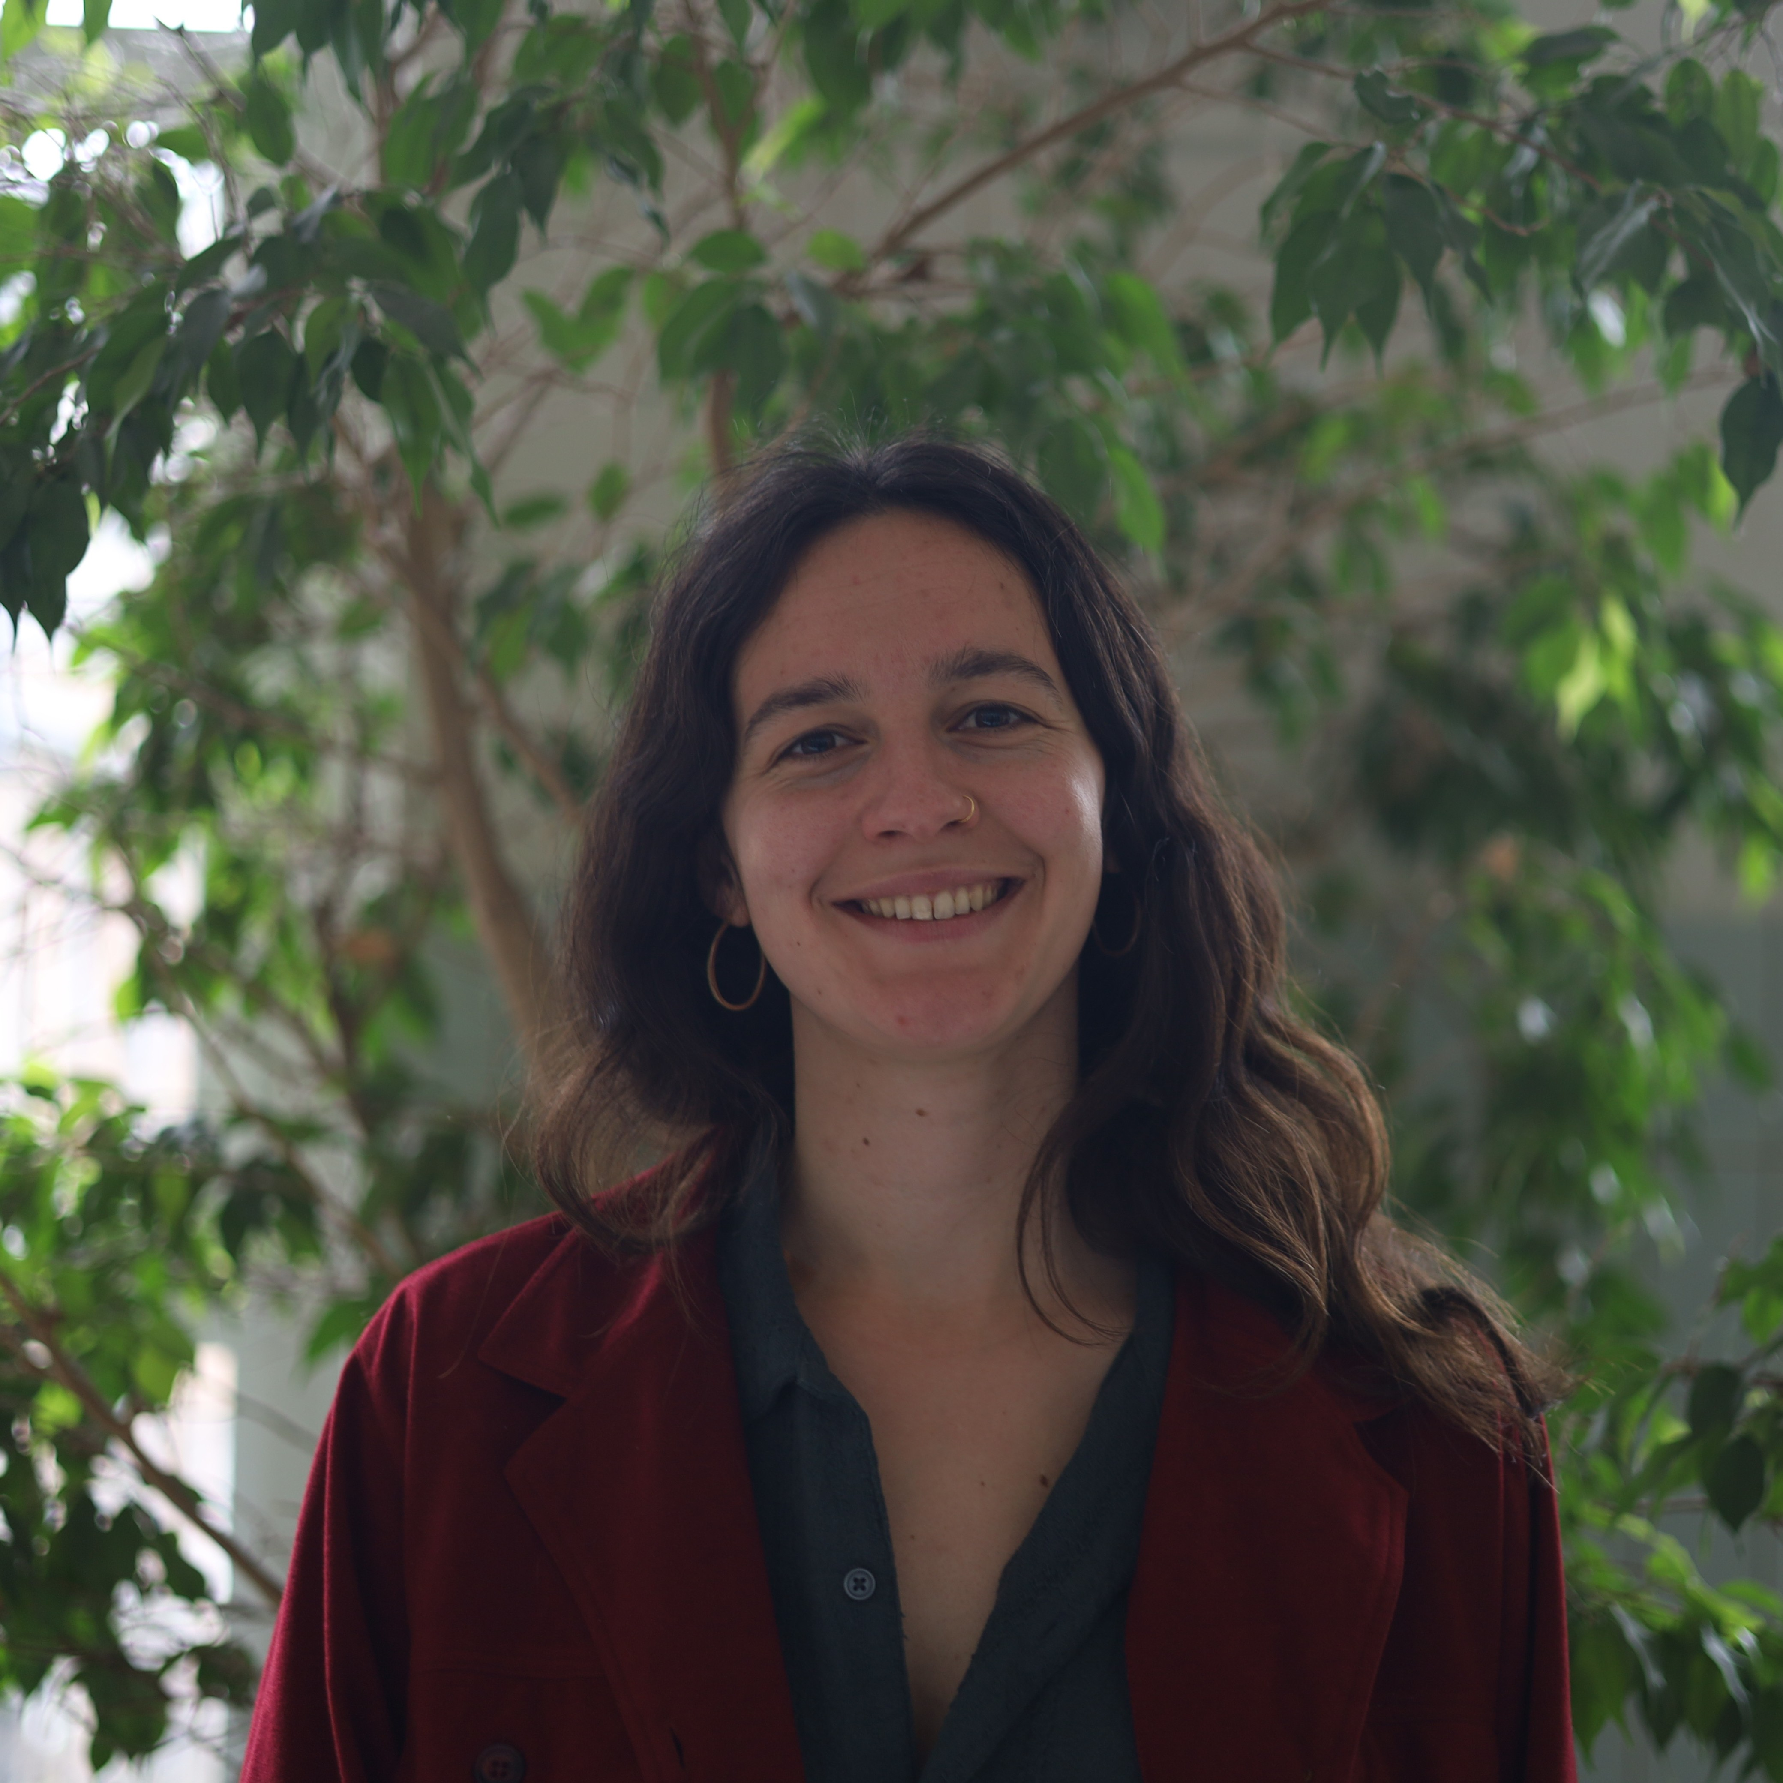

Accessing and using spatiotemporal data: climate and satellite products
Personal project on region of choice
Johanna Van Passel - Ghent University
Johanna.vanpassel@ugent.be

Slide 2
This workshop
26/08 – 09:00-12:00 – Class 1 – Theoretical introduction to spatial data and useful programs.
26/08 – 14:00-18:00 – Class 2 – Practical: extracting climate data from Google Earth Engine, visualization and statistics of climate data in R.
27/08 – 14:00-18:00 – Class 3 – Theoretical introduction to the electromagnetic spectrum, optical satellite images, land cover classification.
27/08 – 13:00-17:00 – Class 4 – Practical: extracting satellite data from Google Earth Engine and comparison of satellite with climate data in R.
28/08 – 09:00-12:00 – Class 5 – Personal project on region of choice.
28/08 – 14:00-18:00 – Class 6 – Finalizing personal project, followed by presentation session.

Slide 3
Personal project
Preferably on a region/ecosystem that is relevant to your research
  Can be comparison over space (between ecosystems) or over time (within ecosystem)
  Extract mean signal for multiple polygons or points within ecosystems
  Possibility to first mask land cover types that you’re not interested in
Extract relevant climate variables and/or vegetation indices
Visualize relevant variables
If relevant: quantify relationship of (lagged) climate with vegetation
3 PM: Present results to your peers

Slide 4
Presentation
Can be in English or Portuguese
Presentation of 4-5 slides → 5 minutes + 3 minutes discussion
Content:
  Introduction of study region and research question
  Methods:
    Choice of climate variable and/or vegetation index
    Hypothesis of expected results/relationships
  Results
  Discussion:
    Hypothesis confirmed or not, limitations, outlook, …

Slide 5
Suggestions
How do different ecosystems vary in their vegetation content?
  Comparison between ecosystems (forest – Cerrado – caatinga)
  Time series of biomass (NDVI) and vegetation water content (NDWI)
Is precipitation driving vegetation dynamics in study region?
  Relationship between precipitation and NDVI
  Can be spatial (mean rasterlayers) or temporal (time series) correlation
Are heatwaves becoming more common in my study region?
  Choose definition of heatwave
  Time series of temperature + calculate heatwave events

