Slide 1
Computational Thinking, Artificial Intelligence and the Extended Mind
Strategies for Understanding the Future of the Interface between Human Cognition and Computation
James VanSlyke
Baylor Symposium on Faith and Culture 2026

Slide 2

What time is it?
Person A uses Person B as an external cognitive resource—a living extension of their mind

Slide 3
Questions??
Does she know what time it is?
Knowledge – the cognitive calculation of some type of information
Things we know must come from inside our own cognitive structures or our own brain
OR,
Is knowledge not simply what is inside our own minds?
Knowledge – is our ability to point to the correct information whether that information is generated by our own cognition or not
What is the role of human cognition as a node in this new network of knowledge when AI can provide pre-digested content?

Slide 4
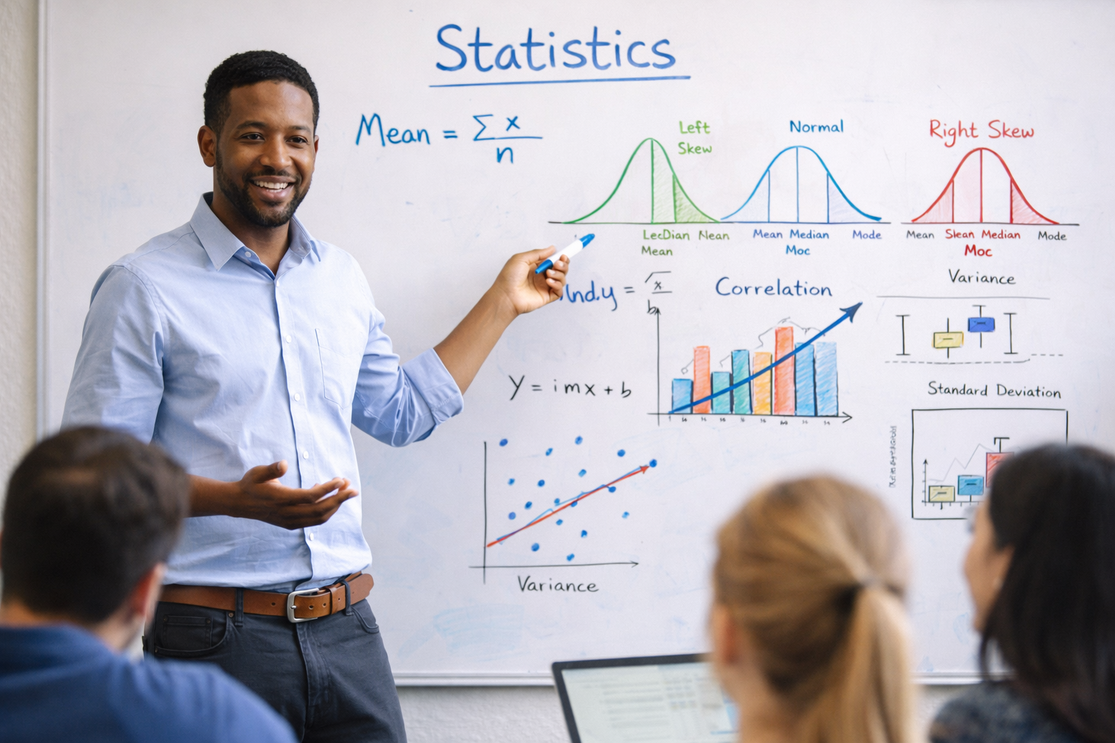
Another Example – Teaching Statistics
Teaching has always involved some type of external technology
Whiteboard/Blackboard
Charts & Graphs
Textbooks
Computer Software

Slide 5
Another Example – Teaching Statistics
Is teaching statistics the transfer of information from my mind to my student’s mind?
Or is teaching statistics pointing my students to the right information
Placing them in a feedback loop between accurate external sources of information and their own minds

Slide 6
The Extended Mind
Andy Clark's Vision (1997)
"We use intelligence to structure our environment so that we can succeed with less intelligence. Our brains make the world smart so that we can be dumb in peace!"
Being There, p. 180

Slide 7
The Extended Mind
Andy Clark's Vision (1997)
Human cognition extends beyond the biological brain
External tools and technologies function as part of our cognitive system
The boundary between mind and world is porous and dynamic
Technology has always been integrated into human thinking processes
Implication: AI can be understood as the latest evolution in cognitive extension

Slide 8
The Challenge Before Us
Human cognition has always been augmented through external memory sources
AI poses a unique challenge: summarizing and packaging information in revolutionary ways
Central Question:
What is the role of human cognition as a node in this new network of knowledge with Artificial Intelligence?

Slide 9

Computational Thinking
Jeannette Wing's Vision (2006)
Computer science provides a way of thinking from which every discipline could benefit
1. Decomposition– Breaking down complex problems into smaller, more manageable parts
2. Pattern Recognition – Identifying similarities, trends, or regularities in data or problems
3. Abstraction– Focusing on the essential information while filtering out irrelevant details
4. Algorithmic Thinking – Developing step-by-step solutions or rules to solve problems

Slide 10
Computational Thinking and Positive Educational Outcomes
Computational thinking is increasingly recognized as a 'new literacy of the 21st century’.
Cognitive Skill Development: Meta-analysis shows significant improvements in problem-solving, planning, inhibition, and working memory.
Critical Thinking: Increases students' critical and analytical thinking skills, which are vital for modern learning.
Creative Thinking: Learning to program and engage with CT concepts is linked to higher achievement in creative thinking and language skills.

Slide 11
Computational Thinking and Positive Educational Outcomes
STEM and Science Education Outcomes
Mathematics: Significantly enhances student engagement and problem-solving abilities; strong correlation between CT proficiency and math achievement.
Science and Technical Problem-Solving: Improves capacity to apply computational approaches to scientific problems, preparing students for advanced technical careers.
Innovation: Fosters innovation skills by moving students from passive users to active producers of technology.

Slide 12
Computational Thinking and AI
Why is this Helpful?
1. Understanding Computation helps us understand AI
Learning the basic skills of computer science helps us understand what AI is doing and how to ask AI better questions
2. AI provides an onramp to computational thinking
Don’t need to understand the details of various computer language, can understand the parameters and jump in and create things

Slide 13
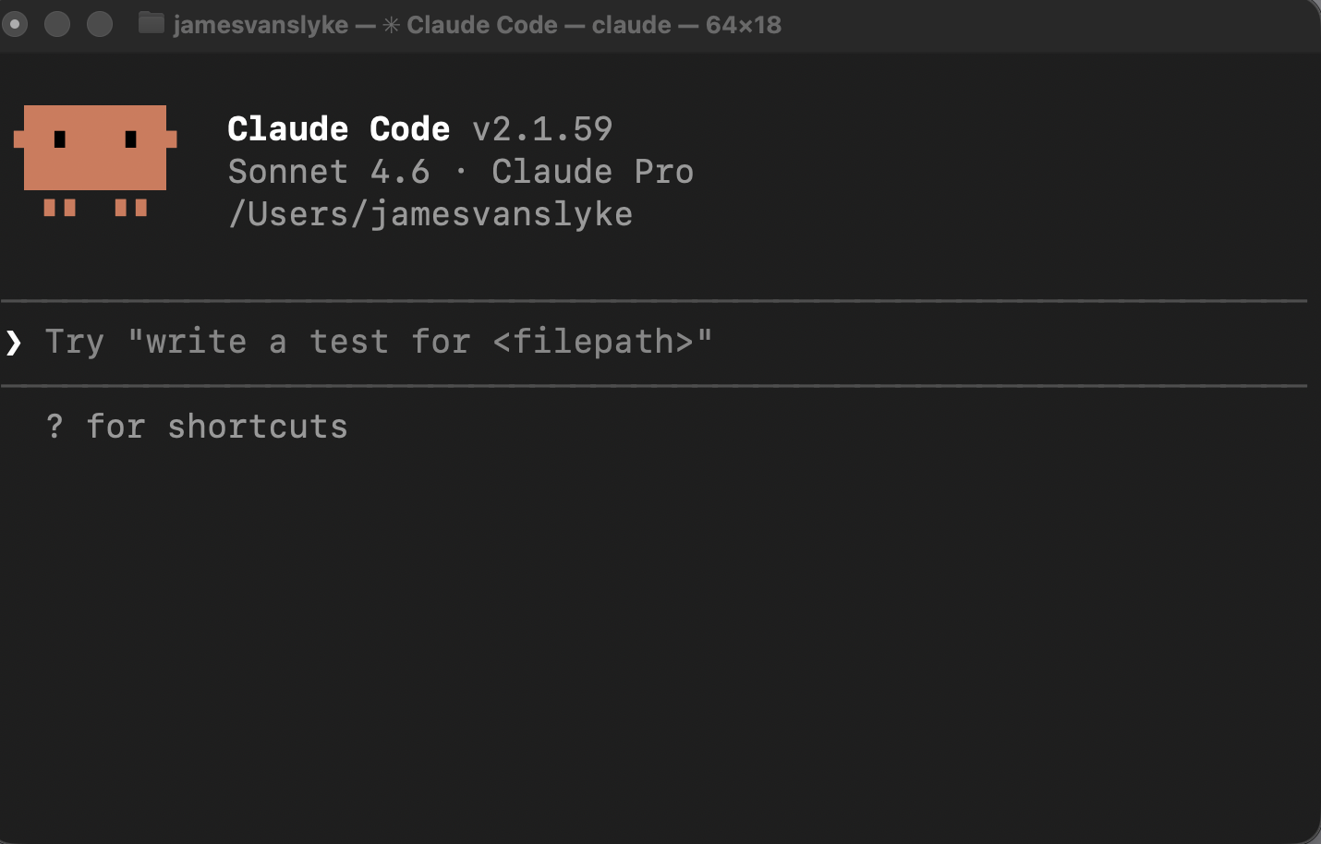
Example: Claude Code
1. Started Using Claude Code for Data Analysis
In a way, it is truly magical, writing some things I need from scratch
2. Still needs a lot of supervision
Works great doing the things computers are good at: repetitious and boring tasks
3. I would say I’m learning more about computers, not less
Claude is great at answering questions, and provides detailed workflows on what is happening

Slide 14

Should education be fully digital?
Embodied approaches to human learning provide better educational outcomes
Experiment by Zhang et. al. (2024) explored the use of different types of representations of a problem in statistics
Understanding the normal curve
3 Conditions
Drawing with a hand
Drawing only
Static Slides
Key Question: How do we maintain human agency and creativity within this AI-augmented network?

Slide 15
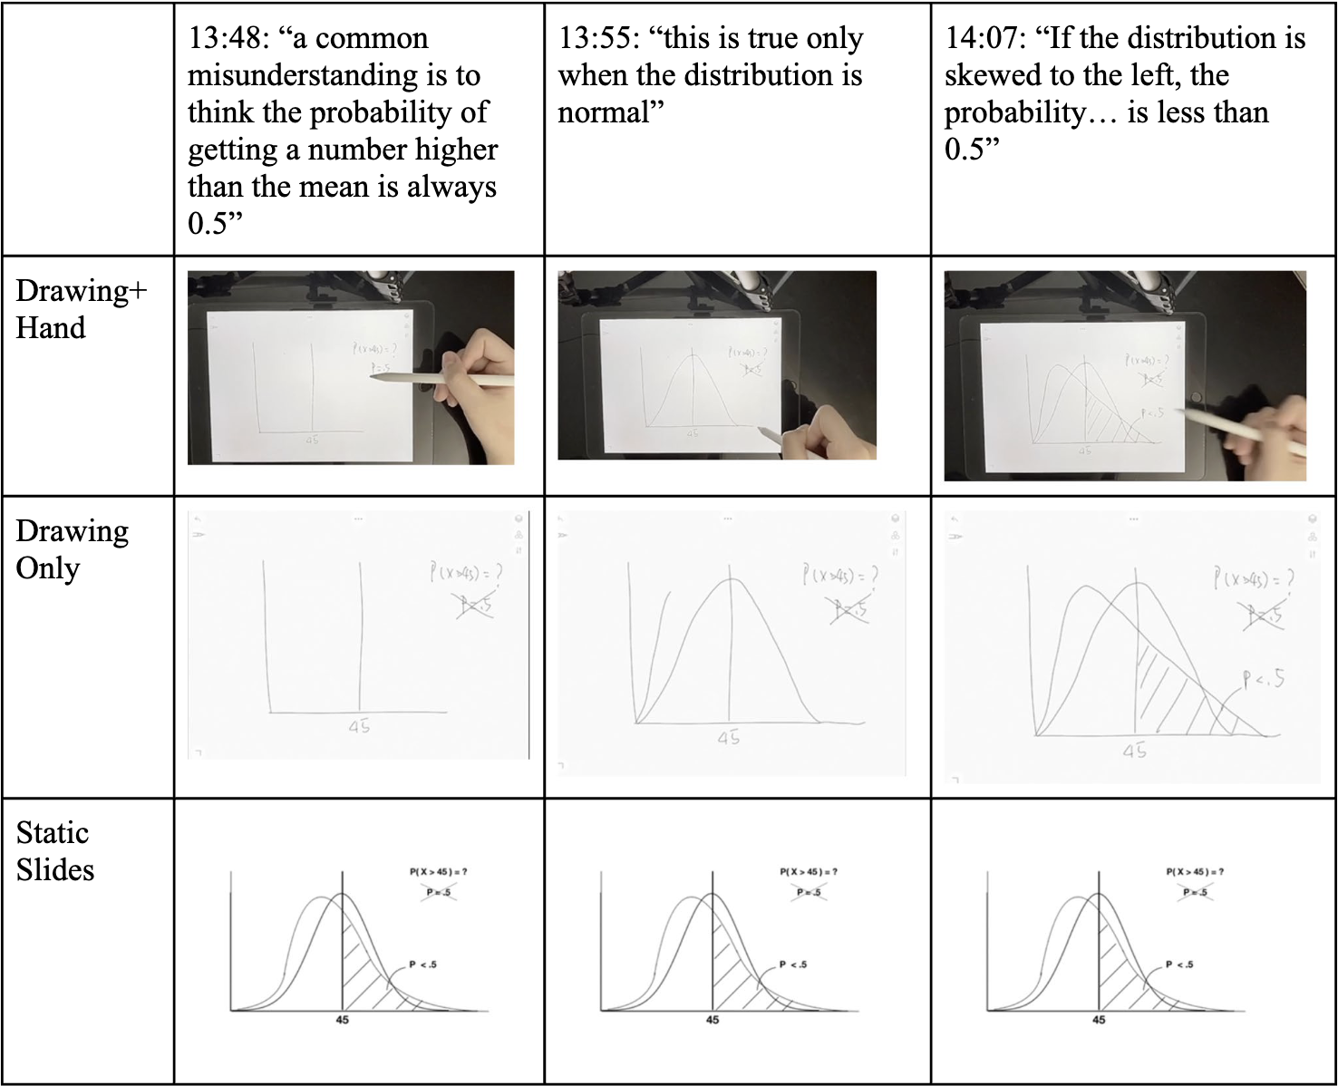

Slide 16
Should education be fully digital?
Embodied approaches to human learning provide better educational outcomes
Zhang et. al. (2024)
Students performed best on a post-test of their understanding of the material in the hand + drawing condition
Why? – Embodied approaches rely on sensorimotor systems that are already well established and easier to learn
Produces less cognitive load, making it easier to understand the new information
Key Question: How do we maintain human agency and creativity within this AI-augmented network?

Slide 17

Implications
Extended Mind Theory (Andy Clark, 1997)
Knowledge is extended outside the mind and always has been, AI is the next extension
Computational Thinking (Wing, 2006)
A way of thinking that can help us in education more broadly, but may also provide a leg up for understanding AI
Embodied Learning (Zhang et. al., 2024)
Embodied approaches to learning will continue to play an important role in learning new information
Together, these frameworks provide strategies for using AI as augmentation without diminishing human cognition's role in the knowledge network

Slide 18
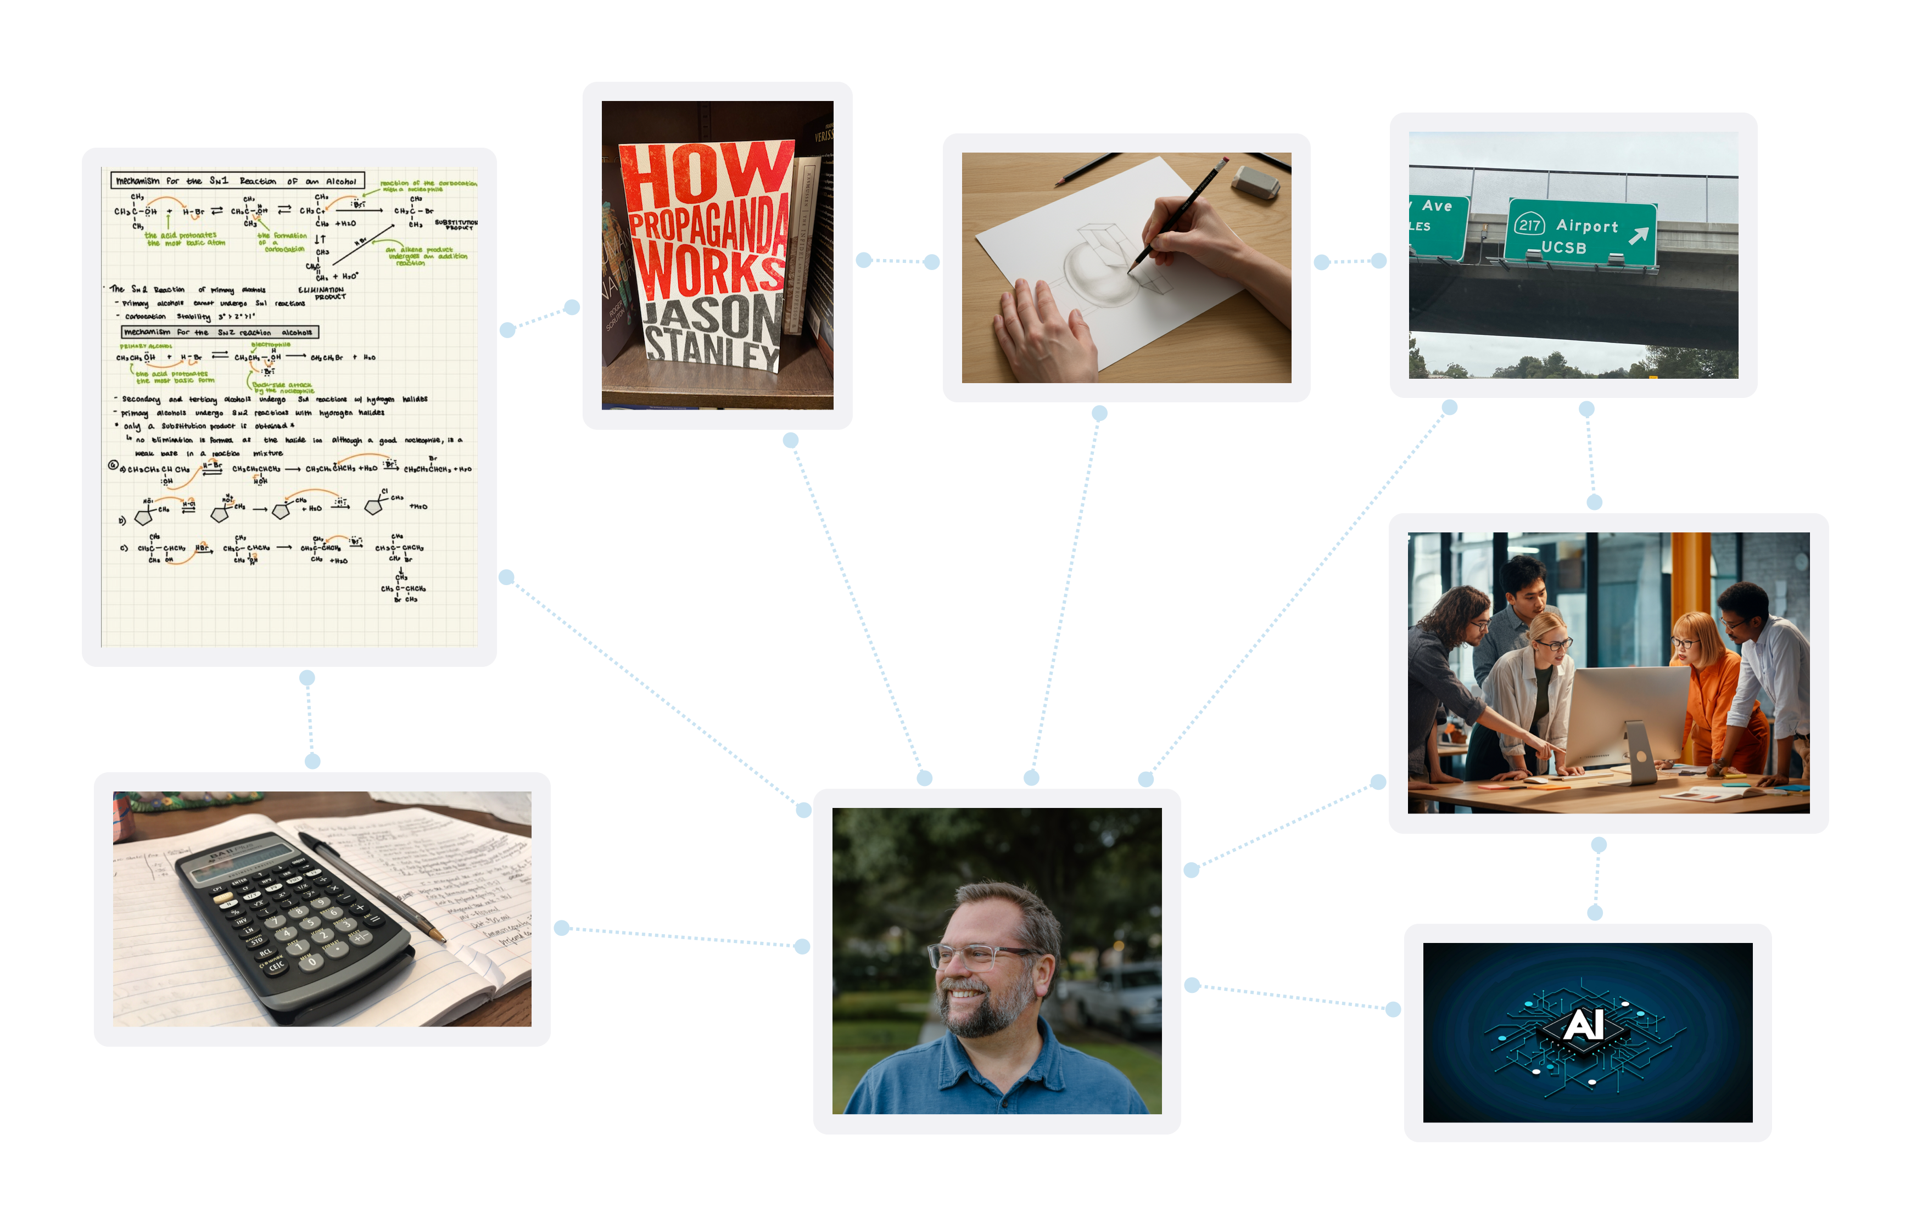

Slide 19
Maintaining Human Centrality
The Goal: AI as Augmentation, Not Replacement
Human cognition must remain a vital node in the distributed knowledge network—not merely a passive recipient of AI-generated content
Critical Considerations:
Preserving human creativity and divergent thinking
Maintaining critical evaluation skills
Avoiding cognitive over-reliance on AI
Ensuring humans shape the questions AI answers

Slide 20
Questions?
James Van Slyke
james.vanslyke@fresno.edu

Slide 21
References
Clark, A. (1997). Being There: Putting Brain, Body, and World Together Again
. MIT Press.
Hsu, T. C., Abelson, H., & Lao, N. W. (2021). A meta-analysis of the effects of game-based learning on students’ computational thinking. _Educational Research Review_, 34, 100408.
Li, F., Wang, X., & Tan, W. (2020). A meta-analysis of the effects of computational thinking on students’ learning outcomes. _Journal of Educational Computing Research_, 58(7), 1264-1289.
Scherer, R., Siddiq, F., & Sánchez Viveros, B. (2019). The cognitive benefits of learning computer programming: A meta-analysis of transfer effects. _Journal of Educational Psychology_, 111(5), 764–792.
Su, J., & Yang, W. (2022). Educational robotics and computational thinking in early childhood education: A meta-analysis. _Computers & Education_, 181, 104461.
Wing, J. M. (2006). Computational thinking.
Communications of the ACM, 49(3), 33-35.
Zhang, I. (Yunyi), Guo, X. H., Son, J. Y., Blank, I. A. & Stigler, J. W. (2025). Watching videos of a drawing hand improves students’ understanding of the normal probability distribution. Memory & Cognition, 53(1), 262–281. https://doi.org/10.3758/s13421-024-01526-7
Zhang, L., & Nouri, J. (2019). A systematic review of learning computational thinking through Scratch in K-9 education. _Computers in Human Behavior_, 94, 271-292.

