Slide 1
Machine learning Introduction and use in yield and yield gap decomposition

Slide 2



Less Fertilizer ?
Was sowing delayed ?
No residue ?
Hi Sonu! I got 5 ton rice yield from my field.
More weed and pest ?
Missed any irrigation ?
Really! I got only 4 ton yield this year.
More weed and pest ?
Was seed poor ?

Slide 3
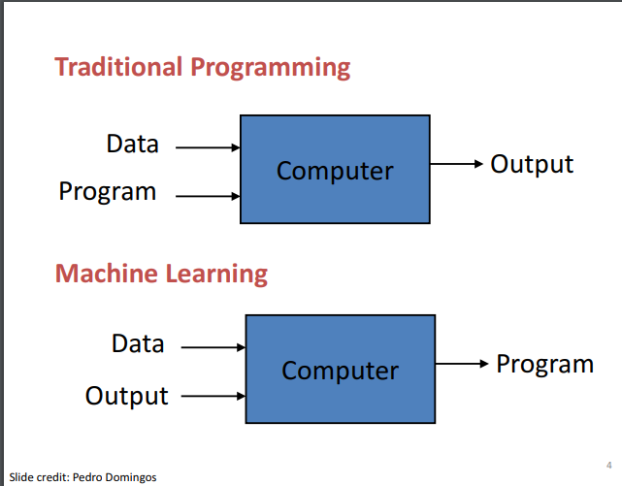
Machine learning
Learning pattern from data
https://observablehq.com/@yizhe-ang/interactive-visualization-of-linear-regression
Say computer to fit a linear regression or frontier or boundary line based on some assumption about what should be the property of parameters, How residuals should be distributed ?
You provide your management and yield to the computer and ask computer how these set of management leads to this yield. How management interacts to affect yield ?
There exists some other technique for model explanation !!
By default, the model are black box

Slide 4
Machine learning not new for you !
Amazon:
Recommended for you, bought together, recently viewed, etc. ML clusters the things based on search criteria
YouTube: If you regularly sees news in morning, When you open you tube in morning, mostly news comes.
If you search for flights in google, you may get an advertisement related to flight price while watching a video
(Video recommendation come based on recent searches ,clicks, likes and dislikes, watch time, and shares)
Movie recommendation from Netflix:
Browsing history and ratings issued, movie type and popularity, seasonal trends, and item-item similarity
Establishing relationship between two things based on data, maybe we don’t know earlier how they are related

Slide 5
Yield decomposition vs Yield gap decomposition
Explainable Machine learning says how management directly and interacting with other variable affects yield ?
For example, ML says the farms with low irrigation and late sowing has less yield.
Does not it mean, management of these factors can improve yield and hence close yield gap ?
N | P | Irrigation | Sowing | Weed | Soil |  |  | Yield
100 | 50 | 5 | 05-Nov | Most | Heavy | Farmer 1 |  | 2500
150 | 55 | 5 | 06-Nov | Most | Heavy | Farmer 2 |  | 3500
Explainable ML says Farmer 1 attained 1000 kg less yield because of 50 kg less N
Part of yield gap
But it does not say anything about, what will be the yield if farmer 1 uses 50 kg additional N with all other existing management.
Predictive ML and Yield gap

Slide 6
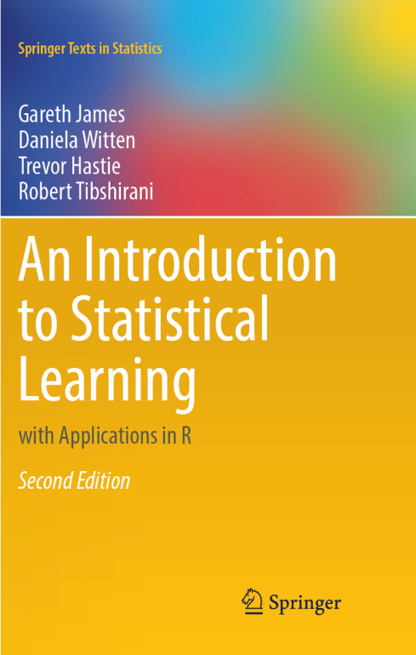

Till end of the day,
Development of Model
Feature engineering and fine tuning
Model interpretation for yield explanation…

Slide 7
Step 1: Model comparison
Why we need this ?
Based on data structure various model may fit differently.
If underlying structure is linear and small data set linear regression, Lasso or Ridge regression may perform better.
If too much complex, nonlinear interactions tree-based models works best.
if too-too much complex ensemble model may be required (mixture of two model one overcoming the others limitation).
Useful in many agronomic data not limited to yield gap only…. (Clustering of farms, Resource use efficiency, homogenous of weed occurrence, …)

Slide 8
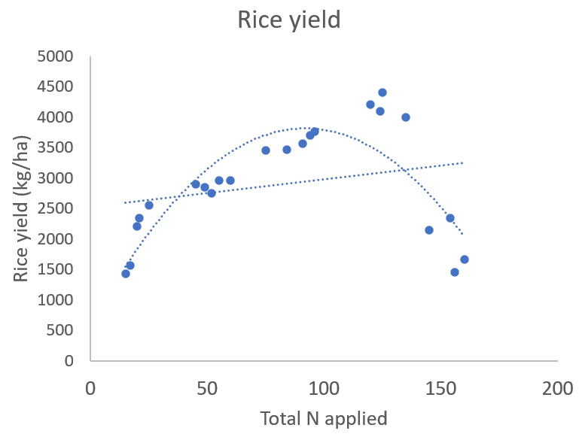
Model 1
Linear and quadratic regression
We get coefficient which can be directly interpreted
No iteration required
Easy to calculate and interpret
Not good for nonlinear and complex interactions

Slide 9
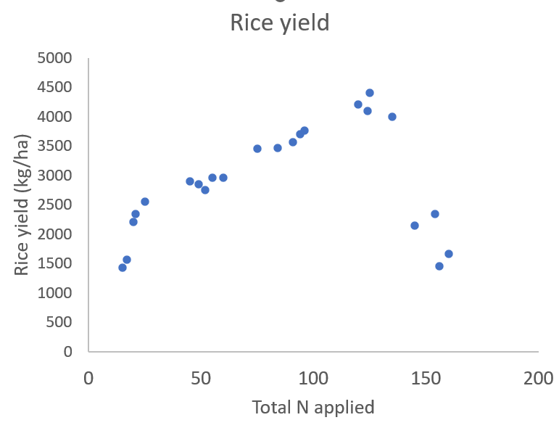
Model 2
Regression tree intuition
Total N applied < 30
Rice yield
2000 kg/ha
Total N applied > 140
Rice yield
1900 kg/ha
Total N applied > 110
Rice yield
4100 kg/ha
Total N applied > 66
Rice yield
3588 kg/ha
Rice yield
2884 kg/ha

Slide 10
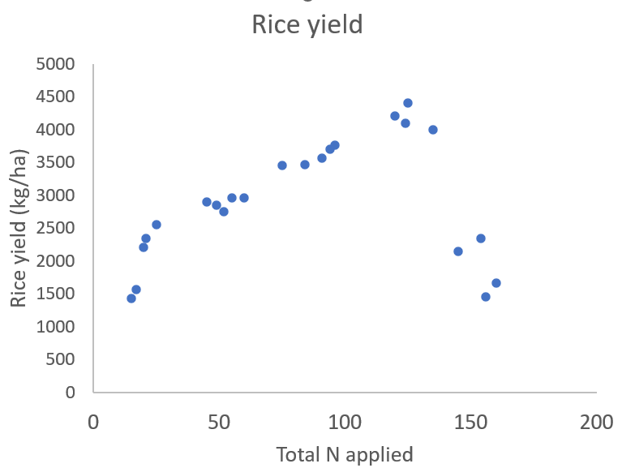
How regression tree choose variable and threshold

Slide 11
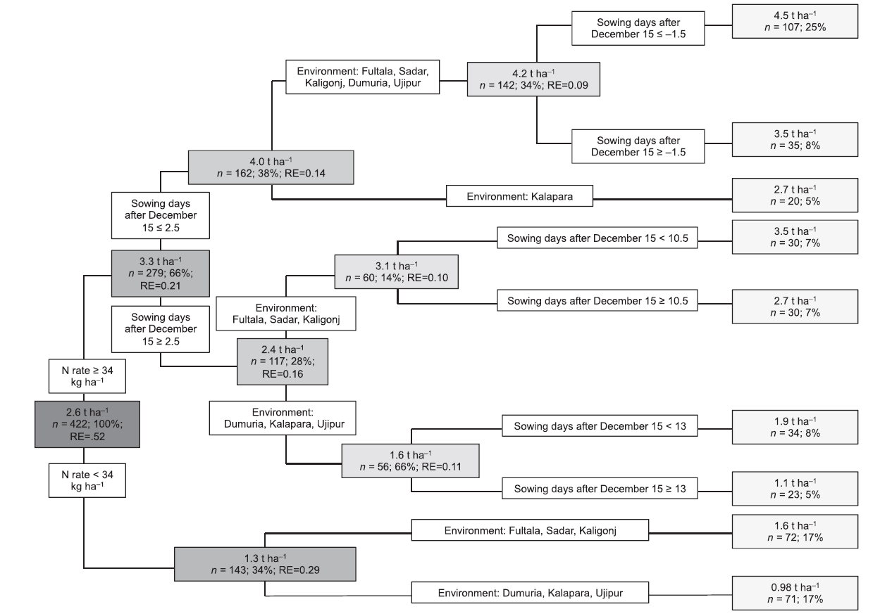
(Krupnik et al., 2015)

Slide 12
Features of Classification and regression tree
Interpretation is easy based on some rule (Structure of tree for model explanation)
Variable selection is based on some criteria (minimization of sum of square of error)
We can grow tree up to any complexity depth (Hyperparameter; cp)
Sensitive to data, variable, and outlier
Solution require Iterative running
Also, we can take classification problem based on Ginni’s Purity index
rpart, rpart.plot

Slide 13
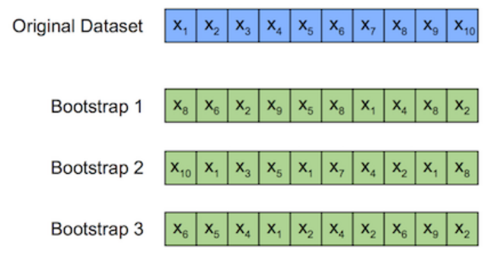
Random forest; bagging method
Model 3

Slide 14
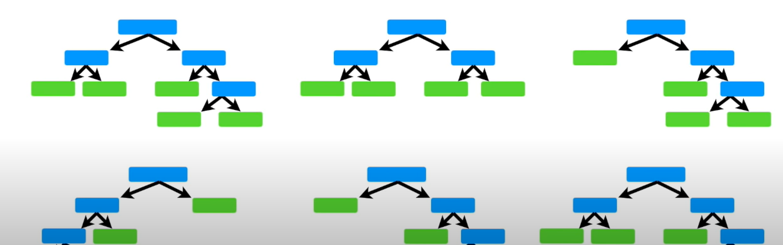
Using a bootstrapped dataset (Now less sensitive to outlier)
Only considering a random subset of variable at each step (mtry or max.nodesize) (Not over rely on a variable)
Repeat ideally for 100, 500, or 1000 times (num.tree)
We get wide variety of tree (More effective than individual decision tree)

Slide 15
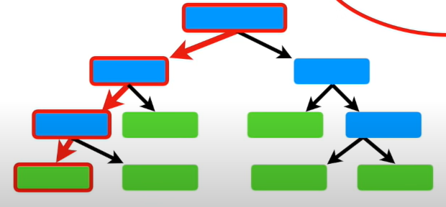
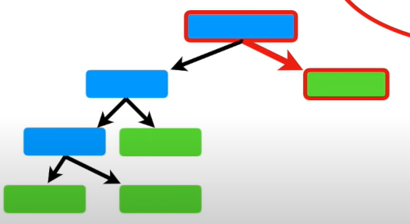
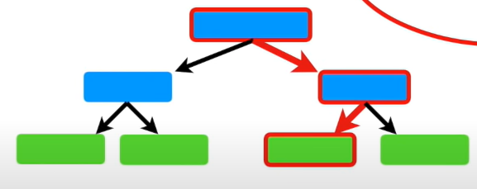
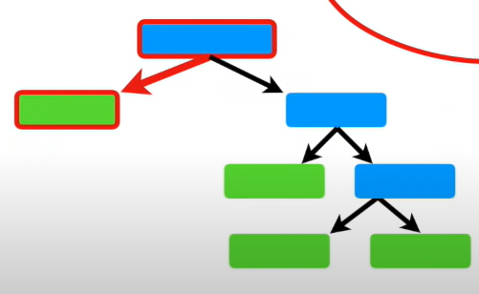
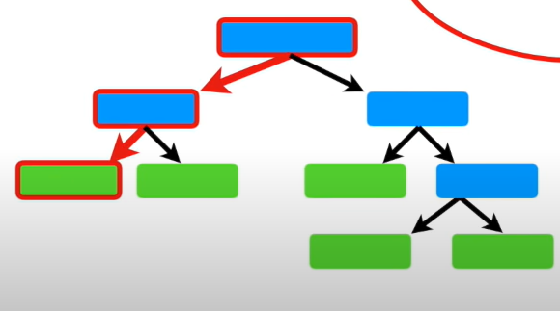
Bootstrap the data + Aggregating the decision = Bagging
4
1
2
3
500

Slide 16
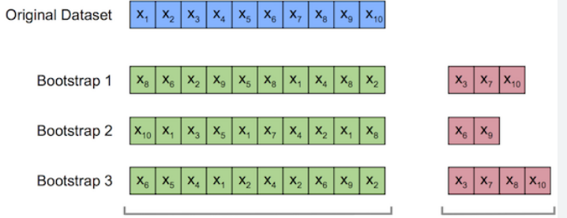
Internal check on performance on Out-of-bag or Out-of-boot data set
Performance of random forest is checked based on correct prediction of out-of-bag sample.
Out-of-bag error

Slide 17
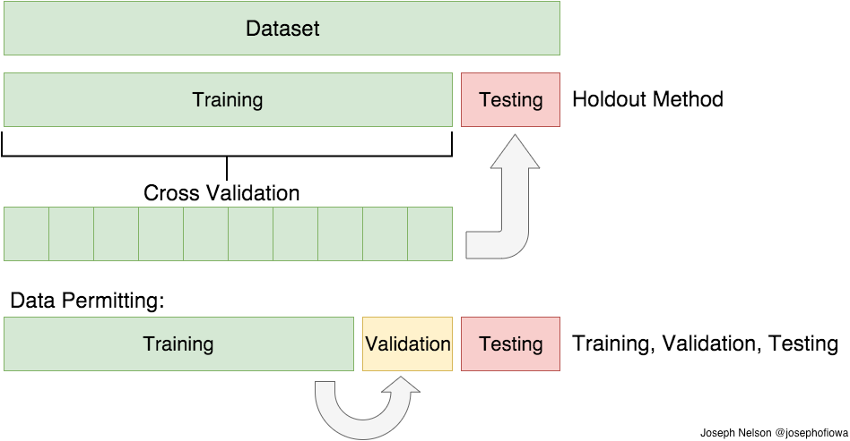

Cross-validation: Techniques to check performance on unseen data set while building model
We can use whole data set for model building
On the expectation that the model performance on the cross validated data set is an unbiased estimator on the model performance on the test set

Slide 18
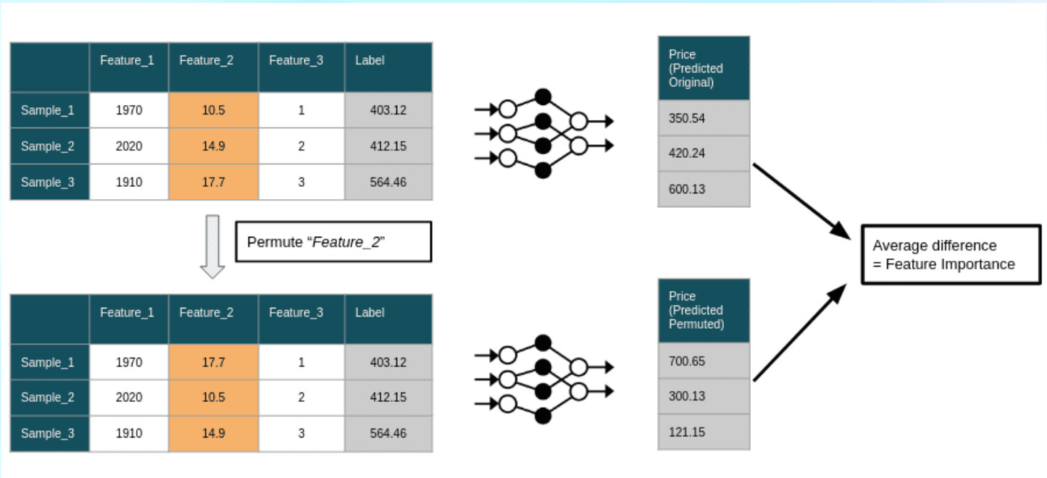
Permutation based feature importance

Slide 19
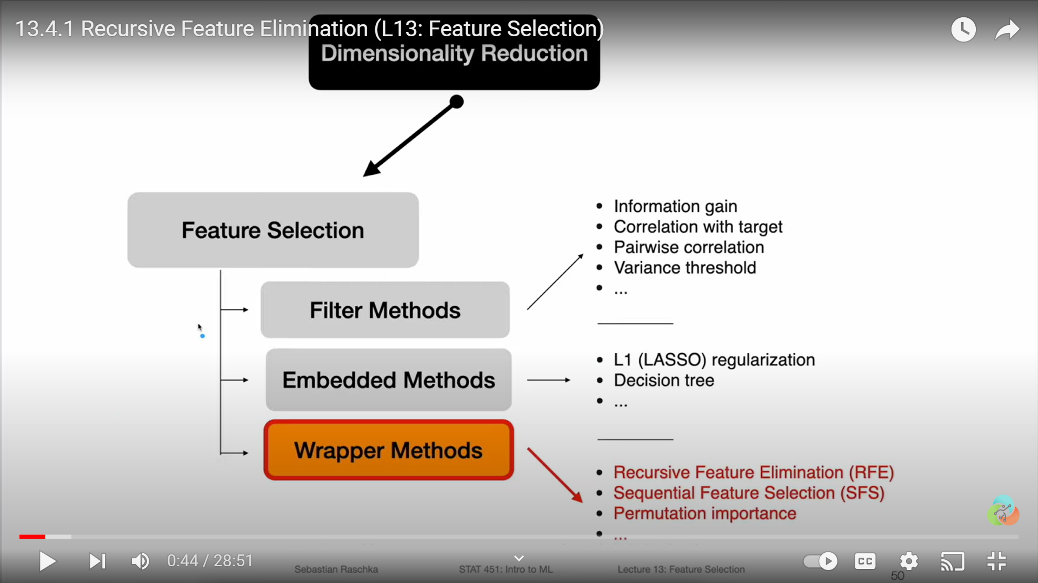
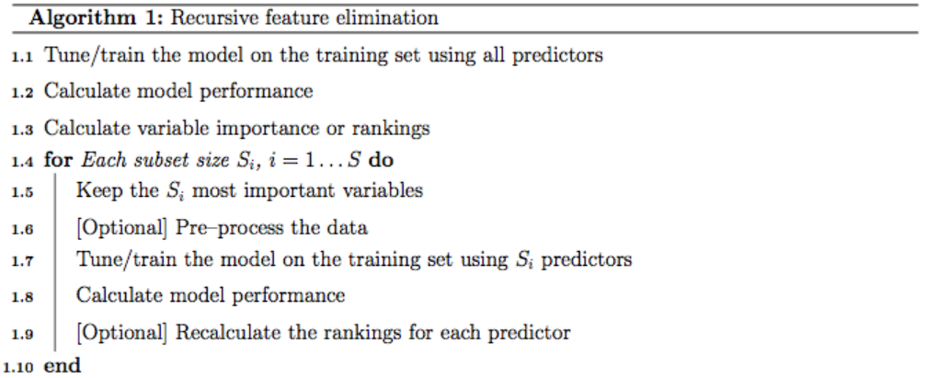
Feature selection methods: Recursive feature elimination
 | Round 1 | Round 2 | Round 3 | Round 4 | Round 5 | Round 6 | Round 7
 | V2 | V2 | V2 | V2 | V2 | V2 | V2
 | V1 |  | V1 | V1 | V1 | V1 | V1
 | V3 |  |  | V3 | V3 | V3 | V3
 | V5 |  |  |  | V5 | V5 | V5
 | V4 |  |  |  |  | V4 | V4
 | V6 |  |  |  |  |  | V6
Number of variable |  | 1 | 2 | 3 | 4 | 5 | 6
RMSE
R2
(https://www.youtube.com/watch?v=SljoN0cO95Q)

Slide 20
There can be many random forest..
Based on number of random subset of variable selected (mtry) or Number of data points at terminal node (nodesize)
Based on number of trees in the random forest (num.tree)
Aim is to select
(The) random forest with minimum out-of-bag error and (The) random forest which performs well on un-seen data (Test data)
Hyperparameter tuning

Slide 21
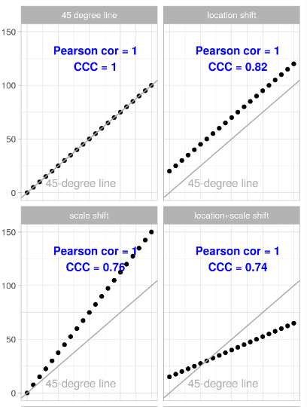
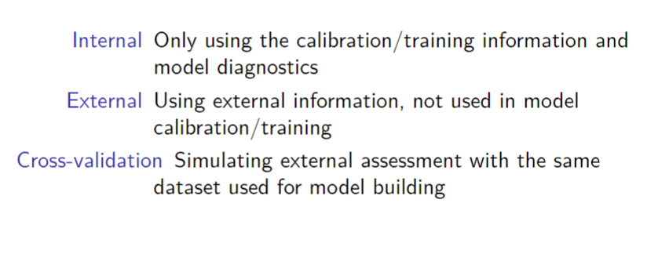
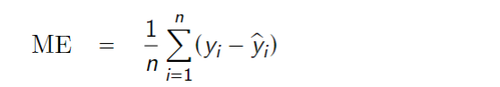
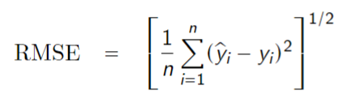
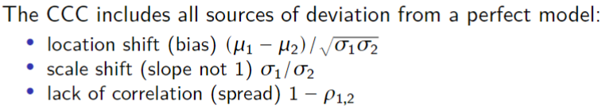
Model evaluation statistics
(David Rosetire)

Slide 22
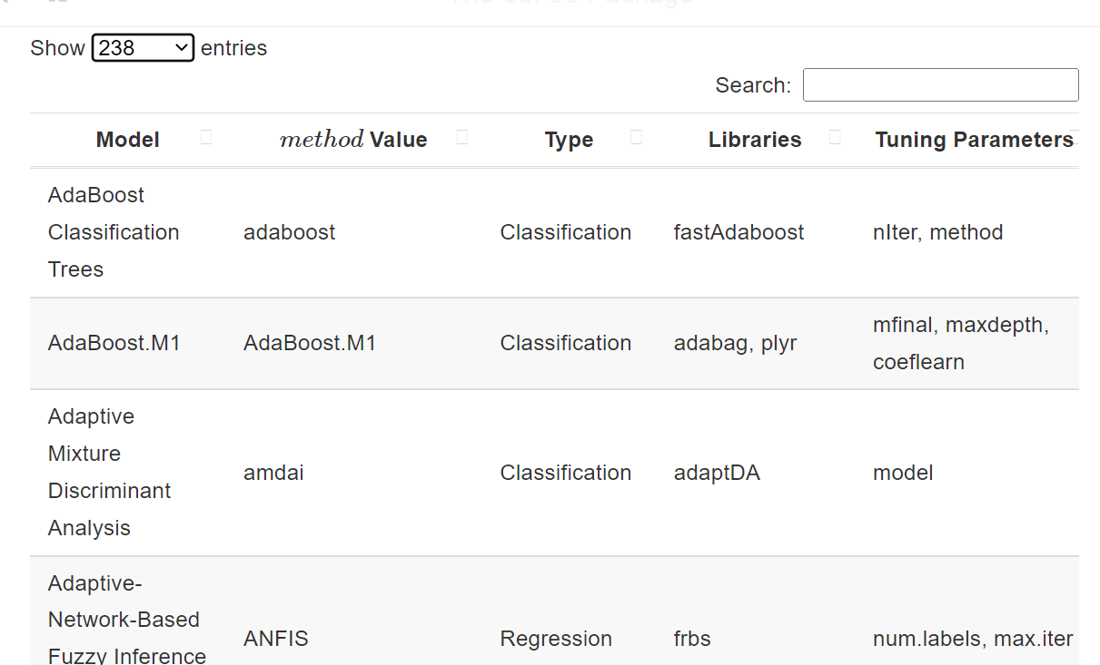
Numerous model (and variants) exists in literature and are increasing day by day too…
Snapshot from caret github page on 13/05/2023

Slide 23
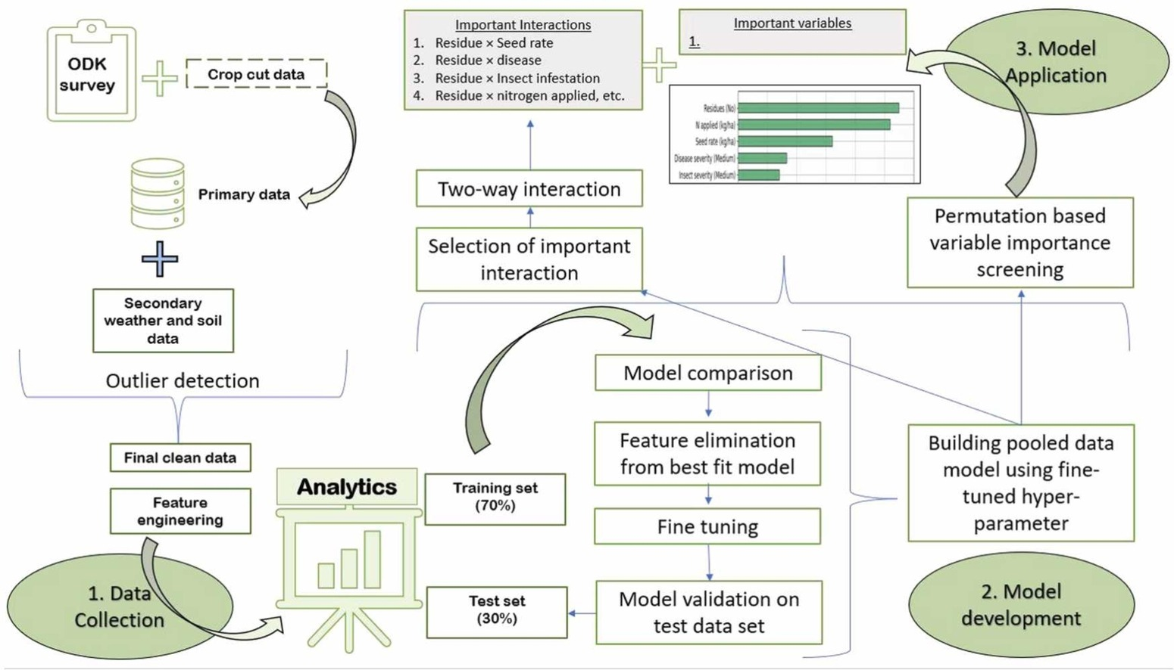
What a typical ML workflows should be ?
(Nayak, H.S., Silva J V., Parihar C.M., et al., 2022)

Slide 24
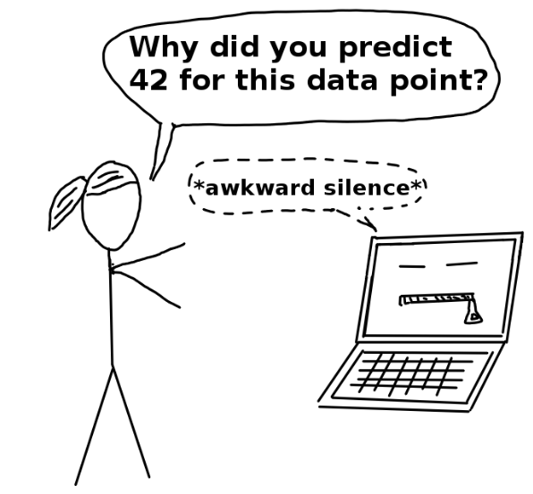
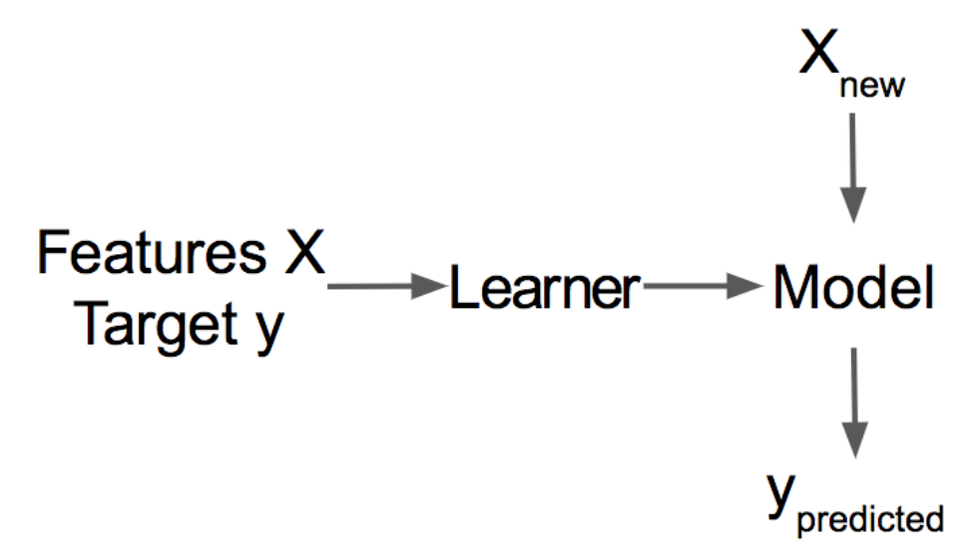
RF model developed! How to interpret ??
We don’t have any coefficient alike in linear regression for interpreting or publishing
We don’t have a regression tree like structure (We have 500s of trees)
How to say which variable are important ? And their effect ?

Slide 25
Model interpretation
Local or global?
Linear regression
Classification and regression tree
…
Which variable is more important for describing yield at population level ?
What is the effect of the variable (say N) on yield ?
With which factor N is interacting to affect yield ? (Important two-way interactions)
Intrinsically interpretable models
Vs
Post hoc (and model-agnostic) interpretation models.
Gradient boosting
Random forest
…
At farm level what is the effect of any production practices on rice yield ?

Slide 26
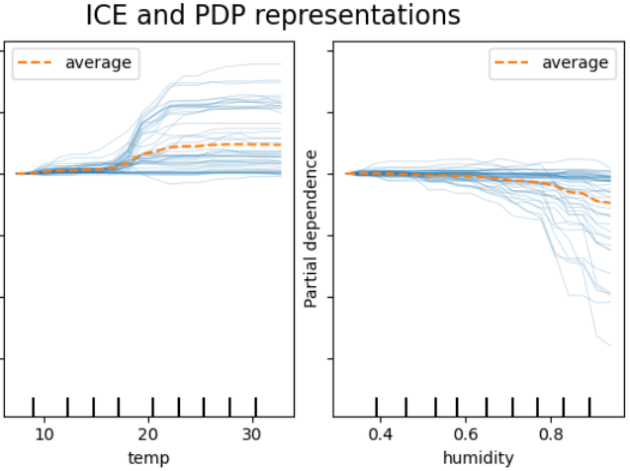
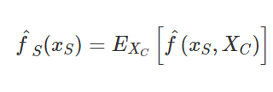
Effect of production practices on yield or (any outcome of interest)
Partial dependence plots (Single variable or two-way interactions)
By marginalizing the machine learning model output over the distribution of the features in set C, PDP shows the relationship between the features in set S we are interested in and the predicted outcome

Slide 27
Feature interaction
We will look at the exercise..

Slide 28
Thank You

