Slide 1

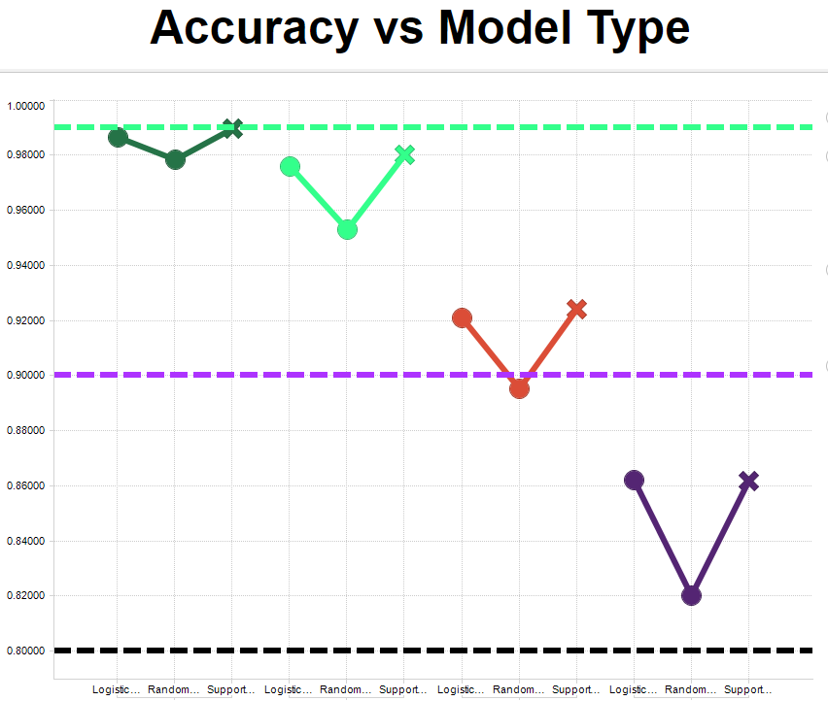
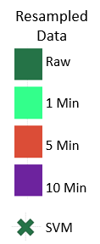
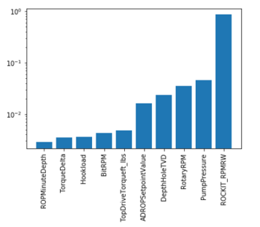
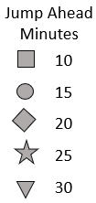
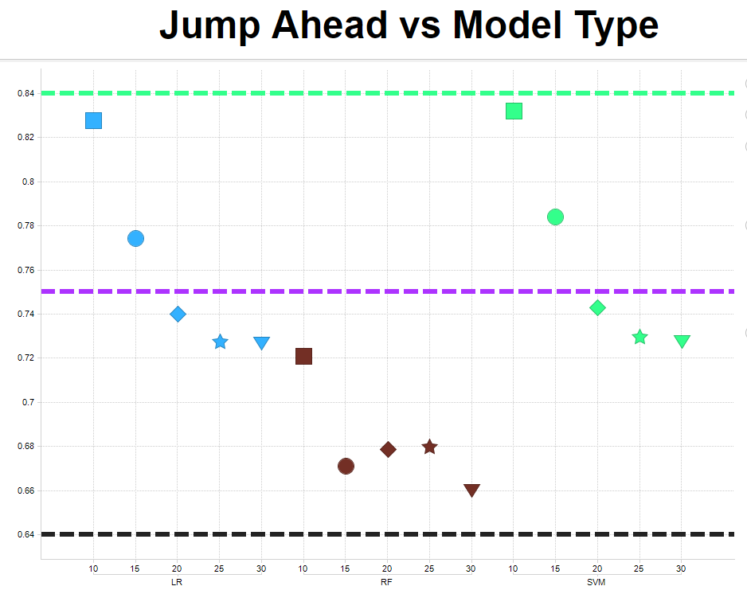
Achieving Optimal Horizontal Drill Operations
Daniel Serna, James Vasquez
Master of Science in Data Science
Southern Methodist University, Dallas, TX 75275, USA
Introduction
Method
Drilling an oil well is cost intensive and requires many key data features to understand the knowns and start to understand the unknowns.
Our team created a model to predict slide events in horizontal drill operations.
Slide events occur when the drill bit is no longer rotating.
Model Accuracy
Data was reduced using decision tree feature selection and business knowledge.
Grid search used to identify optimal parameters for the model.
  Business knowledge reduced further
  512 features reduced to ten features
.99
Why Bother?
.90
Actionable Features
Slides events are a bigger concern in horizontal drilling operations.
Slide events are currently mitigated by relying on expensive field consultants.
Our unique approach is cheaper, faster, and more accurate.
With the help of the reservoir engineers we were able to remove features that drill operations cannot control.
Features identified are a mix of features to monitor and to take action on to minimize slide events.
.80
Feature Selection
Problem
Predict future slide events to increase drill operation efficiencies.
Enable drill operations to become proactive in minimizing slide events.
Future Prediction
.85
Modeling
Three models were created
  Logistic Regression (LR)
  Random Forest (RF)
  Support Vector Machine (SVM)
SVM was found to be the most accurate but also the most CPU intensive.
  To reduce time the data was re-sampled to one-minute data sets
.75
Conclusions
SVM model produced best accuracy scores at 99%.
For simplicity and speed, Logistic Regression was determined to be the best model.
When predicting into the future, LR accuracy drops to 82% at ten minute prediction window.
Re-sampled data at one minute provides the same accuracy as the full data set.
.65

