Slide 1

Prediction of Slide Events for Horizontal Drill Operations
Daniel Serna
James Vasquez
Donald Markley – VP Drilling & Completions

Slide 2
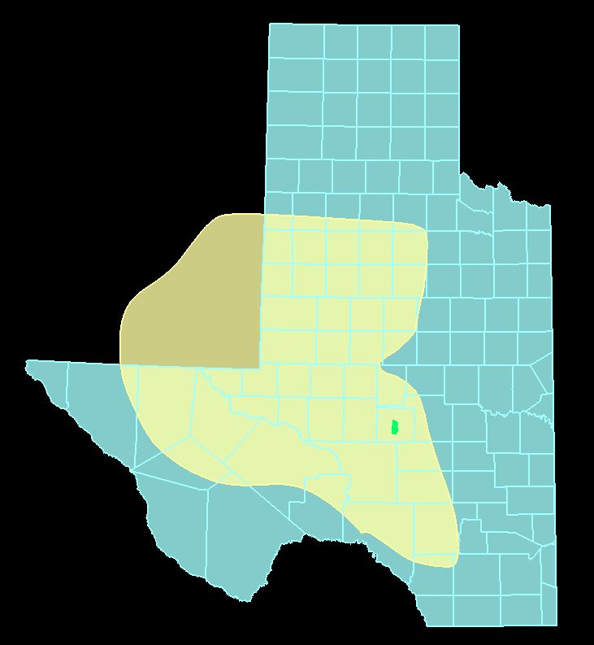
Permian Basin
Notes:
Talk about the size of the basin
86K square miles
If the basin was it’s own state it would be the 11th largest state in the US
Larger than 39 other states
IF you would add the bottom 10 states, Permian basin would still be larger

Slide 3
Permian Basin
Notes:
Talk about the size of the basin
86K square miles
If the basin was it’s own state it would be the 11th largest state in the US
Larger than 39 other states
IF you would add the bottom 10 states, Permian basin would still be larger

Slide 4
Why is drilling hard
Well density
Cost
Unknowns
Technical
Notes:
So many wells have already been drilled
Drilling cost are about 1.2 to 1.6 million dollars
Drilling through faults, rock types
Drilling underground is just hard

Slide 5
Why is drilling hard
Well density
Cost
Unknowns
Technical
Notes:
So many wells have already been drilled
Drilling cost are about 1.2 to 1.6 million dollars
Drilling through faults, rock types
Drilling underground is just hard

Slide 6

Vertical Drilling
Limestone
Sandstone
Shale
Basement Rock
Well Paths
Total Depth
Notes:
Traditional drilling
Multiple wells to get at the same formation
Basic rock types

Slide 7
Vertical Drilling
Limestone
Sandstone
Shale
Basement Rock
Well Paths
Total Depth
Notes:
Traditional drilling
Multiple wells to get at the same formation
Basic rock types

Slide 8
Horizontal Drilling
Limestone
Sandstone
Shale
Basement Rock
Vertical Section
Kick Off Point
Horizontal
Total Depth
Notes:
Horizontal well being the norm
Talk about the lengths 10 ft lateral
Less surface damage

Slide 9
Horizontal Drilling
Limestone
Sandstone
Shale
Basement Rock
Vertical Section
Kick Off Point
Horizontal
Total Depth
Notes:
Horizontal well being the norm
Talk about the lengths 10 ft lateral
Less surface damage

Slide 10
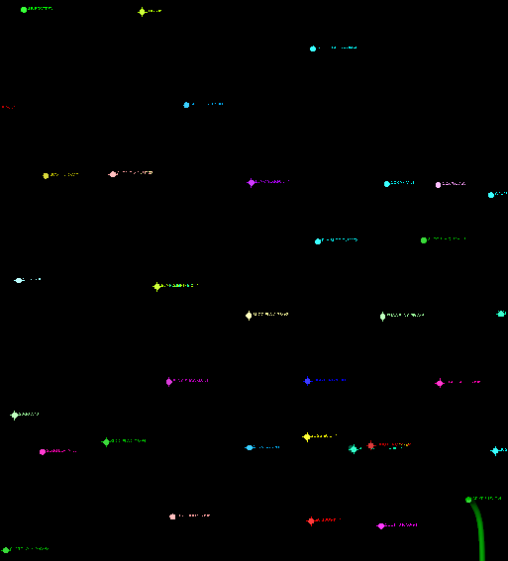
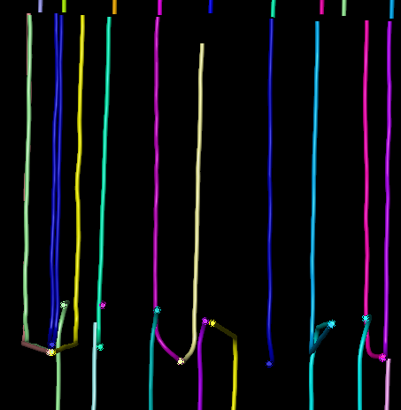
From a Birds Eye
Vertical Wells Horizontal Wells
2 mile
2 mile
32 Wells
19 Wells
Notes:
Explain the birds eye view

Slide 11
From a Birds Eye
Vertical Wells Horizontal Wells
2 mile
2 mile
32 Wells
19 Wells
Notes:
Explain the birds eye view

Slide 12
Geological Software View
Notes:
Explain the birds eye view

Slide 13
Sliding vs Rotating
Limestone
Sandstone
Shale
Basement Rock
Well Paths
Total Depth
Notes:
Talk about the rotation and why its important
What happens when we slide
Why do we want more rotation
Ever possible to eliminate slidding

Slide 14

Problem Statement
Predict future slide events to increase drill operation efficiencies
As part of this is it possible to use the classification
Notes:
Bullet 2 first, bullet 1 is part of bullet 2
What happens when we slide
Why do we want more rotation
Ever possible to eliminate slidding

Slide 15
Problem Statement
Predict future slide events to increase drill operation efficiencies
As part of this is it possible to use the classification
Notes:
Bullet 2 first, bullet 1 is part of bullet 2
What happens when we slide
Why do we want more rotation
Ever possible to eliminate slidding

Slide 16
Where’s the data come from?
Vertical Section
Kick off Point
Horizontal Section
Notes:
Instead of wordcloud use the image and highlight where the data comes from
Data come in real time
Data given on 21 wells
3 million rows of data
Stored in SQL Server
500+ features

Slide 17
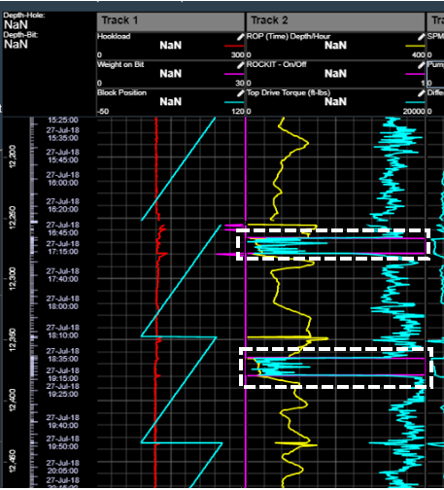
Engineering View
Hook Load
Rate of Penetration
Torque
Slide Event
Label
Notes:
Label figure directly, make image larger
MyWells
User looks at this while drill operations happening
User is in office and can view

Slide 18
Engineering View
Hook Load
Rate of Penetration
Torque
Slide Event
Label
Notes:
Label figure directly, make image larger
MyWells
User looks at this while drill operations happening
User is in office and can view

Slide 19
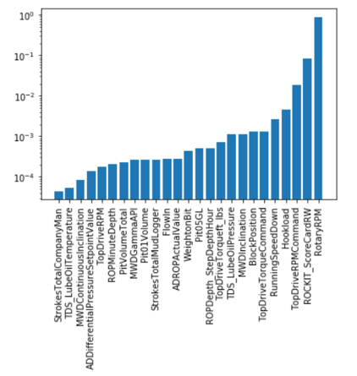
Data Cleansing Feature Selection
25 Features
Notes:
Remember the 500+ features
First round of EDA removed unnecessary columns
Left with over 100+ columns
Still too many features and unimportant features coming up

Slide 20
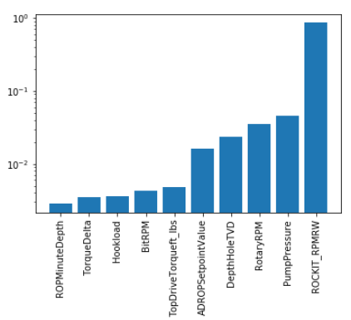
Data Cleansing Feature Selection
10 Features
Notes:
A grid search applied
Working with BU removed additional features and features we cannot do anything about
Wanted to keep actionable features

Slide 21
Problem Statement
Predict future slide events to increase drill operation efficiencies
As part of this is it possible to use the classification
Notes:
Bullet 2 first, bullet 1 is part of bullet 2
What happens when we slide
Why do we want more rotation
Ever possible to eliminate slidding

Slide 22
Models Accuracy vs Model Type
Notes:
Tell them about the models and why we used them

Slide 23
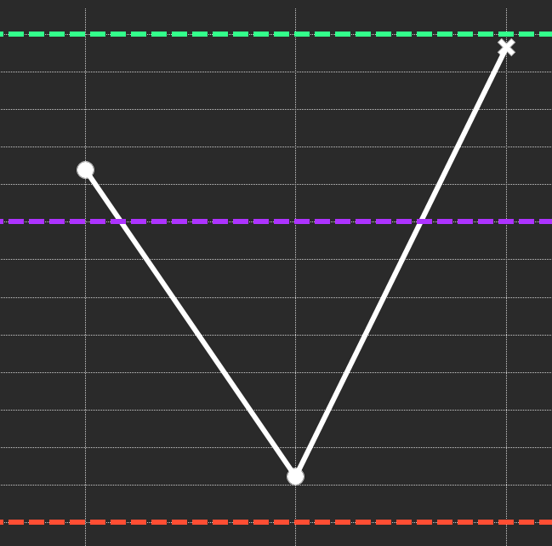
Models Accuracy vs Model Type
.99 Accuracy
.985 Accuracy
Accuracy
.977 Accuracy
LR
RF
SVM
Notes:
Tell them what we need to tell them, 1st step are sliding or rotating
Talk about the 3 models we built
Why these 3 models – Classification
Talk about prediction was on the next point and not future points

Slide 24
Models Accuracy vs Model Type
.99 Accuracy
.985 Accuracy
Accuracy
.977 Accuracy
LR
RF
SVM
Notes:
Classifier window vs non classified window (static model)

Slide 25
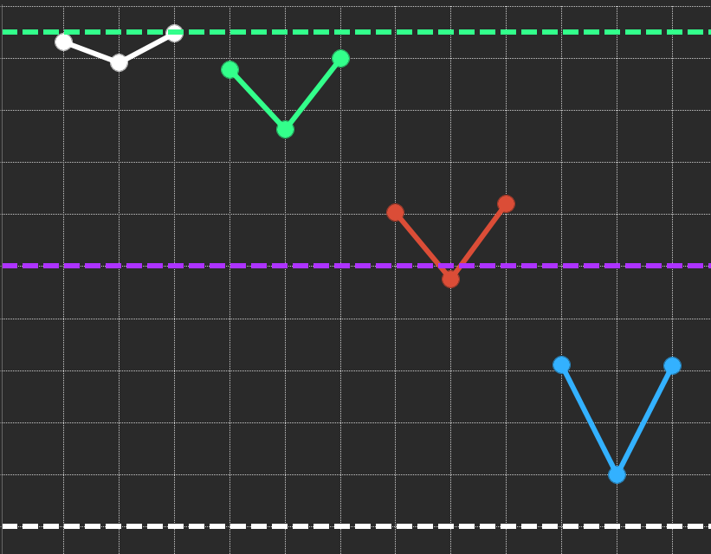
Accuracy vs Model Type
SVM
.99 Accuracy
LR
RF
LR
SVM
Raw
RF
1 Min
LR
SVM
Accuracy
.90 Accuracy
RF
5 Min
LR
SVM
RF
10 Min
.80 Accuracy
Resample
Notes:
Why did we want to re-sample
Model ran for several hours with raw data
Re-sampled data took a fraction of the time
Dropped data rown count from 729K to 120K rows

Slide 26
Accuracy vs Model Type
SVM
.99 Accuracy
LR
RF
LR
SVM
Raw
RF
1 Min
LR
SVM
Accuracy
.90 Accuracy
RF
5 Min
LR
SVM
RF
10 Min
.80 Accuracy
Resample
Notes:
Why did we want to re-sample
Model ran for several hours with raw data
Re-sampled data took a fraction of the time
Dropped data rown count from 729K to 120K rows

Slide 27
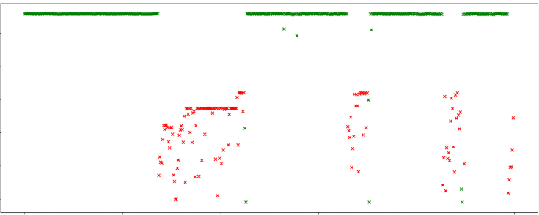
Model Predictions
High
Rotating
Mis classified
RPM
Sliding
Low
TIME
Notes:
Explain the colors
Label the graph directly
Why misclassification are the beginning and end
Is this ok, it is because we are concerned about the are in the slidding

Slide 28
Model Predictions
High
Rotating
Sliding
RPM
Mis classified
Low
TIME
Notes:
Explain the colors
Label the graph directly
Why misclassification are the beginning and end
Is this ok, it is because we are concerned about the are in the slidding

Slide 29
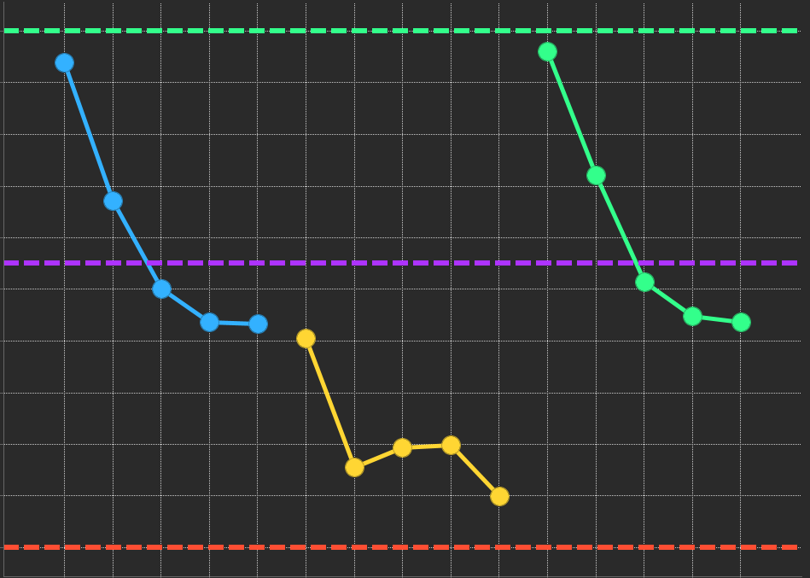
Future Predictions Jump Ahead vs Model Type
.85 Accuracy
10 Min
10 Min
.75 Accuracy
Accuracy
30 Min
30 Min
10 Min
30 Min
.65 Accuracy
LR
RF
SVM

Slide 30
Future Predictions Jump Ahead vs Model Type
.85 Accuracy
10 Min
10 Min
.75 Accuracy
Accuracy
30 Min
30 Min
10 Min
30 Min
.65 Accuracy
LR
RF
SVM

Slide 31
Conclusions
Best model and why
Accuracy
Speed to predict
Simplistic
Resampled data for use
Faster compute time
Faster reprduciablity
Notes:
Jump ahead at 10 minutes
Support Vector Machine 0.831907142
Logistic Regression 0.827755655
Random Forest 0.720876048
Resampled at 1 minute samples
Support Vector Machine 0.98004
Logistic Regression 0.97578
Random Forest 0.95285

Slide 32
Conclusions
SVM model produces 98% accuracy on test data
Jumping ahead predictions are lower at 83%

Slide 33
Conclusions
SVM model produces 98% accuracy on test data
Jumping ahead predictions are lower at 83%

Slide 34
END

