Slide 1

Prediction of Slide Events for Horizontal Drill Operations
Daniel Serna
James Vasquez
Donald Markley – VP Drilling & Completions

Slide 2
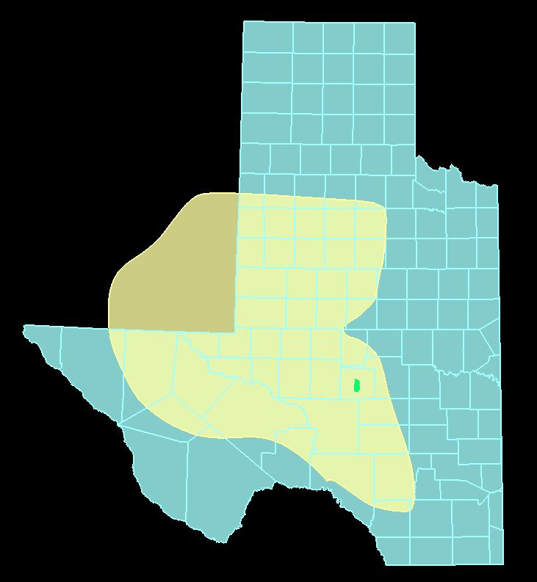
Permian Basin
86K mi2
Largest producing oil field

Slide 3
Why is drilling hard
Well density
Cost

Slide 4

Vertical Drilling
Limestone
Sandstone
Shale
Basement Rock
Well path
Target Formation
Total Depth

Slide 5
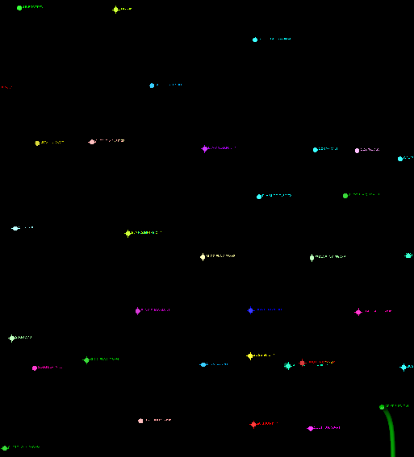
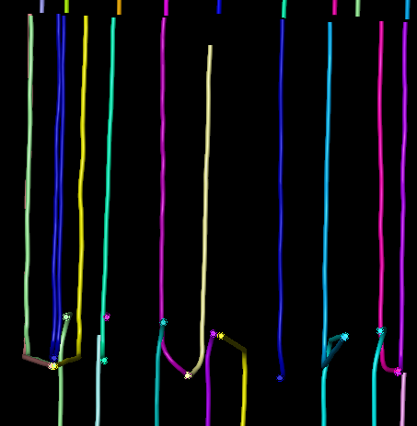
Vertical Drilling vs Horizontal Drilling
2 mile
2 mile

Slide 6
Horizontal Drilling
Limestone
Sandstone
Shale
Basement Rock
Well path
Target Formation
Total Depth

Slide 7
Horizontal Drilling Sliding vs Rotating
Limestone
Sandstone
Shale
Basement Rock
Well path
Target Formation
Total Depth

Slide 8
Problem Statement
Identify the classification of sliding vs rotating
Predict the future slide events
Current
Desired
Total Depth
Drill bit path
Target Formation

Slide 9
Problem Statement
Identify the classification of sliding vs rotating
Predict the future slide events
Current
Desired
Total Depth
Drill bit path
Target Formation

Slide 10

Data

Slide 11
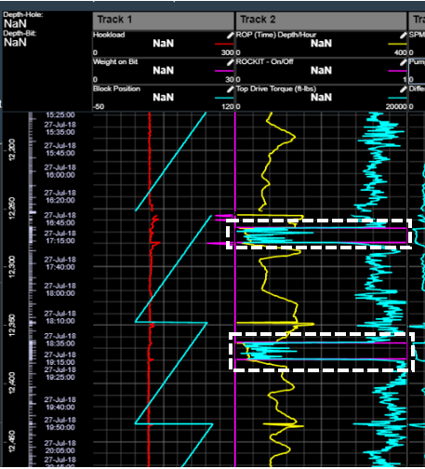
Data
Slide Events
Torque
Rate of Penetration
Block Position
Label

Slide 12
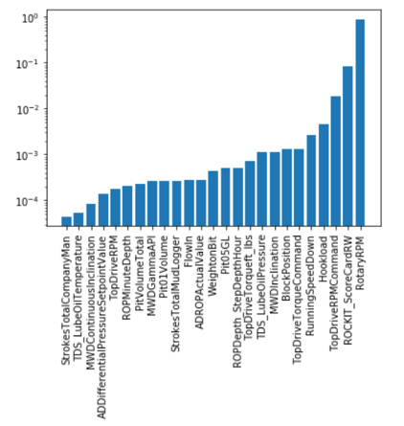
Data Cleansing Feature Selection

Slide 13
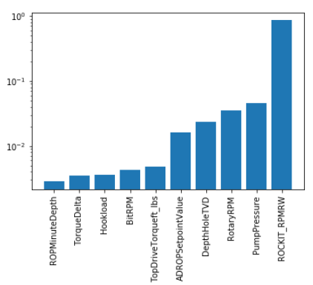
Data Cleansing Feature Selection

Slide 14
Restate problem
Identify the classification of sliding vs rotating
Predict the future slide events
Picture of traffic → Sliding compared to stop and go

Slide 15
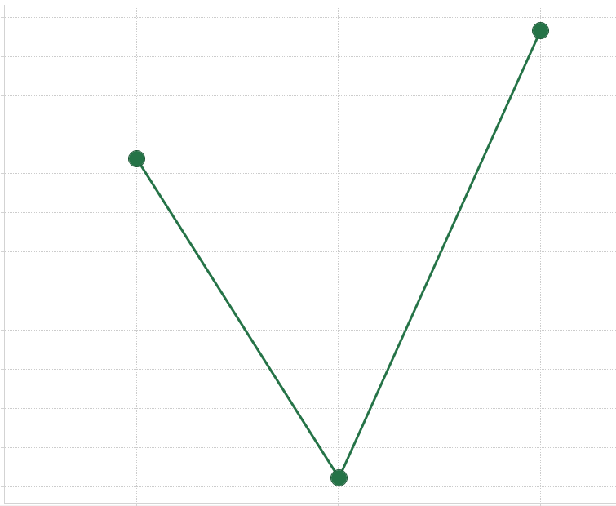
Models No Re-Sampling
Accuracy
LR
RF
SVM

Slide 16

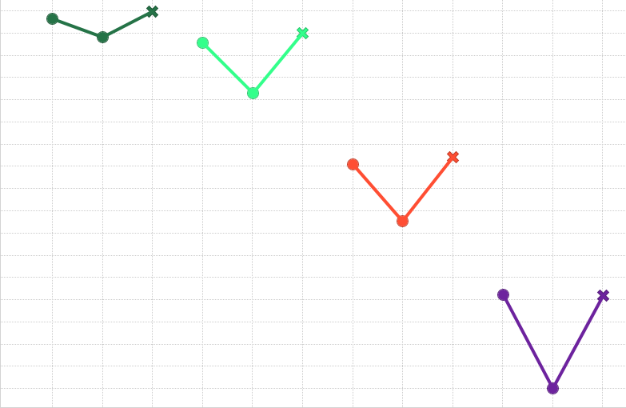

Models Resampled
Raw
1 Min
5 Min
10 Min
SVM
Accuracy
Resample Data

Slide 17
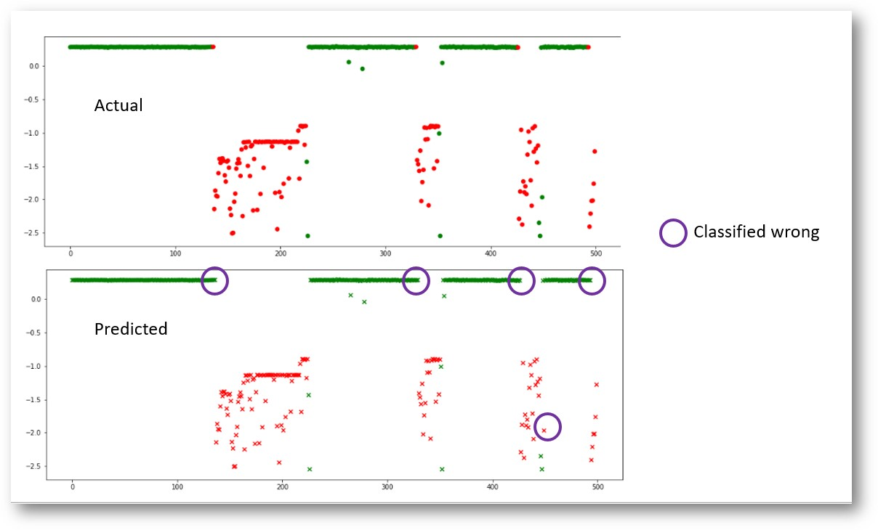

Results
Rotating
Sliding
Mis-classified

Slide 18
Results
Rotating
Sliding
Mis-classified

Slide 19
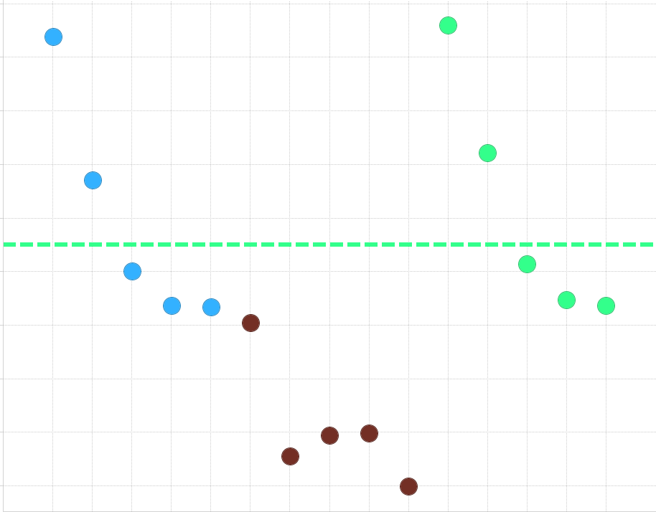
Future Predictions
Accuracy
.75 Accuracy
LR
RF
SVM

Slide 20
Future Predictions
Accuracy
.75 Accuracy
LR
RF
SVM

Slide 21
Summary
SVM model produces 98% accuracy on test data
Jumping ahead predictions are lower at 83%
In talks with Triple Crown Resources to determine viability of model

Slide 22
END

