Slide 1
Prediction of Slide Events for Horizontal Drill Operations
Daniel Serna
James Vasquez

Slide 2
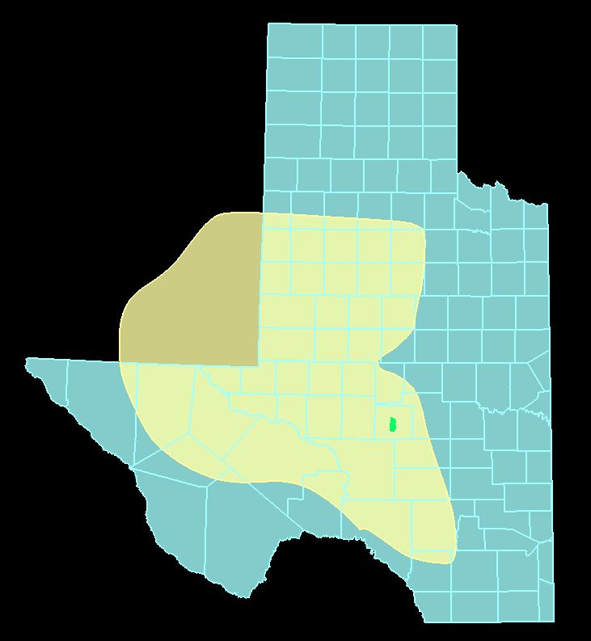
Permian Basin (take all the words off, enlarge picture. Put details on picture)
Extends from South East New Mexico into West Texas
250 mi x 300 mi
86K mi²
Produced 4.1M barrels of oil per day (March 2019)
Highest producing oil field in the world
Saudi Ghawar 3.8 BPD

Slide 3
Why is drilling hard
Well density

Slide 4
Horizontal Drilling
Process of drilling into a formation in horizontal fashion
Is the norm for shale reservoirs
Cost effective
First seen in 1930 in California

Slide 5
Horizontal Drilling (get rid text, augment picture with details)
Shale reservoirs
Reduces environmental impact
Well bore in formation longer
Target Formation

Slide 6
Horizontal Drilling Sliding vs Rotating
Rotating
Spinning through the rock
Sliding
Pushing through the rock
Days to Total Depth
Total Depth
Drill bit path
Target Formation

Slide 7
Problem Statement
Minimize the mean average error in slide event prediction
These images are not related to problem. They are motivational images, not problem images.
Current
Desired
Total Depth
Drill bit path
Target Formation

Slide 8
Data
Data provided by Triple Crown Resources on 25 oil wells
Resolution of data is 10 second intervals
Stored in SQL Server Database
2.96 million rows by 505 columns

Slide 9
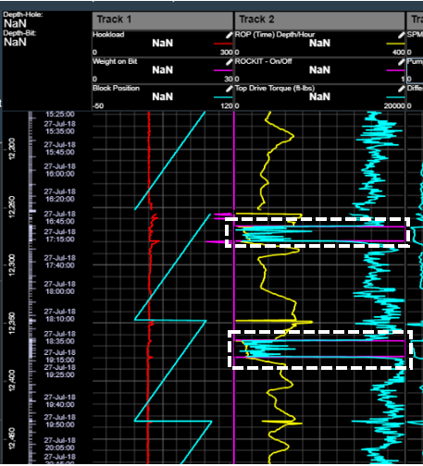
Data
Used in real-time by software called ‘MyWells’ provided by Nabors.
Ability to monitor operations from office
Binary feature for classification (rotating vs sliding)

Slide 10
Data Cleansing Feature Selection
To reduce features to manageable set
Grid search applied after initial results
Original features not aligned with business knowledge
Decision Tree Classifier approach used
Top 50% quartile, 11 features explained 99% of the variance

Slide 11
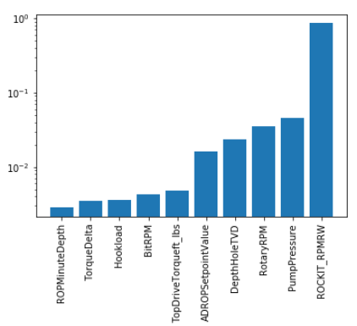
Data Cleansing Feature Selection
Feature Selection Results

Slide 12
Restate problem

Slide 13
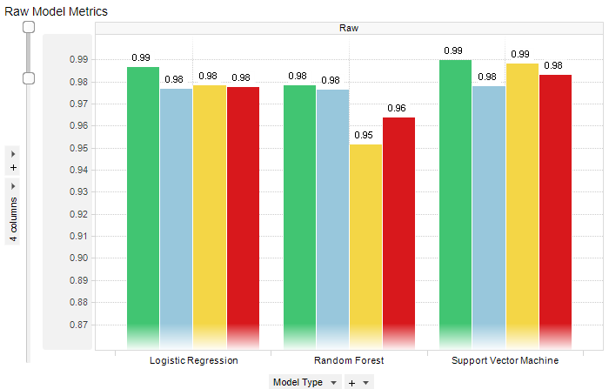
Models No Re-Sampling
Three models
Logistic Regression
Random Forest
SVM
Model Type | Accuracy | Precision | Recall | F1 Score
Logistic Regression | 0.98639 | 0.97685 | 0.97816 | 0.97751
Random Forest | 0.97823 | 0.97612 | 0.95127 | 0.96353
Support Vector Machine | 0.98966 | 0.97791 | 0.98811 | 0.98298

Slide 14
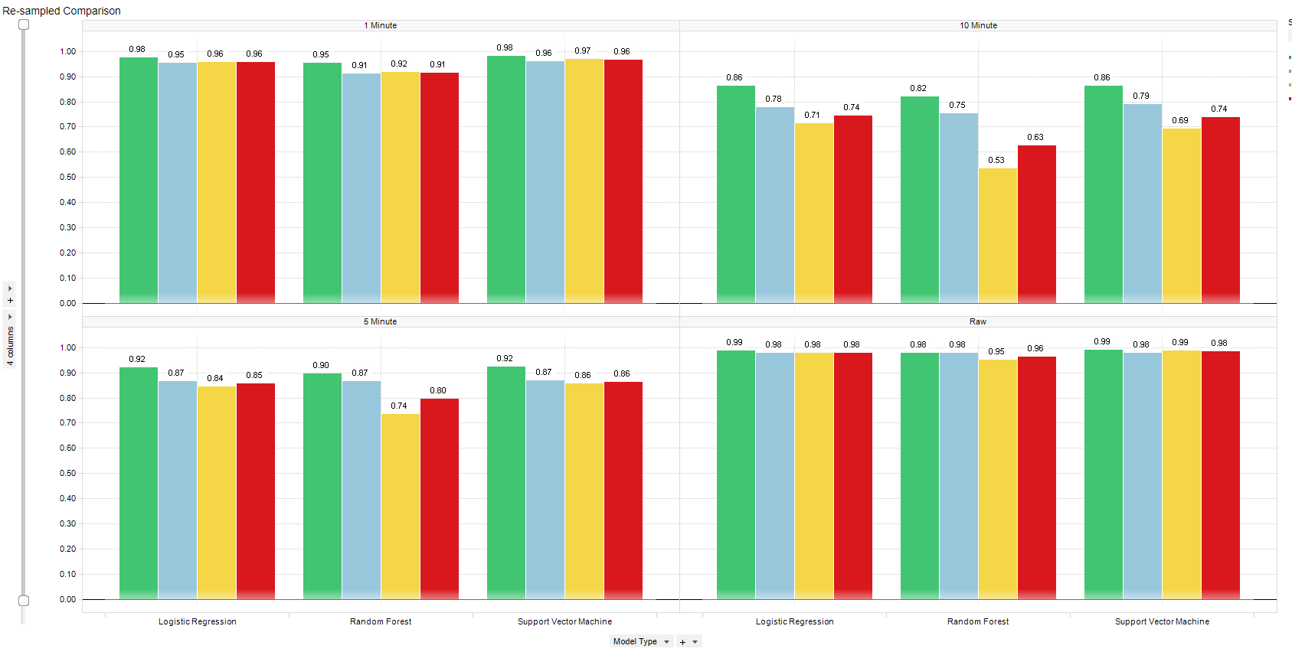
Models Resampled
Resampled
Faster run time
Resampled 1 Minute Data
Raw Data

Slide 15
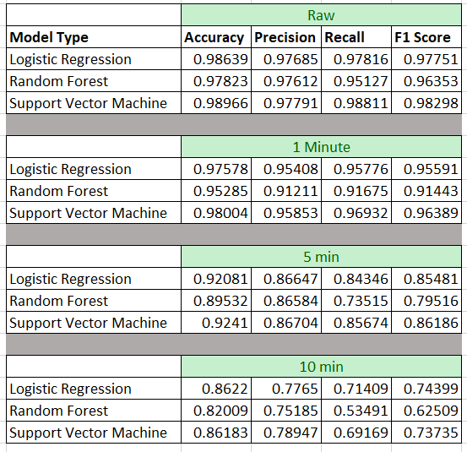
Models Resampled
Resampled
Faster run time

Slide 16
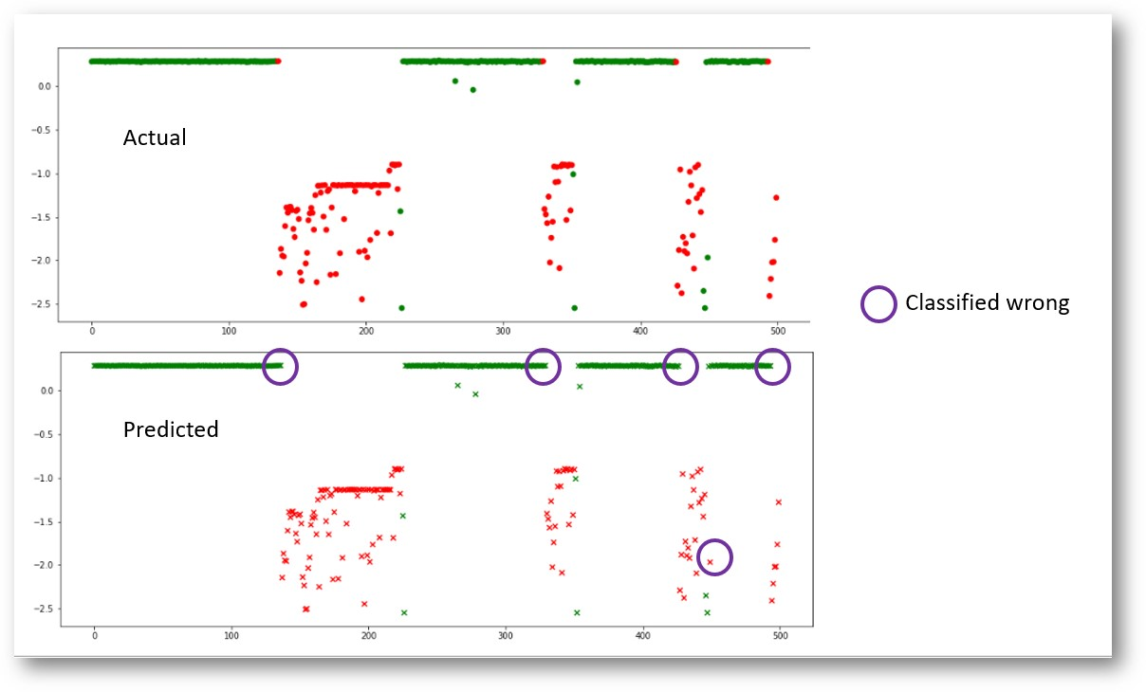
Results (explain what we are predicting, misclassifying. Move closer to data explanation). Label rotation and sliding
Mis-classified

Slide 17
Business Requirements (this is motivation. Slide does not need to exit, just talk about this closer to top.)
Ability to predict X amount of time units into the future
Become proactive in drilling operations
Maintain longer rate of penetrations
Lower total well cost
Issues
Accuracy of predictions

Slide 18
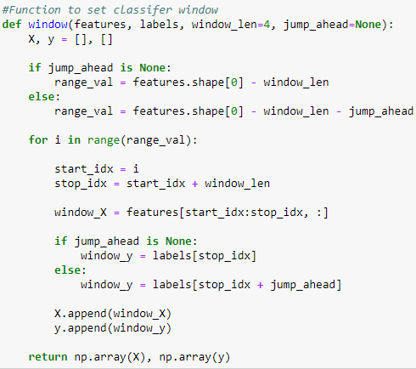
Functions Created (no code!)
“jump_ahead” function created to predict X time units into future

Slide 19
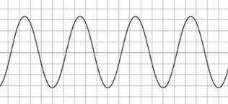
Functions Created
“window” allows a look back for learning with a time series problem

Slide 20
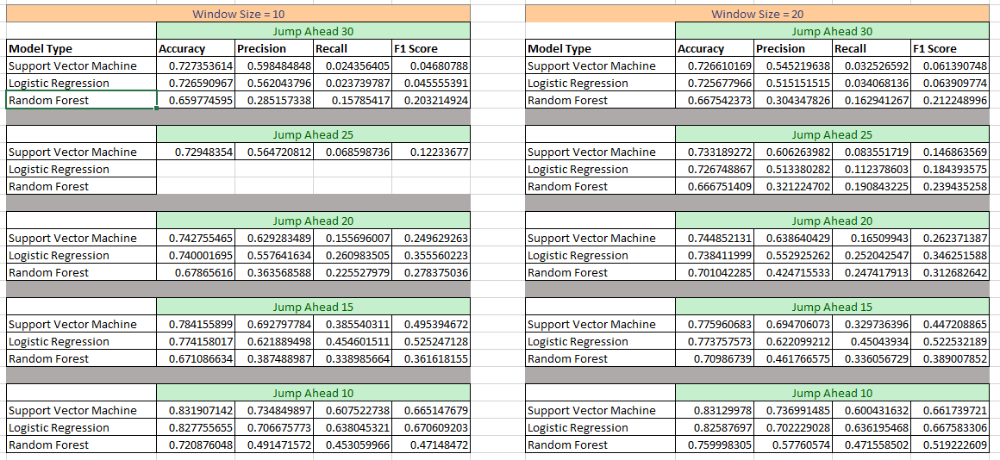
Future Predictions
Compared 10, 15, 20, 25, 30 min predictions

Slide 21
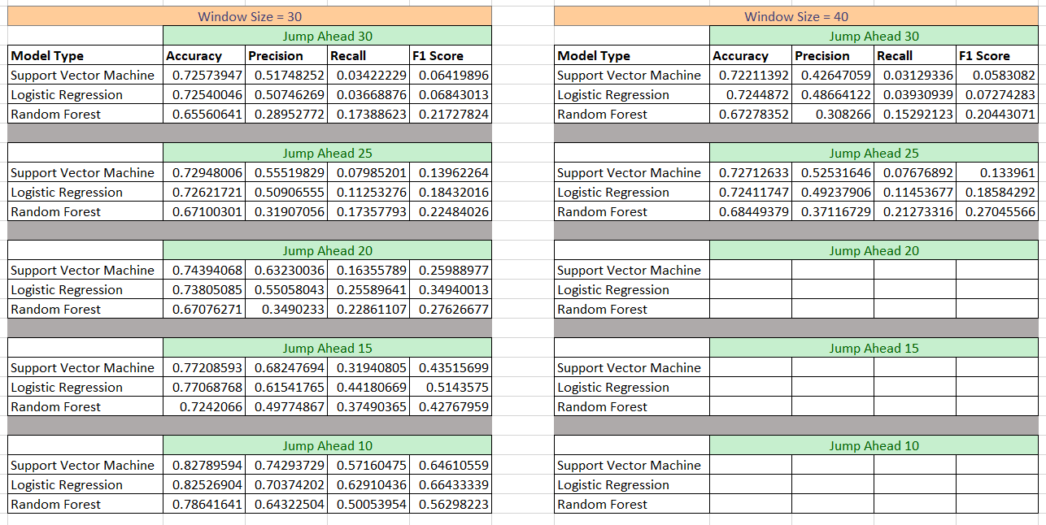
Future Predictions

Slide 22
Summary
SVM model produces 98% accuracy on test data
Jumping ahead predictions are lower at 83%
In talks with Triple Crown Resources to determine viability of model

Slide 23
END

