Slide 1
Prediction of Slide Events for Horizontal Drill Operations
Daniel Serna
James Vasquez

Slide 2
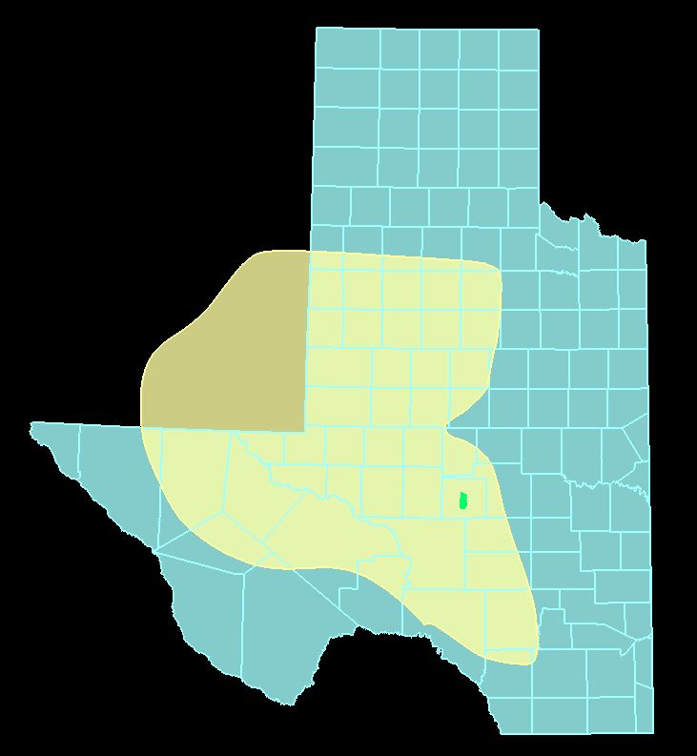
Permian Basin
Extends from South East New Mexico into West Texas
250 mi x 300 mi
86K mi²
Produced 4.1M barrels of oil per day (March 2019)
Highest producing oil field in the world
Saudi Ghawar 3.8 BPD

Slide 3
Horizontal Drilling
Process of drilling into a formation in horizontal fashion
Is the norm for shale reservoirs
Cost effective
First seen in 1930 in California

Slide 4
Horizontal Drilling
Shale reservoirs
Reduces environmental impact
Well bore in formation longer
Target Formation

Slide 5
Horizontal Drilling Sliding vs Rotating
Rotating
Spinning through the rock
Sliding
Pushing through the rock
Days to Total Depth
Total Depth
Drill bit path
Target Formation

Slide 6
Problem Statement
Minimize the mean average error in slide event prediction
Current
Desired
Total Depth
Drill bit path
Target Formation

Slide 7
Data
Data provided by Triple Crown Resources on 25 oil wells
Resolution of data is 10 second intervals
Stored in SQL Server Database
2.96 million rows by 505 columns

Slide 8
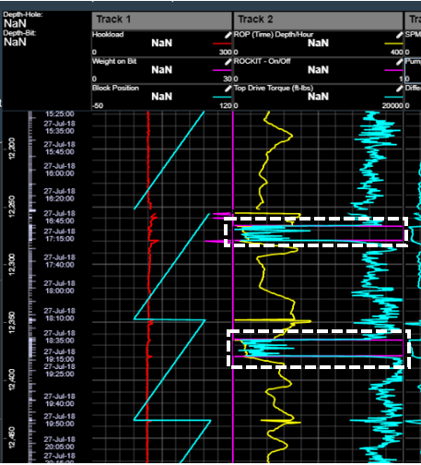
Data
Used in real-time by software called ‘MyWells’ provided by Nabors.
Ability to monitor operations from office
Binary feature for classification (rotating vs sliding)

Slide 9
Data Cleansing Feature Selection
To reduce features to manageable set
Grid search applied after initial results
Original features not aligned with business knowledge
Decision Tree Classifier approach used
Top 50% quartile, 11 features explained 99% of the variance

Slide 10
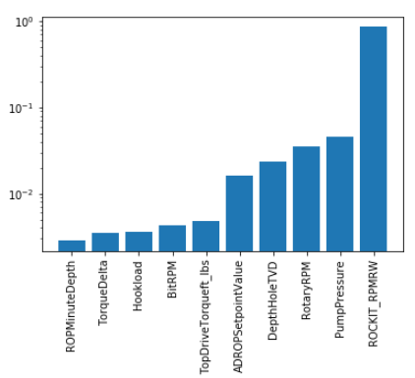
Data Cleansing Feature Selection
Feature Selection Results

Slide 11
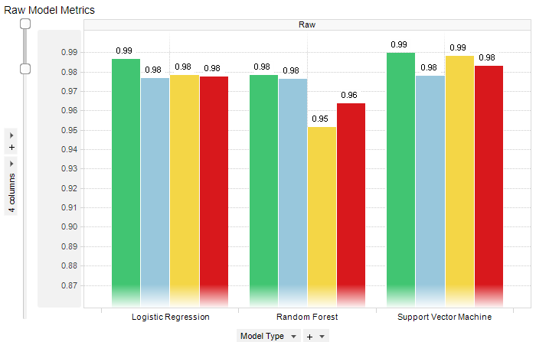
Models No Re-Sampling
Three models
Logistic Regression
Random Forest
SVM
Model Type | Accuracy | Precision | Recall | F1 Score
Logistic Regression | 0.98639 | 0.97685 | 0.97816 | 0.97751
Random Forest | 0.97823 | 0.97612 | 0.95127 | 0.96353
Support Vector Machine | 0.98966 | 0.97791 | 0.98811 | 0.98298

Slide 12
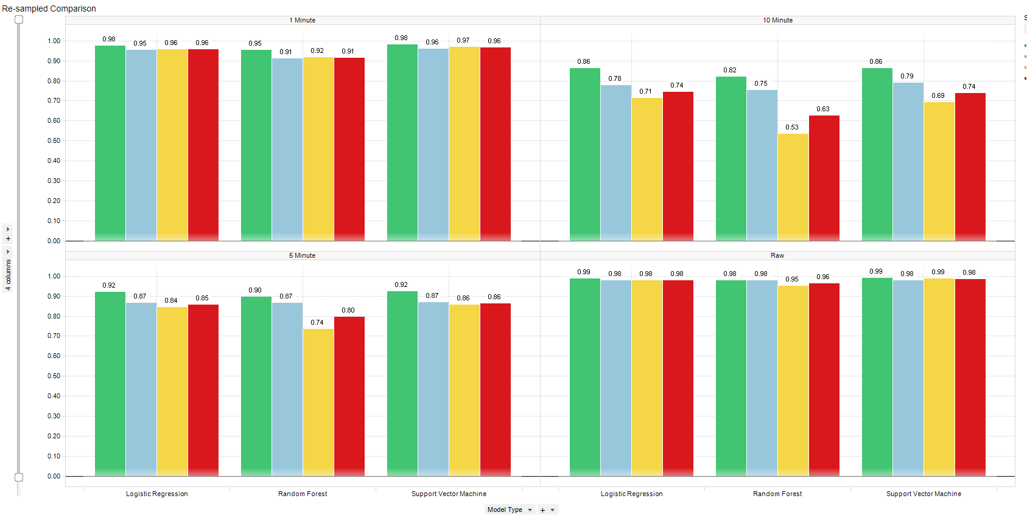
Models Resampled
Resampled
Faster run time
Resampled 1 Minute Data
Raw Data

Slide 13
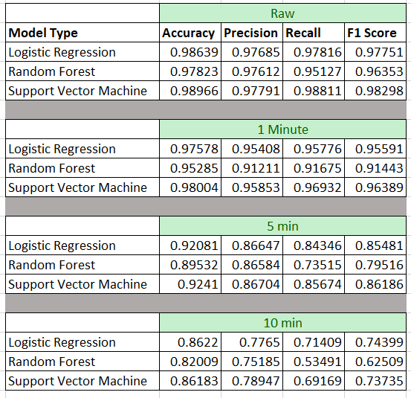
Models Resampled
Resampled
Faster run time

Slide 14
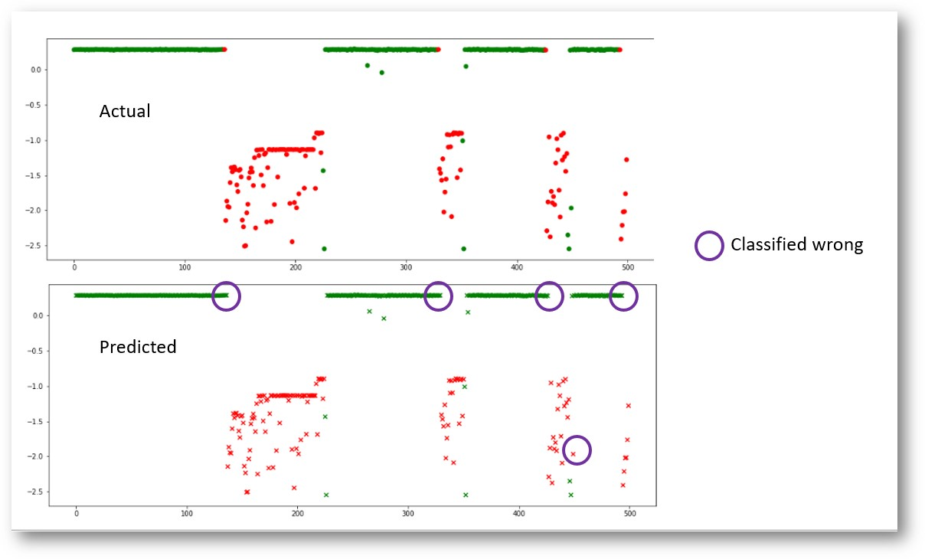
Results
Using resampled data
Mis-classified

Slide 15
Business Requirements
Ability to predict X amount of time units into the future
Become proactive in drilling operations
Maintain longer rate of penetrations
Lower total well cost
Issues
Accuracy of predictions

Slide 16
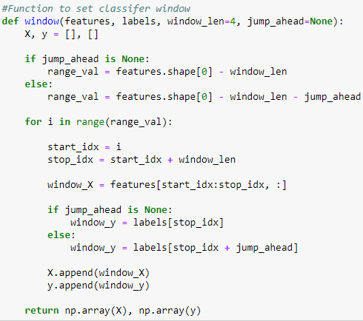
Functions Created
“jump_ahead” function created to predict X time units into future

Slide 17
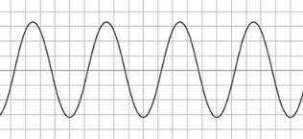
Functions Created
“window” allows a look back for learning with a time series problem

Slide 18
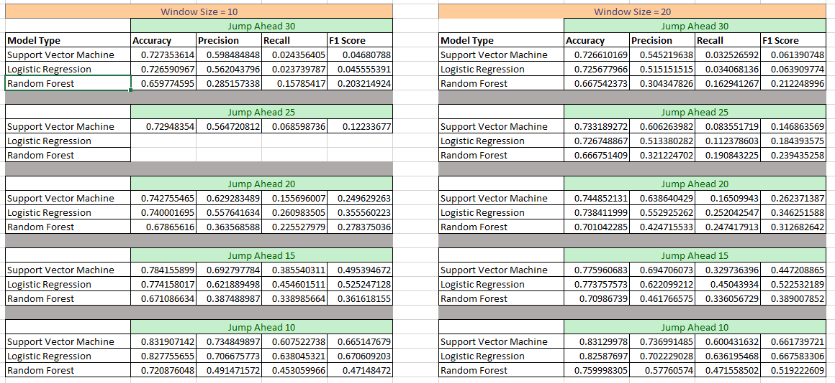
Future Predictions
Compared 10, 15, 20, 25, 30 min predictions

Slide 19
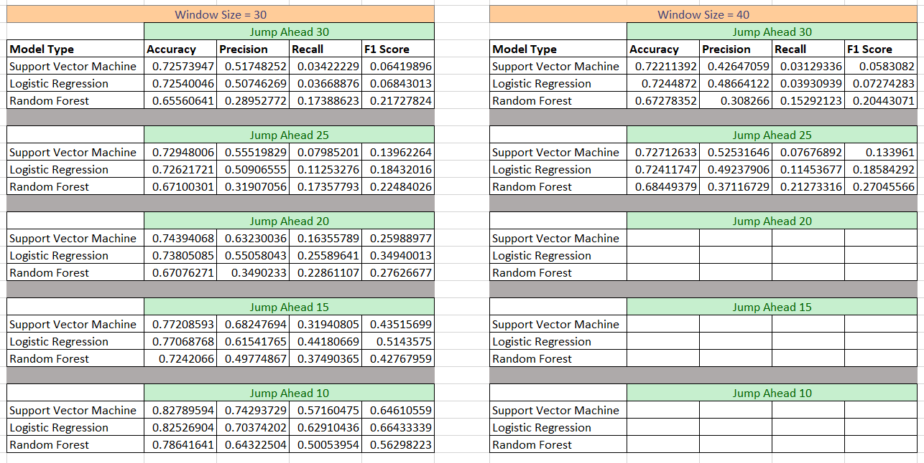
Future Predictions

Slide 20
Summary
SVM model produces 98% accuracy on test data
Jumping ahead predictions are lower at 83%
In talks with Triple Crown Resources to determine viability of model

Slide 21
END

