Slide 1
GraphQL
(the coolest thing I’ve seen all year)

Slide 2

What is GraphQL?
New declarative query language for web APIs
Developed by Facebook, open sourced
Robust REST replacement
Has implementations in most modern languages
So hot right now

Slide 3
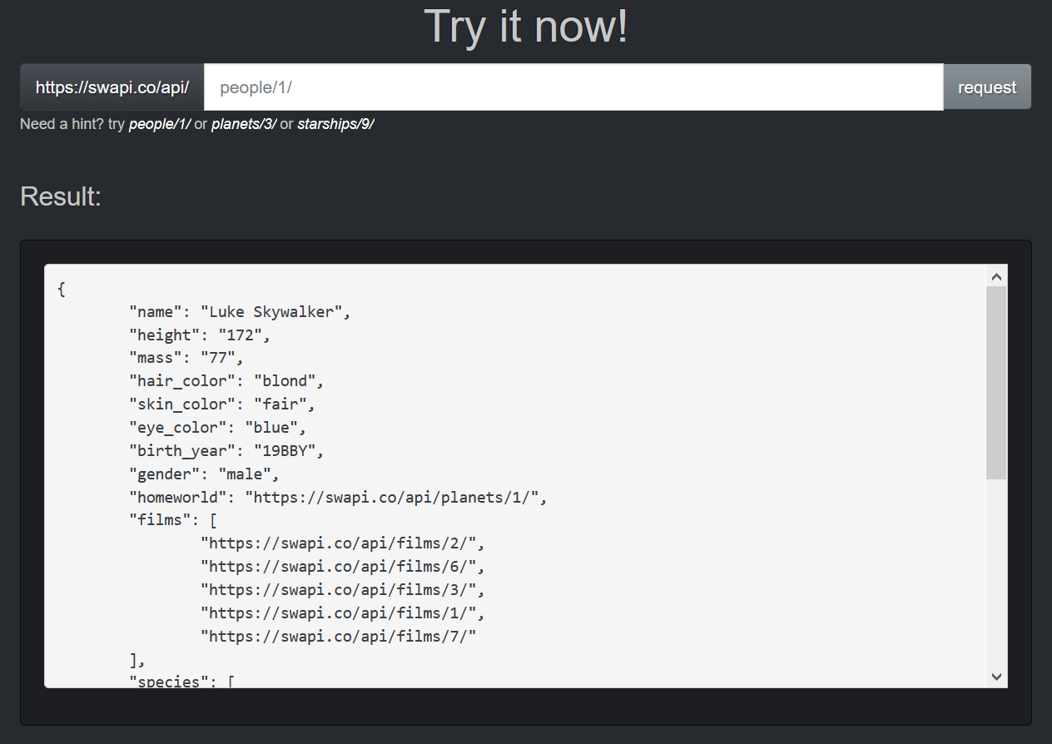
The REST Problem
Overquerying sucks
Special endpoints for “lite” data?
WebAPI controller hell
API consumers limited by exposed endpoints
https://www.swapi.co/

Slide 4
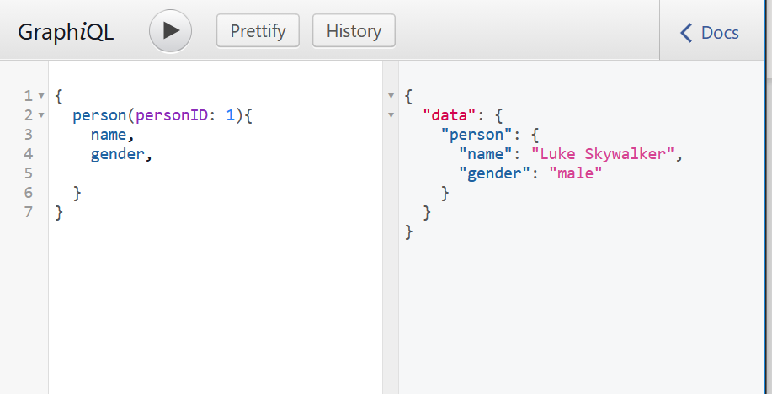
Remedy: GraphQL
Only query the fields you want
Readable query syntax
Equivalent to: SELECT name, gender FROM person WHERE personId = 1
Endless possibilities
https://graphql.org/swapi-graphql/

Slide 5
Demo

Slide 6
Benefits
Single-endpoint APIs

