Slide 1
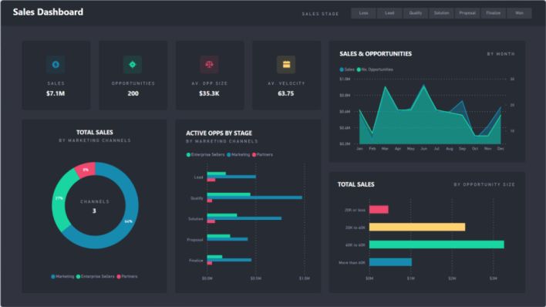






Manufacturing Dashboards
asdasdasd
Total Production
Planned Production
Total Rejected
Total Hours
Uptime
Downtime
Overall Equipment Effectiveness by Month
Availability
Performance
Quality
OEE

