Slide 1
NUM 1019
Numerical Methods on the PIC Micro

Slide 2
Class Objective
When you finish this class you will:
  Know the basics of numerical methods as applied to embedded systems
  Know what the PIC micro can really do
  See a complex mechatronics demo
  Know where to find additional design resources
Notes:
My introduction.
Poll the audience. Who’s taken a course in numerical methods? What is it? What the most numerically intensive thing you’ve done with the PIC? Advanced mathematics? Dynamic simulations? Real-time?
What are numerical methods? Why should I care about it? Maybe you took a numerical methods class in college or perhaps this will be your first exposure to it. We’ll do a brief overview of the field all the while I’ll be showing you how it fits into the field of embedded systems and more specifically our PIC microcontrollers.
The PIC microcontroller, what can it really do? It’s only an 8-bit microcontroller anyway right? What could it possibly do? Well, I’ll show. You’ll be surprised by what can be done with this low cost micro.
I’ll be showing you various examples and applications of numerical methods as we go along. I’ll also be able to demo a couple applications for you today including a rang finder and PIC Ballistics!
And lastly, you couldn’t possibly absorb all this material in a mere 90 minutes so I’ll be sending you off with plenty of references and resources to take home with you today.

Slide 3
Agenda
Introduction
The Basics
Trigonometry
Finding the square root
Dynamic systems
What is numerical methods?
The basics
Trigonometry
Finding the square root
Dynamic systems

Slide 4
What is Numerical Methods?

Slide 5
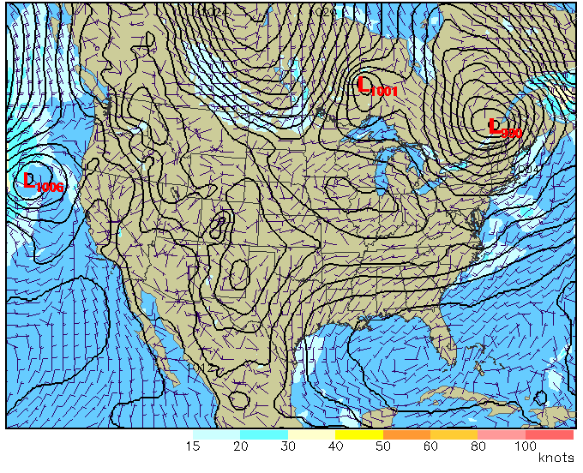
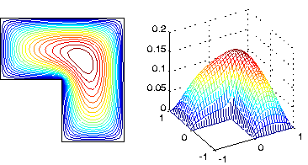
Introduction
Introduction
The Basics
Trigonometry
Finding the square root
Dynamic systems
Numerical methods use numbers to simulate mathematical processes (The world around us)
Notes:
Numerical methods use numbers to simulate mathematical processes, which in turn usually simulate real-world situations. And not only simulate, but also predict, act on, and control the world around us. Almost anything in the physical world can be described by a mathematical process whether it’s as simple as an ideal mass in constant motion or as complex as the movement of billions of starts in the cosmos. And while the modeling/simulation of such complex systems “remains a burden assiduously avoided, it is not unexpected, and thus not beyond a measure of control.” –The Matrix
Numerical methods are often divided into elementary and intensive methods. Some of the elementary methods include finding the root of and equations, integrating a function, or solving a linear system of equations. These are things you have probably done a hundreds of times on paper using analytical methods learned in your beginning college mathematics class. But how do you get a computer to do it in a useful way? It knows only of numbers, ones and zeros. What is actually happening when you push that integration button on your graphing calculator?
The more intensive methods include finite element methods used to solve partial differential equations. These intensive methods are often needed for the solution of practical problems and often require the systematic application of a rage of elementary methods. Sometimes millions of times over. This is where computing gives us some very useful results. And there are some engineering problems that don’t have a very easy analytical/closed form/traditional analysis solution. So numerical solutions becomes very important.

Slide 6
Introduction
Introduction
The Basics
Trigonometry
Finding the square root
Dynamic systems
“The Purpose of Computing Is Insight, Not Numbers” –R.W. Hamming
Computers are for Computing
Notes:
“The purpose of Computing Is Insight, not numbers”. When we develop methods for computing mathematical operations, as engineers we are sometimes tempted to take a black box approach to there computation. How fast and efficient can we get this black box to be? Or why not just #include math.h and be done with it? Without any regard for how it’s being used. And this is where we can run into trouble. we shouldn’t forget where the inputs are coming from and where the outputs are going. They are not steps to be taken in isolation from reality. EXAMPLE OF BLACKBOX CATASTROPE Choosing a different method can make the difference.
Computers are for computing. These days computers are used for just about everything right? Everything from wake us up in the morning to matching up suitable personal adds. But in the early days of computers, there was no dought what the computer was for. It was for computing. The computing of numbers and doing calculations free of human error. Some of the most earliest motivations were for the military. MILITARY/APOLLO EXAMPLE (firing tables/rocket trajectories)
So while the majority of today's programmers use non-numerical programming, numerical programming is still a big part of embedded applications.
Who is Mr. Hamming?

Slide 7
The Basics

Slide 8
Numbers
Introduction
The Basics
Trigonometry
Finding the square root
Dynamic systems
The three number systems
  Counting numbers
    0,1,2,…,32,767
  Fixed point
    3.1415, 0.01234, -123.4
  Floating point
    -.12345678 x 10⁴
Notes:
It only makes sense to begin a discussion of numerical methods with a review of numbers.
A thorough understanding is very important.
The three numbering systems used by computing machines are Counting numbers, Fixed Point, and Floating Point numbers. As the name suggests counting numbers are the numbers used to count with. Note that this does include zero.
Fixed Point numbers are the numbers we are most familiar with. They are always a fixed length, usually the word length of the machine your using and the differences between numbers are always the same. They are the numbers used for hand calculations. Hand calculations can carry any number of digits along while a computer will generally always stay constant.
Floating Point numbers are very closely related to scientific notation and is used to represent very large or very small numbers. The first fixed length number is called the mantissa and us usually follow by the exponent.
What are integers? What are real numbers? What are imaginary numbers. What is a rational/irrational number? Non-terminating numbers?

Slide 9
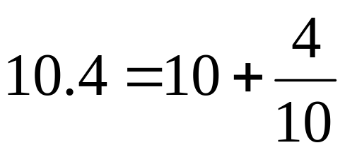
Fixed Point
Introduction
The Basics
Trigonometry
Finding the square root
Dynamic systems
Fixed point numbers represent whole numbers and fractions
10.4 can also be represented as 104 when scaled by 10 (decimal shifted once right)
Computations can be done on whole numbers as long as we remember where to put the decimal in the end (called the radix point)

Slide 10
Fixed Point
Introduction
The Basics
Trigonometry
Finding the square root
Dynamic systems
The same applies to binary numbers often referred to as the Qx.x format or Qi.j
i and j are the number of bits to the left and right of the decimal point respectively.
  Ex) 11011010.1101 → Q8.4
Notes:
Does every one know what/how binary numbers work?
Here is a representation of an Unsigned fixed point binary number.
Case 1) r=0 it’s an integers
Case 2) r=n it’s a fraction less than 1
R only affects interpretation in a calculation, the actual binary number is independent of r
Can be factored out and is analogous to an exponent in a floating pint system.
n - number of bits
a(k) - k^{th} bit a(0) - LSb
r - location of the radix point
In Qx.x Qi.j format: Qn-r.r
10 people joke
Work w/0 decimal

Slide 11
Fixed Point
Introduction
The Basics
Trigonometry
Finding the square root
Dynamic systems
Signed-magnitude format for negative numbers
  First bit is used as a sign bit
  ex) 10010011 = -19
2’s complement is most often used for fixed point negative numbers
  Complement +1
  ex) 9 = 00001001 → 11110111 = -9
Notes:
Improved performance if:
Arguments not too big for the rang and precision needed
Otherwise floating point better.
What is the range of a each kind of 6 bit number?

Slide 12
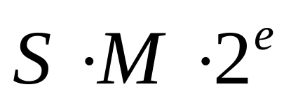
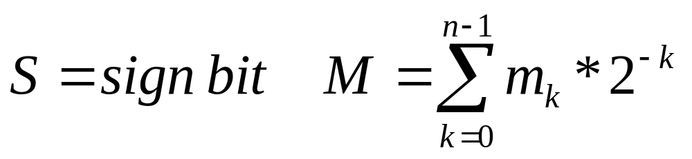
Floating Point
Introduction
The Basics
Trigonometry
Finding the square root
Dynamic systems
Floating Point Notation: Sign * (Mantissa) * 2^{exponent} =
Fractional component stored in signed-magnitude format and is in binary form
Notes:
Always one sig fig left of the decimal (normalized)
With base two, it has to be a one so it’s assumed.
The fractional number is represented in a signed-magnitude format with S as the sign bit and the radix located to the right of the MSb which is always an implied 1. (so it’s not actually represented in the format, it’s assumed)
e is the exponent value which is actually stored in a biased form eb. So easy unsigned comparisons can be done. An eb of 0 serves as a unique representation of zero.
Floating Point notation is actually independent of the base. In this case the base is 2. If it were changed to 10 then you would have the typical scientific notation that we are more familiar with.
f is always going to be between 1 and 2.
The microchip format simply shifts all eb values into the eb register for easer PIC computing. This plus the infinity provision is the only change from the IEEE format and can easily be converted back and forth.

Slide 13
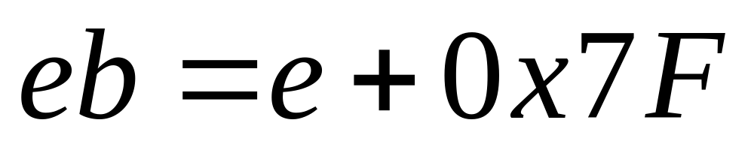
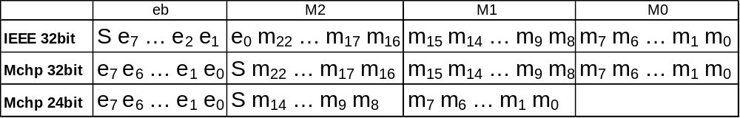
Floating Point
Introduction
The Basics
Trigonometry
Finding the square root
Dynamic systems
Exponent stored in biased format
  This makes number comparisons easier
Floating point number stored as:

Slide 14
Floating Point
Introduction
The Basics
Trigonometry
Finding the square root
Dynamic systems
Good for large and small numbers (10³⁸,10⁻³⁸)
Number system is not linear, distance between numbers jumps
Using Floating point numbers for counting and/or logical decision making is generally a bad idea
Notes:
Any other floating point pitfalls???????
More dynamic range
You are trading off dynamic range for precision,
What is the range of a FP #?

Slide 15
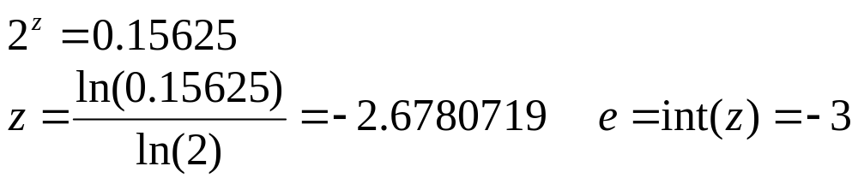
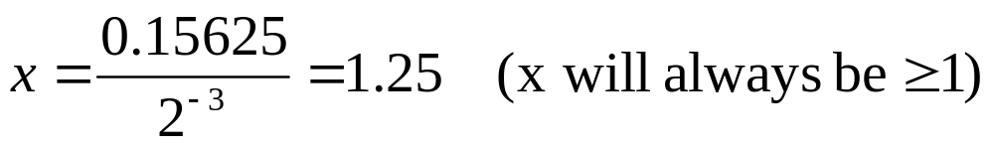
Fixed → Float
Introduction
The Basics
Trigonometry
Finding the square root
Dynamic systems
Example:
1) Find exponent:
2) Find fractional component:
Notes:
INT function always rounds down.
ENTER Y: 456.1234
e = 8 f = 1.110 0100 0000 1111 1100 1011 1001 0010
IEEE FORMAT: 43E40FCC
PIC FORMAT: 87640FCC
From APPNOTE:

Slide 16
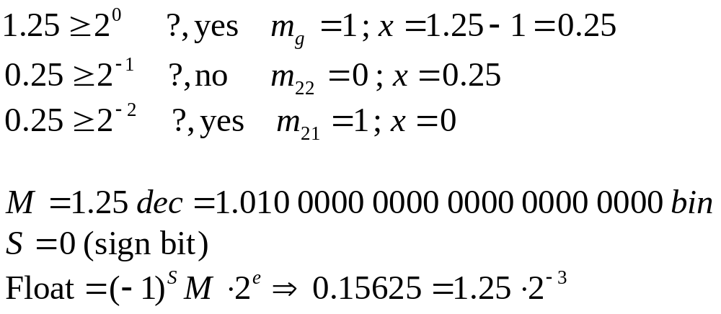
Fixed → Float
Introduction
The Basics
Trigonometry
Finding the square root
Dynamic systems
3) Find binary number:

Slide 17
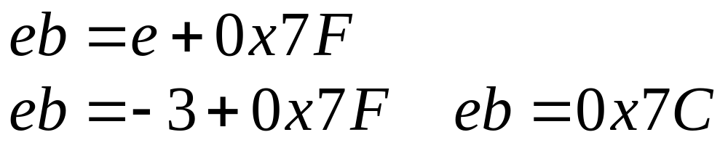
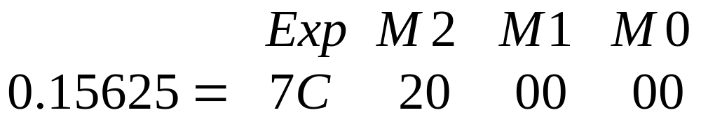
Fixed → Float
Introduction
The Basics
Trigonometry
Finding the square root
Dynamic systems
4) Convert to Microchip float format
  eb= Biased Exponent
Microchip Float Format:

Slide 18
Bases
Introduction
The Basics
Trigonometry
Finding the square root
Dynamic systems
We typically do calculations in decimal (base 10)
130_{ten} = (1 * 10²) + (3 * 10¹) + (0 * 10⁰)
Machines only understand 1’s and 0’s so they use binary (base 2)
130_{ten} = (1*2⁷)+(0*2⁶)+(0*2⁵)+(0*2⁴)+(0*2³)+(0*2²)+(1*2¹)+(0*2⁰)
= 1000 0010_{two}
Hexadecimal (base 16) serves as a shorthand for binary numbers
1000 0010_{two} = (8*16¹) + (2 * 16⁰) = 82_{sixteen} (0x82)
Notes:
Why have we used 10? fingers/toes

Slide 19
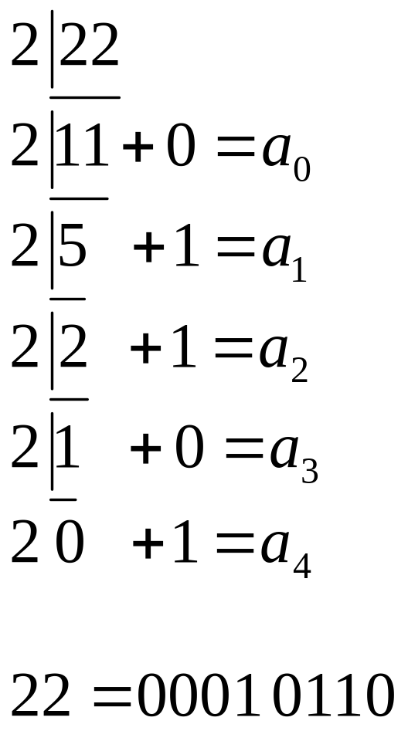
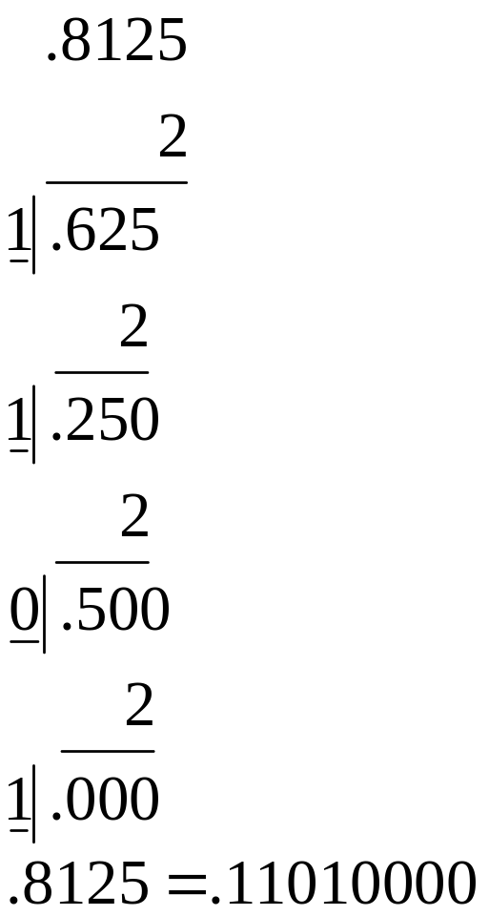
Bases
Introduction
The Basics
Trigonometry
Finding the square root
Dynamic systems
Dec → Bin
Fraction → Bin
Notes:
What would be an easy test for an odd/even number?
If LSB=1 -> odd

Slide 20
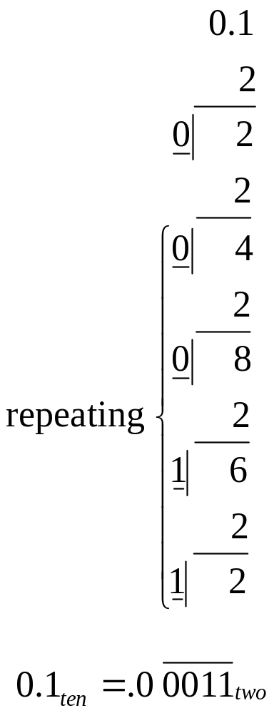
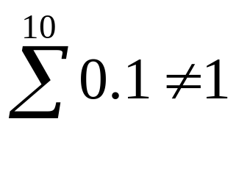
Bases
Introduction
The Basics
Trigonometry
Finding the square root
Dynamic systems
Watch out for non-terminating numbers
Never enough precision
Try it:
Notes:
Just like 1/3 rd
An amusing example [SK93] concerns the Vancouver Stock Exchange, which over a twenty-two month period accumulated sufficient round-off error to reduce its index from the correct value of 1098.982 to 574.081.
PICDEM 2+

Slide 21
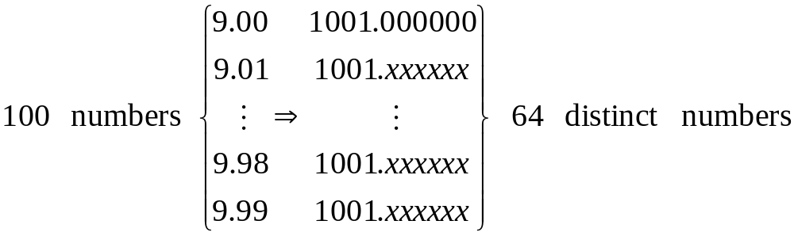
Bases
Introduction
The Basics
Trigonometry
Finding the square root
Dynamic systems
Making the Dec → Bin → Dec conversion doesn’t always return the same result
Example:
Notes:
10³ < 2¹⁰ ⁼ 1,024

Slide 22
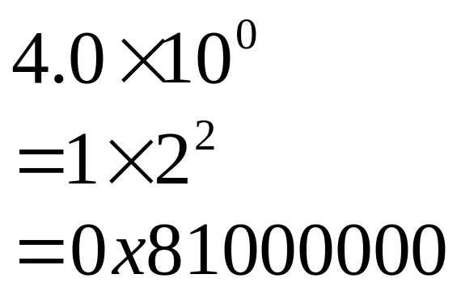
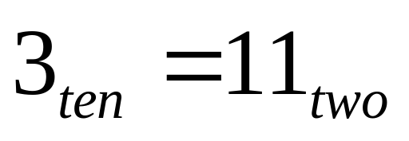
Bases
Introduction
The Basics
Trigonometry
Finding the square root
Dynamic systems
Do not confuse the kind of number system used (Counting, Fixed Point, Float) with the form of the number representation (Dec, Bin, Hex)
(they are the same number)

Slide 23
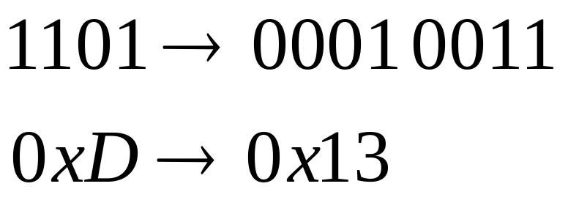
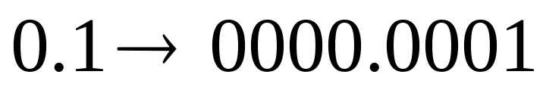
BCD
Introduction
The Basics
Trigonometry
Finding the square root
Dynamic systems
Binary Coded Decimal (BCD)
  Counting to ten in binary
Solves 0.1 approximation problem
BCD arithmetic is sometimes required by law for financial applications
Notes:
BCD AN526
20% memory loss?

Slide 24
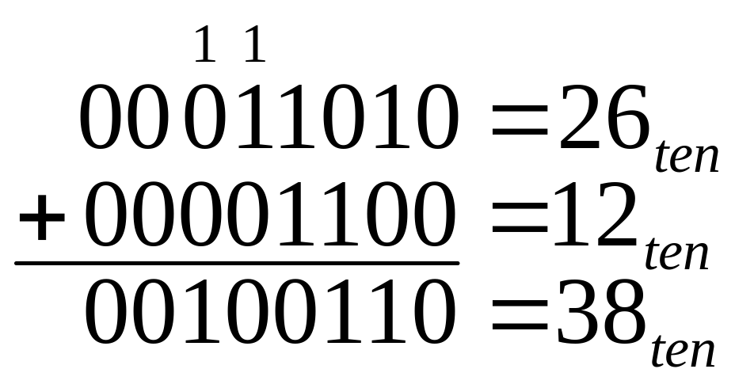
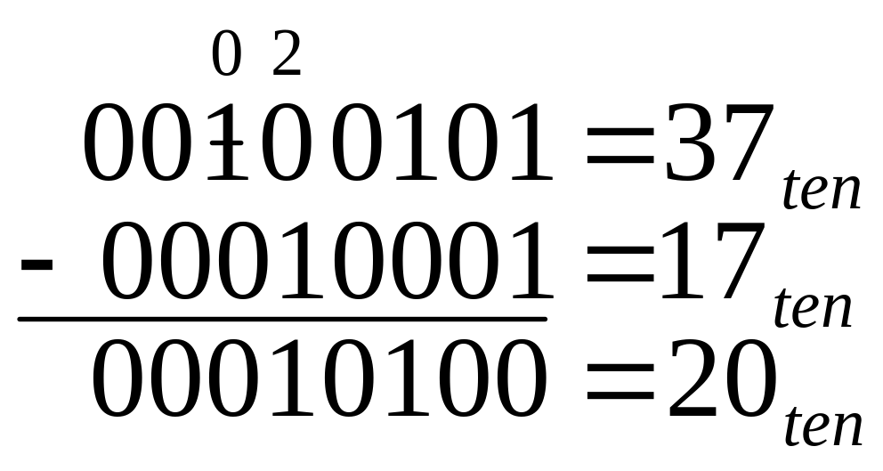
Four Functions
Introduction
The Basics
Trigonometry
Finding the square root
Dynamic systems
Addition:
Subtraction:

Slide 25
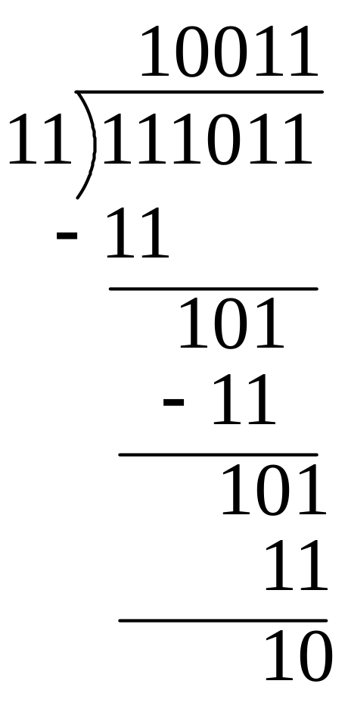
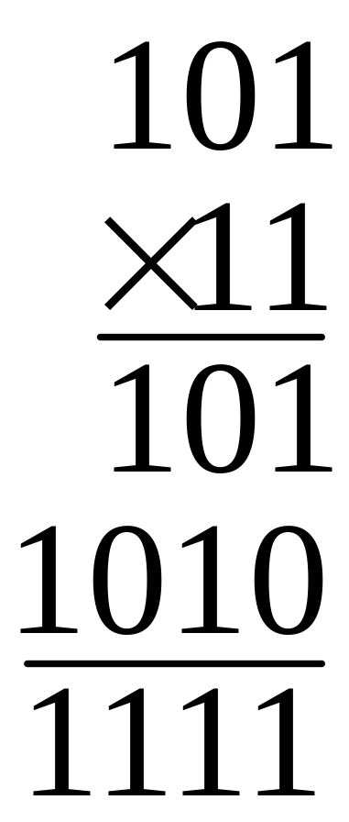
Four Functions
Introduction
The Basics
Trigonometry
Finding the square root
Dynamic systems
Division:
Multiplication:

Slide 26
Multiplication
Introduction
The Basics
Trigonometry
Finding the square root
Dynamic systems
A trick that can speed up multiplication in software
  Round by inspection to allow shift and add instead of multiply
Use two or three shift and add routines instead of a multiply routine
  Need to multiply x(n) by 10010101 (dec 149)
  10010000 (dec 144) => error = -5 ✓
  10100000 (dec 160) => error = +11 x
  x(n)*10010101 ≈ x(n)<<7 + x(n)<<4 = x(n)*2⁷+x(n)*2⁴
To multiply y(n) by 00001011(dec 11)
  00001100 (dec 12) => error = +1
  00001010 (dec 10) => error = -1
  In general round down for y(n)

Slide 27
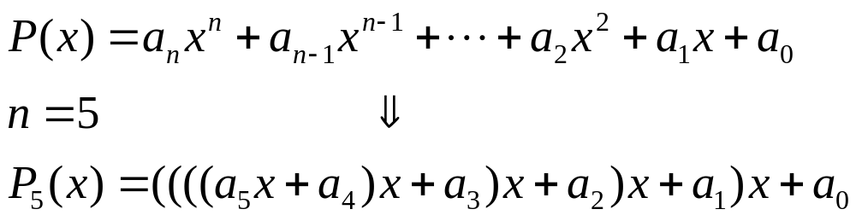
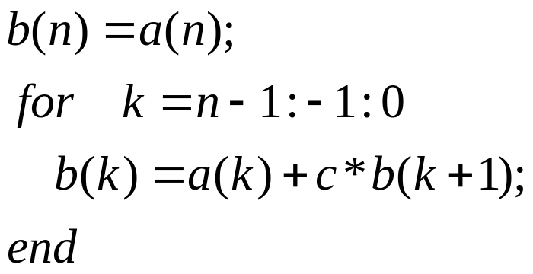
Evaluating
Introduction
The Basics
Trigonometry
Finding the square root
Dynamic systems
Horner’s method for a polynomial
  Evaluated:
  Used to convert thermocouple voltage to temperature (oC) over a wide range of temperatures.

Slide 28
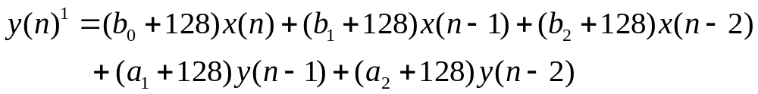

Evaluating
Introduction
The Basics
Trigonometry
Finding the square root
Dynamic systems
Using unsigned coefficients is sometimes beneficial
Subtract values with negative coefficients in algorithm
For scaled coefficients between -128 and 127 convert these to 0 to 255
IIR digital filter example:
  Start with difference equation:

Slide 29
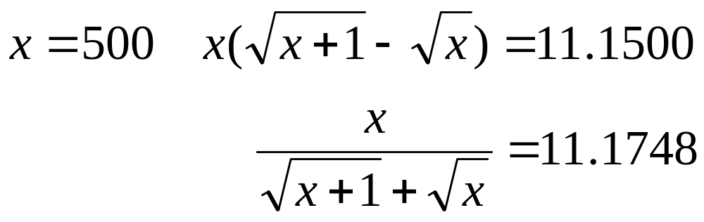
Error analysis
Introduction
The Basics
Trigonometry
Finding the square root
Dynamic systems
Things to watch out for:
  Loss of significance when subtracting two nearly equal numbers
  Example with algebraically equivalent expressions:

Slide 30
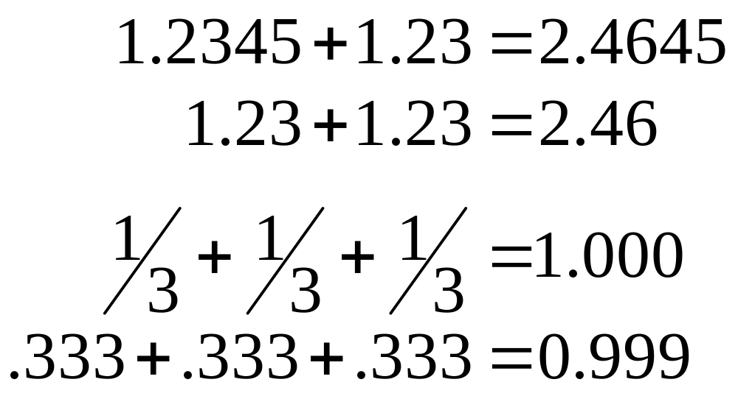
Error analysis
Introduction
The Basics
Trigonometry
Finding the square root
Dynamic systems
Two kinds of error, Round-Off and Truncation
Round-Off is a result of a fixed precision (machine dependant)
Notes:
Precision and Accuracy are not the same thing.
Just as, Random error and Systematic error are not the same thing.
Round off (representation error) and Truncation error (discretization error) are not the same thing.
Precision is the quality of being exactly defined. Sometimes indicated by the minimum number of significant digits required for an adequate representation of a quantity
A measurement having small random error is said to have high precision. Random error is the inherent imprecision of a given process of measurement; the unpredictable component of repeated independent measurements on the same object under sensibly uniform conditions.
Round off error is the difference between a computers representation of a number and it’s true value. It is the result of a computers finite word length or number of digits in it’s calculations and is not always precise enough to represent the true value exactly.
Accuracy is the extent to which your result can approach the true value.
A measurement having small systematic error or bias is said to have high accuracy. Systematic error is due to a single cause or small number of causes having the same sign, and hence, in principle, is correctable; a bias or constant offset from the true value.
The Truncation error results from a finite sum of an infinite series or only doing a finite number of steps/calculations for something that would take an infinite number of steps. It is independent of your round off error. It is more systematic.

Slide 31
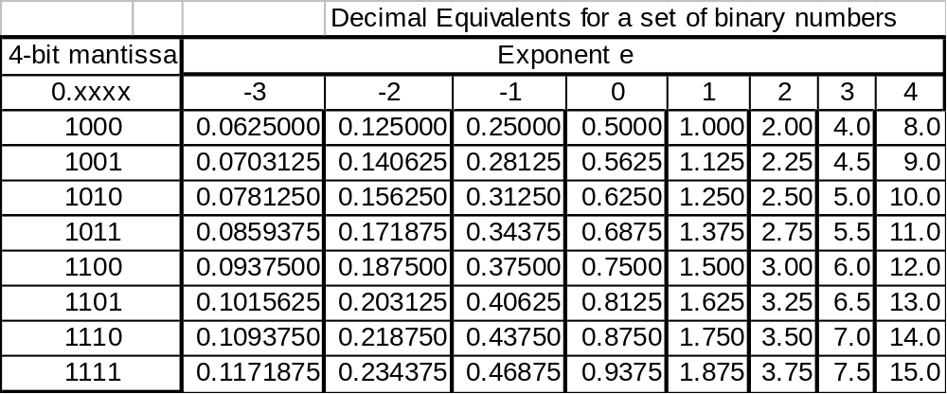
Error analysis
Introduction
The Basics
Trigonometry
Finding the square root
Dynamic systems
Round-off example:

Slide 32
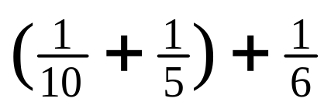
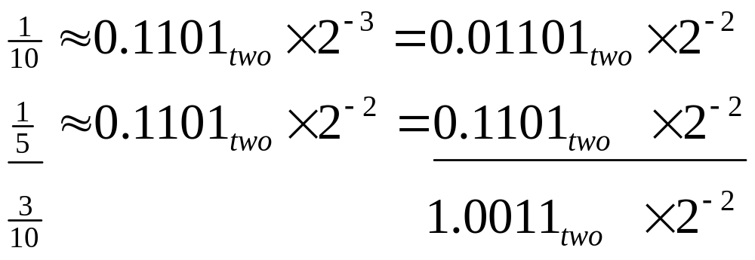
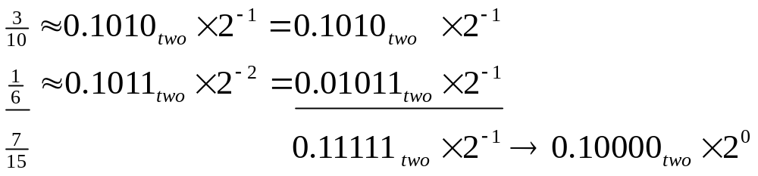
Error analysis
Introduction
The Basics
Trigonometry
Finding the square root
Dynamic systems
Round-off example:
Notes:
Use Table 3.1 of Decimal Equivalents for a set of binary numbers
with a 4-bit mantissa and exponent of n = -3, -3, …, 3, 4
So people can follow along
On June 4, 1996 an unmanned Ariane 5 rocket launched by the European Space Agency exploded just forty seconds after lift-off (918K QuickTime movie). The rocket was on its first voyage, after a decade of development costing $7 billion. The destroyed rocket and its cargo were valued at $500 million. A board of inquiry investigated the causes of the explosion and in two weeks issued a report. It turned out that the cause of the failure was a software error in the inertial reference system. Specifically a 64 bit floating point number relating to the horizontal velocity of the rocket with respect to the platform was converted to a 16 bit signed integer. The number was larger than 32,768, the largest integer storeable in a 16 bit signed integer, and thus the conversion failed.

Slide 33
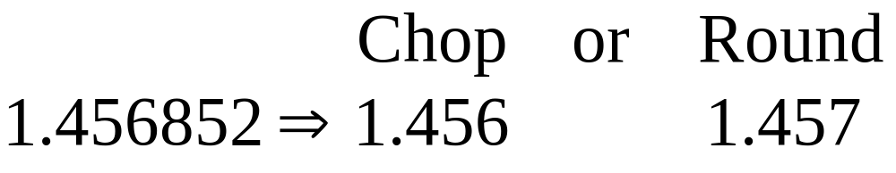
Error analysis
Introduction
The Basics
Trigonometry
Finding the square root
Dynamic systems
What is the difference between Chop-off and Round-off?
Chop-off will introduce unnecessary bias errors
Round-off minimizes bias
Notes:
The Vancouver Stock Exchange
In 1982 the Vancouver Stock Exchange instituted a new index initialized to a value of 1000.000. The index was updated after each transaction. Twenty two months later it had fallen to 520. The cause was that the updated value was truncated rather than rounded. The rounded calculation gave a value of 1098.892.
Sources:
The Wall Street Journal November 8, 1983, p.37.
The Toronto Star, November 19, 1983.
B.D. McCullough and H.D. Vinod
Journal of Economic Literature
Vol XXXVII (June 1999), pp. 633-665.

Slide 34
Error analysis
Introduction
The Basics
Trigonometry
Finding the square root
Dynamic systems
Truncation error is the result of implementing a finite number of steps of an infinite step sequence (algorithm dependant)
For example, using a fixed number of terms in a Taylor expansion
  See hand out for further information on Taylor approximations
Notes:
Truncation error is not the result of truncating a larger number into a smaller number!
More on this later.

Slide 35
Trigonometry

Slide 36
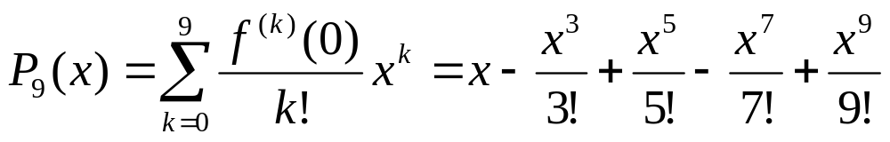
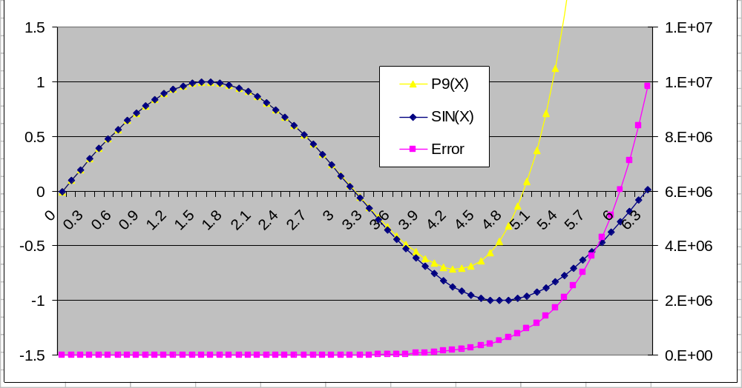
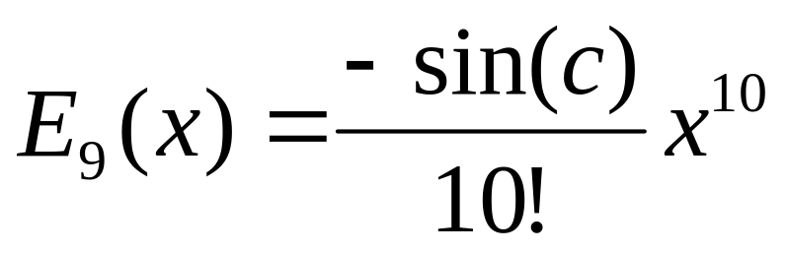
Trigonometry
Introduction
The Basics
Trigonometry
Finding the square root
Dynamic systems
Taylor approximation for sin(x) of degree 9, P₉(x) about x₀ = 0
Notes:
Get better plot from osX
Horners, yes.
Range reduction…
BAM, binary angular measure

Slide 37
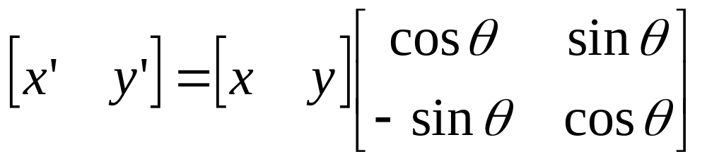
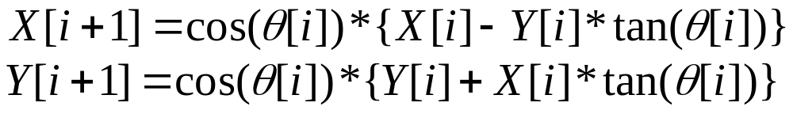
CORDIC Transform
Introduction
The Basics
Trigonometry
Finding the square root
Dynamic systems
Coordinate Rotation Digital Computer
  An iterative algorithm used for calculating trig functions
The CORDIC Transform only works for angles between ±90º

Slide 38
Trigonometry
Introduction
The Basics
Trigonometry
Finding the square root
Dynamic systems
How does it work?
  Rotates the phase of a complex number, by multiplying it by a succession of constant values
  The multiplier used is in 2, so in binary arithmetic we will use the shift command
  See handout for more detail on the derivation
Notes:
* x[i+1] = cos(theta[i]) { x[i] - y[i] tan(theta[i]) }
* y[i+1] = cos(theta[i]) { y[i] + x[i] tan(theta[i]) }

Slide 39
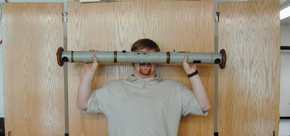
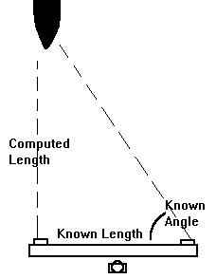
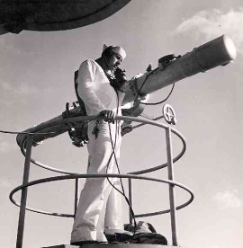
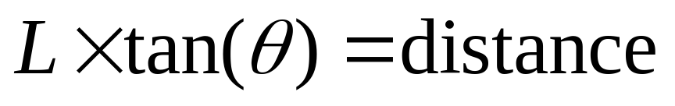
Trigonometry
Introduction
The Basics
Trigonometry
Finding the square root
Dynamic systems
Range finders have been around for a long time
They used right triangles to find distances
Notes:
Coordinate Rotation Digital Computer (CORDIC) transforms are iterative algorithms used for calculating trig functions
J

Slide 40
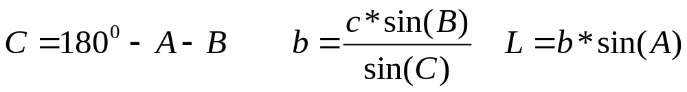
Trigonometry
Introduction
The Basics
Trigonometry
Finding the square root
Dynamic systems
Lets make a laser range finder!
Our setup:
Use law of Sines to find L:
C
Line up the laser pointers!
b
L
a
A
B
c
Notes:
Do no do A-B, both are similar size and will result in loss of significants.

Slide 41
Trigonometry
Introduction
The Basics
Trigonometry
Finding the square root
Dynamic systems
What is the error using CORDIC SIN(X)?
What is the error using Taylor approximation to SIN(X)?

Slide 42
Finding the square root

Slide 43
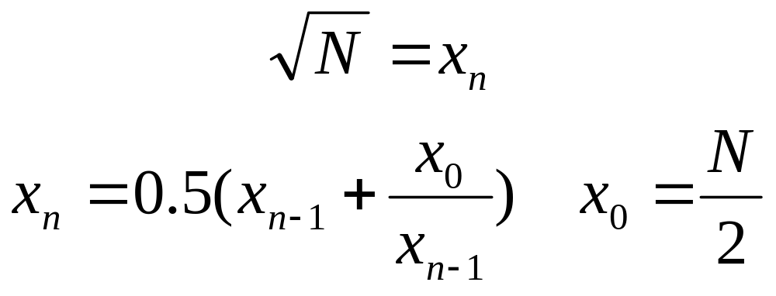
Square Root
Introduction
The Basics
Trigonometry
Finding the square root
Dynamic systems
Fixed point Newton-Raphson method (AN526)

Slide 44
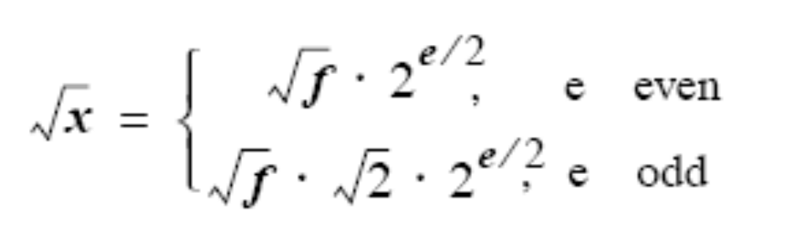
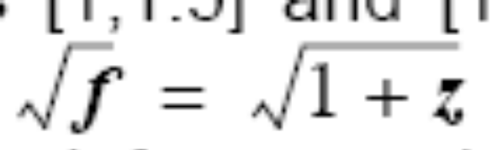
Square Root
Introduction
The Basics
Trigonometry
Finding the square root
Dynamic systems
MINIMAX floating point approximation
1) Limit your input range
Notes:
Misc: an integer devide will trucate the results!

Slide 45
Square Root
Introduction
The Basics
Trigonometry
Finding the square root
Dynamic systems
MINIMAX floating point approximation
2) Find the best linear solution
Sqr(2)
Same maximum error at mid-point and both end-points
1
2

Slide 46
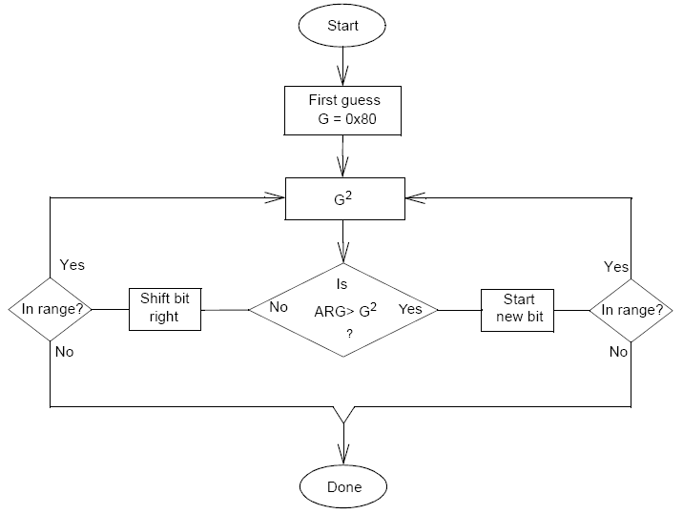
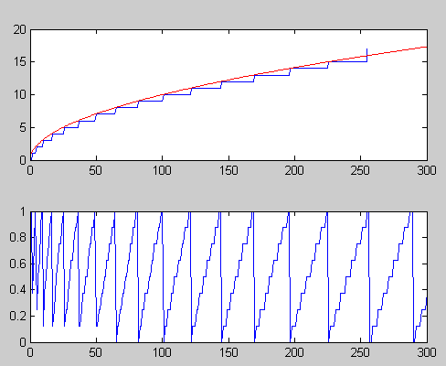
Square Root
Introduction
The Basics
Trigonometry
Finding the square root
Dynamic systems
Fast integer square root (TB040)
Notes:
Don’t forget to differentiate method’s benefit/drawback, which is good in what situation?

Slide 47
Dynamic Systems

Slide 48


Differentiation
Introduction
The Basics
Trigonometry
Finding the square root
Dynamic systems
Backward difference “three-point formula”
  M = maximum value for the 4th derivative
  Find a step size h to minimize error E₃
Notes:
Find optimum step size
AN544

Slide 49


Integration
Introduction
The Basics
Trigonometry
Finding the square root
Dynamic systems
Simpson’s 3/8th rule

Slide 50



Dynamic simulation
Introduction
The Basics
Trigonometry
Finding the square root
Dynamic systems
World of differential equations

Slide 51
PIC Ballistics
Introduction
The Basics
Trigonometry
Finding the square root
Dynamic systems
Lets play the PIC Ballistics demo!
  Calculate a trajectory for a given initial velocity and angle
  Calculate the acceleration along trajectory using differentiation methods
Notes:
Not Done

Slide 52
Summary
What is numerical methods?
The basics
Trigonometry
Finding the square root
Dynamic systems

Slide 53
References
AN670 “Floating Point to ASCII conversion”
TB040 “Fast Integer Square root”
AN526 “PIC16 Math Utility Routines”
AN544 “Math Utility Routines”
AN617 “Fixed Point Routines”
AN660 “Floating Point Math Functions”

Slide 54
References
“German Optical Rangefinders” by Peter Lienau
“Fixed-Point Trigonometry With CORDIC Iterations” By Ken Turkowski
“A survey of CORDIC algorithms for FPGA based computers” By Ray Andraka
“Math Toolkit for Real-Time programming” by Jack Crenshaw
“Numerical Methods Using Matlab” by Kurtis D. Fink
“Numerical Methods for Scientists and Engineers” by Richard Hamming

