Slide 1

DoDAF Viewpoints Jeff Bond June 2021

Slide 2
Objectives
What will be covered
Provide a high-level overview of DoDAF and it’s associated viewpoints (Examples provided from a ZT perspective)
Identify important viewpoints for staff understanding and support
Identify important viewpoints for RMF artifacts
Relationships between viewpoints
A list and description of viewpoints that can be created in standard IT tools (Visio, PPT, etc.)
What will NOT be covered
UML/SysML/etc. modeling language
Model Based System Engineering (MBSE) process and diagrams
Modular Open Systems Approach (MOSA) process and evaluation

Slide 3
DoDAF Steps
The 6 Steps of the DoDAF Framework Design Process
Step 1: Determine Intended Use of Architecture
Step 2: Determine Scope of Architecture
Step 3: Determine Data Required to Support Architecture Development
Step 4: Collect, Organize, Correlate, and Store Architectural Data
Step 5: Conduct Analyses in Support of Architecture Objectives
Step 6: Document Results in Accordance with Decision-Maker Needs
Step 1: Determine Intended Use of Architecture
Defines the purpose and intended use of the architecture; how the Architectural Description effort will be conducted; the methods to be used in architecture development; the data categories needed; the potential impact on others. This information is generally provided by the process owner.
Step 2: Determine Scope of Architecture
The scope defines the boundaries that establish the depth and breadth of the architecture, helps define its context and defines the level of detail required for the architectural content.
Step 3: Determine Data Required to Support Architecture Development Determines
The required level of detail to be captured for each of the data entities and attributes. This includes the data identified as needed for the execution of the process. The initial type of architectural data content to be collected is determined by the established scope of the Architectural Description and recorded as attributes, associations, and concepts.

Slide 4
Viewpoint Overview
All Viewpoint (AV): describes the overarching aspects of architecture context that relate to all viewpoints.
Capability Viewpoint (CV): articulates the capability requirements, the delivery timing, and the deployed capability.
Data and Information Viewpoint (DIV): articulate the data relationships and alignment structures in the architecture content for the capability and operational requirements, system engineering processes, and systems and services.
Operational Viewpoint (OV): includes the operational scenarios, activities, and requirements that support capabilities.
Project Viewpoint (PV): describes the relationships between operational and capability requirements and the various projects being implemented.
Services Viewpoint (SvcV): is the design for solutions articulating the Performers, Activities, Services, and their Exchanges, providing for or supporting operational and capability functions.
Standards Viewpoint (StdV): articulate the applicable operational, business, technical, and industry policies, standards, guidance, constraints, and forecasts that apply to capability and operational requirements, system engineering processes, and systems and services.
Systems Viewpoint (SV): for Legacy support, is the design for solutions articulating the systems, their composition, interconnectivity, and context providing for or supporting operational and capability functions.

Slide 5
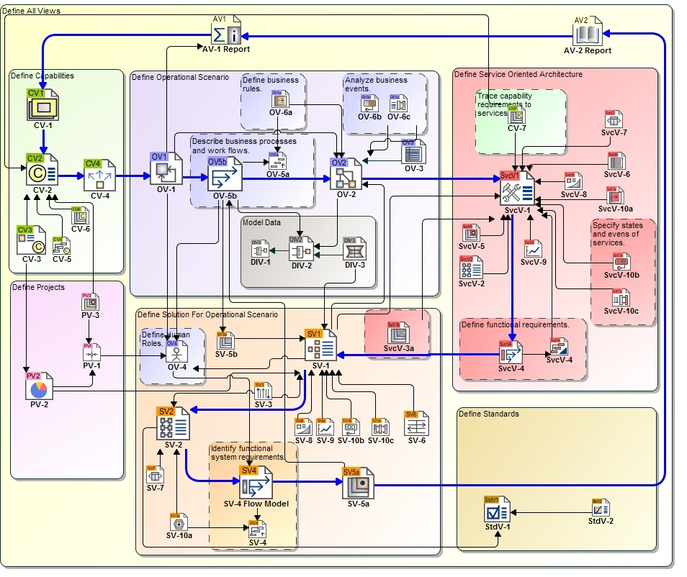
DoDAF Meta Model
The DoDAF Meta Model (DM2) defines architectural data elements and enables the integration and federation of Architectural Descriptions. It establishes a basis for semantic (i.e., understanding) consistency within and across Architectural Descriptions.
This is provided for informational purposes to illustrate the relationships between the viewpoints.

Slide 6
Priority Viewpoints
Many viewpoints can be represented by Excel tables where two axes are mapped together. These are important but not the current priority for artifacts. Currently, visual depictions are not only the most useful to us as a program but consistent with the artifacts we are in process of creating or have already created.
The highlighted viewpoints are the focus of the current push with the particular goal of having the following created: CV-2, CV-7, SV-2

Slide 7
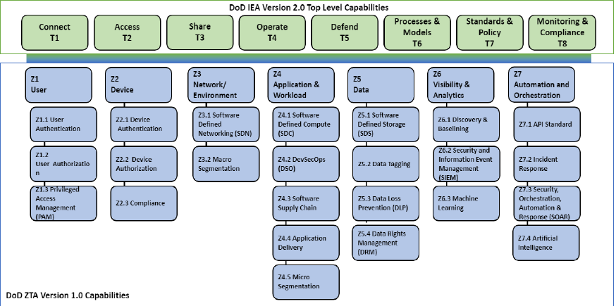
CV-2 Capability Taxonomy
The CV-2 captures capability taxonomies. The model presents a hierarchy of capabilities.
The intended usage of the CV-2 includes:
Identification of capability requirements.
Capability planning (capability taxonomy).
Codifying required capability elements.
Capability audit.
Capability gap analysis.
Source for the derivation of cohesive sets of user requirements.
Providing reference capabilities for architectures.
A CV-2 is structured as a hierarchy of capabilities, with the most general at the root and most specific at the leaves.
* A Capability should be different than an activity.

Slide 8
CV-4: Capability Dependencies
The CV-4 describes the dependencies between planned capabilities. It also defines logical groupings of capabilities.
The CV-4 is intended to provide a means of analyzing the dependencies between capabilities. The groupings of capabilities are logical, and the purpose of the groupings is to guide enterprise management. In particular, the dependencies and groupings may suggest specific interactions between acquisition projects to achieve the overall capability.
The intended usage of the CV-4 includes:
Identification of capability dependencies.
Capability management (impact analysis for options, disposal etc.).

Slide 9
CV-7: Capability to Services
The CV-7 describes the mapping between the capabilities required and the services that enable those capabilities. Specifically, it identifies how services can be performed using various available capability elements.
The capability to service mappings may include both situations where a service fully satisfies the desired capability and those where the service only partially meets the capability requirement.
The intended usage of the CV-7 includes:
Tracing capability requirements to services.
Capability audit.
Our version of a CV-7 is loosely interpreted to satisfy a program need.

Slide 10
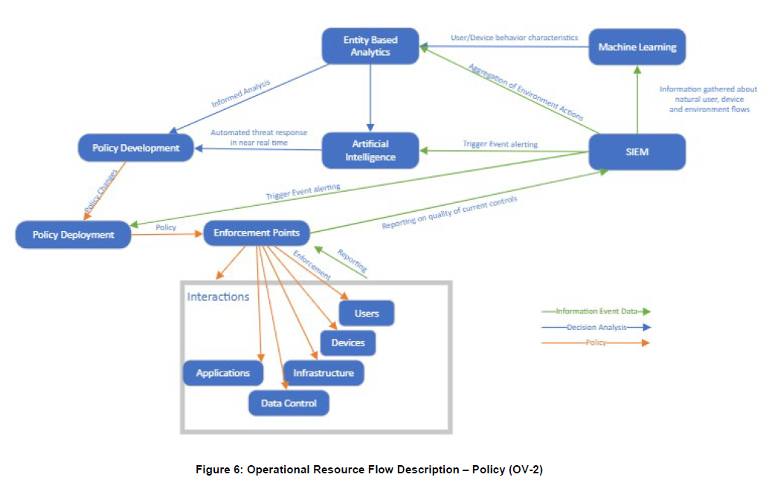
OV-2 Operational Resource Flow Description
The primary purpose of the OV-2 is to define capability requirements within an operational context.
A specific application of the OV-2 is to describe a logical pattern of resource (information, funding, personnel, or materiel) flows.
The intended usage of the OV-2 includes:
Definition of operational concepts.
Elaboration of capability requirements.
Applying a local context to a capability.
Problem space definition.
Operational planning.
Supply chain analysis.
This is similar to the SV-2 except the relationships are types of information rather than the details (port, etc.) of the connection.

Slide 11
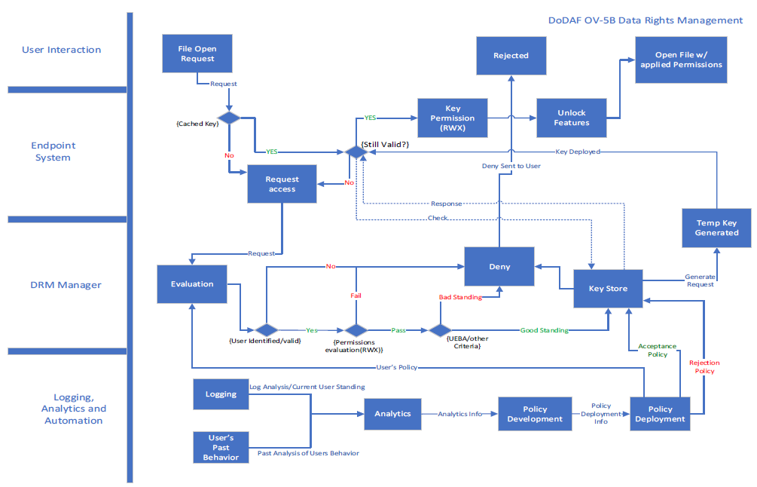
OV-5b Operational Activity Flow Model
The OV-5b provides the context of capabilities and activities (operational activities) and their relationships among activities, inputs, and outputs; Additional data can show cost, performers or other pertinent information.
An Operational Activity is what work is required, specified independently of how it is carried out.

Slide 12
SV-2 Systems Internal Resource Flow Description
An SV-2 specifies the internal System Resource Flows between Systems and may also list the protocol stacks used in connections.
This is the classic Visio style architecture diagram similar to that of the master architecture diagrams that have already been created. A sample snipping of which is shown here.
This should include the following details:
Communication Paths
Ports, Protocols, Services
Assets
Boundaries

Slide 13
SV-2 Systems Internal Resource Flow Description
An SV-2 can and should be created at multiple different levels of detail within a system. These different “zoom” levels are pertinent to different audiences depending on their focus.
Imagine this diagram to be a map. The high-level diagram may depict buildings and streets but have no additional details.
The accompanying diagram is an example of this type of zoom level from a fictional Splunk implementation.

Slide 14
SV-2 Systems Internal Resource Flow Description
In this SV-2 the view is then zoomed in further to detail the specific connections within the Splunk system itself. This is the magnified view of the highlighted section of the previous diagram.
At this stage of the map metaphor this would be a map of the inside of a building along your route.
The accompanying diagram is an example of this type of zoom level from a fictional Splunk implementation.
*Rule of thumb: If <60% of connections are internal a deeper view diagram should be used.

Slide 15
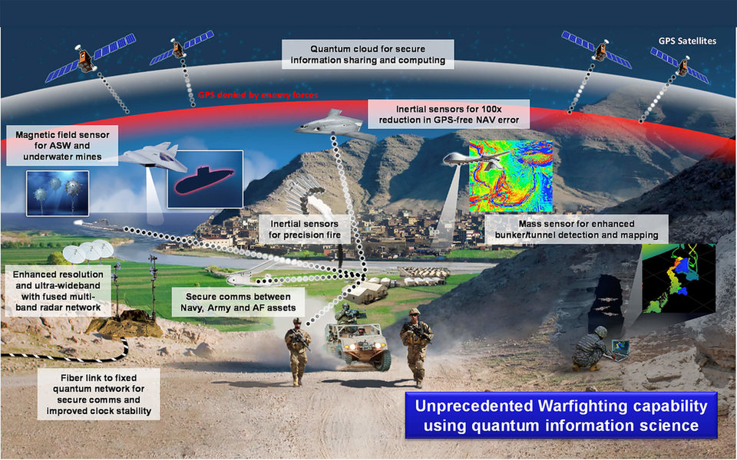
Questions?
https://twitter.com/DefenseCharts

