Slide 1

HR Services
PyHR is a provider of human resources business process outsourcing (BPO) services and consulting.
Services provided include payroll, benefits, recruitment, learning, workforce administration, time and attendance, background checking and compensation management.
Team Members: Drew Adams, Joao Bonini, Melissa Decoster, Nadia Patel , Richa Desai
Github: https://github.com/jvbonini/Project-I
Notes:
# Opening - Bonini

Slide 2





DEFINITIONS | background
# Ticket : Case ID = Request
# Requestors = Employee, 3rd Party, Business Partner(BHR), HROps, Manager
# Service Group = Service Family Type Category : Application Management, Compensation..
# Service = Type Category: Accounting, AdHoc Report Request, Annual wage statements..
# Summary Workflow
Requestor
COEs
HR Connect Consultants
Notes:
# Definitions - Bonini

Slide 3
AGENDA | Timeline
Data Exploration and Clean Up
Identify Useful Fields
Data Munging and Field Mapping
Request Analysis
Popular Request Services
Days of Week
Service Level Analysis
Close date vs Due date
Duration by Ticket
Limitations and further analysis
Use Pandas .value_counts() to determine quality of the data
Export cleansed data as new CSV file
Ticket Center Locations
Hours of Day
Service Type
Erroneous SLA Periods
Days to complete
SLA requirements
Duration by location
Location based time studies
Service type by location
Service type by time of year / seasonality
Correlations between service spikes and other major company events

Slide 4
Data Exploration and Clean up
Data Extraction
Initial Data Exploration
Data Exporting
Data Creation
Data Formatting
PyHR Ticket System
Replacing
CSV Creation
Look at Missing Values and Removal of Data
Creating New Columns and sort by category
Renamed the columns.
Export the cleaned up data ready for analysis.
The ticket system provides a report.
Removed inconsistent data.
Day, Month, year, hour
Notes:
# Data Exploration and Clean Up - Drew

Slide 5
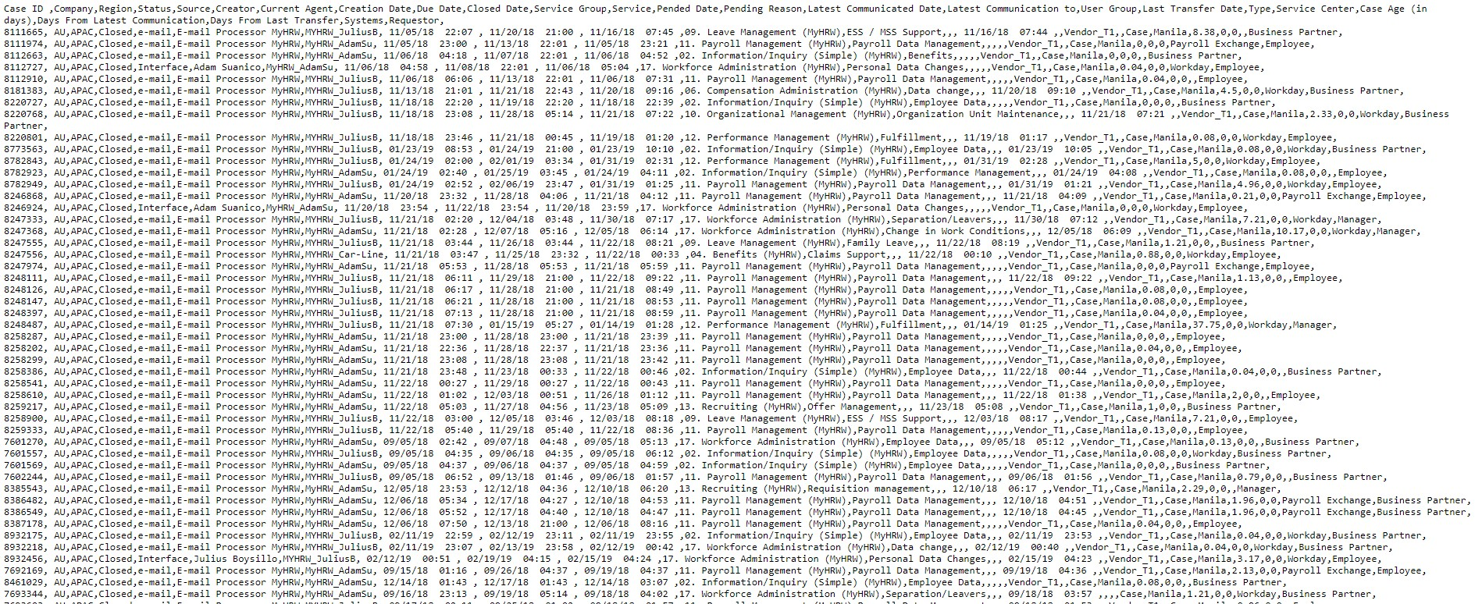
Data Exploration | Initial Data Loading
Utilize the pandas library for Python (Jupyter Notebook)
Read in the data as CSV
Output list of column headers
Explore fields and analyze data quality
Create plan to map fields to common values

Slide 6
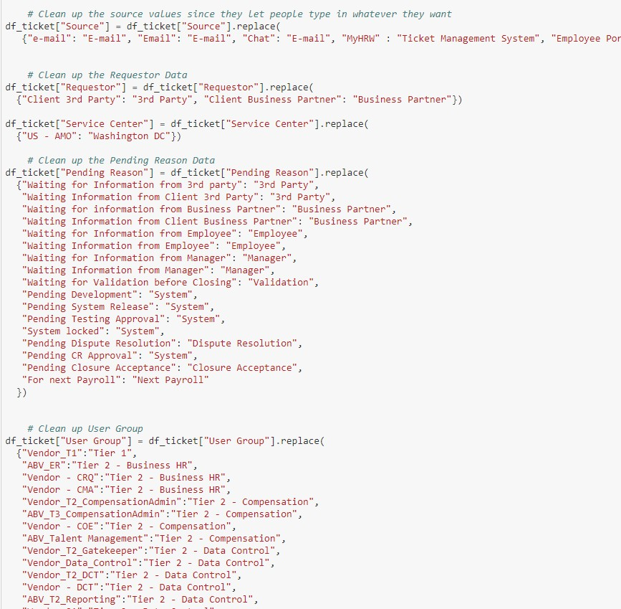
Data Exploration | Findings
Data was overall very clean and easy to work with
Originating Source had similar strings which were easy to group
‘e-mail’, ‘Email’, ‘email’, ‘Electronic Mail’
This also applied to the “Service” and “Service Group” fields
User Groups were obscurely named and done on a Tier system
Re-distributed these into more useful categories (i.e. Compenation, Payroll, Business HR, Data Control, etc…)
Identified a system issue with “Open” tickets receiving a “Closed Date”
Easily able to manipulate Date/Time columns where there were no nulls
Indicated it was a user input field without data validation
Determined that the root cause was an IT System integration that occurred over a certain 4 day date range
Needed to handle “Closed Date” and “Pending Date” columns separately, as there were null values for open tickets
Required dropping some columns and header/tail rows in order to read properly into a dataframe

Slide 7
AGENDA | Timeline
Request Analysis
Popular Request Services
Days of Week
Ticket Center Locations
Hours of Day
Service Type

Slide 8
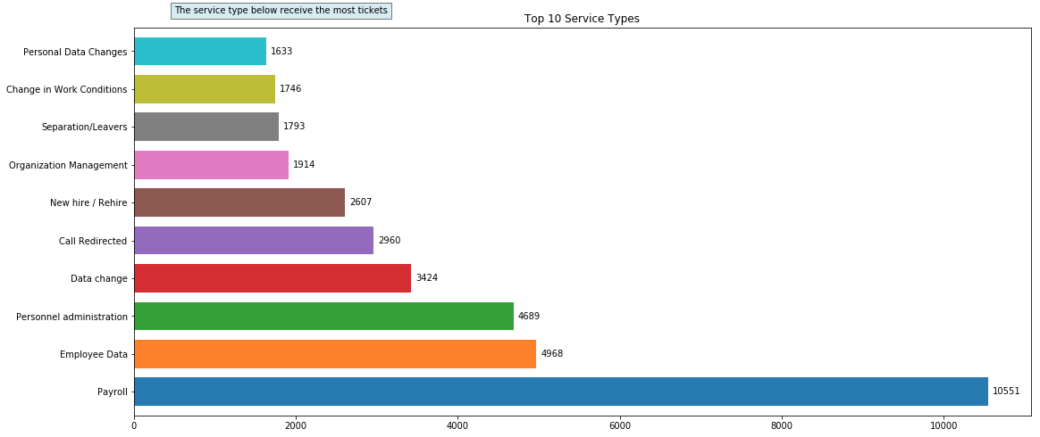
What are the most popular Request Service?
The chart below illustrates the top 10 most common service requests.
Majority of the services are payroll driven, followed by employee data, and personal administration.
Payroll service requests are double, in comparison to employee data requests.
Notes:
# Popular Request Service - Richa

Slide 9
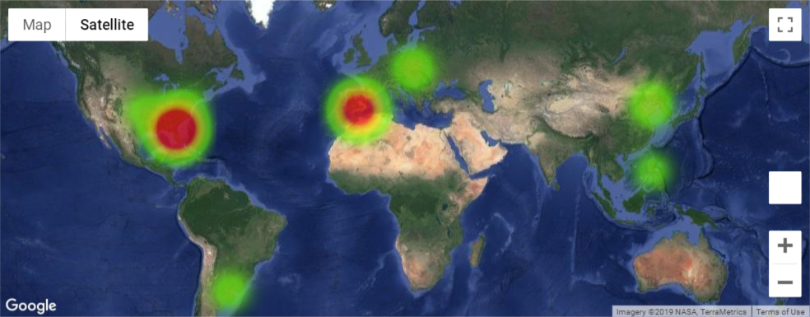
Volume of Tickets Processed – By Location
One area of interest was the location of each "Service Center" and the quantity of fielded inquiries. We began evaluated the number inquiries by location, and used theGoogle Maps API to create a heat map, with the intensity representing the volume of tickets by Service Center
We can observe from the map that the US (Jacksonville, FL) and Western Europe (Granada) covered the majority of the inquiries.
Notes:
# Ticket Center Location- Richa

Slide 10
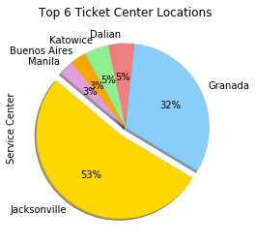
What are the top 6 Ticket Center location?
In the previous slide, we saw that US and West Europe made up majority of the inquires.
When we drilled down, we saw Jacksonville, FL and Granada, Spain were the particular city’s majority of tickets resided.
Notes:
# Top 6 Center Location - Richa

Slide 11
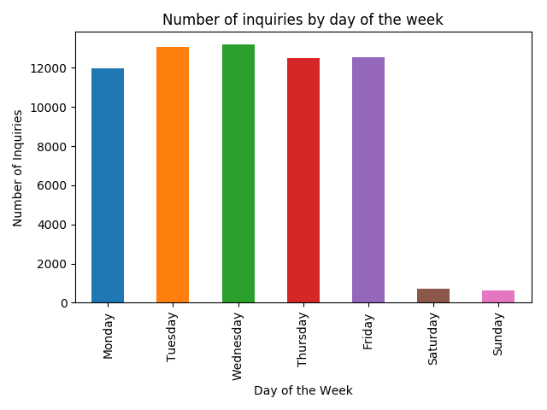
Which day of week has the highest PyHR Services utilization?
In reviewing the number of inquiries by day of the week, we saw that the majority of tickets were submitted during typical weekday working days
Interestingly, a small subset of inquiries took place during the weekend, which substantiates the need to investigate if there are potential trends among these inquiries. The company may wish to observe the need for having an inquiry center open on weekends or during "off business hours"
Notes:
# Day of Week - Nadia or Richa

Slide 12
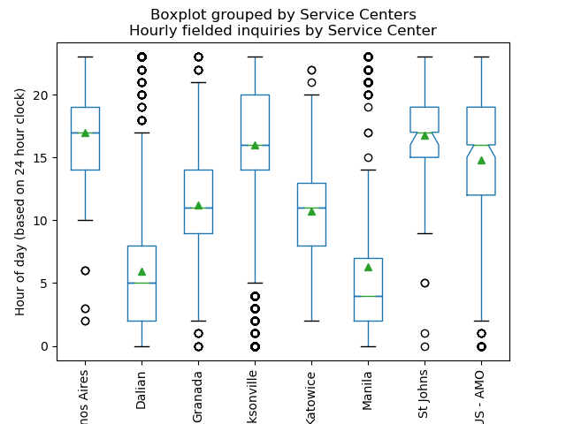
How About PyHR Services hours utilization?
We also took a look at the distribution of hours that each service center received inquiries. This was necessary in order to better understand if there were overlaps in coverage based on location/timezone
Based on the above, we are able to see that Dalian, Jacksonville and Manila had a number of outlying inquiries that could potentially be fielded by service centers that clearly had the majority of their inquiries during those time frames
Note: time was reclassified as an integer based on a 24 hour clock to better understand the data that was originally a string
Notes:
# Hour of Day – Nadia or Richa

Slide 13
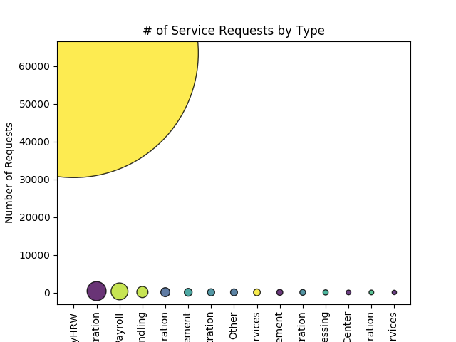
How About PyHR Services utilization?
Finally, we wanted to better understand whether there was a "service type" that represented the type of inquiries that were received. In the chart, we see that "service type" was based on systems that are used within HR
Clearly a majority of those inquiries were categorized as those that fell under "MyHRW". This is a broad category, which may further warrant better categorization of inquiries to have a clear understanding of "inquiry type"
Notes:
# Service Type – Nadia or Richa

Slide 14
AGENDA | Timeline
Service Level Analysis
Close date vs Due date
Duration by Ticket
Erroneous SLA Periods
Days to complete
SLA requirements
Duration by location

Slide 15
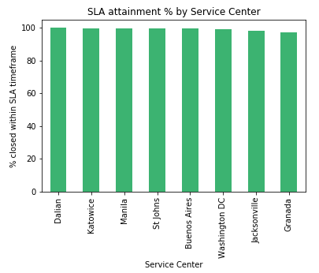
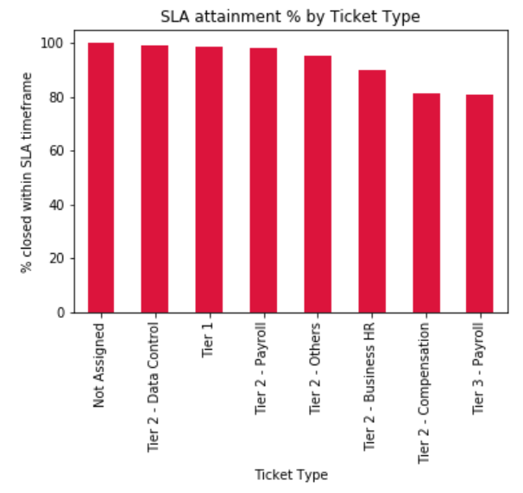
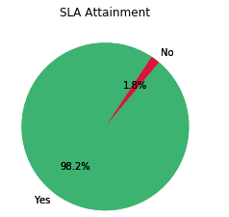
Service Level Agreement Period
By evaluating the close date versus the due date it appears that 98.2% of Tickets were closed before the SLA due date. This was true across all Service Centers and generally across Ticket Types with the exception of Tier 2 – Compensation and Tier-3 Payroll which were closer to 80%
Notes:
Melissa time analysis

Slide 16
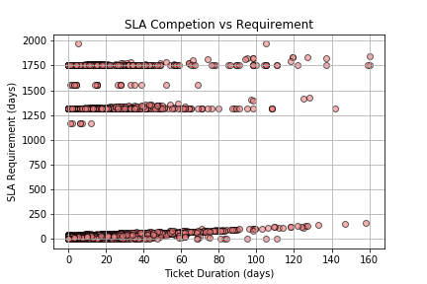
Service Level Agreement Period
Final band fell right around 1750 days.
Next band fell between 1250 and 1500 days.
One band fell between 0 and 250 days.
Notes:
However, a closer look reveals that there are un-reasonable and potentially erroneous SLA Periods in the system. We mapped a scatter plot of the SLA Requirement in Days versus the Ticket Duration and found that there were three distinct bands of SLA Requirements, making it unlikely that the requirement is accurate in the system.
These SLA Requirements are years out from the completion of the ticket making it unlikely that is the accurate requirement

Slide 17
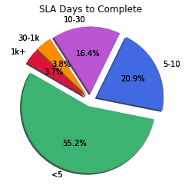
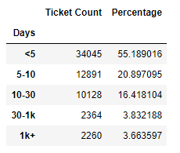
Service Level Agreement Period
Binning the SLA Days to complete into distinct groups we can see that most SLA Requirements are between 1 and 30 days with a minority percentage 7.5% greater than 30 days.
Notes:
Melissa time analysis

Slide 18
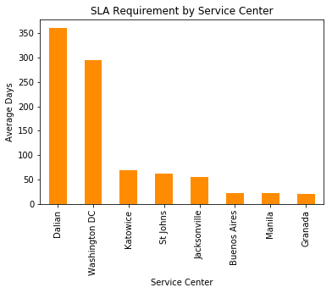
Service Level Agreement Period
These large SLA periods skew the average data in total resulting in unreasonable SLA requirements especially in Dalian and Washington DC.
Notes:
Melissa time analysis

Slide 19
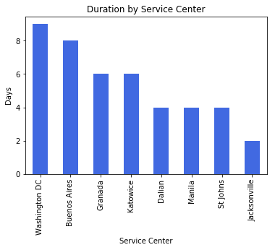
Service Level Agreement Period
The ‘Washington DC’ Service Center has the longest average ticket duration at ~9 days and the ‘Jacksonville’ service center has the shortest at ~2 days
Notes:
Melissa time analysis

Slide 20
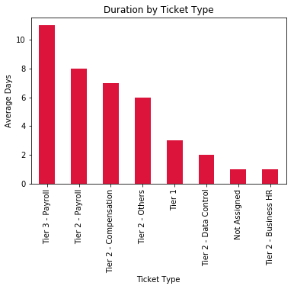
Service Level Agreement Period
‘Tier 3 – Payroll’ takes 11 days to close and Tier 2 – Payroll takes the next most average days at 8 days. This would suggest that on average Payroll issues are most complex and require additional turn-around. ‘Tier 2 – Business HR’ and ‘Not Assigned’ tickets close in 1 day on average suggesting that these issues are typically resolved the same day.
Notes:
Melissa time analysis

Slide 21
Limitations and Further Analysis
Limitations and Further Analysis
# Run some analysis for bigger data set period
# Split analysis for each of location
Location based time studies
Service type by location
# Service type by time of year / seasonality
# Inquiries that took place during the weekend
# Pending tickets
# Correlations between service spikes and other major company events
Company intranet portal articles
Earnings Reports
Mentions in the news
Notes:
Limitations and further analysis: Melissa

Slide 22


