Slide 1
Proposal
Project Title: PyHR Services -Ticket Analysis
Team Members: Drew Adams, Joao Bonini, Melissa Decoster, Nadia Patel , Richa Desai
Project Description/Outline: We will run opened ticket analysis in the last 4 years
Research Question to Answer: Is there any variation in the usage over 4 years?, What are the high demand service center inquiries and times that PyHR needs to meet?, What have been the different service types/categories and what is the service utilization pattern by type of requestor?, Is there a correlation between annual HR events, type of requestor and tickets?, How long is a ticket open on average and where do the requests usually start from?
Data Sets to be Used: PyHR Services ticket system
Rough Breakdown of Tasks: Data Extraction, Initial Data Exploration, Data Splitting, Data Creation, Data Formatting , Data Exporting, Creating a Python script, Prepare PowerPoint presentation

Slide 2

HR Services
Prototype| Dummy
PyHR is a provider of human resources business process outsourcing (BPO) services and consulting.
Services provided include payroll, benefits, recruitment, learning, workforce administration, time and attendance, background checking and compensation management.
Team Members: Drew Adams, Joao Bonini, Melissa Decoster, Nadia Patel , Richa Desai
Github: to be included

Slide 3
DEFINITIONS
Prototype| Dummy
# Eu acrescentaria um slide com DEFINIÇÕES (o que se chama de ticket, quem são os possíveis requestors, quais são alguns service type request, outros tipos de categorização), e o fluxo resumido deste processo

Slide 4
Agenda
Prototype| Dummy
# Data Exploration and Clean up
# Fundamental Questions
xxx
# Conclusion and further analysis
Goal for this presentation
xxxxxxx

Slide 5





Data Exploration and Clean up
Prototype| Dummy
Data Extraction
Initial Data Exploration
Data Splitting
Data Exporting
Data Creation
Data Formatting
PyHR Ticket System
Look at Missing Values
Fill-in the Blanks
Renaming and Removal of Data
CSV Creation
The ticket system provides a report.
Used the check_out date to extract the year, month and ticket date and ticket day of the week to fill up the missing values.
Creating New Columns and sort by category
Export the cleaned up data ready for analysis.
Pended date, Pending reason, Latest Communicated Date , Latest Communication to, User Group, Last Transfer Date Days From Latest Communication, Days From Last Transfer, Systems had missing values.
Renamed the columns. Removed inconsistent data. Changed the data types.
Day, Month, year, hour

Slide 6
Fundamental Questions
Prototype| Dummy
Is there any variation in the usage over 4 years?
What are the high demand service center inquiries and times that PyHR needs to meet?
What have been the different service types/categories and what is the service utilization pattern by type of requestor?
Is there a correlation between annual HR events, type of requestor and tickets?
How long is a ticket open on average and where do the requests usually start from?
Notes:
ft

Slide 7
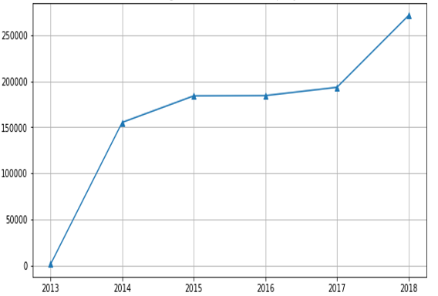
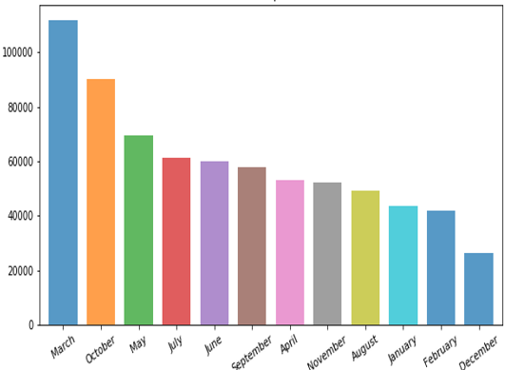
What is the PyHR Services utilization over the years?
Prototype| Dummy
Line graph shows that there is an increase in the tickets number
Bars indicate high usage for the months of March and October

Slide 8
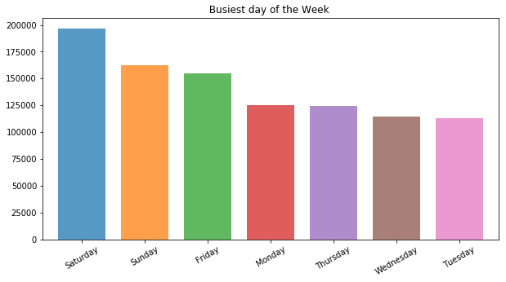
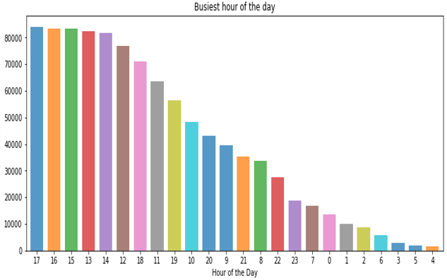
Which day has the highest PyHR Services utilization?
There is more usage of tickets on weekends compared to weekdays
Saturday seems to be more popular
2:00pm through 5:00 pm are the busiest hours in the week
Prototype| Dummy

Slide 9
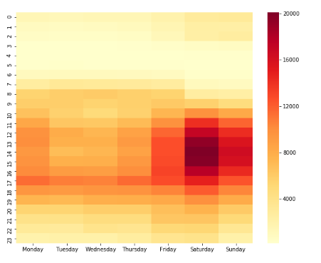
PyHR Services Variation by Time and Day
Prototype| Dummy
There is a spike in services usage on weekdays during the hours of 8:00am , 12:00pm and 5:00pm
During Friday and weekends the service usage increases between 12:00pm to 5:00pm
Monday also has a fair amount of usage throughout the entire day.

Slide 10
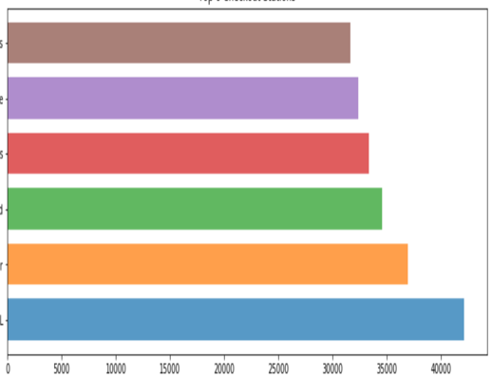
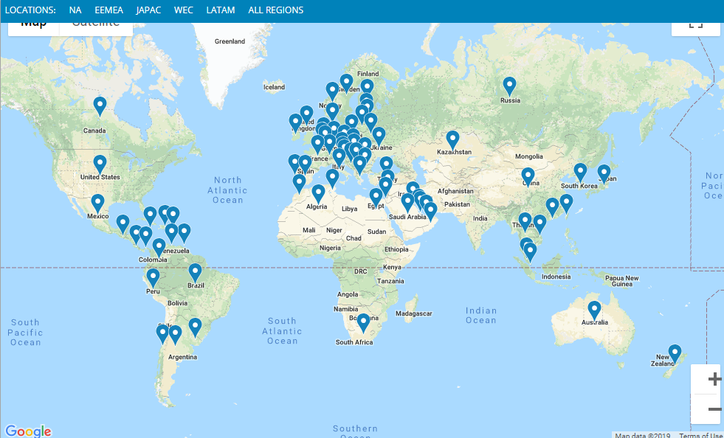
Which Service Center do EMPLOYEES use the most?
Prototype| Dummy
The most popular stations are located in U.S. Jacksonville that receives significantly more rentals than any other area.

Slide 11

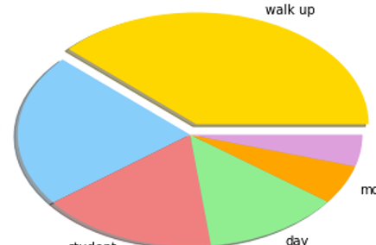
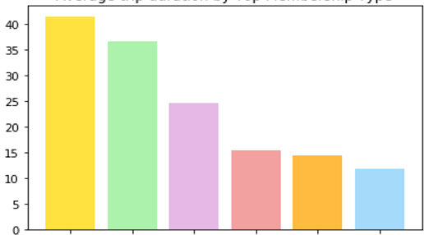
What are the most popular SERVICE & their average Ticket durations?
Prototype| Dummy
The most popular membership type is “Employee Data” with the longest average duration of 41 minutes. The average of all of the tickets is 28 minutes.

Slide 12
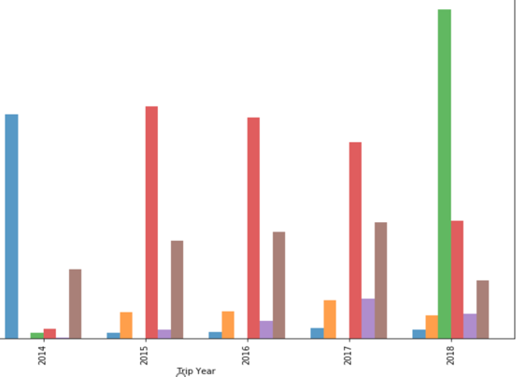
Popular SERVICE Types Trends Over the Years
Prototype| Dummy
Effect of XX

Slide 13
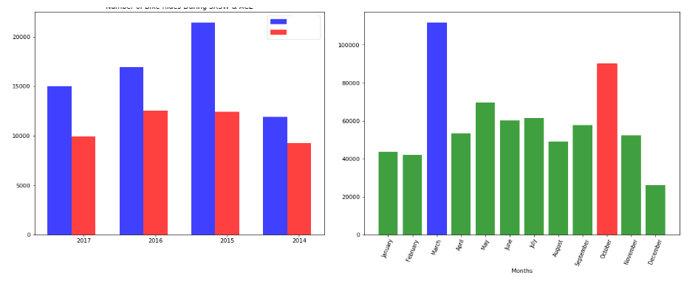
Is there a correlation between HR annual events and TICKETS?
Prototype| Dummy
Events like RPT and Goals setting affects ridership
We can see a spike in total tickets for the months of March and October

Slide 14
Conclusion and Further Analysis
In conclusion, our initial questions xxxxxx
In the future we’d like to include the following discussion points:
Pending tickets
Correlation between ticket and company intranet portal article
Prototype| Dummy

Slide 15


