Slide 1

HR Services
PyHR is a provider of human resources business process outsourcing (BPO) services and consulting.
Services provided include payroll, benefits, recruitment, learning, workforce administration, time and attendance, background checking and compensation management.
Team Members: Drew Adams, Joao Bonini, Melissa Decoster, Nadia Patel , Richa Desai
Github: https://github.com/jvbonini/Project-I

Slide 2
Agenda
# Definitions
# Data Exploration and Clean up
# Fundamental Questions
# Analysis
# Conclusion and further analysis

Slide 3





DEFINITIONS | Declare in Memory
# Ticket : Case ID = Request
# Requestors = Employee, 3rd Party, Business Partner(BHR), HROps, Manager
# Service Group = Service Family Type Category : Application Management, Compensation..
# Service = Type Category: Accounting, AdHoc Report Request, Annual wage statements..
# Summary Workflow
Requestor
COEs
HR Connect Consultants
Notes:
DEFINITIONS - BONINI

Slide 4
Data Exploration and Clean up
Data Extraction
Initial Data Exploration
Data Exporting
Data Creation
Data Formatting
PyHR Ticket System
Replacing
CSV Creation
Look at Missing Values and Removal of Data
Creating New Columns and sort by category
Renamed the columns.
Export the cleaned up data ready for analysis.
The ticket system provides a report.
Removed inconsistent data.
Day, Month, year, hour
Notes:
DREW

Slide 5
Fundamental Questions
Is there any variation in the usage over 6 months?
What are the high demand service center inquiries and times that PyHR needs to meet?
What have been the different service types/categories and what is the service utilization pattern by type of requestor?
Is there a correlation between annual HR events, type of requestor and tickets?
How long is a ticket open on average and where do the requests usually start from?
Notes:
ft

Slide 6
Service Center Analysis
Notes:
Melissa

Slide 7
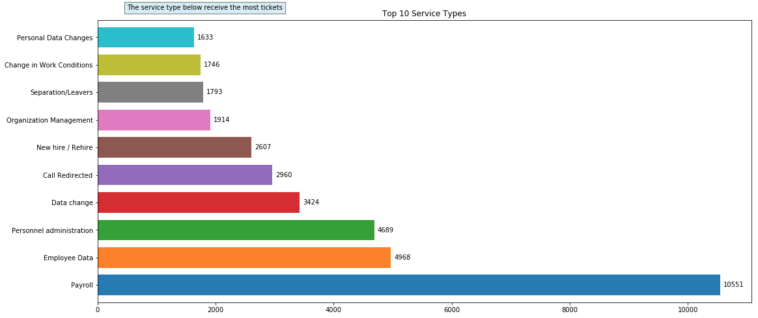
What are the most popular SERVICE & their average Ticket durations?
The most popular membership type is “Employee Data” with the longest average duration of 41 minutes. The average of all of the tickets is 28 minutes.
Notes:
Richa by user Group

Slide 8
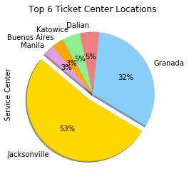
Popular SERVICE Types Trends Over the Years
Effect of XX
Notes:
Richa Case aged

Slide 9
Service level Analysis
Notes:
Melissa

Slide 10
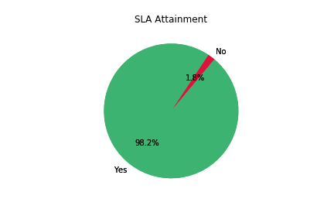
Service Level Agreement Period
By evaluating the close date versus the due date it appears that 98.2% of Tickets are closed within the SLA Period.
Notes:
Melissa time analysis

Slide 11
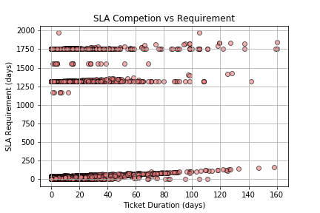
Service Level Agreement Period
However, a closer look reveals that there are un-reasonable and potentially erroneous SLA Periods in the system. We mapped a scatter plot of the SLA Requirement in Days versus the Ticket Duration and found that there were three distinct bands of SLA Requirements. of the ticket making it unlikely that is the accurate requirement
One band fell between 0 and 250 days.
Next band fell between 1250 and 1500 days.
Final band fell right around 1750 days.
These SLA Requirements are years out from the completion of the ticket making it unlikely that is the accurate requirement
Notes:
Melissa time analysis

Slide 12
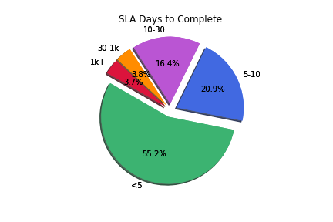
Service Level Agreement Period
Binning the SLA Days to complete into distinct groups we can see that most SLA Requirements are between 1 and 30 days with a minority percentage 7.5% between 30 and 1k days..
Notes:
Melissa time analysis

Slide 13
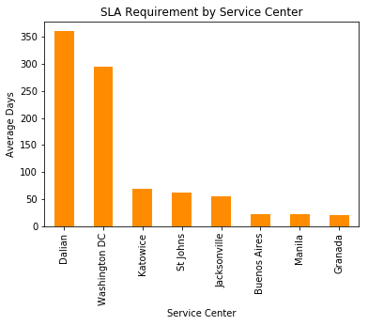
Service Level Agreement Period
By Binning the SLA Days to complete into distinct groups we can see that most SLA Requirements are between 1 and 30 days with a minority percentage 7.5% between 30 and 1k days.
Notes:
Melissa time analysis

Slide 14
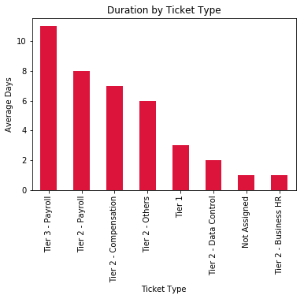
Service Level Agreement Period
Evaluating duration to close the tickets reveals that on average ‘Tier 3 – Payroll’ takes 11 days to close and Tier 2 – Payroll takes the next most average days at 8 days. ‘Tier 2 – Business HR’ and ‘Not Assigned’ tickets close in 1 day on average
Notes:
Melissa time analysis

Slide 15
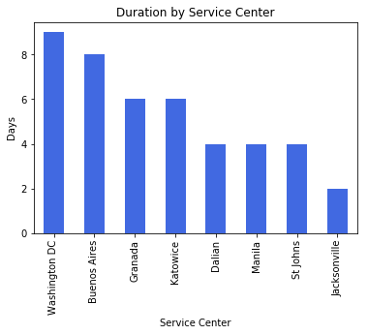
Service Level Agreement Period
Washington DC has the Longest Ticket Duration at an Average of 9 days and Jacksonville has the shortest at 2 days
Notes:
Melissa time analysis

Slide 16
NADIA DATA
Notes:
Melissa

Slide 17
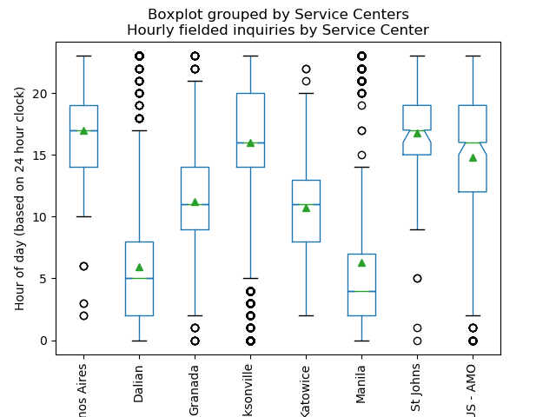
Which Service Center do EMPLOYEES use the most?
The most popular stations are located in U.S. Jacksonville that receives significantly more tickets than any other area.
Notes:
Nadia

Slide 18
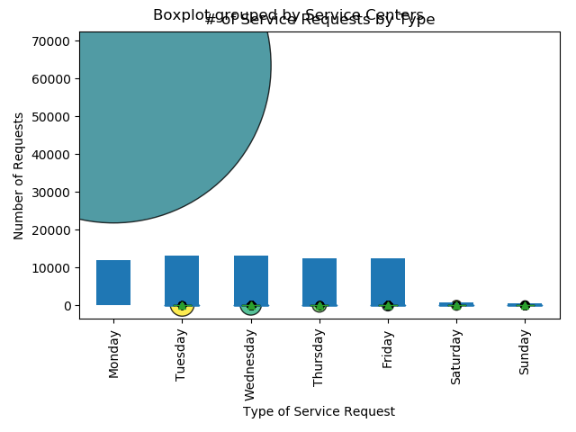
Which Service Center do EMPLOYEES use the most?
The most popular stations are located in U.S. Jacksonville that receives significantly more tickets than any other area.
Notes:
Nadia

Slide 19
Which Service Center do EMPLOYEES use the most?
The most popular stations are located in U.S. Jacksonville that receives significantly more tickets than any other area.
Notes:
Nadia

Slide 20


Slide 21
Conclusion and Further Analysis
In conclusion, our initial questions xxxxxx
In the future we’d like to include the following discussion points:
Pending tickets
Correlation between ticket and company intranet portal article

Slide 22
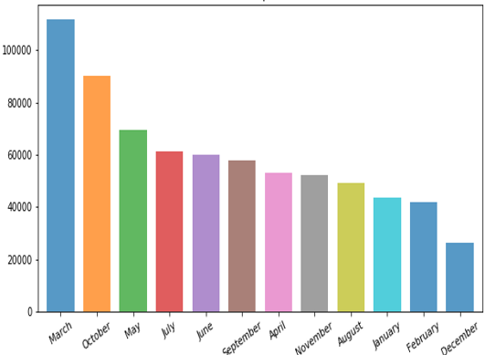
What is the PyHR Services utilization over the years?
Line graph shows that there is an increase in the tickets number
Bars indicate high usage for the months of March and October
Notes:
Melissa

Slide 23
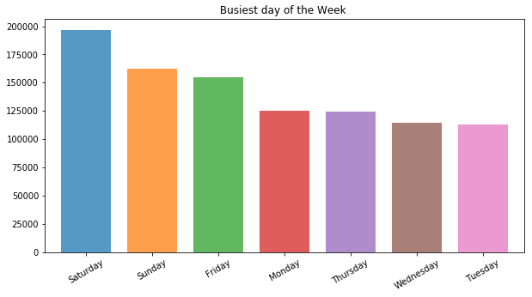
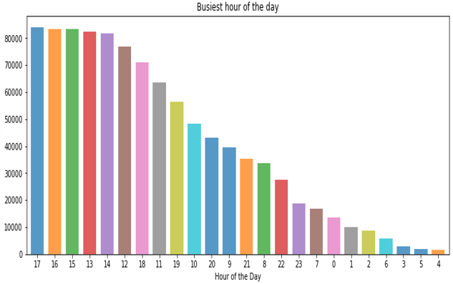
Which day has the highest PyHR Services utilization?
There is more usage of tickets on weekends compared to weekdays
Saturday seems to be more popular
2:00pm through 5:00 pm are the busiest hours in the week
Notes:
Melissa

Slide 24
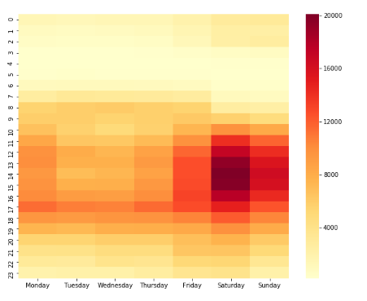
PyHR Services Variation by Time and Day
Prototype| Dummy
There is a spike in services usage on weekdays during the hours of 8:00am , 12:00pm and 5:00pm
During Friday and weekends the service usage increases between 12:00pm to 5:00pm
Monday also has a fair amount of usage throughout the entire day.
Notes:
Nadia

