Slide 1

HR Services
PyHR is a provider of human resources business process outsourcing (BPO) services and consulting.
Services provided include payroll, benefits, recruitment, learning, workforce administration, time and attendance, background checking and compensation management.
Team Members: Drew Adams, Joao Bonini, Melissa Decoster, Nadia Patel , Richa Desai
Github: https://github.com/jvbonini/Project-I

Slide 2
Agenda
# Definitions
# Data Exploration and Clean up
# Fundamental Questions
# Analysis
# Conclusion and further analysis

Slide 3





DEFINITIONS | Declare in Memory
# Ticket : Case ID = Request
# Requestors = Employee, 3rd Party, Business Partner(BHR), HROps, Manager
# Service Group = Service Family Type Category : Application Management, Compensation..
# Service = Type Category: Accounting, AdHoc Report Request, Annual wage statements..
# Summary Workflow
Requestor
COEs
HR Connect Consultants
Notes:
DEFINITIONS - BONINI

Slide 4
Data Exploration and Clean up
Data Extraction
Initial Data Exploration
Data Exporting
Data Creation
Data Formatting
PyHR Ticket System
Replacing
CSV Creation
Look at Missing Values and Removal of Data
Creating New Columns and sort by category
Renamed the columns.
Export the cleaned up data ready for analysis.
The ticket system provides a report.
Removed inconsistent data.
Day, Month, year, hour
Notes:
DREW

Slide 5
Fundamental Questions
Is there any variation in the usage over 6 months?
What are the high demand service center inquiries and times that PyHR needs to meet?
What have been the different service types/categories and what is the service utilization pattern by type of requestor?
Is there a correlation between annual HR events, type of requestor and tickets?
How long is a ticket open on average and where do the requests usually start from?
Notes:
ft

Slide 6
Service Center Analysis
Notes:
Melissa

Slide 7
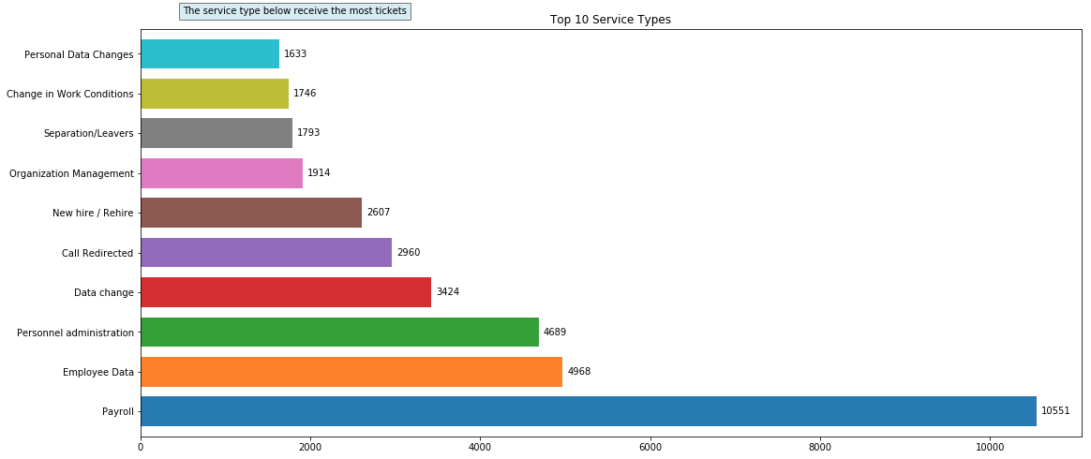
What are the most popular SERVICE & their average Ticket durations?
The most popular membership type is “Employee Data” with the longest average duration of 41 minutes. The average of all of the tickets is 28 minutes.
Notes:
Richa by user Group

Slide 8
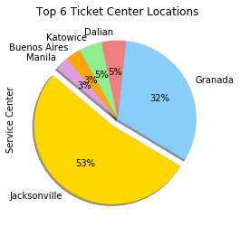
Popular SERVICE Types Trends Over the Years
Effect of XX
Notes:
Richa Case aged

Slide 9
NADIA DATA
Notes:
Melissa

Slide 10
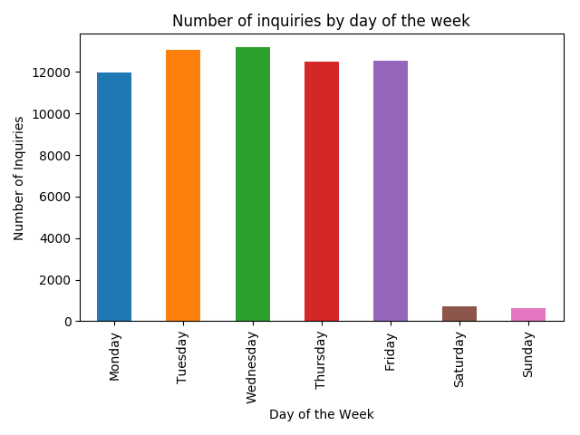
Which day has the highest PyHR Services utilization?
In reviewing the number of inquiries by day of the week, we saw that the majority of tickets were submitted during working days
Interestingly, we also saw that there were some inquiries that took place during the weekend, which substantiates the need to investigate further on what the inquiries were regarding. While we did not have clarity on this, we suggest that the company may wish to observe the need for having an inquiry center open during "off business hours"
Notes:
Melissa

Slide 11
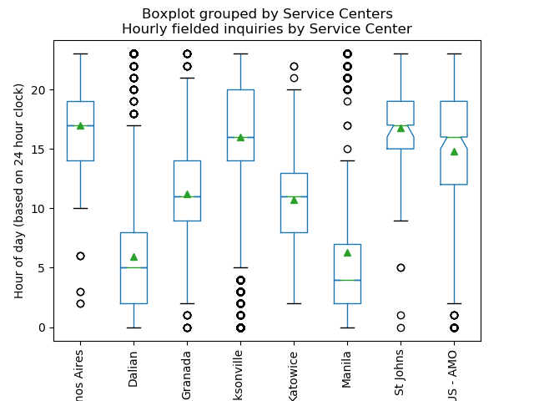
How About PyHR Services utilization?
We also took a look at the distribution of hours that each service center received inquiries. This was necessary in order to better understand if there were overlaps in coverage based on location/timezone
Based on the above, we are able to see that Dalian, Jacksonville and Manila had a number of outlying inquiries that could potentially be fielded by service centers that clearly had the majority of their inquiries during those time frames
Note: time was reclassified as an integer based on a 24 hour clock to better understand the data that was originally a string
Notes:
Melissa

Slide 12
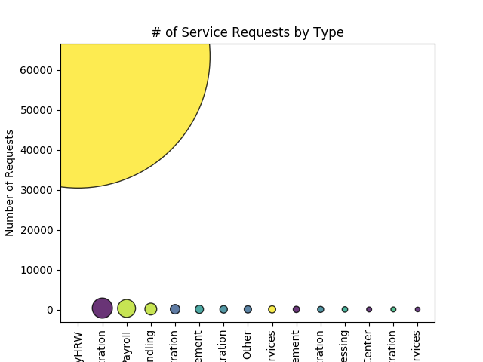
How About PyHR Services utilization?
Lastly, we wanted to better understand whether there was a "service type" that represented the type of inquiries that were received. In the chart, we see that "service type" was based on systems that are used within HR
Clearly a majority of those inquiries were categorized as those that fell under "MyHRW". This is a broad category, which may further warrant better categorization of inquiries to have a clear understanding of "inquiry type"
Notes:
Melissa

Slide 13
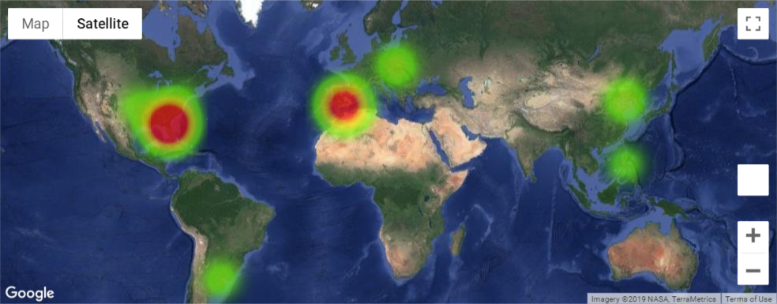
How About PyHR Services utilization?
One are of interest was the location of each "Service Center" and the fielded inquiries. We began by looking at where the majority of inquiries were fielded through Googlemaps and layering it with a heat map, indicating intensity by way of number of tickets by Service Center
We can observe from the map that the US and Western Europe covered the majority of the inquiries.
Notes:
Melissa

Slide 14
Service level Analysis
Notes:
Melissa

Slide 15
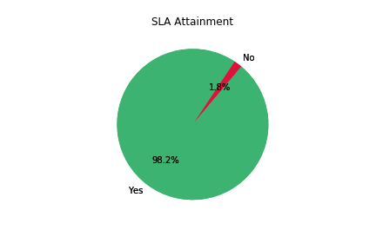
Service Level Agreement Period
By evaluating the close date versus the due date it appears that 98.2% of Tickets are closed within the SLA Period.
Notes:
Melissa time analysis

Slide 16
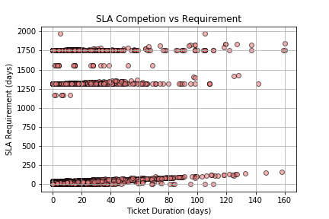
Service Level Agreement Period
However, a closer look reveals that there are un-reasonable and potentially erroneous SLA Periods in the system. We mapped a scatter plot of the SLA Requirement in Days versus the Ticket Duration and found that there were three distinct bands of SLA Requirements. of the ticket making it unlikely that is the accurate requirement
One band fell between 0 and 250 days.
Next band fell between 1250 and 1500 days.
Final band fell right around 1750 days.
These SLA Requirements are years out from the completion of the ticket making it unlikely that is the accurate requirement
Notes:
Melissa time analysis

Slide 17
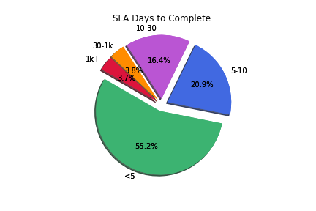
Service Level Agreement Period
Binning the SLA Days to complete into distinct groups we can see that most SLA Requirements are between 1 and 30 days with a minority percentage 7.5% between 30 and 1k days..
Notes:
Melissa time analysis

Slide 18
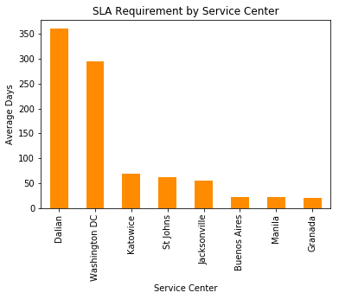
Service Level Agreement Period
By Binning the SLA Days to complete into distinct groups we can see that most SLA Requirements are between 1 and 30 days with a minority percentage 7.5% between 30 and 1k days.
Notes:
Melissa time analysis

Slide 19
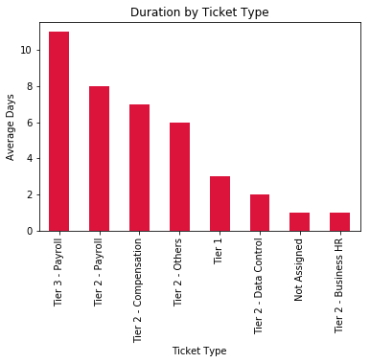
Service Level Agreement Period
Evaluating duration to close the tickets reveals that on average ‘Tier 3 – Payroll’ takes 11 days to close and Tier 2 – Payroll takes the next most average days at 8 days. ‘Tier 2 – Business HR’ and ‘Not Assigned’ tickets close in 1 day on average
Notes:
Melissa time analysis

Slide 20
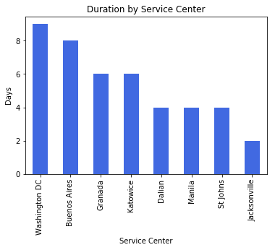
Service Level Agreement Period
Washington DC has the Longest Ticket Duration at an Average of 9 days and Jacksonville has the shortest at 2 days
Notes:
Melissa time analysis

Slide 21


Slide 22
Conclusion and Further Analysis
In conclusion, our initial questions xxxxxx
In the future we’d like to include the following discussion points:
Pending tickets
Correlation between ticket and company intranet portal article

Slide 23
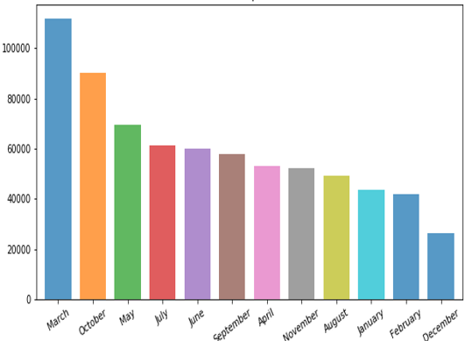
What is the PyHR Services utilization over the years?
Line graph shows that there is an increase in the tickets number
Bars indicate high usage for the months of March and October
Notes:
Melissa

Slide 24
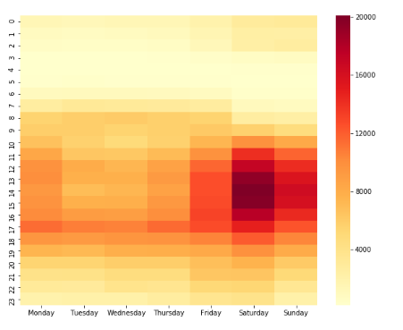
PyHR Services Variation by Time and Day
Prototype| Dummy
There is a spike in services usage on weekdays during the hours of 8:00am , 12:00pm and 5:00pm
During Friday and weekends the service usage increases between 12:00pm to 5:00pm
Monday also has a fair amount of usage throughout the entire day.
Notes:
Nadia

