Slide 1


PyLacrosse is a provider of lacrosse games data driven documents and consulting.
Team Members: Drew Adams, Joao Bonini, Melissa Decoster, Nadia Patel , Richa Desai
Github: to be included

Slide 2
DEFINITIONS | background
# Ground ball : xxxx
# Turnover : xxxx
#Foul : xxxx
Notes:
# Definitions - Bonini

Slide 3
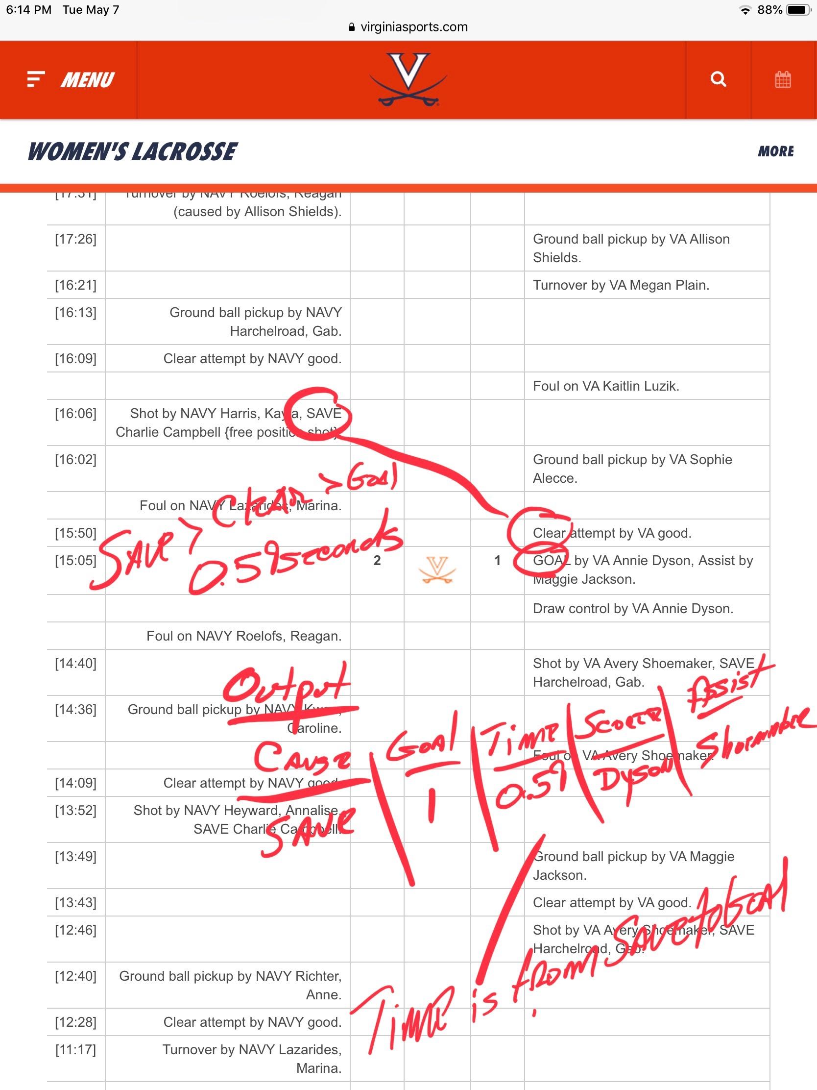
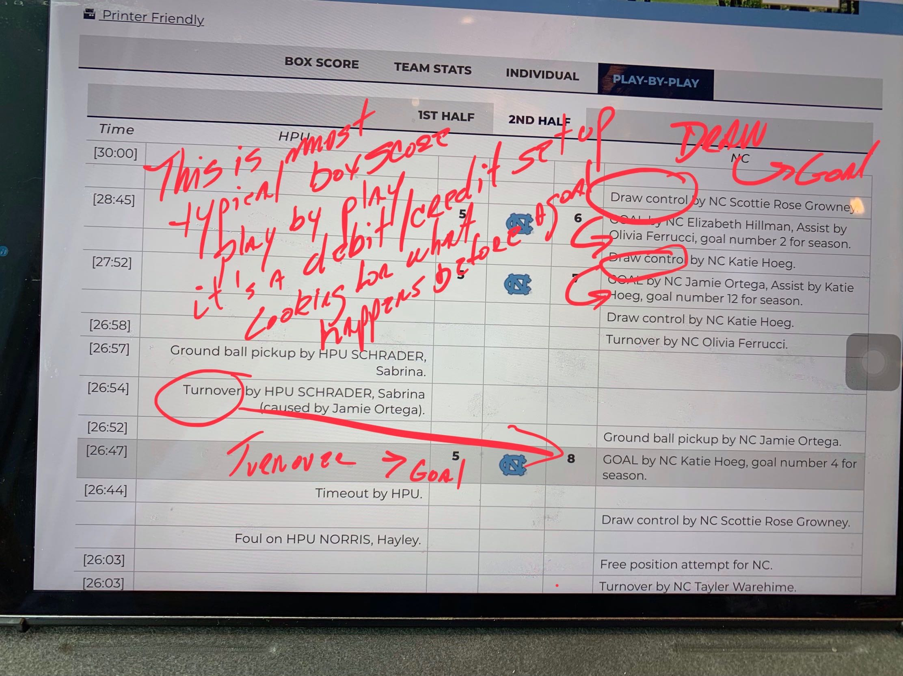
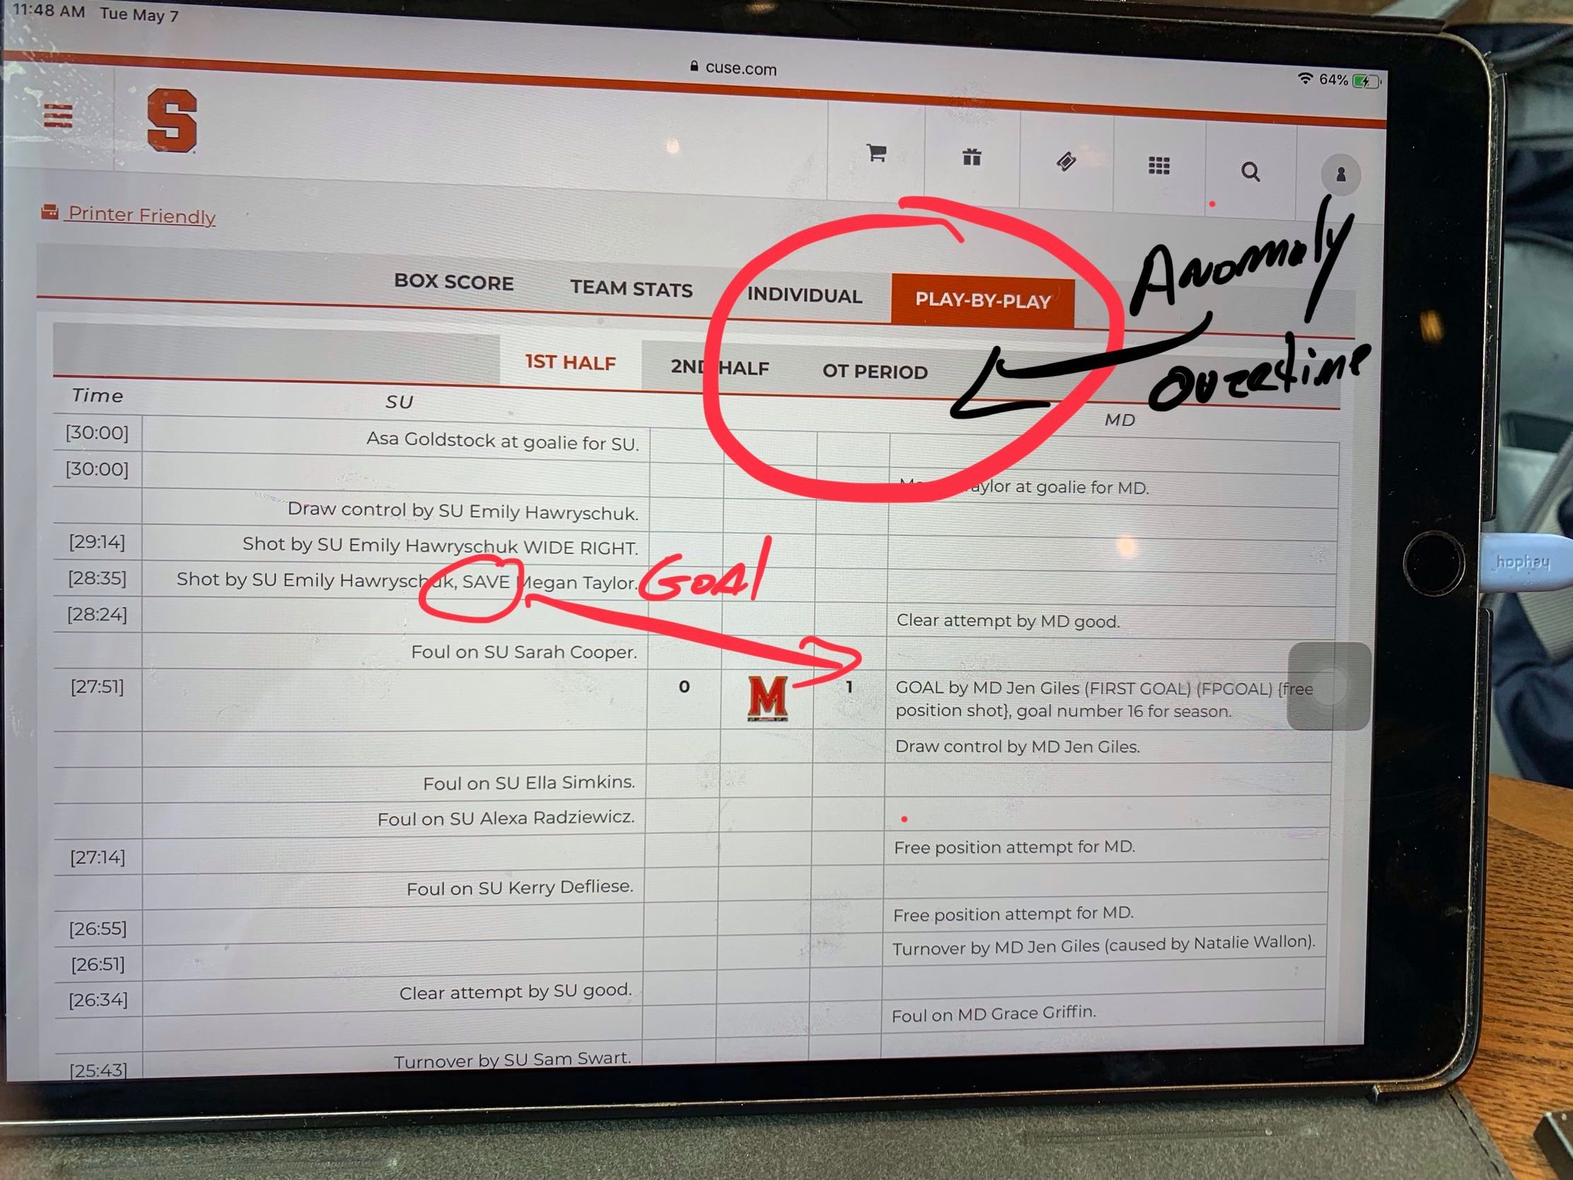
Data Exploration | REQUIREMENTS

Slide 4


Slide 5

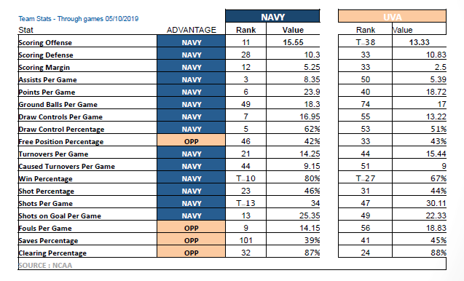

Slide 6

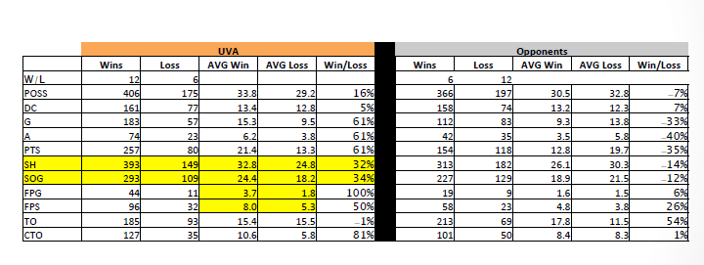

Slide 7
AGENDA | Timeline
Data Exploration and Clean Up
Identify Useful Fields
Data Munging and Field Mapping
Request Analysis
Popular Request Services
Days of Week
Service Level Analysis
Close date vs Due date
Duration by Ticket
Limitations and further analysis
Use Pandas .value_counts() to determine quality of the data
Export cleansed data as new CSV file
Ticket Center Locations
Hours of Day
Service Type
Erroneous SLA Periods
Days to complete
SLA requirements
Duration by location
Location based time studies
Service type by location
Service type by time of year / seasonality
Correlations between service spikes and other major company events

Slide 8
Data Exploration and Clean up
Data Extraction
Initial Data Exploration
Data Exporting
Data Creation
Data Formatting
PyHR Ticket System
Replacing
CSV Creation
Look at Missing Values and Removal of Data
Creating New Columns and sort by category
Renamed the columns.
Export the cleaned up data ready for analysis.
The ticket system provides a report.
Removed inconsistent data.
Day, Month, year, hour
Notes:
# Data Exploration and Clean Up - Drew

Slide 9
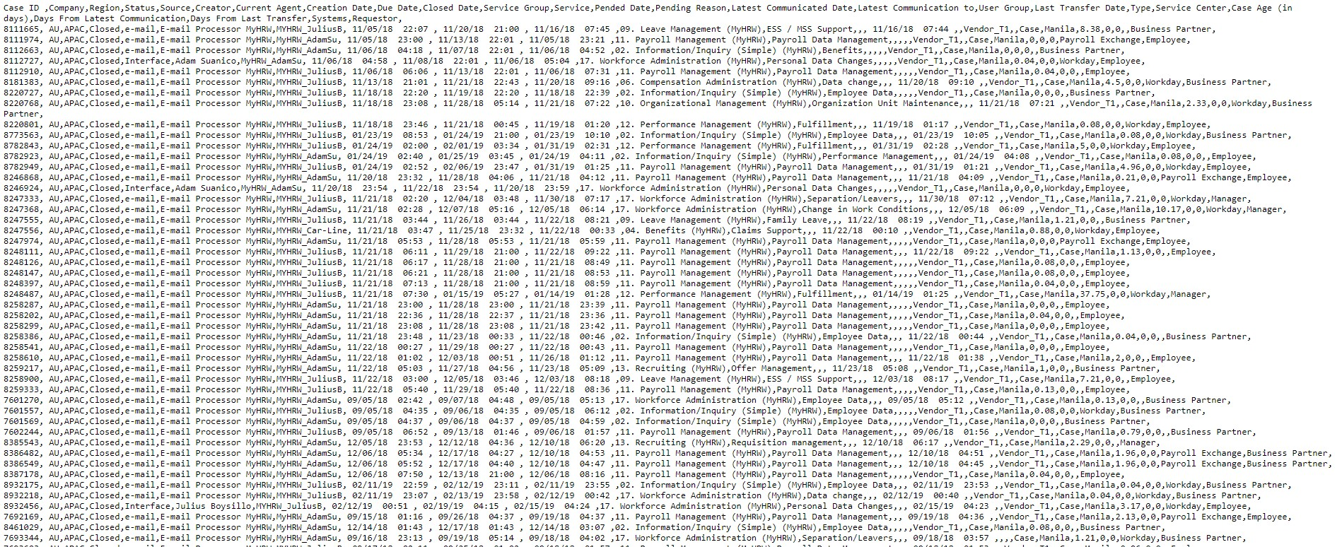
Data Exploration | Initial Data Loading
Utilize the pandas library for Python (Jupyter Notebook)
Read in the data as CSV
Output list of column headers
Explore fields and analyze data quality
Create plan to map fields to common values

Slide 10
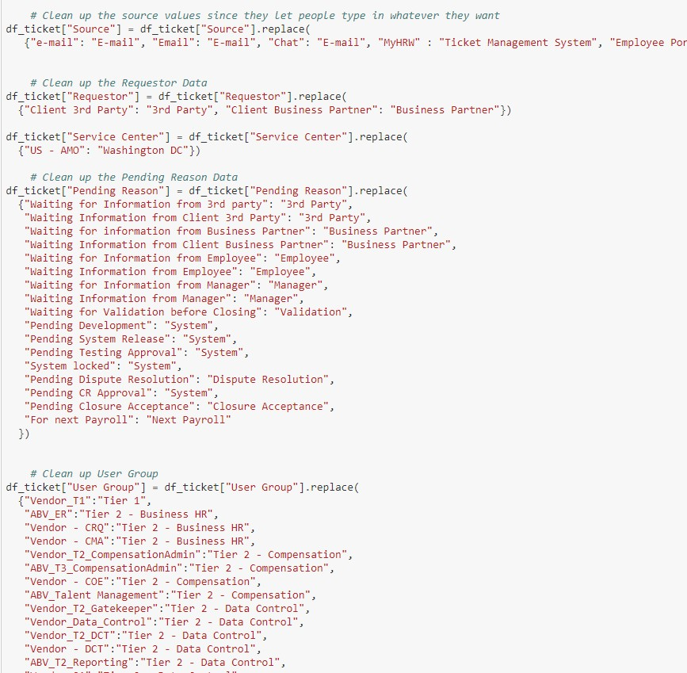
Data Exploration | Findings
Data was overall very clean and easy to work with
Originating Source had similar strings which were easy to group
‘e-mail’, ‘Email’, ‘email’, ‘Electronic Mail’
This also applied to the “Service” and “Service Group” fields
User Groups were obscurely named and done on a Tier system
Re-distributed these into more useful categories (i.e. Compenation, Payroll, Business HR, Data Control, etc…)
Identified a system issue with “Open” tickets receiving a “Closed Date”
Easily able to manipulate Date/Time columns where there were no nulls
Indicated it was a user input field without data validation
Determined that the root cause was an IT System integration that occurred over a certain 4 day date range
Needed to handle “Closed Date” and “Pending Date” columns separately, as there were null values for open tickets
Required dropping some columns and header/tail rows in order to read properly into a dataframe

Slide 11
AGENDA | Timeline
Request Analysis
Popular Request Services
Days of Week
Ticket Center Locations
Hours of Day
Service Type

Slide 12
ANALYSIS
Xxxxxxx
Xxxxxxx
Xxxxxxxx
xxxxxxxx
Notes:
# Popular Request Service - Richa

Slide 13
Limitations and Further Analysis
Limitations and Further Analysis
# Run some analysis for bigger data set period
# Split analysis for each of location
Location based time studies
Service type by location
# Service type by time of year / seasonality
# Inquiries that took place during the weekend
# Pending tickets
# Correlations between service spikes and other major company events
Company intranet portal articles
Earnings Reports
Mentions in the news
Notes:
Limitations and further analysis: Melissa

Slide 14


