Slide 1
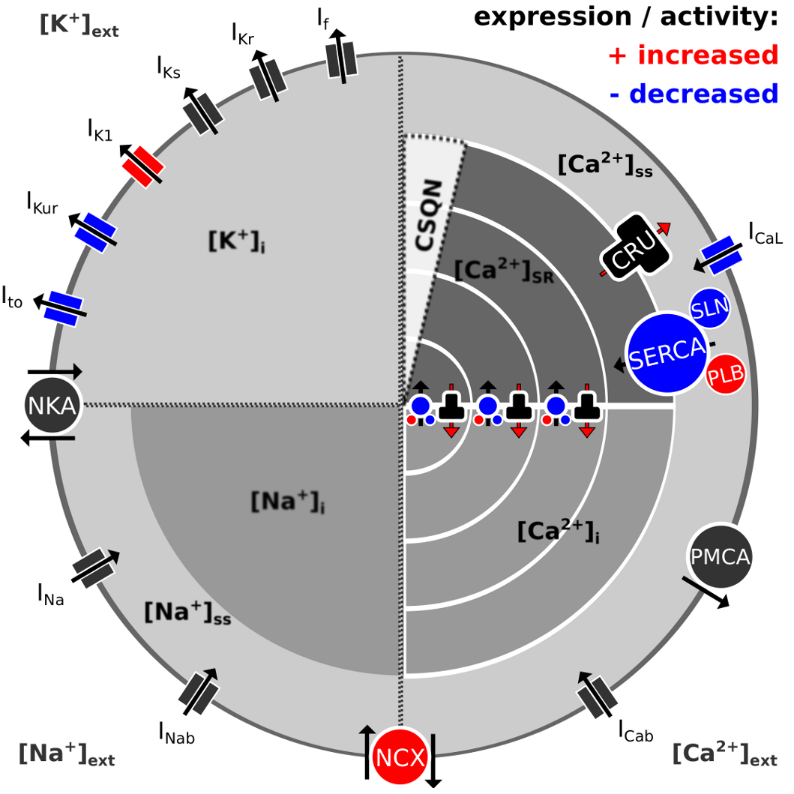
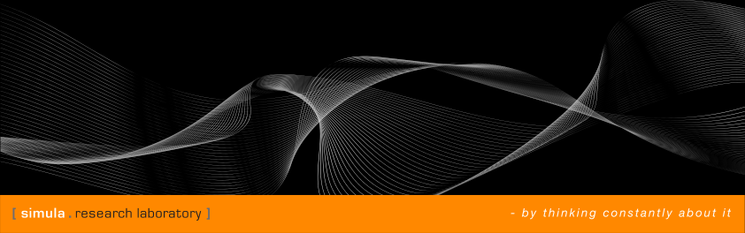
Reducing a model for human atrial myocytes using a phenomenological model
Project 1/3
Jonas van den Brink
Simula Summer School
2014

Slide 2
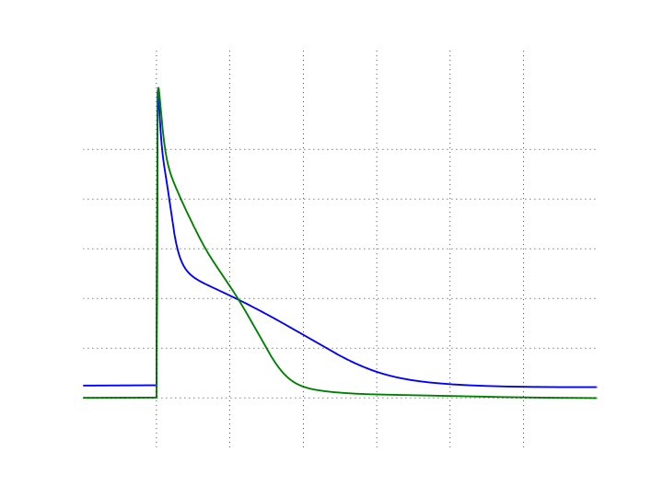
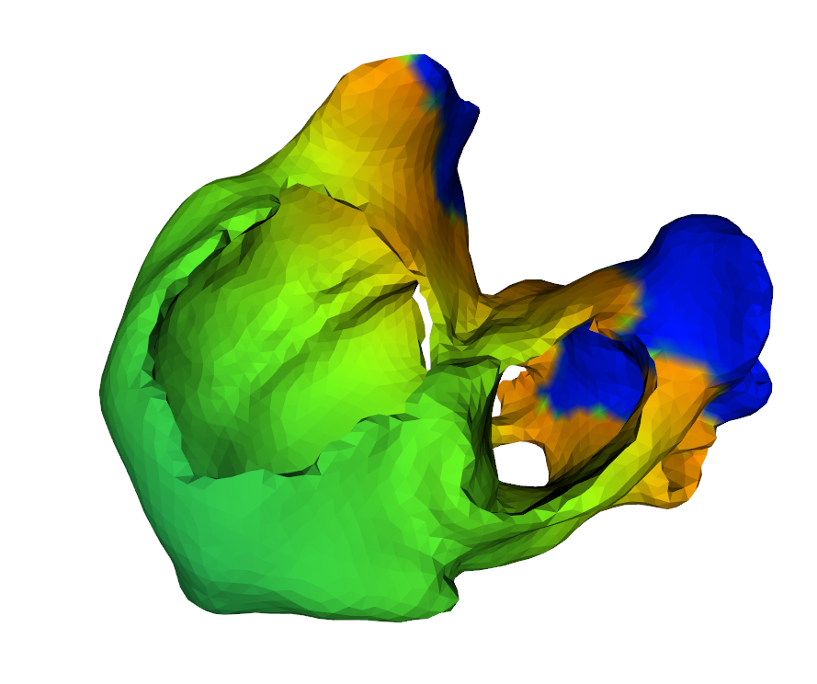
This presentation will focus mostly on methods
and protocols
Reducing the model
Future work

Slide 3
We are looking at a complex atrial myocyte model and a reduced, simpler version
Koivumäki nSR
Koivumäki cAF
Cellular remodelling
Reduction through
parameter fitting
Fenton-Karma nSR
Fenton-Karma cAF

Slide 4
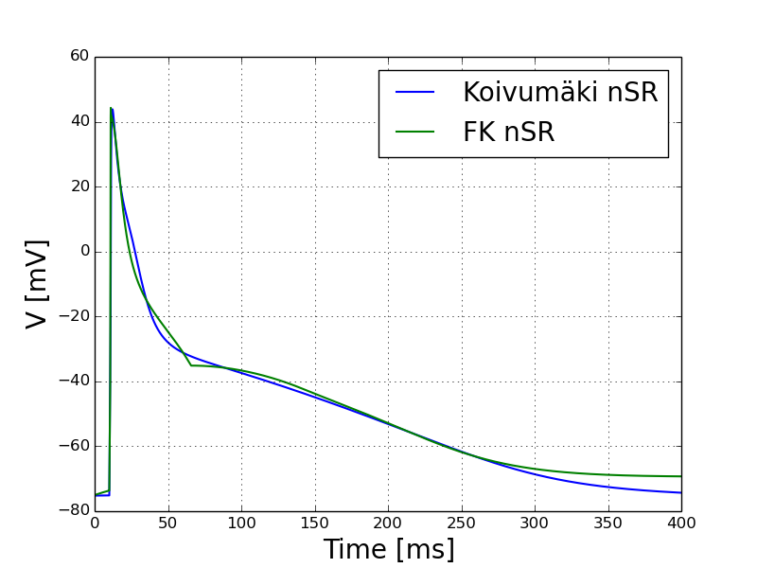
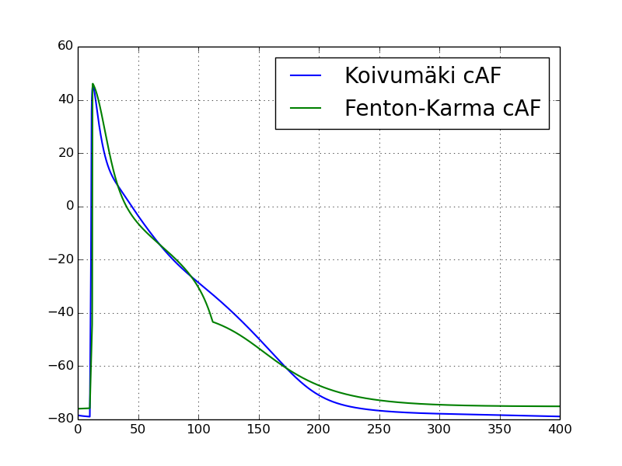
The reduced model accurately reproduces action potential shape

Slide 5
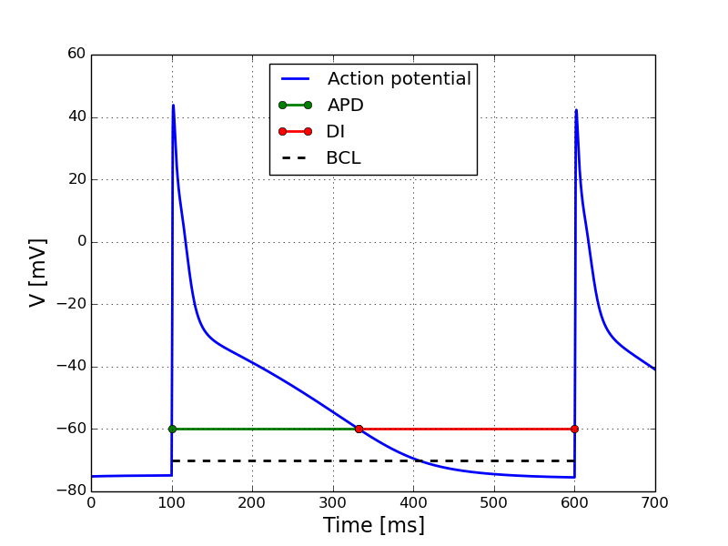
Action potential duration is the time when the potential is over a given threshold

Slide 6
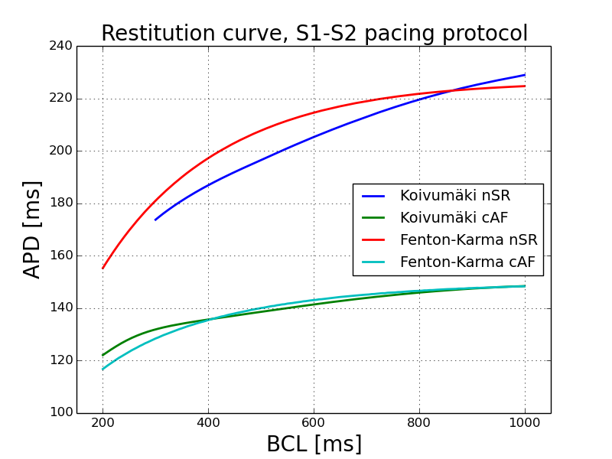
Action potential duration is reproduced quite well by the reduced model
S1: Pace for many cycles to reach steady-cycle
S2: Issue a premature
stimulus and measure

Slide 7
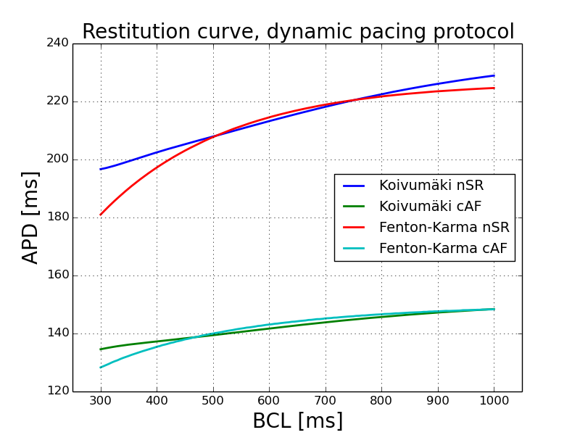
The fit is even better for a dynamic pacing
Measure the APD at
steady-cycle

Slide 8
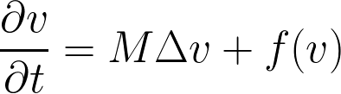
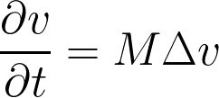
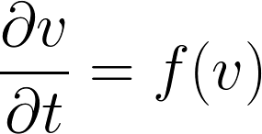
Operator splitting decouples the monodomain equations into a linear PDE and a source term
Operator splitting
Heat equation
Solve with finite element
Non-linear ODE system
Solve with rush-larsen

Slide 9
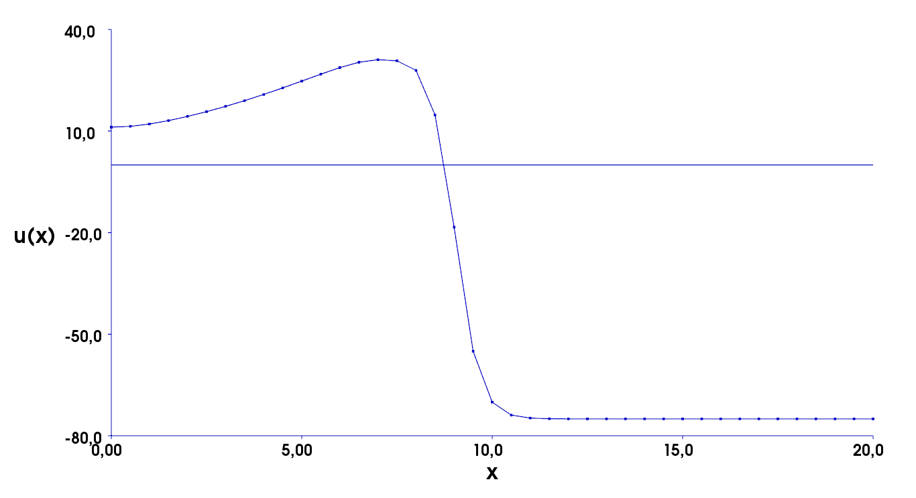
Conduction velocity is measured by solving monodomain equations in a 1D tissue strand

Slide 10
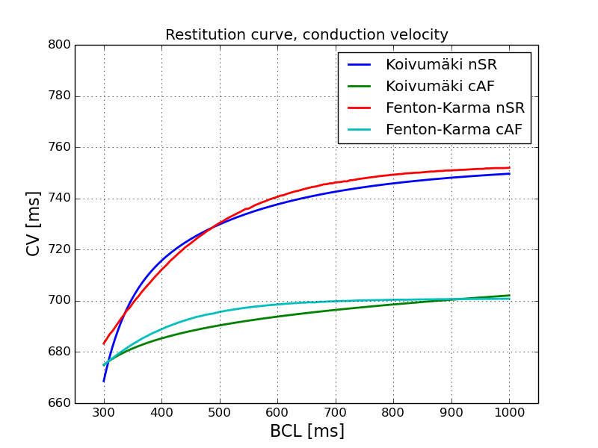
The Fenton-Karma model is quite effective in reproducing the CV-BCL shape

Slide 11
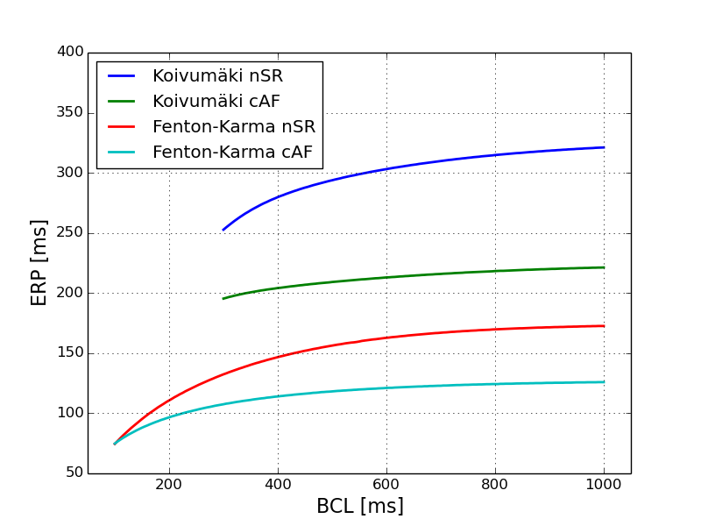
The FK model fails horribly at reproducing the refractory period

Slide 12
Discrepancies between models leads to very different 2D behaviour
Koivumäki nSR
Fenton-Karma nSR

Slide 13
The tools developed so far are well suited for further study of atrial fibrillation

Slide 14
Structural heterogeneties can be added by altering the conductivity tensor

Slide 15
Different forms of fibrosis can easily be included

Slide 16
The solvers work just as well in real geometries

Slide 17
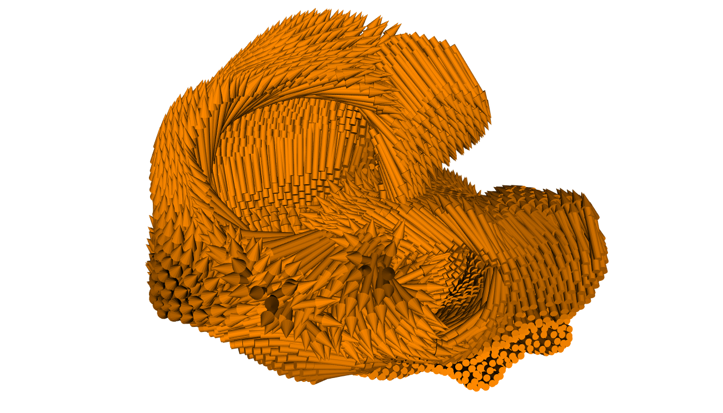
The conductivity tensor can also account for the direction of the fibers in the tissue

Slide 18
The Fenton-Karma model might be to simple to reproduce the Koivumäki model
Further work can be done, e.g., studying fibrosis and reentrant waves in an atrial mesh
Notes:
Ved hjelp av den utrolige teknologien og ingeniørkunsten vi idag har tilgang til, så kan vi bygge opp modeller som beskriver universet vårt, og vår plass i det.

