Slide 1
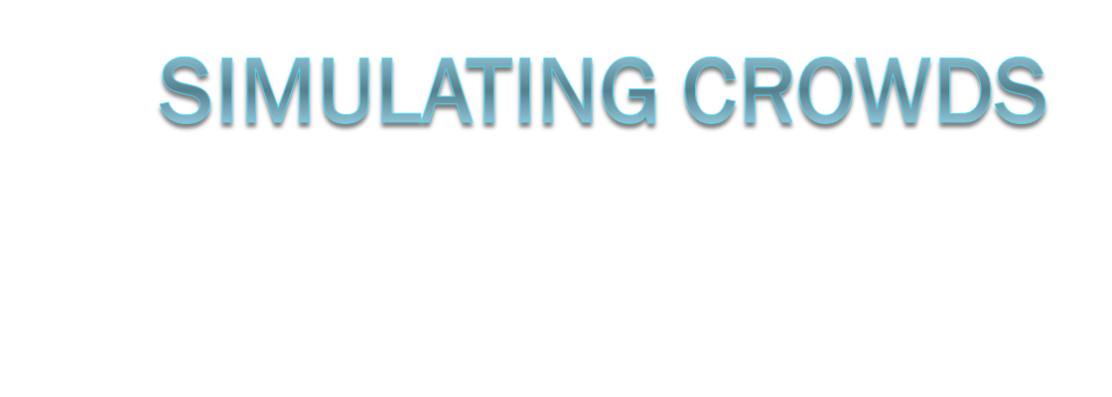
Yann Le Gall
Lindsey Bieda
Joe Cavanaugh

Slide 2
Motivation
Encryption can hide the content of a message, but not the actual transaction.
Eavesdroppers and servers can record a clients IP, length of data, and time/frequency of communication.
How can we hide these?

Slide 3
Crowds
Originally published by Rubin and Reiter, 1998.
Collection of clients called “jondos” (As in John Doe)
Anonymously issue web requests

Slide 4
How crowds work
Web requests are forwarded to either another jondo or the end server
The server knows who finally forwarded the request, but no idea who initiated it
//Insert image

Slide 5
How crowds work
A “centralized blender” manges metadata, e.g. crowd membership, random paths, keys, etc.
Blender pre-computes random paths using a probability of forwarding, P_{f}.

Slide 6
Problem
A crowd may contain collaborators, called “attackers”
“attackers” can determine where a request originated with a certain probability.
Sufficient crowd size and path forwarding can insure probable innocence

Slide 7

Probable Innocence

Slide 8
Our Simulation
Designed to compare security and performance
Each simulation is a fixed size (jondos, attackers, and servers)
Each of these is scheduled to complete one operation per time step.
One operation may be: forwarding a request, or responding to a request
Requests are initiated randomly

Slide 9
Our Simulation
During this simulation, we calculate the following:
  Response time of messages (including all forwards)
  Number of forwards
  Probable innocence

Slide 10
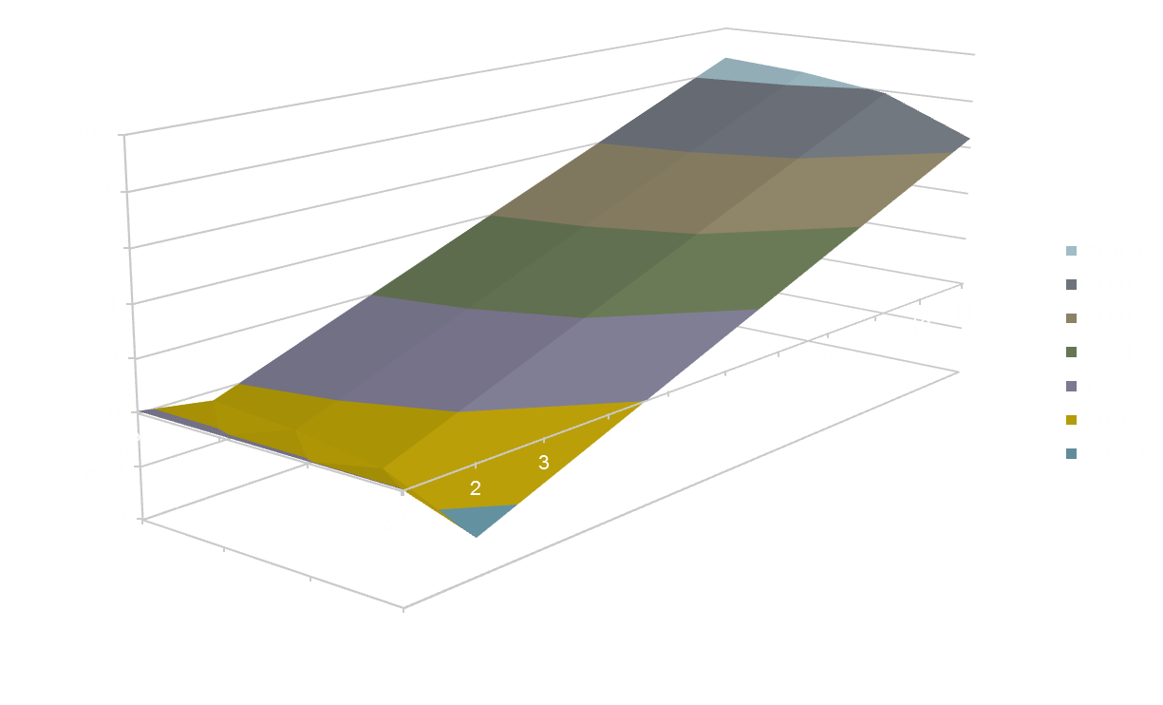
Results – Innocence vs. P_{f} AND Crowd Size

Slide 11
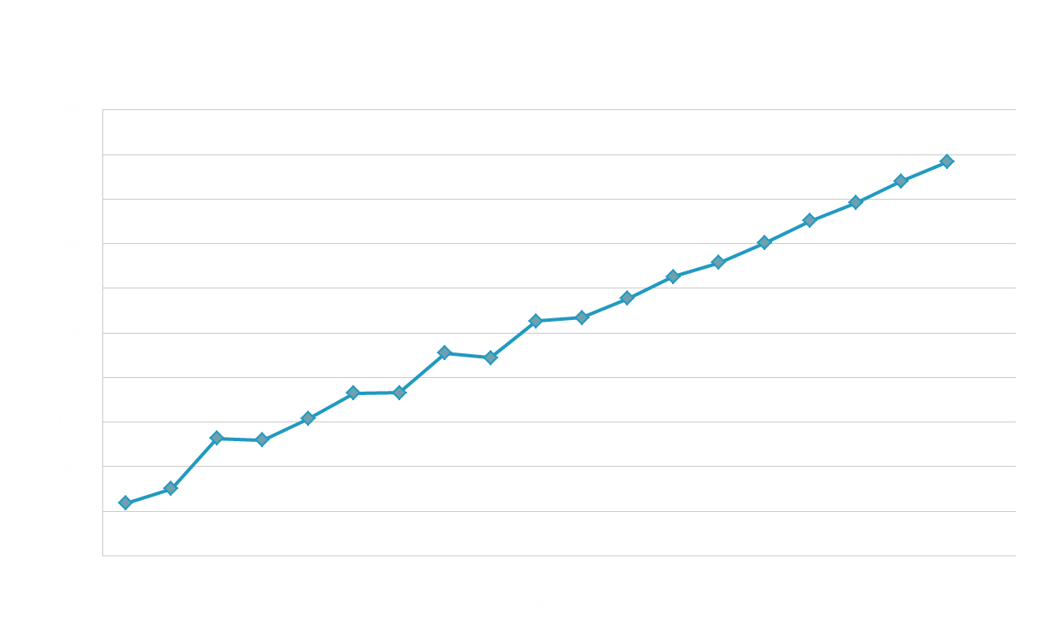
Results – Performance vs. Innocence

Slide 12
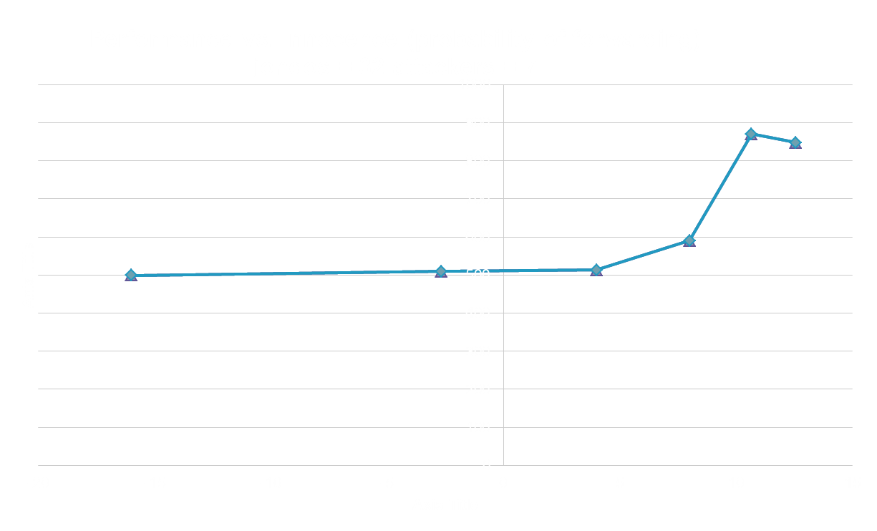
Results – Performance vs. Innocence

Slide 13
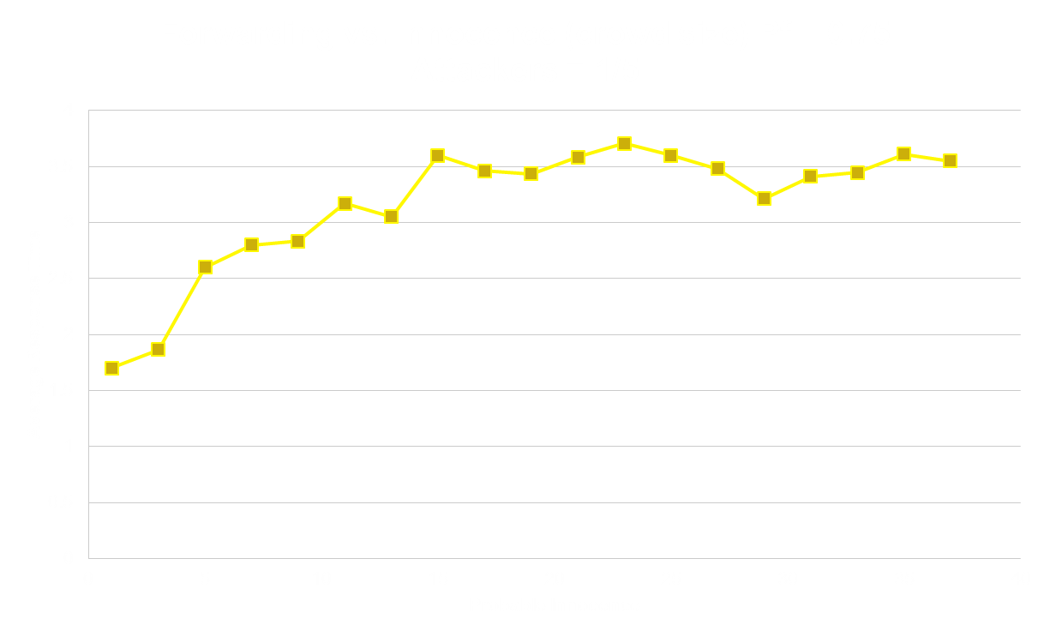
Path Length vs. Innocence

Slide 14
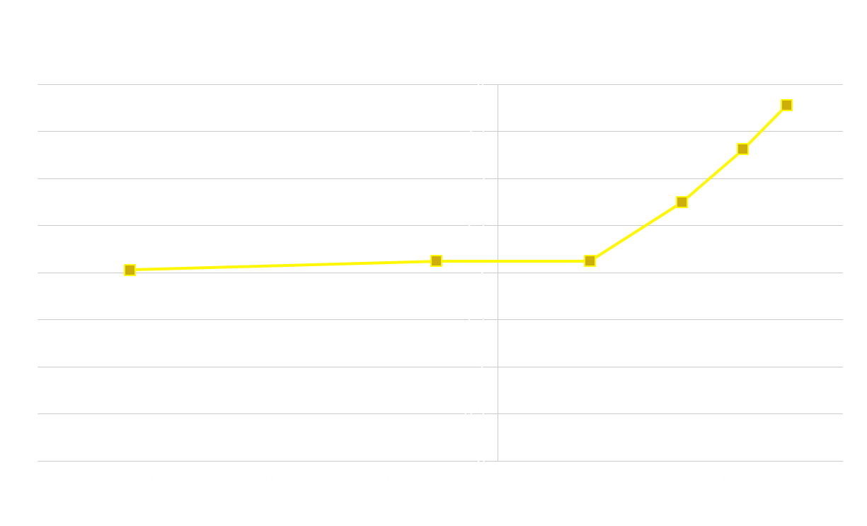
Path Length vs. Innocence

Slide 15
Conclusion
Performance is exponentially related to P_{f}
BUT, privacy only grows by the log of P_{f}
Optimal P_{f} for a given crowd configuration

